Slide 1




RNA-Seq Data Analysis
27-28 November, 2017
Taught module for DPhil programme in
Genomic Medicine and Statistics
Organised by Bioinformatics Core at WHG:
Helen Lockstone M.Sc.
Ben Wright PhD
Santiago Revale, M.Sc.

Slide 2



Differential Gene Expression Analysis
Helen Lockstone
Bioinformatics Core Group

Slide 3
Overview
General remarks on gene expression technology and data (RNA-Seq and microarray)
Experimental design considerations
Hypothesis testing
Differential expression analysis using R/BioConductor
Practical session working with a cancer dataset

Slide 4
A brief history of gene expression

Slide 5
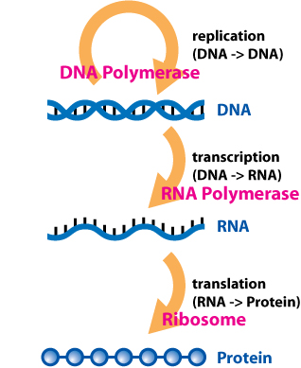
Transcriptome Profiling
Transcriptome can be measured by microarrays or RNA-Seq
Widely-used techniques, provide insight into biological system, albeit a snapshot – highly dynamic and complex process (splicing, gene methylation, RNA stability/degradation, miRNA regulation etc)

Slide 6
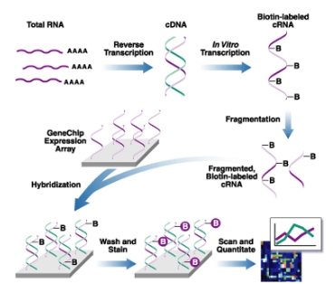
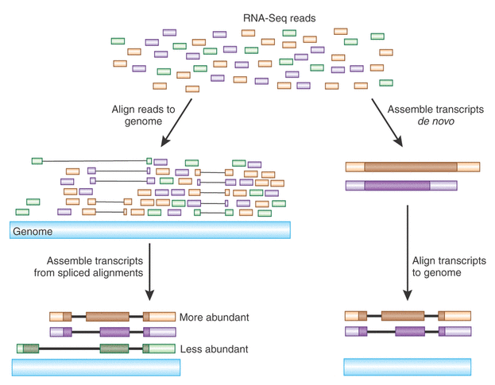
Two key technologies
Microarrays
RNA-Seq
Complementary hybridisation Next-generation sequencing
early 1990s onwards 2007 onwards

Slide 7
Publications by Technology

Slide 8
Which technology to use?
Microarrays and RNA-Seq are complementary technologies (despite common perception that RNA-Seq superior)
Choice usually depends how detailed a characterisation of the transcriptome is required
  Gene level changes => microarrays sufficient, reliable and cheap
  Isoform structure, splicing, novel transcripts => RNA-Seq
  Note that exon arrays can also assess splicing
Both report relative gene expression level estimates, influenced by a range of factors and biases inherent to each technology
Fold-change concordance reasonably high between arrays and RNA-Seq

Slide 9
RNA-Seq Myths and Caveats
Can detect low expressed genes better than arrays
  Possibly but may need prohibitively expensive sequencing depth
  In typical designs, up to half of all genes are too low expressed to be reliably detected (if at all)
  Additional sequencing will still tend to be of highly expressed genes, so lower end hard to interrogate
The issue of low counts is even more problematic for splicing analysis where you may be comparing exons or junction-spanning reads
What you sequence in an RNA-Seq library influences your data for all genes – very inter-dependent in a way that arrays are not

Slide 10

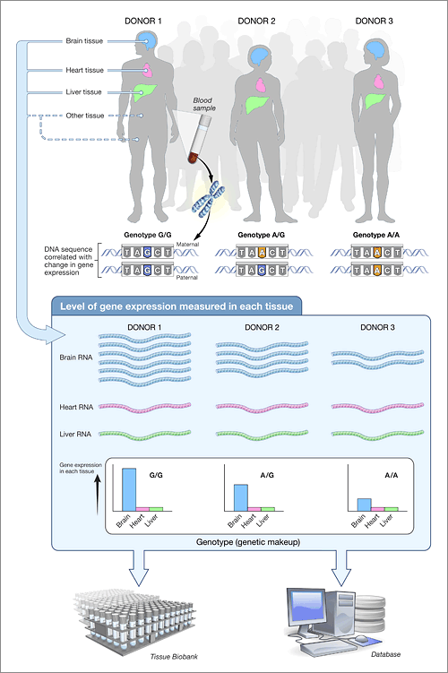

Large-scale gene expression projects
ENCODE
Allen brain atlas
Genotype-Tissue Expression Project (GTEx)
TGCA
Public repositories
  Gene Expression Omnibus (GEO) http://www.ncbi.nlm.nih.gov/geo/
  Sequence Read Archive (SRA)
  http://www.ncbi.nlm.nih.gov/sra

Slide 11
Typical experimental designs
Disease vs control
Gene knockdown/knockout vs wildtype
Effect of treatment/stimulus/drug
Clinical applications
  Tumour-normal pairs
  Good prognosis vs poor prognosis
  Patient subgroups responding to different treatments
  ‘Gene signature’ to predict who will respond well to a given treatment
Time course
Different tissues/stages of development

Slide 12
Limitations of transcriptomic profiling
Comprehensive but inherently limited to descriptive results, no matter how well experiment performed or data analysed
Produce large amounts of information; subjective interpretation, can be mined in different ways, always much left untouched (often publically available)
Expensive and time-consuming so often published as a stand-alone experiment
However best used as starting point for further work - following up hypotheses from gene expression data to uncover mechanistic/causal effects can produce elegant studies

Slide 13
Experimental design considerations

Slide 14
Replication
Depends on context – type of sample, size of effect, heterogeneity within conditions
Human clinical samples for heterogeneous disease
Cell line
Mouse model
Human samples
n=3 n=5 n=10 n=100

Slide 15
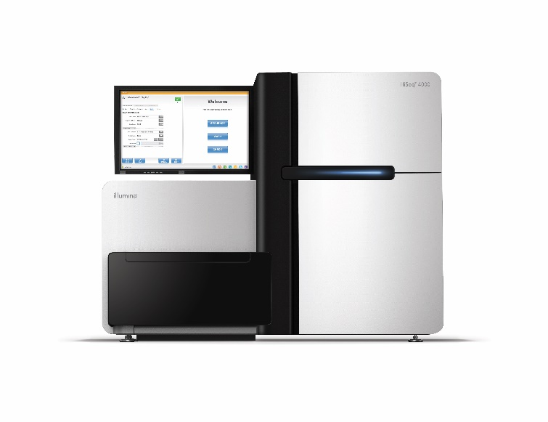
Sequencing Depth
Number of reads required per sample depends on experimental question
HiSeq4000 – one lane = 250 million reads
Multiplexing e.g. 10-plex human samples gives ~25m reads for each, plenty for quantifying gene expression (except for very low/unexpressed genes)
Higher depth required in some situations e.g. for splicing analysis, certain library prep methods (ribo-depletion)

Slide 16
Potential confounds and covariates
Gene expression data highly sensitive to many factors
  Lab operator/conditions, day performed, sample collection methods, RNA extraction day and so on
  Often influence the data to greater extent than any experimental effects
  Any step where treated and control samples are handled differently could confound the experiment
  If split into batches containing mix of treated/control samples, can account for potential effects in analysis
Also be aware of potential effects from factors unrelated to the experiment on the data, which may need to be accounted for to optimise analysis

Slide 17
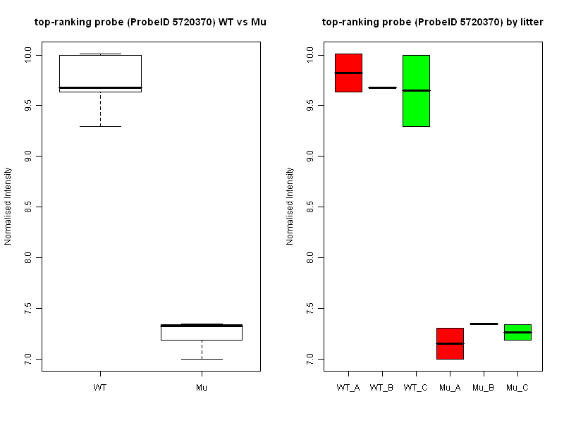
Gene not influenced by litter
Wt and Mut groups
Three different litters
Top gene ~ 5x higher expression in Wt compared to Mut
Similarly expressed across litters in both genotypes

Slide 18
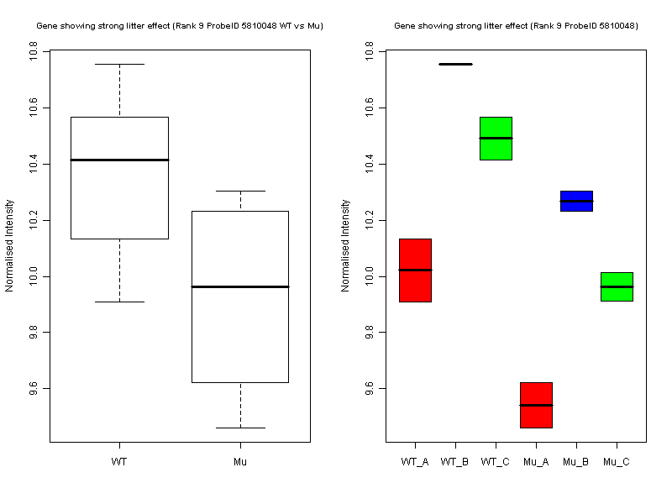
Gene with strong litter effect
Within litters, consistent pattern of higher expression in WT vs Mut
Within genotypes, B>C>A – expression depends on litter
Accounting for this source of variability increases power to detect changes of interest

