Slide 1

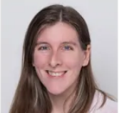
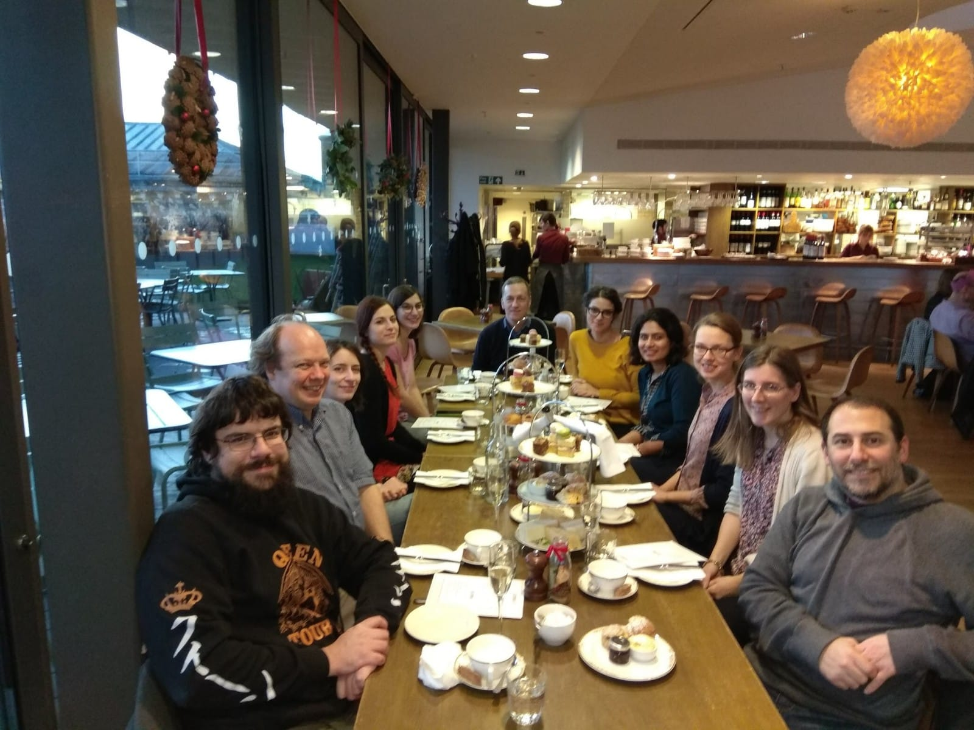
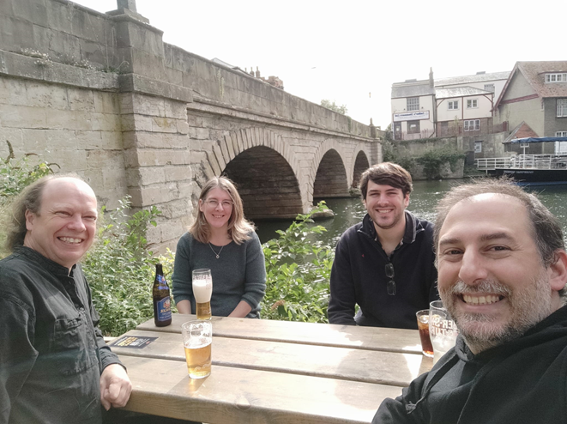
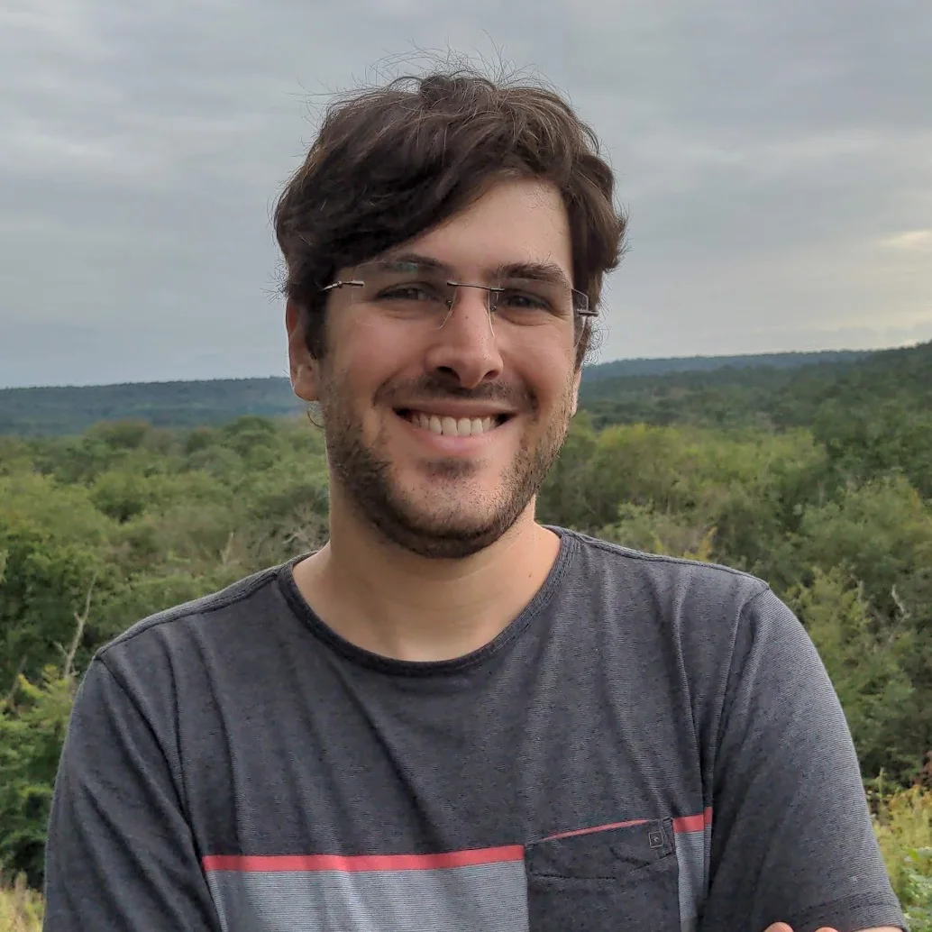
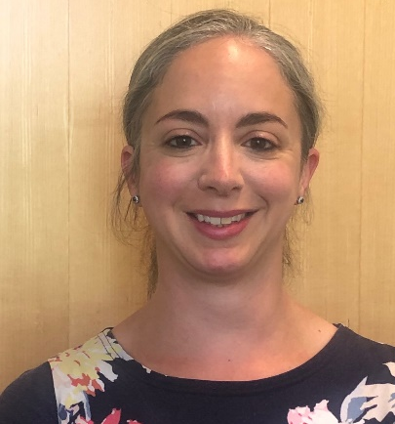
Bioinformatics Core Group
(current team, in order of appearance)
Helen Lockstone
Head of Bioinformatics
and Training
Joined 2007
Ben Wright
Bioinformatics Analyst
Joined 2011
Duncan Parkes
Senior Software Developer
Joined 2016
Matthieu Miossec
Bioinformatics Analyst
Joined 2020
Avigail Taylor
Deputy Manager, Bioinformatics Core
Joined last week!
Providing analytical support to WHG research groups
Help and advice on programming, bioinformatics tools and pipelines
Training and workshops
Further outreach and identifying areas of support in coming months, plus additional staff

Slide 2

Bioinformatics Core Group
(Past and present)
Welcoming Matthieu to the group in one of the rare weeks pubs were open in 2020
Enjoying a cream tea at the Ashmolean a few years ago

Slide 3
MSc in Genomic Medicine
New MSc in Genomic Medicine starting October 2022
Based at WHG and directed by Julian Knight with co-directors Helen Lockstone, Delia O’Rourke, Usha Kini and Calli Dendrou
Course officer – Jamie Musson
Course tutor – Heba Shawer (starting in August 2022)
MSc joins the existing DPhil in Genomic Medicine and Statistics at WHG, and together form critical training platform for careers in academia, healthcare or industry
Teaching throughout Michaelmas Term on both programmes and some training will be opened out to WHG…. more information later this year

