Slide 1
Principles of data visualisation
Eddie Cano-Gamez, PhD
October, 2022

Slide 2
Data visualisation theory

Slide 3
Why is data visualization important?
“…the sharp end of each little stroak pointing out that part of the Horizon, from whence the wind continually blows.”
- Edmond Halley
(Halley, 1686)

Slide 5
Aims of data visualisation
Graphics reveal data. Good data visualization should:
Show the data truthfully
Induce the viewer to think about the substance
Present many numbers in a small space
Encourage the eye to notice patterns
Reveal several levels of detail, from broad to fine structure

Slide 6
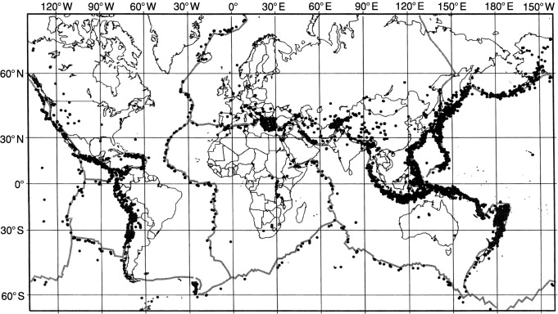
An example of effective data visualisation
(US National Earthquake Information Center, 1994)

Slide 7
An example of effective data visualisation
(US National Earthquake Information Center, 1994)
Minimal distortion
Emphasis on substance
Thousands of data points
Patterns are evident
Details are noticeable

Slide 8
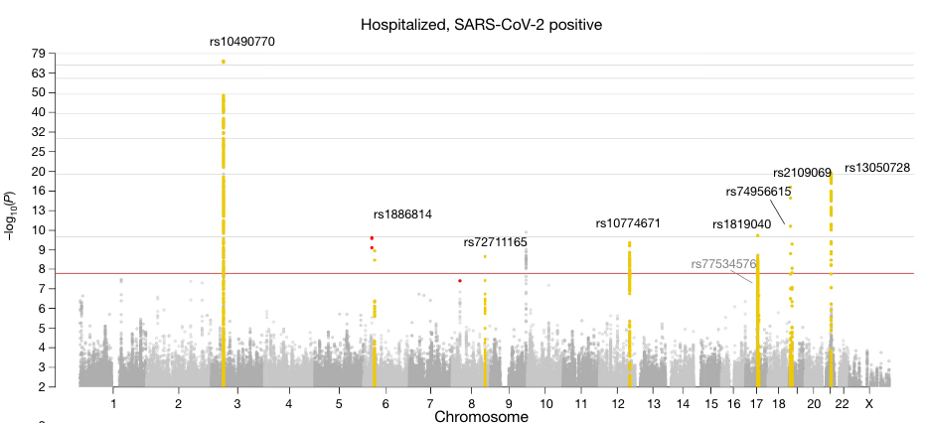
Elements of quantitative graphs
Marks
Channels
Geometric element used to represent a data point:
Aspects of a mark’s appearance which can be modified to encode information:
Lines
Points
Areas
Angle
Colour
Length
Position
Mark:
Dot
Channels:
X position
Y position
Colour
(COVID-19 Host Genetics Initiative, Nature; 2021)

Slide 9
Elements of quantitative graphs

Slide 10
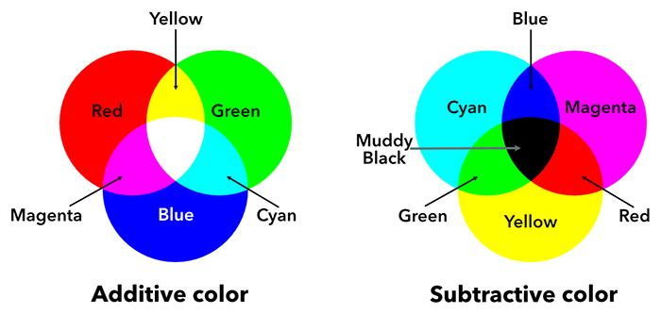
Types of channels
Position
Length
Angle
Area
Colour (saturation and brightness)*
Transparency
Quantitative
Channels
Spatial grouping
Shape
Colour (hue)*
Qualitative
*Colour is perceived by the human eye as red, green, and blue light:
Hue: Wave length (i.e. RGB)
Saturation: amount of colour
Brightness: amount of white

Slide 11
Are all channels equally effective?
Length

Slide 12
Length

Slide 13
Are all channels equally effective?
Length
Length = 2
Length = 4
2X larger
Length = 6
3X larger

Slide 14
Are all channels equally effective?
Area

Slide 15
Area

Slide 16
Are all channels equally effective?
Area
Radius = 2
Area = 12.6
Radius = 4
Area = 50.3
4X larger
Radius = 6
Area = 113
9X larger

Slide 17
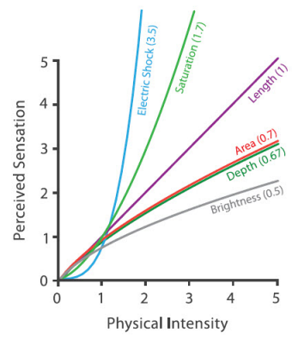
Steven’s psychophysical power law
Power
exponent
(distortion)
Proportionality
constant
Perceived
sensation
Stimulus
intensity
(Stevens, Psych Rev; 1957)
(Munzer, 2014)

Slide 18
List of plots by decreasing quantitation quality
Bar charts
Stacked bars
Scatter plots
Pie charts
Bubble plots
Rectangular areas
Colour (luminance)
Colour (Saturation)
Perceptual
distortion
Clarity

Slide 19
Misleading use of channels
Changing lengths should not be confounded by changing areas
(Tufte, 1983)

Slide 20
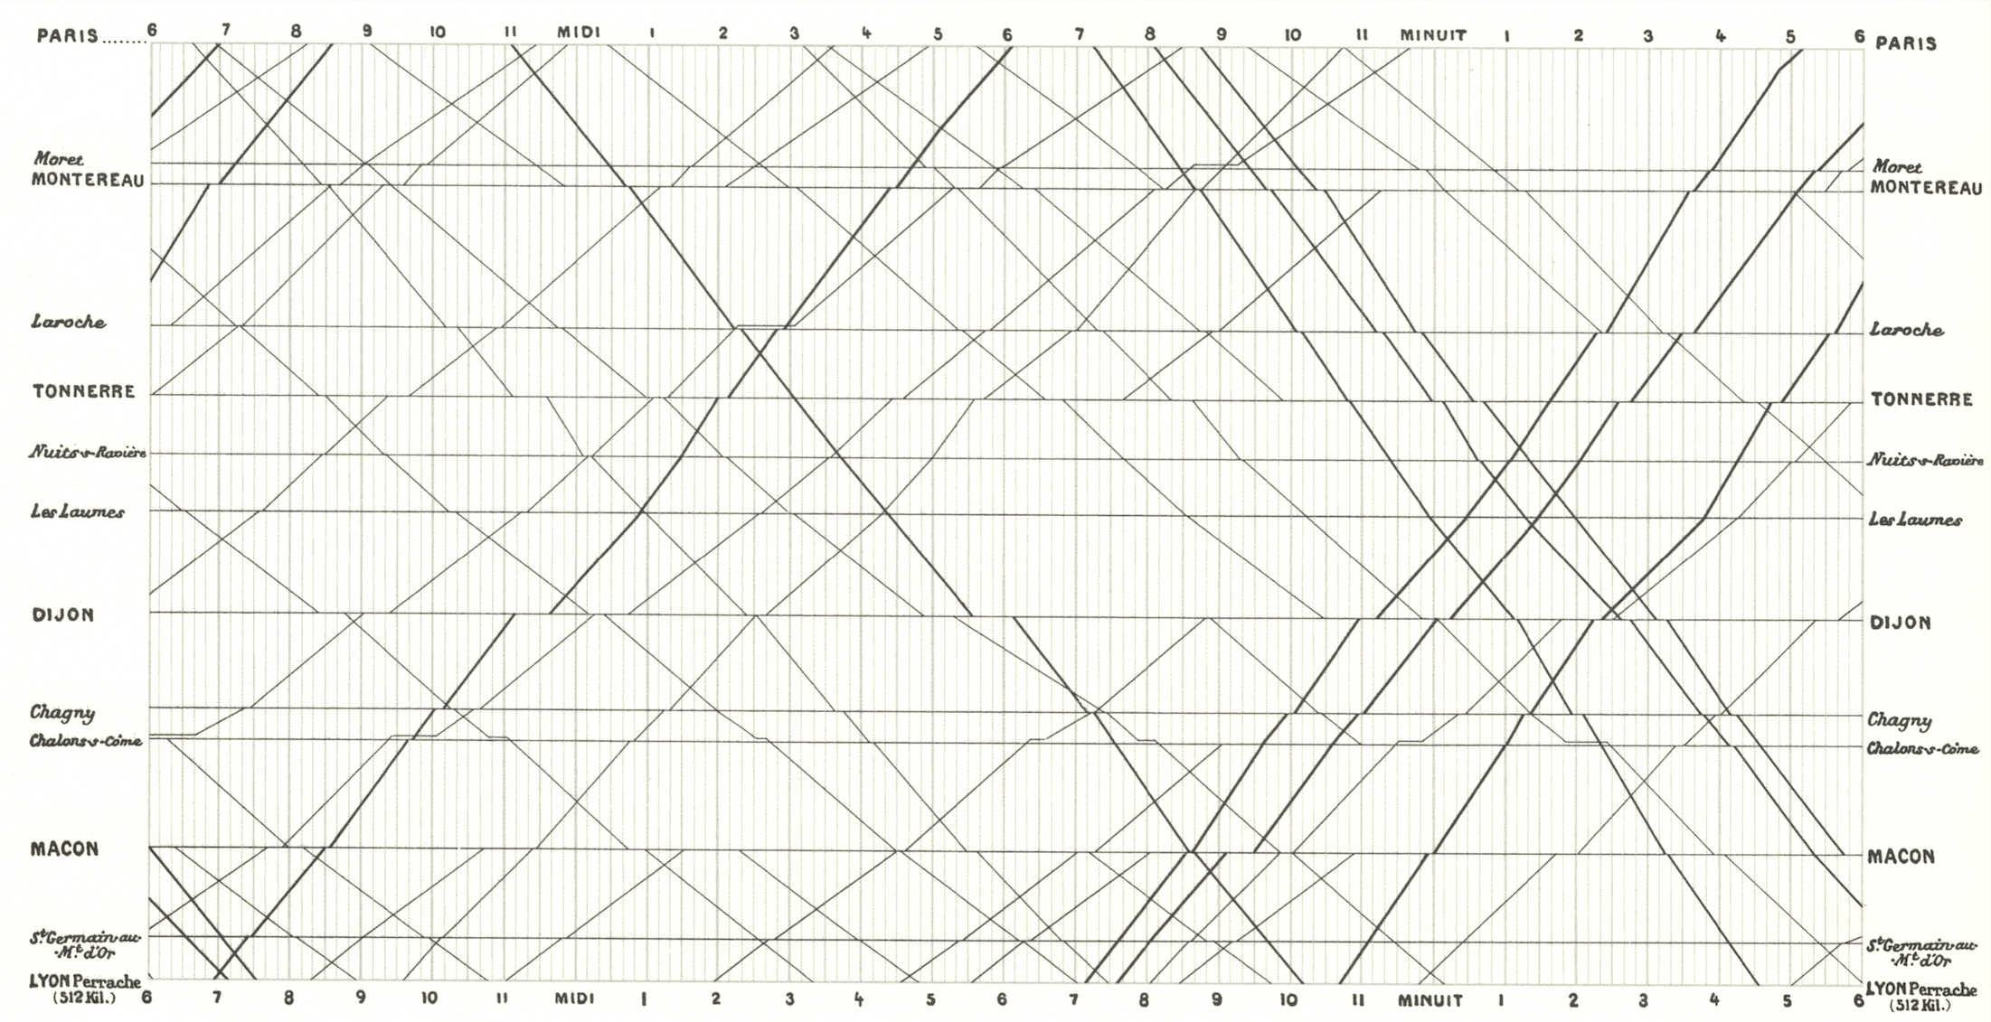
Effective use of channels
Distance and time are encoded as length.
This enables the observer to intuitively understand speed.
(Marey, 1885)

Slide 21
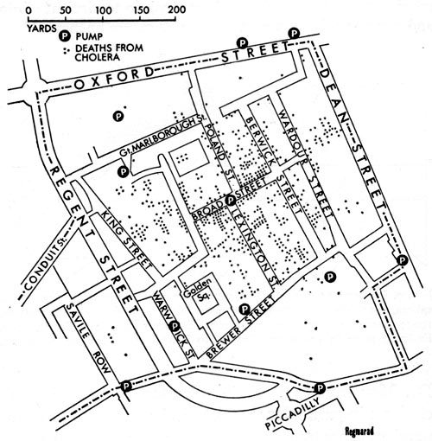
Effective use of channels
Distance is encoded as length. Disease frequency is encoded by point density.
(Snow, 1854)

Slide 22
Effective use of channels
Visual trick: Using generally accepted hue orders to encode quantitative variables (e.g. “cold to hot” or “rainbow spectrum”)
(Shi et al., Nat Commun; 2021)

Slide 23
General principles for data visualisation
Encode most important variable using most effective channel
Match remaining variables to channels by importance
Encode quantitative/qualitative variables using quantative/qualitative channels
Modify only one colour property (i.e. either hue, saturation, or brightness)
Avoid areas and volumes
Only use > 6 colours at a time if absolutely necessary

Slide 24
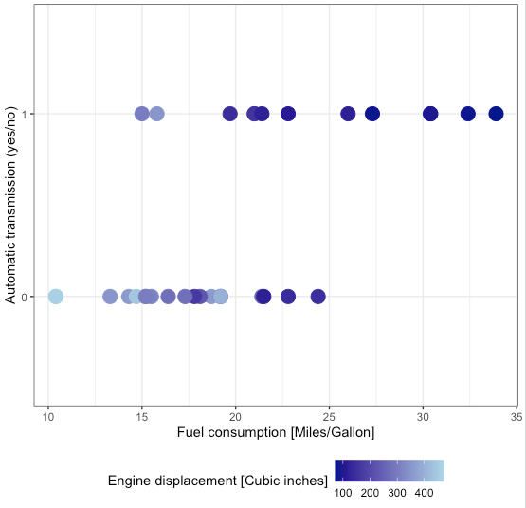
How could this graph be improved?

Slide 25
How could this graph be improved?

Slide 26
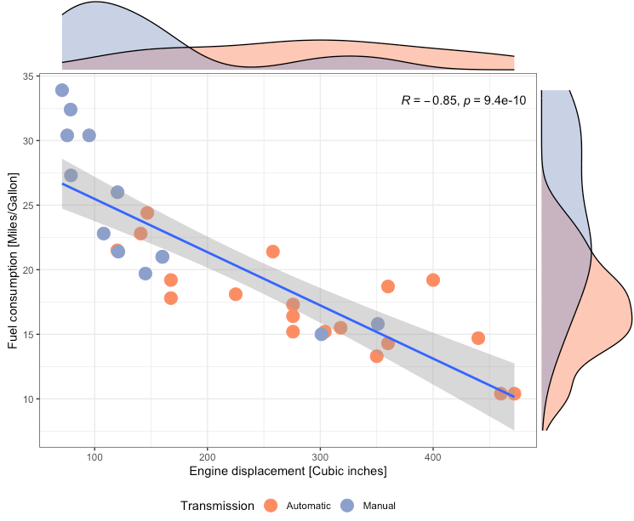
A better visualisation of the same data

Slide 27
Data visualisation in R
using ggplot2

Slide 28
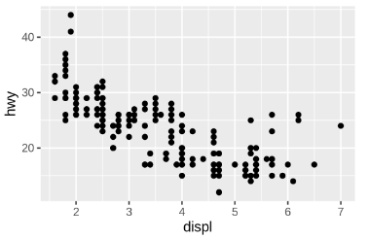
The ggplot syntax
ggplot2 is an R package for data visualisation. It is based on the Grammar of Graphics. To create a graph, ggplot2 needs you to specify three elements:
A dataset
A set of aesthetic mappings (i.e. specifying channels)
A layer (i.e. specifying marks)
Code
Output
(Wickham, 2022)

Slide 29
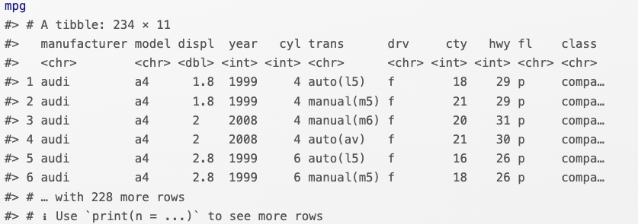
The ggplot syntax
Dataset: mpg
Mapping: aes()
Variable
Channel
Engine displacement (disp)
X position
Code
Highway miles per gallon (hwy)
Y position
Output
Layer: geom_point()
Mark →

Slide 30
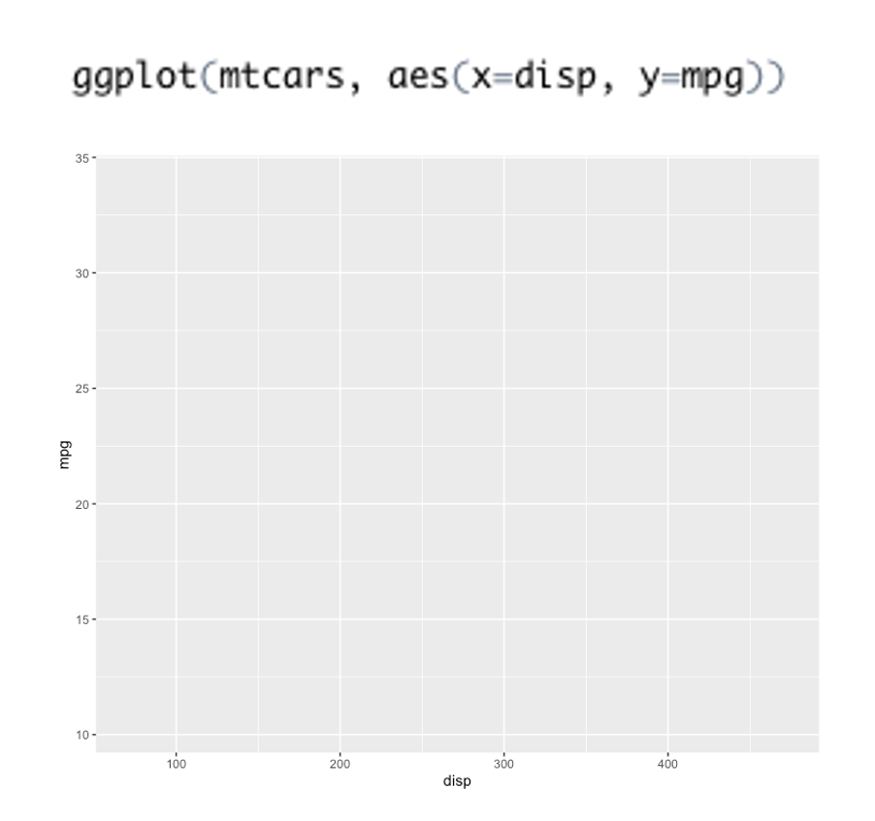
What is wrong with this code?

Slide 32
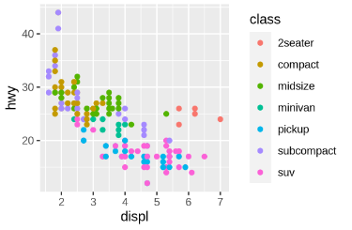
Encoding additional channels
To use other channels in addition to the X and Y position (e.g. colour, shape, size…), simply add them to the aesthetic mapping:
Code
New mapping
Mapping: aes()
Variable
Channel
Output
Engine displacement (disp)
X position
Highway miles per gallon (hwy)
Y position
Car type (class)
Color (hue)
(Wickham, 2022)

Slide 33
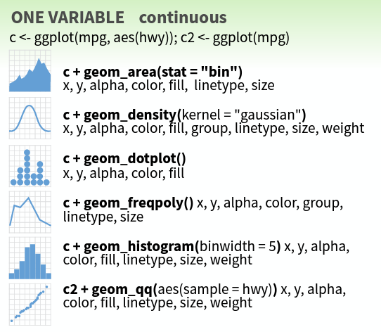
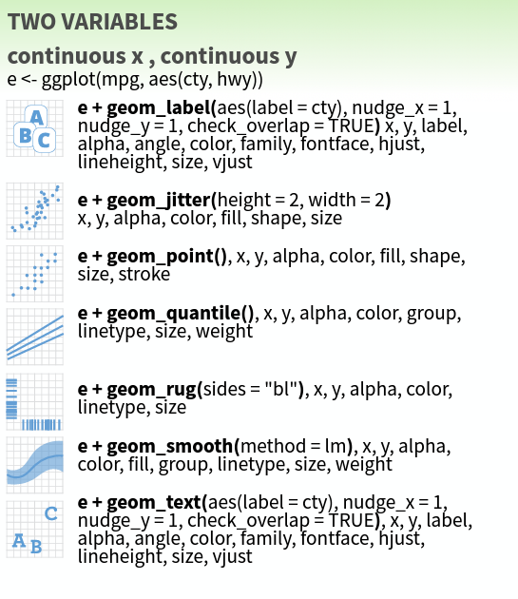
Most frequently used ggplot marks
(R Studio, 2018)
https://www.maths.usyd.edu.au/u/UG/SM/STAT3022/r/current/Misc/data-visualization-2.1.pdf

Slide 34
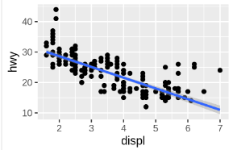
Adding multiple layers
ggplot2 allows us to superimpose multiple layers by simply adding them from the back to the front using the + symbol:
First layer: geom_point()
Code
Mark → Points
Second layer: geom_smooth()
Output
Mark → Line (linear fit)
(Wickham, 2022)

Slide 35
What does this code do?

Slide 36
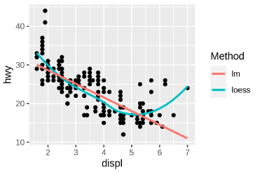
What does this code do?

Slide 37
Does this code make sense? Why?

Slide 38
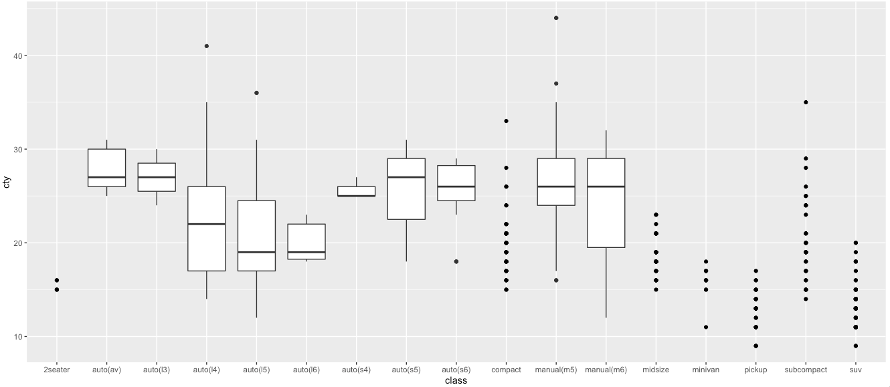
Does this code make sense? Why?

Slide 39
Practical:
Visualising RNA-seq data

Slide 40
Thank you!
@eddiecg
ecg@well.ox.ac.uk

