Slide 1
Fundamentals of RNA-seq
Eddie Cano-Gamez, PhD

Slide 2
Introduction to RNA-seq

Slide 3
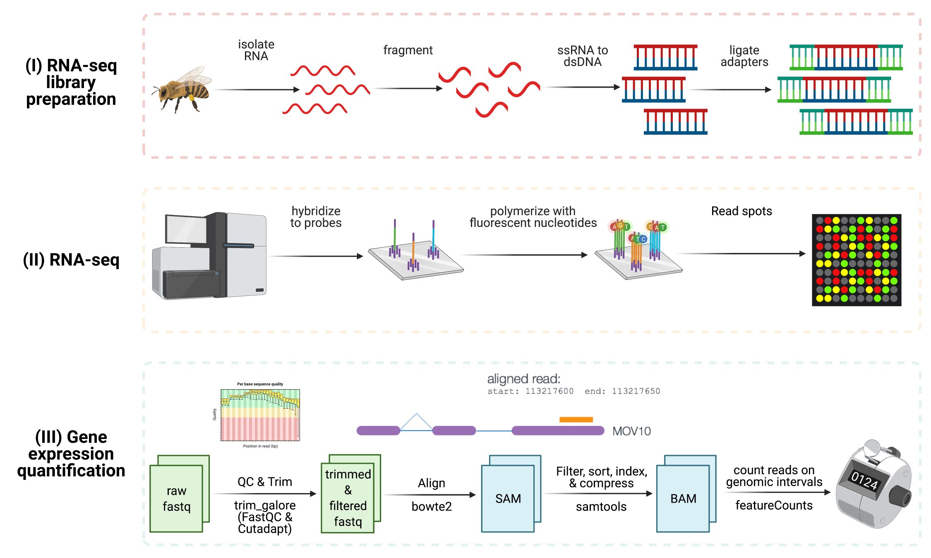
The RNA-sequencing workflow
(Bresnahan, 2021)

Slide 4
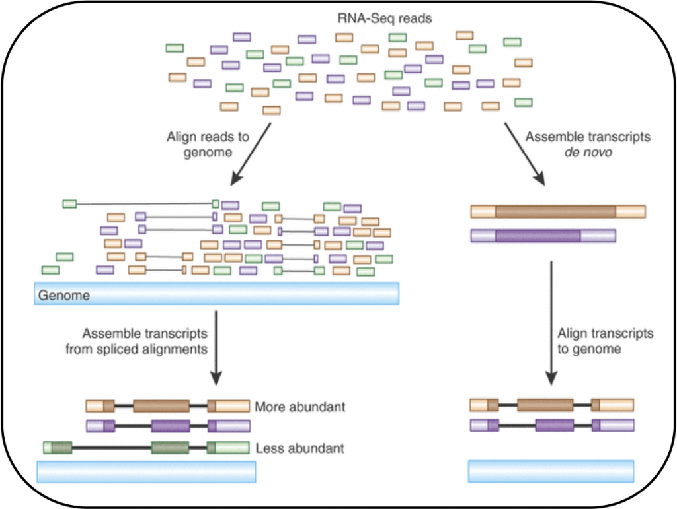
RNA-seq data processing steps

Slide 5
RNA-seq data normalisation
We usually cannot take the read counts directly. Instead we need to take the following factors into account:
Differences in sequencing depth between samples
Differences in gene length (longer gene = more reads)
RPKM = Reads per kilobase per million
Gene length
Sequencing depth

Slide 6
Dimensionality reduction for RNA-seq data analysis

Slide 7
What is dimensionality?
genes
Each gene can be thought of as a dimension in space:
1 2 3 4 ... n
1
2
3
4
…
m
0 | 20 | 28 | 0 |  | 0
0 | 10 | 5 | 0 |  | 0
5 | 7 | 10 | 8 |  | 10
0 | 0 | 50 | 12 |  | 1
... | ... | ... | ... |  | ...
10 | 0 | 5 | 0 |  | 6
The number of genes in a data set is referred to as its dimensionality (N).
gene 3
cell 1
samples
gene 1
gene 2
sample 2
A typical RNA-seq data set has about 20,000 dimensions

Slide 8
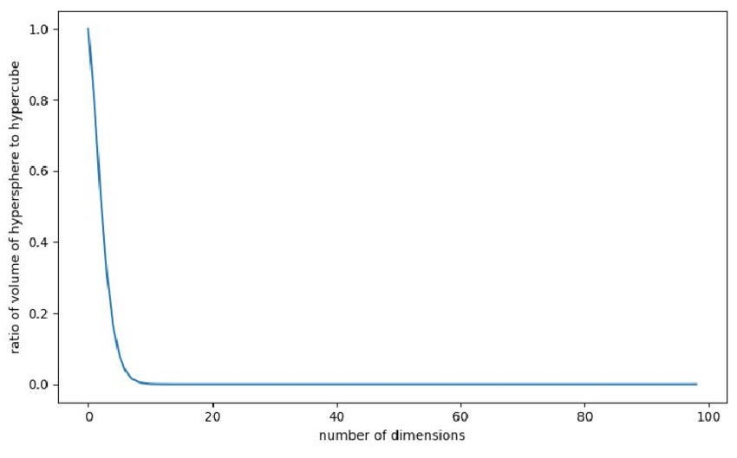
Why are too many dimensions a problem?
The curse of dimensionality is the name given to a collection of perplexing effects that appear as the number of dimensions in a space increases:
1. Volumes increase so fast that space becomes unimaginably vast
Dimensionality =
1 2 3 4 9 … ∞
Visualisation =
Sphere/cube ratio =
1 0.78 0.52 0.3. 0.11 … 0

Slide 9
Why are too many dimensions a problem?
2. This causes points to be roughly at the same distance from one another (everything is very far away)
Distance between points
Number of dimensions
Altman and Krzywinski, 2018; Nature Methods

Slide 10
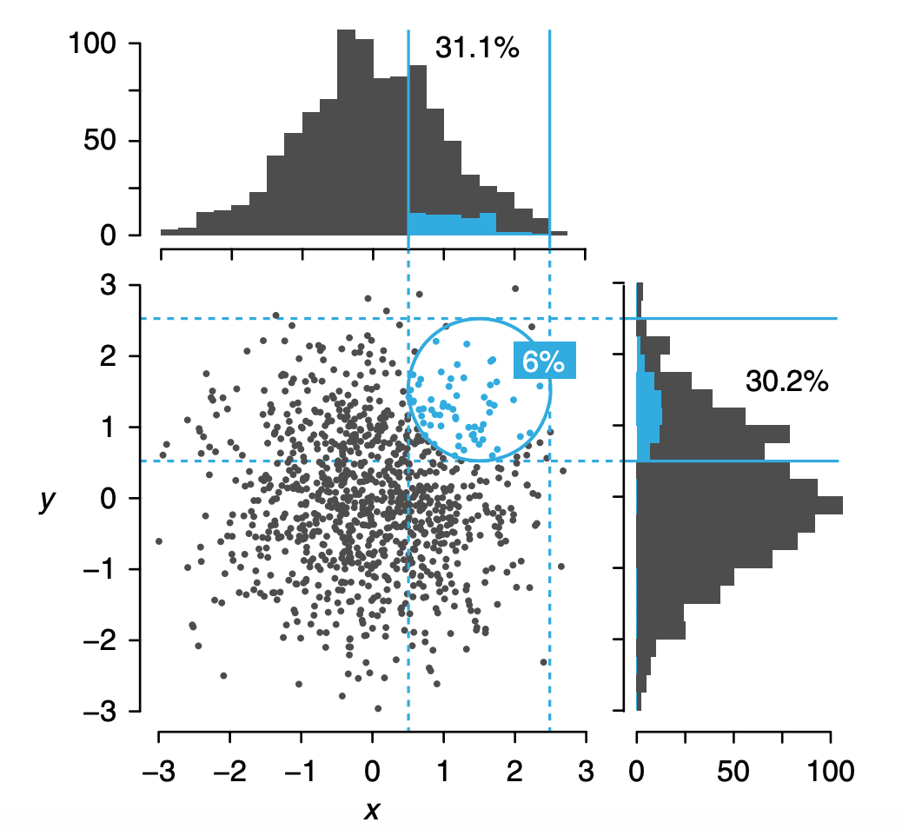
Why are too many dimensions a problem?
3. Most of the space is empty (points occupy a tiny part of it)
Altman and Krzywinski, 2018; Nature Methods

Slide 11
Why are too many dimensions a problem?
4. This causes correlations between variables to all drop to zero
Correlation between variables
Number of dimensions
Altman and Krzywinski, 2018; Nature Methods

Slide 12
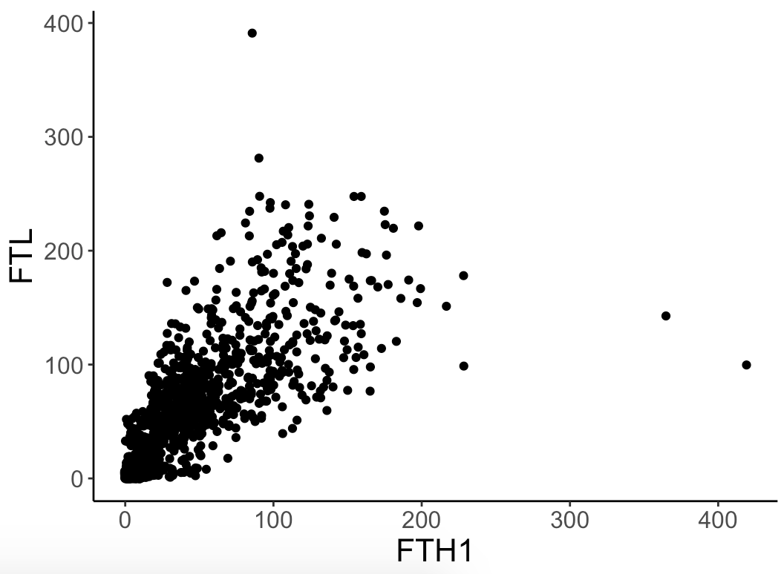
Dimensionality reduction: making the most of collinearity
In real-world data many dimensions are correlated and thus redundant (collinearity).
For example, take a look at the expression of these two genes in this RNA-seq data set:
They are redundant!
It would be better to have a single number that summarises both
This is the basis of PCA

Slide 13
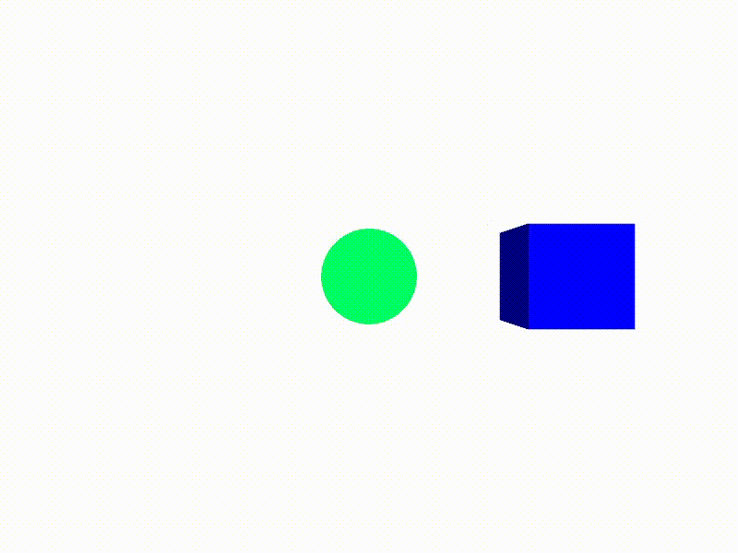
Dimensionality reduction: PCA
Principal component analysis (PCA) is a method which to rotate our reference coordinate system until we find the dimensions that best capture the variability in the data. We keep only those and discard the rest.
Think of this as rotating your viewpoint in a video game:

Slide 14
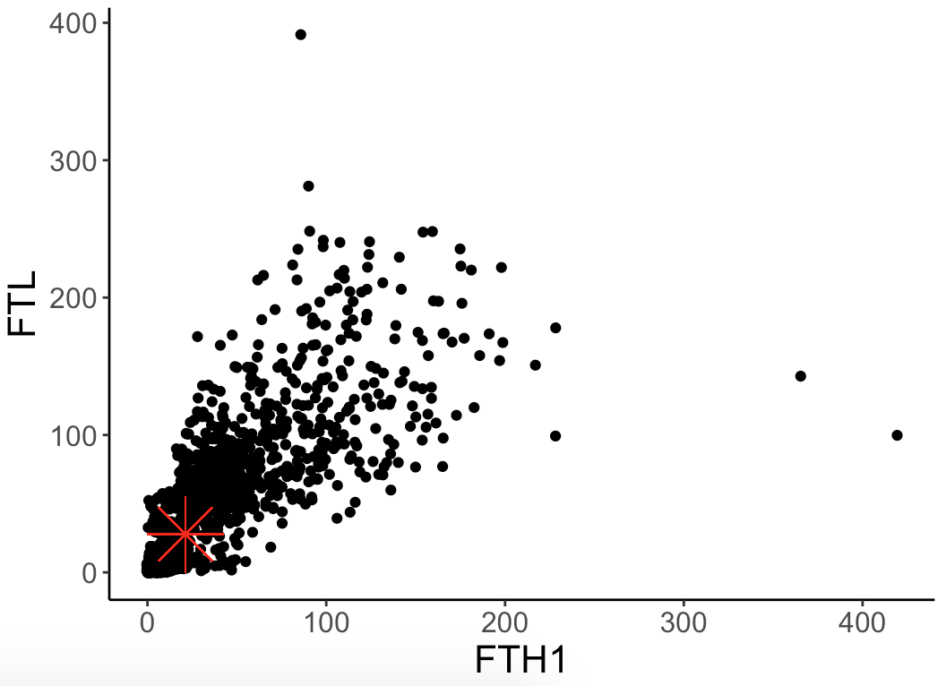
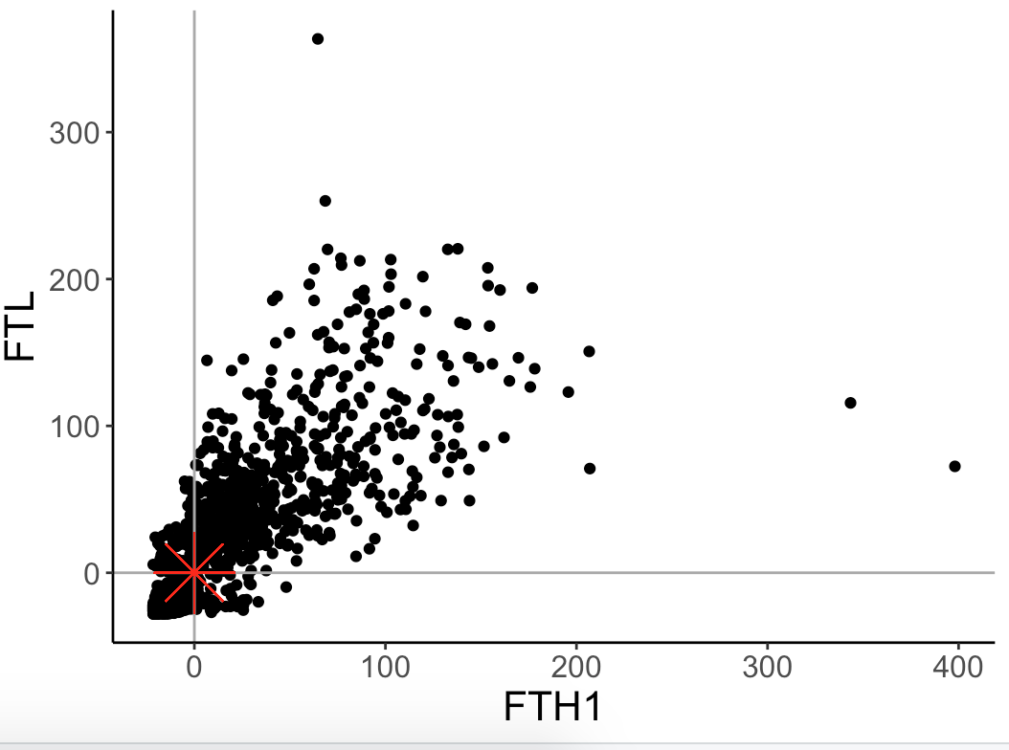
Dimensionality reduction: PCA
Let’s perform PCA step by step. We’ll use the two genes shown above:
1. We first find the centre of this data. We’ll turn this into our new zero (0,0):

Slide 15
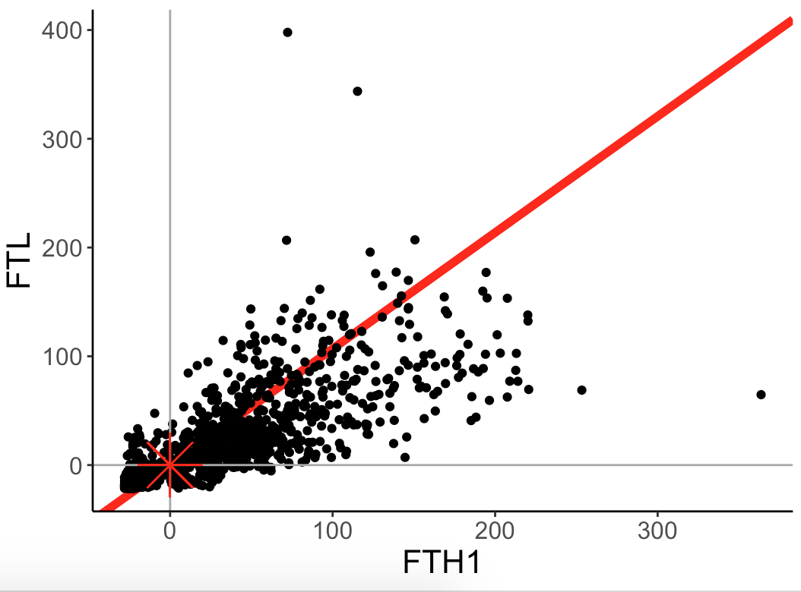
Dimensionality reduction: PCA
Let’s perform PCA step by step. We’ll use the two genes shown above:
2. We then find the line that best fits the data.

Slide 16
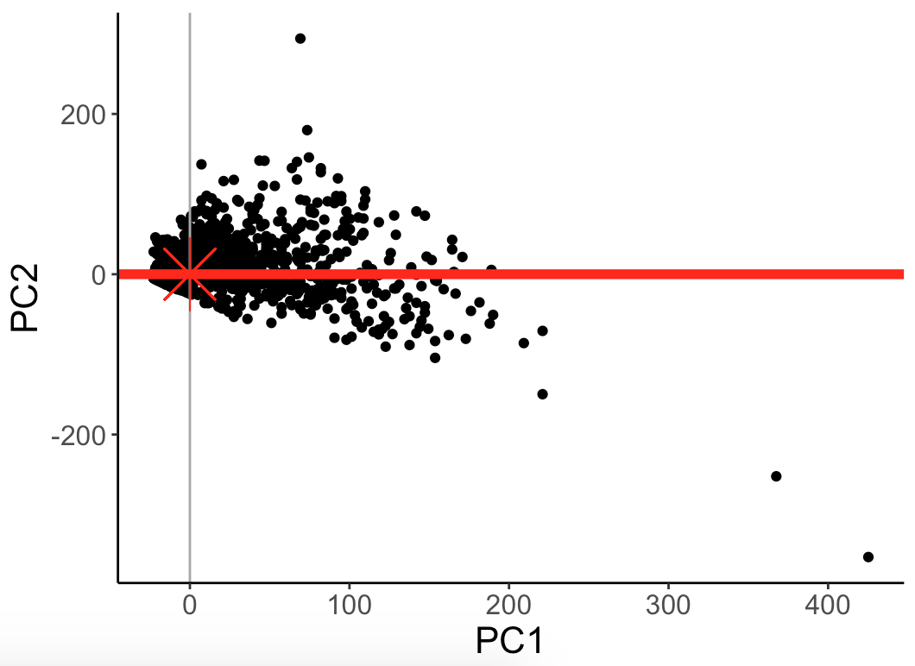
Dimensionality reduction: PCA
Let’s perform PCA step by step. We’ll use the two genes shown above:
3. This line becomes our new X axis (we will call it PC1).

Slide 17
Dimensionality reduction: PCA
Let’s perform PCA step by step. We’ll use the two genes shown above:
4. We find the line perpendicular to PC1 that best fits the data (in this case there is only one). We call it PC2. etc...
We can continue like this for any number of dimensions!

Slide 18
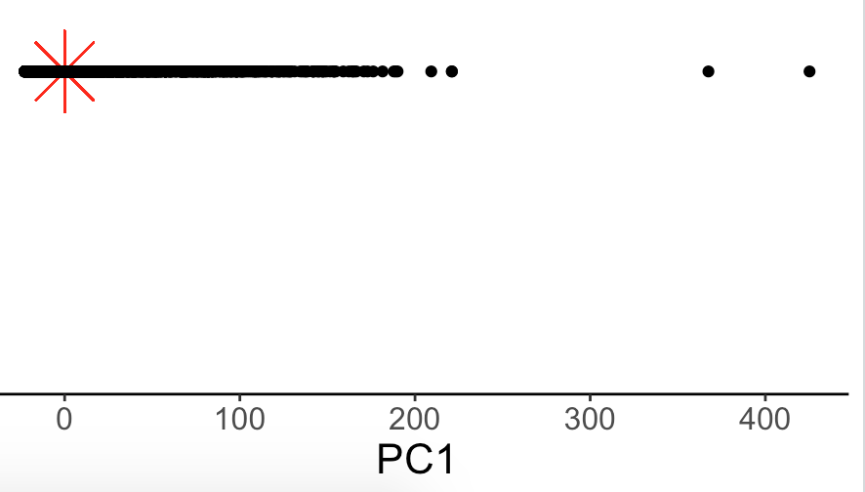
Dimensionality reduction: PCA
Let’s perform PCA step by step. We’ll use the two genes shown above:
5. Finally, we discard any uninformative dimensions. In this case, PC1 is enough

Slide 19
Questions

