Slide 1
Normalisation, scaling and feature selection
Charlotte Rich-Griffin and Jacqueline Siu
2023-02-01

Slide 2
Preprocessing of single cell data
QC
Normalise
Log-Transform
Scale

Slide 3
Why normalise?
remove systematic differences in sequencing coverage
Today we are going to cover size-factor normalisation and log-transformation,

Slide 4
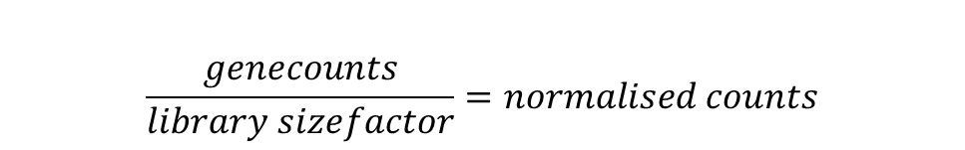
Normalising by proportions
5000 reads
Gene 1 – 3000
Gene 2 – 1000
Gene 3 – 500
Gene 4 – 500
Gene 1 – 0.6
Gene 2 – 0.2
Gene 3 – 0.1
Gene 4 – 0.1
Divide by library size to convert to proportions
$$\frac{genecounts}{library sizefactor}=normalised counts$$
100 reads
Gene 1 – 65
Gene 2 – 15
Gene 3 – 8
Gene 4 - 12
Gene 1 – 0.65
Gene 2 – 0.15
Gene 3 – 0.8
Gene 4 – 0.12
These cells would be very hard to compare
These values are comparable
Why might proportions not work for sequencing data sets?

Slide 5
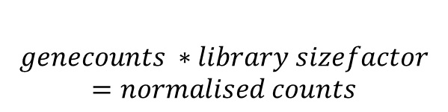
Normalising by scale factors
Goal is to make all cells have the same equivalent counts e.g. 10000
$$genecounts ∗library sizefactor=normalised counts$$
5000 reads
Gene 1 – 3000
Gene 2 – 1000
Gene 3 – 500
Gene 4 – 500
Gene 1 – 6000
Gene 2 – 2000
Gene 3 – 1000
Gene 4 – 1000
Size factor = 2
12000 reads
Gene 1 – 7800
Gene 2 – 1800
Gene 3 – 960
Gene 4 - 1440
Gene 1 – 6474
Gene 2 – 1494
Gene 3 – 796.8
Gene 4 – 1195.2
Size factor = 0.83

Slide 6
What is the appropriate library size to aim for?
Some methods just choose a number in the right range (e.g. 10000) counts
But if your dataset has very high or low coverage this might not be the best choice

Slide 7
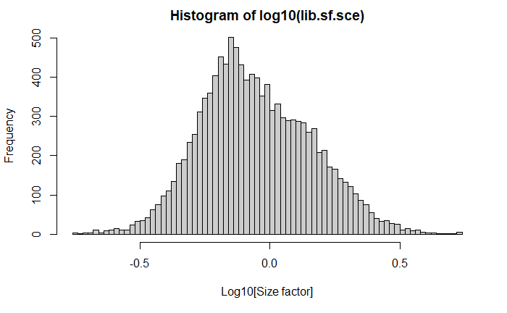
Range of size factors
The “scater” packages calculates the best library size as:
  The “library size factor” for each cell is directly proportional to its library size where the proportionality constant is defined such that the mean size factor across all cells is equal to 1.
What is the normalised library size in our dataset?

Slide 8
Why log-transform?
log-values represent log-fold changes in expression.
 | Cell type A | Cell type B
Gene 1 | 50 | 10
Gene 2 | 1100 | 1000
Log 10 normalisation
 | Cell type A | Cell type B
Gene 1 | 1.60 | 1.00
Gene 2 | 3.04 | 3.00
Fold change
0.6
0.04
Log transformation promotes contributions from genes with strong relative differences.

Slide 9
Pseudocounts
Typically when log transforming single cell data, you add a “pseudocount” to each observation.
This is because we don’t want to lose zero counts from the dataset since:
  Log10(0) = -Inf
The pseudocount value is typically 1 since this means raw 0 counts are still 0 after transformation
  Log10( 1) = 0

Slide 10
There are complex alternatives
Normalising by spike-ins
Normalising by deconvolution
scTransform
Links to read about these further are in the rmarkdown script for today’s session.

Slide 11
Normalising by spike-ins
“Spike-ins” are extra transcripts added in equal amounts to each cell
It is particularly used in plate based single cell methods.
“Spike factors” are calculated in the same way as library size factors, but only uses the spike genes as input, rather than all genes

Slide 12
Feature selection
Otherwise known as finding “highly variable genes”
The package scran provides methods that forma workflow to identify and select features that display a high amount of biological variance
`scran::modelGeneVar()` decomposes the log-expression profiles for each gene into technical and biological components based on a fitted mean-variance trend
`scran::: getTopHGVs()` uses modeeling statistics from `scran::modelGeneVar()` to define a set of highly variable genes

Slide 13
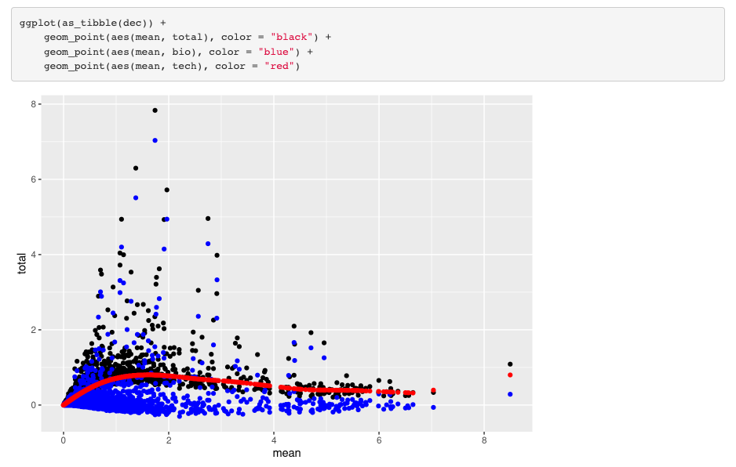
Plotting features

