Slide 1
Annotation

Slide 2
Location matters for cell types
Figures from https://www.science.org/stoken/author-tokens/ST-495/full

Slide 3
Key PBMC populations
Cell type | Markers
T cells (CD4+ vs CD8+) Naïve Memory | CD3E+ CCR7+ CCR7-
B cells Naïve Memory | CD19 / MS4A1+ CD27- IgD+ CD27+ IgD-
NK cells | NCAM+, NKG7+, GNLY+
Neutrophils
Myeloid cells | CD14+ or CD16+
DC | FCER1A+, CST3+
Platelet | PPBP+

Slide 4
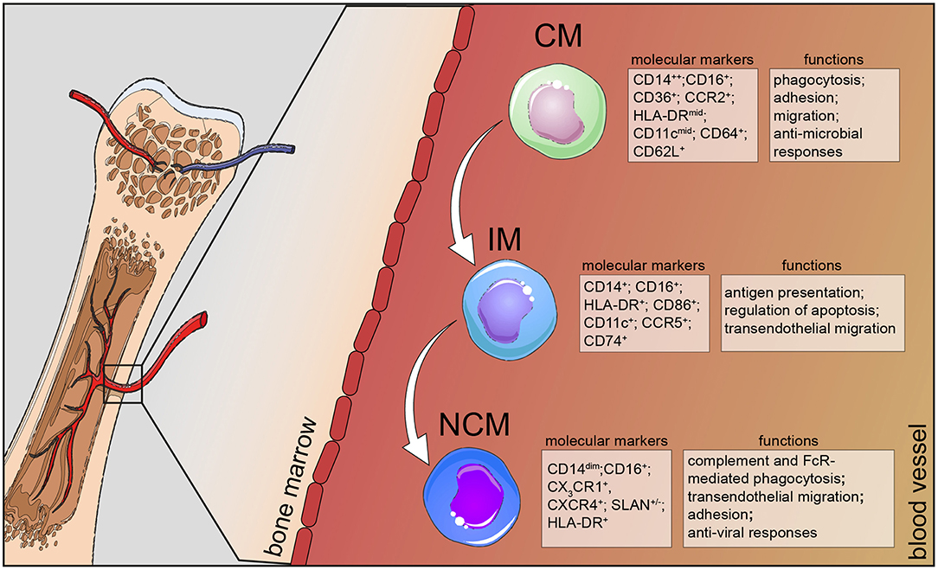
Figure from https://www.frontiersin.org/articles/10.3389/fimmu.2019.02035/full

