Slide 1



Introduction to genetic
association studies in Africa
Dr Kirk Rockett

Slide 2
Introductions
Epidemiology
Bioinformatics
Genetics
Basic principles of measuring disease in populations
Basic genotype data summaries and analyses
population genetics
Public databases and resources for genetics
GWAS QC
Principal components analyses
GWAS association analyses
whole genome sequencing and fine-mapping
GWAS results and interpretation
meta-analysis and power of genetic studies

Slide 3
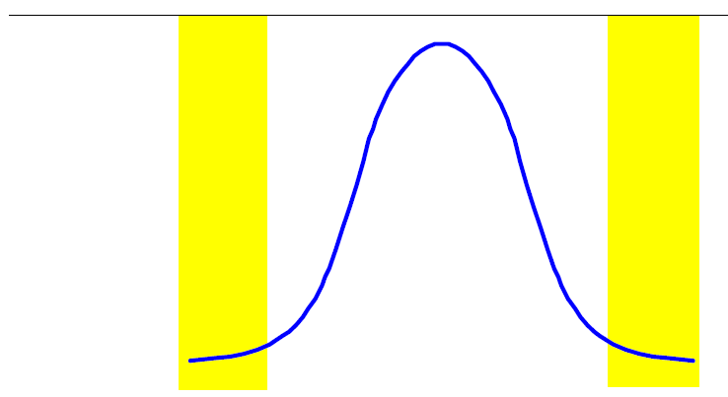
A complex trait
rare common rare
Proportion of individuals
Variation due to age, sex, environmental factors (e.g. diet), and genetic variation.
A small proportion of variation is caused by rare gene defects causing major disruption of normal physiological processes. These tend to be found at the extremes of the distribution.
Most variation is probably due to multiple common variants that slightly alter normal physiological processes. It is challenging to pin down the variants responsible because, at an individual level, they do not have strong effects.

Slide 4
Variation in resistance & susceptibility to disease
Why should we look for common variants with small effects?
These variants may not contribute much to overall risk.
But they may lead to new insights into etiology of disease – e.g. mechanisms of immunity, disease, drug action, erythrocyte invasion and other critical host – parasite interactions.
…and new drug targets.
We now have the scientific tools to do it.

Slide 5
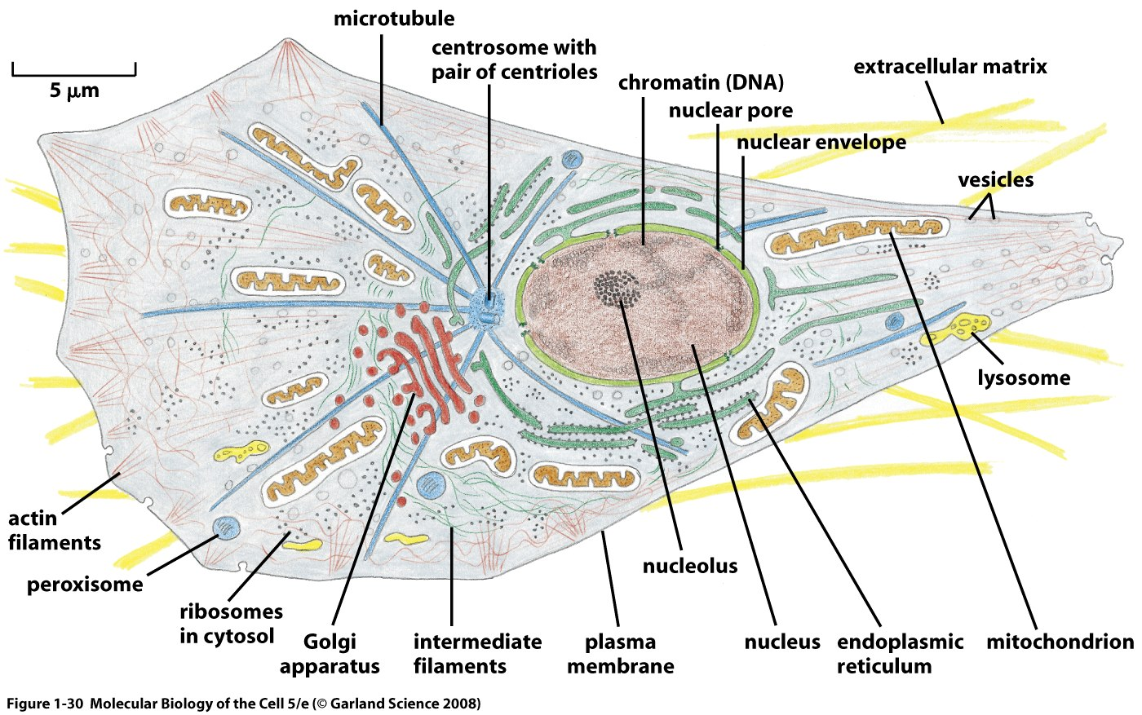
Genetic variation

Slide 6
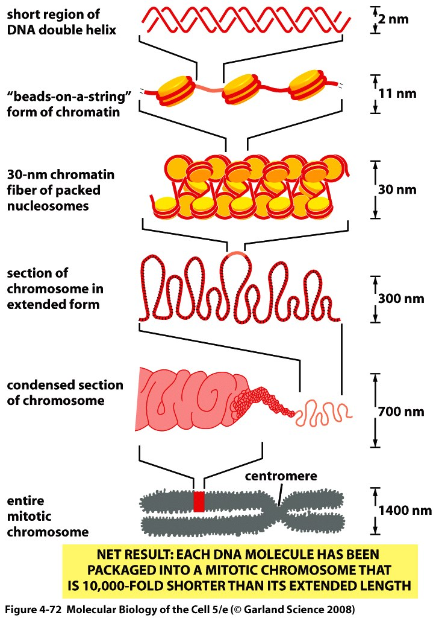
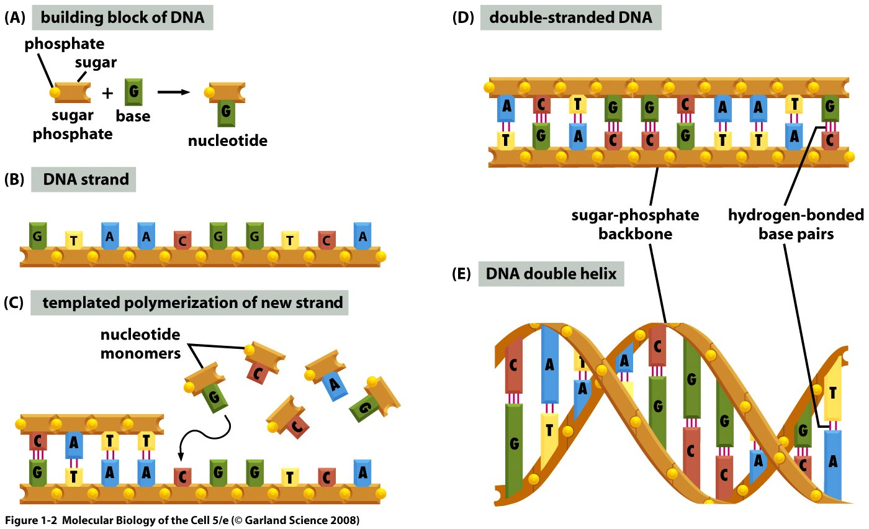
DNA structure overview
5bp

Slide 7
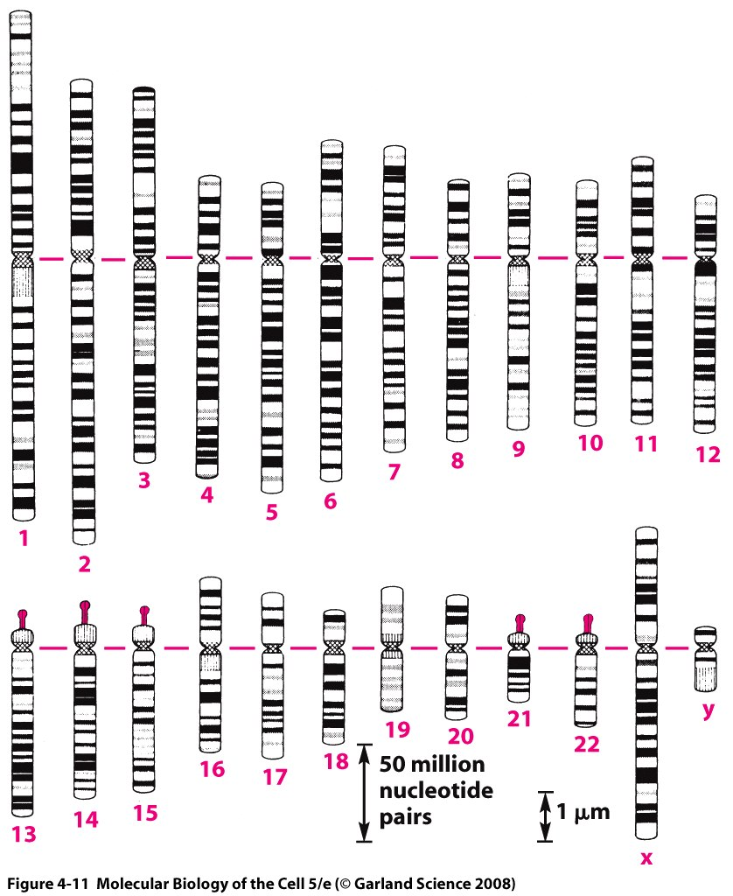
Genetic variation in the human genome

Slide 8
Common forms of variation in the human genome
There are many different variants including
small variations in the DNA sequence, e.g.
• a small ‘spelling mistake’
• deletion or insertion of a few characters
large structural variations, e.g.
• deletion of a large part of DNA sequence
• multiple copies of a section of DNA sequence, with variable
copy number

Slide 9
Common forms of variation in the human genome
Most variants are single nucleotide polymorphisms (SNPs)
ACTCTACGATTTACGGTACTTAGGAGCATATGCTACT
ACTGTACGATTTACGGTACTTAG.AGCATATGCTACT
SNP
single nucleotide
polymorphism
indel
insertion /
deletion
About 38 million SNPs found across the human genome worldwide – one every 84bp.
Maybe ~2 million small indels worldwide – about one every 1,600bp.

Slide 10
Common forms of variation in the human genome
Structural variants
Hundreds of kilobases
Gene A Gene B Gene C
Duplications:
Gene A
Gene B
Gene B
Gene C
Inversions:
Gene A
Gene B
Gene C
Complex rearrangements:
Gene A
Gene C
Gene B
Gene B

Slide 11
Finding loci that influence disease
?

Slide 12
Finding loci that influence disease
Association studies broadly fall into two categories:
Family-based studies
Case/control studies
Mixed designs are also possible.

Slide 13
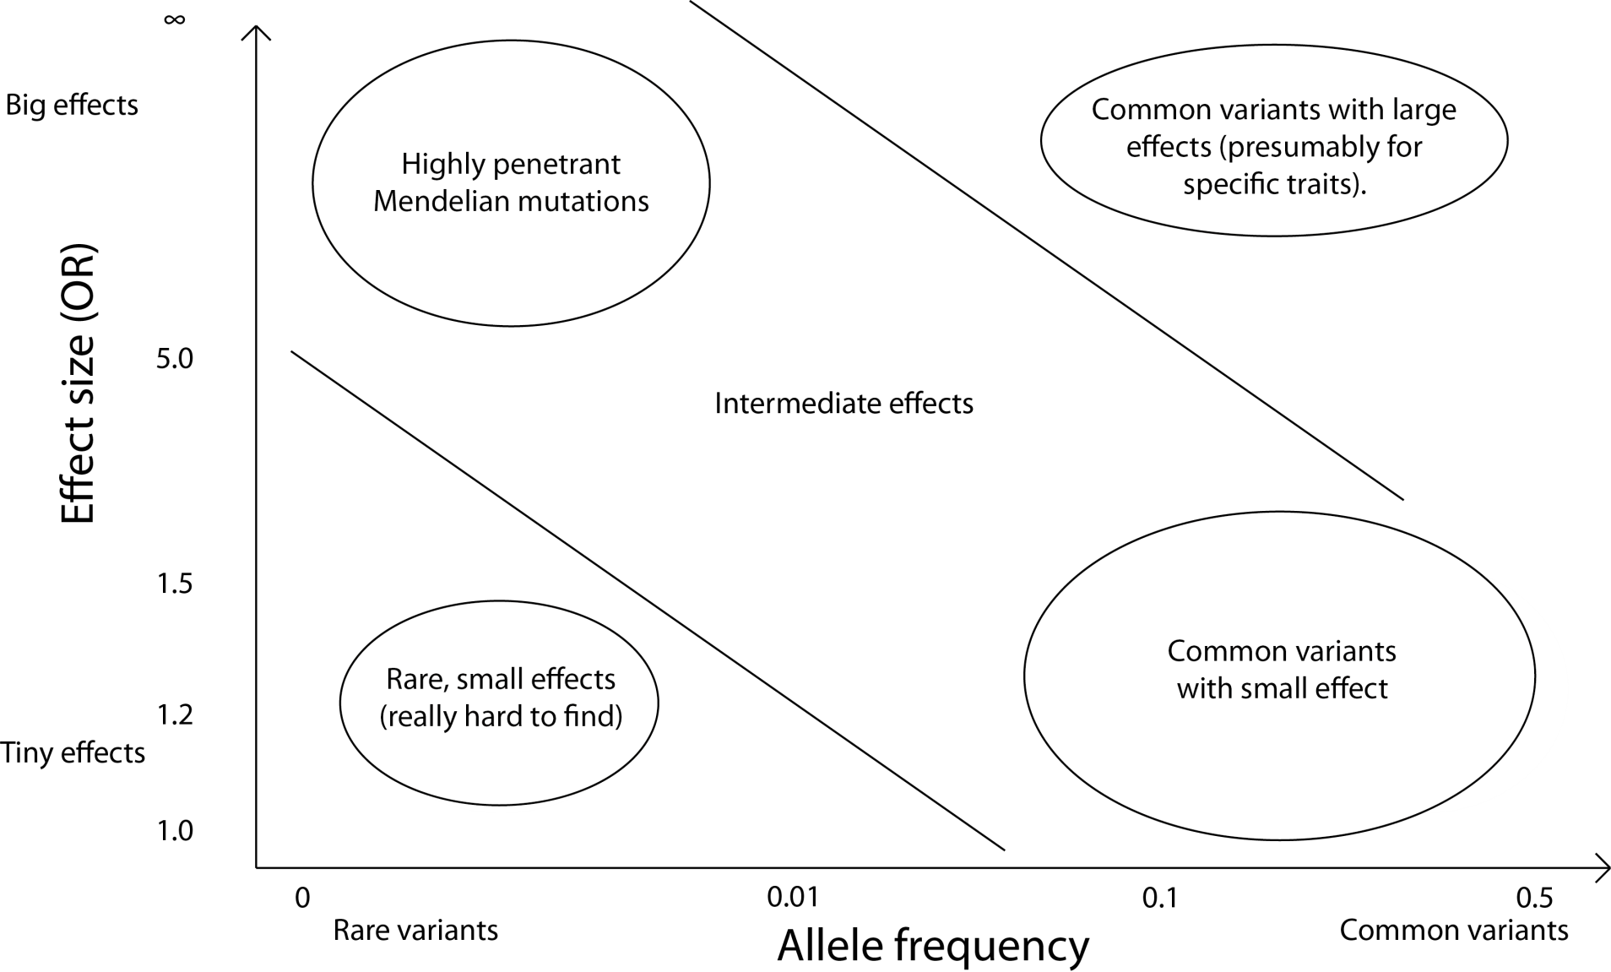
Variation in resistance & susceptibility to disease

Slide 14
Variation in resistance & susceptibility to disease
Family (linkage and/or sequencing) studies

Slide 15
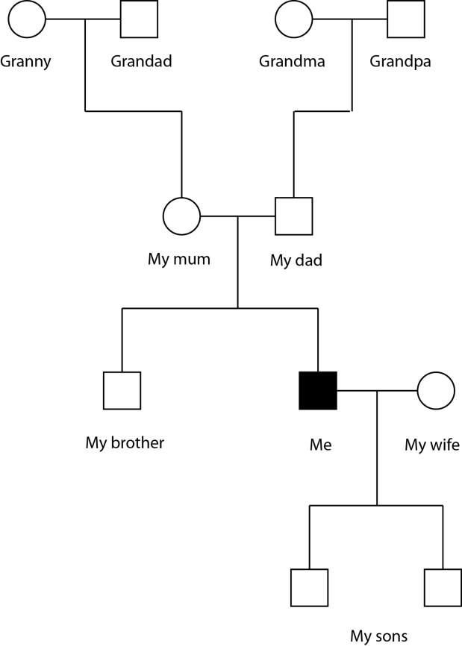
Family-based association analysis
Compare probands (e.g. cases) with other family members, such as parents.
Pros:
Robust against potential confounding factors, such as population structure or environmental effects.
Great when looking for variants with big effects.
Extended family designs can go where other designs can’t^{(*).}
Cons:
Can be harder difficult to collect large samples.
For common variants / complex trait association there is potentially reduced power (for equal sample size)
^{(*)} e.g. Kong et al, “Parental origin of sequence variants associated with complex diseases”, Nature 462 (2009)

Slide 16
Variation in resistance & susceptibility to disease
GWAS studies

Slide 17
Case/control association analysis
Compare disease-affected individuals (cases) with unaffected individuals (controls).
Pros:
Large sample sizes can be realised => powered to detect small effects.
Cons:
Potential confounding effects from differential selection of cases and controls – (e.g. cases and controls should be ethnically matched where possible).
The general population
cases
Most of this course will focus on case/control designs.

Slide 18
What do we need to know to detect our effect?
Or what POWER do we have to detect an effect

Slide 19
A heuristic for statistical power
Power = how likely are we to find a real effect?
Power ≈ N β² f(1-f) r²
Effect size
Number of samples
LD
Allele frequency

Slide 20

Variation in resistance & susceptibility to disease
Power ≈ N β² f(1-f) r²

Slide 21
Finding loci that influence disease
• Consider a position in the genome that shows variation
between individuals, for example …
A T G A C T C G T A allele 1
A T G A C A C G T A allele 2
• Each of the different variant forms is called an allele
• We are looking for alleles that are associated with high or
low risk of disease

Slide 22
Example: sickle and severe Malaria
Gambian data (MalariaGEN consortium)
Genotype
HbAA HbAS HbSS
 | TT | AT | AA
Population controls | 3689 | 588 | 22
Severe malaria cases | 2700 | 35 | 13
N = 7047
f = 0.07 (7%)

Slide 23
Example: sickle and severe Malaria
Gambian data (MalariaGEN consortium)
 | TT | AT | AA
Population | 3689 | 588 | 22
Severe malaria cases | 2700 | 35 | 13
Odds ratio = 3689*35 / 2700 * 588 = 0.08
P < 2x10⁻¹⁶
e.g. chisq.test in R
Individuals with AT (sickle) genotype have 10‐fold lower risk of malaria than those with TT (wild-type) genotype.
Notes:
Simplest kind of statistical test possible here.
Caution is needed in interpreting OR in terms of risk in population, but.
Also no treatment of structure here.
We will do this kind of test in the practical.

Slide 24
Genome‐wide association analysis (GWAS) in a nutshell
Aim:
Find common variants influencing disease by performing this test at millions of variants across the human genome.
Typical modern experiment: type 2.5M variants in thousands of cases and thousands of population controls. Use estimated genome-wide relationships to control for population structure.
This design exploits linkage disequilibrium to assess variants that are not directly typed.
Key concept: linkage
disequilibrium

Slide 25
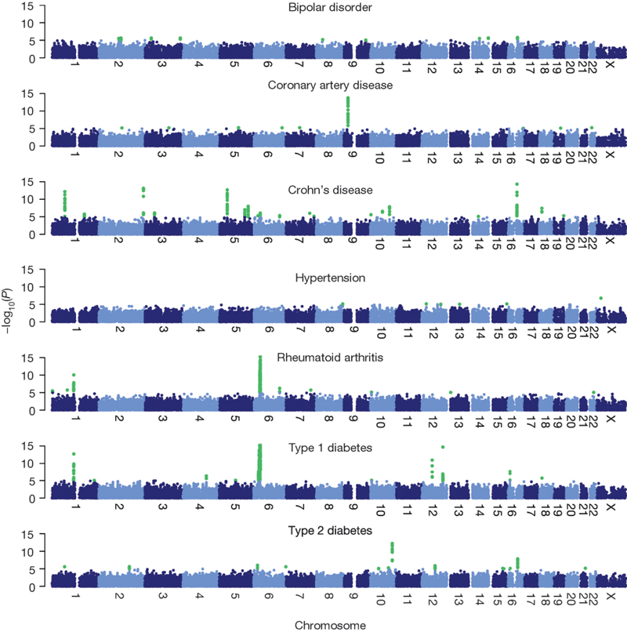
Genome‐wide association (GWA) analysis in a nutshell
Amazingly, it works! E.g: 2,000 cases and 3,000 controls typed at 500k variants:
“Genome-wide association study of 14,000 cases of seven common diseases and 3,000 shared controls”
The Wellcome Trust Case Control Consortium Nature 447 (2007)

Slide 26
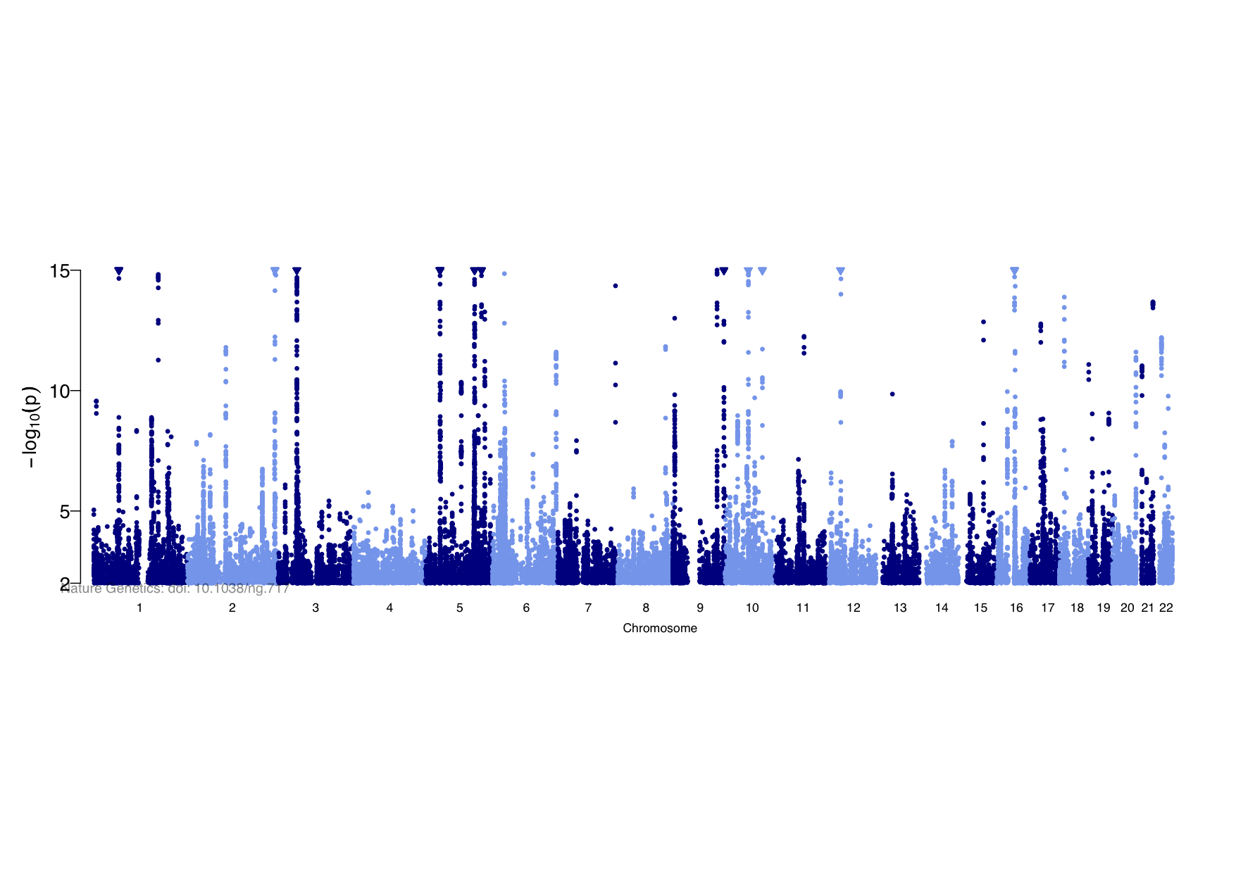
Genome‐wide association (GWA) analysis in a nutshell
Amazingly, it works! E.g: 2,000 cases and 3,000 controls typed at 500k variants:
“Genome-wide association study of 14,000 cases of seven common diseases and 3,000 shared controls”
The Wellcome Trust Case Control Consortium Nature 447 (2007)
With 6,000 cases and 15,000 controls imputed to 1 million variants:
“Genome-wide meta-analysis increases to 71 the number of confirmed Crohn's disease susceptibility loci”, Franke et al Nature Genetics 42 (2010)

Slide 27
Genome‐wide association (GWA) analysis in a nutshell
Amazingly, it works! E.g: 2,000 cases and 3,000 controls typed at 500k variants:
“Genome-wide association study of 14,000 cases of seven common diseases and 3,000 shared controls”
The Wellcome Trust Case Control Consortium Nature 447 (2007)
Different diseases have different architectures:
“Genome-wide association study of 14,000 cases of seven common diseases and 3,000 shared controls”
The Wellcome Trust Case Control Consortium Nature 447 (2007)

Slide 28
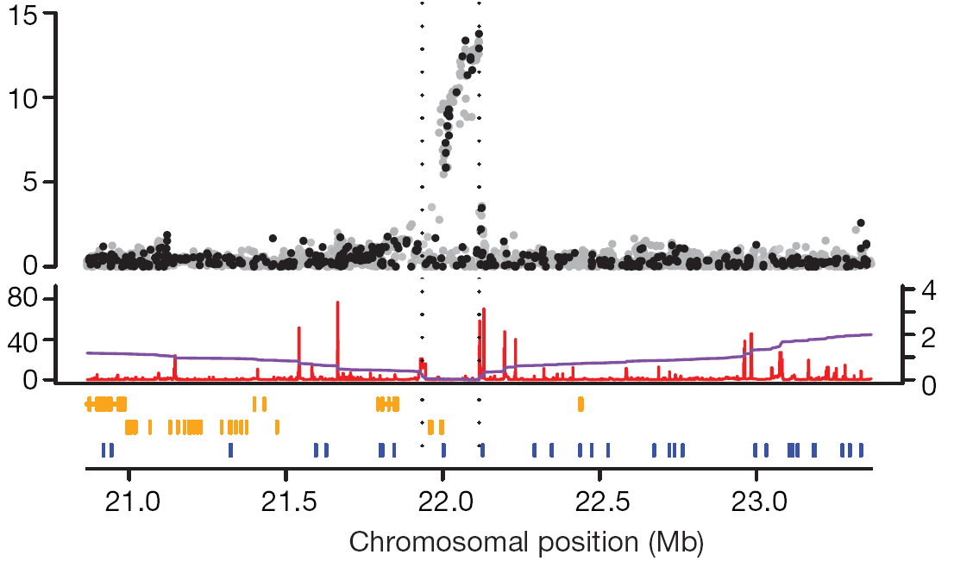
Wellcome Trust Case Control Consortium
rs1333049
P = 1.8x10⁻¹⁴
Discovery of a
common genetic
variant that affects
risk of coronary
artery disease
CDKN2A
CDKN2B
Chromosome 9
Best SNP marker was rs1333049
• OR ~ 1.47: one copy of the risk allele (present in half the population) increases “risk” of coronary artery disease by ~50%
• two copies of risk allele (present in quarter of population)
almost doubles “risk” of coronary artery disease (OR 1.47 * 1.47)

Slide 29
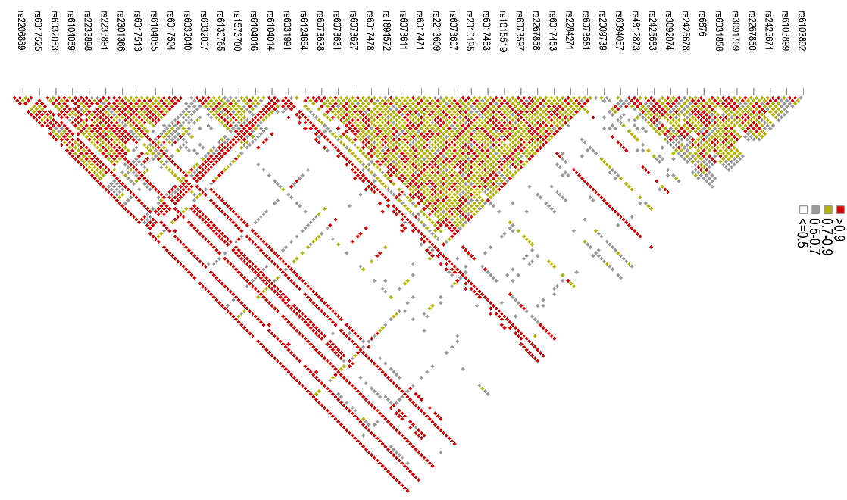
Each population has a distinct pattern of genome variation
SNPs
Most SNPs are correlated with surrounding SNPs. This is known
as linkage disequilibrium
Linkage disequilibrium reflects the common combinations of
variants (haplotypes) that exist in the population

Slide 30
GWAS in Africa
A number of factors make GWAS particularly challenging in Africa.
Genome diversity much higher in African than other populations – more SNPs, more structure, more haplotypes.
Low levels of LD…
…and differences in LD between populations means power to detect untyped causal loci is reduced.
A unique burden of infectious disease - the full story might involve two or more genomes at once!

Slide 31

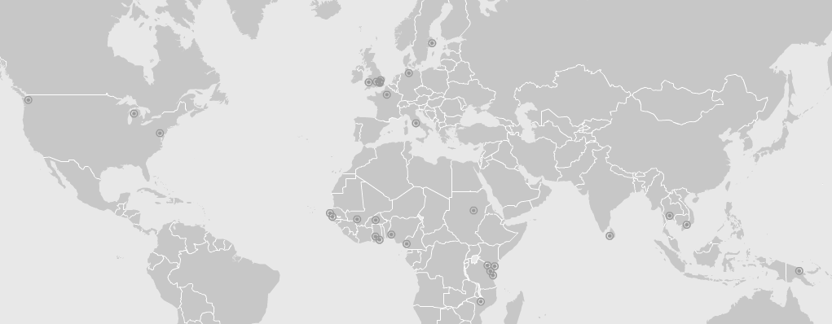
Malaria Genomic Epidemiology Network
www.malariagen.net
• Investigators in 16 malaria endemic countries: Burkina Faso, Cambodia, Cameroon, Gambia, Ghana, Ghana, Kenya, Malawi, Mali, Nigeria, Papua New Guinea, Senegal, Sudan, Tanzania, Thailand, Vietnam.
• …and 6 non‐endemic countries: France, Germany, Italy, Sweden, UK, USA
Building a resource of DNA and clinical data from ~100,000 subjects

Slide 32
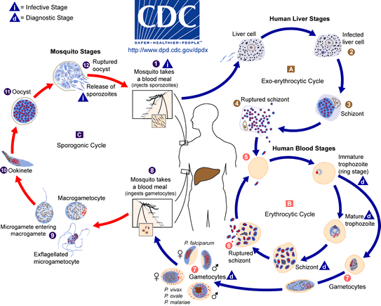

Slide 33
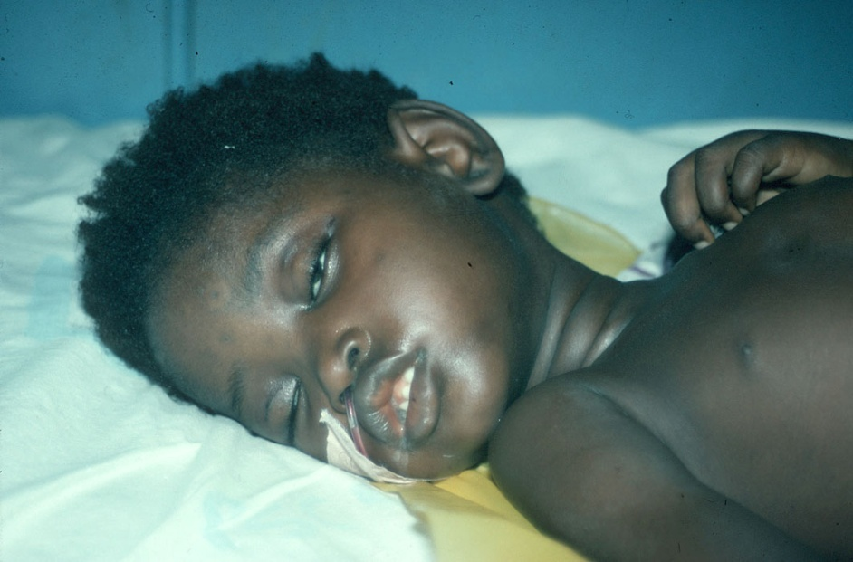
Recruitment of 13,000 cases of severe malaria
Cases and controls from:
Burkina Faso
Cameroon
Gambia
Ghana (Navrongo)
Ghana (Kumasi)
Kenya
Malawi
Mali
Nigeria
Papua New Guinea
Tanzania
Vietnam
Question: In communities where
every child is repeatedly infected
with malaria, why do some children die and not others?

Slide 34
Consistent effects despite phenotypic heterogeneity
HbAS effect in severe malaria
Country | Cases (n/N) | Cntls (n/N)
Gambia | 32/2542 | 460/3332
Mali | 4/453 | 28/344
Burkina Faso | 21/865 | 73/729
Ghana (Navrongo) | 19/6820 | 50/484
Ghana (Kumasi) | 32/1495 | 271/2042
Nigeria | 9/77 | 9/40
Cameroon | 32/621 | 99/576
Kenya | 57/2261 | 594/3941
Tanzania | 5/428 | 75/452
Malawi | 2/1388 | 132/2696
All severe malaria | 213/10685 | 1791/14641
Rockett et al. (2014) Nature Genetics 46: 1197
Sickle cell trait
Protective effect
of rs334 against
severe malaria
P=10⁻²²⁷
0.01 0.1 1 10
ODDS RATIO

Slide 35
Consistent effects despite phenotypic heterogeneity
O blood group effect in severe malaria
Country | Cases (O/total) | Cntls (O/total)
Gambia | 1000/2345 | 1664/3624
Mali | 130/445 | 143/336
Burkina Faso | 321/854 | 326/729
Ghana (Navrongo) | 263/674 | 227/556
Ghana (Kumasi) | 548/1480 | 992/1988
Nigeria | 27/78 | 24/40
Cameroon | 267/608 | 312/572
Kenya | 1061/2254 | 2131/3899
Tanzania | 189/423 | 221/455
Malawi | 615/1414 | 1298/2607
Vietnam | 272/788 | 1000/2517
Papua New Guinea | 139/385 | 76/239
All severe malaria | 4832/11948 | 8414/17652
Rockett et al. (2014) Nature Genetics 46: 1197
O blood group
Protective effect
of rs8176719 against severe malaria
P=10⁻³²
0.1 1 10
ODDS RATIO

Slide 36
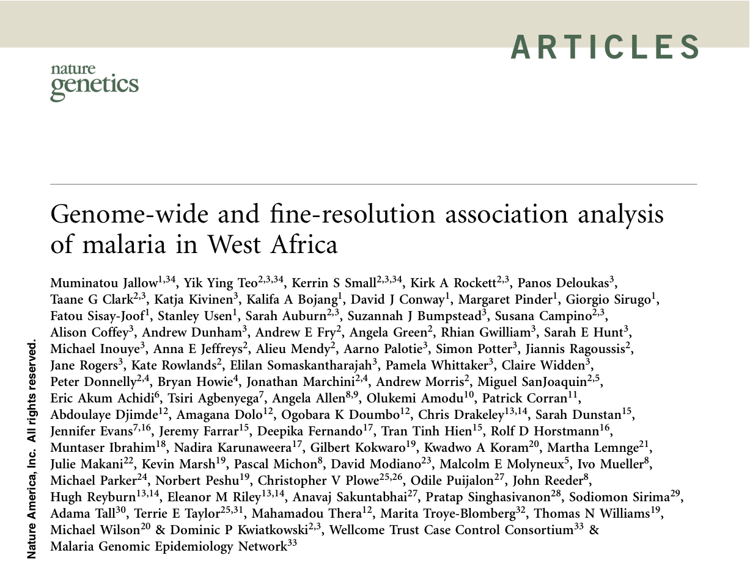

Attempt #1: GWAS of Severe Malaria in Gambia (2009)

Slide 37
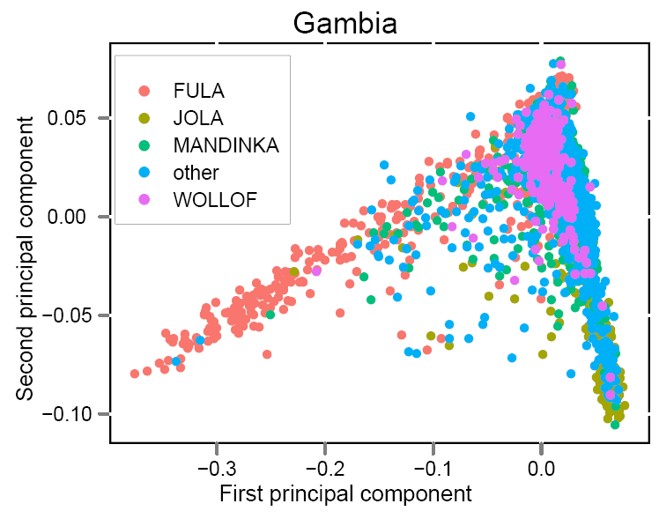
Importance of population structure
Principal components analysis
• Within a 40 sq mile area of
The Gambia we find
complex population structure
• Population structure can give rise to
false positive genetic associations
Jallow et al. (2009) Nature Genetics 41: 657

Slide 38
Importance of population structure
Subpopulation A
Subpopulation B
Cases
Cases
Controls
Controls
Genotype aa Aa AA

Slide 39
Importance of population structure
Subpopulation A
Subpopulation B
Cases
Cases
Controls
Controls
χ² = 2.1
(p = 0.34)
χ² = 16.3
(p <0.001)
χ² = 1.57
(p = 0.46)
Genotype aa Aa AA

Slide 40
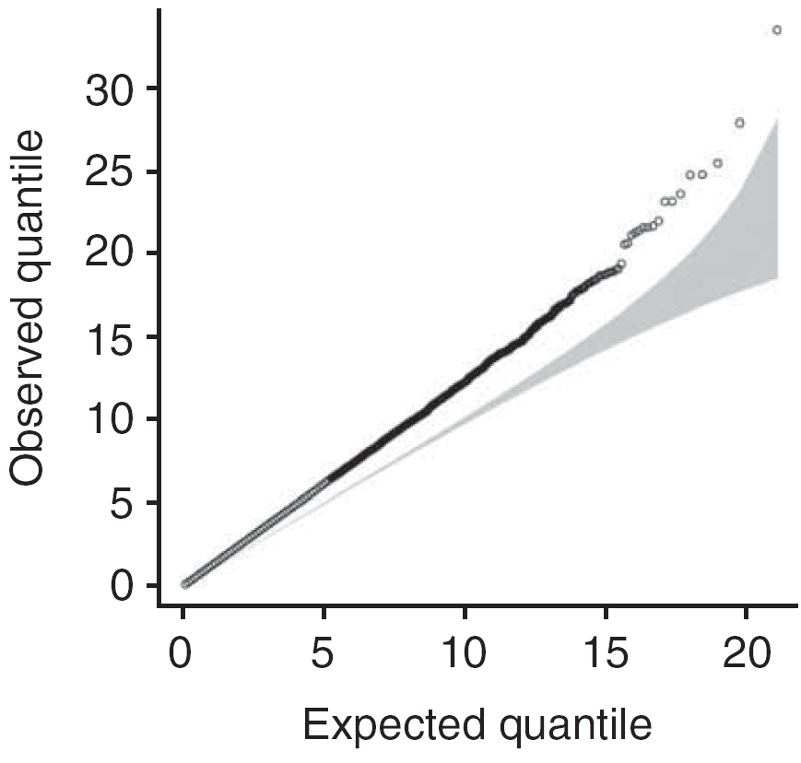
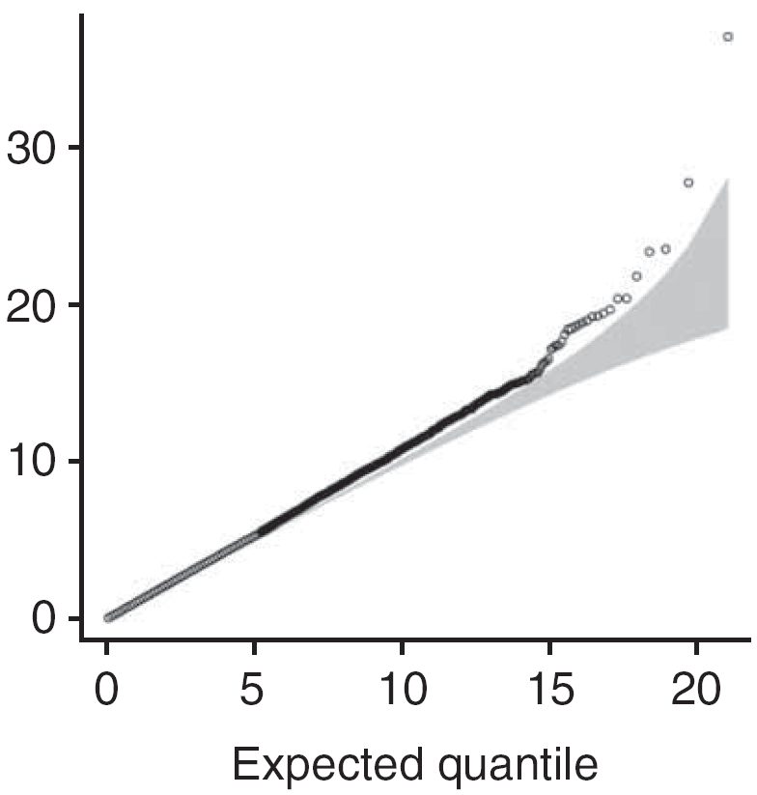
Importance of population structure
Quantile‐quantile plot of chi‐squared statistic comparing what
we observed versus what we’d expect if no disease association
Corrected by principal
components analysis
Uncorrected
Inflation factor
= 1.25
Inflation factor
= 1.03
Jallow et al. (2009) Nature Genetics 41: 657

Slide 41
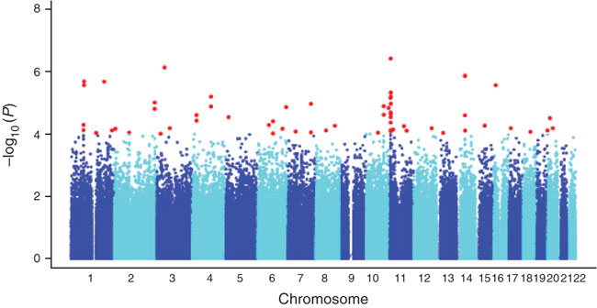
GWA studies of severe malaria
Study of 500,000 SNPs in 2,500 Gambian children
Jallow et al. (2009) Nature Genetics 41: 657
Sickle (P = 3.9 × 10⁻⁷⁾
ABO
Low LD acts to attenuate GWA signals of association
• HbS signal is P=4x10^{‐7} (causal variant P=10^{‐28})
• No signal at ABO

Slide 42
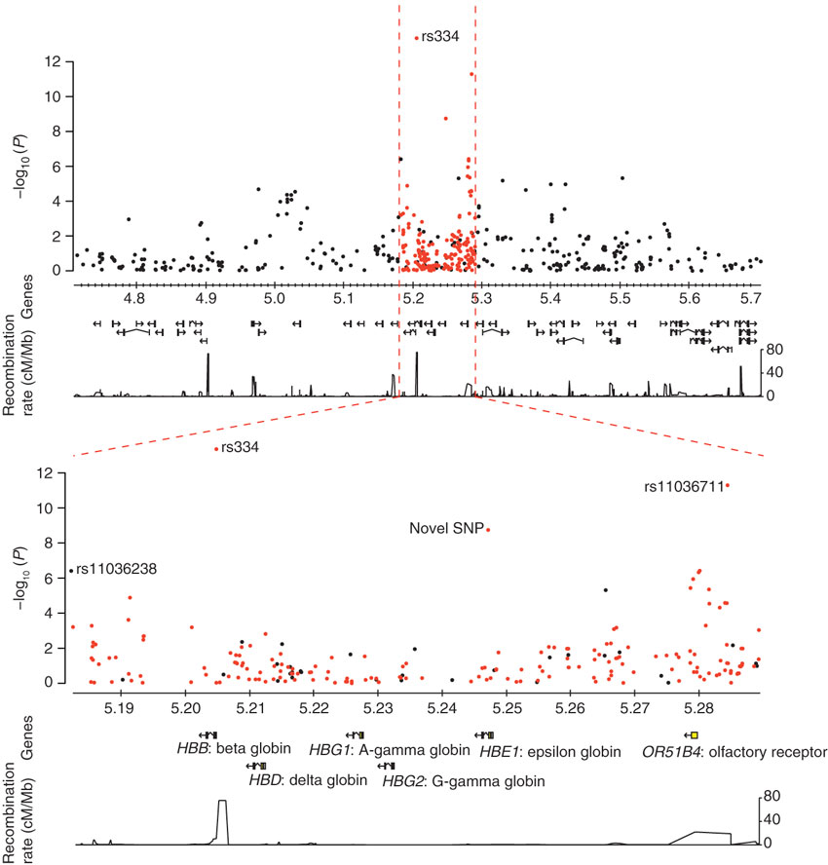
Targetted resequencing

Slide 43
Attempt #2: GWAS of severe malaria in three African populations (Gambia, Kenya and Malawi) (2013).
5,000 cases and 7,000 controls from Gambia, Kenya and Malawi.
Imputed to ~1.3M variants from the publically available HapMap reference panel.
Novel methods to allow for heterogeneity and differences in haplotype background: heterogeneity Bayes factors, and region-based tests that take into account all variants in each region.

Slide 44
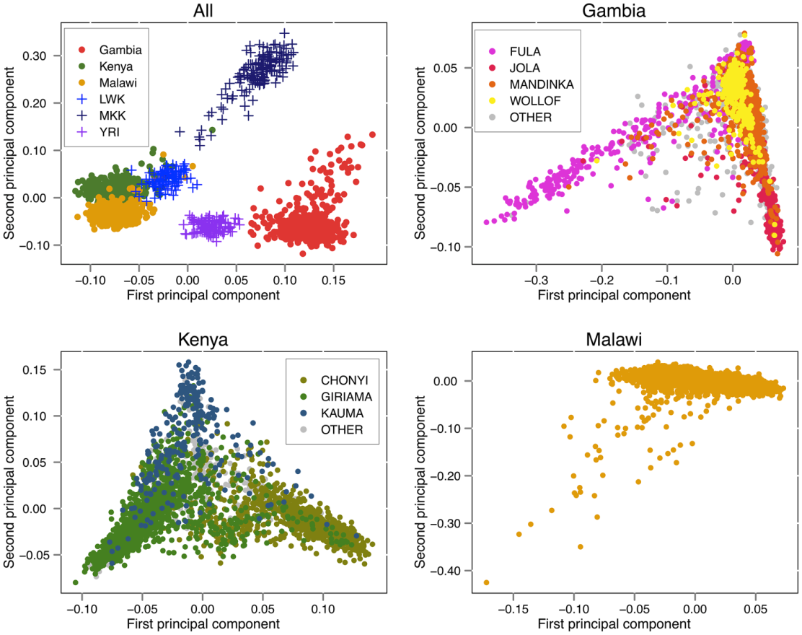
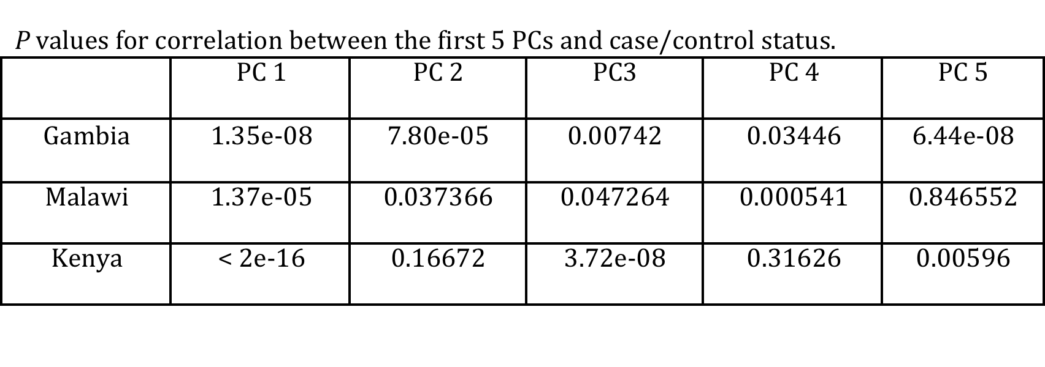
Attempt #2: GWAS of severe malaria in three African populations (Gambia, Kenya and Malawi) (2013).
Control for the extensive structure using a mixed model that takes into account relatedness at all levels. (PCs also used for comparison with similar results.)
“Imputation-Based Meta-Analysis of Severe Malaria in Three African Populations”, Band G, et al. PLoS Genetics (2013)

Slide 45
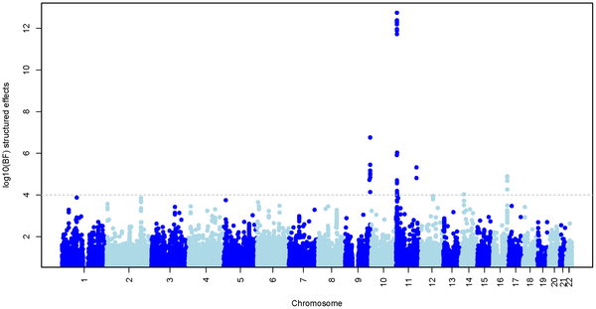
Attempt #2: GWAS of severe malaria in three African populations (Gambia, Kenya and Malawi) (2013).
Sickle
ABO
5000 cases and 7000 controls from Gambia, Kenya and Malawi.
Use of imputation into publically available reference set (HapMap) to assess association at 1.3M variants.
“Imputation-Based Meta-Analysis of Severe Malaria in Three African Populations”, Band G, et al. PLoS Genetics (2013)

Slide 46
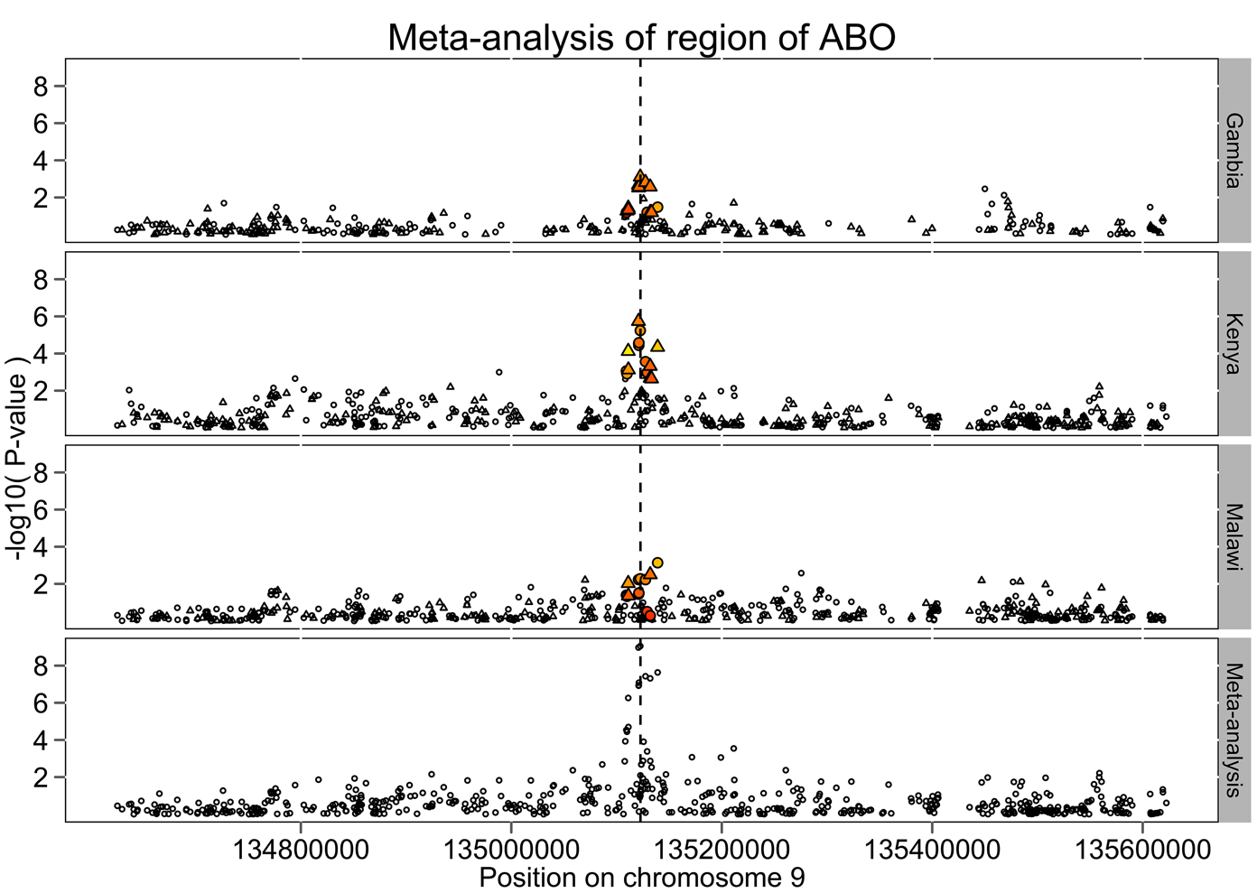
Attempt #2: GWAS of severe malaria in three African populations (Gambia, Kenya and Malawi) (2013).

Slide 47
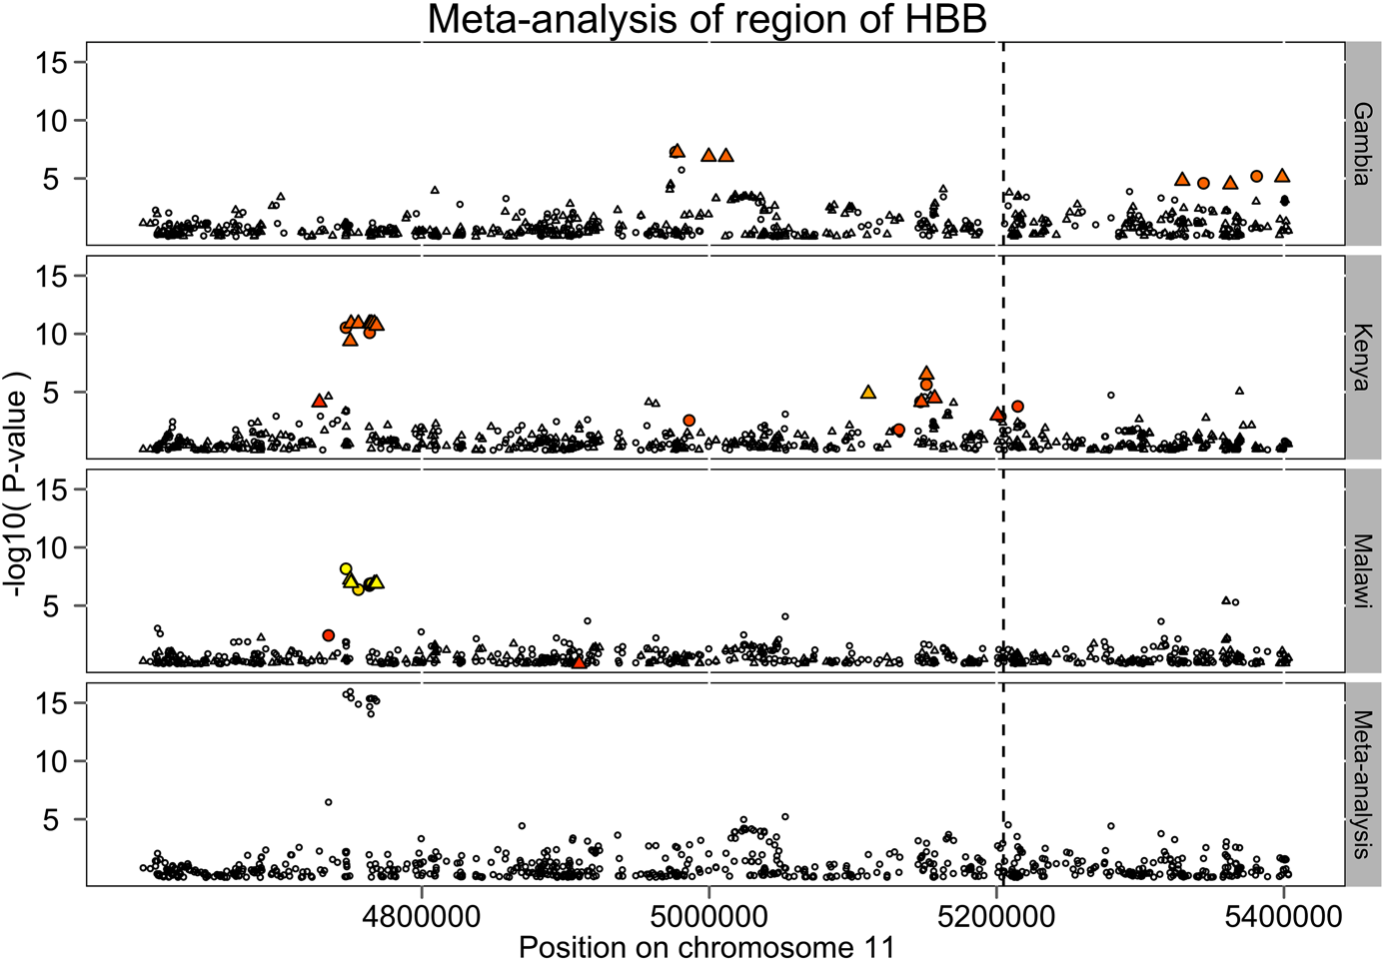
Attempt #2: GWAS of severe malaria in three African populations (Gambia, Kenya and Malawi) (2013).
Where we see the most signal
Where sickle is

Slide 48
Attempt #2: GWAS of severe malaria in three African populations (Gambia, Kenya and Malawi) (2013).
Region | Chromosome | Regional test Bayes factor
OR51F1 (HBB region) | 11 | > 10¹¹
ABO | 9 | 4920
BET1L | 11 | 319
C10orf57 | 10 | 243
MYOT | 5 | 112
SMARCA5 | 4 | 110
ATP2B4 | 1 | 103
Notes:
N=2,153 discovery, N=3,542 replication, N=2,213 Gambian replication. OR ~= 0.61 combined. Our Gambian data: ~0.81, P = 8.6e-06. Ethnic groups are

Slide 49
Attempt #3 (2014?): GWAS of severe malaria in eight populations in sub-Saharan Africa
Approx. 10,000 cases and 10,000 controls.
Typed at 2.5M variants and imputed up to 20M variants from the 1000 Genomes reference panel.
Starting to find new loci. Some evidence that there are rarer, bigger effects around, differing between populations.
Data is being made publically available – we have an ongoing effort to develop web-based tools for data sharing.

Slide 50
GWAS Summary
Power to detect association depends on sample size, effect size, frequency, and density of markers. Bigger is better!
Careful QC and control for confounding factors is essential.
High diversity and patterns of LD make GWAS in Africa particularly challenging.

Slide 51
GWAS : the hare and the tortoise?
Europe Africa
Level of LD high low
Variability of LD low high
Finding signals of association by
genome‐wide SNP typing easy difficult
Localising causal variants
by genome sequencing difficult ?easy

Slide 52
Next‐generation sequencing will transform genome‐wide association analysis
In the near term
The 1000 Genomes Project is including 2 MalariaGEN study sites (Gambia, Vietnam) in addition to existing Kenyan Luhya and Nigerian Yoruban samples.
Other groups working to create Africa-specific reference panels.
By combining GWAS data with population‐specific sequence data, we can boost signals of association and localise causal variants.
In the longer term
• GWAS‐by‐sequencing will replace GWAS‐by‐SNP‐typing.
• This will particularly benefit studies in Africa and multiethnic
studies.

Slide 53
Sequencing - other designs
With the advent of low-cost sequencing, it would be very interesting to try other approaches to Malaria susceptibility.
E.g. sequence families of individuals who never get symptoms of Malaria, looking for very rare, highly penetrant protective alleles.

Slide 54
What’s next?
As a warm-up for a full GWAS analysis later in the week, the next practical shows you how to perform association analyses on individual SNPs using R. (Based on MalariaGEN data.)

