Slide 1
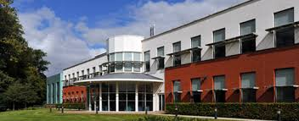


Population genetics
Dr Gavin Band

Slide 2
Introductions
Epidemiology
Bioinformatics
Genetics
Basic principles of measuring disease in populations
Basic genotype data summaries and analyses
population genetics
Public databases and resources for genetics
GWAS QC
Principal components analyses
GWAS association analyses
whole genome sequencing and fine-mapping
GWAS results and interpretation
meta-analysis and power of genetic studies

Slide 3

Let’s imagine we’ve collected and sequenced some samples...
ATAGATAGACCATACTGCATCGCAAGCAGCTACGCTAGCGTTA
ATAGAAAGACCAGACTCCATCGCTAGCAGCTACGCTAGAGTTA
K samples
ATTGAAAGACCATACTCCATCGCTAGCAGC-ACGCTAGAGTTA
ATAGAAAGACCAGACTCCATCGCAAGCAGC-ACCCTAGCGTTA
ATAGAAAGACCAGACTCCATCGCAAGCAGCTACGCTAGAGTTA
.
.
.
Notes:
Sequenced samples lined up next to a reference sequence.

Slide 4
Let’s imagine we’ve collected and sequenced some samples...
ATAGATAGACCATACTGCATCGCAAGCAGCTACGCTAGCGTTA
ATAGAAAGACCAGACTCCATCGCTAGCAGCTACGCTAGAGTTA
ATTGAAAGACCATACTCCATCGCTAGCAGC-ACGCTAGAGTTA
ATAGAAAGACCAGACTCCATCGCAAGCAGC-ACCCTAGCGTTA
ATAGAAAGACCAGACTCCATCGCAAGCAGCTACGCTAGAGTTA
Insertion / deletion polymorphism
SNPs
Notes:
As discussed yesterday there are many types of genetic variation. But to allow us to talk generally about the processes we are going to simplify the process assuming that at each polymorphism there are two alleles that segregate and that they are result from a single ancestral mutation event.
C.f. sequencing practical on Thursday

Slide 5
Let’s imagine we’ve collected and sequenced some samples...
ATAGATAGACCATACTGCATCGCAAGCAGCTACGCTAGCGTTA
ATAGAAAGACCAGACTCCATCGCTAGCAGCTACGCTAGAGTTA
ATTGAAAGACCATACTCCATCGCTAGCAGC-ACGCTAGAGTTA
ATAGAAAGACCAGACTCCATCGCAAGCAGC-ACCCTAGCGTTA
ATAGAAAGACCAGACTCCATCGCAAGCAGCTACGCTAGAGTTA
Notes:
As discussed yesterday there are many types of genetic variation. But to allow us to talk generally about the processes we are going to simplify the process assuming that at each polymorphism there are two alleles that segregate and that they are result from a single ancestral mutation event.
C.f. sequencing practical on Thursday

Slide 6
24 haplotypes (12 individuals) 100 SNPs on chromosome 20
Utah residents, ancestrally Northern and Western European
Yoruba from Ibadan, Nigeria
Notes:
So as an example lets look at some real data from a small region of Human chromosome 20 the HapMap project.
There are clearly differences between in the patterns of diversity between these two groups, but what generated them?

Slide 7
Key questions
What should we expect to observe?
How can we interpret observed patterns?
What processes generated this data?
Notes:
This talk is about these three questions (really it’s just one question).
Will now talk about how theoretical population genetics approaches that. Here is our sample of chromosomes. Let’s imagine it came from a population genetic model…

Slide 8
Key ancestral processes
Genetic drift
Mutation
Recombination
(and selection)

Slide 9
A simple model of a population
2N chromosomes
Past
G generations
Present
Notes:
About the simplest useful model of population is the Wright-Fisher model.
Non-overlapping generations, random mating, no recombination, etc. It is not realistic! But still useful.
This is not the epidemiology type of definition (“population at risk”, etc.)
This is a mathematically convenient model of a population.

Slide 10
A simple model of a population
Past
G generations
Present
Notes:
Another stupid thing: one individual gets both chromosomes from the same parent!
(Although I’ve drawn it as diploid, this model doesn’t really model individuals as diploid).

Slide 11
A simple model of a population
Past
G generations
Present
Notes:
A “population” in this sense is a theoretical construct – useful but totally wrong.
Let’s paint on the alleles – here I’ve put red for the haplotype carrying the middle allele and white for the haplotype not carrying it.
Let’s see what the population looked like back in time.

Slide 12
A simple model of a population
Past
G generations
Present
Notes:
Oh.
More colours => more alleles.

Slide 13
A simple model of a population
Past
G generations
Present
Notes:
A “population” in this sense is a theoretical construct – useful but totally wrong.

Slide 14
Genetic drift
Notes:
Over time alleles drift upwards and downwards in frequency. This is not due to any force like selection, but simply the stochastic random sampling process.
In this population the blue and yellow alleles have been lost and the white allele has drifted to 70% frequency.

Slide 15
Genetic drift
Genetic drift reduces diversity
(it makes everyone look the same)
π=1.49
(mean number of pairwise differences)
π=0.35
Past
G generations
Present
Notes:
The numbers are mean number of pairwise differences between samples – nucleotide diversity, often denoted by pi.
Point is that samples on the right are rather homogeneous.
(NB. mutation rate ~ 1.1E-08 per site per generation.)

Slide 16
Genetic drift
Genetic drift creates correlations between alleles
(it increases LD)
r²=0.33
Between and
r²=0.51
Between and
Past
G generations
Present
Notes:
The numbers are mean number of pairwise differences between samples – nucleotide diversity, often denoted by pi.
Point is that samples on the right are rather homogeneous.
(NB. mutation rate ~ 1.1E-08 per site per generation.)

Slide 17
Genetic drift
Genetic drift decreases heterozygosity
p(1-p)=0.24
p(1-p)=0.16
Past
G generations
Present
Notes:
The numbers are mean number of pairwise differences between samples – nucleotide diversity, often denoted by pi.
Point is that samples on the right are rather homogeneous.
(NB. mutation rate ~ 1.1E-08 per site per generation.)

Slide 18
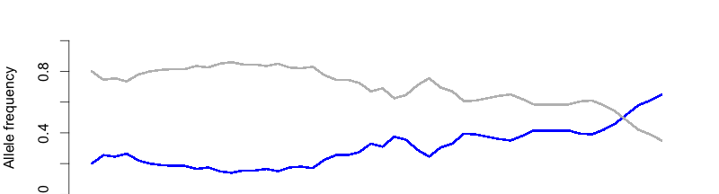
Size matters
In a smaller population:
- Genetic drift acts faster. E.g:
Approximate variance in allele frequency after s generations
K=100
50 generations

Slide 19
Size matters
In a smaller population:
- Genetic drift acts faster. E.g:
- There is more relatedness. E.g:
Approximate variance in allele frequency after s generations
Probability two samples coalesce (i.e. have the same parent) in the previous generation
1/2N
The expected time to the most recent common ancestor of two samples
2N

Slide 20
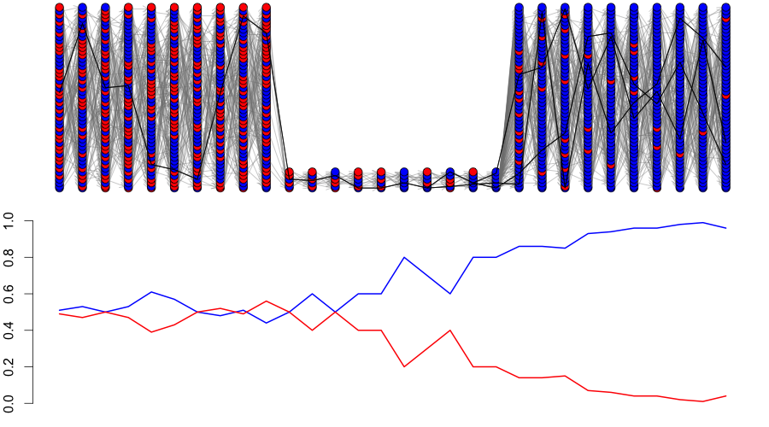
Example: a bottleneck
Notes:
In a bottleneck (e.g. out of Africa) diversity is lost.
And many lineages coalesce during the bottleneck. There are few ‘old’ relationships.

Slide 21
24 haplotypes (12 individuals) 100 SNPs on chromosome 20
Utah residents, ancestrally Northern and Western European
Yoruba from Ibadan, Nigeria
Notes:
So as an example lets look at some real data from a small region of Human chromosome 20 the HapMap project.
There are clearly differences between in the patterns of diversity between these two groups, but what generated them?

Slide 22
Genetic drift summary
Genetic drift decreases diversity by causing haplotypes to fluctuate in frequency, so that alleles are lost and everyone starts looking the same. This creates correlations between alleles along chromosomes (i.e. it creates LD).
Genetic drift acts faster in smaller populations. In the same way, individuals in smaller populations tend to be more closely related.
Simple population genetic models are definitely wrong, but still useful in understanding genetic variation.
Notes:
‘pushing’ is the wrong word. It is stochastic.

Slide 23
An acknowledgement
To make these slides I’ve used modified version of code originally written by Graham Coop. I’ll make this code available on the course materials site, but the original code is here:
https://github.com/cooplab/popgen-notes/
Graham’s group website www.gcbias.org is also a good place to look for information on population genetics topics.

Slide 24
Ancestral processes
Mutation
Recombination
Coalesce
2μ 2r 1/2N
If only drift were operating, we’d all look identical to each other. Something must be acting against drift.
Notes:
Will briefly mention mutation.

Slide 25
Mutation
2N chromosomes
Past
G generations
Present
Genetic drift means most mutations that arise are lost.
Some survive and contribute to genetic variation in the population
Notes:
Mutation is of course where genetic variation originates. But it is the interplay with drift that determines what overall variation in a population looks like.
In humans mutation rate is something like 1.1E-08 per base per generation
There are 3.2E9 base pairs in the (haploid) human genome. So ~60 mutations per genome per generation.
In a small region mutation will be much rarer than this picture!

Slide 26
Ancestral processes
Mutation
Recombination
Coalesce
2μ 2r 1/2N
If only drift were operating, we’d all look identical to each other. Something must be acting against drift.

Slide 27
Recombination
Paternal (father)
Maternal (mother)
No recombination
Recombination
Notes:
A picture of the mechanism of recombination

Slide 28
Recombination
.
.
.
.
.
.
Recombination breaks down the correlation between alleles
Notes:
Recombination acts in contrast to genetic drift breaking down correlations between alleles.

Slide 29
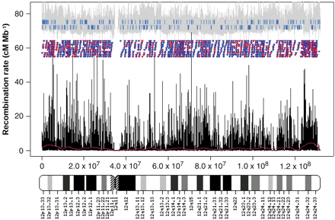
Recombination in humans has a complex, interesting structure
Notes:
A map of recombination rates across a chromosome.
In the last 20 years the surprising observation was made that recombination is highly nonuniform. It clusters in hotsplots along the genome. Let’s zoom in.

Slide 30
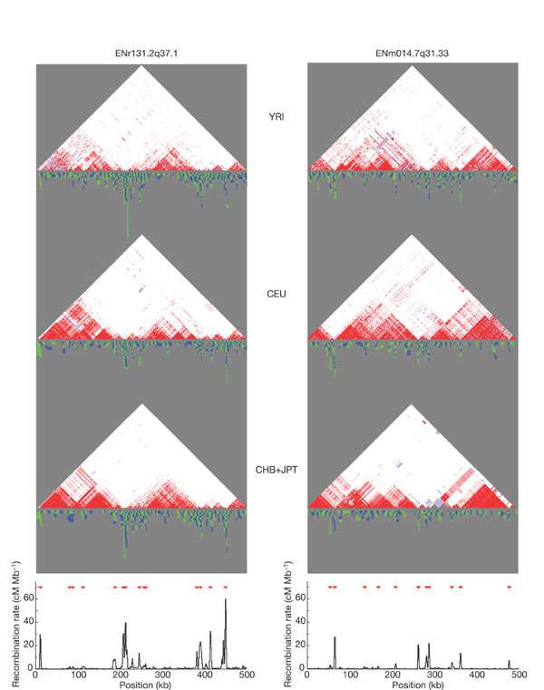
Recombination clusters along chromosomes
centiMorgans per Mb
Studies have shown that recombination is not uniform along chromosomes
Notes:
Recombination is typically measured in centimorgans per Mb.
A rate of 1cM per megabase means a 1% chance of a recombination happening The strongest hotspot has rate about 80cM/Mb. But a hotspot is not 1Mb long, it’s probably only a few tens of bps wide.
This means that even the strongest hotspots aren’t that strong – many meioses will happen without a crossover occuring. In total there are about 4000cM in the human genome.
Will give a picture of what happens near a hotspot, and then talk about LD measures.

Slide 31
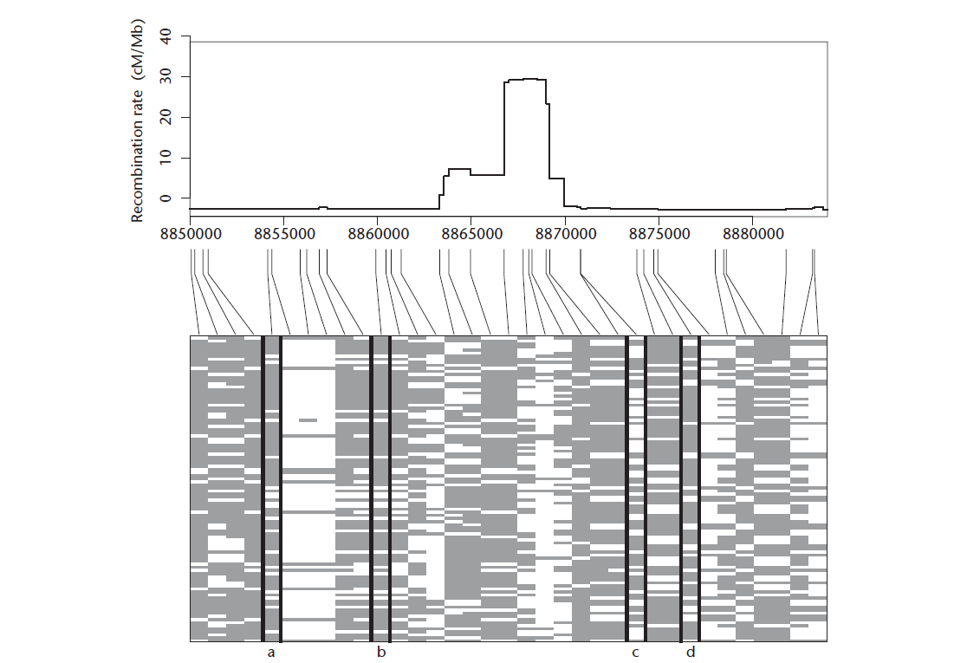
Hotspots and haplotypes
Hotspots can break down
correlations over short distances

Slide 32
Hotspots and haplotypes
Recombination hotspots lead to regions of strong correlation separated by regions of low LD
Recombination rate

Slide 33
Measuring correlations
In genetics correlation between alleles is called linkage disequilibrium (LD)
There are several measures of LD
Understanding LD in natural populations is important for genomic epidemiology

Slide 34
Linkage equilibrium
A
B
AB
Ab
a
b
aB
ab
Here, haplotype frequencies are determined by SNP allele frequencies (they are in equilibrium).
f_{AB} = f_{A}f_{B}
Notes:
Independence between the two loci.
The expected frequency of the AB haplotype is just the product of the marginal allele frequencies.

Slide 35
Linkage disequilibrium
AB
Ab
aB
ab
Here, haplotype frequencies differ from those expected if the SNPs are independent (they are in disequilibrium)
f_{AB} ≠ f_{A}f_{B}

Slide 36
Measuring LD
D ≈ 0 when near linkage equilibrium
D ≠ 0 when there is linkage disequilibrium
Two commonly-used measures:
= the (squared) correlation
between the two SNPs
Notes:
These measures look similar but behave rather differently.

Slide 37
Haplotypes and LD
1
2
3
4
r² is less than one unless SNP A is a perfect surrogate of SNP B in the sample
D’ statistic less than one if and only if all four haplotypes are present in sample
So D’is 1 unless visible recombination has occurred

Slide 38
Haplotypes and LD
1
2
3
4
r²=1, |D’|=1
r²<1, |D’|=1
r²<1, |D’|<1
r² is less than one unless SNP A is a perfect surrogate of SNP B in the sample
D’ statistic less than one if and only if all four haplotypes are present in sample
So D’is 1 unless visible recombination has occurred

Slide 39
Recombination and LD
Notes:
In the last 20 years the surprising observation was made that recombination is highly nonuniform.
It clusters in ‘hotspots’ along the genome. Recombination is typically measured in centimorgans per Mb.
A rate of 1cM per megabase means a 1% chance of a recombination happening The strongest hotspot has rate about 80cM/Mb. But a hotspot is not 1Mb long, it’s probably only a few tens of bps wide.
This means that even the strongest hotspots aren’t that strong – many meioses will happen without a crossover occuring. In total there are about 4000cM in the human genome.

Slide 40
Population genetic processes summary
Genetic drift decreases diversity and heterozygosity, and increases levels of LD. It acts faster in smaller populations.
Mutations occur at about 60 mutations per diploid genome per generation. But most are lost due to drift.
Recombination breaks down correlations between alleles. It occurs in a highly nonuniform manner, clustered into recombination hotspots.

Slide 41
Population size matters
We’ve seen that in larger populations we have to go further back in time to time to find the common ancestor
Consequently there is more opportunity for
  Mutation, increasing genetic diversity
  Recombination, decreasing correlation between alleles

Slide 42
The power of population genetic inference from a large genome
The human genome is very large, and broken up into essentially independent chunks by recombination.
This gives us many observations of the ancestral process, and considerable power to understand ancestry. Will give two examples.
Notes:
Want to give two examples.

Slide 43
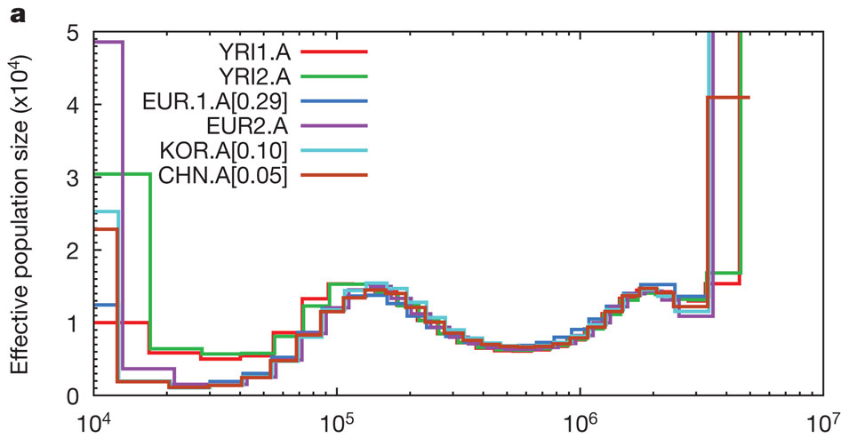
An example
Years in the past
Idea: a single genome gives us many observations of the ancestral process. As for the bottleneck example, more coalescence => smaller population size.
Li and Durbin, “Inference of human population history from individual whole-genome sequences”, Nature 2011
Notes:
Each line on this plot is estimated from a single diploid genome.
This was an influential paper.

Slide 44
Human population history
The recent migration of European from Africa has lead to small effective population sizes

Slide 45
Differences between populations
The overall pattern of LD is conserved
The different ancestral histories lead to different levels of LD

Slide 46
Population genetics
Genetic drift generates correlations between alleles
Recombination breaks them down
The ancestral population size and history determines the amount of diversity and how it is structured
Natural selection can generate strong differences between populations

Slide 47
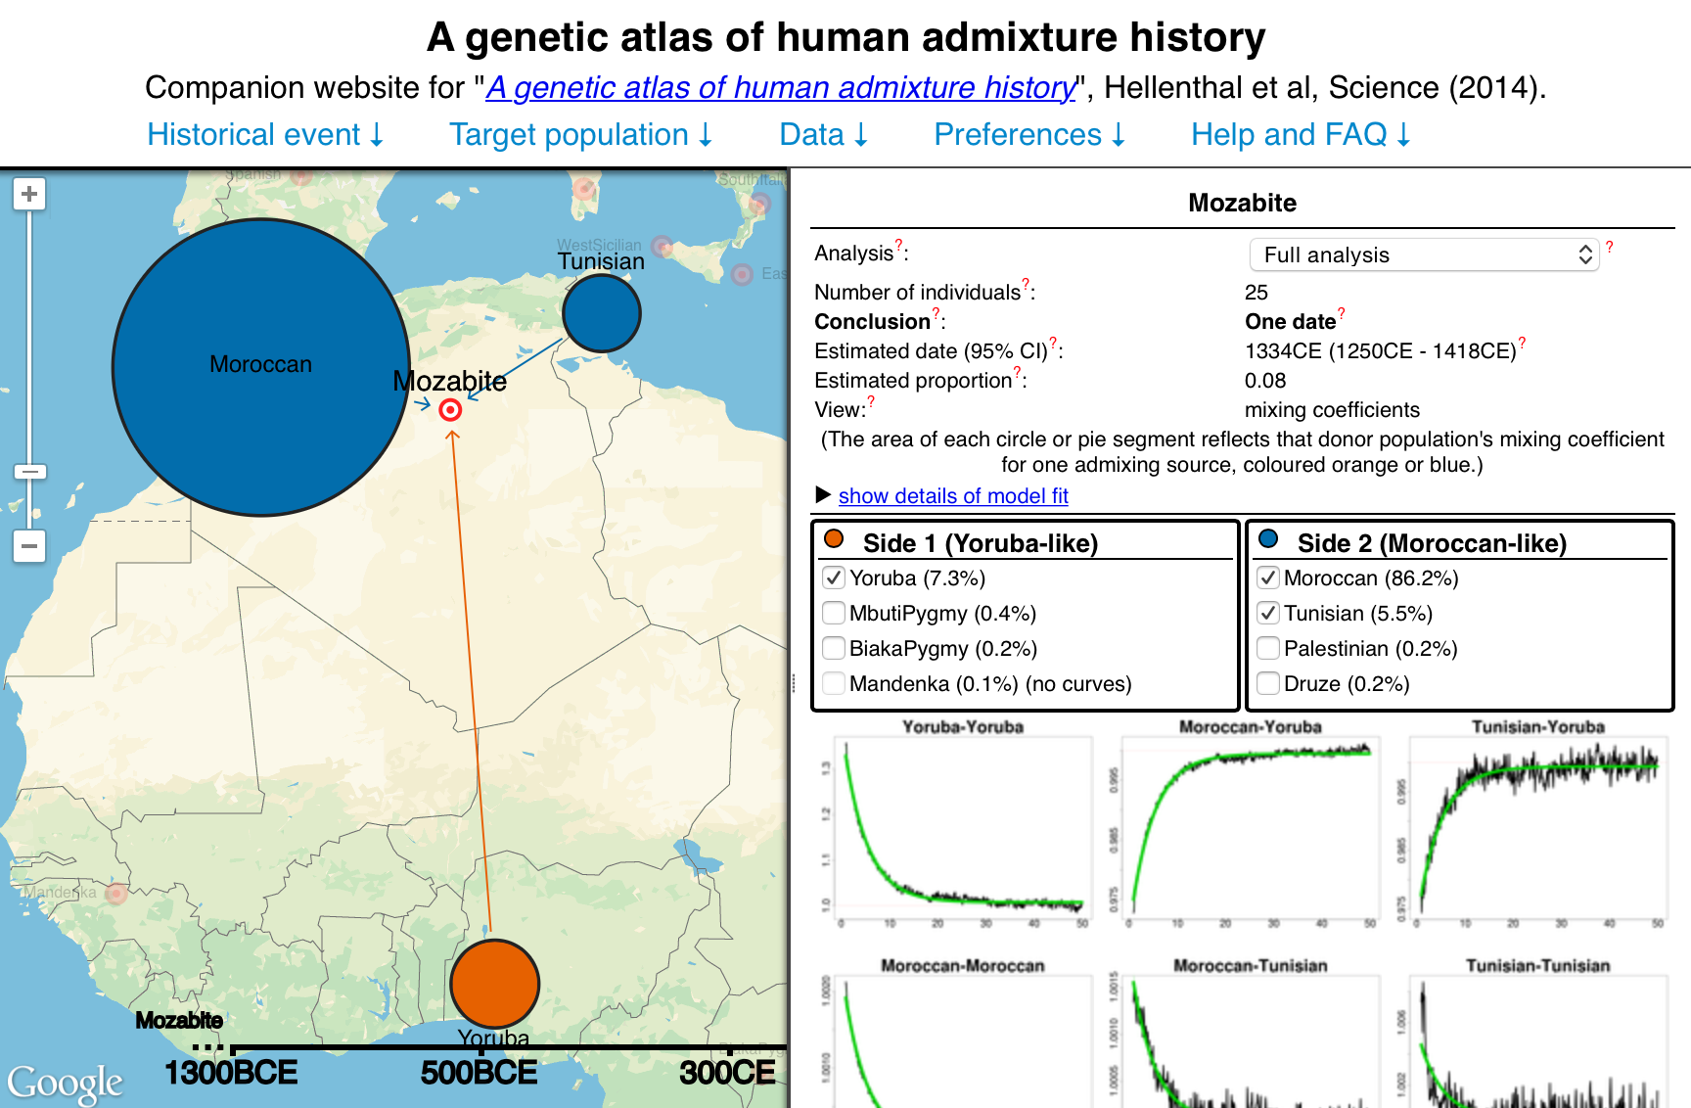
Real populations are more complex admixture
http://admixturemap.paintmychromosomes.com

Slide 48
Real populations are more complex natural selection
When a beneficial mutation arises it spreads quickly through the population generating strong correlations between alleles

Slide 49
Natural Selection
Big differences in the patterns of diversity between populations can be generated by natural selection

Slide 50
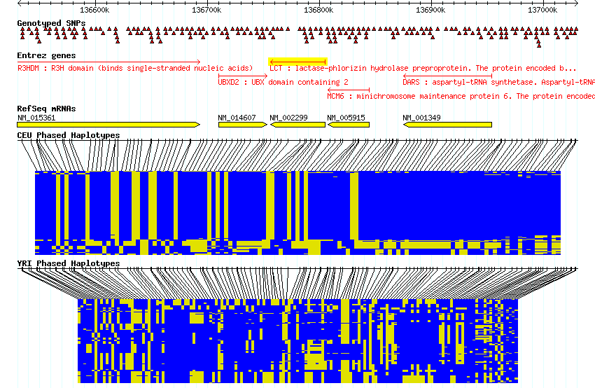
Differences between populations
Big differences in the patterns of diversity between populations can be generated by natural selection

Slide 51
24 haplotypes (12 individuals) 100 SNPs on chromosome 20
Utah residents, ancestrally Northern and Western European
Yoruba from Ibadan, Nigeria
Notes:
So as an example lets look at some real data from a small region of Human chromosome 20 the HapMap project.
There are clearly differences between in the patterns of diversity between these two groups, but what generated them?

Slide 52
Differences in patterns of LD
An experiment:
Take genome-wide SNP data collected from a European population (A)
Take each SNP and find the SNPs which is most correlated with it (and remember how correlated it is)
Go to another European population (B) and compare the correlation between the two SNPs in the new population
(Measure correlation as r²)

Slide 53
Differences in patterns of LD
Across Europe
Within Kenya
We will look at this in the practical

Slide 54
Thanks!

Slide 55
Recombination and physical distance
r²=1
r²=0.9
r²=0.5
r²=0.1
Correlations decay with distance (due to recombination)

Slide 56
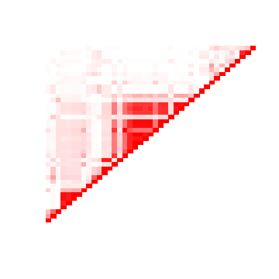
Looking at patterns of LD
High r²
Low r²
Assume similar physical spacing
LD patterns are complicated

Slide 57
Recombination clusters along chromosomes
Studies have shown that recombination is not uniform along chromosomes
Notes:
In the last 20 years the surprising observation was made that recombination is highly nonuniform.
It clusters in ‘hotspots’ along the genome. Recombination is typically measured in centimorgans per Mb.
A rate of 1cM per megabase means a 1% chance of a recombination happening The strongest hotspot has rate about 80cM/Mb. But a hotspot is not 1Mb long, it’s probably only a few tens of bps wide.
This means that even the strongest hotspots aren’t that strong – many meioses will happen without a crossover occuring. In total there are about 4000cM in the human genome.

Slide 58
The power of population genetic inference from a large genome

Slide 59
24 haplotypes (12 individuals) 100 SNPs on chromosome 20
Utah residents, ancestrally Northern and Western Europe
Yoruba from Ibadan, Nigeria
Notes:
We’ve explained a good deal in this picture.
(Probably a good time to pause.)

Slide 60
LD and Recombination
There are lots of ways to measure LD
Recombination is not uniform along chromosomes
Much of the recombination happens in hotspots and these demark breakdown in correlations
Correlations do persist across hot spots

Slide 61
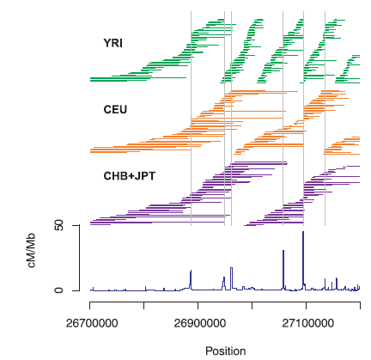
Differences between populations
The overall pattern of LD is conserved
The different ancestral histories lead to different levels of LD

Slide 62
Population structure in Africa
There is evidence for widespread population structure across Africa

Slide 63
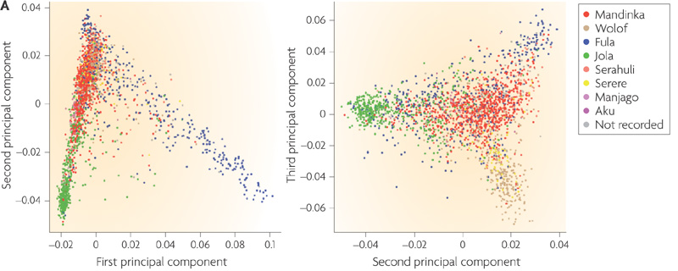
Population structure in Africa
Add population differences between groups from the same region

Slide 64
24 haplotypes (12 individuals) 100 SNPs on chromosome 20
Luhya in Webuye, Kenya
Maasai in Kinyawa, Kenya

Slide 65
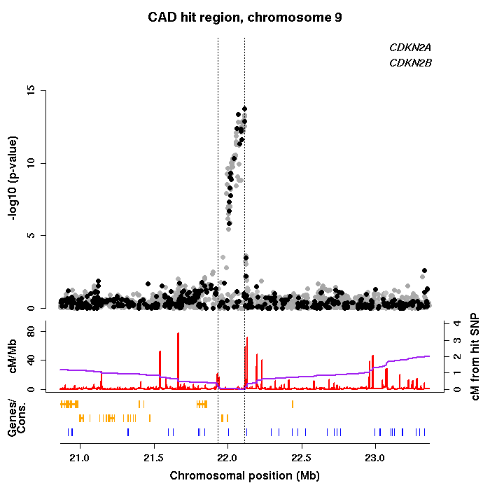

Slide 66
LD terminology
‘Causal’ variant – a variant that has a functional effect on a trait (such as disease).
Linkage disequilibrium – the pattern of correlations between alleles along a chromosome
Tag SNP – a SNP that is in LD with a variant of interest (and that we may have typed directly)

Slide 67
Summary
Different ancestral histories have led to different patterns of diversity
Natural selection can generate strong differences in haplotype patterns
Population structure across Africa, and between groups in Africa, will lead to differences in the structure of LD

Slide 68
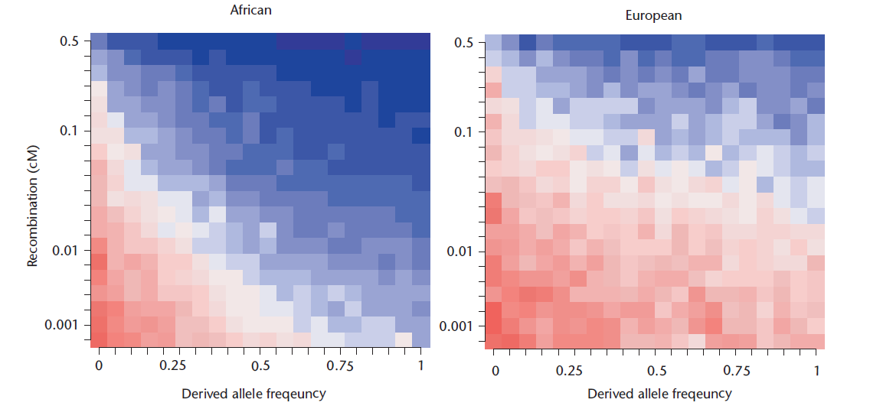

Slide 70
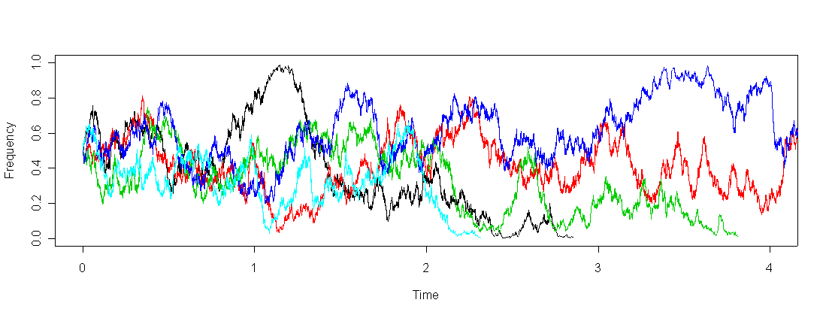
Genetic drift
Allele frequencies change by chance over time

Slide 71
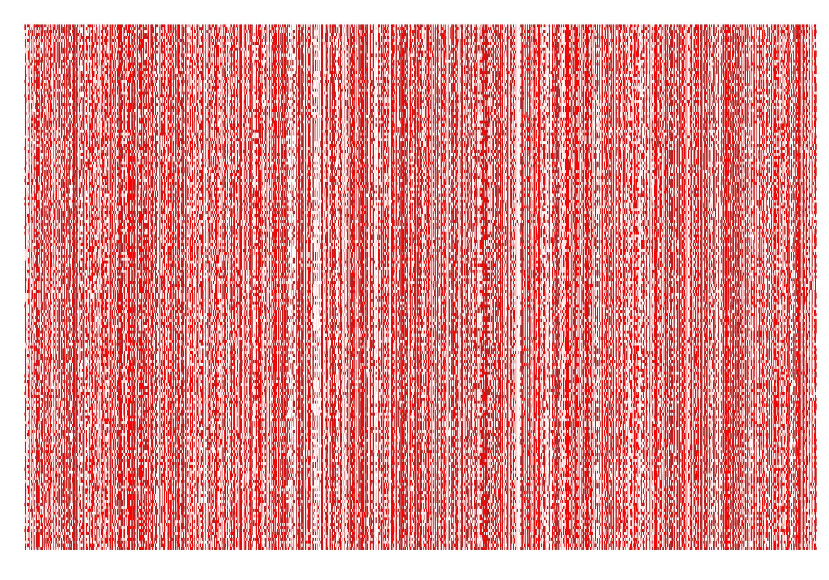
Genetic diversity
180 haplotypes (90 individuals) from Luhya in Webuye, Kenya typed at 6856 SNPs in 10 Mb region on chromosome 20

