Slide 1
Principal components analysis
Gavin Band

Slide 2
Why do PCA?
PCA is good at detecting “directions” of major variation in your data. This might be:
Population structure – subpopulations having different allele frequencies.
Unexpected (“cryptic”) relationships.
Artifacts such as genotyping errors, etc.
Apart from intrinsic interest, these are precisely the factors that need to be controlled for in association tests.

Slide 3
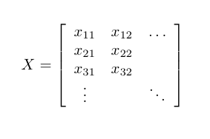
Performing PCA
1. Take genotype data^{(*)}...
N samples
L SNPs
^{(*)} Suitably normalised – see later.

Slide 4
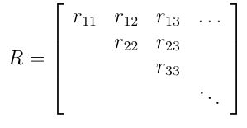
Performing PCA
1. Take genotype data^{(*)}...
2. Form ‘relatedness matrix’…
N samples
N samples
L SNPs
N samples
r_{ij} = relatedness^{(*)} between sample i and sample j.
^{(*)} With suitable normalisation:
r_{ij} ≈ 1 if samples i and j are duplicates (or MZ twins)
r_{ij} ≈ 0 if samples i and j are unrelated (relative to the sample.)
^{(*)} Suitably normalised – see later.

Slide 5
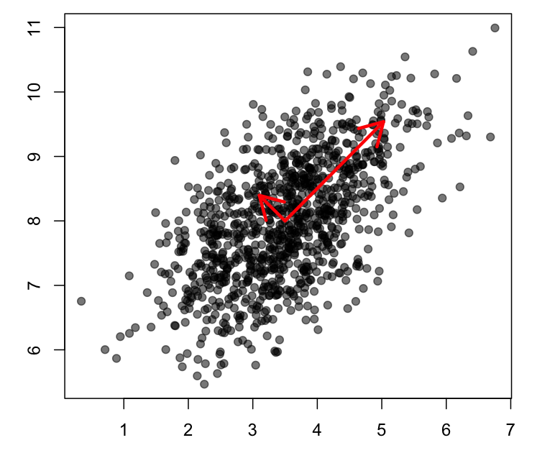
Performing PCA
1. Take genotype data^{(*)}...
2. Form ‘relatedness matrix’…
N samples
N samples
L SNPs
N samples
3. Eigen-decompose it...
Eigen-decomposition picks out directions in the data along which the variance is maximised.
Eigenvalues represent the variance of the data along these directions.
You can do this in R! E.g:
> R = 1/L * (t(X) %*% X)
> V = eigen(R)$vectors
> plot( V[,1], V[,2] )

Slide 6
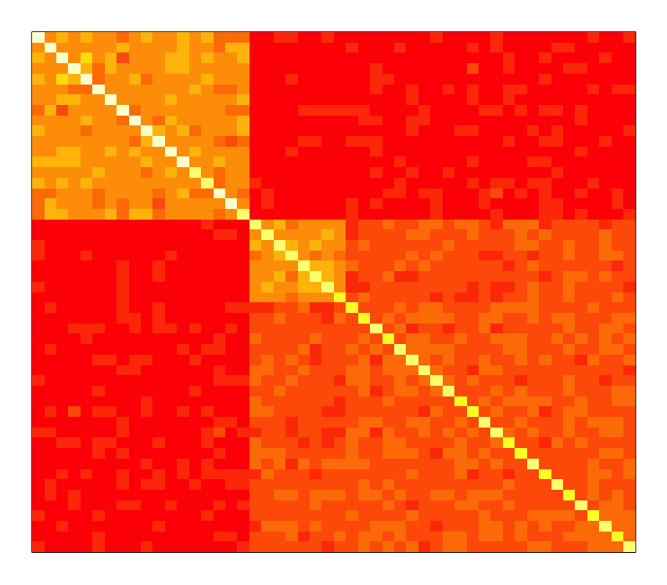
Example (Simulated data, N=50 individuals, L=1000 SNPs)
Relatedness matrix R
> R = (1/1000) %*% (t(X) * X)

Slide 7
Example (Simulated data, 50 individuals, 1000 SNPs)
Eigenvectors
Relatedness matrix R
v₁
v₂
> V = eigen(R)$vectors

Slide 8
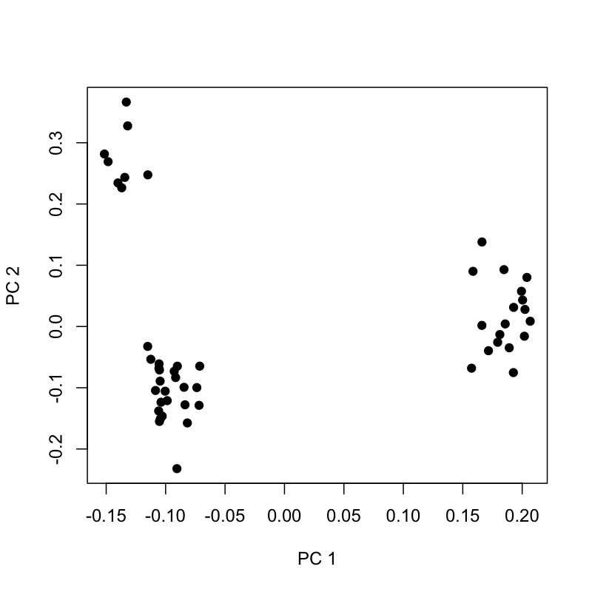
Example (Simulated data, 50 individuals, 1000 SNPs)
Eigenvectors
Relatedness matrix R
v₁
v₂
> plot( V[,1], V[,2] )

Slide 9
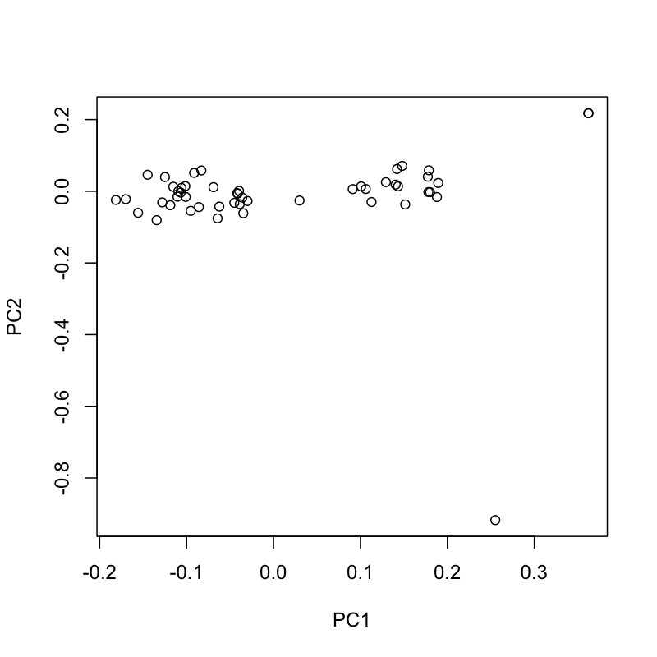
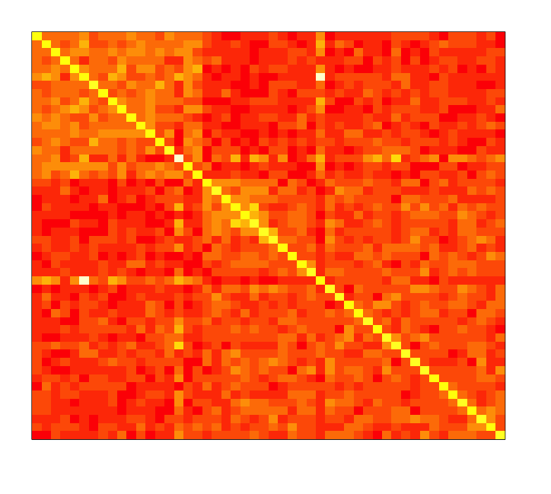
Caution! PCA picks up any source of variation
duplicate
Pair of duplicate samples
duplicate
Badly genotyped sample
Badly genotyped sample

Slide 10
Relatedness or why scale by f(1-f)
At a SNP with frequency f in a ‘base’ population.
What is the probability of seeing these alleles in two haplotypes drawn from the population?
 | Individual 2
Individual 1 |  | Allele A | Allele B | frequency
 | Allele A |  |  | f
 | Allele B |  |  | 1-f
 | frequency | f | 1-f

Slide 11
Relatedness or why scale by f(1-f)
At a SNP with frequency f in a ‘base’ population.
What is the probability of seeing these alleles in two haplotypes drawn from the population?
 | Individual 2
Individual 1 |  | Allele A | Allele B | frequency
 | Allele A | f² | f(1-f) | f
 | Allele B | f(1-f) | (1-f)² | 1-f
 | frequency | f | 1-f
 | Correlation = 0
“Unrelated” individuals
Alleles drawn independently

Slide 12
Relatedness or why scale by f(1-f)
At a SNP with frequency f in a ‘base’ population.
What is the probability of seeing these alleles in two haplotypes drawn from the population?
 | Individual 2
Individual 1 |  | Allele 1 | Allele 2 | total
 | Allele 1 | rf + (1-r)f² | (1-r)f(1-f) | f
 | Allele 2 | (1-r)f(1-f) | r(1-f)+(1-r)(1-f)² | 1-f
 |  | f | 1-f
 | Correlation = r
Individuals with relatedness r
Alleles co-inherited ”identical by descent” with probability r

Slide 13
Relatedness and population history – a heuristic explanation
Ancestral population
Ancestral frequency = f
Drift in allele frequency proportional to f(1-f)
Drift in allele frequency proportional to f(1-f)
Time
Population 1
SNP frequency $f_{1}=\text{f}+ε_{1}$
Population 2
SNP frequency $f_{2}=\text{f}+ε_{2}$
So $\frac{f_{i}−f}{√f(1−f)}$ = the amount of drift in population i, similar across all variants

Slide 14
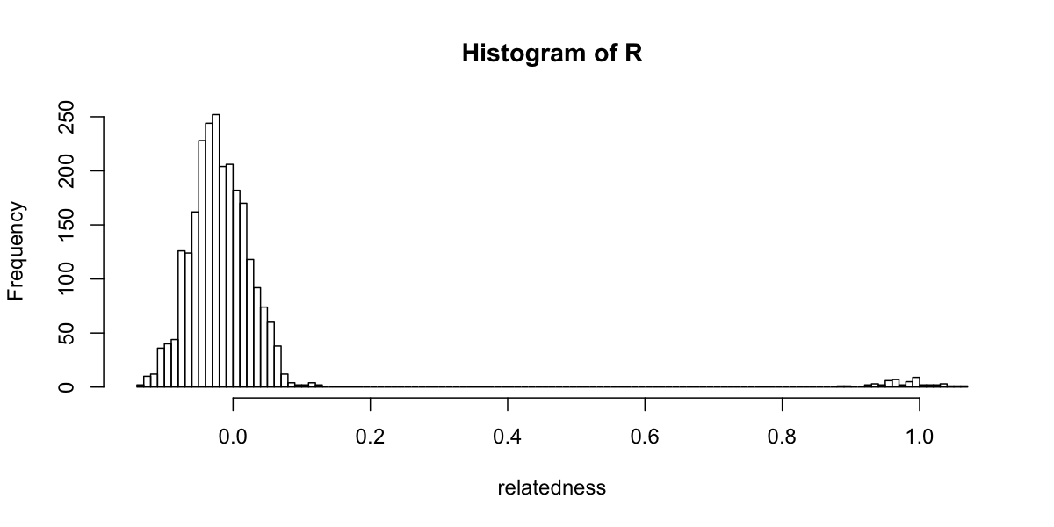
Relatedness
Or: mean centre rows of X and divide by standard deviation, and compute as before:
Because f comes from the sample (not an ancestral population), ½r_{ij} is almost the same as a kinship coefficient, but is relative to the sample, not an ancestral population.

Slide 15
Association testing
Without controlling for structure:
Outcome ~ baseline + genotype
Traditional approaches control for structure using a number of principal components.:
Outcome ~ baseline + genotype + PC₁ + PC₂ + ...
The most recent mixed model approach includes the whole relatedness matrix to control for structure:
Outcome ~ baseline + genotype +

Slide 16
Association testing with linear mixed models
Outcome ~ baseline + genotype +
This is a bit like including all the PCs in a single regression, but constrained to explain a proportional amount of residual variation. In some circumstances it’s been shown to control for structure better than using principal components directly. For example see “Genetic risk and a primary role for cell-mediated immune mechanisms in multiple sclerosis”, IMSGC & WTCCC2, Nature 2011. Or play with it at http://www.well.ox.ac.uk/wtccc2/ms.
However – these are linear models and some caveats remain in their use for case/control studies.

Slide 17
Summary
PCA good at picking up sources of variation in datasets, including genetic datasets.
Any form of variation can be picked up – population structure, but also cohort or plate effects, genotyping error, sample duplication.
This is what we want when controlling for structure / unwanted variation in an association test.

Slide 18
Software for performing PCA
Plink (v1.9 or above)
http://www.cog-genomics.org/plink2
EIGENSOFT
http://genetics.med.harvard.edu/reich/Reich_Lab/Software.html
Or use R!

Slide 19
Software for mixed model analysis
GCTA
http://genetics.med.harvard.edu/reich/Reich_Lab/Software.html
FastLMM
http://research.microsoft.com/en-us/um/redmond/projects/mscompbio/fastlmm/
MMM
http://www.helsinki.fi/~mjxpirin/download.html
GEMMA
http://www.xzlab.org/software.html

Slide 20
Recommended reading
“Population Structure and Eigenanalysis”, Patterson N, Price AL, Reich D, PLoS Genetics (2006). (The “SmartPCA” paper)
“Population Structure and Cryptic Relatedness in Genetic Association Studies”, Astle W. and Balding DJ, Statistical Science (2009).
"Reconciling the analysis of IBD and IBS in complex trait studies”, Powell JE, Visscher PM, Goddard ME Nat. Rev. Genetics (2010).
“A Genealogical Interpretation of Principal Components Analysis”, Gil McVean, PLoS Genetics (2009).
“Interpreting principal component analyses of spatial population genetic variation”, John Novembre and Matthew Stephens, Nature Genetics (2008).
“Advantages and pitfalls in the application of mixed-model association methods”, Yang et al, Nature Genetics (2014)

