Slide 1




Preparing data for GWAS analysis
Tommy Carstensen

Slide 2
WTAC Durban module summaries V2
Introductions
Epidemiology
Bioinformatics
Genetics
Basic principles of measuring disease in populations
Basic genotype data summaries and analyses
population genetics
Public databases and resources for genetics
GWAS QC
Principal components analyses
GWAS association analyses
whole genome sequencing and fine-mapping
GWAS results and interpretation
meta-analysis and power of genetic studies

Slide 3
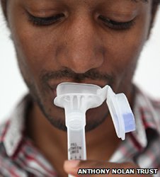

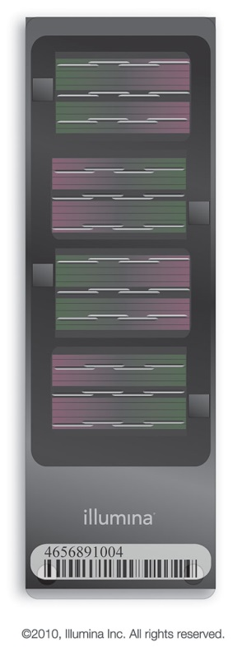
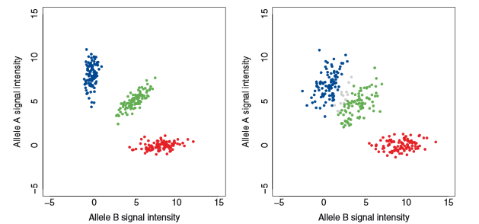

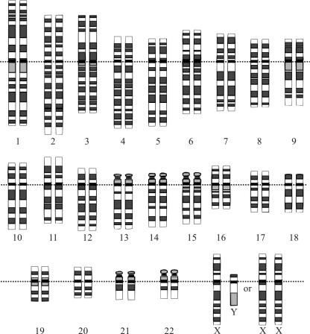

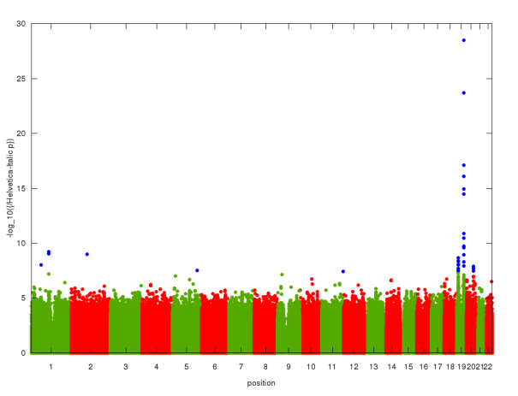
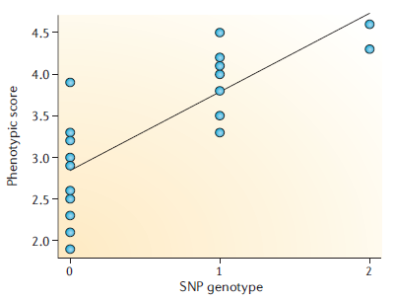
AA
AB
BB
Quality Control
QC
?
Manhattan Plot
GWAS

Slide 4
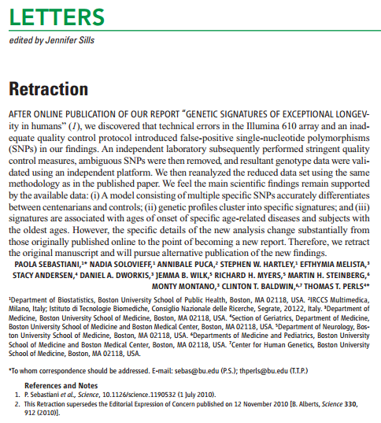
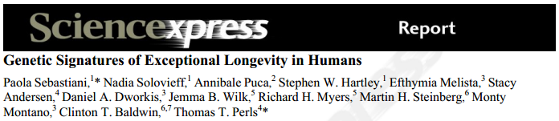
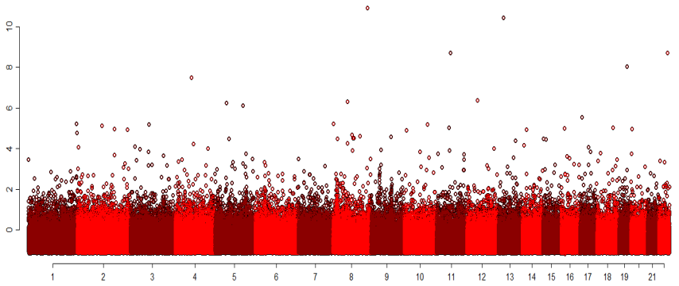
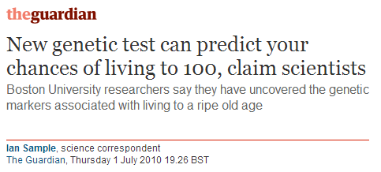
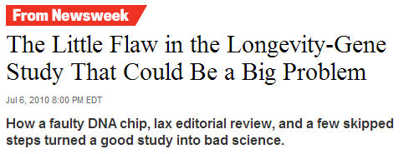

Bad QC > Bad Data > Bad Results
Notes:
Nice Manhattan
Questioning
Retraction due to inadequate QC

Slide 5
Genotype data
SNPs
 | SNP A | SNP B | SNP C | SNP D | SNP E
Female 1 | 00 | AG | GG | GA | 00
Male 1 | 00 | GG | GG | AA | CC
Female 2 | AC | 00 | GG | AA | CC
Female 3 | AA | AG | GC | AA | CC
Male 2 | AC | AA | 00 | AA | CA
samples
00 = missing data

Slide 6
How did we get the genotype data?
Genotype Calling
Good data
SNP1
Bad data
SNP2
AA
AA or AB? 00!
AB
BB
Notes:
basic problem
affy uses BRLMM
we use chiamo++

Slide 7
Sample QC and SNP QC
SNP QC
 | SNP A | SNP B | SNP C | SNP D | SNP E
Female 1 | 00 | AG | GG | GA | 00
Male 1 | 00 | GG | GG | AA | CC
Female 2 | AC | 00 | GG | AA | CC
Female 3 | AA | AG | GC | AA | CC
Male 2 | AC | AA | 00 | AA | CA
sample QC
00 = missing data

Slide 8
Quality Control Steps
Sample QC
SNP QC
Sample Call Rate/Proportion
SNP Call Rate/Proportion
Autosomal Heterozygosity
Hardy Weinberg Equilibrium (HWE)
Sex / Gender
X Chromosome Heterozygosity
Too Much Relatedness
Identity By Descent (IBD)
Too Little Relatedness / Confounding
Principal Component Analysis (PCA)
Notes:
Conservative approach would be to do sample and SNP call rate simultaneously
Do not start with PCA – need high quality data

Slide 9
Quality Control Steps
Sample QC
SNP QC
Sample Call Rate/Proportion
SNP Call Rate/Proportion
Autosomal Heterozygosity
Hardy Weinberg Equilibrium (HWE)
Sex / Gender
X Chromosome Heterozygosity
Too Much Relatedness
Identity By Descent (IBD)
Too Little Relatedness / Confounding
Principal Component Analysis (PCA)
Notes:
Conservative approach would be to do sample and SNP call rate simultaneously
Do not start with PCA

Slide 10
How did we get the data?
Genotype Calling
Good data
SNP1
Bad data
SNP2
AA
AA or AB? 00!
AB
BB
Notes:
basic problem
affy uses BRLMM
we use chiamo++

Slide 11
Sample Call Rate/Proportion
 | SNP1 | SNP2 | SNP3 | SNP4 | SNP5 | Sample Call Rate
Sample1 | 00 | AG | GG | GA | 00 | 60%
Sample2 | 00 | GG | GG | AA | CC | 80%
Sample3 | AC | 00 | GG | AA | CC | 80%
Sample4 | AA | AG | GC | AA | CC | 100%
Sample5 | AC | AA | 00 | AA | CA | 80%
 | SNP1 | SNP2 | SNP3 | SNP4 | SNP5
Sample1 | 00 | AG | GG | GA | 00
Sample2 | 00 | GG | GG | AA | CC
Sample3 | AC | 00 | GG | AA | CC
Sample4 | AA | AG | GC | AA | CC
Sample5 | AC | AA | 00 | AA | CA
Notes:
Conservative approach would be to do sample call rate and SNP call rate simultaneously
QC is an art and not a science
The sequence of QC steps matters
Thresholds and procedures should depend on the quality of the data and the questions being asked

Slide 12
Quality Control Steps
Sample QC
SNP QC
Sample Call Rate/Proportion
SNP Call Rate/Proportion
Autosomal Heterozygosity
Hardy Weinberg Equilibrium (HWE)
Sex / Gender
X Chromosome Heterozygosity
Too Much Relatedness
Identity By Descent (IBD)
Too Little Relatedness / Confounding
Principal Component Analysis (PCA)
Notes:
Conservative approach would be to do sample and SNP call rate simultaneously
Do not start with PCA

Slide 13
Definition of Heterozygosity Rate
Copy 1
Copy 2
SNP1
SNP2
SNP3
SNP4
SNP5
SNP6
SNP7
SNP8
A A
homozygous
C C
heterozygous
A T
heterozygosity = 2/8 = 0.25
C C
C G
A A
A A
T T
chromosome 1

Slide 14
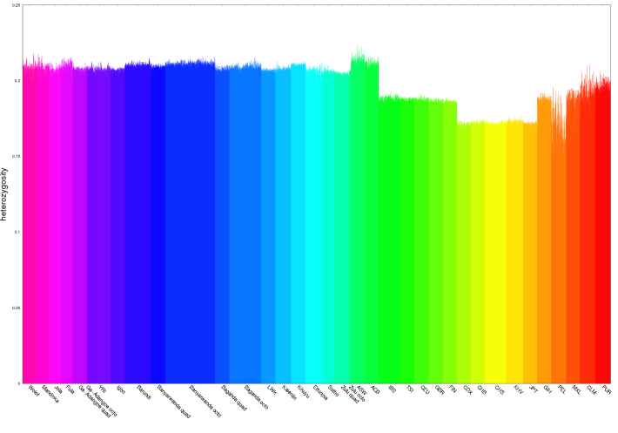
Heterozygosity
Remove samples deviating from average
Deviations could arise due to several reasons
  Contamination of samples (high heterozygosity)
  Inbreeding (low heterozygosity)
  Ancestral differences
  Data quality / Poor genotype calling
    Heterozygotes more likely to be missing
Sample 1
Sample 2
heterozygous
homozygous
homozygous
heterozygosity
populations

Slide 15
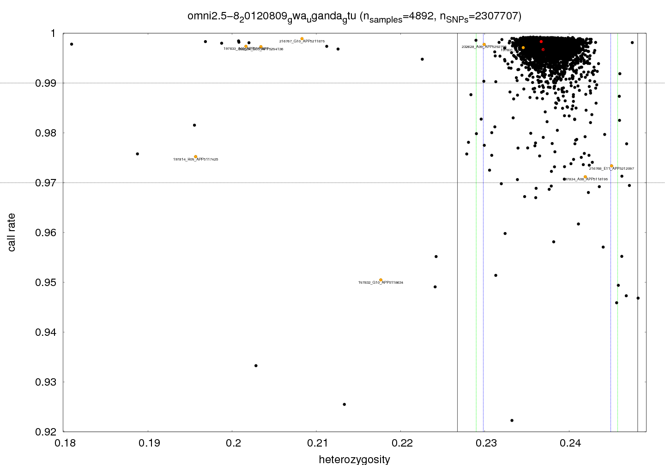
Correlation between quality metrics
Notes:
sequence matters – black line vs blue line

Slide 16
Quality Control Steps
Sample QC
SNP QC
Sample Call Rate/Proportion
SNP Call Rate/Proportion
Autosomal Heterozygosity
Hardy Weinberg Equilibrium (HWE)
Sex / Gender
X Chromosome Heterozygosity
Too Much Relatedness
Identity By Descent (IBD)
Too Little Relatedness / Confounding
Principal Component Analysis (PCA)
Notes:
Conservative approach would be to do sample and SNP call rate simultaneously
Do not start with PCA

Slide 17
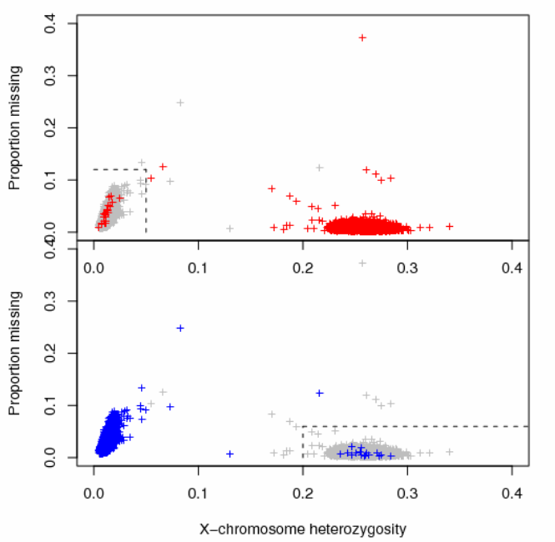

Sex check
Looking for mislabelled samples
Females
Bad
Good
Males
Good
Male
1 allele
SNPs in PARs are excluded from analysis.
Female
2 alleles
Bad
Notes:
Genomewide association study of 14,000 cases of seven common diseases and 3,000 shared controls
Don’t use SNPs in pseudoautosomal regions for sex check

Slide 18
Quality Control Steps
Sample QC
SNP QC
Sample Call Rate/Proportion
SNP Call Rate/Proportion
Autosomal Heterozygosity
Hardy Weinberg Equilibrium (HWE)
Sex / Gender
X Chromosome Heterozygosity
Too Much Relatedness
Identity By Descent (IBD)
Too Little Relatedness / Confounding
Principal Component Analysis (PCA)
Notes:
Conservative approach would be to do sample and SNP call rate simultaneously
Do not start with PCA

Slide 19
Relatedness
Relatedness is a problem because of overrepresentation of selected alleles, which will bias any multivariate analysis (correlated data!); e.g. PCA or multivariate regression
Related samples need to be excluded or taken into account during subsequent analyses
One metric of relatedness is Identity By Descent (IBD), which involves calculation of proportion of common alleles between two individuals.
Prior to the calculation of IBD, SNPs with a low call rate are permanently excluded and rare SNPs (MAF<5%) and SNPs in Linkage Disequilibrium (LD) are temporarily excluded.
Notes:
EITHER exclude relateds OR take them into account

Slide 20
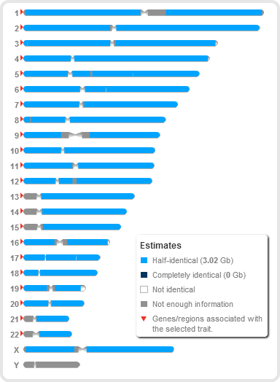
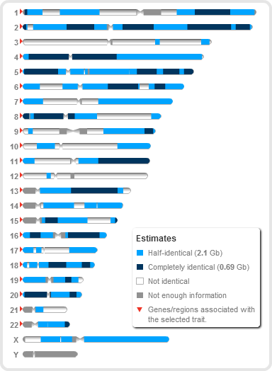
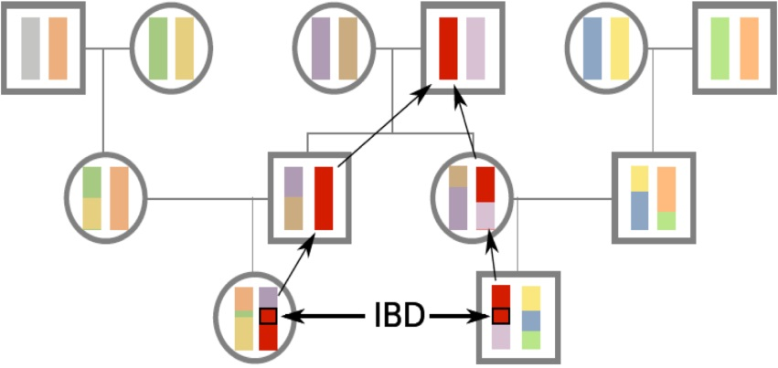
Relatedness / IBD
Completely identical
Relationship category | Relatedness
Monozygotic twins | 1
Parent-Offspring | 1/2
Full siblings | 1/2
Grandparent-grandchild | 1/4
Uncle/Aunt-Nephew/Niece | 1/4
First cousins | 1/8
Unrelated | 0
Half-identical
Not identical
Me and my mom
Me and my sister
Notes:
Pedigree shows why some regions are IBD

Slide 21
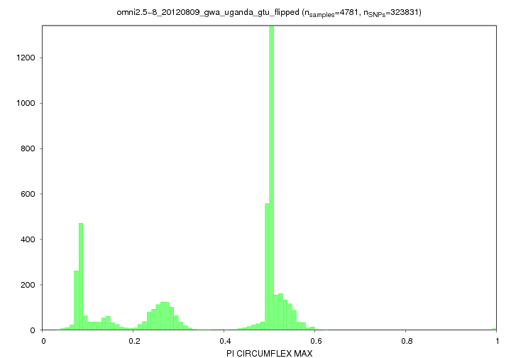
Relatedness / IBD
A Ugandan cohort study as an example
threshold for
temporary exclusion
prior to HWE check
Count of sample pairs
first cousins (12.5%)
etc.
siblings
parent-child
uncle-niece
aunt-nephew
etc.
duplicates
identical twins
Maximum IBD for each sample
Notes:
Relatedness either needs to be taken into account in analysis, or related individuals need to be removed

Slide 22
Quality Control Steps
Sample QC
SNP QC
Sample Call Rate/Proportion
SNP Call Rate/Proportion
Autosomal Heterozygosity
Hardy Weinberg Equilibrium (HWE)
Sex / Gender
X Chromosome Heterozygosity
Too Much Relatedness
Identity By Descent (IBD)
Too Little Relatedness / Confounding
Principal Component Analysis (PCA)
Notes:
Conservative approach would be to do sample and SNP call rate simultaneously
Do not start with PCA

Slide 23
How did we get the data?
Genotype Calling
Good data
SNP1
Bad data
SNP2
AA
AA or AB? 00!
AB
BB
Notes:
basic problem
affy uses BRLMM
we use chiamo++

Slide 24
SNP Call Rate/Proportion
 | SNP1 | SNP2 | SNP3 | SNP4 | SNP5
Sample1 | 00 | AG | GG | GA | 00
Sample2 | 00 | GG | GG | AA | CC
Sample3 | AC | 00 | GG | AA | CC
Sample4 | AA | AG | GC | AA | CC
Sample5 | AC | AA | 00 | AA | CA
SNP Call Rate | 60% | 80% | 80% | 100% | 80%
 | SNP1 | SNP2 | SNP3 | SNP4 | SNP5
Sample1 | 00 | AG | GG | GA | 00
Sample2 | 00 | GG | GG | AA | CC
Sample3 | AC | 00 | GG | AA | CC
Sample4 | AA | AG | GC | AA | CC
Sample5 | AC | AA | 00 | AA | CA
Notes:
Conservative approach would be to do sample call rate and SNP call rate simultaneously
QC is an art and not a science
The sequence of QC steps matters
Thresholds and procedures should depend on the quality of the data and the questions being asked

Slide 25
Quality Control Steps
Sample QC
SNP QC
Sample Call Rate/Proportion
SNP Call Rate/Proportion
Autosomal Heterozygosity
Hardy Weinberg Equilibrium (HWE)
Sex / Gender
X Chromosome Heterozygosity
Too Much Relatedness
Identity By Descent (IBD)
Too Little Relatedness
Principal Component Analysis (PCA)
Notes:
Conservative approach would be to do sample and SNP call rate simultaneously
Do not start with PCA

Slide 26
Hardy Weinberg Equilibrium
 | SNP1 | SNP2 | SNP3
Sample1 | AC | AA | AC
Sample2 | AA | AA | AC
Sample3 | AC | CC | AC
Sample4 | CC | CC | AC
f (A)=p | 4/8 | 4/8 | 4/8
f(C)=q=1-p | 4/8 | 4/8 | 4/8
f_{e}(AA)=p² | 1/4 | 1/4 | 1/4
f_{e}(AC)=2pq | 2/4 | 2/4 | 2/4
f_{e}(CC)=q² | 1/4 | 1/4 | 1/4
f_{o}(AA) | 1/4 | 2/4 | 0/4
f_{o}(AC) | 2/4 | 0/4 | 4/4
f_{o}(CC) | 1/4 | 2/4 | 0/4
 | SNP1 | SNP2 | SNP3
Sample1 | AC | AA | AC
Sample2 | AA | AA | AC
Sample3 | AC | CC | AC
Sample4 | CC | CC | AC
f (A)=p | 4/8 | 4/8 | 4/8
f(C)=q=1-p | 4/8 | 4/8 | 4/8
f_{e}(AA)=p² | 1/4 | 1/4 | 1/4
f_{e}(AC)=2pq | 2/4 | 2/4 | 2/4
f_{e}(CC)=q² | 1/4 | 1/4 | 1/4
 | SNP1 | SNP2 | SNP3
Sample1 | AC | AA | AC
Sample2 | AA | AA | AC
Sample3 | AC | CC | AC
Sample4 | CC | CC | AC
f (A)=p | 4/8 | 4/8 | 4/8
f(C)=q=1-p | 4/8 | 4/8 | 4/8
 | SNP1 | SNP2 | SNP3
Sample1 | AC | AA | AC
Sample2 | AA | AA | AC
Sample3 | AC | CC | AC
Sample4 | CC | CC | AC
random mating
allele frequencies
 |  | Females
 |  | A (p) | C (q)
Males | A (p) | AA (p²) | AC (pq)
 | C (q) | AC (pq) | CC (q²)
expected
genotype frequencies
observed
genotype frequencies
χ² test
Notes:
Random mating!

Slide 27
When HWE does not apply
Non-random mating
Selection forces
Alleles in disease causing loci
  Apply HWE only to controls in a case-control study
Migration
Data quality

Slide 28
Quality Control Steps
Sample QC
SNP QC
Sample Call Rate/Proportion
SNP Call Rate/Proportion
Autosomal Heterozygosity
Hardy Weinberg Equilibrium (HWE)
Sex / Gender
X Chromosome Heterozygosity
Too Much Relatedness
Identity By Descent (IBD)
Too Little Relatedness / Confounding
Principal Component Analysis (PCA)
Notes:
Conservative approach would be to do sample and SNP call rate simultaneously
Do not start with PCA

Slide 29
Principal Component Analysis
A statistical technique for summarizing many variables with minimal loss of information
PCA requires clean non-correlated data

Slide 30
Principal Component Analysis
A statistical technique for summarizing many variables with minimal loss of information
PCA can reveal
  Population outliers

Slide 31
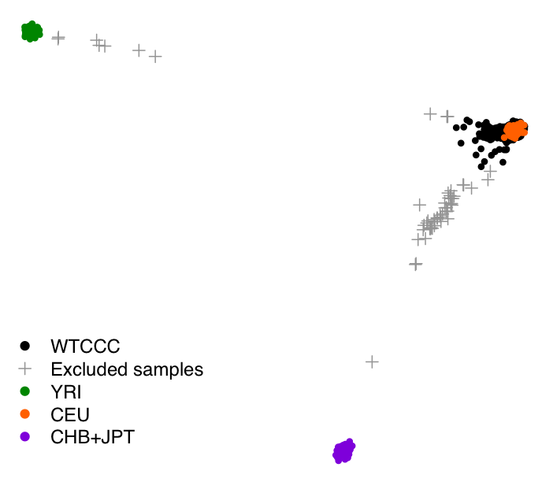
PCA and Population Outliers
Africa
Europe
Study samples
Asia
Notes:
We will already have gotten rid of some outliers during heterozygosity check
PCA - take multiple variables and find dimensions with greatest variability
Quality of data very important when doing multivariate statistics such as PCA and hence often last step of QC

Slide 32
Principal Component Analysis
A statistical technique for summarizing many variables with minimal loss of information
PCA can reveal
  Population outliers
  Population structure / Confounding

Slide 33
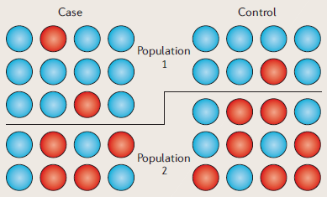
Why population structure / confounding is a problem in a case-control study
“Causal” allele
“Non-causal” allele
Balding, Nature Reviews Genetics (2006)
Notes:
1) Population 1 over represented in study. 2) Blue allele overrepresented among population 1. 3) Blue allele overrepresented among cases and appears as causal allele.
“Causal” allele overrepresented among cases because of higher frequency in overrepresented population among cases
Confounding occurs when the population substructure is not equally distributed between case and control groups.
Population / Chip / Lab

Slide 34
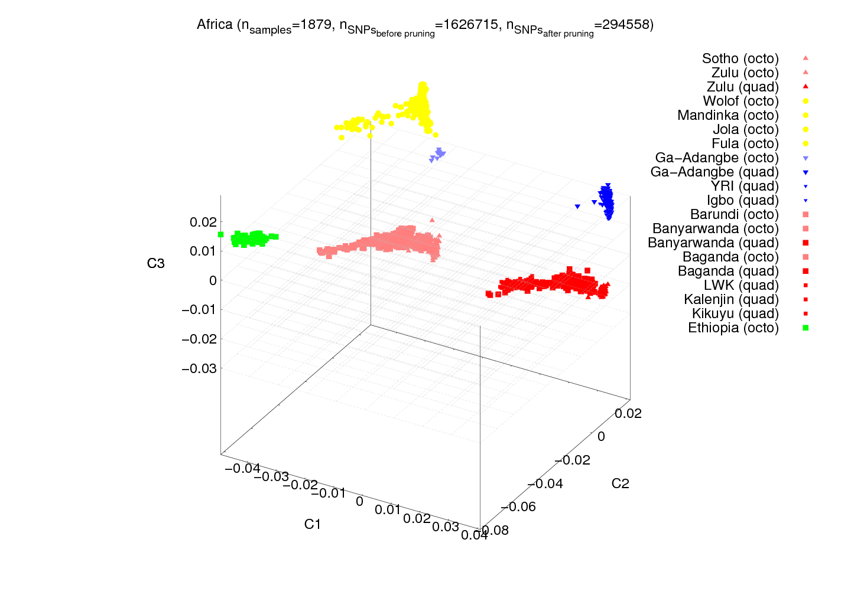
Confounding due to chip effects
EAST QUAD
EAST OCTO

Slide 35
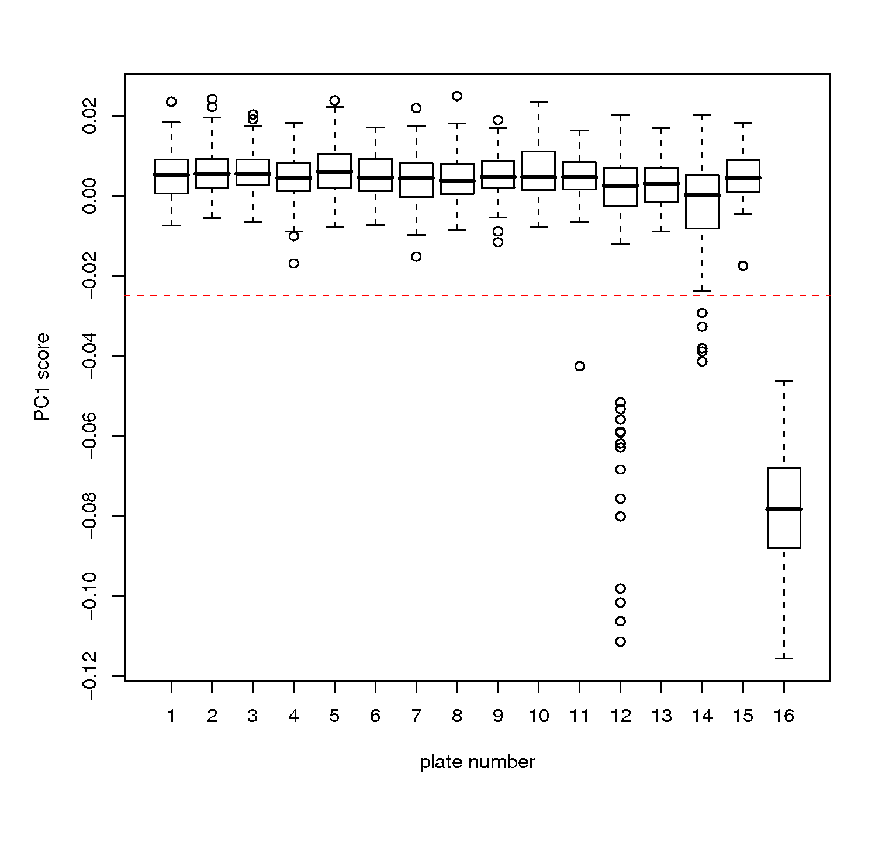
Confounding due to plate effects
PC 1
Plate Number

Slide 36
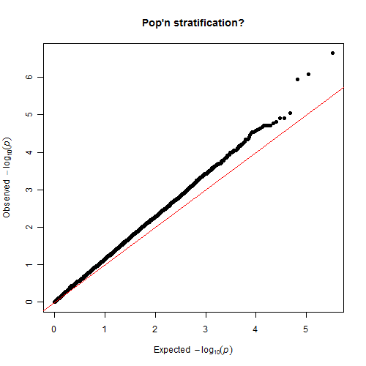
Population structure - λ
Inflated QQ-plot
Observed test statistic
λ is a measure of the deviation from the diagonal
Expected test statistic

Slide 37
Simple But Effective QC
Common Thresholds
Sample QC
SNP QC
Sample Call Rate
>97%
SNP Call Rate/Proportion
>97%
Autosomal Heterozygosity
mean±3SD
Hardy Weinberg Equilibrium (HWE)
p>10⁻⁴
Sex / Gender
PLINK default thresholds
Identity By Descent (IBD)
<0.05
Principal Component Analysis (PCA)
EIGENSOFT, 6SD, PCs 1-10
Notes:
Conservative approach would be to do sample and SNP call rate simultaneously
Do not start with PCA

Slide 38
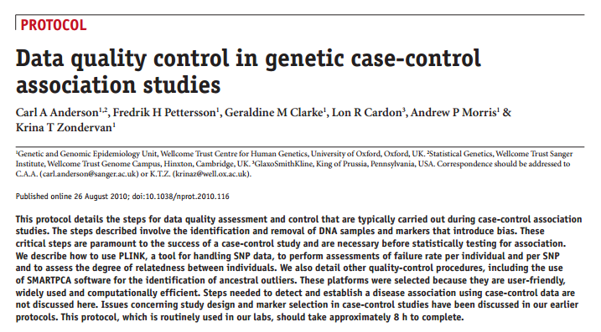
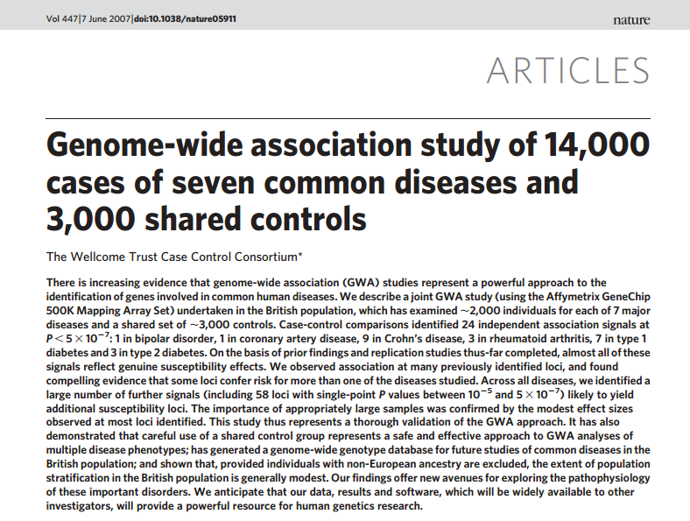
Useful references

Slide 39
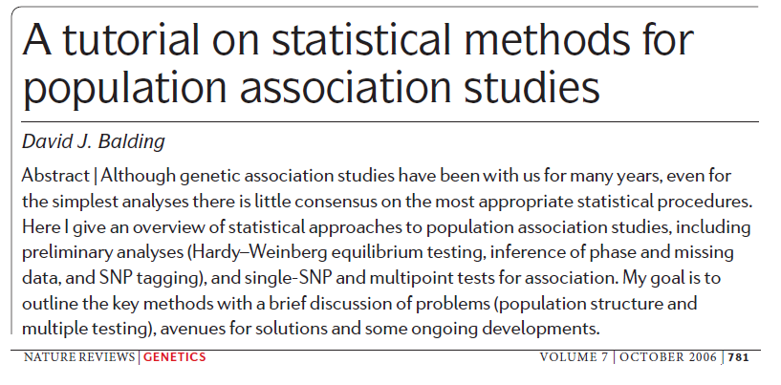
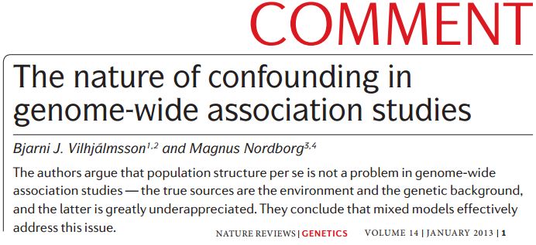
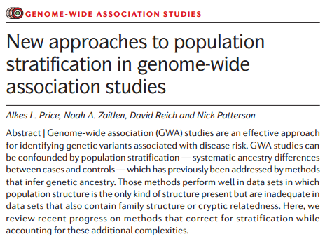
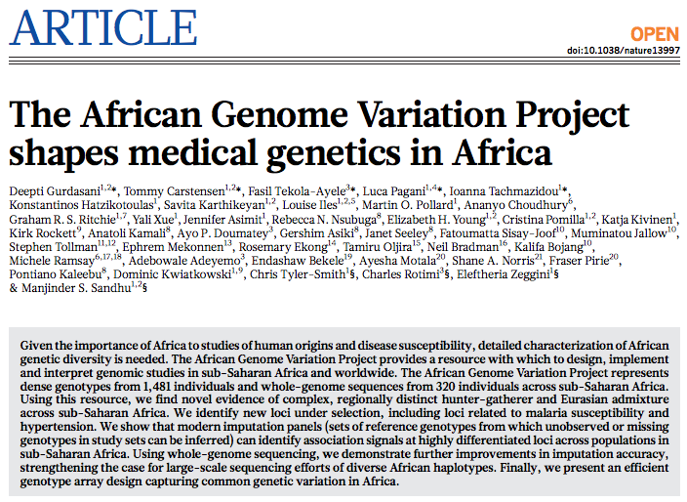
Useful references

Slide 40
Useful software
PLINK (QC and PCA and file format conversion and many other things)
https://www.cog-genomics.org/plink2
EIGENSOFT (PCA)
http://genetics.med.harvard.edu/reich/Reich_Lab/Software.html
GEMMA (Association analysis)
http://www.xzlab.org/software.html
SNPTEST (Association analysis)
https://mathgen.stats.ox.ac.uk/genetics_software/snptest/snptest.html
shellfish : Parallel PCA and data processing for genome-wide SNP data
http://www.stats.ox.ac.uk/~davison/software/shellfish/shellfish.php
IMPUTE2 (imputation)
https://mathgen.stats.ox.ac.uk/impute/impute_v2.html

Slide 41

Thank you for your attention!

