Slide 1



Power and Meta-Analysis
Dr Geraldine M. Clarke

Slide 2
WTAC Durban module summaries V2
Introductions
Epidemiology
Bioinformatics
Genetics
Basic principles of measuring disease in populations
Basic genotype data summaries and analyses
population genetics
Public databases and resources for genetics
GWAS QC
Principal components analyses
GWAS association analyses
whole genome sequencing and fine-mapping
GWAS results and interpretation
meta-analysis and power of genetic studies

Slide 3
Objectives
Power
  Define and be able to calculate the power to detect a genetic association
  Understand the impact of various parameters on the power of a genetic association test … and thus ways to increase power
Meta analysis
  Define meta-analysis and appreciate how it can be used to increase power for discovery and replication in genetic association testing
  Explore the stages in a typical genome-wide discovery meta-analysis
  Combined effect size estimates
  Appraisal of the evidence

Slide 4
Power

Slide 5
Power
Power of a statistical test is the probability of detecting an effect, given that it is there
Equivalently, power is the probability of rejecting the null hypothesis when it is false
E.g. power of 0.9 or 90% = if we repeat an association test at a locus with a real effect 1000 times, then we would expect to see a statistically significant difference 900 times.

Slide 6
Power and Significance
Effect | Detect | Reject
True | 1-β | β
False | α | 1-α
Type I Error [α] Significance
  Probability of incorrectly detecting an effect
  Significance; α ; false positive; P(detected|false)
  Typical significance levels are < 5%, 1%
  Type II Error [β]
  Probability of incorrectly rejecting an effect
  Power; 1-β; true positive ; P(detected|true)
  Typical power values are > 80%
Decreasing Type I increases Type II and vice versa
Aim to minimise α and maximise power
Notes:
There are two types of error that researchers are concerned with.
A=0.05 - 5 in 100 times the association we are seeing is due to chance
e.g. repeat a test at a locus with no effect 1000x, expect statistically significant difference 50x.

Slide 7
E.g. Power to detect association at a SNP with risk allele frequency = 0.3 in cases and an allelic OR = 1.1
Notes:
80% power is achieved for 4200, 12800, 21100 cases and equal numbers of controls for the three values of alpha respectively.

Slide 8
Significance levels in GWAS
Frequentist approach
Suppose you have m=20 tests and α=0.05
  P(one or more false positive) = 1-P(no false positives)
  = 1-(1-α)^{m} = 0.64
Bonferroni α = 0.05/m
  Control the probability of one or more false positives
  P(one or more false positives) = 1-(1-α/m)^{m} ≈ mα=0.05
  Assumes tests are independent, conservative
False Discovery
  Control the proportion of false positives among all significant results
Notes:
Classical theory holds that a suitable choice of threshold for alpha must account for Multiple testing.
Multiple testing refers to the potential increase in type I errors that can occur when multiple tests are performed

Slide 9
Significance levels in GWAS
Bayesian approach
True Discovery
  Control the proportion of true positives among all significant results
Notes:
Bayesian approach assumes that the issue is not the number of tests performed but the a priori probability that there is likely to be an association at specified location in the genome.

Slide 10
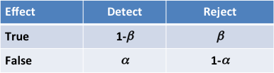
Significance levels in GWAS
Bayesian approach
True Discovery
  Control the proportion of true positives among all significant results

Slide 11
Significance levels in GWAS
Bayesian approach
True Discovery
  Control the proportion of true positives among all significant results
  Depends on your prior belief of an association
    Replication 1/100
    Candidate gene study 1/1,000
    GWAS 1/100,000
    E.g. For a prior of 1 x 10⁻⁵, power of 0.5 and α=5 x 10⁻⁸, the posterior probability of a true association is ~ 0.99
Notes:
Cannot know prior probability but can estimate an order of magnitude from objective evidence.

Slide 12
True Discovery Rate
Notes:
Plot shows power to detect an OR of 1.1 in a sample of 15,000 cases and 15,000 controls where SNP control allele frequency is 0.3.
Power decr as type I error decreases.
Red lines show corresponding true discovery rates for different prior beliefs.
For example, in a replication study where we might have a prior belief that an association is true of 1/100
discovery rate and power are greater than 90% for alpha ~ 0.0005.
In a GWAS study where we might have a = 1/100,000, we must select alpha <5e-07 to maintain
a true dscovery rate greater than 80%.
This kind of analysis is behind the motivation for selecting a GWAS threshold of 5e-08.

Slide 13
Why calculate power?
To determine the sample size required to achieve a given power to detect an anticipated effect
….or whether the given sample size has sufficient power
Also sheds light on the result of a completed study, particularly in the interpretation of negative results
Often required as part of a grant proposal

Slide 14
Calculating Power
Many genetic association tests have a χ² distribution
Shape of χ² distribution depends on the non centrality parameter (NCP) and degrees of freedom (df).
  For a test statistic T,
    Under the null: NCP=0 and E(T)=df central χ²
    Under the alternative: NCP≠0 and E(T)=NCP+df noncentral χ²
Because shapes of central and noncentral χ² are known, we can deduce the areas under the curves and hence the power if we know the NCP, df and type I error α

Slide 15
E.g. Case/control allelic test
A bi-allelic causal SNP genotyped in N samples with φΝ cases:
The true population effect, e.g. β=log(OR), depends on the disease prevalence, effect size and risk allele frequency f
For an allelic test at the causal SNP
For an allelic test at a marker locus in LD r² with the causal SNP
For the same power at the marker locus, the sample size must be increased by a factor of 1/r²
Notes:
For a given set of individuals, equal numbers of cases and controls may be most powerful ratio but when affected individuals are expensive or difficult to obtain, recruiting more controls can still increase power – most potential gain in power can be achieved through recruiting 3-5 times the number of control individuals. Depends, in the end on relative costs of recruitment.

Slide 16
Power summary
Power to detect association at a marker locus depends on
  Sample size N and proportion φ of cases
  SNP allele frequency f
  Effect size e.g. OR=exp(β), RR
  LD r² between marker and causal SNP
  Disease prevalence
  Disease model e.g. additive (df=1), genotypic (df=2) etc.
  Type I error α
Investigator can increase power
  Increasing sample size
  Increasing effect size. E.g. by extreme designs or reducing measurement error
  Reducing LD. E.g. by genotyping a region of interest more densely
Notes:
Type I error indicates critical value. Decreasing type I error can increase power at expense of false positives.

Slide 17
Meta Analysis

Slide 18
What is Meta-analysis ?
The statistical synthesis of information from multiple independent studies to obtain a summary based on evidence from the combined data
Increase power by increasing sample size
Reduce false positive findings
Evaluate consistency (homogeneity) or inconsistency (heterogeneity) of results across multiple datasets
Meta-analysis can be used for the discovery of new variants or for the replication of previous finding
Notes:
Maximise the value and information from pre-existing data
Discovery meta-analysis helps identify further susceptibility variants of moderate/ small effect size that would have otherwise escaped detection due to low power
Replication meta-analysis seeks to provide conclusive evidence for a candidate association

Slide 19
Typical Genome-wide meta-analysis
Study 1
Association Signals
Meta-analysis
Meta-analysis
Replication in similar populations
Replicating loci
Study 2
Association signals
Association testing in diverse populations
Re-sequencing & fine-mapping
Study 3
Association signals
Study 4
Association signals
Study 5
Association Signals
Causal Variants
Notes:
Could also do a quantitative analysis of published data as a meta-analysis

Slide 20

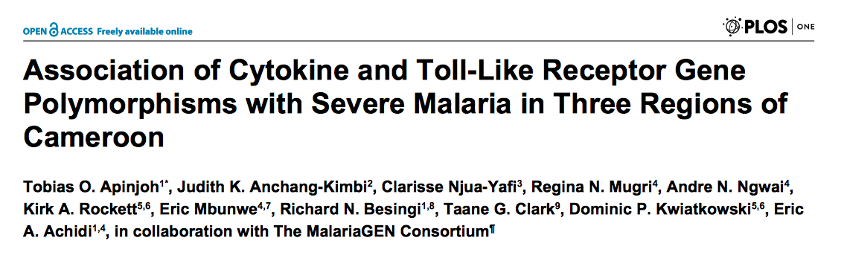

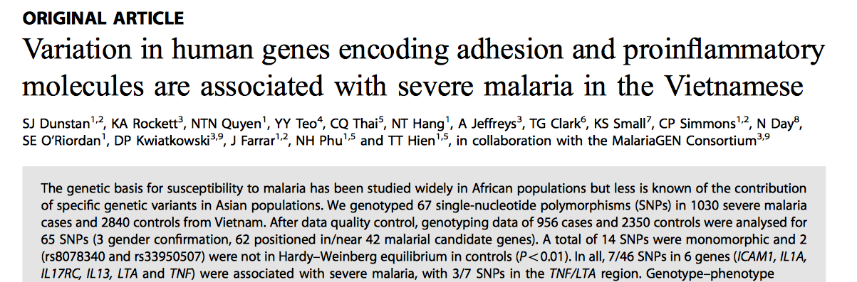

E.g. MalariaGEN Consortium – Individual studies
Notes:
11 different population from 12 different sites across SSA, asia and oceanis.
Each study has performed analyses on their own data

Slide 21
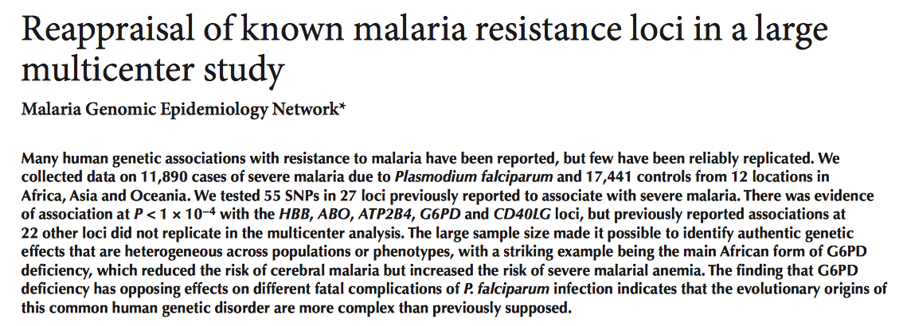

E.g. MalariaGEN Consortium –
Meta-analysis

Slide 22
Synthesize results
There are several ways to combine datasets in a meta-analysis framework..
P-value meta-analysis
Effect-size meta-analysis
  Fixed Effects
  Random Effects
  Bayesian approach
Multivariate approaches
Other extensions
  E.g. Multiple phenotypes; multiple variants; main and interaction effects

Slide 23
Effect size meta-analysis
Given effect sizes and standard errors from multiple studies we estimate a combined effect by computing a weighted mean
Fixed Effects Model
  One true effect size shared by all studies
  Combined effect estimates the common effect size
  Observed effect size varies due to random error in each study
  Weights assigned according to amount of information captured in each study i.e. large studies given more weight
Random Effects Model
  True effect size can vary from study to study
  Each study is estimating a different effect size
  Combined effect estimates the mean of the distribution of effects
  Observed effect size varies due to random error in each study and true variation in effect size between studies
  Weights are more balanced compared to fixed effects model
Notes:
Random effects model – Study effect sizes are assumed to be a random sample of the distribution of effects.
Effect size may vary due to environmental, study design, duration, phenotype definition etc.
Weights are more balanced because each study is estimating a different effect size.
Large studies are less likely to dominate the analysis and small studies are less likely to be trivialised. Exercise caution.
Random effects accommodate diversity between studies and usually preferable in the presence or anticipation of any
between-study heterogeneity.
When no heterogeneity exists, both models show similar effects anyhow.
An important caveat exists when small studies in retrospective meta-analysis report very strong effects, whereas larger studies show no or minimal effects. Random effects give relatively more weight to smaller studies, and the summary effect may become stronger than that with fixed effects, while smaller studies may be less trustworthy. Extra cau- tion is needed when effects are driven by mostly small studies which tend to show overestimated effect sizes Ref Kavvoura & Ioannidis

Slide 24
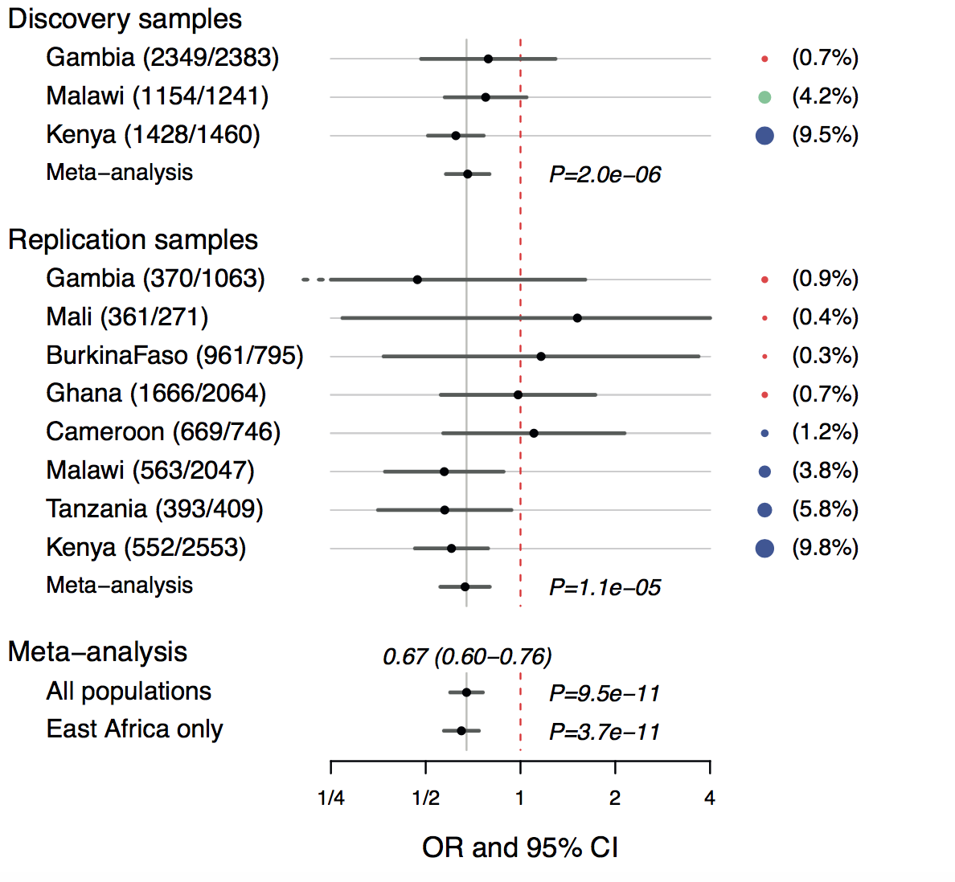
Evidence for association

Slide 25
Evidence for association

Slide 26
Heterogeneity
Genuine diversity in the genetic effects between studies may arise for a variety of reasons
  Variable LD between typed and causal variant
  Study phenotype may be correlated true phenotype with variable correlation across studies E.g. FTO
  Differences in environmental exposure
  Chance
Heterogeneity must be carefully examined against potential biases.
  Differences in study design
  Population structure
  Publication bias, selective outcome bias etc.
Commonly used statistical heterogeneity metrics include Cochran’s Q statistic or the between study variance τ²
Notes:
There are many reasons that can underlie heterogeneity
Use of tag polymorphisms in GWAS studies makes this a potential problem.
An association between FTO and diabetes was observed but the effect was inconsistent across populations. The gene is not directly associated with diabetes but rather, indirectly through its associatino with BMI and obesity. The association with BMI and obesity was consistent across populations.
HETEROGENEITY can be informative and potentially reveal information about the mechanism through which the variant is acting on disease risk.
Not necessarily representative of failure BUT must be examined against potential biases
Reliability of meta-analysis depends on the reliability of included data.

Slide 27
Summary
Meta-analysis can improve the power to detect and validate associations with common variants with small effects typical in major diseases
A wide array of methods for meta-analysis is available, including fixed effects, random effects and Bayesian approaches each with particular advantages and disadvantages
Meta-analysis allows the exploration of heterogeneity of genetic effects across data sets as well as providing summary effects
Selection biases need to be carefully considered and reported in any meta-analysis
Careful collection and quality checking of information is essential to avoid errors

Slide 28
Additional Reading
Hum Genet. 2008 Feb;123(1):1-14. Epub 2007 Nov 17. Methods for meta- analysis in genetic association studies: a review of their potential and pitfalls. F.K.Kavoura & J.P.Ioannidis
Trends Genet. 2004 Sep;20(9):439-44. Meta-analysis of genetic association studies. M.R.Munafo & J. Flint
Pharmacogenomics. 2009 Feb;10(2):191-201. doi: 10.2217/14622416.10.2.191. Meta-analysis in genome-wide association studies. E. Zeggini & JP Ioannidis.

