Slide 1
Using public resources to understand associations
Dr Luke Jostins

Slide 2
Introductions
Epidemiology
Bioinformatics
Genetics
Basic principles of measuring disease in populations
Basic genotype data summaries and analyses
population genetics
Public databases and resources for genetics
GWAS QC
Principal components analyses
GWAS association analyses
whole genome sequencing and fine-mapping
GWAS results and interpretation
meta-analysis and power of genetic studies

Slide 3
2003: The HGP publishes the sequence of a “reference” human genome

Slide 4
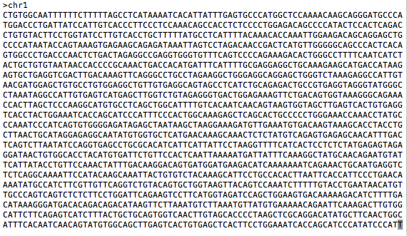
You can download the human genome sequence from here:
http://www.ncbi.nlm.nih.gov/projects/genome/assembly/grc/human/
It looks like this:
The sequence alone is not that useful!

Slide 5
Other projects generated resources to shed more light on genomes.
Genome variation
How does the genome sequence vary from person to person?
Genotype (HapMap) or sequence (1000 Genomes) many more individuals
Genome function
How does the DNA sequence make and regulate RNA and proteins?
Gene prediction models (GenCode, RefSeq), assays of non-coding function (ENCODE)
All these resources can be access free on the internet

Slide 6
Genome browsers
Most of the data that we will discuss is available from “genome browsers”
These are websites that put together public data in one place, and make it searchable and browsable
The main two genome browsers are Ensembl and the University of California Santa Cruz (UCSC) genome browser

Slide 7
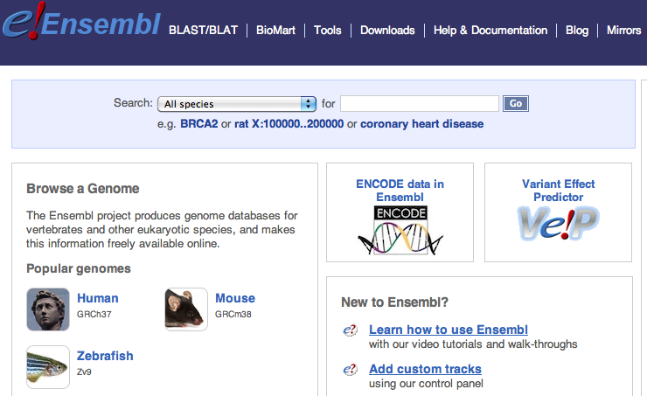
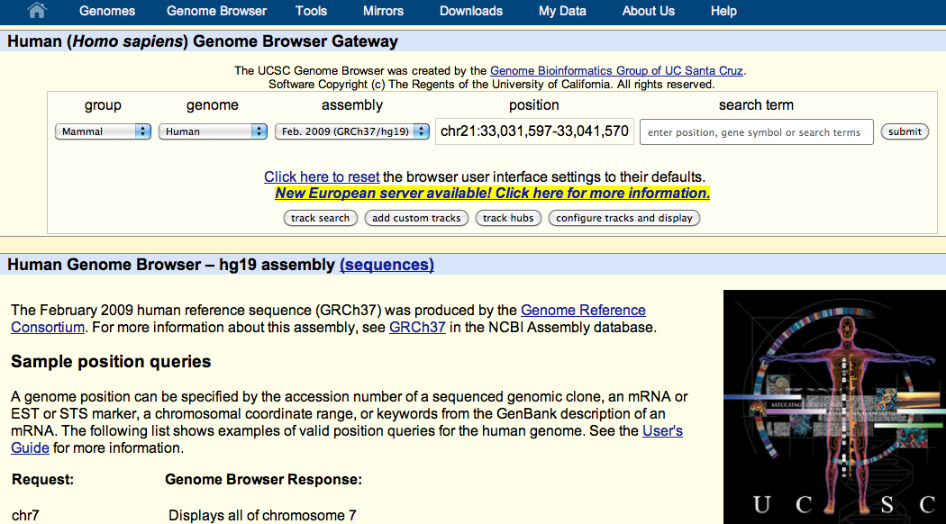
Ensembl http://www.ensembl.org
Much of the data
UCSC genome browser http://genome.ucsc.edu/cgi-bin/hgGateway

Slide 8
Genome variation

Slide 9
2005-2010: HapMap documents common variation within and across human populations
- ~2M single nucleotide polymorphisms (SNPs) genotyped in ~1000 individuals from 11 populations
- Used genotyping microarrays.

Slide 10
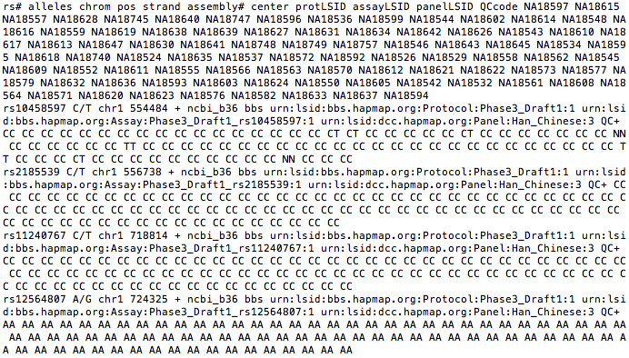
You can download the HapMap data from here:
http://hapmap.ncbi.nlm.nih.gov/
It looks like this:

Slide 11
2010-2013: 1000 Genomes Project sequences thousands more human genomes
- 2500 samples from 25 populations, documenting over 40M SNPs,
insertions, deletions and inversions
- Used high-throughput sequencing

Slide 12
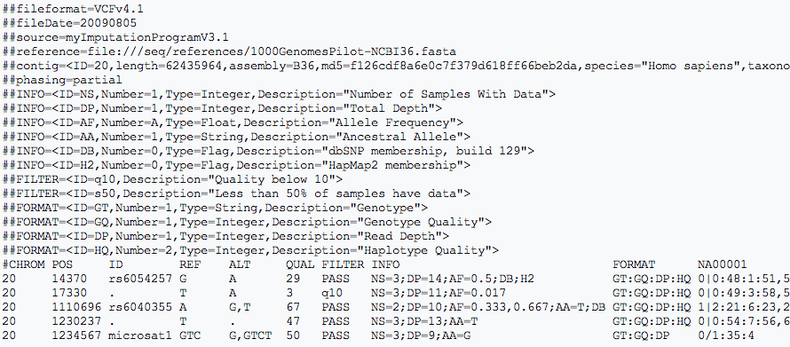
You can download the 1000 Genomes data from here:
http://www.1000genomes.org/
It looks like this:

Slide 13
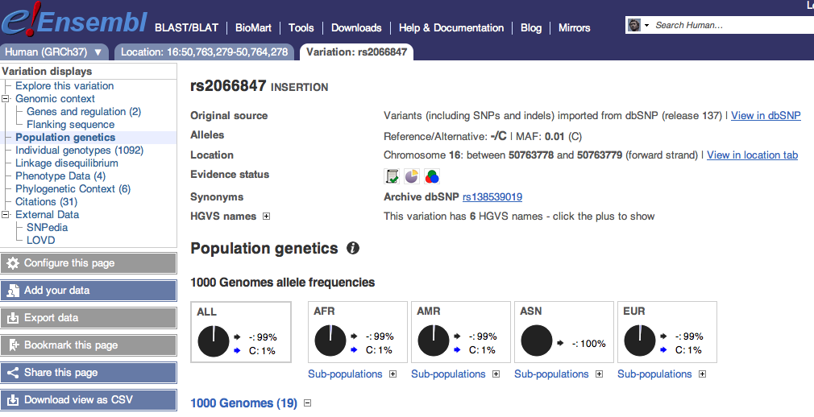
Ensembl can give us HapMap and 1000 Genomes information on particular SNPs:

Slide 14
Genome function

Slide 15
Annotating function onto sequence
ACTCATGCATCGATGCGATG

Slide 16
Annotating function onto sequence
Transcription start site

Slide 17
Annotating function onto sequence
Transcription start site
Transcript end

Slide 18
Annotating function onto sequence
Transcription start site
Transcript end
Start codon
End codon

Slide 19
Annotating function onto sequence
Transcription start site
Transcript end
Start codon
Splice sites
End codon

Slide 20
Annotating function onto sequence
Introns
5’ UTR
Exons
3’ UTR

Slide 21
Annotating function onto sequence
Introns
5’ UTR
Exons
3’ UTR
mRNA:
Coding sequence

Slide 22
Annotating function onto sequence
Introns
enhancer
promoter
Transcription factor
binding
5’ UTR
Exons
3’ UTR
mRNA:
Coding sequence

Slide 23
Functional annotation projects
Gene model builders (e.g. RefSeq, GENCODE)
Use computational models to predict where transcription starts and stops, and where splicing occurs to make predicted transcripts. Use both sequence data and experimental data.
Discovery of non-coding regulatory elements (e.g. ENCODE)
Use experimental data (RNA-Seq, ChIP-Seq, histone modifications) to discover functional regulatory elements outside of genes.

Slide 24
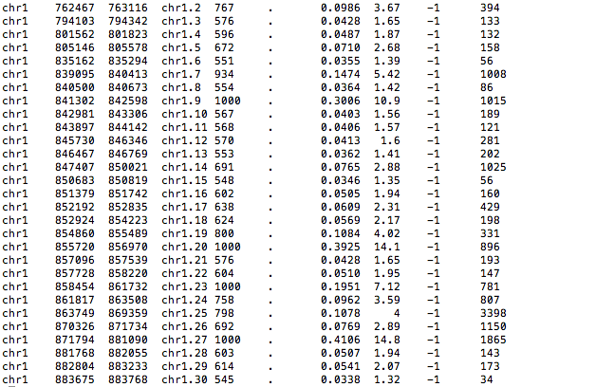
You can download GENCODE data from here: http://www.gencodegenes.org/
And ENCODE data from here:
http://genome.ucsc.edu/ENCODE/
They look like this:

Slide 25
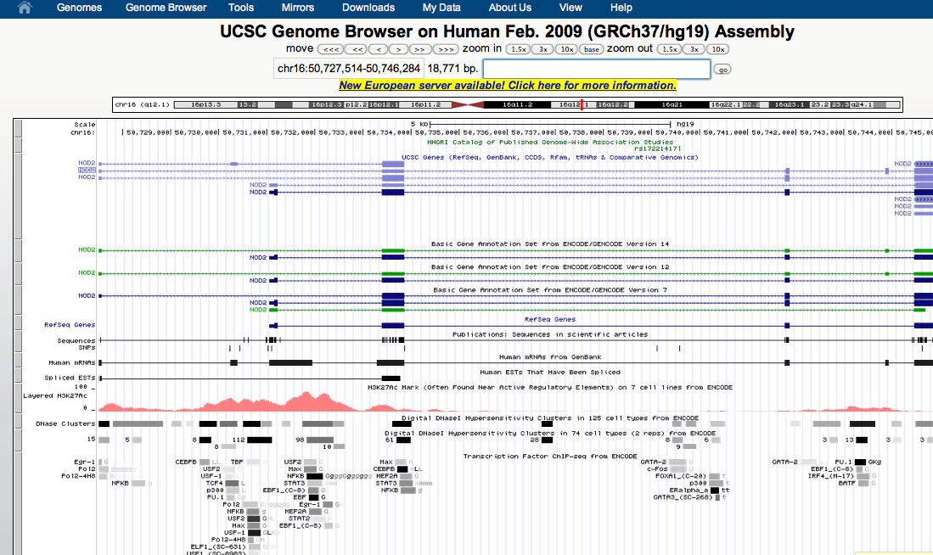
UCSC can show us functional information on a gene
Transcripts
Promoter
activity
Transcription
factor
binding

Slide 26
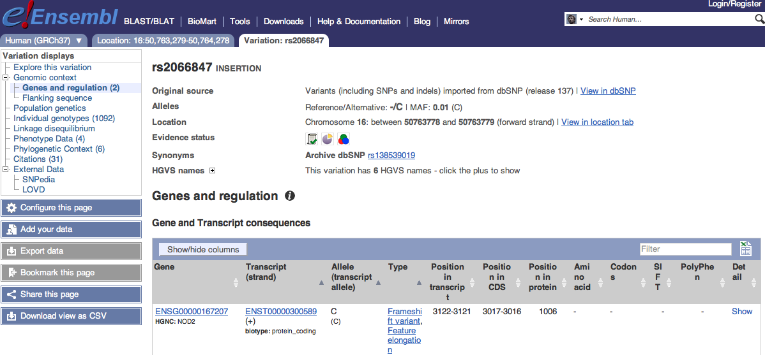
Ensembl tells us what impact a variant has on nearby genes
This variant causes a frameshift in the gene NOD2

Slide 27
Putting it all together
We discover a protective effect of the A allele of SNP rs334 on severe malaria
How common is this variant?
Search for rs334 in Ensembl, click “Variation”, then “Human”, then “rs334”, then “Population Genetics”.

Slide 28
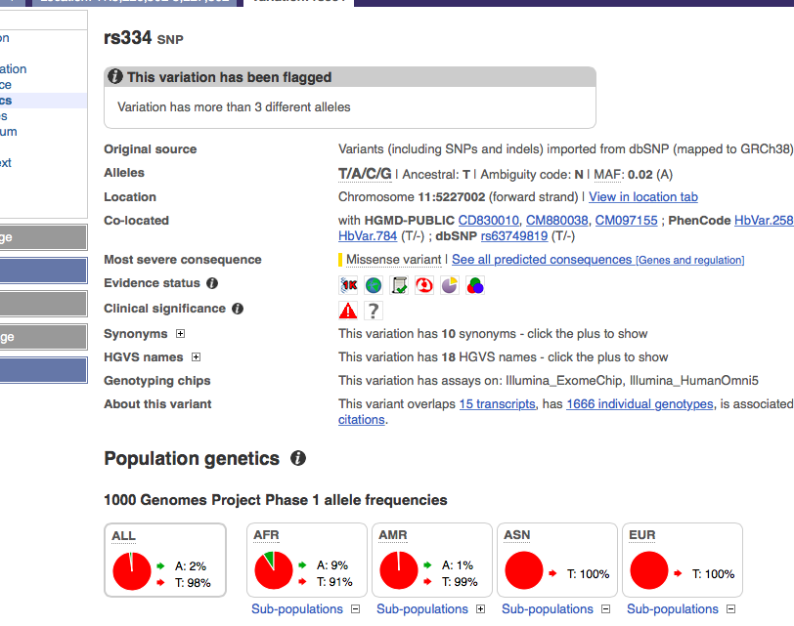
According to 1000 Genomes, Europeans and Asians do not carry the A variant, but 9% of Africans do.

Slide 29
Putting it all together
Does this variant lie within a predicted gene?
Search for rs334 in the UCSC genome browser and click “rs334”

Slide 30
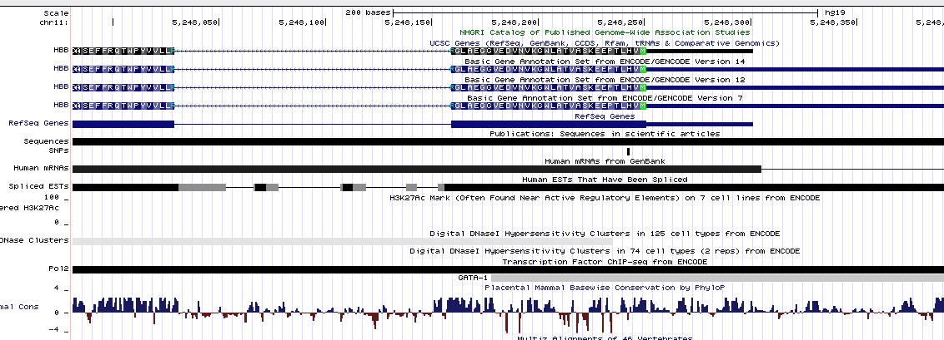
According to RefSeq and GENCODE, this variant lies within a transcript for the gene HBB

Slide 31
Putting it all together
Does this variant alter the HBB gene?
Search for rs334 in Ensembl, click “Variation”, then “Human”, then “rs334”, then “Genes and Regulation”.

Slide 32
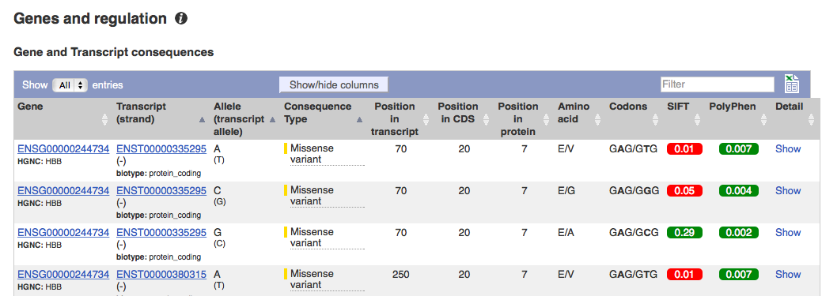
The A allele changes the 7th amino acid in the HBB protein from Glutamic acid (E) to Valine (V)

Slide 33
Practical task
For each of the following variants please find:
The allele frequencies in different populations
The gene it is in (if any)
The consequence it has on the gene (if any). This could be an amino acid change, or presence in a regulatory region.
Any other interesting information you can find on those pages. You can even search Google for these SNPs to see if you can learn anything else!
The variants are:
rs11209026
rs17293632
rs6983267
rs8176719

