Slide 1
Some more advanced techniques used in genome-wide association studies
Luke Jostins-Dean
17/11/2021

Slide 2
GWAS techniques we will cover today
Today we will cover:
GWAS meta-analysis
Heritability estimation
Fine-mapping
We will look at these in the context of two recent(ish) GWAS papers:
- Astle et al (2016) The Allelic Landscape of Human Blood Cell Trait Variation and Links to Common Complex Disease. Cell 17;167(5):1415-1429.e19 https://pubmed.ncbi.nlm.nih.gov/27863252/
- Robertson, Inshaw, et al (2021) Fine-mapping, trans-ancestral and genomic analyses identify causal variants, cells, genes and drug targets for type 1 diabetes. Nat Genet . 53(7):962-971. https://pubmed.ncbi.nlm.nih.gov/34127860/
There will a practical on meta-analysis and fine-mapping, and we will give links to other suggested tutorials and vignettes in the slides.

Slide 3
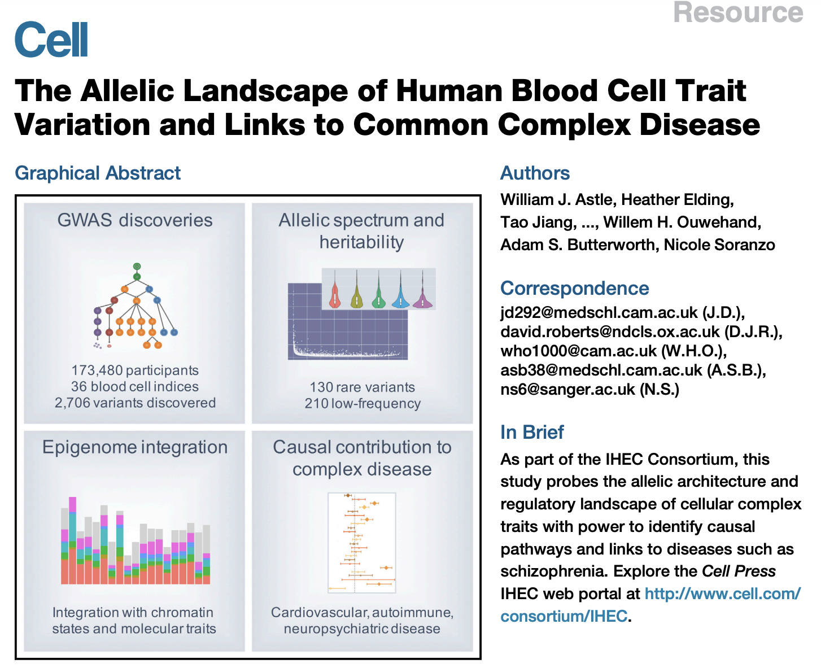

Slide 4
Meta-analysis

Slide 5
Modern large-scale GWAS are usually meta-analyses

Slide 6
Modern large-scale GWAS are usually meta-analyses

Slide 7
Meta-analyzing genetic data
Meta-analysis is a technique for combining summary statistics across multiple different studies.
You need two bits of data for each study, to capture effect size precision
  e.g. betas and standard errors, or p-values and sample sizes
The paper uses the software METAL, with settings for Inverse Variance Based analysis
  This is more properly called a “Fixed Effect Variance Weighted Meta-analysis”

Slide 8
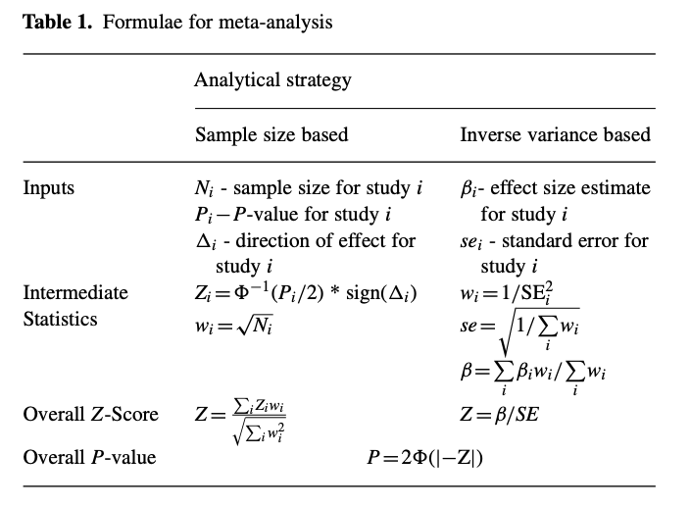
Meta-analyzing genetic data
Meta-analysis is a technique for combining summary statistics across multiple different studies.
You need two bits of data for each study, to capture effect size precision
  e.g. betas and standard errors, or p-values and sample sizes
The paper uses the software METAL, with settings for Inverse Variance Based analysis
  This is more properly called a “Fixed Effect Variance Weighted Meta-analysis”
Willer et al (2010) METAL: fast and efficient meta-analysis of genomewide association scans. Bioinformatics. 26(17): 2190–2191.

Slide 9
Meta-analyzing two studies with variance-weighted fixed-effect meta-analysis
 | Study 1 | Study 2 | Study 3
Effect size | 0.5 | 0.2 | 0.4
Standard error | 0.1 | 0.05 | 0.2
Z score
P-value
Weight

Slide 10
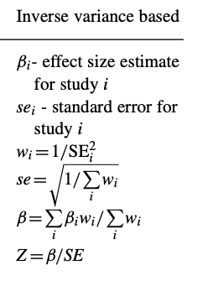

Meta-analyzing two studies with variance-weighted fixed-effect meta-analysis
 | Study 1 | Study 2 | Study 3
Effect size | 0.5 | 0.2 | 0.4
Standard error | 0.1 | 0.05 | 0.2
Z score
P-value
Weight

Slide 11
Meta-analyzing two studies with variance-weighted fixed-effect meta-analysis
 | Study 1 | Study 2 | Study 3
Effect size | 0.5 | 0.2 | 0.4
Standard error | 0.1 | 0.05 | 0.2
Z score | 0.5/0.1 = 5 | 0.2/0.05=4 | 0.4/0.2=2
P-value
Weight

Slide 12
Meta-analyzing two studies with variance-weighted fixed-effect meta-analysis
 | Study 1 | Study 2 | Study 3
Effect size | 0.5 | 0.2 | 0.4
Standard error | 0.1 | 0.05 | 0.2
Z score | 0.5/0.1 = 5 | 0.2/0.05=4 | 0.4/0.2=2
P-value | 2*pnorm(-5) = 5.7e-7 | 2*pnorm(-4)=6.3e-5 | 2*pnorm(-2)=0.046
Weight

Slide 13
Meta-analyzing two studies with variance-weighted fixed-effect meta-analysis
 | Study 1 | Study 2 | Study 3
Effect size | 0.5 | 0.2 | 0.4
Standard error | 0.1 | 0.05 | 0.2
Z score | 0.5/0.1 = 5 | 0.2/0.05=4 | 0.4/0.2=2
P-value | 2*pnorm(-5) = 5.7e-7 | 2*pnorm(-4)=6.3e-5 | 2*pnorm(-2)=0.046
Weight | 1/0.1^2 = 100 | 1/0.05^2=400 | 1/0.2^2 = 25

Slide 14
Meta-analyzing two studies with variance-weighted fixed-effect meta-analysis
 | Study 1 | Study 2 | Study 3
Effect size | 0.5 | 0.2 | 0.4
Standard error | 0.1 | 0.05 | 0.2
Z score | 0.5/0.1 = 5 | 0.2/0.05=4 | 0.4/0.2=2
P-value | 2*pnorm(-5) = 5.7e-7 | 2*pnorm(-4)=6.3e-5 | 2*pnorm(-2)=0.046
Weight | 1/0.1^2 = 100 | 1/0.05^2=400 | 1/0.2^2 = 25
Sum of weights = 525

Slide 15
Meta-analyzing two studies with variance-weighted fixed-effect meta-analysis
 | Study 1 | Study 2 | Study 3
Effect size | 0.5 | 0.2 | 0.4
Standard error | 0.1 | 0.05 | 0.2
Z score | 0.5/0.1 = 5 | 0.2/0.05=4 | 0.4/0.2=2
P-value | 2*pnorm(-5) = 5.7e-7 | 2*pnorm(-4)=6.3e-5 | 2*pnorm(-2)=0.046
Weight | 1/0.1^2 = 100 | 1/0.05^2=400 | 1/0.2^2 = 25
Sum of weights = 525
Meta-analysis effect size = (0.5*100 + 0.2*400 + 0.4*25)/(525) = 0.267

Slide 16
Meta-analyzing two studies with variance-weighted fixed-effect meta-analysis
 | Study 1 | Study 2 | Study 3
Effect size | 0.5 | 0.2 | 0.4
Standard error | 0.1 | 0.05 | 0.2
Z score | 0.5/0.1 = 5 | 0.2/0.05=4 | 0.4/0.2=2
P-value | 2*pnorm(-5) = 5.7e-7 | 2*pnorm(-4)=6.3e-5 | 2*pnorm(-2)=0.046
Weight | 1/0.1^2 = 100 | 1/0.05^2=400 | 1/0.2^2 = 25
Sum of weights = 525
Meta-analysis effect size = (0.5*100 + 0.2*400 + 0.4*25)/(525) = 0.267
Meta-analysis standard error = sqrt(1/525) = 0.0436

Slide 17
Meta-analyzing two studies with variance-weighted fixed-effect meta-analysis
 | Study 1 | Study 2 | Study 3
Effect size | 0.5 | 0.2 | 0.4
Standard error | 0.1 | 0.05 | 0.2
Z score | 0.5/0.1 = 5 | 0.2/0.05=4 | 0.4/0.2=2
P-value | 2*pnorm(-5) = 5.7e-7 | 2*pnorm(-4)=6.3e-5 | 2*pnorm(-2)=0.046
Weight | 1/0.1^2 = 100 | 1/0.05^2=400 | 1/0.2^2 = 25
Sum of weights = 525
Meta-analysis effect size = (0.5*100 + 0.2*400 + 0.4*25)/(525) = 0.267
Meta-analysis standard error = sqrt(1/525) = 0.0436
Meta-analysis Z = 0.267/0.0436 = 6.12

Slide 18
Meta-analyzing two studies with variance-weighted fixed-effect meta-analysis
 | Study 1 | Study 2 | Study 3
Effect size | 0.5 | 0.2 | 0.4
Standard error | 0.1 | 0.05 | 0.2
Z score | 0.5/0.1 = 5 | 0.2/0.05=4 | 0.4/0.2=2
P-value | 2*pnorm(-5) = 5.7e-7 | 2*pnorm(-4)=6.3e-5 | 2*pnorm(-2)=0.046
Weight | 1/0.1^2 = 100 | 1/0.05^2=400 | 1/0.2^2 = 25
Sum of weights = 525
Meta-analysis effect size = (0.5*100 + 0.2*400 + 0.4*25)/(525) = 0.267
Meta-analysis standard error = sqrt(1/525) = 0.0436
Meta-analysis Z = 0.267/0.0436 = 6.12
Meta-analysis p = 9.4e-10

Slide 19
Some things to be keep in mind
Fixed effect meta-analysis assumes that them true effect size is exactly the same in each study.
  It also requires them to be on the same SCALE
  E.g. meta-analyzing a study measured in kg and one measured in lbs would not work as expected – you first need to convert them onto the same scale.
You can test whether this assumption is violated using a heterogeneity test, e.g. the Cochran Q test (implement in most meta-analysis software).
There are lots of other options for meta-analysis:
  Random effects meta-analysis: effect size assumed to vary across studies, normally distributed with some variance tau^2
  Trans-ethnic meta-analysis: a specific type of random effect meta-analysis designed to study genetics across populations (the MANTRA software is an example).
  Meta-regression: designed to answer the question “why do these studies differ?”, by including per-study covariates (eg average age, ethnicity, etc).

Slide 20
Visualizing meta-analysis results: Forest plot
Default forest plotting using R package “meta”:
> forest.meta(metagen(betas,ses))

Slide 21
Visualizing meta-analysis results: Forest plot
TE=“Treatment effect”, i.e. effect size
and its standard error
Default forest plotting using R package “meta”:
> forest.meta(metagen(betas,ses))

Slide 22
Visualizing meta-analysis results: Forest plot
TE=“Treatment effect”, i.e. effect size
and its standard error
Confidence intervals on effect size for each individual study
Default forest plotting using R package “meta”:
> forest.meta(metagen(betas,ses))

Slide 23
Visualizing meta-analysis results: Forest plot
Weights:
1/se^2 for fixed effect
1/(se^2 + tau^2) for random effects
TE=“Treatment effect”, i.e. effect size
and its standard error
Confidence intervals on effect size for each individual study
Default forest plotting using R package “meta”:
> forest.meta(metagen(betas,ses))

Slide 24
Visualizing meta-analysis results: Forest plot
Weights:
1/se^2 for fixed effect
1/(se^2 + tau^2) for random effects
TE=“Treatment effect”, i.e. effect size
and its standard error
Confidence intervals on effect size for each individual study
Confidence intervals for meta-analysed effect size
Default forest plotting using R package “meta”:
> forest.meta(metagen(betas,ses))

Slide 25
Visualizing meta-analysis results: Forest plot
Weights:
1/se^2 for fixed effect
1/(se^2 + tau^2) for random effects
TE=“Treatment effect”, i.e. effect size
and its standard error
Confidence intervals on effect size for each individual study
Measures of study-to-study variation.
Confidence intervals for meta-analysed effect size
Default forest plotting using R package “meta”:
> forest.meta(metagen(betas,ses))

Slide 26
Back to the paper
These are the results of the meta-analysis for every SNP and every blood trait. Red dots are new top hits, green are known top hits, and black are variants that are in LD with either.

Slide 27
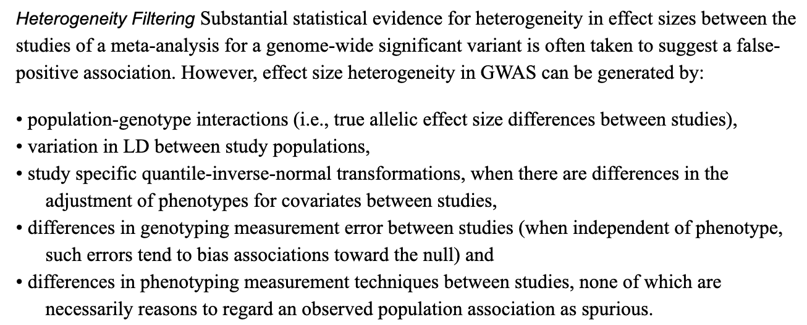
The authors were worried about heterogeneity

Slide 28
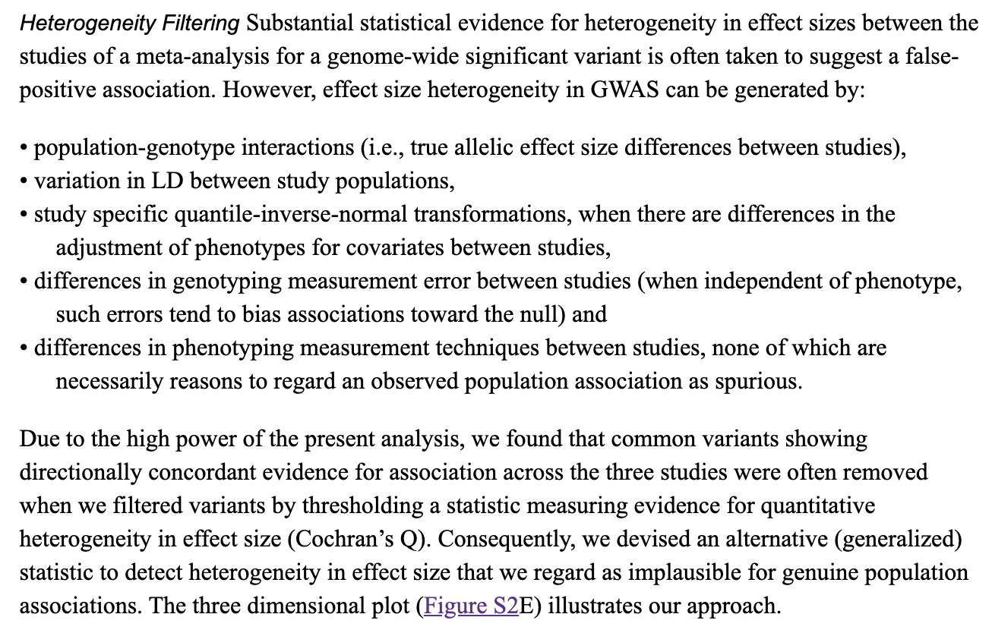
The authors were worried about heterogeneity

Slide 29
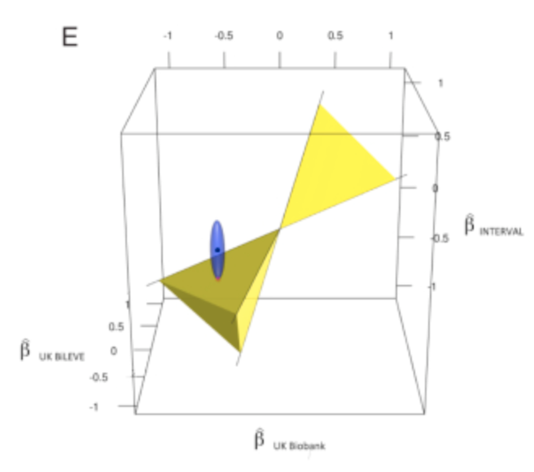
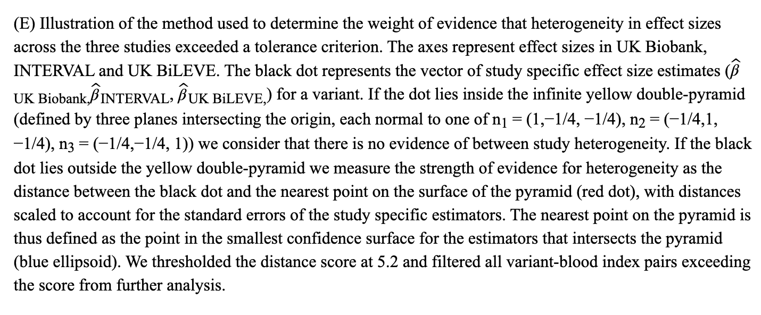
The authors were worried about heterogeneity

Slide 30
The authors were worried about heterogeneity
TL;DR: The authors tolerate some amount of between-study heterogeneity, providing it lies within plausible bounds.

Slide 31
Running these yourself
The practical today will cover meta-analysed genome-wide summary statistics from two studies, and visualizing them using forest plots.
The METAL paper (cited earlier in the talk) is also quite short and readable, and they also have a Quick Start tutorial that includes example data:
  https://genome.sph.umich.edu/wiki/METAL_Quick_Start

Slide 32
Heritability estimation

Slide 33
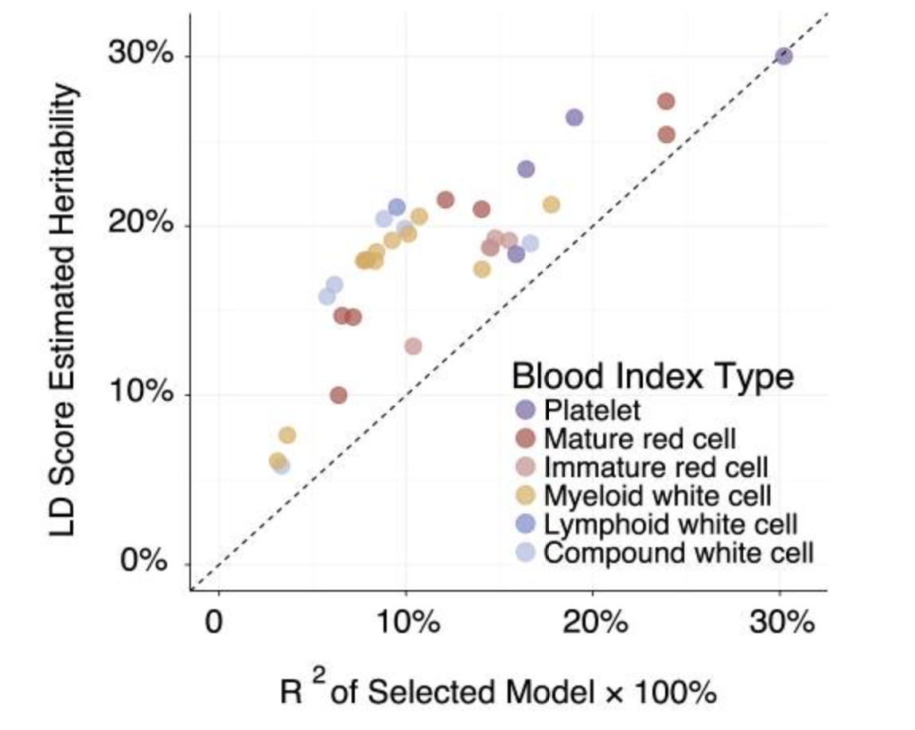
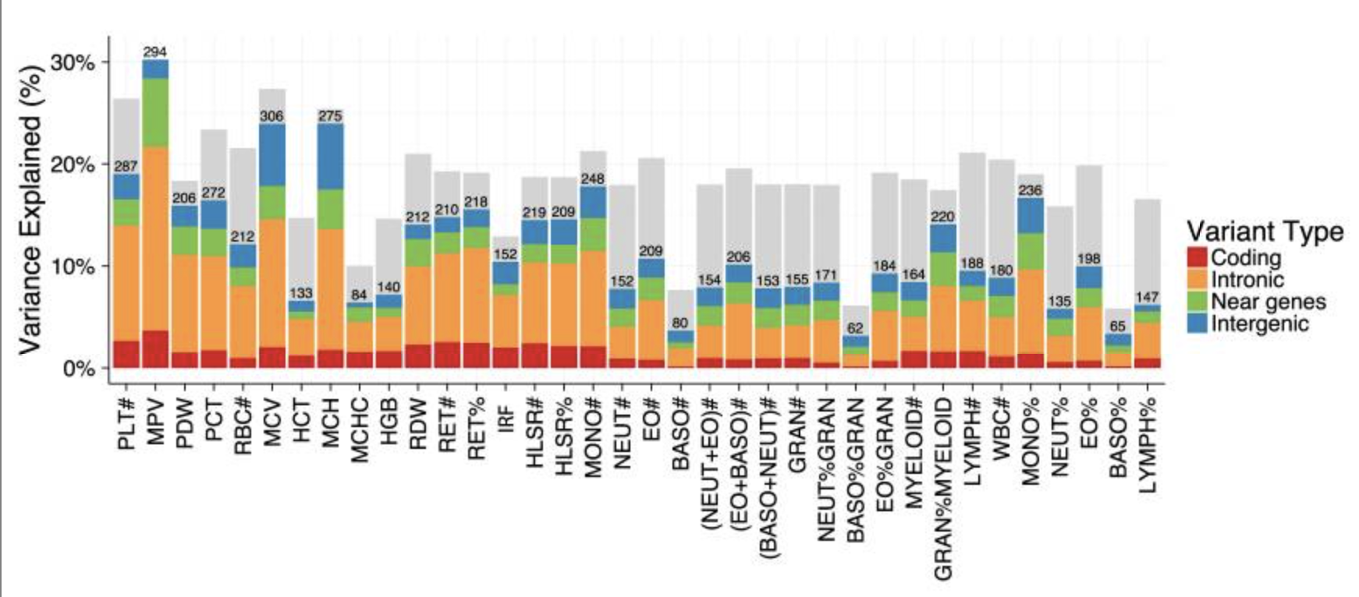
A lot of figures involve heritability, variance explained, R2, etc

Slide 34
The broad-sense heritability

Slide 35
The broad-sense heritability
Actual phenotype

Slide 36
The broad-sense heritability
Actual phenotype
Best genetic prediction of phenotype based on genome (G)

Slide 37
The broad-sense heritability
environment
Actual phenotype
Best genetic prediction of phenotype based on genome (G)

Slide 38
The broad-sense heritability
environment
Actual phenotype
Best genetic prediction of phenotype based on genome (G)

Slide 39
The broad-sense heritability
environment
Actual phenotype
Best genetic prediction of phenotype based on genome (G)
The squared correlation between the best possible genetic predictor and the real phenotype is the broad sense heritability, H2:

Slide 40
The broad-sense heritability
environment
Actual phenotype
Best genetic prediction of phenotype based on genome (G)
The squared correlation between the best possible genetic predictor and the real phenotype is the broad sense heritability, H2:
The broad sense heritability is a measure of the totality of genetic effects. It is mostly theoretical, though it is (in theory) equal to the correlation in phenotype of identical twins raised apart.

Slide 41
The narrow-sense heritability
The squared correlation between the best possible linear genetic predictor and the real phenotype is the narrow sense heritability, h2:

Slide 42
The narrow-sense heritability
Environment plus non-linear genetics
Actual phenotype
Best LINEAR genetic prediction of phenotype based on genome (G)
The squared correlation between the best possible linear genetic predictor and the real phenotype is the narrow sense heritability, h2:

Slide 43
The narrow-sense heritability
Environment plus non-linear genetics
Actual phenotype
Best LINEAR genetic prediction of phenotype based on genome (G)
The squared correlation between the best possible linear genetic predictor and the real phenotype is the narrow sense heritability, h2:
The narrow sense heritability is the extent to which genetics ‘breeds true’, i.e. is passed down in families i.e. where the correlation in phenotype is proportional to relatedness.

Slide 44
The SNP-heritability
Environment, non-linear genetics, snps not in the study
Actual phenotype
Best linear genetic prediction of phenotype based on the set of snps that are in the study (G_snp)
The squared correlation between the best possible linear genetic predictor using the snps in your study and the real phenotype is the NNP heritability, h2_snp:

Slide 45
The SNP-heritability
Environment, non-linear genetics, snps not in the study
Actual phenotype
Best linear genetic prediction of phenotype based on the set of snps that are in the study (G_snp)
The squared correlation between the best possible linear genetic predictor using the snps in your study and the real phenotype is the NNP heritability, h2_snp:
The SNP heritability measured the total narrow-sense heritability captured, i.e. the “variance explained”, by the variants you have studied. In a GWAS, this usually means “captured by common variants”. This gives a lower bound for the narrow-sense heritability.

Slide 46
Estimating the SNP heritability using a polygenic risk score
Estimate a polygenic risk score, by trying to estimate the effect sizes (beta^hat):

Slide 47
Estimating the SNP heritability using a polygenic risk score
Estimate a polygenic risk score, by trying to estimate the effect sizes (beta^hat):
Estimated weights for each snp

Slide 48
Estimating the SNP heritability using a polygenic risk score
Crude method: estimate betas for genome-wide significant hits and set beta = 0 for everything else.
More sophisticated methods: use a lasso or a Bayesian prior to shrink effect sizes genome-wide.
Estimate a polygenic risk score, by trying to estimate the effect sizes (beta^hat):
Estimated weights for each snp

Slide 49
Estimating the SNP heritability using a polygenic risk score
Crude method: estimate betas for genome-wide significant hits and set beta = 0 for everything else.
More sophisticated methods: use a lasso or a Bayesian prior to shrink effect sizes genome-wide.
Estimate a polygenic risk score, by trying to estimate the effect sizes (beta^hat):
And test how well that correlates with the phenotype in an external replication dataset. Square it and you get the “variance explained by the PRS”:

Slide 50
Estimating the SNP heritability using a polygenic risk score
Crude method: estimate betas for genome-wide significant hits and set beta = 0 for everything else.
More sophisticated methods: use a lasso or a Bayesian prior to shrink effect sizes genome-wide.
Estimate a polygenic risk score, by trying to estimate the effect sizes (beta^hat):
And test how well that correlates with the phenotype in an external replication dataset. Square it and you get the “variance explained by the PRS”:
But this will be less than the true SNP heritability, as inaccuracy in beta^hat introduces error and reduces the correlation.

Slide 51
LD Score Regression – a better way of estimating SNP heritability
We would like to measure the total amount of signal in the GWAS (eg by average p-value or chi-square statistic).
  But this can be driven by real signal or population stratification
Bulik-Sullivan et al (2015) LD Score regression distinguishes confounding from polygenicity in genome-wide association studies. Nature Genetics 47, 291–295

Slide 52
LD Score Regression – a better way of estimating SNP heritability
We would like to measure the total amount of signal in the GWAS (eg by average p-value or chi-square statistic).
  But this can be driven by real signal or population stratification
Real signal
Population stratification
Bulik-Sullivan et al (2015) LD Score regression distinguishes confounding from polygenicity in genome-wide association studies. Nature Genetics 47, 291–295

Slide 53
LD Scores
LD matrix:
 | rs1 | rs2 | rs3 | rs4
rs1 | 1 | 0.1 | 0.05 | 0
rs2 | 0.1 | 1 | 0.9 | 0.85
rs3 | 0.05 | 0.9 | 1 | 0.9
rs4 | 0 | 0.85 | 0.9 | 1

Slide 54
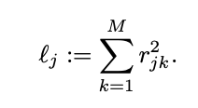
LD Scores
LD matrix:
LD scores:
 | rs1 | rs2 | rs3 | rs4
rs1 | 1 | 0.1 | 0.05 | 0
rs2 | 0.1 | 1 | 0.9 | 0.85
rs3 | 0.05 | 0.9 | 1 | 0.9
rs4 | 0 | 0.85 | 0.9 | 1
Variant | LD Score
rs1
rs2
rs3
rs4
LD scores measure how much potential each variant has for tagging causal variants. The higher the LD score, the more true signal we expect it to tag, and the larger we expect it’s test statistic (or the smaller we expect its p-value) to be.

Slide 55
LD Scores
LD matrix:
LD scores:
 | rs1 | rs2 | rs3 | rs4
rs1 | 1 | 0.1 | 0.05 | 0
rs2 | 0.1 | 1 | 0.9 | 0.85
rs3 | 0.05 | 0.9 | 1 | 0.9
rs4 | 0 | 0.85 | 0.9 | 1
Variant | LD Score
rs1 | 1^2 + 0.1^2 + 0.05^2 + 0^2 = 1.0125
rs2
rs3
rs4
LD scores measure how much potential each variant has for tagging causal variants. The higher the LD score, the more true signal we expect it to tag, and the larger we expect it’s test statistic (or the smaller we expect its p-value) to be.

Slide 56
LD Scores
LD matrix:
LD scores:
 | rs1 | rs2 | rs3 | rs4
rs1 | 1 | 0.1 | 0.05 | 0
rs2 | 0.1 | 1 | 0.9 | 0.85
rs3 | 0.05 | 0.9 | 1 | 0.9
rs4 | 0 | 0.85 | 0.9 | 1
Variant | LD Score
rs1 | 1^2 + 0.1^2 + 0.05^2 + 0^2 = 1.0125
rs2 | 0.1^2 + 1^2 + 0.9^2 + 0.85^2 = 2.5425
rs3 | 0.05^2+0.9^2+1^2+0.9^2 = 2.6225
rs4 | 0^2+0.85^2+0.9^2 + 1^2 = 2.5325
LD scores measure how much potential each variant has for tagging causal variants. The higher the LD score, the more true signal we expect it to tag, and the larger we expect it’s test statistic (or the smaller we expect its p-value) to be.

Slide 57
LD Scores
Small LD score, only tags itself and no other causal variants
LD matrix:
LD scores:
 | rs1 | rs2 | rs3 | rs4
rs1 | 1 | 0.1 | 0.05 | 0
rs2 | 0.1 | 1 | 0.9 | 0.85
rs3 | 0.05 | 0.9 | 1 | 0.9
rs4 | 0 | 0.85 | 0.9 | 1
Variant | LD Score
rs1 | 1^2 + 0.1^2 + 0.05^2 + 0^2 = 1.0125
rs2 | 0.1^2 + 1^2 + 0.9^2 + 0.85^2 = 2.5425
rs3 | 0.05^2+0.9^2+1^2+0.9^2 = 2.6225
rs4 | 0^2+0.85^2+0.9^2 + 1^2 = 2.5325
LD scores measure how much potential each variant has for tagging causal variants. The higher the LD score, the more true signal we expect it to tag, and the larger we expect it’s test statistic (or the smaller we expect its p-value) to be.
Large LD score, tags itself and two other causal variants.

Slide 58
LD Scores
Small LD score, only tags itself and no other causal variants
LD matrix:
LD scores:
 | rs1 | rs2 | rs3 | rs4
rs1 | 1 | 0.1 | 0.05 | 0
rs2 | 0.1 | 1 | 0.9 | 0.85
rs3 | 0.05 | 0.9 | 1 | 0.9
rs4 | 0 | 0.85 | 0.9 | 1
Variant | LD Score
rs1 | 1^2 + 0.1^2 + 0.05^2 + 0^2 = 1.0125
rs2 | 0.1^2 + 1^2 + 0.9^2 + 0.85^2 = 2.5425
rs3 | 0.05^2+0.9^2+1^2+0.9^2 = 2.6225
rs4 | 0^2+0.85^2+0.9^2 + 1^2 = 2.5325
LD scores measure how much potential each variant has for tagging causal variants. The higher the LD score, the more true signal we expect it to tag, and the larger we expect it’s test statistic (or the smaller we expect its p-value) to be.
Large LD score, tags itself and two other causal variants.
But more than that – the higher the heritability, the larger the slope between LD score and test statistic:
χ2 = test statistic, N = sample size, M = number of SNPs, a = confounding

Slide 59
LD Score Regression – a better way of estimating SNP heritability
We would like to measure the total amount of signal in the GWAS (eg by average p-value or chi-square statistic).
  But this can be driven by real signal or population stratification
Population stratification
Real signal
h2_snp = 0%
h2_snp = 33%

Slide 60
Back to the paper
SNP heritability ranges from 5-30%. Polygenic risk scores (based on significant associations) capture a lot, but far from all, of this.
This is h^2_snp
This is h^2_prs

Slide 61
Partitioned heritability
Often we are interested in how much heritability is explained by different type of variants:

Slide 62
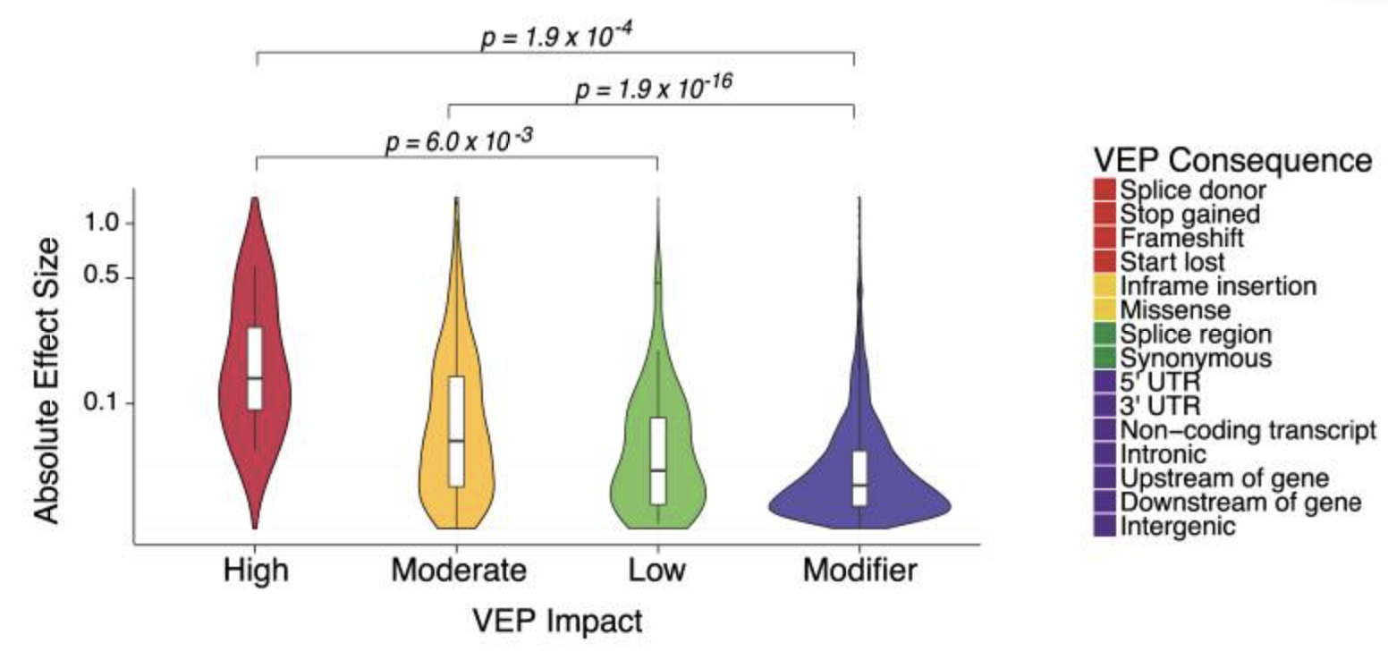
Partitioned heritability
Often we are interested in how much heritability is explained by different type of variants:
Eg different consequences of the mutation on nearby genes

Slide 63
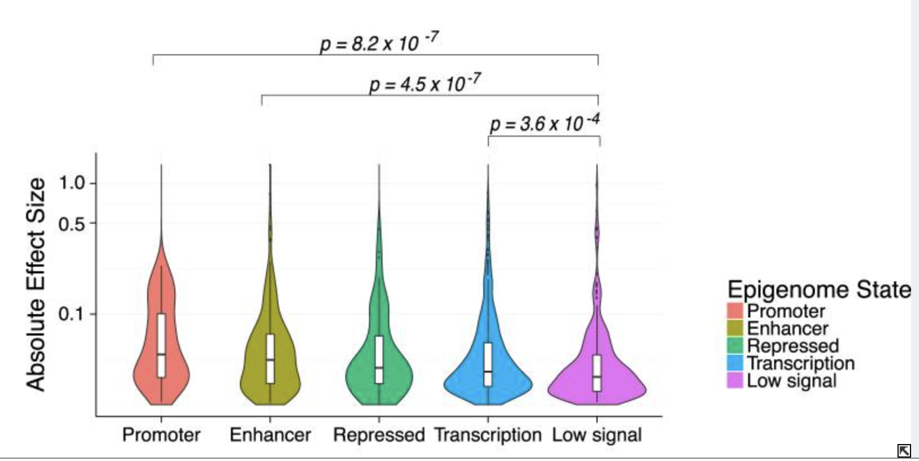
Partitioned heritability
Often we are interested in how much heritability is explained by different type of variants:
Eg different consequences of the mutation on nearby genes
Or variants that lie in different types of gene regulatory region.

Slide 64
Partitioned heritability
Genetic contribution of coding variants
Genetic contribution of coding variants

Slide 65
Partitioned heritability
Genetic contribution of coding variants
Genetic contribution of coding variants
We break the heritability down into contributions from each category. We want to estimate the heritability of each category (h2_coding, h2_noncoding, etc).

Slide 66
Partitioned LD Scores
LD matrix:
 | rs1 (coding) | rs2 (noncoding) | rs3 (noncoding) | rs4 (noncoding)
rs1 | 1 | 0.1 | 0.05 | 0
rs2 | 0.1 | 1 | 0.9 | 0.85
rs3 | 0.05 | 0.9 | 1 | 0.9
rs4 | 0 | 0.85 | 0.9 | 1

Slide 67
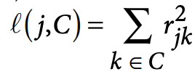
Partitioned LD Scores
Partitioned LD score for category C
LD matrix:
LD scores:
 | rs1 (coding) | rs2 (noncoding) | rs3 (noncoding) | rs4 (noncoding)
rs1 | 1 | 0.1 | 0.05 | 0
rs2 | 0.1 | 1 | 0.9 | 0.85
rs3 | 0.05 | 0.9 | 1 | 0.9
rs4 | 0 | 0.85 | 0.9 | 1
Variant | Coding LD score | Noncoding LD score
rs1
rs2
rs3
rs4
Partitioned LD scores measure how much each variant tags different classes of variant.

Slide 68
Partitioned LD Scores
Partitioned LD score for category C
LD matrix:
LD scores:
 | rs1 (coding) | rs2 (noncoding) | rs3 (noncoding) | rs4 (noncoding)
rs1 | 1 | 0.1 | 0.05 | 0
rs2 | 0.1 | 1 | 0.9 | 0.85
rs3 | 0.05 | 0.9 | 1 | 0.9
rs4 | 0 | 0.85 | 0.9 | 1
Variant | Coding LD score | Noncoding LD score
rs1 | 1^2 = 1 | 0.1^2 + 0.05^2 + 0^2 = 0.0125
rs2
rs3
rs4
Partitioned LD scores measure how much each variant tags different classes of variant.

Slide 69
Partitioned LD Scores
Partitioned LD score for category C
LD matrix:
LD scores:
 | rs1 (coding) | rs2 (noncoding) | rs3 (noncoding) | rs4 (noncoding)
rs1 | 1 | 0.1 | 0.05 | 0
rs2 | 0.1 | 1 | 0.9 | 0.85
rs3 | 0.05 | 0.9 | 1 | 0.9
rs4 | 0 | 0.85 | 0.9 | 1
Variant | Coding LD score | Noncoding LD score
rs1 | 1^2 = 1 | 0.1^2 + 0.05^2 + 0^2 = 0.0125
rs2 | 0.1^2 = 0.01 | 1^2 + 0.9^2 + 0.85^2 = 2.5325
rs3 | 0.05^2 = 0.00025 | 0.9^2 + 1^2 + 0.9^2 = 2.62
rs4 | 0^2 = 0 | 0.85^2 + 0.9^2 + 1^2 = 2.5325
Partitioned LD scores measure how much each variant tags different classes of variant.

Slide 70
Partitioned LD Scores
Partitioned LD score for category C
LD matrix:
LD scores:
 | rs1 (coding) | rs2 (noncoding) | rs3 (noncoding) | rs4 (noncoding)
rs1 | 1 | 0.1 | 0.05 | 0
rs2 | 0.1 | 1 | 0.9 | 0.85
rs3 | 0.05 | 0.9 | 1 | 0.9
rs4 | 0 | 0.85 | 0.9 | 1
Variant | Coding LD score | Noncoding LD score
rs1 | 1^2 = 1 | 0.1^2 + 0.05^2 + 0^2 = 0.0125
rs2 | 0.1^2 = 0.01 | 1^2 + 0.9^2 + 0.85^2 = 2.5325
rs3 | 0.05^2 = 0.00025 | 0.9^2 + 1^2 + 0.9^2 = 2.62
rs4 | 0^2 = 0 | 0.85^2 + 0.9^2 + 1^2 = 2.5325
Partitioned LD scores measure how much each variant tags different classes of variant.
We can now estimate the two different slopes:
χ2 = test statistic, N = sample size, M = number of SNPs, a = confounding

Slide 71
Back to the paper
Most of the heritability in blood traits is driving by intronic variation

Slide 72
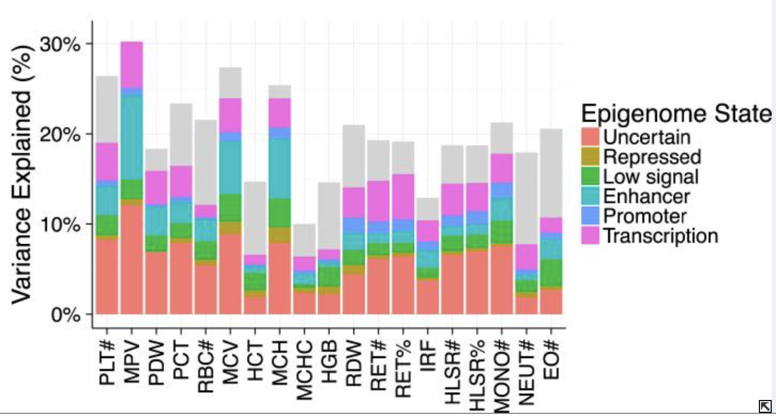
Back to the paper
Most of the heritability in blood traits is driving by intronic variation
and by variants in enhancers and transcribed regions.

Slide 73
Running these yourself
We do not have a practical on LD Score regression, but the LDSC authors have a number of good tutorials with real, publicly available data on their wiki:
https://github.com/bulik/ldsc/wiki

Slide 74
Fine-mapping

Slide 75
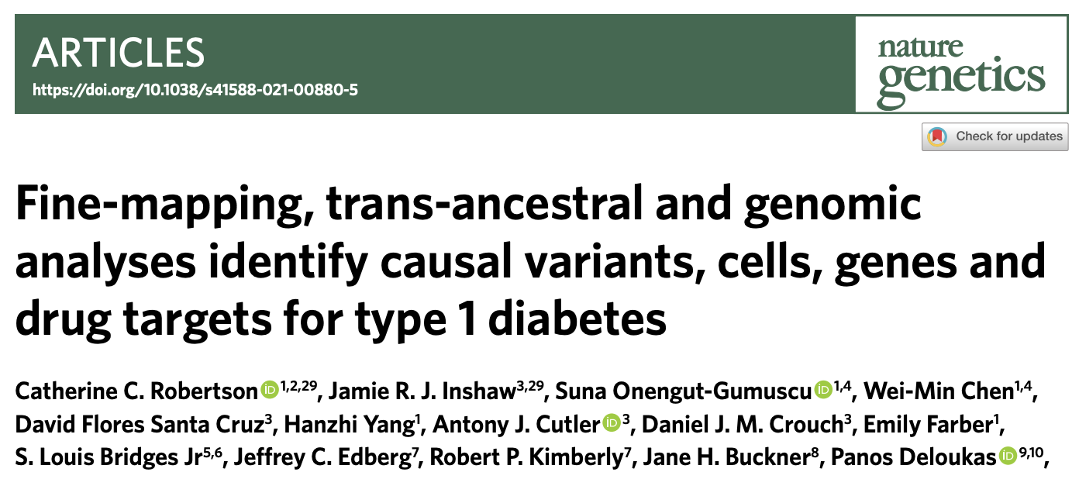
Swapping out for a new paper

Slide 76
Aims of fine-mapping

Slide 77
Aims of fine-mapping
Identify the number of independent signals (i.e. the number of causal variants) in the region.

Slide 78
Aims of fine-mapping
Identify the number of independent signals (i.e. the number of causal variants) in the region.
Identify the candidates for the actual causal variant for each signal.

Slide 79
Aims of fine-mapping
Identify the number of independent signals (i.e. the number of causal variants) in the region.
Identify the candidates for the actual causal variant for each signal.
Identify possible functions of these causal variants

Slide 80
Maller et al fine-mapping
Maller et al (2012) Bayesian refinement of association signals for 14 loci in 3 common diseases. Nat Genet. 44(12): 1294–1301

Slide 81
Maller et al fine-mapping
In Maller-style mapping, we assume that there is only one causal variant, and thus we can consider each variant one-at-a-time:
Maller et al (2012) Bayesian refinement of association signals for 14 loci in 3 common diseases. Nat Genet. 44(12): 1294–1301

Slide 82
Maller et al fine-mapping
In Maller-style mapping, we assume that there is only one causal variant, and thus we can consider each variant one-at-a-time:
Assume P(C = i) is a constant for all i
Maller et al (2012) Bayesian refinement of association signals for 14 loci in 3 common diseases. Nat Genet. 44(12): 1294–1301

Slide 83
Maller et al fine-mapping
In Maller-style mapping, we assume that there is only one causal variant, and thus we can consider each variant one-at-a-time:
Assume P(C = i) is a constant for all i
Where BF is the Bayes factor:
Maller et al (2012) Bayesian refinement of association signals for 14 loci in 3 common diseases. Nat Genet. 44(12): 1294–1301

Slide 84
Maller et al fine-mapping
In Maller-style mapping, we assume that there is only one causal variant, and thus we can consider each variant one-at-a-time:
Assume P(C = i) is a constant for all i
Where BF is the Bayes factor:
The likelihood of seeing the observed beta_i given a non-zero effect size prior sigma_0
The likelihood of seeing the observed beta_i under the null
Maller et al (2012) Bayesian refinement of association signals for 14 loci in 3 common diseases. Nat Genet. 44(12): 1294–1301

Slide 85
Maller et al fine-mapping
P-value

Slide 86
Maller et al fine-mapping
P-value
Bayes factor

Slide 87
Maller et al fine-mapping
P-value
Bayes factor
Posterior:
A note on credible sets: Rank the SNPs by posterior, and go down the list adding them up. When you go over 95%, that is your 95% credible set. There is at least a 95% chance that the true causal variant is in this set.

Slide 88
Maller et al fine-mapping
P-value
Bayes factor
Posterior:
Variant | Posterior
rs1 | 0.06
rs2 | 0.65
rs3 | 0.25
rs4 | 0.02
A note on credible sets: Rank the SNPs by posterior, and go down the list adding them up. When you go over 95%, that is your 95% credible set. There is at least a 95% chance that the true causal variant is in this set.

Slide 89
Maller et al fine-mapping
P-value
Bayes factor
Posterior:
Variant | Posterior
rs2 | 0.65
rs3 | 0.25
rs1 | 0.06
rs4 | 0.02
A note on credible sets: Rank the SNPs by posterior, and go down the list adding them up. When you go over 95%, that is your 95% credible set. There is at least a 95% chance that the true causal variant is in this set.

Slide 90
Maller et al fine-mapping
P-value
Bayes factor
Posterior:
Variant | Posterior | Cumsum
rs2 | 0.65 | 0.65
rs3 | 0.25 | 0.90
rs1 | 0.06 | 0.96
rs4 | 0.02 | 0.98
A note on credible sets: Rank the SNPs by posterior, and go down the list adding them up. When you go over 95%, that is your 95% credible set. There is at least a 95% chance that the true causal variant is in this set.

Slide 91
Maller et al fine-mapping
P-value
Bayes factor
Posterior:
Variant | Posterior | Cumsum
rs2 | 0.65 | 0.65
rs3 | 0.25 | 0.90
rs1 | 0.06 | 0.96
rs4 | 0.02 | 0.98
A note on credible sets: Rank the SNPs by posterior, and go down the list adding them up. When you go over 95%, that is your 95% credible set. There is at least a 95% chance that the true causal variant is in this set.
Credible set

Slide 92
A simple worked example
Variant: | rs1 | rs2 | rs3 | rs4
Effect size (beta_i) | 0.4 | 0.41 | 0.3 | 0.1
Standard error (se_i) | 0.05 | 0.05 | 0.1 | 0.1
f(beta_i | mu = 0, sigma = se^2 + sigma_0^2)
f(beta_i | mu = 0, sigma = se^2)
BF_i
Posterior_i

Slide 93
A simple worked example
Variant: | rs1 | rs2 | rs3 | rs4
Effect size (beta_i) | 0.4 | 0.41 | 0.3 | 0.1
Standard error (se_i) | 0.05 | 0.05 | 0.1 | 0.1
f(beta_i | mu = 0, sigma = se^2 + sigma_0^2) | dnorm(0.4,0,sqrt(0.05^2 + 0.2^2)) = 0.295 | dnorm(0.41,0,sqrt(0.05^2 + 0.2^2)) = 0.268 | dnorm(0.3,0,sqrt(0.1^2 + 0.2^2)) = 0.725 | dnorm(0.1,0,sqrt(0.1^2 + 0.2^2)) = 1.614
f(beta_i | mu = 0, sigma = se^2)
BF_i
Posterior_i

Slide 94
A simple worked example
Variant: | rs1 | rs2 | rs3 | rs4
Effect size (beta_i) | 0.4 | 0.41 | 0.3 | 0.1
Standard error (se_i) | 0.05 | 0.05 | 0.1 | 0.1
f(beta_i | mu = 0, sigma = se^2 + sigma_0^2) | dnorm(0.4,0,sqrt(0.05^2 + 0.2^2)) = 0.295 | dnorm(0.41,0,sqrt(0.05^2 + 0.2^2)) = 0.268 | dnorm(0.3,0,sqrt(0.1^2 + 0.2^2)) = 0.725 | dnorm(0.1,0,sqrt(0.1^2 + 0.2^2)) = 1.614
f(beta_i | mu = 0, sigma = se^2) | dnorm(0.4,0,sqrt(0.05^2)) = 1.01e-13 | dnorm(0.42,0,sqrt(0.05^2)) = 3.80e-15 | dnorm(0.3,0,sqrt(0.1^2)) = 0.0443 | dnorm(0.1,0,sqrt(0.1^2)) = 2.420
BF_i
Posterior_i

Slide 95
A simple worked example
Variant: | rs1 | rs2 | rs3 | rs4
Effect size (beta_i) | 0.4 | 0.41 | 0.3 | 0.1
Standard error (se_i) | 0.05 | 0.05 | 0.1 | 0.1
f(beta_i | mu = 0, sigma = se^2 + sigma_0^2) | dnorm(0.4,0,sqrt(0.05^2 + 0.2^2)) = 0.295 | dnorm(0.41,0,sqrt(0.05^2 + 0.2^2)) = 0.268 | dnorm(0.3,0,sqrt(0.1^2 + 0.2^2)) = 0.725 | dnorm(0.1,0,sqrt(0.1^2 + 0.2^2)) = 1.614
f(beta_i | mu = 0, sigma = se^2) | dnorm(0.4,0,sqrt(0.05^2)) = 1.01e-13 | dnorm(0.42,0,sqrt(0.05^2)) = 3.80e-15 | dnorm(0.3,0,sqrt(0.1^2)) = 0.0443 | dnorm(0.1,0,sqrt(0.1^2)) = 2.420
BF_i | 0.295/1.01e-13 = 2.92e12 | 0.243/3.80e-15 = 6.39e13 | 0.725/0.0443 = 16.37 | 1.614/2.420 = 0.667
Posterior_i

Slide 96
A simple worked example
Variant: | rs1 | rs2 | rs3 | rs4
Effect size (beta_i) | 0.4 | 0.41 | 0.3 | 0.1
Standard error (se_i) | 0.05 | 0.05 | 0.1 | 0.1
f(beta_i | mu = 0, sigma = se^2 + sigma_0^2) | dnorm(0.4,0,sqrt(0.05^2 + 0.2^2)) = 0.295 | dnorm(0.41,0,sqrt(0.05^2 + 0.2^2)) = 0.268 | dnorm(0.3,0,sqrt(0.1^2 + 0.2^2)) = 0.725 | dnorm(0.1,0,sqrt(0.1^2 + 0.2^2)) = 1.614
f(beta_i | mu = 0, sigma = se^2) | dnorm(0.4,0,sqrt(0.05^2)) = 1.01e-13 | dnorm(0.42,0,sqrt(0.05^2)) = 3.80e-15 | dnorm(0.3,0,sqrt(0.1^2)) = 0.0443 | dnorm(0.1,0,sqrt(0.1^2)) = 2.420
BF_i | 0.295/1.01e-13 = 2.92e12 | 0.243/3.80e-15 = 6.39e13 | 0.725/0.0443 = 16.37 | 1.614/2.420 = 0.667
Posterior_i
Sum of BFs = 6.682e13

Slide 97
A simple worked example
Variant: | rs1 | rs2 | rs3 | rs4
Effect size (beta_i) | 0.4 | 0.41 | 0.3 | 0.1
Standard error (se_i) | 0.05 | 0.05 | 0.1 | 0.1
f(beta_i | mu = 0, sigma = se^2 + sigma_0^2) | dnorm(0.4,0,sqrt(0.05^2 + 0.2^2)) = 0.295 | dnorm(0.41,0,sqrt(0.05^2 + 0.2^2)) = 0.268 | dnorm(0.3,0,sqrt(0.1^2 + 0.2^2)) = 0.725 | dnorm(0.1,0,sqrt(0.1^2 + 0.2^2)) = 1.614
f(beta_i | mu = 0, sigma = se^2) | dnorm(0.4,0,sqrt(0.05^2)) = 1.01e-13 | dnorm(0.42,0,sqrt(0.05^2)) = 3.80e-15 | dnorm(0.3,0,sqrt(0.1^2)) = 0.0443 | dnorm(0.1,0,sqrt(0.1^2)) = 2.420
BF_i | 0.295/1.01e-13 = 2.92e12 | 0.243/3.80e-15 = 6.39e13 | 0.725/0.0443 = 16.37 | 1.614/2.420 = 0.667
Posterior_i | 2.92e12/6.39e13 = 0.0457 | 6.39e13/6.682e13 = 0.956 | 16.37/6.682e13 = 2.45e-13 | 0.667/6.682e13 = 9.98e-15
Sum of BFs = 6.682e13

Slide 98
More complex fine-mapping
There are often more than one causal variant at each locus, and we want to:
  a) know how many there are
  b) fine-map each causal variant while controlling for possible LD with other causal variants
There are multiple techniques for fine-mapping in the presence of multiple causal variants
  The paper uses GUESSFM, which is robust and well-behaved but requires access to complete genotype data
  In the practical, we will use FINEMAP, which works just on summary statistics (betas, standard errors and an LD matrix).

Slide 99
How FINEMAP works

Slide 100
How FINEMAP works
“Projects” effects on to tag SNPs in LD with causal variants

Slide 101
How FINEMAP works
“Projects” effects on to tag SNPs in LD with causal variants
The aim is to to calculate the posteriors for all plausible causal configurations.

Slide 102
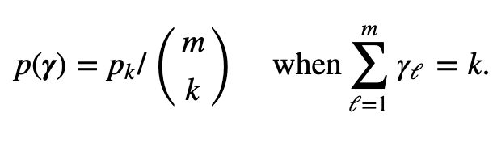
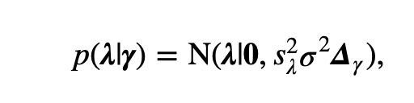
How FINEMAP works
“Projects” effects on to tag SNPs in LD with causal variants
The aim is to to calculate the posteriors for all plausible causal configurations.
Prior on the causal configuration
Prior on the effect sizes conditional on the causal configuration

Slide 103
How FINEMAP works
“Projects” effects on to tag SNPs in LD with causal variants
The aim is to to calculate the posteriors for all plausible causal configurations.
Prior on the causal configuration
Prior on the effect sizes conditional on the causal configuration
The likelihood, marginalizing out the effect size

Slide 104
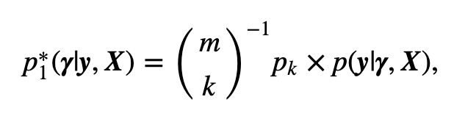
How FINEMAP works
“Projects” effects on to tag SNPs in LD with causal variants
The aim is to to calculate the posteriors for all plausible causal configurations.
Prior on the causal configuration
Prior on the effect sizes conditional on the causal configuration
The likelihood, marginalizing out the effect size
The unnormalized posterior for a given causal configuration.

Slide 105
How FINEMAP works
“Projects” effects on to tag SNPs in LD with causal variants
The aim is to to calculate the posteriors for all plausible causal configurations.
Prior on the causal configuration
Prior on the effect sizes conditional on the causal configuration
The likelihood, marginalizing out the effect size
The unnormalized posterior for a given causal configuration.
Now we just need to calculate this for all possible causal configurations!
BUT For 10 SNPs -> 1024 configurations. 80 SNPs -> more configurations than there are stars in the universe.

Slide 106
The shotgun stochastic search
Make some initial guess

Slide 107
The shotgun stochastic search
Make some initial guess
Search the neighborhood around the guess and calculate p* for each

Slide 108
The shotgun stochastic search
Sample a new configuration in the neighborhood with probability proportional to p*
Make some initial guess
Search the neighborhood around the guess and calculate p* for each

Slide 109
The shotgun stochastic search
Sample a new configuration in the neighborhood with probability proportional to p*
Make some initial guess
Search the neighborhood around the guess and calculate p* for each
Keep searching, Save all the p*s as you go along.

Slide 110
The shotgun stochastic search
Sample a new configuration in the neighborhood with probability proportional to p*
Make some initial guess
Keep searching, until the sum of all saved p*s stops increasing.
Search the neighborhood around the guess and calculate p* for each
Keep searching, Save all the p*s as you go along.

Slide 111
FINEMAP outputs

Slide 112
FINEMAP outputs
Bayes factor that there is at least one causal variant (i.e. evidence that there is any association at all)

Slide 113
FINEMAP outputs
Bayes factor that there is at least one causal variant (i.e. evidence that there is any association at all)
Probability that there are exactly k causal variants

Slide 114
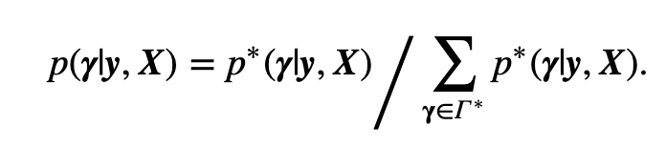
FINEMAP outputs
Bayes factor that there is at least one causal variant (i.e. evidence that there is any association at all)
Probability that there are exactly k causal variants
Posterior probabilities for all causal configurations in the search (by default, top 50k configurations are outputted).

Slide 115
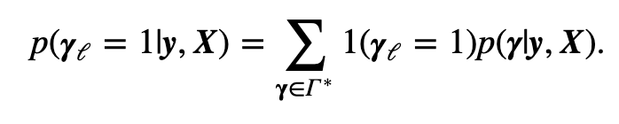
FINEMAP outputs
Bayes factor that there is at least one causal variant (i.e. evidence that there is any association at all)
Probability that there are exactly k causal variants
Posterior probabilities for all causal configurations in the search (by default, top 50k configurations are outputted).
Posterior probabilities for each variant. Also uses these to calculate a credible set for each independent signal.

Slide 116
Back to the paper
The fine-mapping approach used:
Number of signals (causal variants) in each locus, and posterior probability of causality for each variant.
Use GUESSFM to fine-map each region using the European data.

Slide 117
Back to the paper
The fine-mapping approach used:
Number of signals (causal variants) in each locus, and posterior probability of causality for each variant.
Use GUESSFM to fine-map each region using the European data.
Loci with exactly one causal variant
Higher resolution posterior probabilities of causality for each variant in certain loci.
Use PAINTOR to combine European and African data to produce higher resolution posterior probabilities.

Slide 118
Back to the paper
The fine-mapping approach used:
Number of signals (causal variants) in each locus, and posterior probability of causality for each variant.
Use GUESSFM to fine-map each region using the European data.
Loci with exactly one causal variant
Higher resolution posterior probabilities of causality for each variant in certain loci.
Use PAINTOR to combine European and African data to produce higher resolution posterior probabilities.
NOTE: PAINTOR is fine-mapping software that can combine data across ancestry groups, but it is unreliable when there are multiple causal variants.

Slide 119
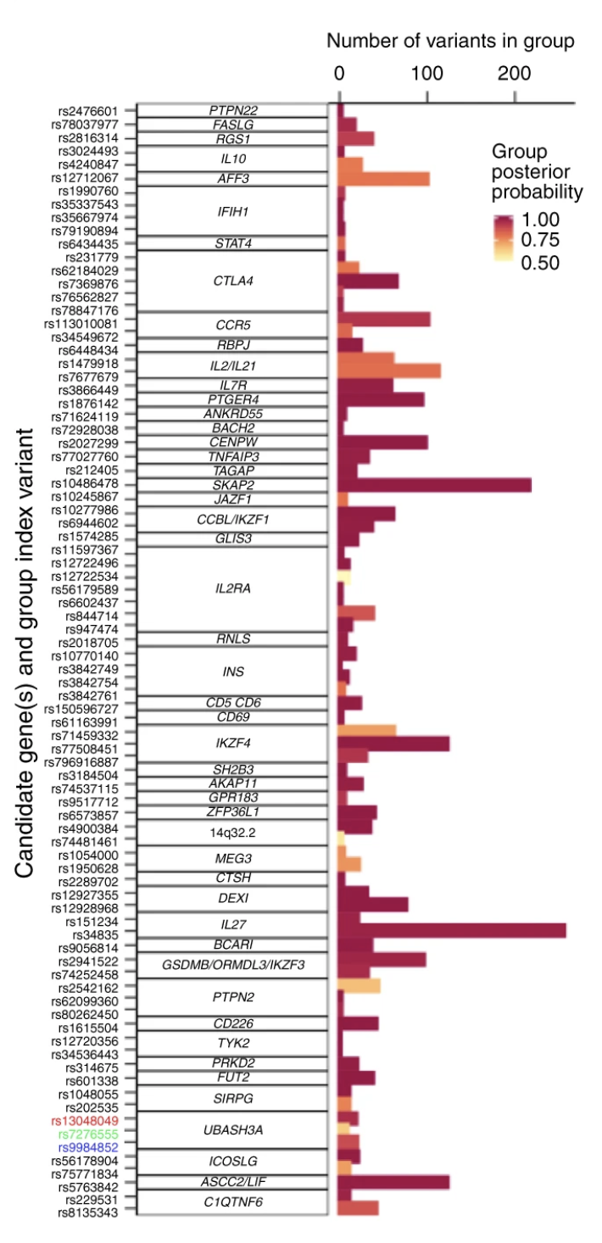
Identifying the number of causal variants at each locus

Slide 120
Identifying the number of causal variants at each locus
Guess FM output – all signals with posterior > 0.5.
Note difference between SIGNAL posterior and VARIANT posterior
Signal posterior == probability that there is an association here
Variant posterior = probability that this variant is a causal variant

Slide 121
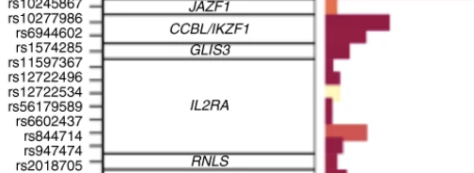
Identifying the number of causal variants at each locus
Guess FM output – all signals with posterior > 0.5.
Note difference between SIGNAL posterior and VARIANT posterior
Signal posterior == probability that there is an association here
Variant posterior = probability that this variant is a causal variant

Slide 122
Identifying the number of causal variants at each locus
For JAZF1, GLIS3 and RNLS loci, the algorithm thinks there is only one causal variant.
Guess FM output – all signals with posterior > 0.5.
Note difference between SIGNAL posterior and VARIANT posterior
Signal posterior == probability that there is an association here
Variant posterior = probability that this variant is a causal variant

Slide 123
Identifying the number of causal variants at each locus
For JAZF1, GLIS3 and RNLS loci, the algorithm thinks there is only one causal variant.
For CCBL/IKZF1, it thinks there are two (high certainty).
Guess FM output – all signals with posterior > 0.5.
Note difference between SIGNAL posterior and VARIANT posterior
Signal posterior == probability that there is an association here
Variant posterior = probability that this variant is a causal variant

Slide 124
Identifying the number of causal variants at each locus
For JAZF1, GLIS3 and RNLS loci, the algorithm thinks there is only one causal variant.
For CCBL/IKZF1, it thinks there are two (high certainty).
For IL2RA it thinks there are seven, though some are lower confidence (50-75%).
Guess FM output – all signals with posterior > 0.5.
Note difference between SIGNAL posterior and VARIANT posterior
Signal posterior == probability that there is an association here
Variant posterior = probability that this variant is a causal variant

Slide 125
Mapping causal variants using trans-ethnic data

Slide 126
Studying potential functions of causal variants

Slide 127
Discussion: following up causal variants
How would you follow up a high-confidence causal variant in an experiment?
How would this differ if you have 10 variant in the credible set, compared to 10?

Slide 128
Running these yourself
Our practical will look at using FINEMAP to carry out fine-mapping using summary statistics.
GUESSFM, which was used in the paper, is written in R and comes with some easy-to-use vignettes (which simulate their own example data):
https://chr1swallace.github.io/GUESSFM/
We haven’t discussed it at all, but the credible sets we have discussed are inherently Bayesian estimators. Anna Hutchinson has done some interesting work on putting Maller-style credible sets into a frequentist framework. Her R package (corrcoverage) has some well-written vignettes that talk you through this:
https://cran.r-project.org/web/packages/corrcoverage/
The paper is good too:
https://journals.plos.org/ploscompbiol/article?id=10.1371/journal.pcbi.1007829

