Slide 1
Genome-wide association studies in humans
gavin.band@well.ox.ac.uk
Wellcome Centre for Human Genetics
Notes:
The title of my talk is genome-wide studies as this has been the main focus of my research over the last 3 years.

Slide 2
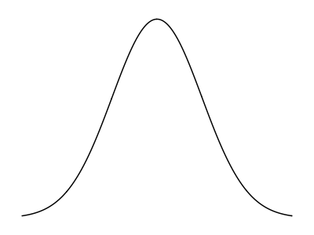
A complex trait
E.g. body mass index
or height
Extreme phenotypes lead to clinical conditions / disease traits
Distribution in population
trait values
Variation due to age, sex, environmental factors (e.g. diet), and genetic variation. May be an effect of multiple common variants that slightly alter normal physiological processes.
Notes:
Genetic variants

Slide 3
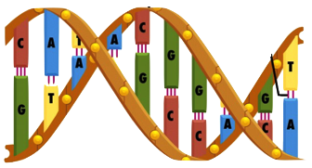
Why find “disease genes”?
Genetic factors are particularly interesting because (unlike environmental factors) they are:
inherited at birth
essentially unchanging
(often) easily measurable
This makes inferences about causation particularly simple.
e.g. compare:
“cyclists tend to be taller” => causation could plausibly work either way
“people with genotype AA tend to be taller” => implies causation (all else being equal)
Inheritance = nature’s randomised control trial
Notes:
E.g. “cyclists have bigger brains”
Versus “People with A/A genotypes have bigger brains”

Slide 4
Why find “disease genes”?
Genetic factors are particularly interesting because (unlike environmental factors) they are:
inherited at birth
essentially unchanging
(often) easily measurable
Reasons to look for disease genes:
Identify drug targets
Predict risk of disease
Personalised medicine (e.g. stratified by likely treatment response)
Gene therapy?
etc...
...understand the biology of disease
Notes:
E.g. “cyclists have bigger brains”
Versus “People with A/A genotypes have bigger brains”

Slide 5
The circle of genetic causation
(a causal mutation)
Notes:
Population individuals pass on DNA with recombination and mutation
DNA is wrapped up into chromosomes inside cells, where it encodes

Slide 6
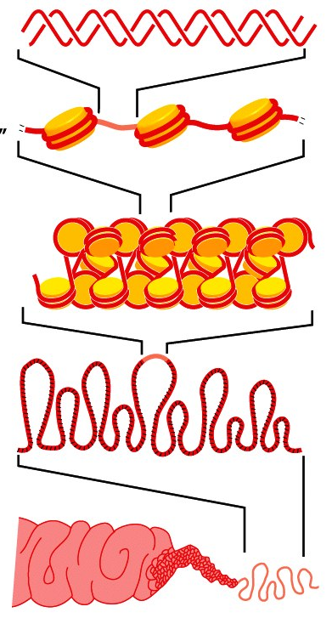
The circle of genetic causation
DNA gets physically packaged up into chromosomes...
Notes:
Population individuals pass on DNA with recombination and mutation
DNA is wrapped up into chromosomes inside cells, where it encodes

Slide 7
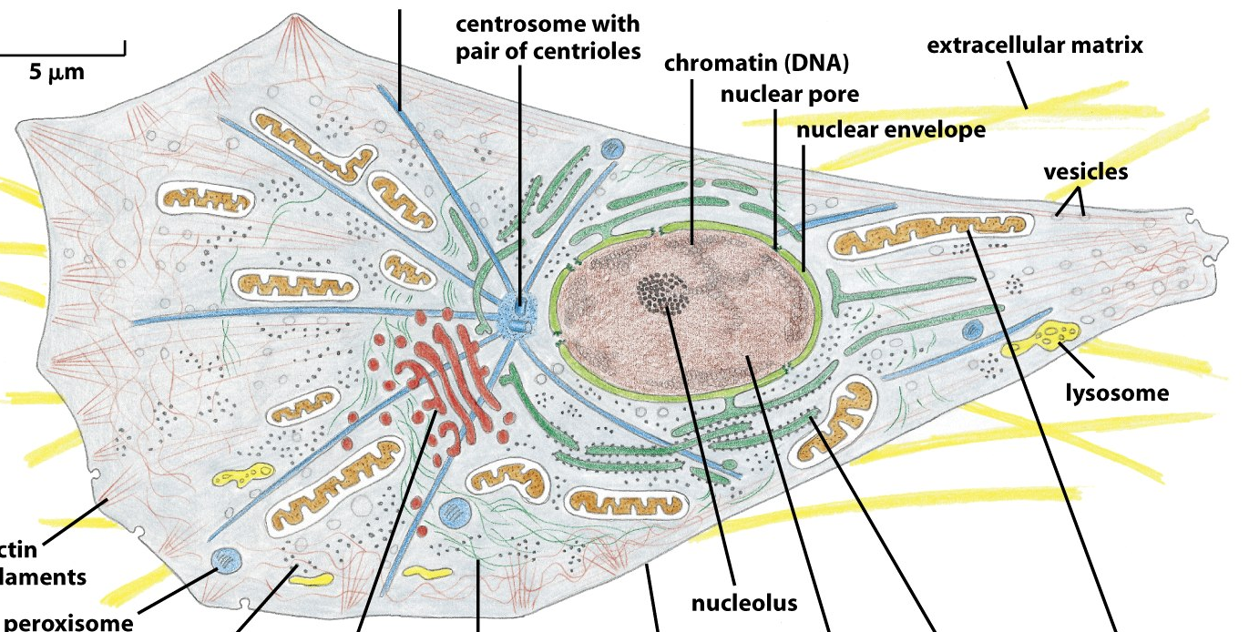
The circle of genetic causation
DNA gets physically packaged up into chromosomes...
...inside cells, where it is transcribed to form proteins and other molecules...
Notes:
Population individuals pass on DNA with recombination and mutation
DNA is wrapped up into chromosomes inside cells, where it encodes....
(2 metres of linear DNA per cell, 50 trillion cells)

Slide 8
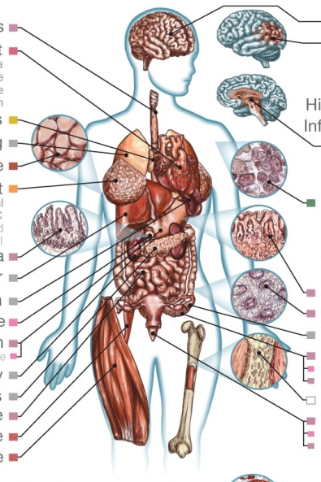
The circle of genetic causation
DNA gets physically packaged up into chromosomes...
...that combine to make individuals...
...inside cells, where it is transcribed to form proteins and other molecules...
...that affect how the cells behave, forming different organs...
Notes:
Population individuals pass on DNA with recombination and mutation
DNA is wrapped up into chromosomes inside cells, where it encodes

Slide 9
The circle of genetic causation
...whose success is affected by the traits they have...
DNA gets physically packaged up into chromosomes...
...that combine to make individuals...
...inside cells, where it is transcribed to form proteins and other molecules...
...that affect how the cells behave, forming different organs...
Notes:
The map from genetics to phenotypes is incredibly complicated
And it gets at what makes us human: evolution.

Slide 10
The circle of genetic causation
...passing on DNA, with mutations and recombination, to new generations...
...whose success is affected by the traits they have...
...that gets physically packaged up into chromosomes...
...that combine to make individuals...
...inside cells, where it is transcribed to form proteins and other molecules...
...that affect how the cells behave, forming different organs...
Notes:
The map from genetics to phenotypes is incredibly complicated
And it gets at what makes us human: evolution.

Slide 11
The circle of genetic causation
...passing on DNA, with mutations and recombination, to new generations...
...whose success is affected by the traits they have...
RFLP, microarrays, genome sequencing
Clinical phenotype measurements
...that gets physically packaged up into chromosomes...
All of this can now be measured
Biomarker measurements
Chromatin state marker assays, ChIP-seq, ...
RNA-seq, spectroscopy, antibody binding
...that combine to make individuals...
...inside cells, where it is transcribed to form proteins and other molecules...
...that affect how the cells behave, forming different organs...
Notes:
The map from genetics to phenotypes is incrediblyt complicated
And it gets at what makes us human: evolution.

Slide 12
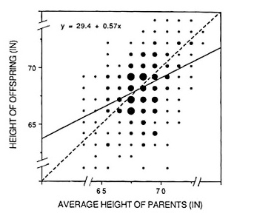
Finding disease genes in practice
I’m going to assume we’ve got a trait that we’ve established is heritable
height is heritable (height of parents predicts height of offspring)
We want to find genetic variants influencing it. How?

Slide 13
Finding needles in the haystack
The human genome is 3.2 billion base pairs long
We want to find a small number of ‘causal’ genetic mutations in there. How?
Luckily, nature has given us a way to narrow down on specific regions of the genome.

Slide 14
Recombination
Mother
Father
Offspring
Genetic recombination breaks up the DNA into segments.
You inherit a mosaic of segments of your parents’ DNA.
Recombination allows us to narrow down where genetic signals are

Slide 15
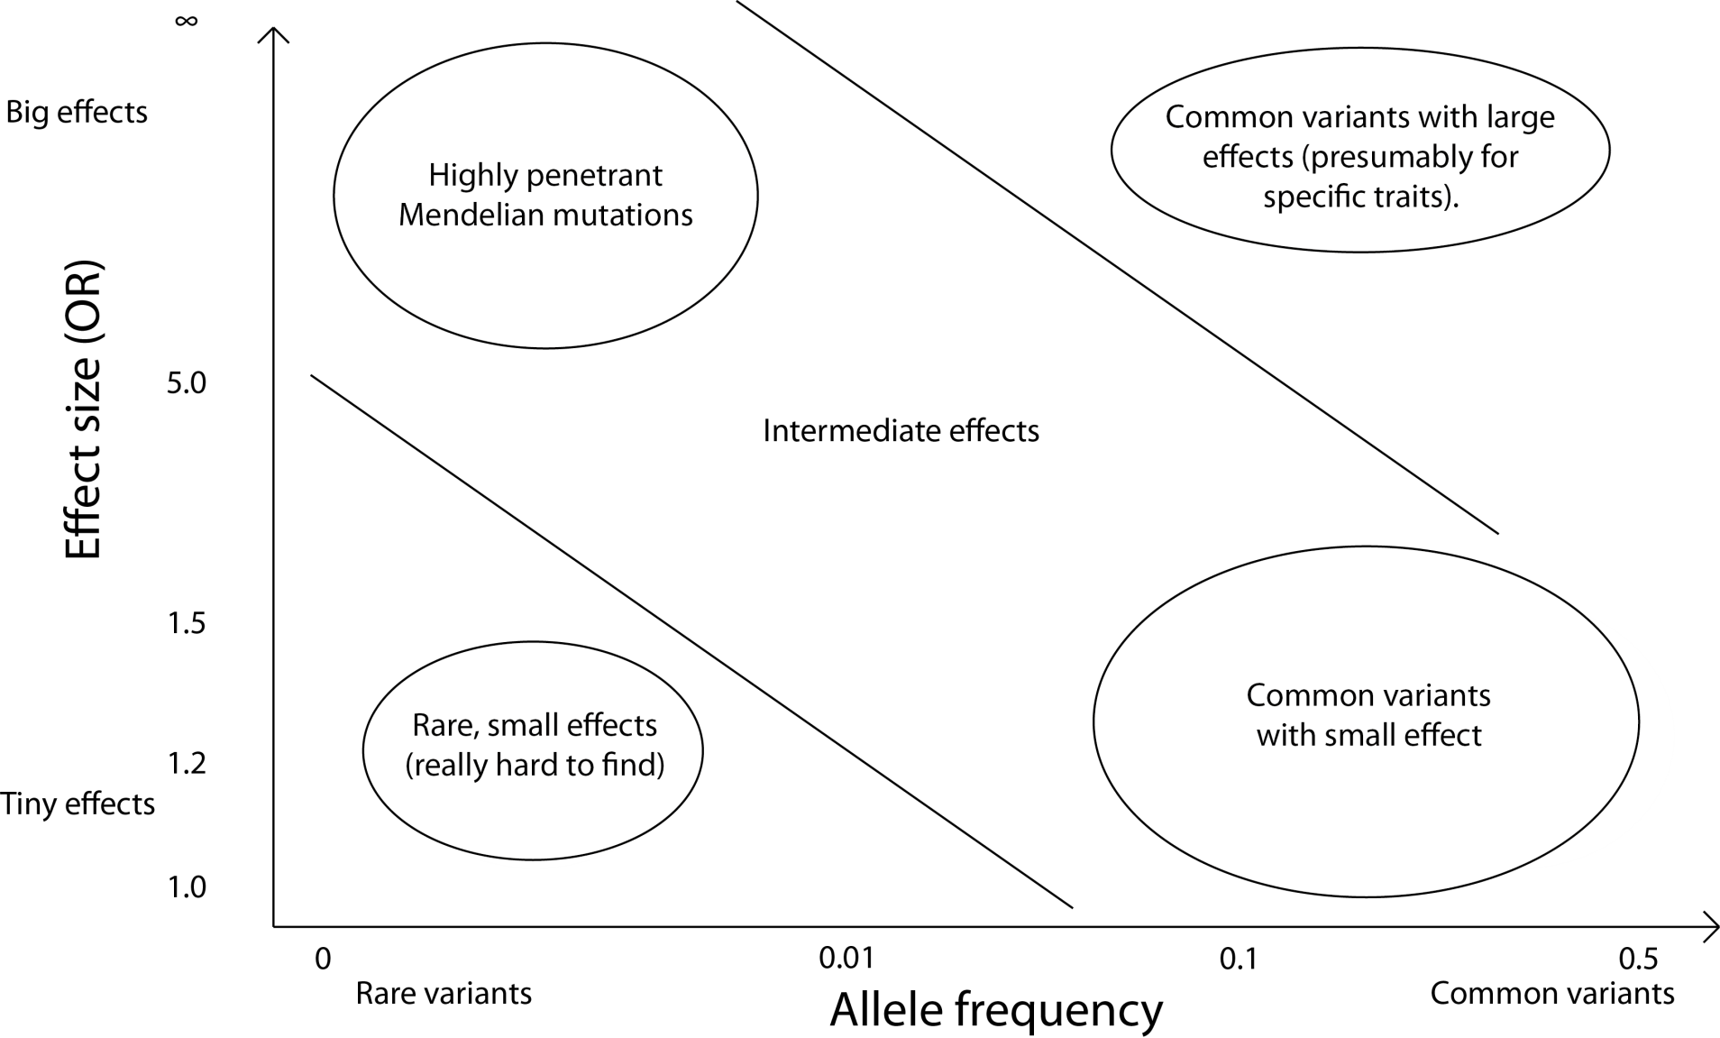


Complex diseases
Relative risk =
$$P( \text{disease} | \text{carry} \text{risk} \text{allele} )$$
$$P( \text{disease} | \text{don}\text{’}\text{t} \text{carry} \text{the} \text{risk} \text{allele} )$$
Unlikely to be found
Mendelian disease
5
Rare-ish, intermediate effects
Effect size (RR)
1.5
Common variants with small effects
1.2
Hard to find
Population frequency
<1%
50%

Slide 16
Complex diseases
Relative risk =
$$P( \text{disease} | \text{carry} \text{risk} \text{allele} )$$
$$P( \text{disease} | \text{don}\text{’}\text{t} \text{carry} \text{the} \text{risk} \text{allele} )$$
Unlikely to be found
Mendelian disease
5
Rare-ish, intermediate effects
Effect size (RR)
1.5
Common variants with small effects
1.2
Hard to find
Population frequency
<1%
50%
GWAS studies look for common genetic variants with small relative risks (say RR < 1.5 or lower).

Slide 17
The GWAS design
Mutation arises
Gets passed on through many generations
Time
Still carries a little bit of its original haplotype, broken up by recombination
=> Causal mutation will be still be correlated with those near it.

Slide 18
The GWAS design
Mutation arises
Gets passed on through many generations
Time
Still carries a little bit of its original haplotype, broken up by recombination
genotyped marker variants
=> Causal mutation will be still be correlated with those near it.
If we could type enough markers, we could access it

Slide 19
GWAS in practice
1. Collect large numbers of case individuals (ideally tens of thousands)
2. Collect large numbers of controls (perhaps randomly from the population).
(3. Get consent)
4. Extract DNA.
5. Genotype individuals at lots and lots of marker variants
6. Throw away data – poor quality samples, poorly genotyped SNPs...
7. At each SNP do a test for allele frequency difference between cases and controls (chi-squared, logistic regression)
8. Look for statistical evidence of association (how strong)?

Slide 20
Association mapping
Cases (D)
Chromosomes
Controls (U)
1. Collect a set of unrelated affected individuals (cases) and unaffected individuals (controls).

Slide 21
Association mapping
Cases (D)
Chromosomes
Controls (U)
Red variant is what we’re looking for – e.g. in this toy example,
P(D|red)
P(red|D) P(not red)
RR =
=
=
5/6 * 5/6 / (1/6)*(1/6) = 25
P(D|not red)
P(not red|D) P(red)
So real effects, e.g. RR<1.5, are much more subtle than this!

Slide 22
Association mapping
Cases (D)
Controls (U)
*
*
*
2. Genotype millions of genetic markers, distributed densely across the genome

Slide 23
Association mapping
Cases (D)
Controls (U)
*
*
*
3. Rely on correlations (or LD) between typed markers and the causal mutations, generated by genetic drift.

Slide 24
Association mapping
e.g in our toy example
 | Not white | white
cases | 5 | 1
controls | 2 | 4
Frequency
1/6
2/3
=> Estimate RR=10 at this marker SNP.
Perform statistical test to test for evidence of difference in allele frequencies between cases and controls.
(In this toy example P=0.24 so not enough data even to detect this strong effect.)
P-value < (a stringent threshhold) => success!

Slide 25
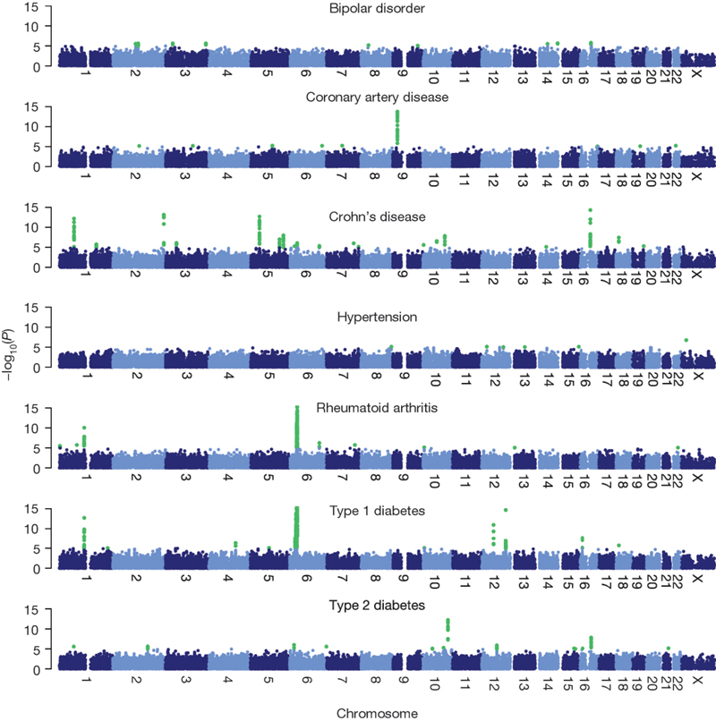
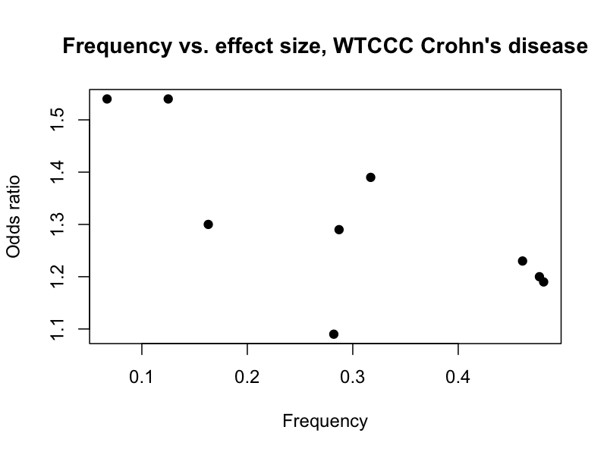

Genome‐wide association (GWA) analysis in a nutshell
Amazingly, it works! E.g: 2,000 cases and 3,000 controls typed at 500k variants:
$$−\log_{10}(P\text{−}\text{value})⁡$$
“Genome-wide association study of 14,000 cases of seven common diseases and 3,000 shared controls”
The Wellcome Trust Case Control Consortium Nature 447 (2007)

Slide 26
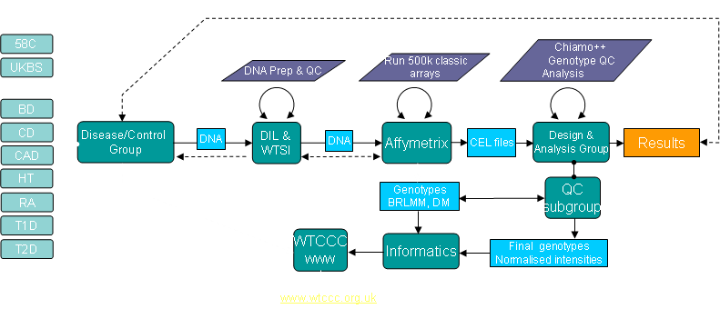
A real study (WTCCC)

Slide 27
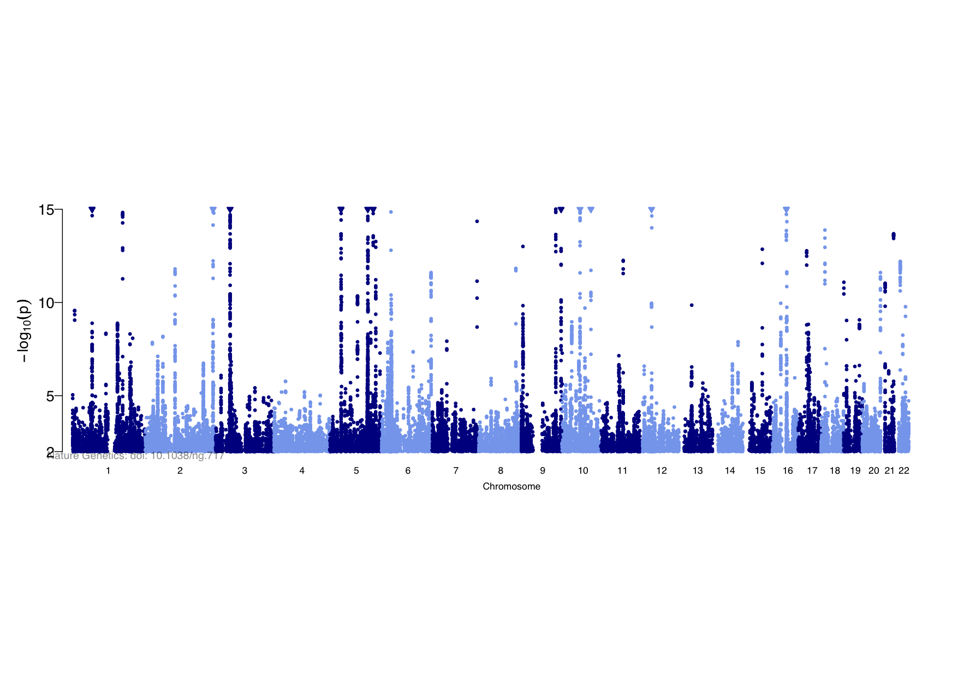
Genome‐wide association (GWAS) analysis in a nutshell
Amazingly, it works! E.g: 2,000 cases and 3,000 controls typed at 500k variants:
With 6,000 cases and 15,000 controls imputed to 1 million variants:
“Genome-wide meta-analysis increases to 71 the number of confirmed Crohn's disease susceptibility loci”, Franke et al Nature Genetics 42 (2010)

Slide 28
Genome‐wide association (GWA) analysis in a nutshell
Amazingly, it works! E.g: 2,000 cases and 3,000 controls typed at 500k variants:
Different diseases have different architectures:
“Genome-wide association study of 14,000 cases of seven common diseases and 3,000 shared controls”
The Wellcome Trust Case Control Consortium Nature 447 (2007)

Slide 29
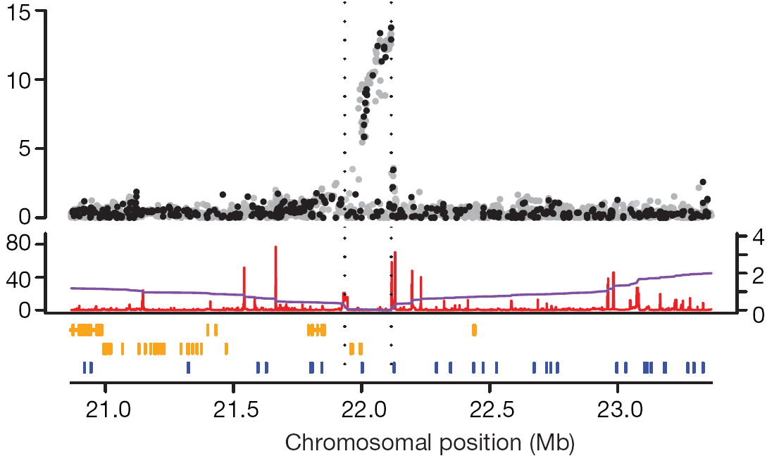
Wellcome Trust Case Control Consortium
rs1333049
P = 1.8x10⁻¹⁴
Discovery of a
common genetic
variant that affects
risk of coronary
artery disease
CDKN2A
CDKN2B
Chromosome 9
Best SNP marker was rs1333049
• OR ~ 1.47: one copy of the risk allele (present in half the population) increases “risk” of coronary artery disease by ~50%
• two copies of risk allele (present in quarter of population)
almost doubles “risk” of coronary artery disease

Slide 30
Example
The UK Biobank has typed ~500,000 individuals on the Affymetrix UK Biobank array (containing ~800k SNPs).
This array might now cost ~£20 per sample. So this project would cost in the order of £10,000,000 for genotyping.

Slide 31
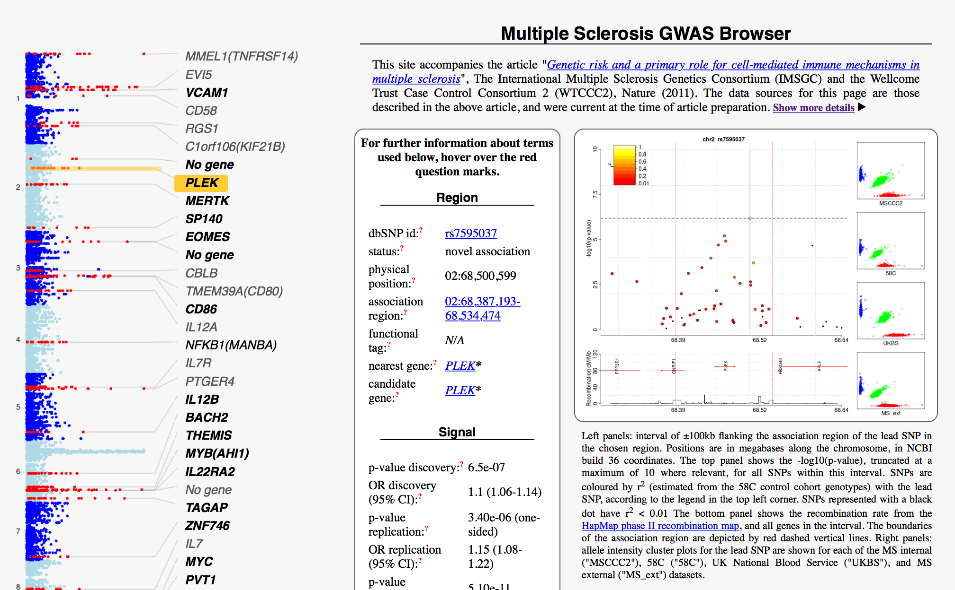
It works!
www.well.ox.ac.uk/wtccc2/ms/
Study of multiple sclerosis (2011)
9772 cases, 17,376 controls from across Europe

Slide 32
Two common problems
Poor quality genotyping
Confounding (by population structure or ‘cryptic’ relatedness)

Slide 33
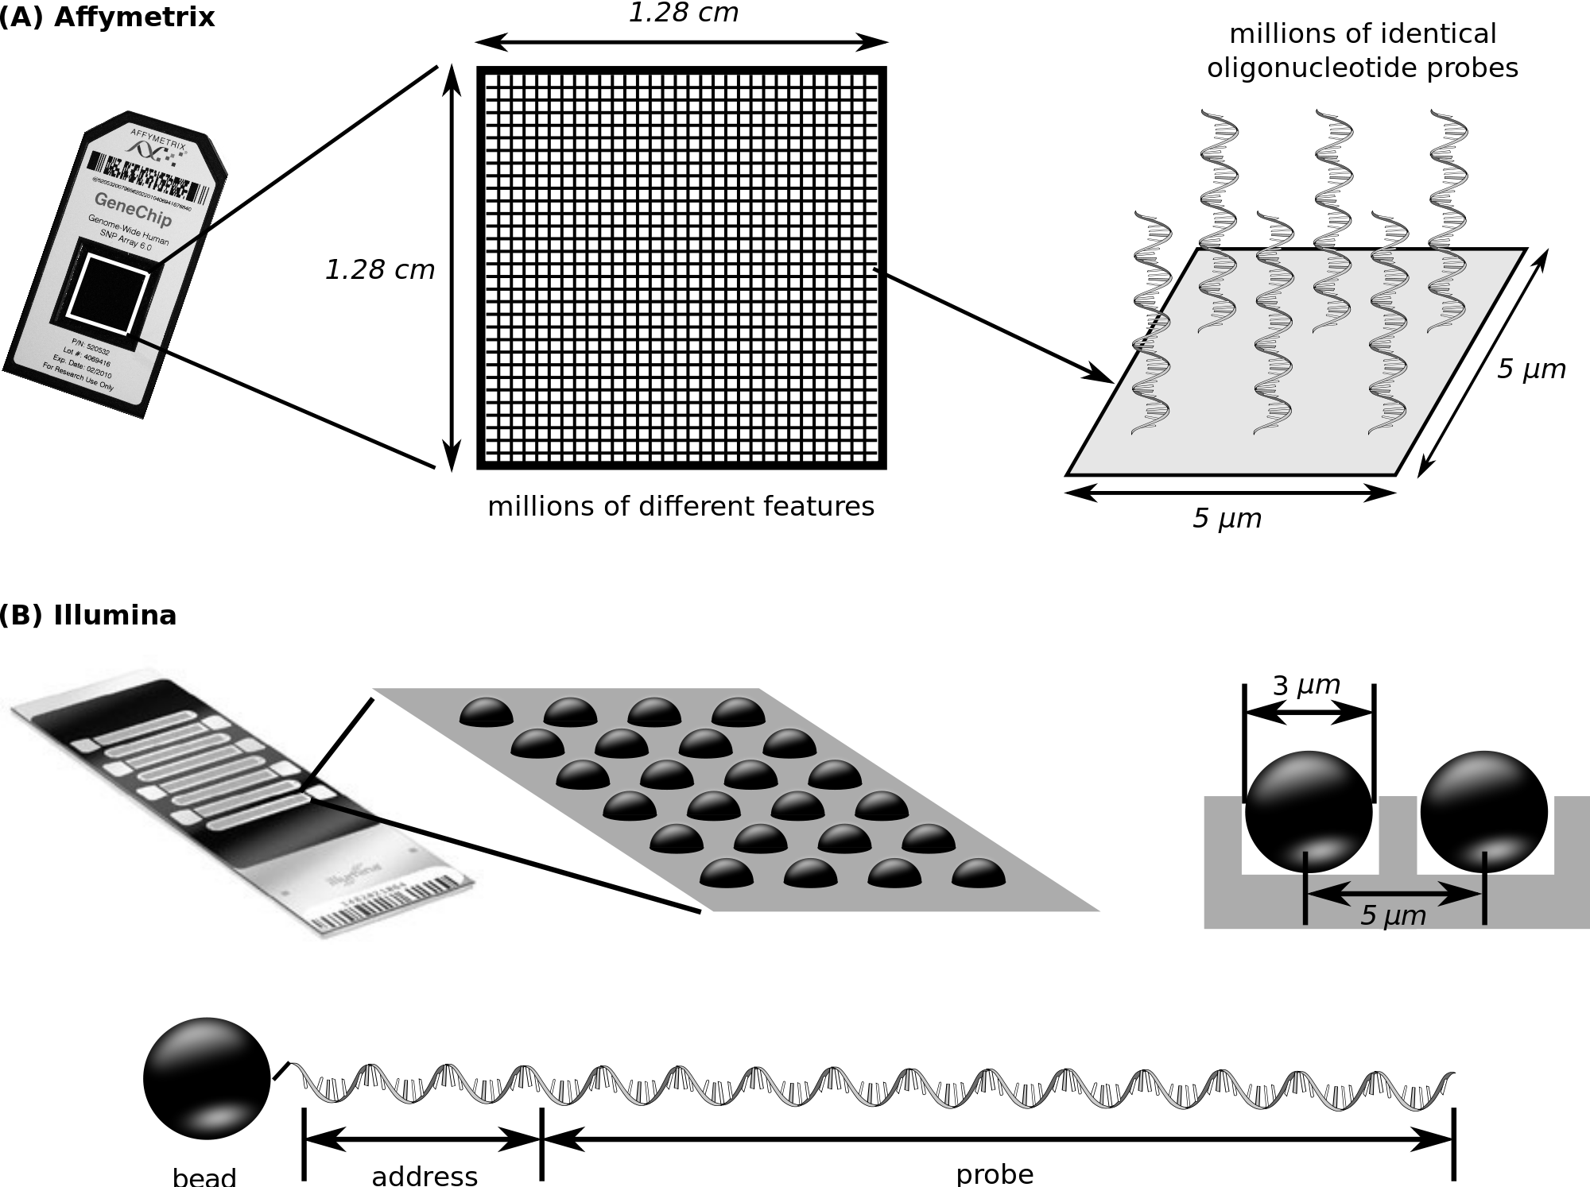
How a microarray works
Wash the DNA over and let it hybridise to millions of probes – one for each SNP
Flourescent markers are then attached. A picture is taken of the array.

Slide 34
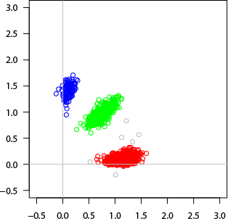
Genotyping
For each SNP, you get back this:
B/B
A/B
A/A
Each dot represents DNA from one individual.
X axis = image intensity for 1st allele probe
Y axis = image intensity for 2nd allele probe

Slide 35
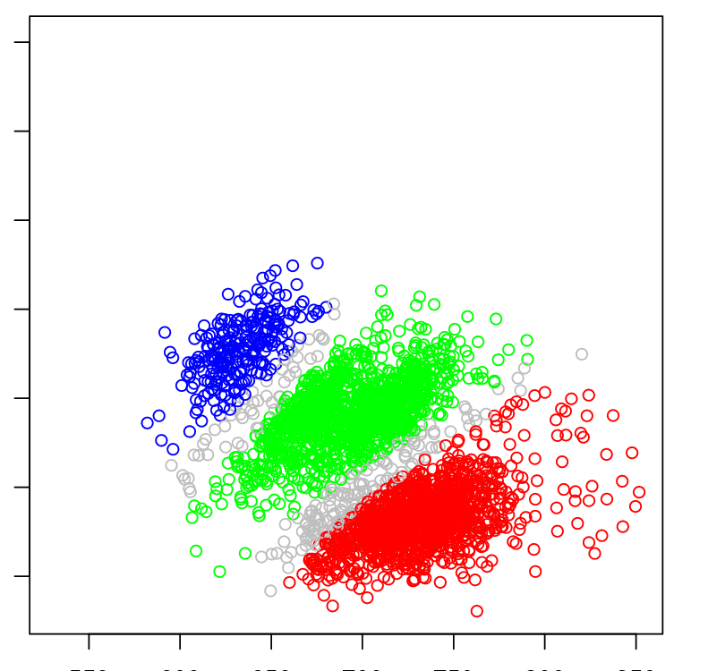
Genotyping problems…
For each SNP, you get back this:
Or this if you’re less lucky:
B/B
A/B
B/B?
?
A/B?
?
A/A
A/A?
Each dot represents DNA from one individual.
X axis = image intensity for 1st allele probe
Y axis = image intensity for 2nd allele probe
Careful QC is needed to weed these out.

Slide 36
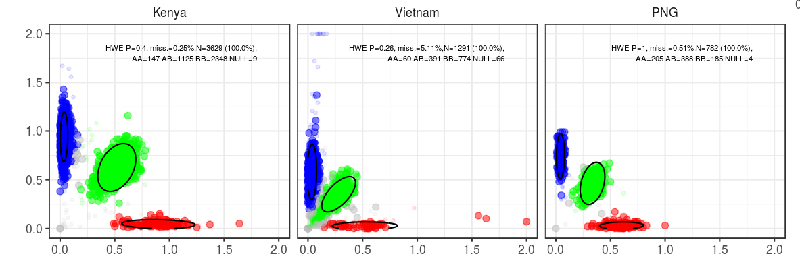
A real example
One SNP typed in samples from three populations
Millions of SNPs like this => requires careful analysis

Slide 37
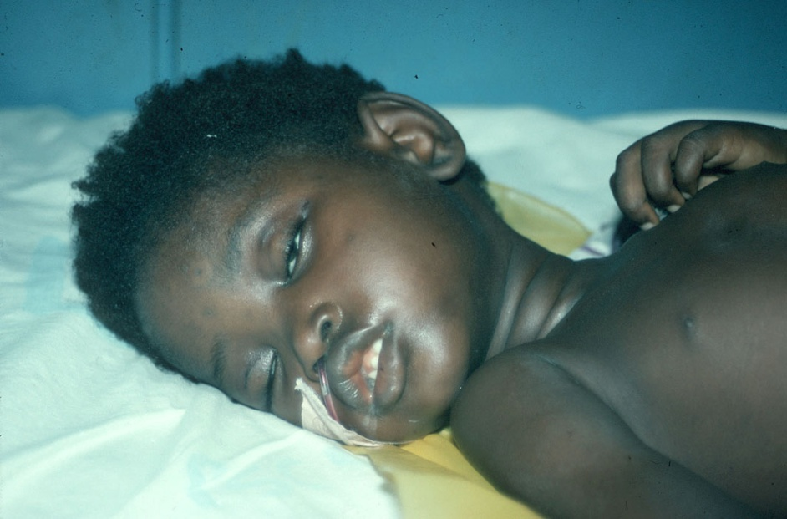

Recruitment of 13,000 cases of severe malaria
Cases and controls from:
Burkina Faso
Cameroon
Gambia
Ghana (Navrongo)
Ghana (Kumasi)
Kenya
Malawi
Mali
Nigeria
Papua New Guinea
Tanzania
Vietnam
Question: In communities where
every child is repeatedly infected
with malaria, why do some children die and not others?

Slide 38
Consistent effects despite phenotypic heterogeneity
O blood group effect in severe malaria
Country | Cases (O/total) | Cntls (O/total)
Gambia | 1000/2345 | 1664/3624
Mali | 130/445 | 143/336
Burkina Faso | 321/854 | 326/729
Ghana (Navrongo) | 263/674 | 227/556
Ghana (Kumasi) | 548/1480 | 992/1988
Nigeria | 27/78 | 24/40
Cameroon | 267/608 | 312/572
Kenya | 1061/2254 | 2131/3899
Tanzania | 189/423 | 221/455
Malawi | 615/1414 | 1298/2607
Vietnam | 272/788 | 1000/2517
Papua New Guinea | 139/385 | 76/239
All severe malaria | 4832/11948 | 8414/17652
Rockett et al. (2014) Nature Genetics 46: 1197
O blood group
Protective effect
of rs8176719 against severe malaria
P=10⁻³²
0.1 1 10
ODDS RATIO

Slide 39
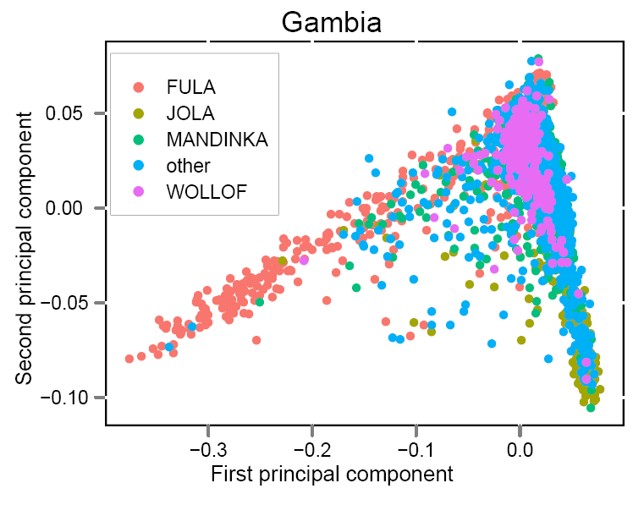

Importance of population structure
Principal components analysis
• Within a 40 sq mile area of
The Gambia we find
complex population structure
• Population structure can give rise to
false positive genetic associations
Jallow et al. (2009) Nature Genetics 41: 657

Slide 40
Importance of population structure
Subpopulation A
Subpopulation B
Cases
Cases
Controls
Controls
Genotype aa Aa AA

Slide 41
Importance of population structure
Subpopulation A
Subpopulation B
Cases
Cases
Controls
Controls
χ² = 2.1
(p = 0.34)
χ² = 16.3
(p <0.001)
χ² = 1.57
(p = 0.46)
Genotype aa Aa AA

Slide 42
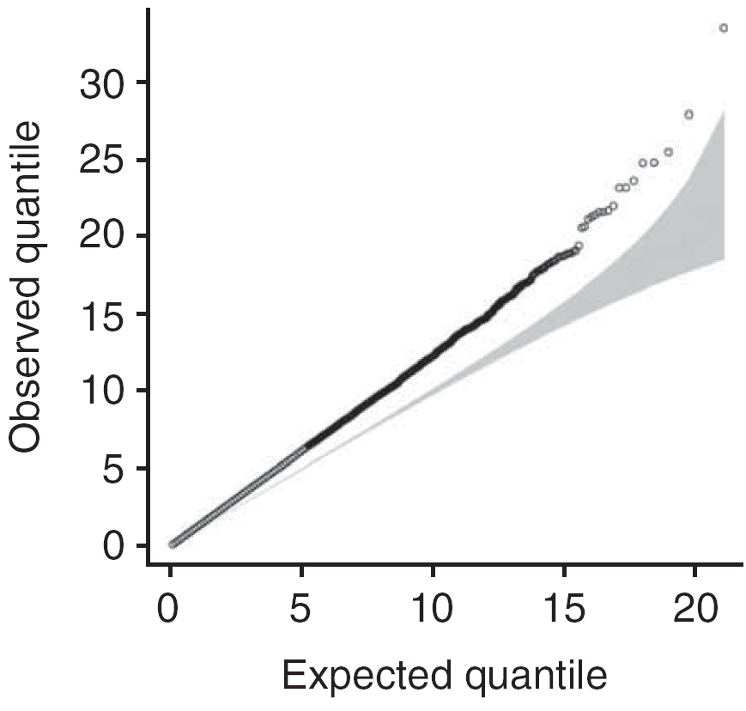
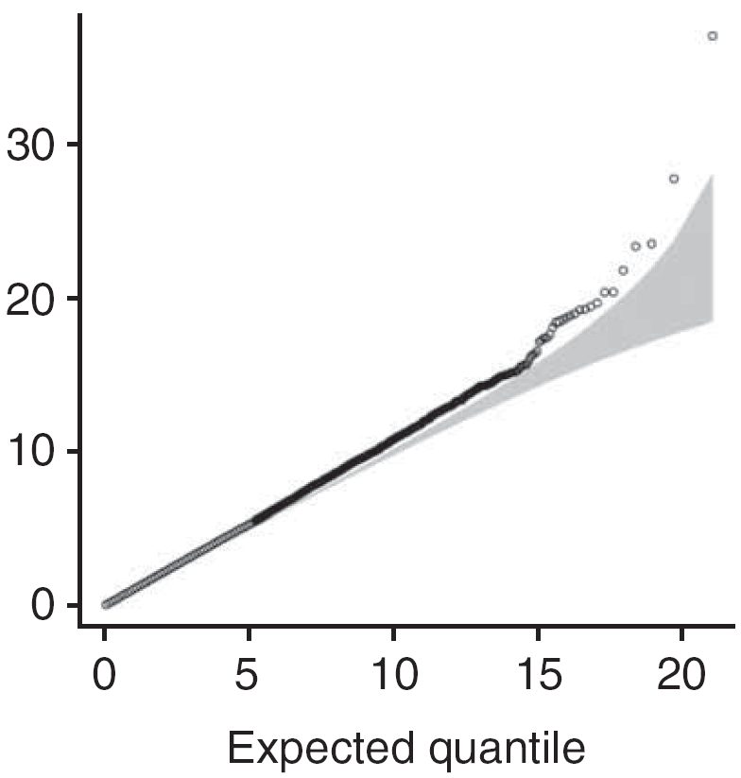
Importance of population structure
Quantile‐quantile plot of chi‐squared statistic comparing what
we observed versus what we’d expect if no disease association
Corrected by principal
components analysis
Uncorrected
Inflation factor
= 1.25
Inflation factor
= 1.03
Jallow et al. (2009) Nature Genetics 41: 657

Slide 43
Practicals
Principal components practical
GWAS practical
Practicals at:
https://github.com/whg-gms/statistics-course/blob/main/Introduction_to_GWAS/practicals/

