Slide 1
Malaria protection due to sickle haemoglobin depends on parasite genotype - but why?
Gavin Band
  Laboratory of malaria & vector research
  NIAID
  14th May 2024

Slide 2
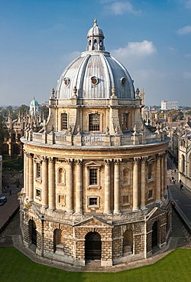
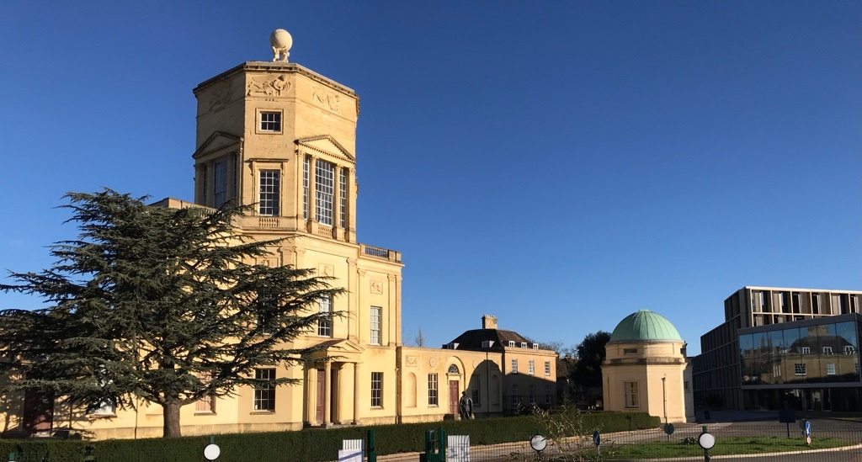
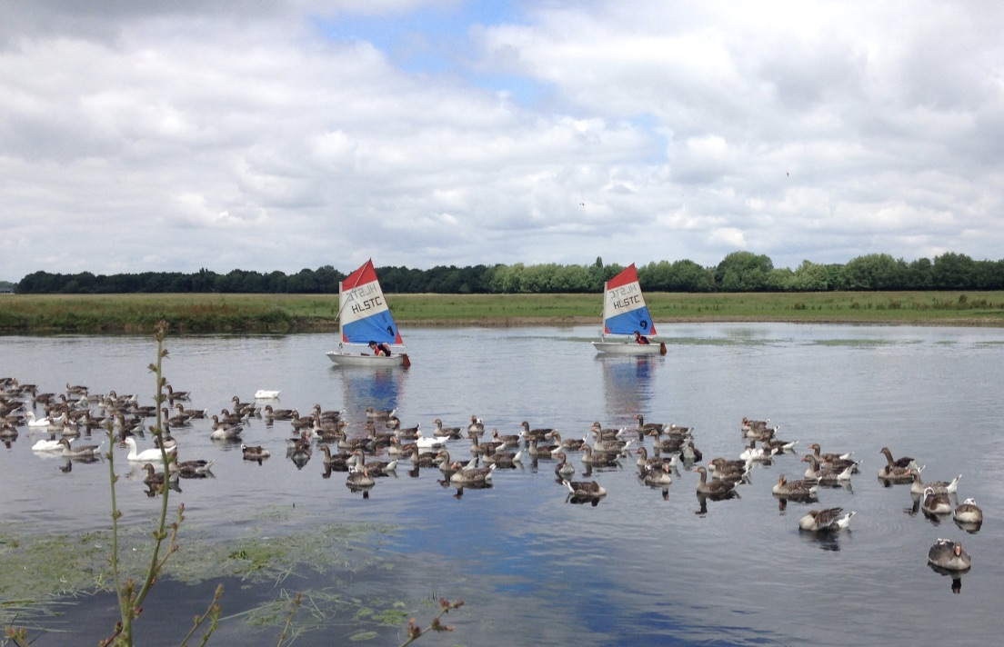
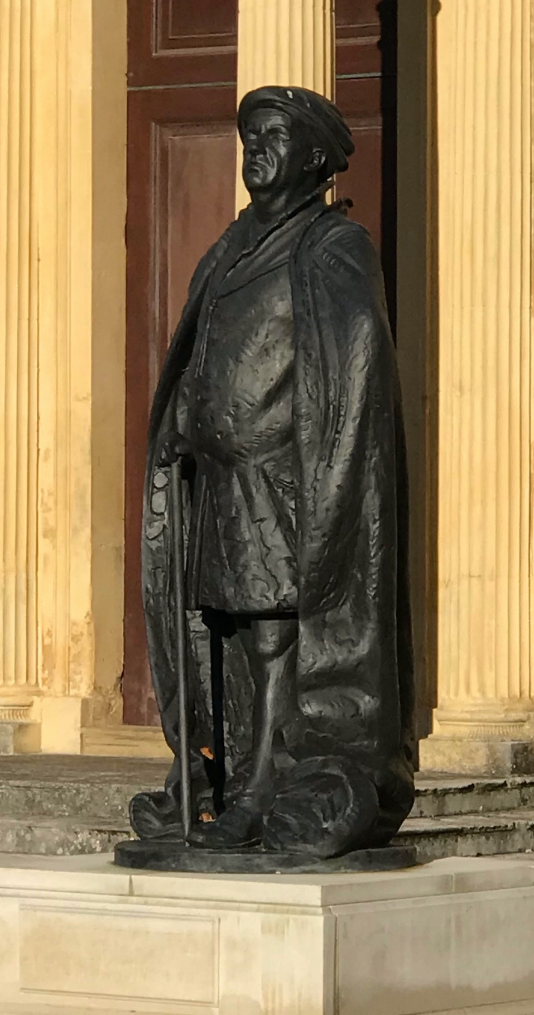
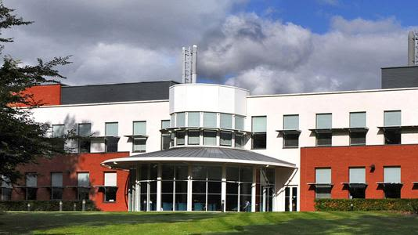


Oxford

Slide 3

HbS
ABO
ATP2B4
Dantu
Dominic
Kwiatkowski
1953-2023
GWAS of severe malaria susceptibility - MalariaGEN Nature Communications 2019

Slide 4
O blood type
frequency ~ 50%
RR ~ 0.75 (recessive)
Dantu blood type
frequency ~ 0-10%
RR ~ 0.6
(additive)
Sickle haemoglobin (HbS)
Frequency ~ 2-20%
RR ~ 0.1-0.2
(heterozygote)
ATP2B4 calcium pump variation
frequency ~ 50%
RR ~ 0.66
(recessive)
Allison Br Med. J. (1954)
Estimates from our GWAS of severe malaria susceptibility - MalariaGEN Nature Communications 2019

Slide 5
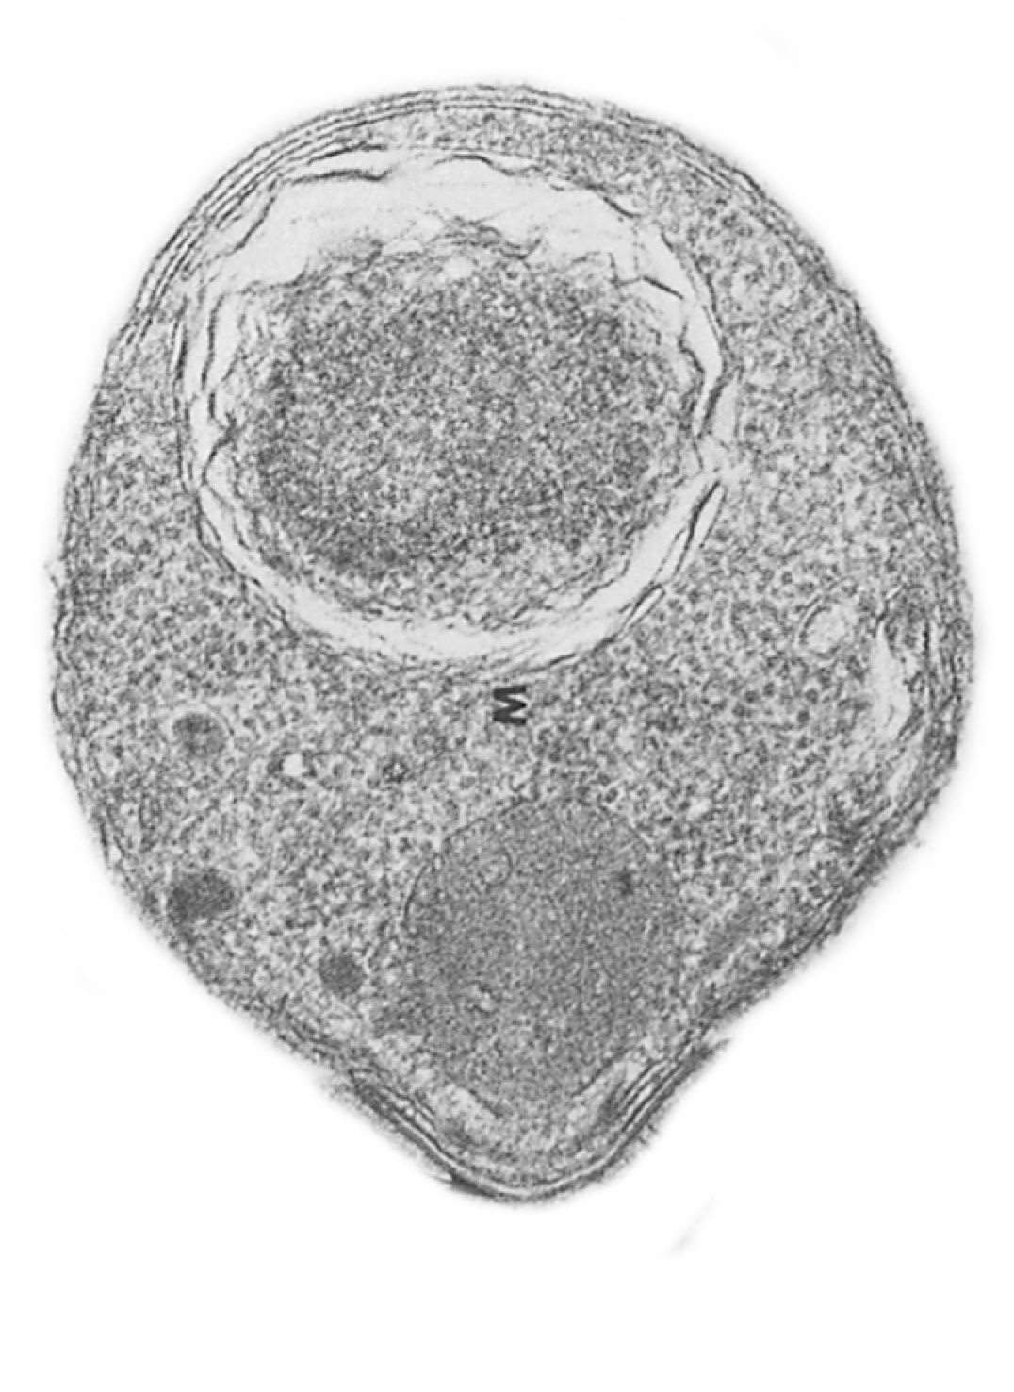
?
O blood type
Dantu blood type
Sickle haemoglobin (HbS)
P.falciparum
23Mb genome
>5,000 genes
millions of variants
ATP2B4 calcium pump variation
Parasite image: Miller et al J. Exp. Med. 1979 (with apologies!)

Slide 6
?
O blood type
Dantu blood type
Sickle haemoglobin (HbS)
P.falciparum
23Mb genome
>5,000 genes
millions of variants
ATP2B4 calcium pump variation
Have parasite populations adapted?
(And is this detectable in current populations?)

Slide 7
Talk outline
Malaria protection due to sickle haemoglobin depends on parasite genotype
Pfsa population genetics
Pfsa biology

Slide 8




Investigating human-parasite genetic interaction in severe malaria cases
Plan of our analysis:
Sequence the P.falciparum genome in severe malaria cases selected from our previously published human GWAS*
Test for association between human and parasite genetic variants
*MalariaGEN human GWAS, Nature Communications 2019

Slide 9
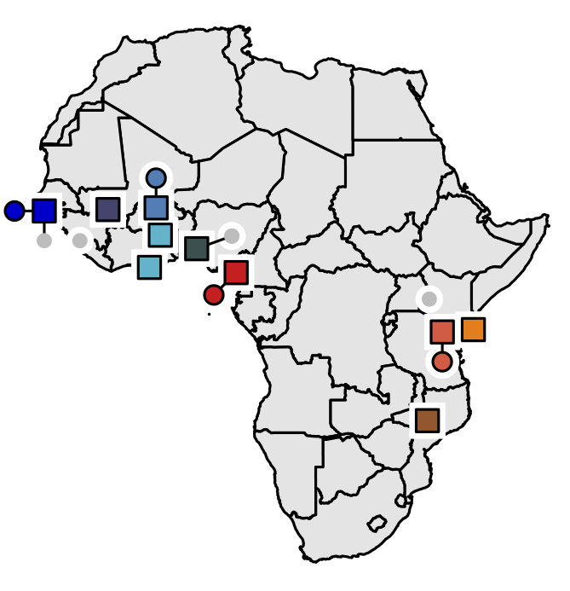
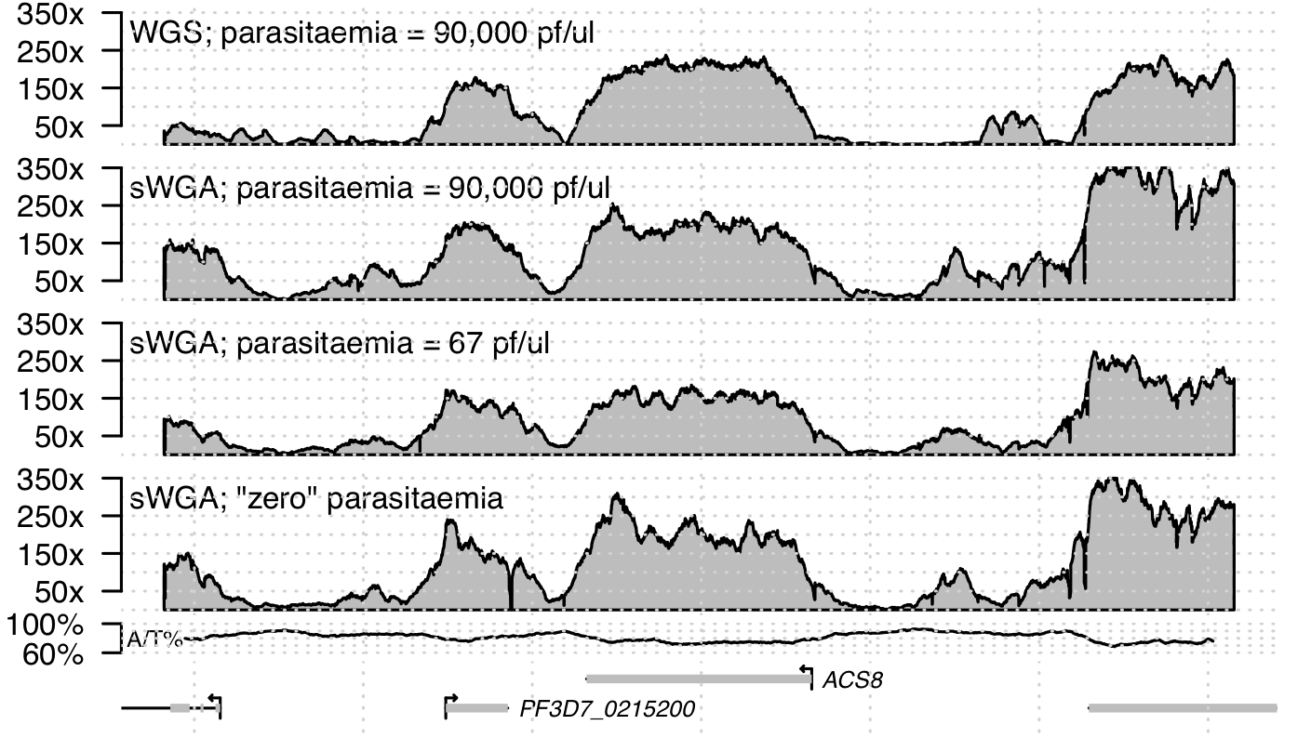
Investigating human-parasite genetic interaction in severe malaria cases
Sequence the P.falciparum genome in severe malaria cases from the published human GWAS
Banjul, The Gambia
N = 2,721
Kilifi, Kenya
N = 2,375
Collected in 1995-2009
Variant calling and quality control
Previously generated human genome-wide genotypes and imputation
Overlap with human data
N = 3,346 samples

Slide 10


2. Test for association pairwise between human and Pf variants
using a simple logistic regression framework:
$g_{\text{Pf}}\text{ \sim }g_{\text{human}}$ + country
Software at: www.well.ox.ac.uk/~gav/hptest
Focus on candidates:
Known protective mutations
Further putative associations
Blood group gene variants
HLA alleles
Focus on ‘easy’ parts:
Biallelic variants in core genome
Seen in at least 25 infections across the sample.
51,552 variants in total
(…excludes multiallelics and complex regions)

Slide 11
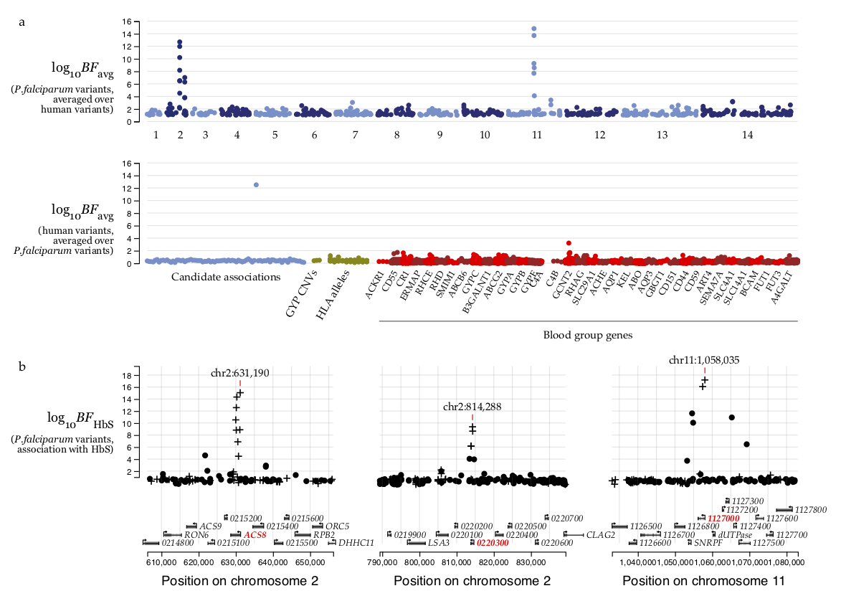
Three regions of the Pf genome are associated…
Evidence for association
for P.falciparum variants
(averaged over human variants)
P.falciparum genetic variants

Slide 12
Three regions of the Pf genome are associated with…
Evidence for association
for P.falciparum variants
(averaged over human variants)
Evidence for association
for human variants
(averaged over Pf variants)

Slide 13
Three regions of the Pf genome are associated with HbS
Pfsa1
Pfsa3
Evidence for association
for P.falciparum variants
(averaged over human variants)
Pfsa2
Evidence for association
for human variants
(averaged over Pf variants)
Sickle haemoglobin (HbS)
“Plasmodium falciparum sickle-associated”

Slide 14
Three regions of the Pf genome are associated with HbS
Pfsa1
Pfsa3
Evidence for association
for P.falciparum variants
(averaged over human variants)
Pfsa2
Evidence for association
for human variants
(averaged over Pf variants)
Sickle haemoglobin (HbS)
Pfsa1
Pfsa2
Pfsa3
Evidence for association
for P.falciparum variants
with HbS
Zoom in to Pf genome:

Slide 15
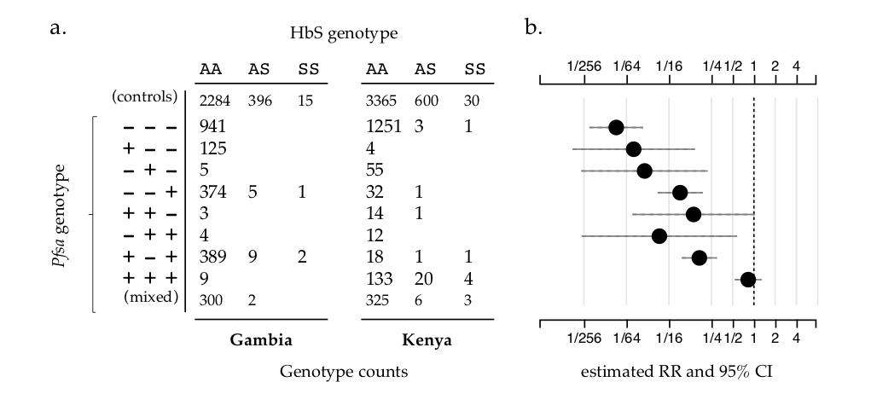

The protective effect of HbS varies with Pfsa genotype
Sample counts
$N=4,071$ severe malaria cases
Pfsa3
Pfsa2
Pfsa1
Pfsa genotype
- = reference allele
+ = HbS-associated allele
45 of 49 severe infections of individuals with HbS genotypes
were with Pfsa+ parasites

Slide 16




The protective effect of HbS varies with Pfsa genotype
Sample counts
Relative risk of HbS
by Pfsa genotype
Pfsa3
Pfsa2
Pfsa1
Population controls
$$RR=0.012$$
Pfsa genotype
- = reference allele
+ = HbS-associated allele
$RR=0.0$9
$$RR=0.17$$
$$RR=0.83$$
Pfsa+ parasites may have overcome HbS protection
https://doi.org/10.1038/s41586-021-04288-3
+ caveats!
Notes:
6:30 to here

Slide 17
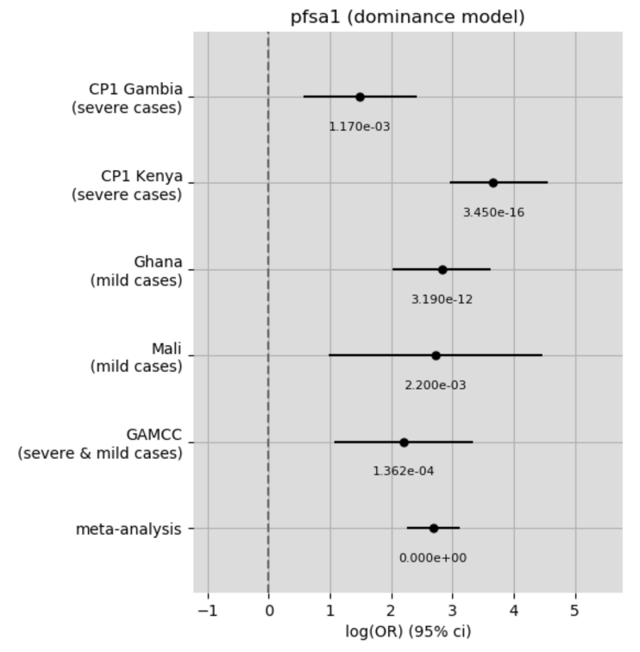
Replication across contexts
Pfsa1
Gambia severe
AS/SS=17 AA=1850
Original study
Kenya severe
AS/SS=32 AA=1519
None
10-fold
100-fold
Fold change in HbS protective effect

Slide 18
Replication across contexts
Pfsa1
Gambia severe
AS/SS=17 AA=1850
Original study
Kenya severe
AS/SS=32 AA=1519
Mali (mild)
AS=16 AA=16
Joseph Saelens, Mahamadou Diakité, Steve M. Taylor mSphere 2021
Mali
N = 32
None
10-fold
100-fold
Fold change in HbS protective effect

Slide 19
Replication across contexts
Pfsa1
Gambia severe
AS/SS=17 AA=1850
Original study
Kenya severe
AS/SS=32 AA=1519
Mali (mild)
AS=16 AA=16
Joseph Saelens, Mahamadou Diakité, Steve M. Taylor mSphere 2021
Mali
N = 32
Ghana (mild)
AS/SS=31 AA = 1,008
Ghana
N = 1,368
Lucas Amenga-Etego, Will Hamilton bioRxiv 2023
None
10-fold
100-fold
Fold change in HbS protective effect

Slide 20
Replication across contexts
Pfsa1
Gambia severe
AS/SS=17 AA=1850
Original study
Kenya severe
AS/SS=32 AA=1519
Mali (mild)
AS=16 AA=16
Joseph Saelens, Mahamadou Diakité, Steve M. Taylor mSphere 2021
Mali
N = 32
Ghana (mild)
AS/SS=31 AA = 1,008
Ghana
N = 1,368
Lucas Amenga-Etego, Will Hamilton bioRxiv 2023
Gambia
(severe + mild)
AS/SS=14 AA=800
Annie Forster, Alfred Amambua-Ngwa, unpublished
None
10-fold
100-fold

Slide 21
Three regions of the Pf genome are associated with HbS
Pfsa1
Pfsa3
Pfsa2
Original study
Will Hamilton, … Lucas Amenga-Etego bioRxiv. doi.org/10.1101/2023.09.14.557461

Slide 22
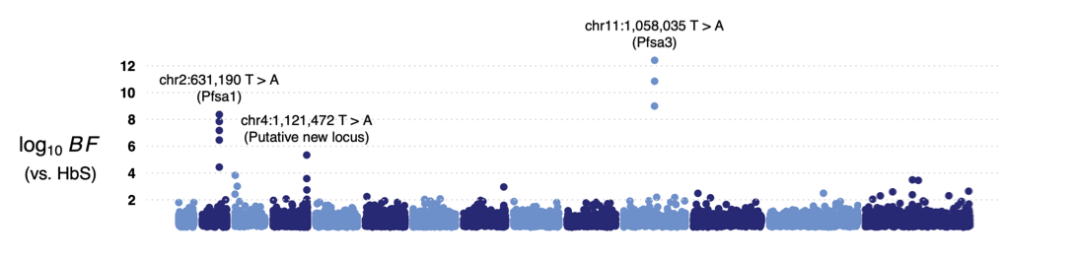
Three Four regions of the Pf genome are associated with HbS
Pfsa1
Pfsa3
Pfsa2
Original study
Pfsa3
New study in Ghana
Pfsa1
Will Hamilton, … Lucas Amenga-Etego bioRxiv. doi.org/10.1101/2023.09.14.557461

Slide 23
Three Four regions of the Pf genome are associated with HbS
Pfsa1
Pfsa3
Pfsa2
Original study
Pfsa3
New study in Ghana
Pfsa1
No sign of Pfsa2!
Will Hamilton, … Lucas Amenga-Etego bioRxiv. doi.org/10.1101/2023.09.14.557461

Slide 24
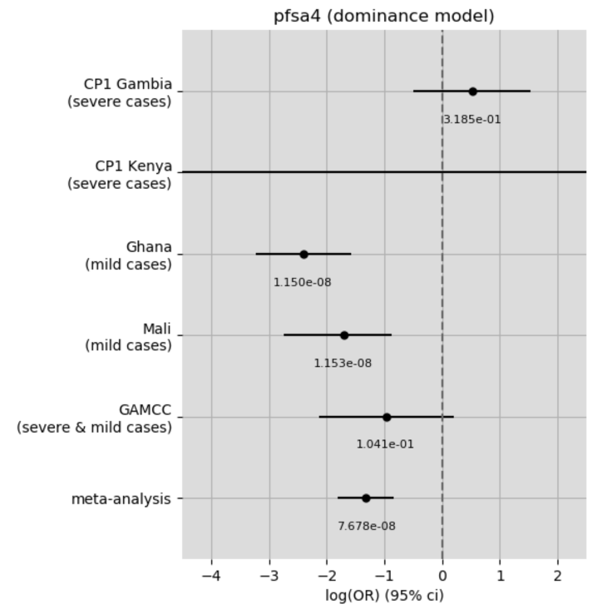
Three Four regions of the Pf genome are associated with HbS
Pfsa1
Pfsa3
Pfsa2
Original study
Pfsa3
Instead there is a
new locus
(Pfsa4)
Ghana (mild)
AS/SS=31 AA = 1,008
New study in Ghana
Pfsa1
Mali (mild)
AS=16 AA=16
1
10
Gambia
(severe + mild)
AS/SS=14 AA=800
Gambia
100-fold
10-fold
None
Fold change in HbS protective effect
Will Hamilton, … Lucas Amenga-Etego bioRxiv. doi.org/10.1101/2023.09.14.557461

Slide 25
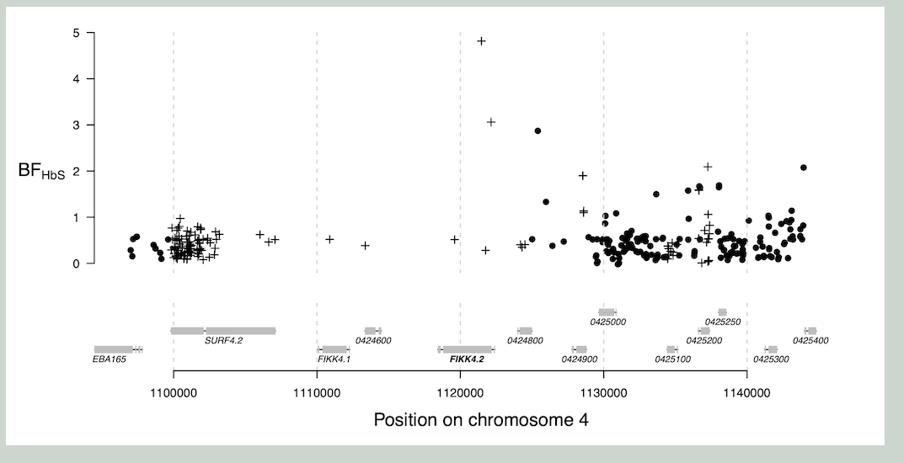
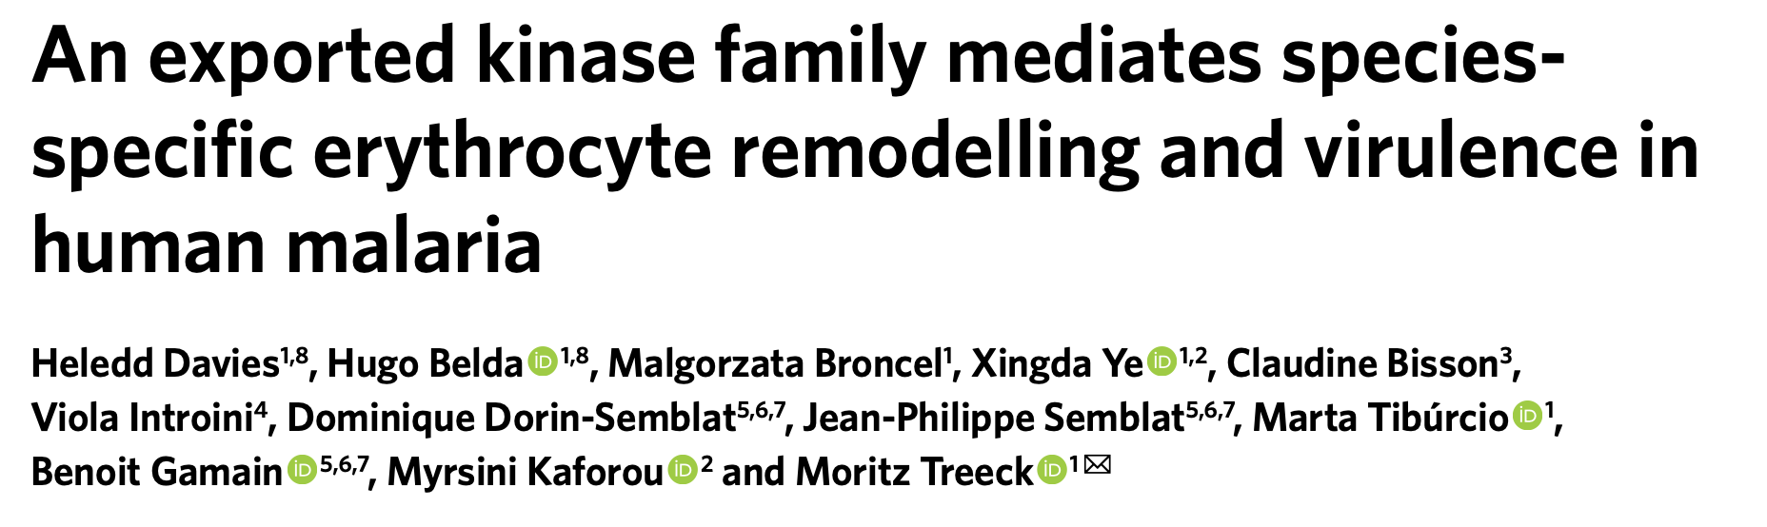
Pfsa4 (chr4)
FIKK4.1
FIKK4.2
There is lots of work on FIKKs e.g. Davies et al 2020

Slide 26
Pfsa1 (chr2)
Pfsa2 (chr2)
Pfsa3 (chr11)
Pfsa4 (chr4)
FIKK4.1
FIKK4.2
Pfsa
Four regions of the Pf genome are associated with sickle
Four genes: PfACS8, 0020300, FIKK4.2, 1127000, are implicated
Almost all infections of HbAS/HbSS individuals carry these mutations
But there’s also complicated variation across populations.

Slide 27
Talk outline
Malaria protection due to sickle haemoglobin depends on parasite genotype
Pfsa population genetics
Pfsa biology

Slide 28
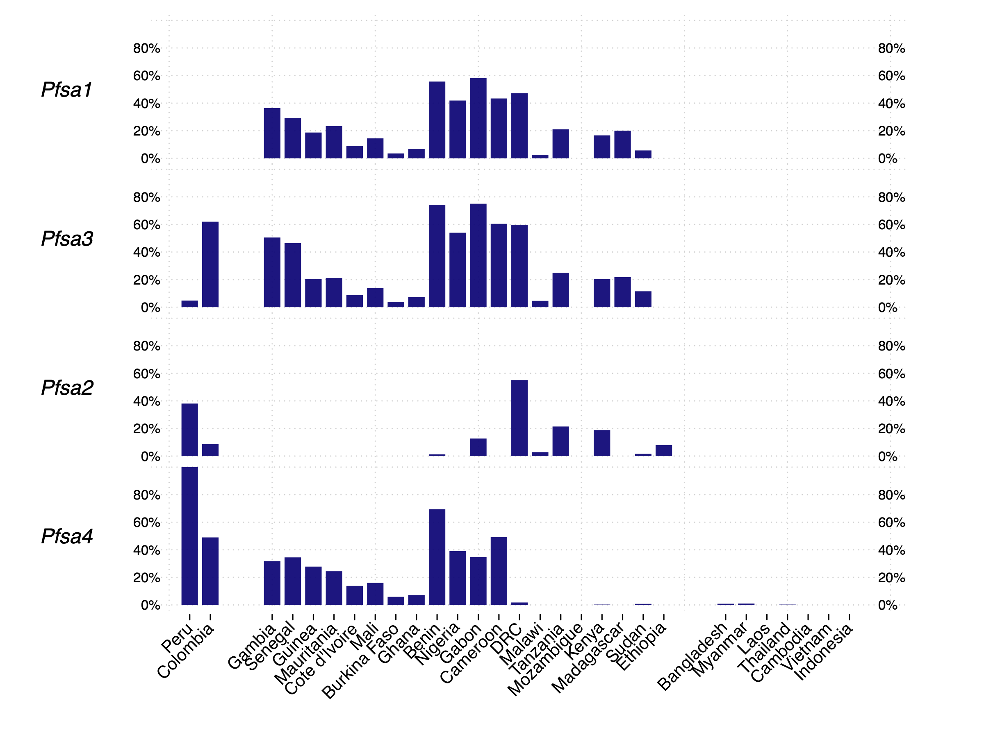
Pfsa1
Widely varying frequencies in Africa
Up to 75% frequency in some populations
Pfsa3
Not present in Asia!
west Africa
east Africa
Asia
Pfsa global frequencies
MalariaGEN Pf7
(MalariaGEN Wellcome Open 2023)

Slide 29
Pfsa1
Pfsa3
Pfsa2 is only present in eastern Africa…
Pfsa2
west Africa
east Africa
Asia

Slide 30
Pfsa1
Pfsa3
Pfsa2
…but Pfsa4 is only present in western Africa!
Pfsa4
west Africa
east Africa
Asia

Slide 31
Pfsa1
Pfsa3
Pfsa2
Also observed in Peru and Columbia
Pfsa4
S.America
west Africa
east Africa
Asia

Slide 32
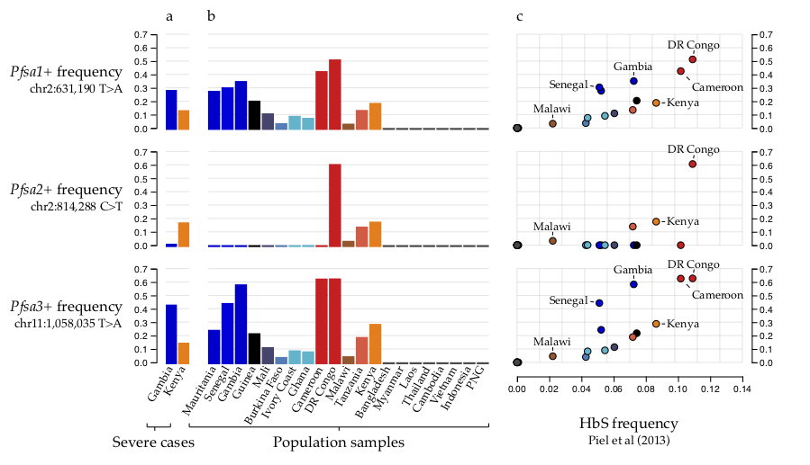
Pfsa+ frequencies are explained by HbS
(HbS data from the Malaria Atlas Project - Piel et al Lancet 2013)

Slide 33
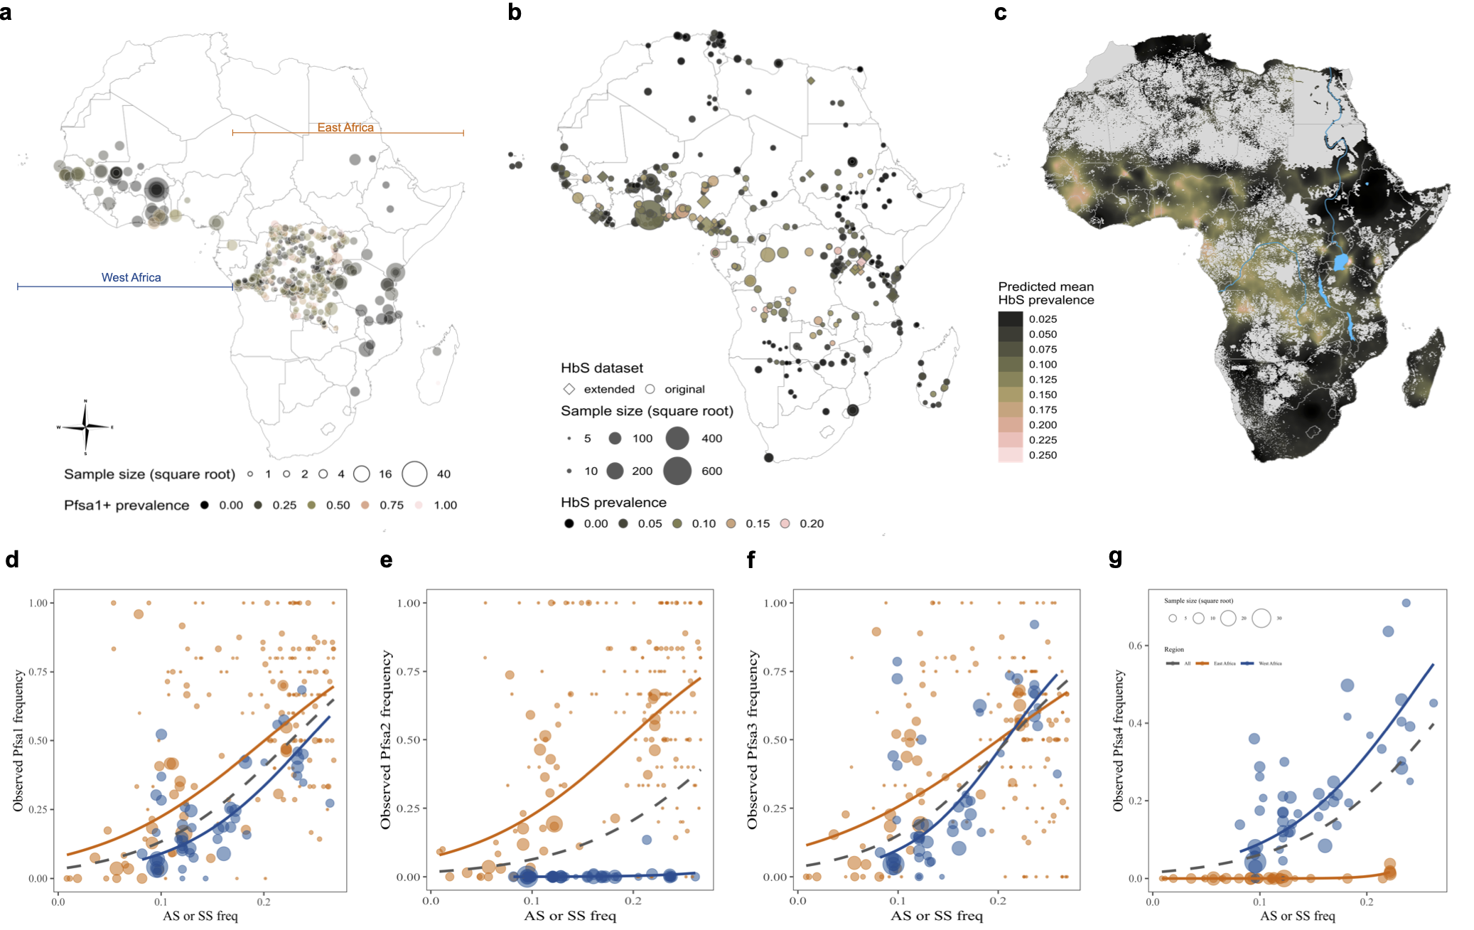
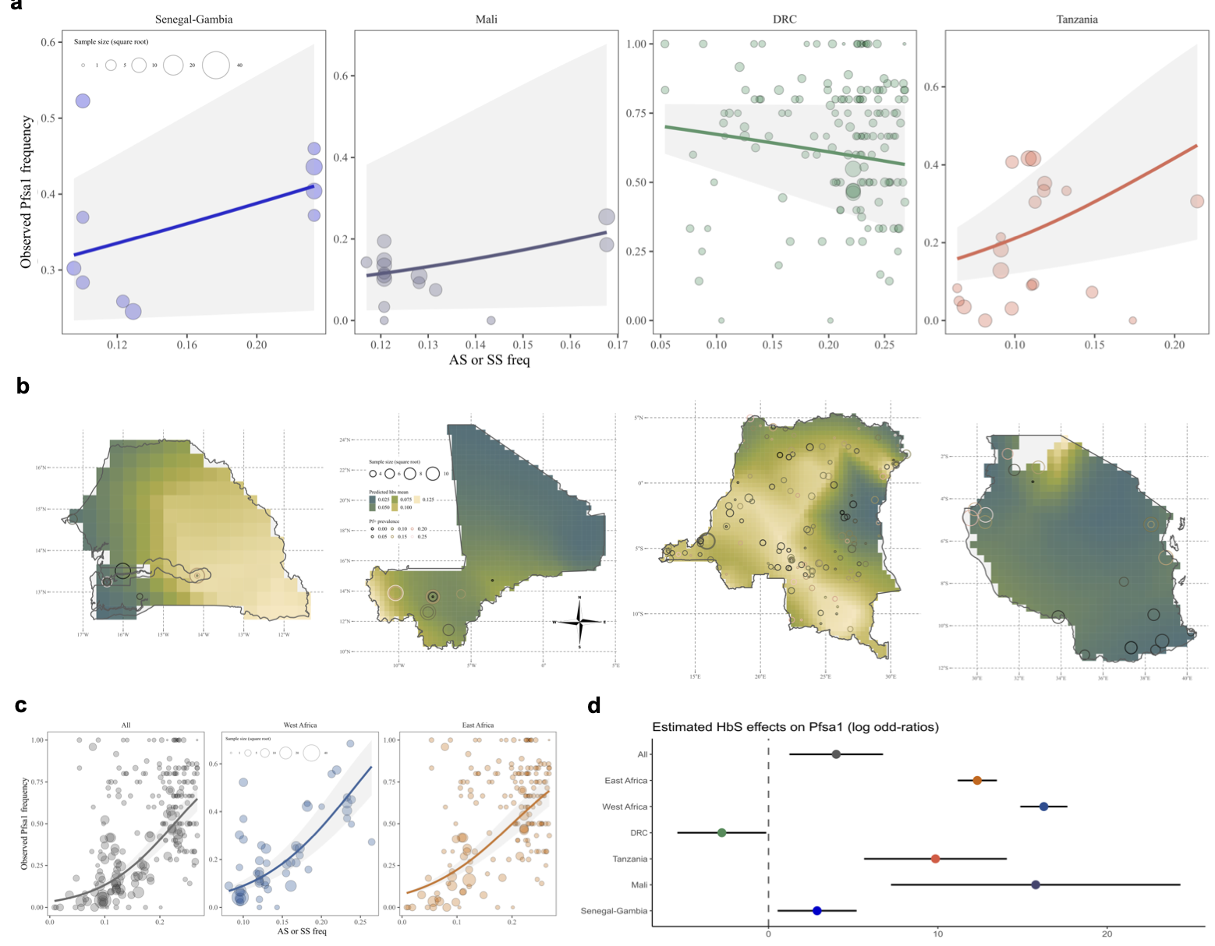
+
=
Pfsa1+ frequency
All the HbS allele frequency data
That exists across Africa
All the Pf allele frequency data
we could gather across Africa
HbAS/HbSS frequency
Estimate the relationship at local scales

Slide 34

+
=
Pfsa1+ frequency
All the HbS allele frequency data
That exists across Africa
All the Pf allele frequency data
we could gather across Africa
HbAS/HbSS frequency
Analysis by Andre Python
(Zheijiang University)
Thanks to: MalariaGEN, Jeffrey Bailey, Robert Verity, Deus Ishengoma for data
Estimate the relationship at local scales
Verity et al 2021 (DRC data)
Moser et al 2021 (Tanzania data)

Slide 35
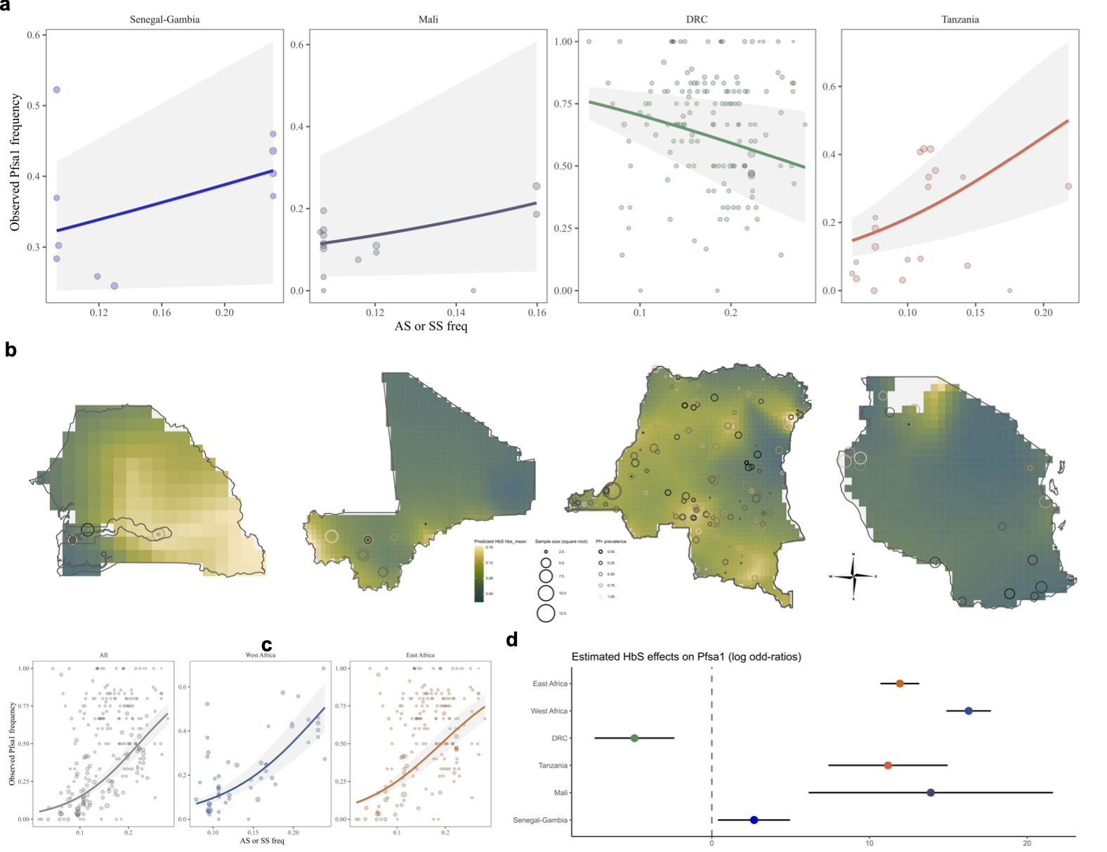
Africa
14.8 (13.9-15.7)
East
all Africa
West
DRC
Tanzania
100%
Pfsa1+ frequency
Mali
Gambia /
Senegal
Pfsa1+ frequency
-5
0
5
10
15
20
Estimated HbS-Pfsa relationship
0%
0%
10%
20%
HbAS/SS freq

Slide 36
Africa
East
East Africa only
(including DRC)
West
DRC
Tanzania
100%
Pfsa1+ frequency
Mali
Gambia /
Senegal
Pfsa1+ frequency
-5
0
5
10
15
20
Estimated HbS-Pfsa relationship
0%
0%
10%
20%
HbAS/SS freq

Slide 37
Africa
East
West Africa only
West
DRC
Tanzania
Pfsa1+ frequency
Mali
60%
Gambia /
Senegal
Pfsa1+ frequency
-5
0
5
10
15
20
Estimated HbS-Pfsa relationship
0%
0%
10%
20%
25%
HbAS/SS freq

Slide 38
Gambia + Senegal
Africa
East
West
DRC
Tanzania
60%
Pfsa1+ frequency
Mali
Gambia /
Senegal
Pfsa1+ frequency
-5
0
5
10
15
20
Estimated HbS-Pfsa relationship
20%
12%
16%
20%
HbAS/SS freq

Slide 39
Africa
Mali
East
West
DRC
Tanzania
Pfsa1+ frequency
60%
Mali
Gambia /
Senegal
Pfsa1+ frequency
-5
0
5
10
15
20
Estimated HbS-Pfsa relationship
0%
12%
14%
16%
HbAS/SS freq

Slide 40
Tanzania
Africa
East
West
DRC
Tanzania
Pfsa1+ frequency
Mali
60%
Gambia /
Senegal
Pfsa1+ frequency
-5
0
5
10
15
20
Estimated HbS-Pfsa relationship
0%
5%
10%
15%
20%
HbAS/SS freq

Slide 41
DRC
Africa
East
West
DRC
!
Tanzania
Pfsa1+ frequency
100%
Mali
Gambia /
Senegal
Pfsa1+ frequency
-5
0
5
10
15
20
Estimated HbS-Pfsa relationship
0%
5%
10%
15%
20%
25%
HbAS/SS freq

Slide 42
Hypothesis: Pfsa+ mutations are +vely selected for by HbS
but prevented from spreading by a balancing fitness cost

Slide 43

My team and collaborators
Students
Collaborators and contributors
Funding
Azim Ansari (Medawar)
Alex Mentzer
David Buck, Amy Trebes, Katie Healey (OGC)
James Docker, Yanxia Wu, Paolo Piazza (TPG)
Andre Python (Zheijang University)
Alfred Ngwa (MRC Unit The Gambia)
Thomas Williams, Silvia Kariuki, Isabella Oyier, Alex Macharia (KEMRI-Wellcome)
John Fell Fund
Medical Sciences Internal Fund
Wellcome
Ellen Leffler (Utah)
Will Hamilton (Wellcome Sanger)
Lucas Amenga-Etego (WACCBIP)
John Todd
MalariaGEN
Annie Forster
Zhipeng Zhang
Qijing Shen

Slide 44



Simple model of parasite evolution
Infected population
A
$$f_{A}$$
N = “population size”
I assume this is constant
$$N$$
$$f_{S}$$
S
Sickle haemoglobin frequency

Slide 45




-
A
-
$$f_{A}$$
+
-
-
+
$$N$$
-
-
-
+
-
$$f_{S}$$
+
S
+
+
+
+
$$f_{+}$$
(= frequency of Pf+ allele)

Slide 46
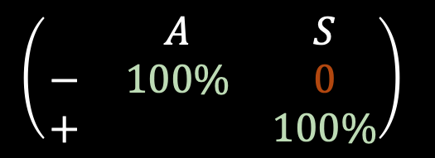
Parasite fitnesses
when infecting A and S individuals
-
A
-
$$f_{A}$$
+
-
$$\left(\begin{matrix} & A & S \\ − & 100\% & 0 \\ + & & 100\%\end{matrix}\right)$$
-
+
$$N$$
-
-
-
+
-
$$f_{S}$$
+
S
+
+
+
+
$$f_{+}$$
(= frequency of Pf+ allele)

Slide 47
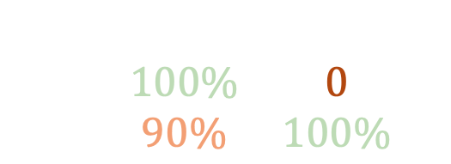
Parasite fitnesses
when infecting A and S individuals
-
A
-
$$f_{A}$$
+
-
$$\left(\begin{matrix} & A & S \\ − & 100\% & 0 \\ + & 90\% & 100\%\end{matrix}\right)$$
-
+
$$N$$
-
-
-
+
-
$$f_{S}$$
+
S
+
+
+
+
Competing fitness costs
$$f_{+}$$
(= frequency of Pf+ allele)

Slide 48


Parasite fitnesses
when infecting A and S individuals
-
A
-
A
-
-
$$f_{A}$$
+
-
+
-
$$\left(\begin{matrix} & A & S \\ − & 100\% & 0 \\ + & 90\% & 100\%\end{matrix}\right)$$
-
+
-
+
$$N$$
-
-
-
-
-
+
-
+
-
-
$$f_{S}$$
+
S
$$f_{+}$$
+
S
+
+
+
+
+
+
+
+
Competing fitness costs
$$f_{+}$$
(= frequency of Pf+ allele)
$$\text{new} f_{+}=\frac{Nf_{A}{f_{+}Γ}_{+A}+Nf_{S}f_{+}Γ_{+s}}{(\text{denominator})}$$
Simulation: start at 10% frequency, see what happens.

Slide 49
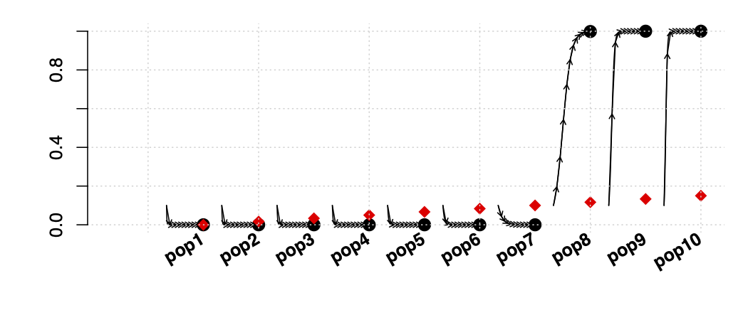
Does not produce polymorphism in independent pops…
‘+’ allele fixes…
…or is lost
HbS frequency

Slide 50
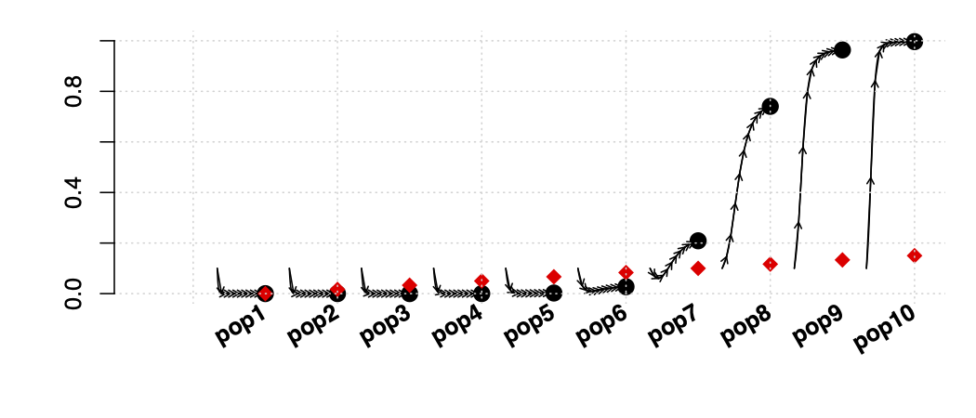
…but does in spatially related pops.
‘+’ allele now reaches a stable value in all populations
With 1% migration between neighbouring populations

Slide 51
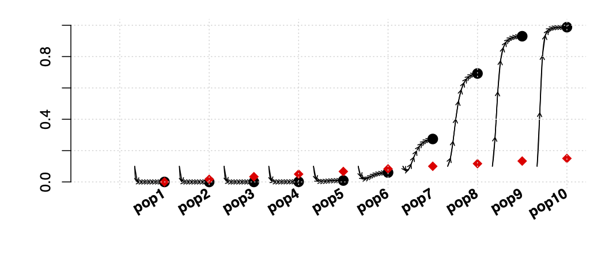
…but stable polymorphism in spatially related pops
With 5% migration between neighbouring populations
5% migration between neighbouring populations

Slide 52
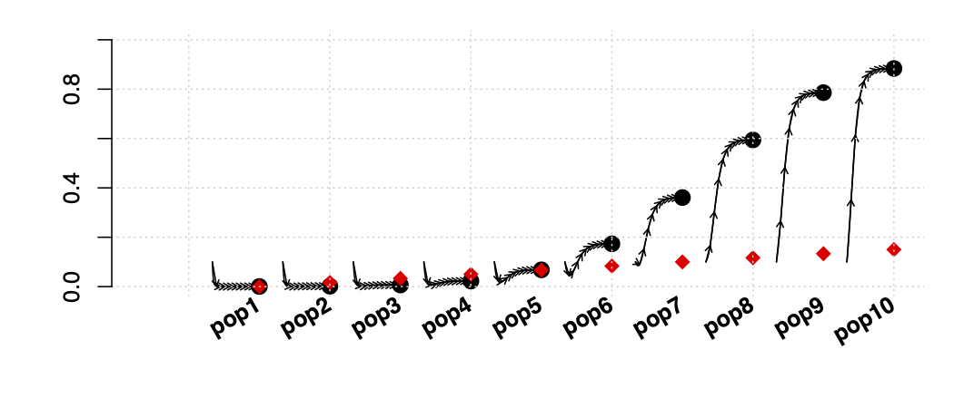
…but stable polymorphism in spatially related pops
Equilibrium depends on degree of migration
With 10% migration between neighbouring populations

Slide 53
What happens if we overlay this model on the real map of HbS frequency?

Slide 54
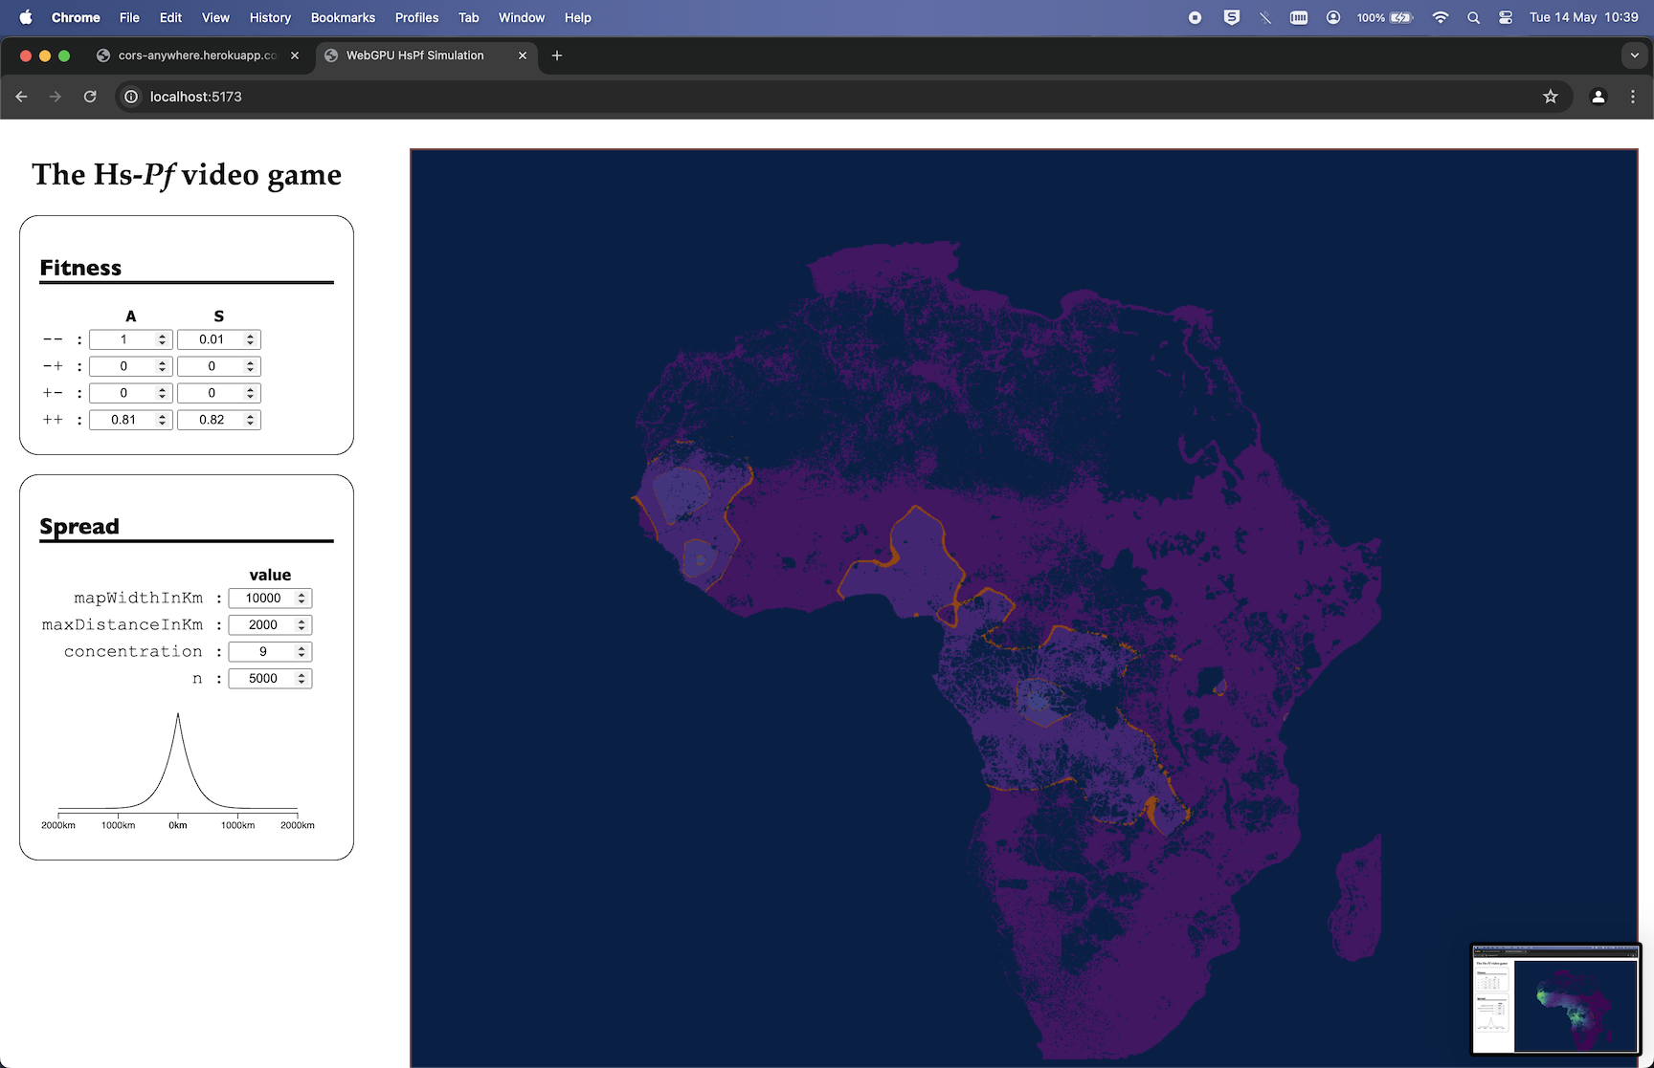

Slide 55
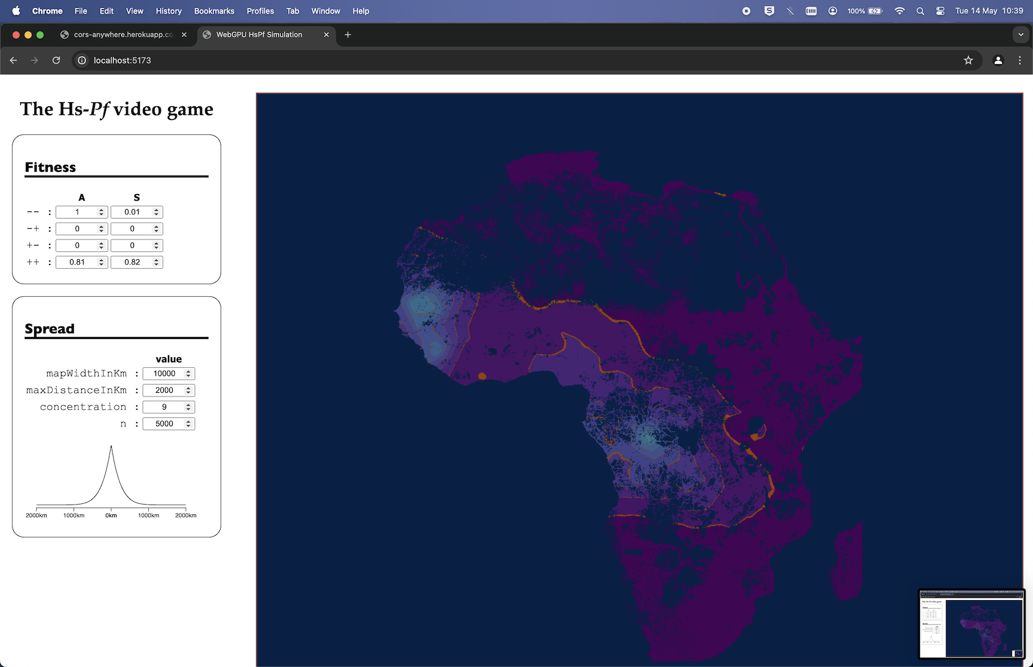

Slide 56
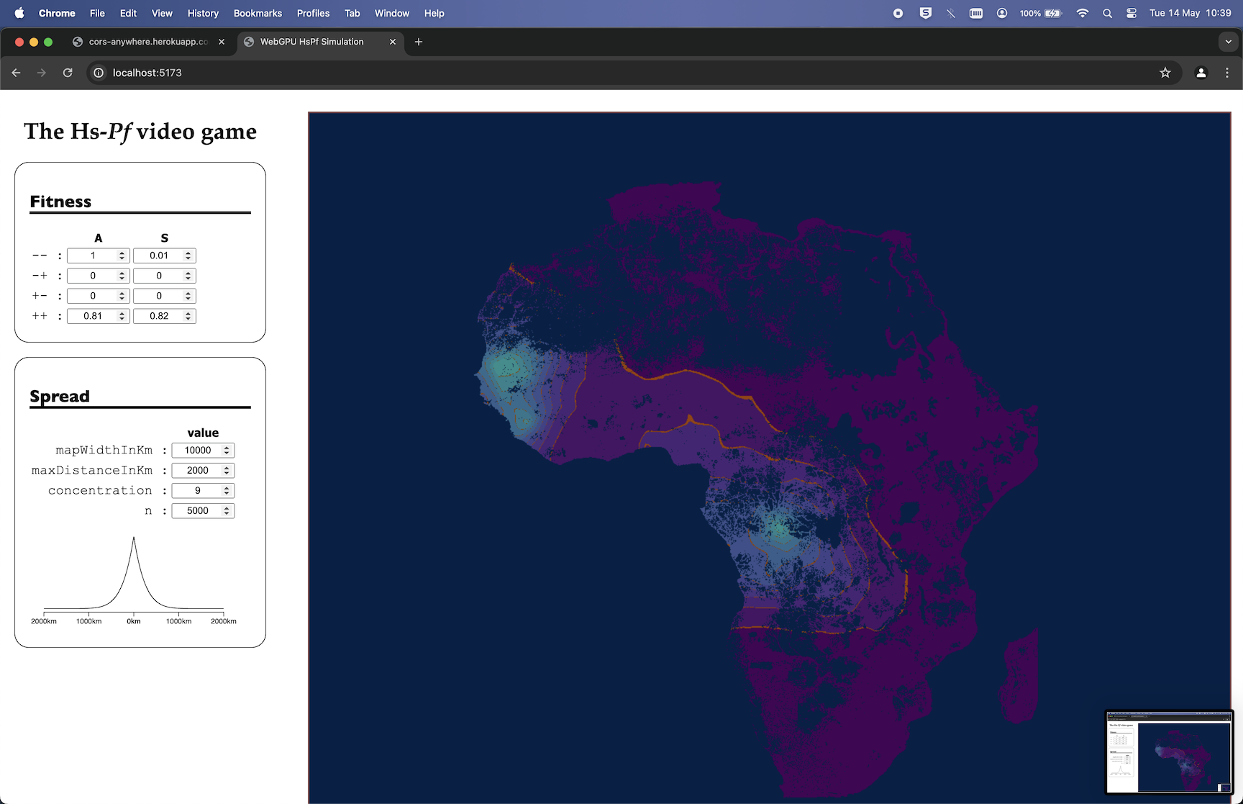

Slide 57


Slide 58
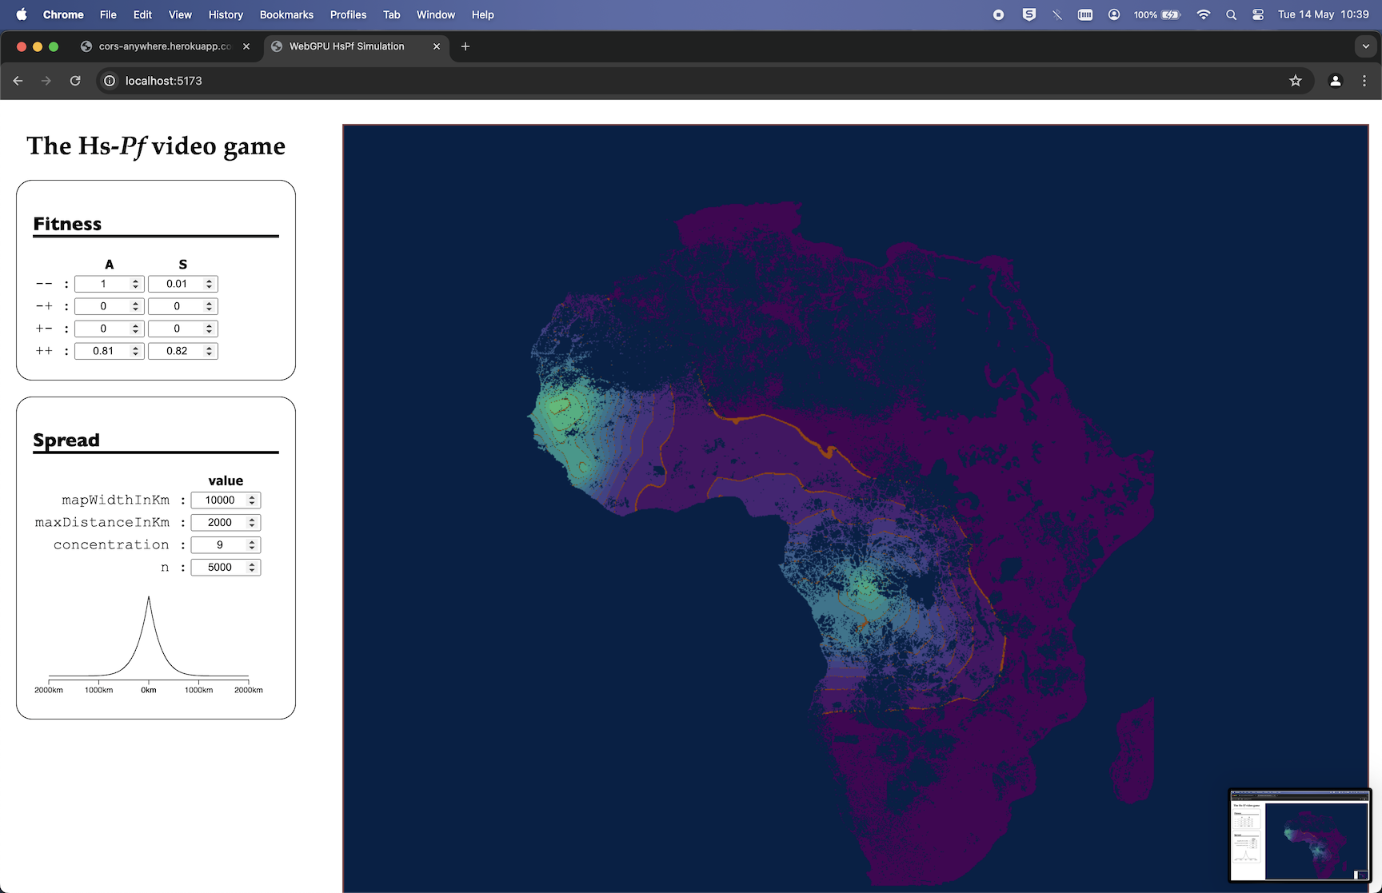

Slide 59
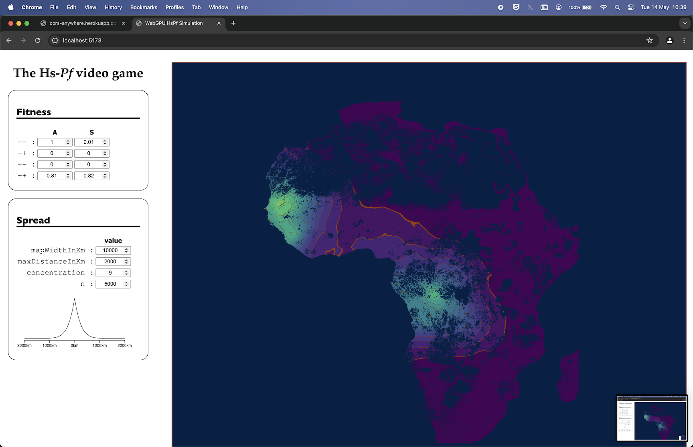

Slide 60
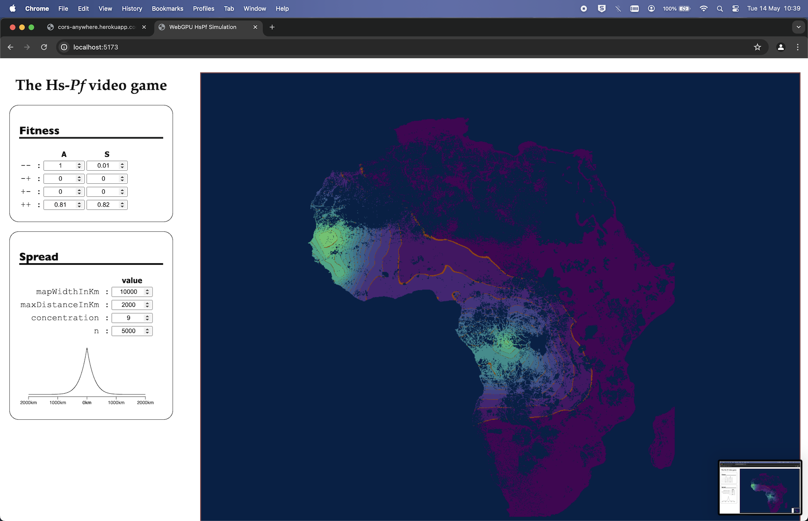

Slide 61
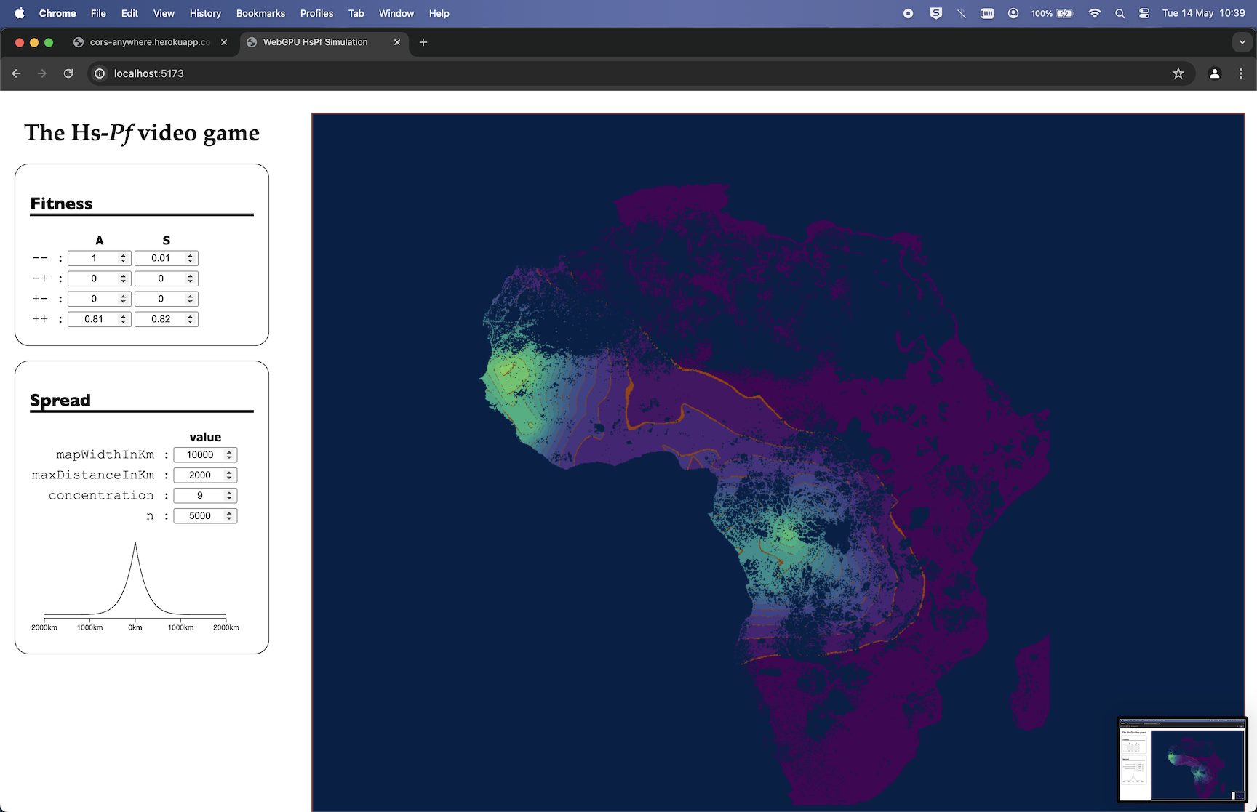

Slide 62


Slide 63


Slide 64
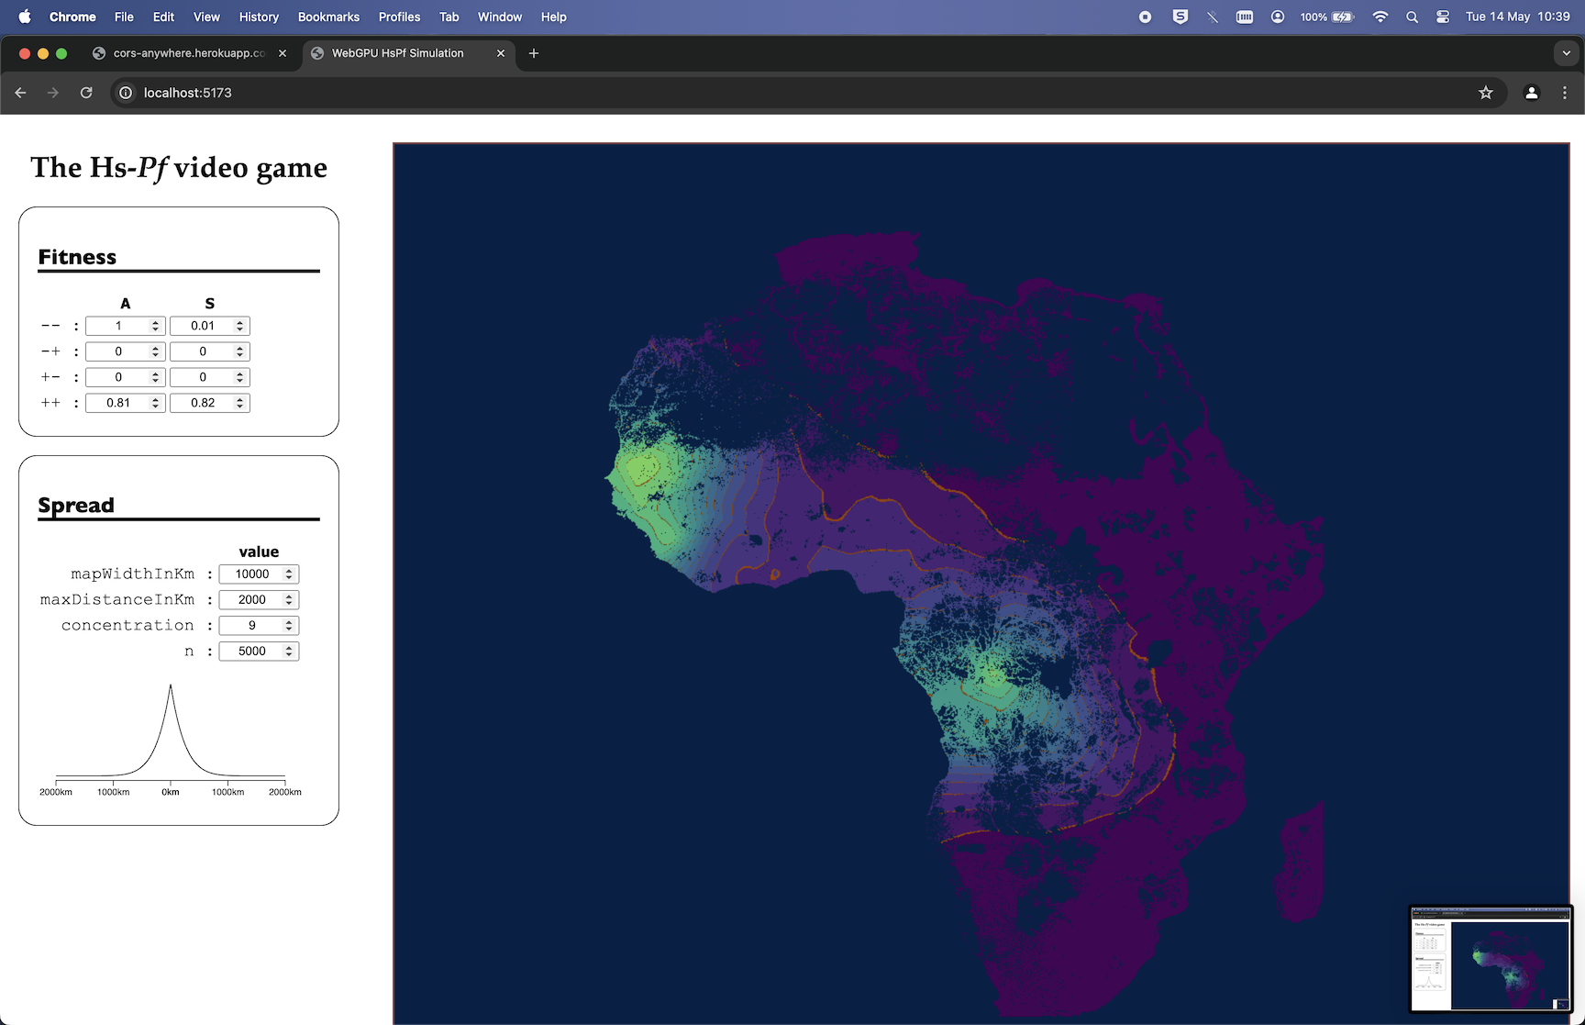

Slide 65


Slide 66


Slide 67
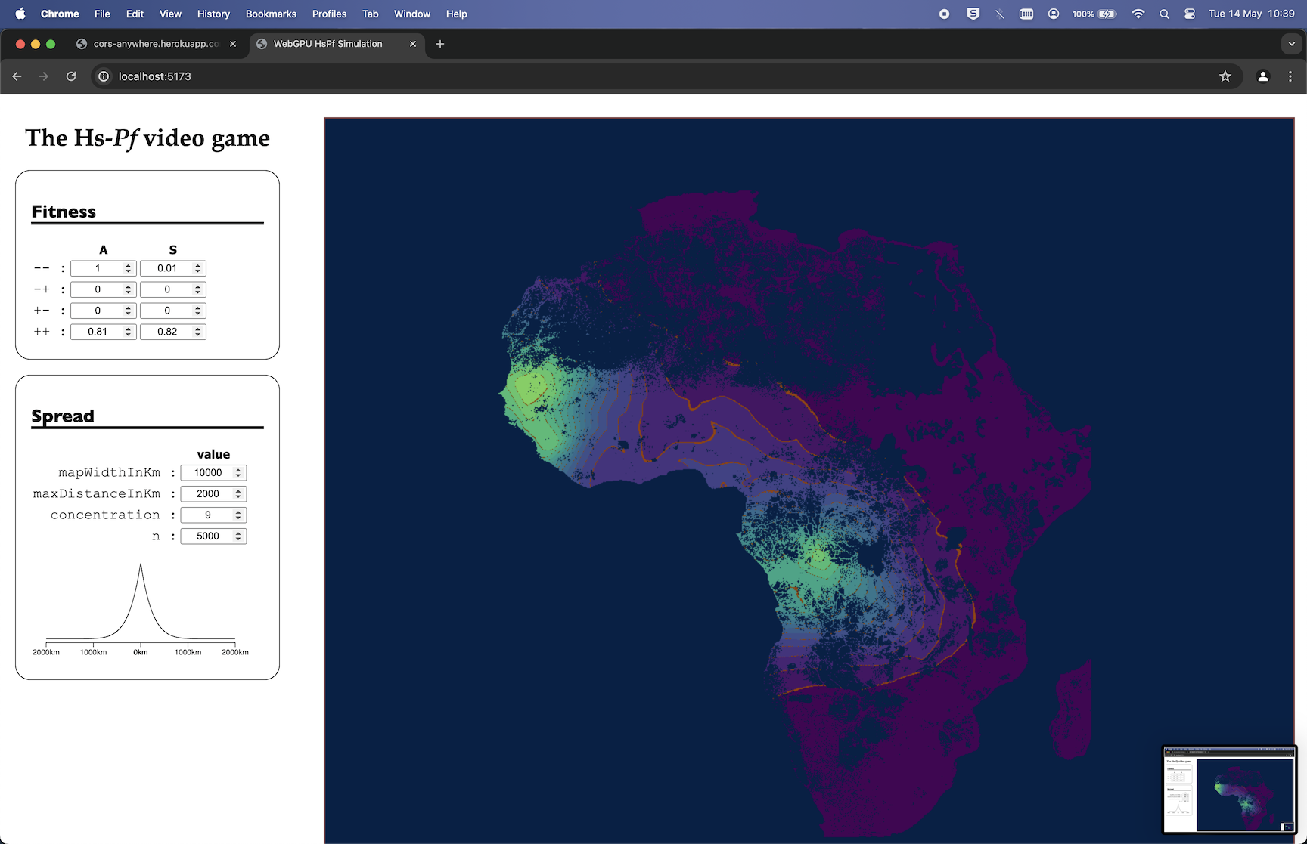

Slide 69
Caution: this is a very simple model of parasites evolving on the real HbS map.
However, it converges to a steady state (with frequencies between ~5% and ~80% everywhere, for the right choice of parameters)
Pfsa3
Acknowledgement: Peter Todd

Slide 70
The Pfsa alleles are in strong linkage disequilibrium i.e. they co-occur
r=0.80
Kenya:
Pfsa1+ vs Pfsa3+
r=0.75
r=0.66
Country | N | r
Gambia | 169 | 0.20
Guinea | 133 | 0.79
Mali | 379 | 0.84
Ghana | 807 | 0.86
Cameroon | 174 | 0.52
Congo | 241 | 0.64
Malawi | 239 | 0.79
Tanzania | 282 | 0.59
Kenya | 89 | 0.71
Pfsa1
Pfsa1
chromosome 2
Pfsa2
chromosome 2
Pfsa3
chromosome 11
Gambia:
r=0.43
MalariaGEN Pf6

Slide 71
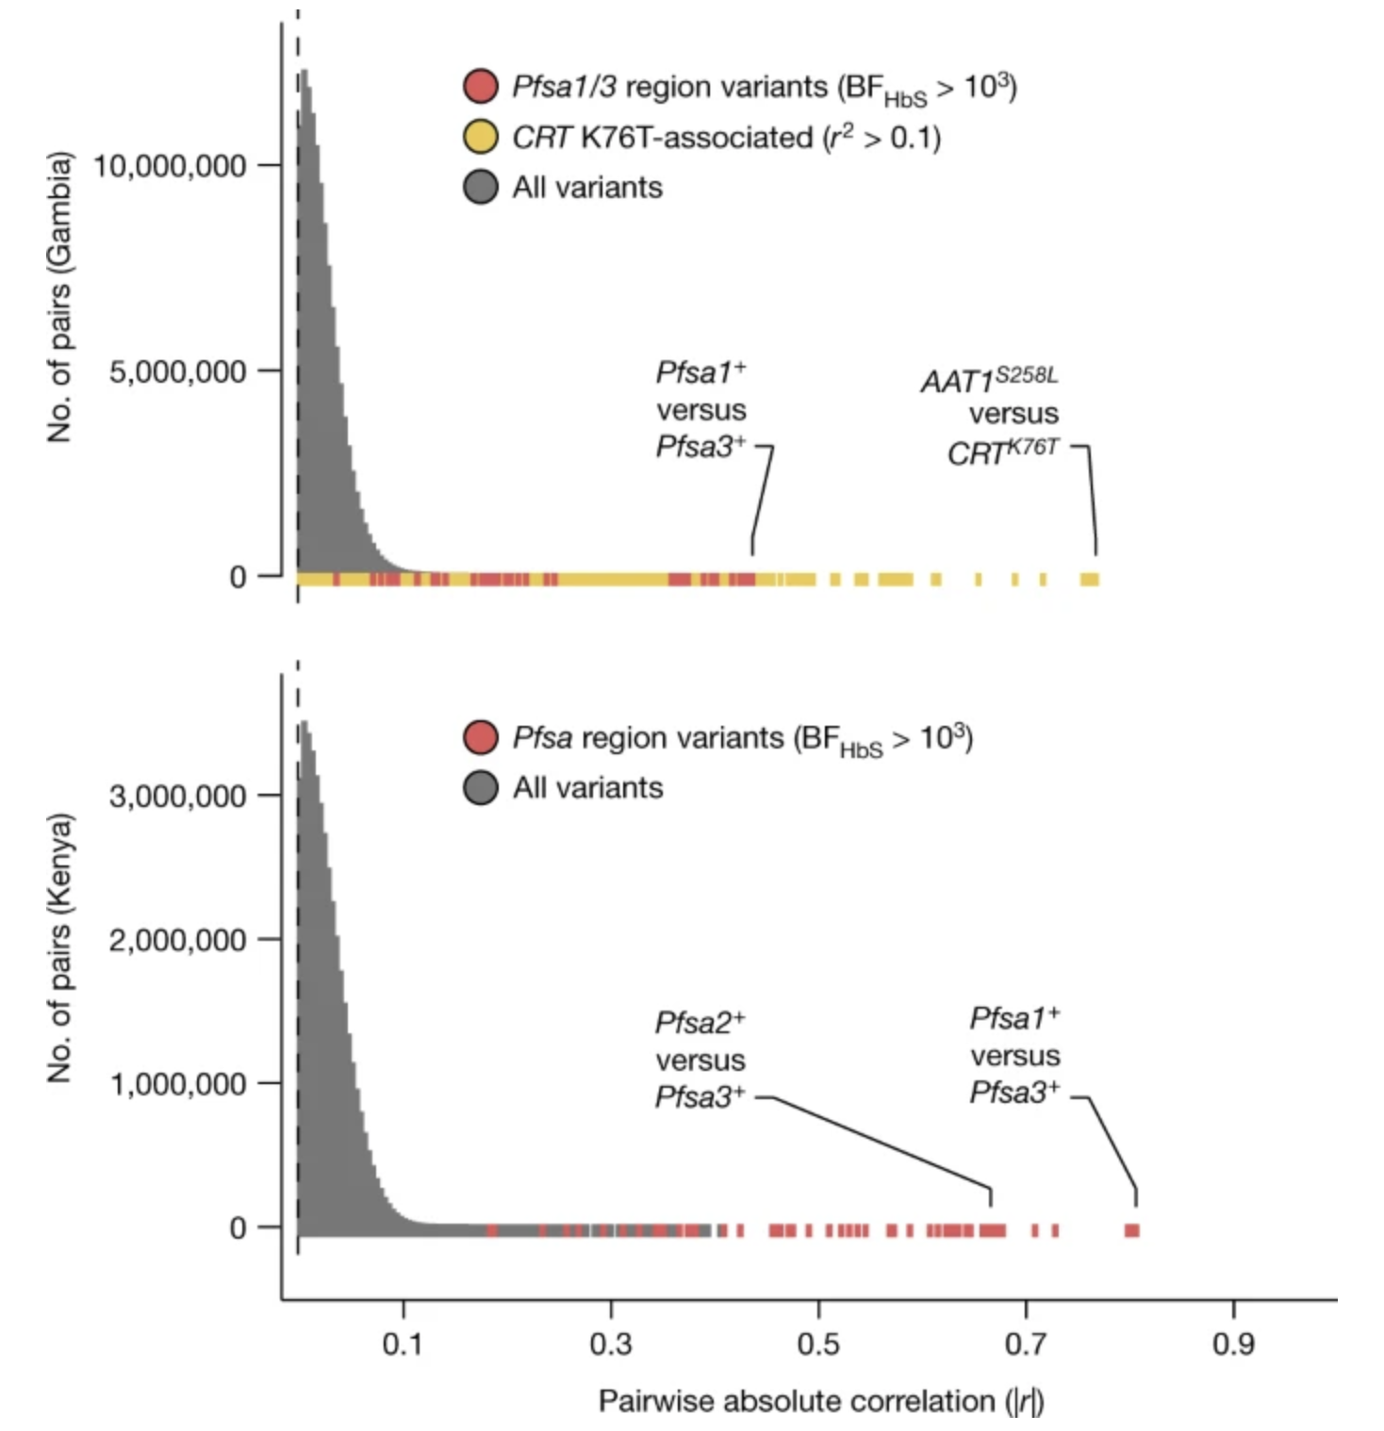
Kenya
In Kenya, Pfsa variants account for all of the strongest between-chromosome LD
Other genes like CLAGs and REX1 turn up with elevated LD

Slide 72
Gambia
In Gambia, the strongest between-chromosome LD is for drug resistance mutations - CRT vs AAT1
Next down the list is Pfsa1 vs Pfsa3.

Slide 73
Questions
Does between-locus LD imply that there is functional epistasis between the genes?
Or is it just an emergent feature of the population genetics and natural selection?

Slide 74
Talk outline
Malaria protection due to sickle haemoglobin depends on parasite genotype
Population genetics and host-parasite coevolution
Pfsa biology

Slide 75
How does sickle provide protection?
Theory 1: sickle induces alterations to the red cell cytoskeleton, that reduce the ability of parasites to put their molecules (notably PfEMPs) on the surface.
Theory 2: parasites are unable to grow in sickle trait erythrocytes, in the low-oxygen conditions likely to be found in real infections.

Slide 76
Pfsa1 (chr2)
Pfsa2 (chr2)
Pfsa3 (chr11)
Pfsa4 (chr4)
FIKK4.1
FIKK4.2

Slide 77
Pfsa1 (chr2)
Pfsa2 (chr2)
Pfsa3 (chr11)
Pfsa4 (chr4)
FIKK4.1
FIKK4.2
PfACS8 is an Acyl co-A synthetase family member. To my knowledge it has not been observed exported (unlike other family members)
0020300 is an exported protein, unknown function.
Has been observed in cytosol
Tamira Butler PhD Thesis
Daniel Golberg lab
1127000 is a predicted exported, putative Tyrosine phosphatase
FIKK4.1/4.2 are exported Serine/Threonine Kinases
None are thought to be essential (for parasite growth in vitro)

Slide 78
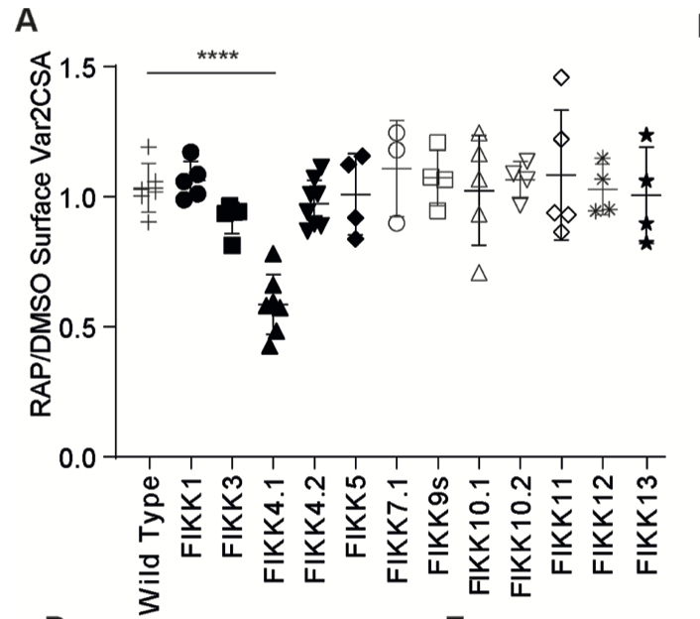
Pfsa1 (chr2)
Pfsa2 (chr2)
Pfsa3 (chr11)
Pfsa4 (chr4)
FIKK4.1
FIKK4.2
FIKK4.1/4.2 are exported Serine/threonine Kinases
Evidence that FIKKs affect var2csa expression:
Davies et al 2023

Slide 79
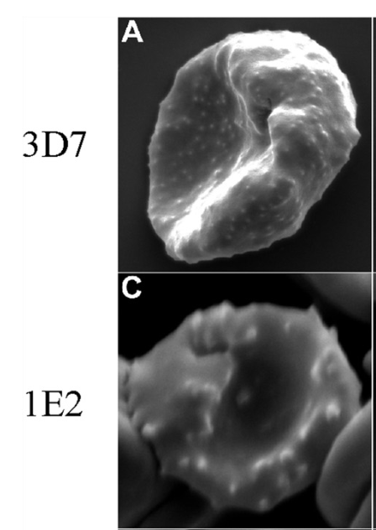
Pfsa1 (chr2)
Pfsa2 (chr2)
Pfsa3 (chr11)
Pfsa4 (chr4)
FIKK4.1
FIKK4.2
Evidence that FIKKs affect var2csa expression:
FIKK4.2 knockout
Davies et al 2023
Kats et a 2014

Slide 80
Pfsa1 (chr2)
Pfsa2 (chr2)
Pfsa3 (chr11)
Pfsa4 (chr4)
FIKK4.1
FIKK4.2
Both ACSs and FIKKs are part of large gene families that have expanded in laverania
(The sub-clade of ape-infecting malaria that includes P.falciparum)
Otto et al, “Genomes of all known members of a Plasmodium subgenus reveal paths to virulent human malaria”, Nat. Microbiol 2018
Davies et al, “An exported kinase family mediates species- specific erythrocyte remodelling and virulence in human malaria”, Nat. Microbiol 2020

Slide 81
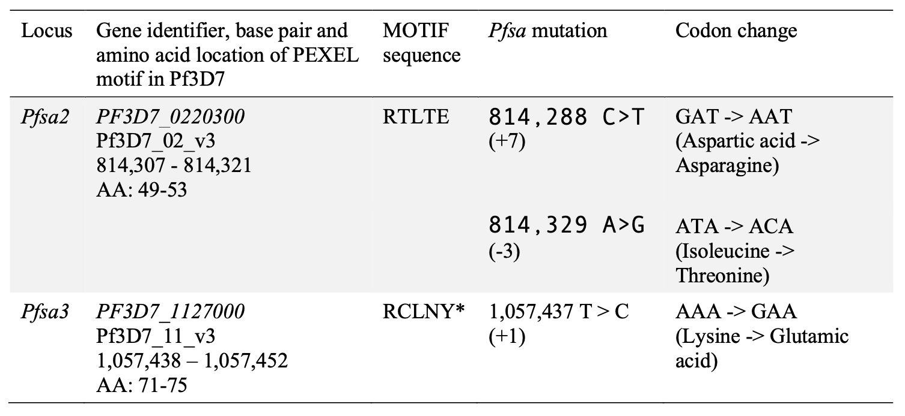
Pfsa2 (chr2)
Pfsa3 (chr11)
Both 0220300 and 1127000 contain PEXEL motifs
These mediate export via cleavage by Plasmepsin V
Possible hypothesis: do the Pfsa mutations affect export?

Slide 82
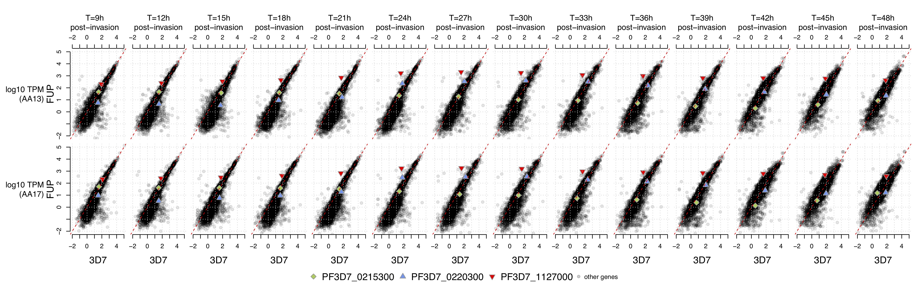
A different hypothesis: the Pfsa+ mutations increase expression of Pfsa genes
Joseph Saelens, Mahamadou Diakité, Steve M. Taylor, mSphere 2021

Slide 83
Parasite gene expression (RNA levels)
sickle-associated (Pfsa+) parasite
T=9
Hours post-invasion
PfACS8, Pfsa1
Pfsa2
Pfsa- parasite
Pfsa3
The parasite takes about 48 hours to replicate within red cells (then they burst and the parasites re-invade). What does gene expression look like across this cycle?

Slide 84
sickle-associated (Pfsa+) parasite
T=15
Hours post-invasion
Pfsa- parasite

Slide 85
sickle-associated (Pfsa+) parasite
T=21
Hours post-invasion
Pfsa- parasite

Slide 86
sickle-associated (Pfsa+) parasite
T=24
Hours post-invasion
Pfsa- parasite

Slide 87
sickle-associated (Pfsa+) parasite
T=27
Hours post-invasion
Pfsa- parasite

Slide 88
sickle-associated (Pfsa+) parasite
T=30
Hours post-invasion
Pfsa- parasite

Slide 89
sickle-associated (Pfsa+) parasite
T=33
Hours post-invasion
Pfsa- parasite

Slide 90
sickle-associated (Pfsa+) parasite
T=39
Hours post-invasion
Pfsa- parasite

Slide 91
sickle-associated (Pfsa+) parasite
T=45
Hours post-invasion
Pfsa- parasite

Slide 92
T=48
Hours post-invasion

Slide 93
T=48
Hours post-invasion
1127000 (Pfsa3) is over-expressed at Troph stage in Pfsa+ parasites.

Slide 94
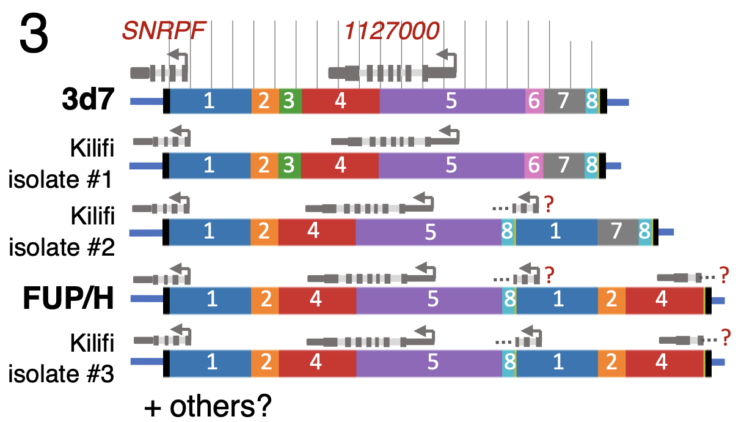
Structural variation at Pfsa3
Pfsa1 (chr2)
Pfsa2 (chr2)
Pfsa3 (chr11)
Pfsa4 (chr4)
Estimated HbS protection
However…
The Pfsa3+ mutation ( ) is linked to a set of structural variants.
Isolate 1
Isolate 2
Annie Forster
FUP/H
Jason Hendry
Anna Jeffreys
Katie Healey
Isolate 3

Slide 95

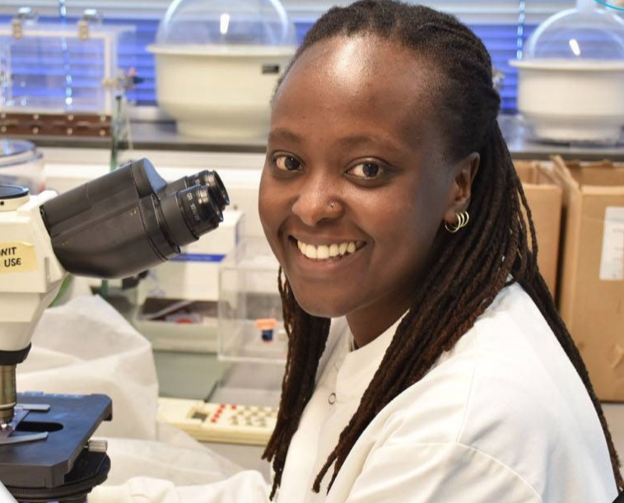



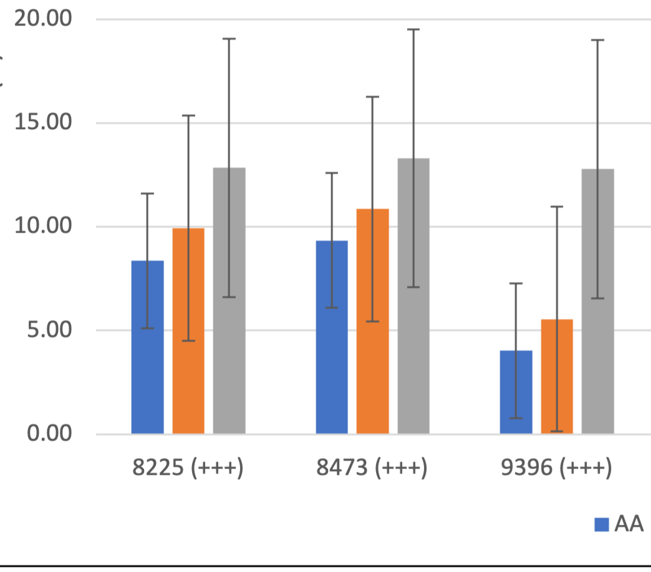
Prelim work – MSIF funded
Tom Williams
Silvia Kariuki
Alex
Macharia
Patrick Ombati
Julian Rayner (CIMR)
Revive parasites from 30-year old frozen stocks, and conduct functional assays under controlled conditions.
Prototype invasion expt.
James Docker, Katie Healey long-read assemblies
Medical Sciences Internal Fund

Slide 96






Genetic association study work
Parasite revival / functional work
Pfsa+ structural variation work:
Annie Forster
Jason Hendry
MRC The Gambia @ LSHTM
Muminatou Jallow
Fatoumatta Sisay-Joof
Kalifa A. Bojang
David J. Conway
Giorgio Sirugo
Umberto d’Alessandro
KEMRI-Wellcome, Kilifi, Kenya
Carolyne M. Ndila
Alexandar W. Macharia
Norbert Peshu
Kevin Marsh
Thomas N. Williams
KEMRI-Wellcome, Kilifi, Kenya
Alexander W. Macharia
Patrick Ombati
Silvia Kariuki
Julian Rayner
Spatial mapping work: Andre Python
MIP data:
Deus Ishengoma
Robert Verity
Jeffrey Bailey
Duke University
Steve M. Taylor
Joseph P. Saeelens
USTTB Mali:
Mahamadou Diakite
Wellcome Sanger Institute
Thuy Nguyen
Sonia M. Goncalves
Cristina V. Ariani
Jim Stalker
Richard D.Pearson
Roberto Amato
Eleanor Drury
Dominic P. Kwiatkowski
“We thank the patients and staff at the Paediatric Department of the Royal Victoria Hospital in Banjul, Gambia, and at Kilifi County Hospital and the KEMRI-Wellcome Trust Research Programme, Kilifi, Kenya for their help with this study.”
University of Oxford
Kirk A. Rockett
Anna E. Jeffreys
Christina Hubbart
Kate Rowlands
Dominic P. Kwiatkowski
Dominic
Kwiatkowski
1953-2023
University of Utah:
Ellen Leffler
Publication at:
doi.org/10.1038/s41586-021-04288-3
University of Utah
Ellen M. Leffler
MSIF

Slide 97
Thank you!

Slide 98
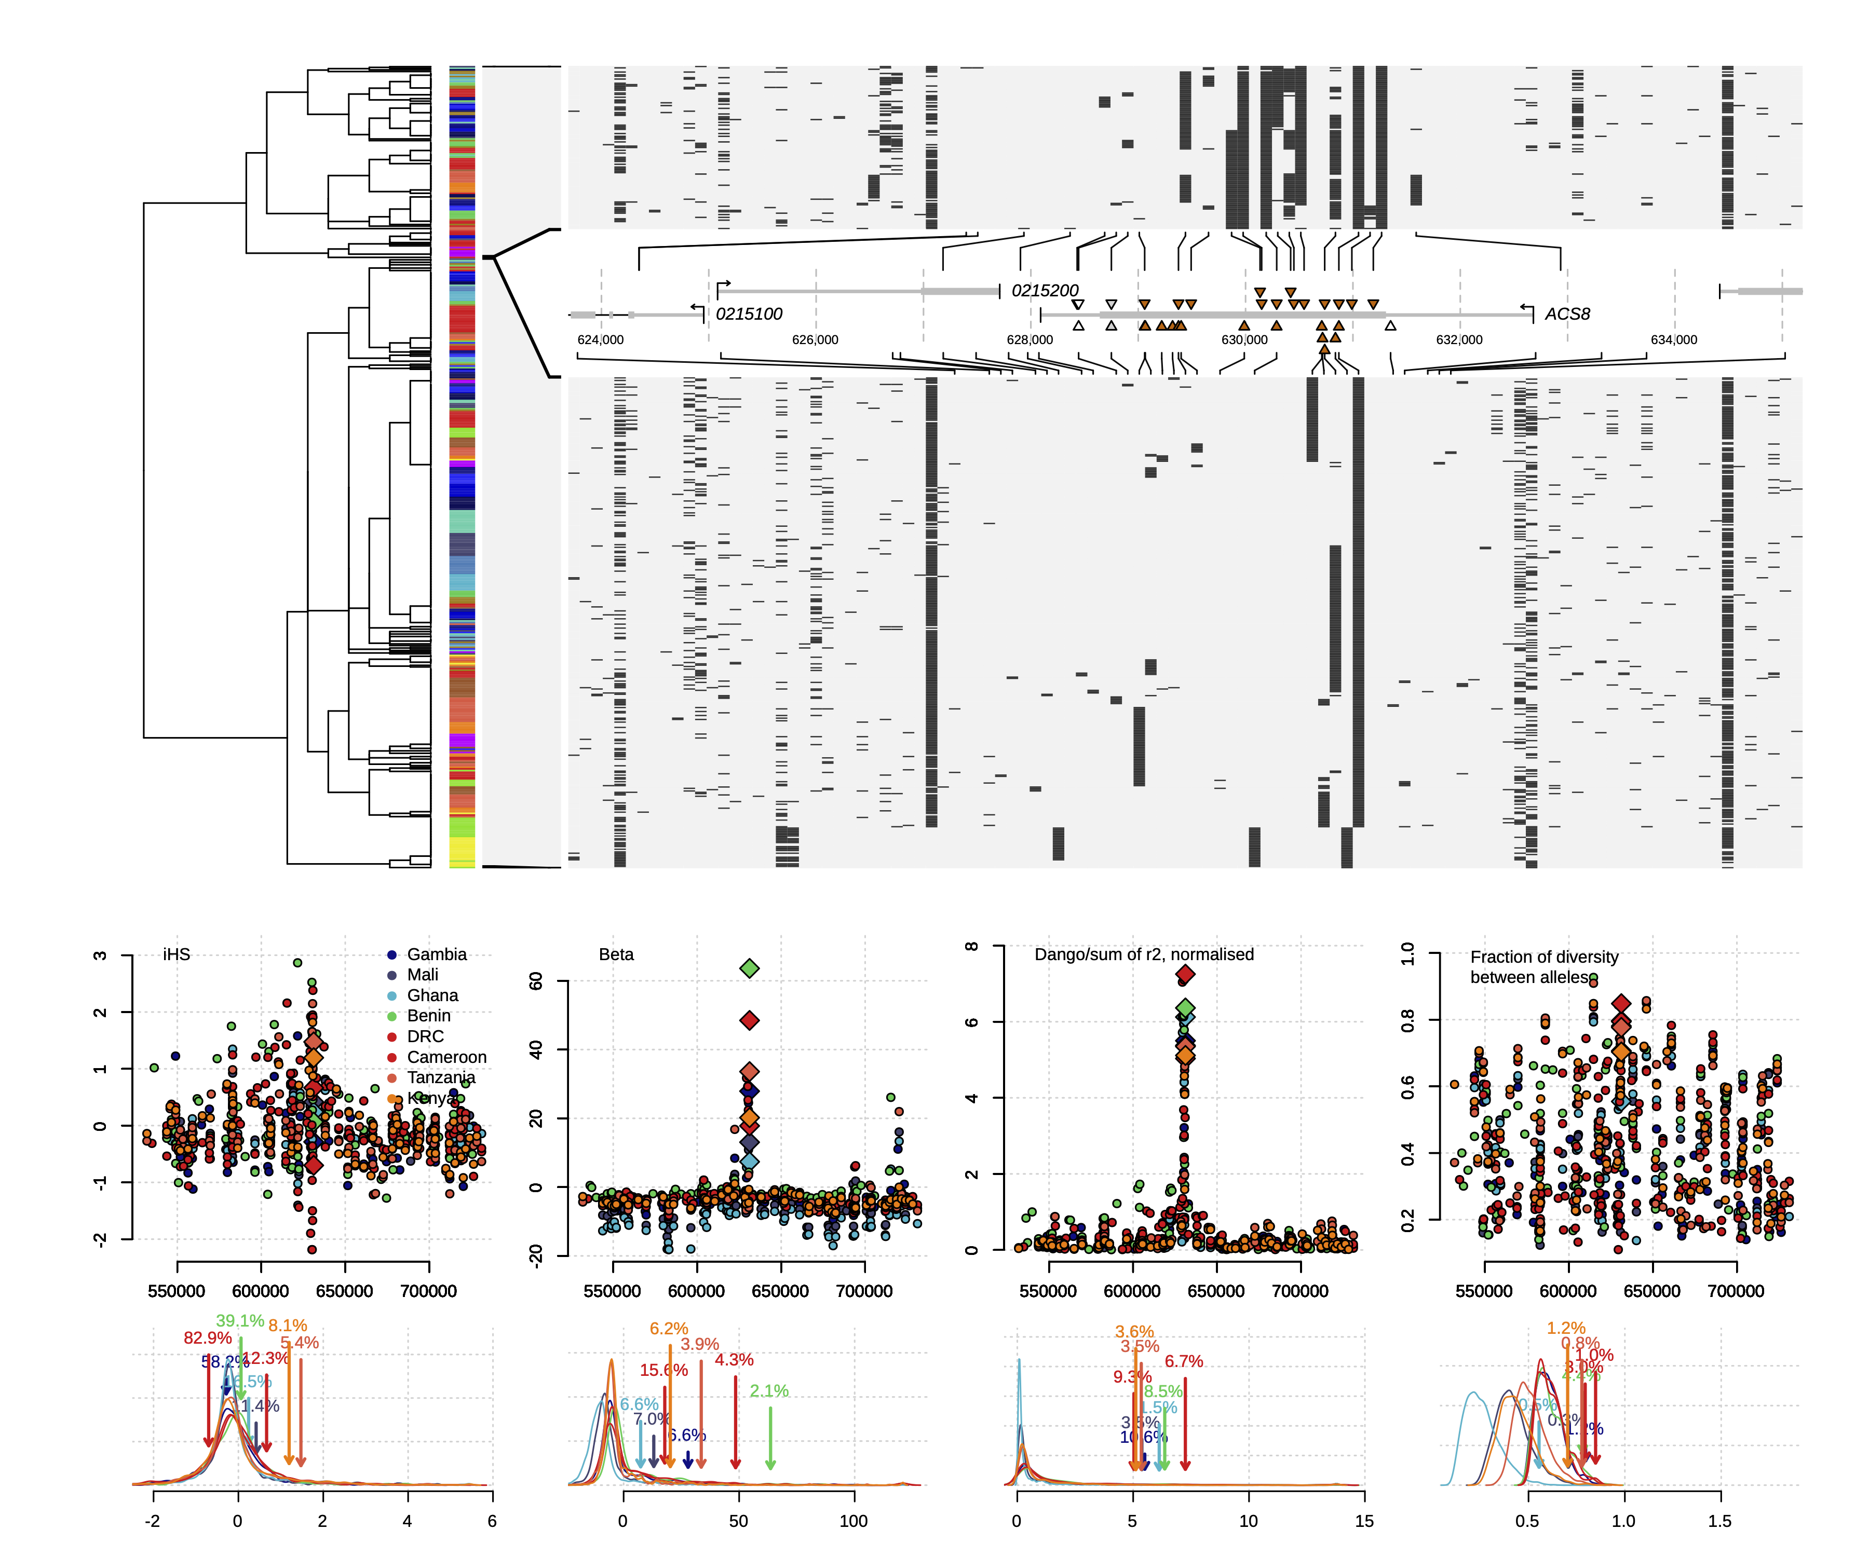
Lead Pfsa+ mutation:
chr2: 631,190 T>A
Pfsa1+ haplotypes:
(Observed in infections of HbAA, HbAS, and HbSS individuals)
Pfsa1- haplotypes:
(Largely only observed in infections of HbAA individuals)
Ancestral allele
Derived (i.e. mutant) allele

Slide 99
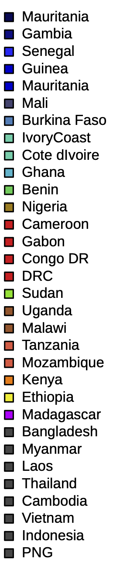
Lead Pfsa+ mutation:
chr2: 631,190 T>A
Pfsa1+ haplotypes:
Pfsa1- haplotypes:
Ancestral allele
Derived (i.e. mutant) allele

Slide 100
Lead Pfsa+ mutation:
chr2: 631,190 T>A
Ancestral allele
Derived (i.e. mutant) allele

Slide 101
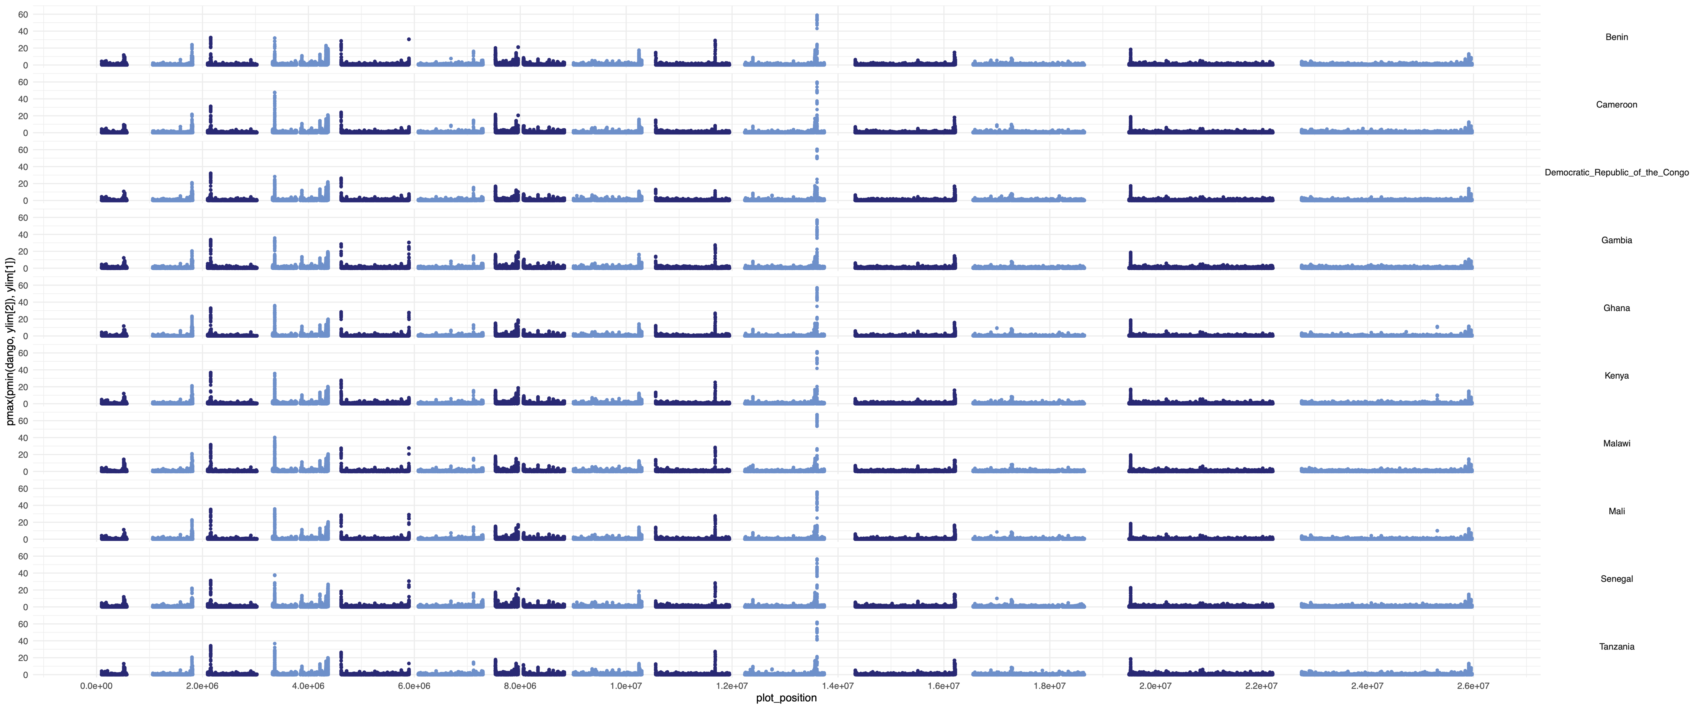
Genome-wide scan for balancing selection
Benin
Cameroon
DRC
Gambia
Ghana
Kenya
Malawi
Mali
Senegal
Tanzania

Slide 102
Pfsa1
Pfsa3
Benin
Cameroon
DRC
Gambia
Ghana
Kenya
Malawi
Mali
Senegal
Tanzania

Slide 103
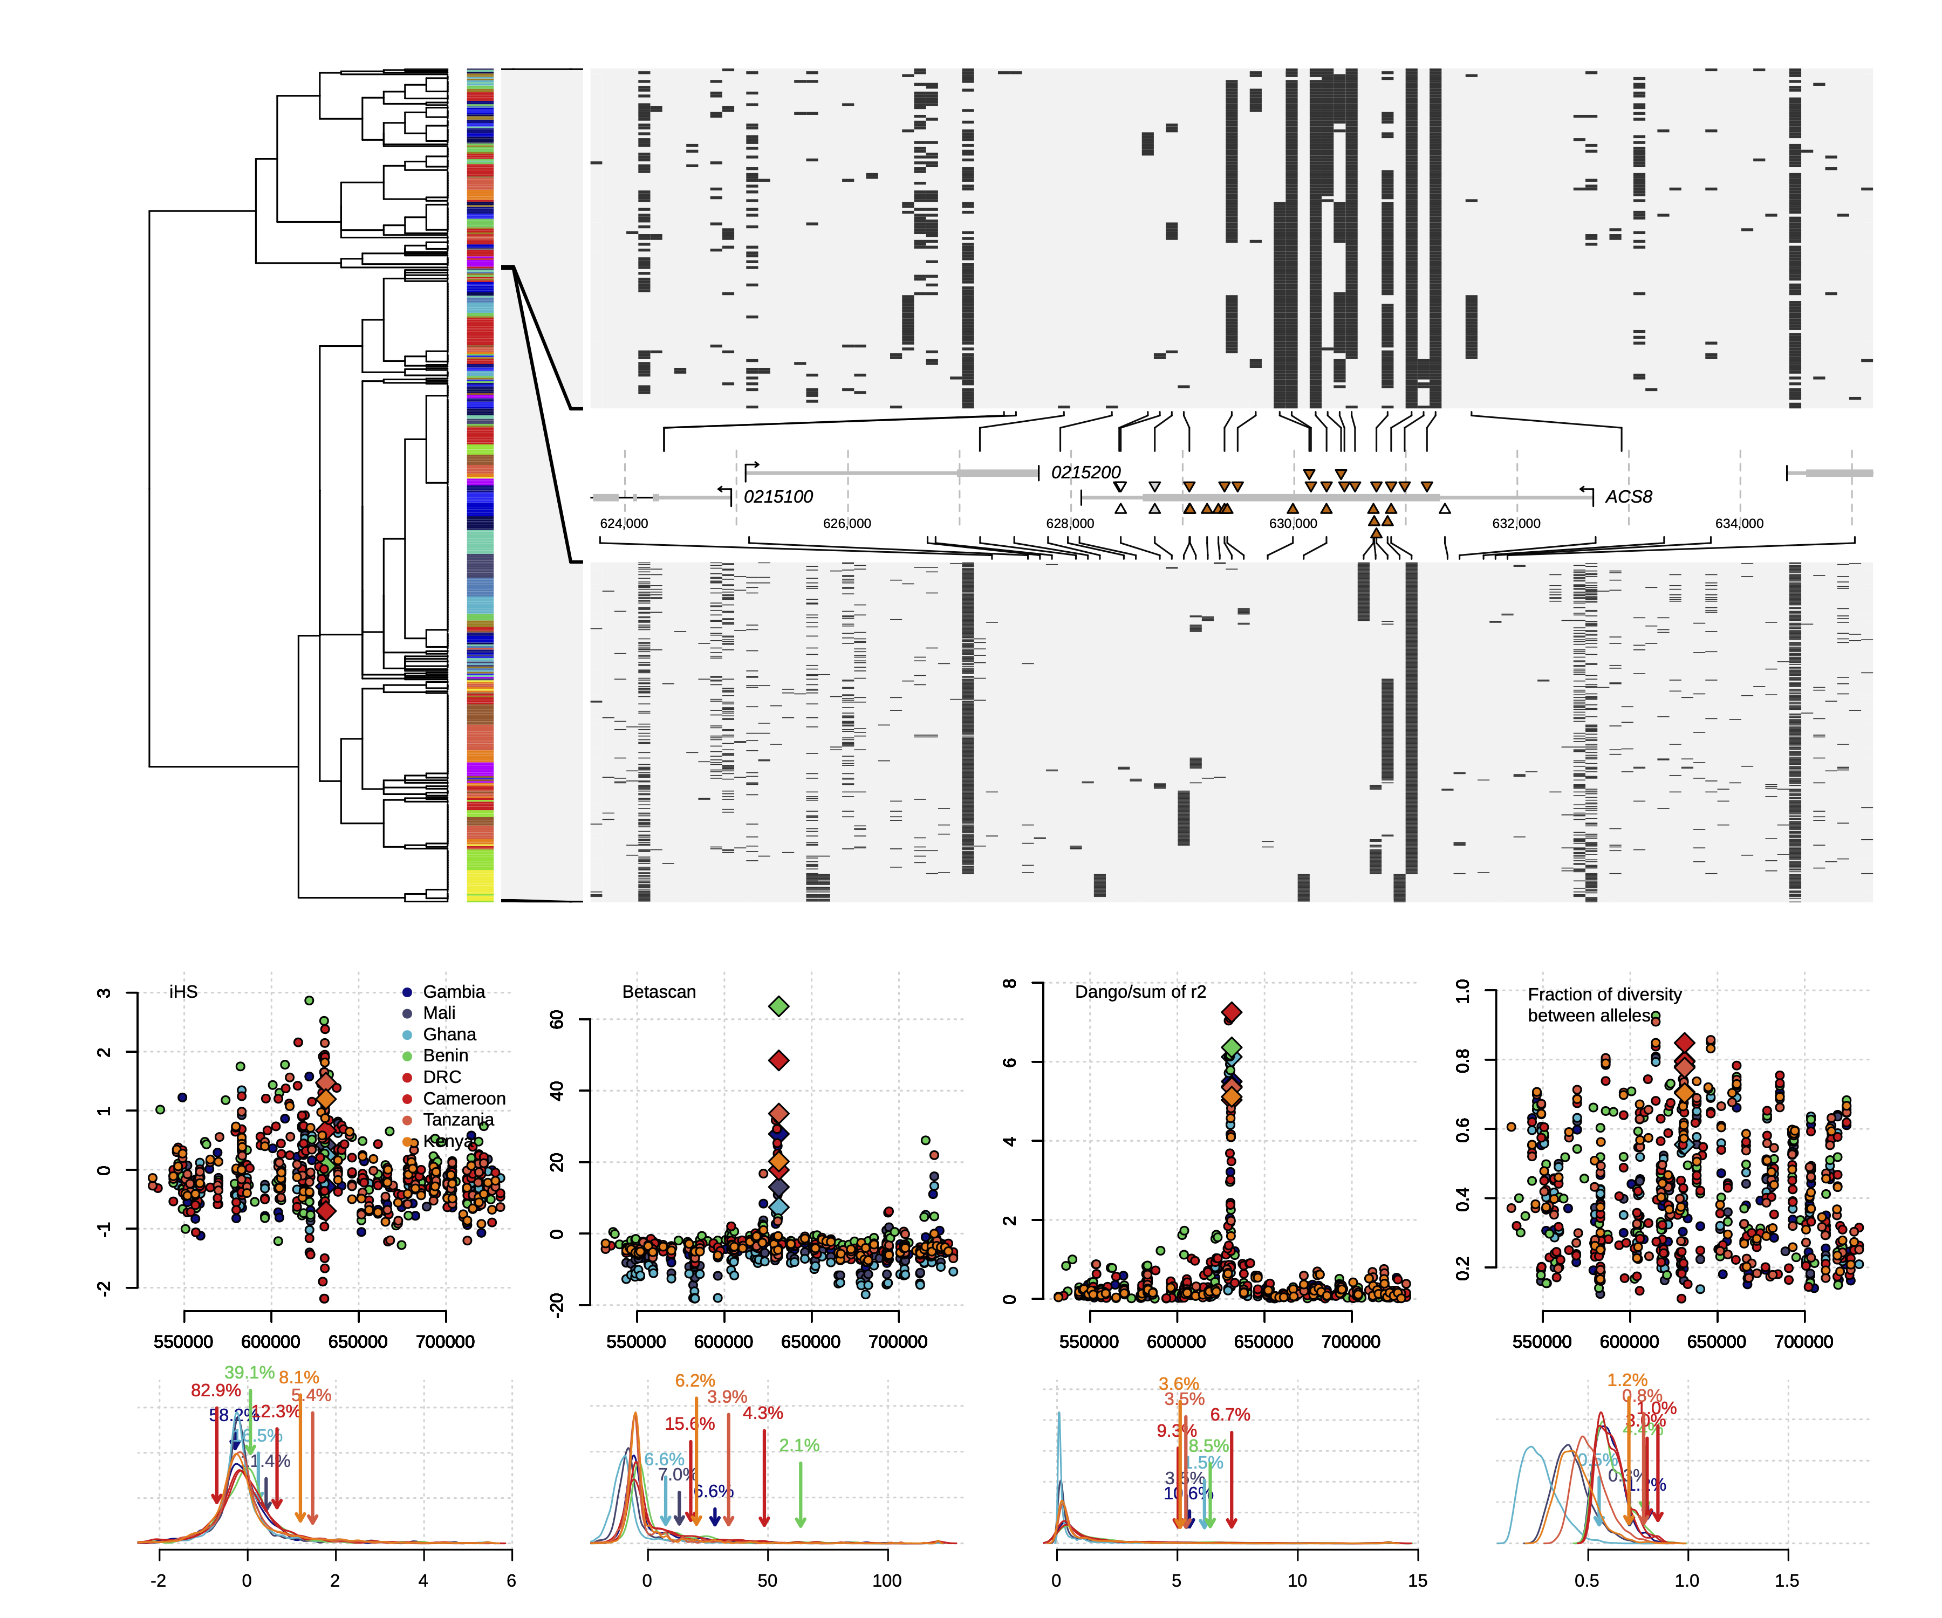
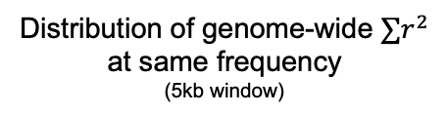
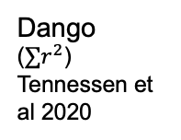
Evidence for balancing selection
‘Beta’
Siewert & Voight 2017
Dango
($∑r^{2}$)
Tennessen et al 2020
There is some evidence for balancing selection.
Distribution of genome-wide Beta
at same frequency
(5kb window)
Distribution of genome-wide $∑r^{2}$
at same frequency
(5kb window)

Slide 104
Evidence for… balancing selection?
‘Beta’
Siewert & Voight 2017
Dango
($∑r^{2}$)
Tennessen et al 2020
Distribution of genome-wide Beta
at same frequency
(5kb window)
Distribution of genome-wide $∑r^{2}$
at same frequency
(5kb window)

