Slide 1
Geographical analysis of the P.falciparum - sickle haemoglobin association at local and continental scales
Gavin Band
  Genomic Epidemiology of Malaria
  19th September 2024

Slide 2
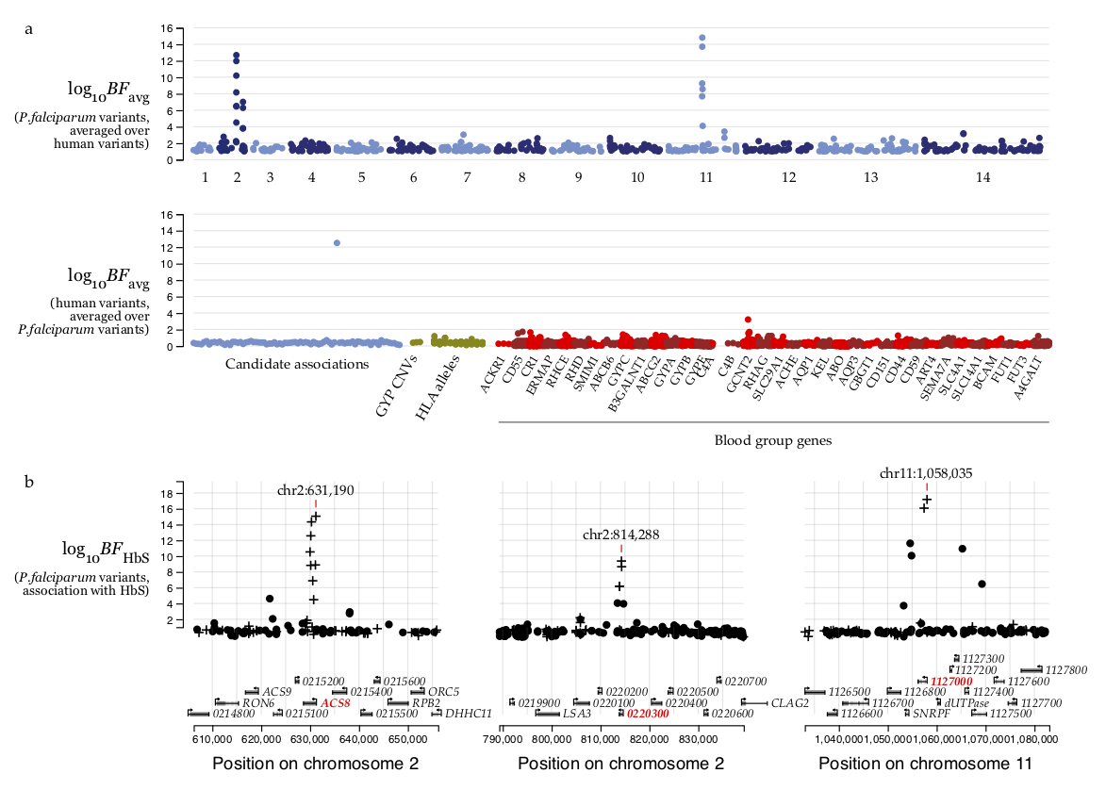
The ‘P.falciparum sickle-associated’ (Pfsa) 1-3 loci
Association
of P.falciparum variants
with HbS
Pfsa1 locus
Chr2: 631,190 T>A
(In PfACS8)
Pfsa2 locus
Chr2: 814,288 C>T
(In putative exported protein)
Pfsa3 locus
Chr11:1,058,035 T>A
In putative tyrosine phosphatase
We previously found mutations in three regions of the P.falciparum genome which are associated with infections of HbS carriers.
https://doi.org/10.1038/s41586-021-04288-3

Slide 3
“45 of 49 severe infections of individuals with HbS genotypes were with Pfsa+ parasites”
 |  | HbAS or SS
Parasites with only Pfsa- alleles |  | 4
Parasites with Pfsa+ alleles |  | 45
# severe infections

Slide 4
“45 of 49 severe infections of individuals with HbS genotypes were with Pfsa+ parasites”
But they also turn up in almost 1/3rd of infections of HbAA individuals.
 | HbAA | HbAS or SS
Parasites with only Pfsa- alleles | 2,192 | 4
Parasites with Pfsa+ alleles | 1,177 | 45
# severe infections

Slide 5
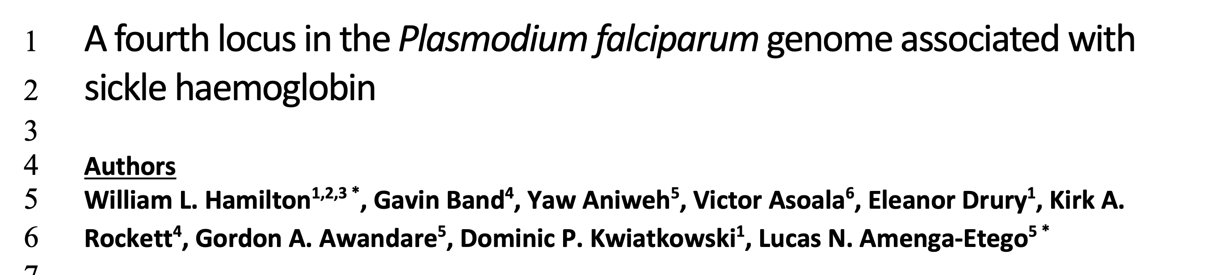
These signals replicate in mild cases too…
…and a fourth, west-African specific ‘Pfsa4’ locus has also been identified.
https://doi.org/10.1101/2023.09.14.557461

Slide 6
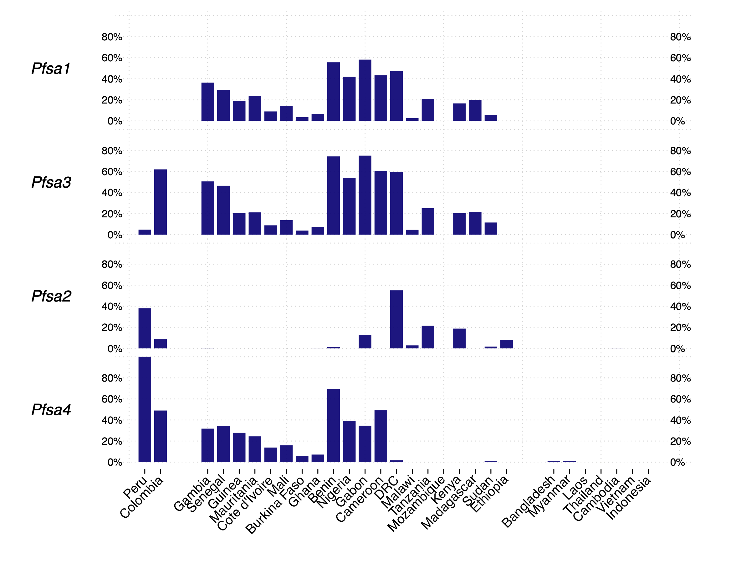
Questions
Are the Pfsa+ loci positively selected for by HbS?
If so, why are they still at intermediate frequencies in African parasite populations?
Pfsa1+
Data from MalariaGEN Pf7
S.America
west
Africa
east
Asia
And why are they in LD?

Slide 7
Plan for the talk
A global geospatial analysis of HbS vs Pfsa
A spatial simulation study, i.e. speculation

Slide 8
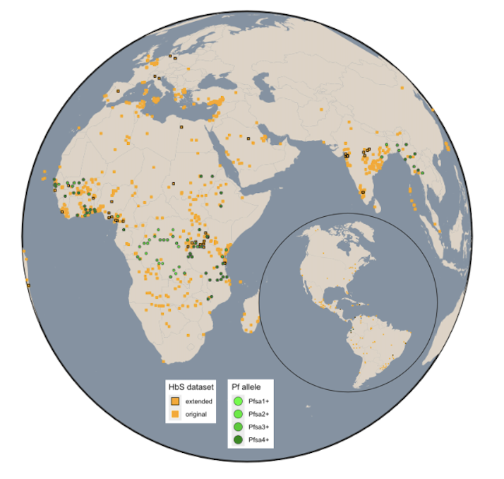
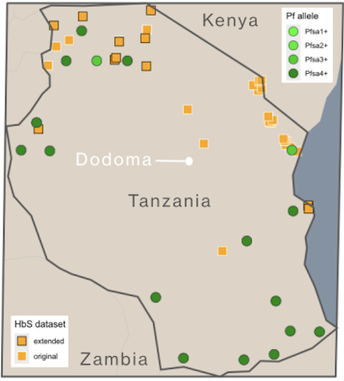
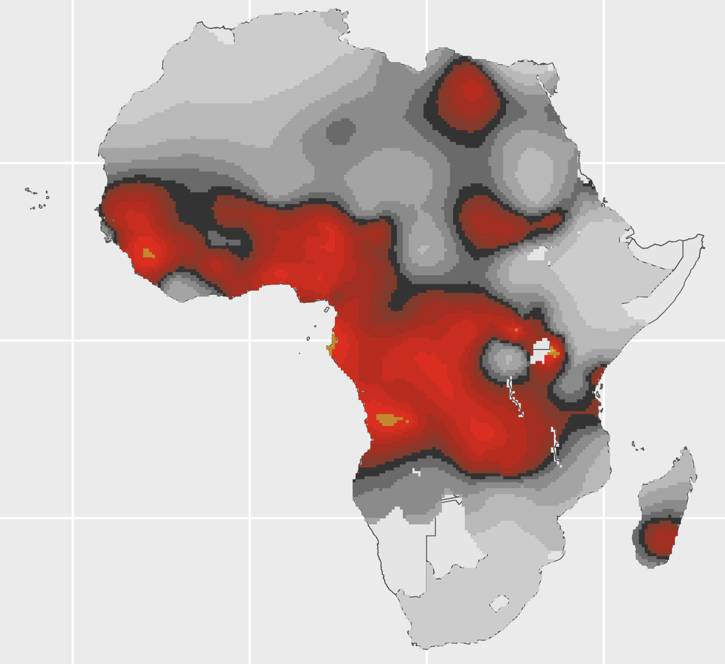
Global geospatial analysis
Gather HbS survey data from global populations
(1,098 orange points)
Similar to Piel et al 2013 global map
Piel et al Lancet 10.1016/S0140-6736(12)61229-X
Global map of HbS frequency
Notes:
1,098 HbS survey points
594 Pf sites

Slide 9
Global geospatial analysis
Gather HbS survey data from global populations
(orange points)
Gather Pfsa+ genotype counts from global populations
(green points)
MalariaGEN Pf7
Whole-genome sequence data
Moser et al 2021 Tanzania
Verity et al 2021 DRC
Molecular inversion probe typing
Global map of HbS frequency

Slide 10
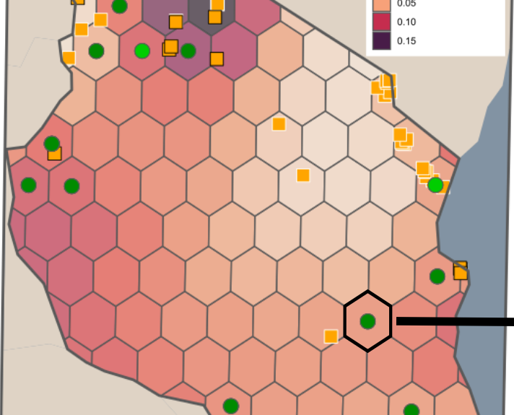
Global geospatial analysis
Gather HbS survey data from global populations
(orange points)
Gather Pfsa+ genotype counts from global populations
(green points)
MalariaGEN Pf7
Whole-genome sequence data
Moser et al 2021 Tanzania
Verity et al 2021 DRC
Molecular inversion probe typing
Global map of HbS frequency
About 100km diameter
Aggregate across hexagons

Slide 11
Global geospatial analysis
Each pt is one hexagon
Pfsa1+ frequency
Congo
DRC
non-African data
Tanzania
HbAS or SS frequency

Slide 12
Global geospatial analysis
Each pt is one hexagon
Pfsa1+ frequency
Slope ~ 1.75
(bigger than 1!)
non-African data
HbAS or SS frequency
Linear model

Slide 13
Global geospatial analysis
Each pt is one hexagon
Slope ~ 17
Log-odds scale
Pfsa1+ frequency
non-African data
HbAS or SS frequency
Logistic (s-shaped) model

Slide 14
Global geospatial analysis
Each pt is one hexagon
Slope ~ 23
Log-odds scale
Pfsa1+ frequency
Congo
DRC
BYM2 model
non-African data
(Usually more conservative)
Tanzania
HbAS or SS frequency
BYM2 model

Slide 15
Local geospatial analysis
in Africa
Slope estimate
(log-odds scale)
Pfsa1+ frequency
BYM2 model

Slide 16
Local geospatial analysis
in west Africa
Slope estimate
(log-odds scale)
Pfsa1+ frequency
BYM2 model

Slide 17
Local geospatial analysis
in east Africa
Slope estimate
(log-odds scale)
Pfsa1+ frequency
BYM2 model

Slide 18
Local geospatial analysis
in Gambia and Senegal
Pfsa1+ frequency
Slope estimate
(log-odds scale)
BYM2 model

Slide 19
Local geospatial analysis
in Mali
Pfsa1+ frequency
Slope estimate
(log-odds scale)
BYM2 model

Slide 20
Local geospatial analysis
in Ghana, Togo and Burkina Faso
Pfsa1+ frequency
Slope estimate
(log-odds scale)
BYM2 model

Slide 21
Local geospatial analysis
in Tanzania
Pfsa1+ frequency
BYM2 model

Slide 22
Local geospatial analysis
in DRC
Pfsa1+ frequency
?!?
BYM2 model

Slide 24
The relationship between HbS and Pfsa is positive everywhere we look
(except DRC)
The slope is >> 1. This is evidence that HbS positively selects for Pfsa+ alleles.
Why haven’t they fixed?

Slide 25
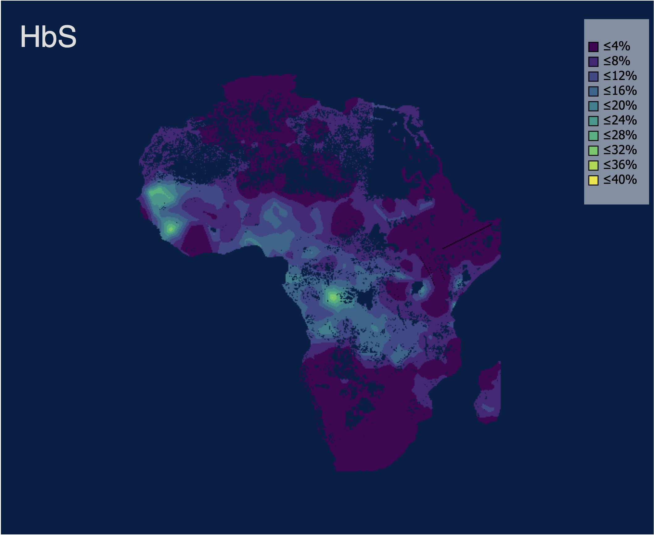
The simplest simulation we could think of
Simulating parasite evolution over the HbS map
Parasite populations at each location evolve in discrete generations t=1,2,3

Slide 26
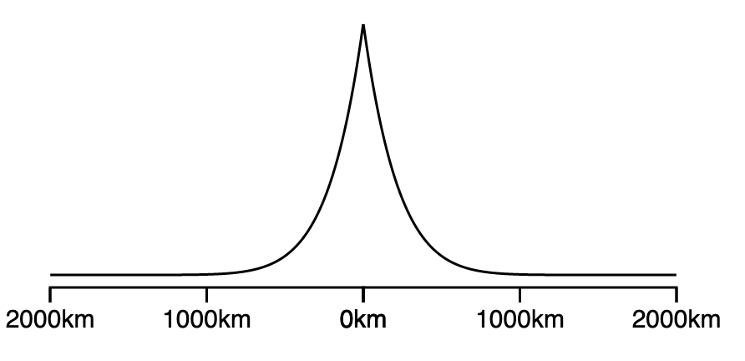
The simplest simulation we could think of
Simulating parasite evolution over the HbS map
Parasite populations at each location evolve in discrete generations t=1,2,3
At each generation, mosquitos bring in infections
from the local area
Biting distance

Slide 27
Simulating parasite evolution over the HbS map
Parasite populations at each location evolve in discrete generations t=1,2,3
At each generation, mosquitos bring in infections
from the local area
Relative fitnesses:
 | A | S
Pfsa- | 100% | 1%
Pfsa+ | 82% | 82%
The infections ‘succeed’ with some probability
that depends on the host and parasite genotype

Slide 28
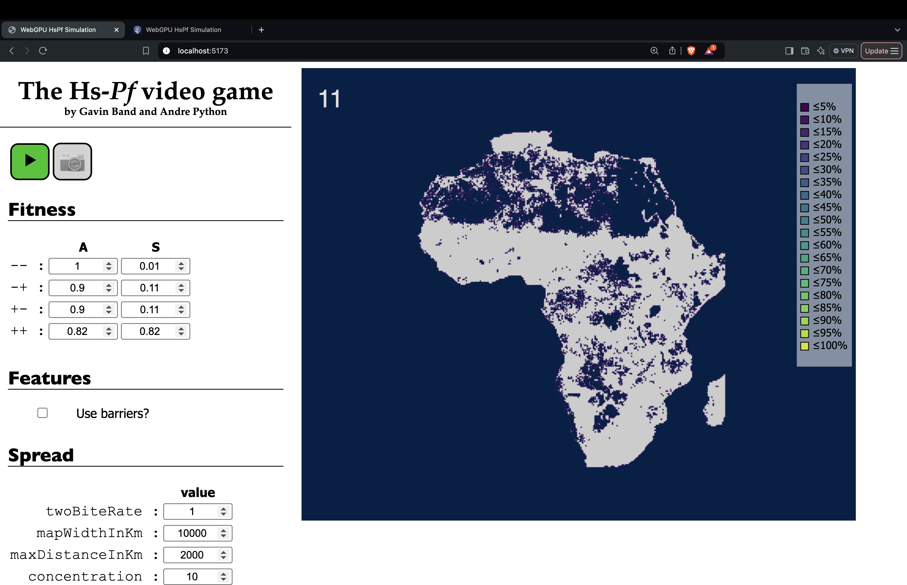
Relative fitness:
 | A | S
- | 100% | 1%
+ | 82% | 82%

Slide 29
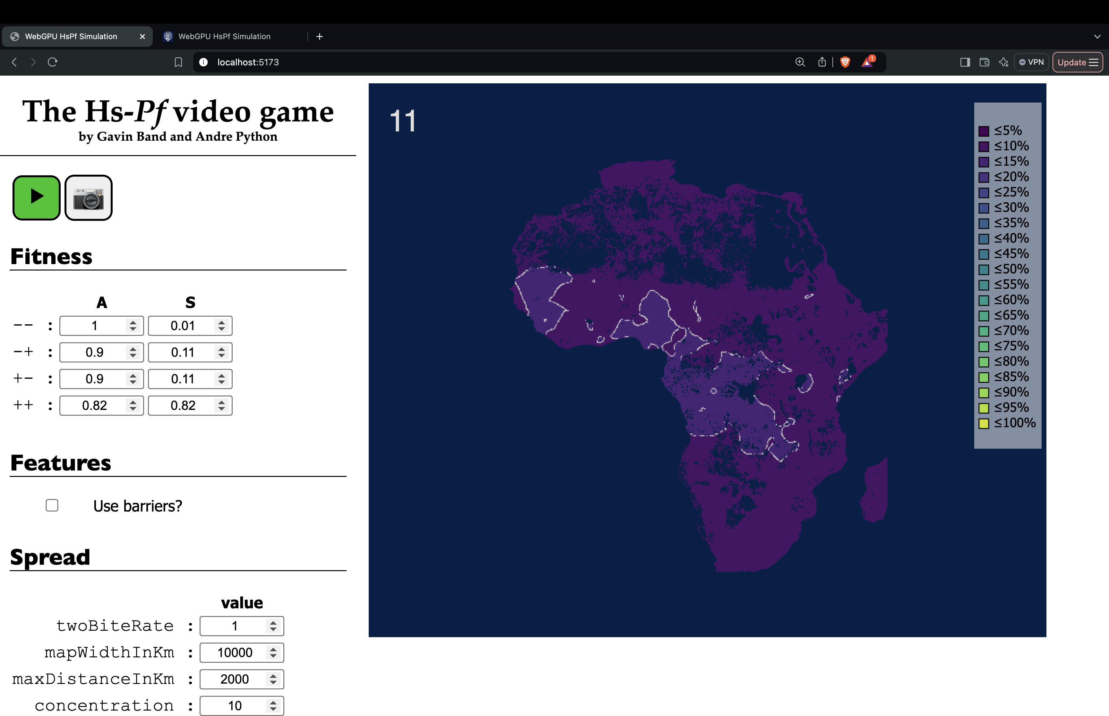
Relative fitness:
 | A | S
- | 100% | 1%
+ | 82% | 82%

Slide 30
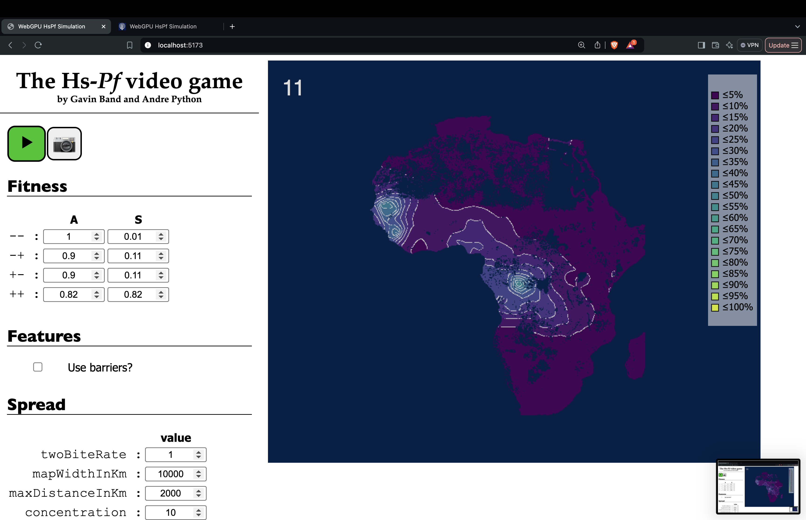
Relative fitness:
 | A | S
- | 100% | 1%
+ | 82% | 82%

Slide 31
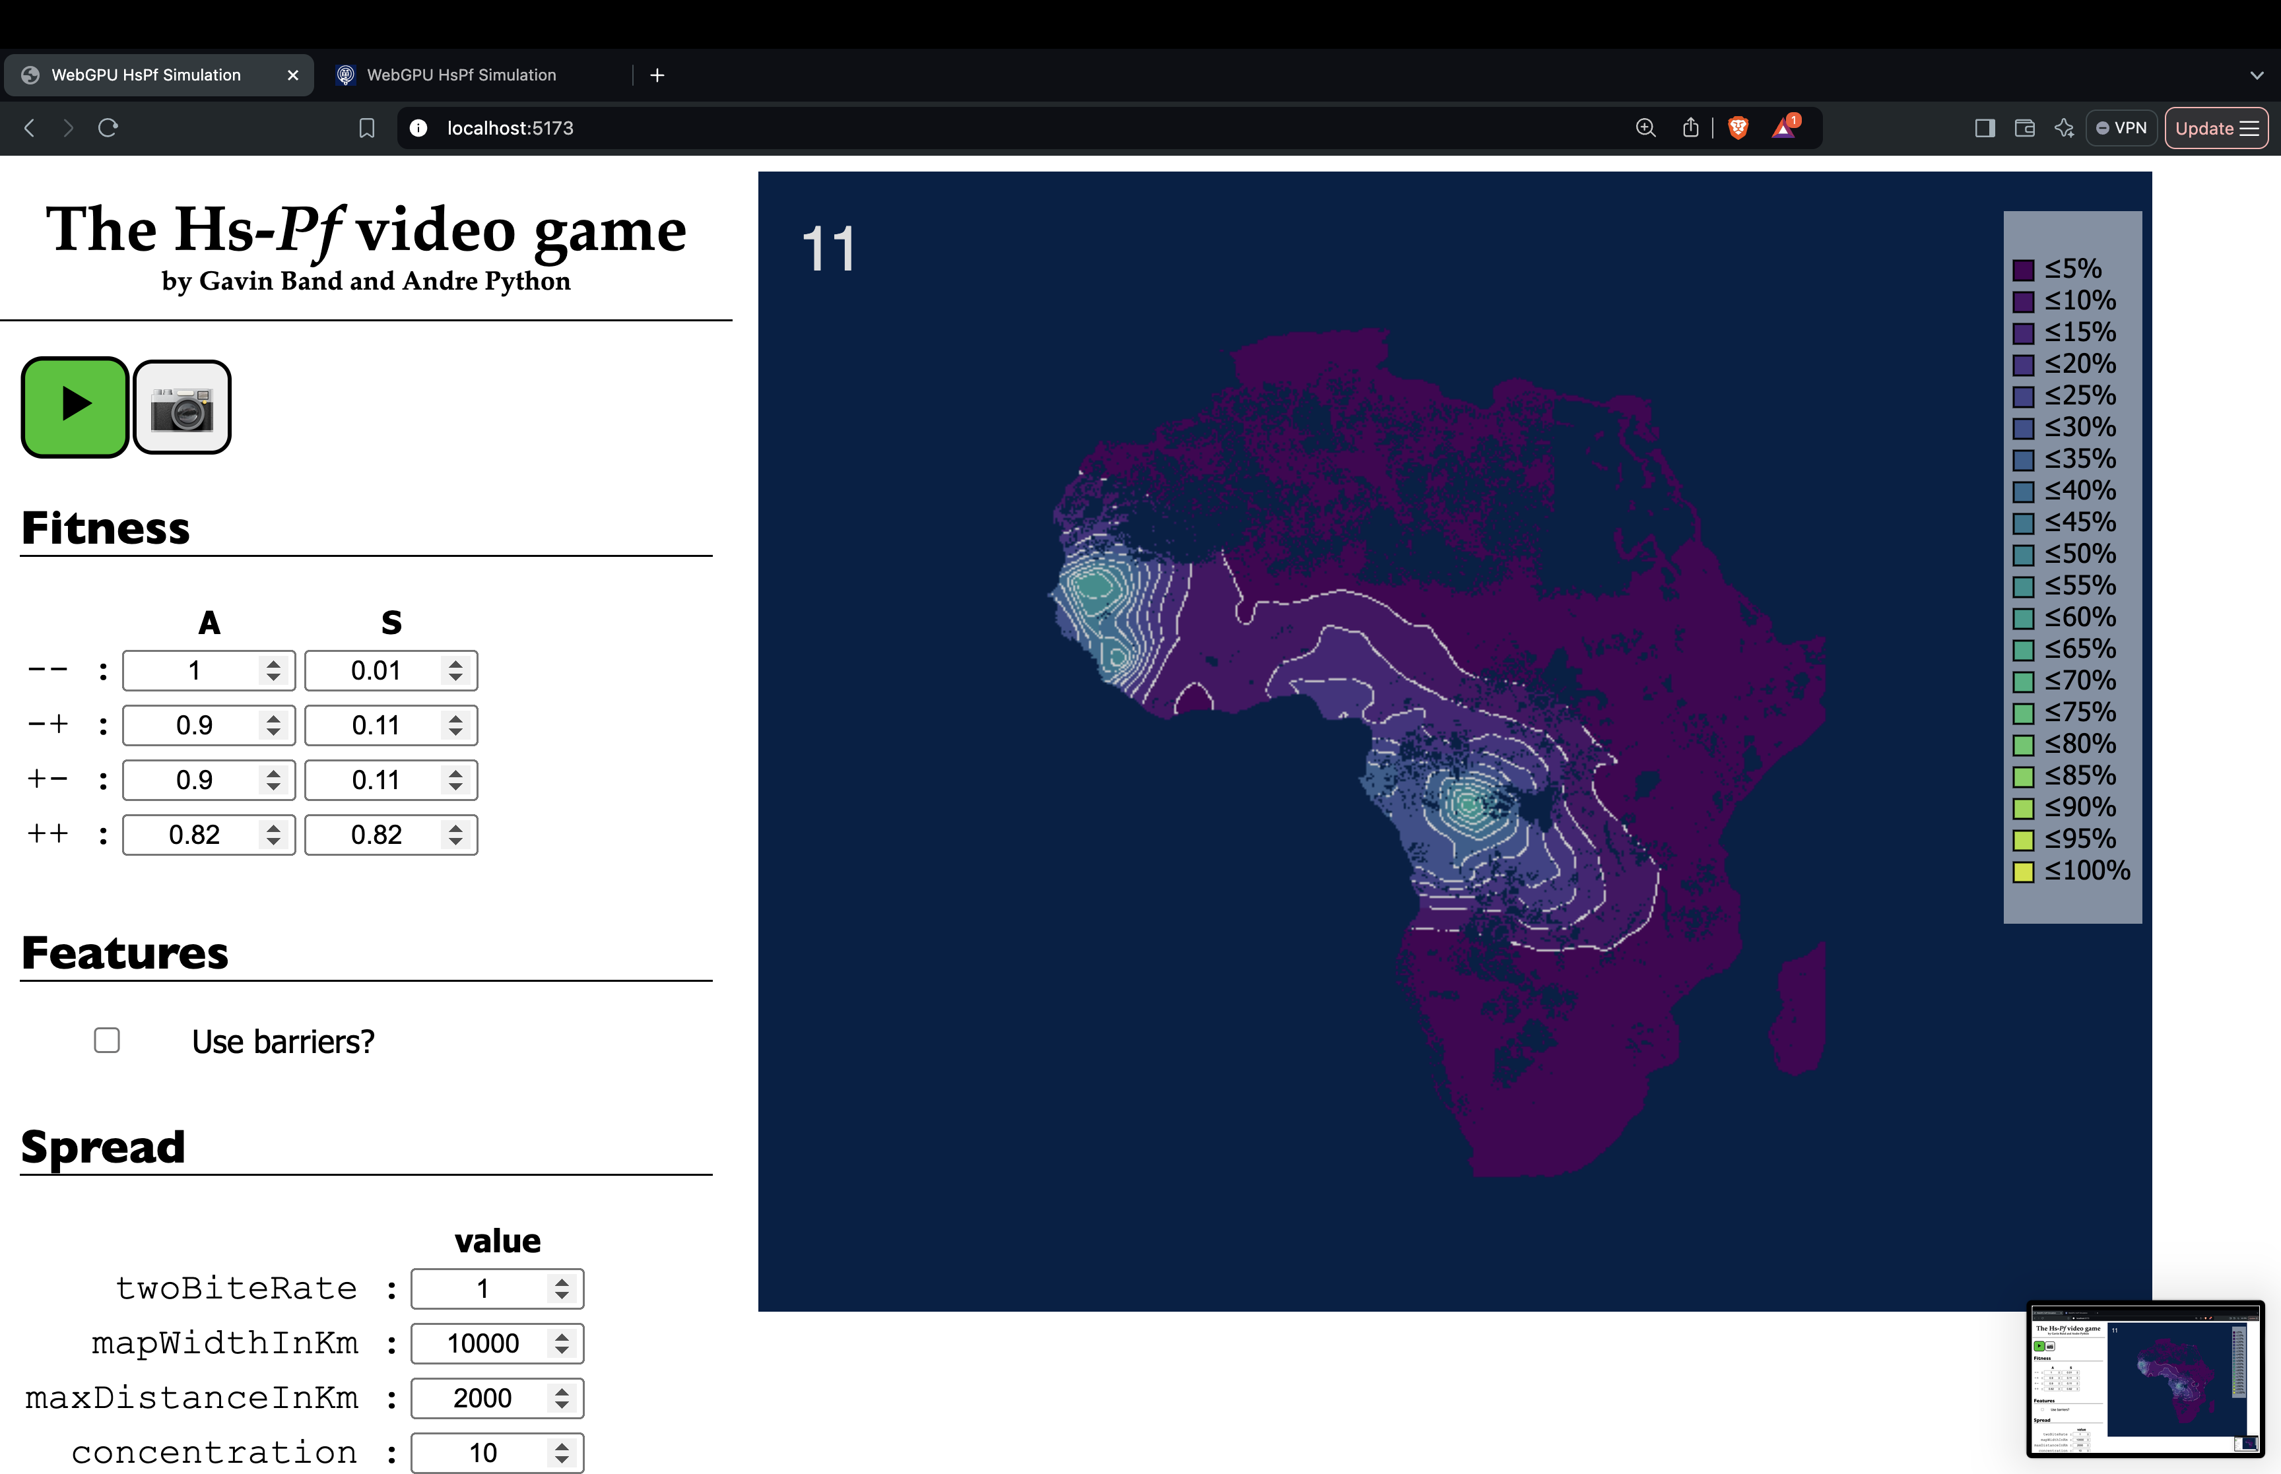
Relative fitness:
 | A | S
- | 100% | 1%
+ | 82% | 82%

Slide 32
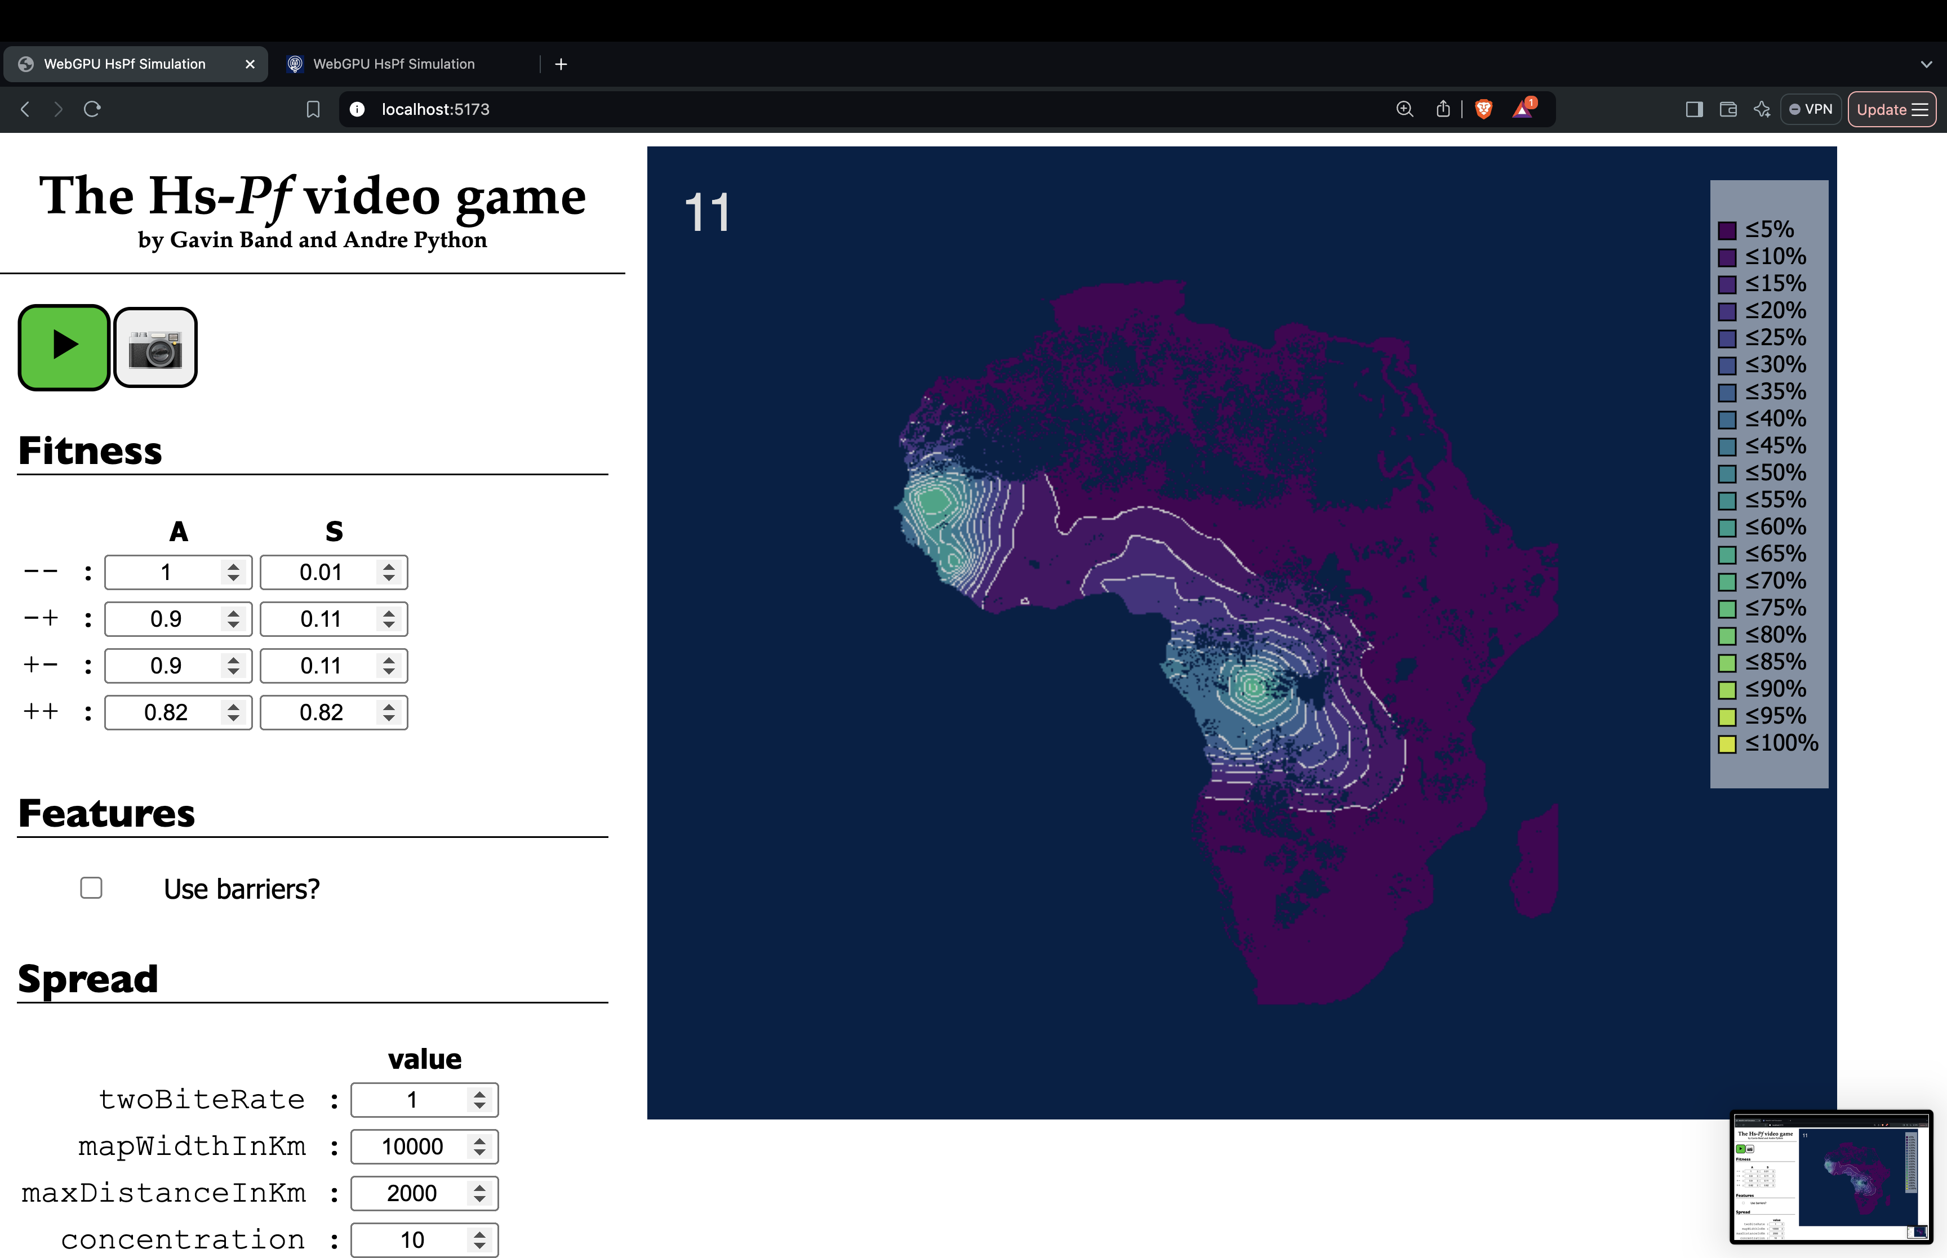
Relative fitness:
 | A | S
- | 100% | 1%
+ | 82% | 82%

Slide 33

Relative fitness:
 | A | S
- | 100% | 1%
+ | 82% | 82%

Slide 34
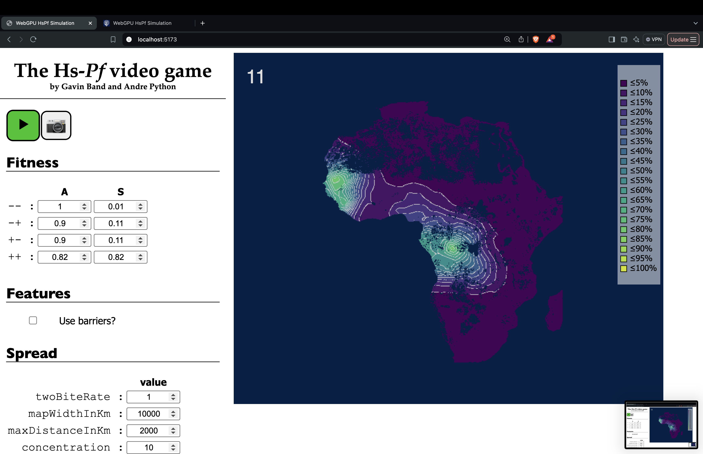
Relative fitness:
 | A | S
- | 100% | 1%
+ | 82% | 82%

Slide 35

Relative fitness:
 | A | S
- | 100% | 1%
+ | 82% | 82%

Slide 36
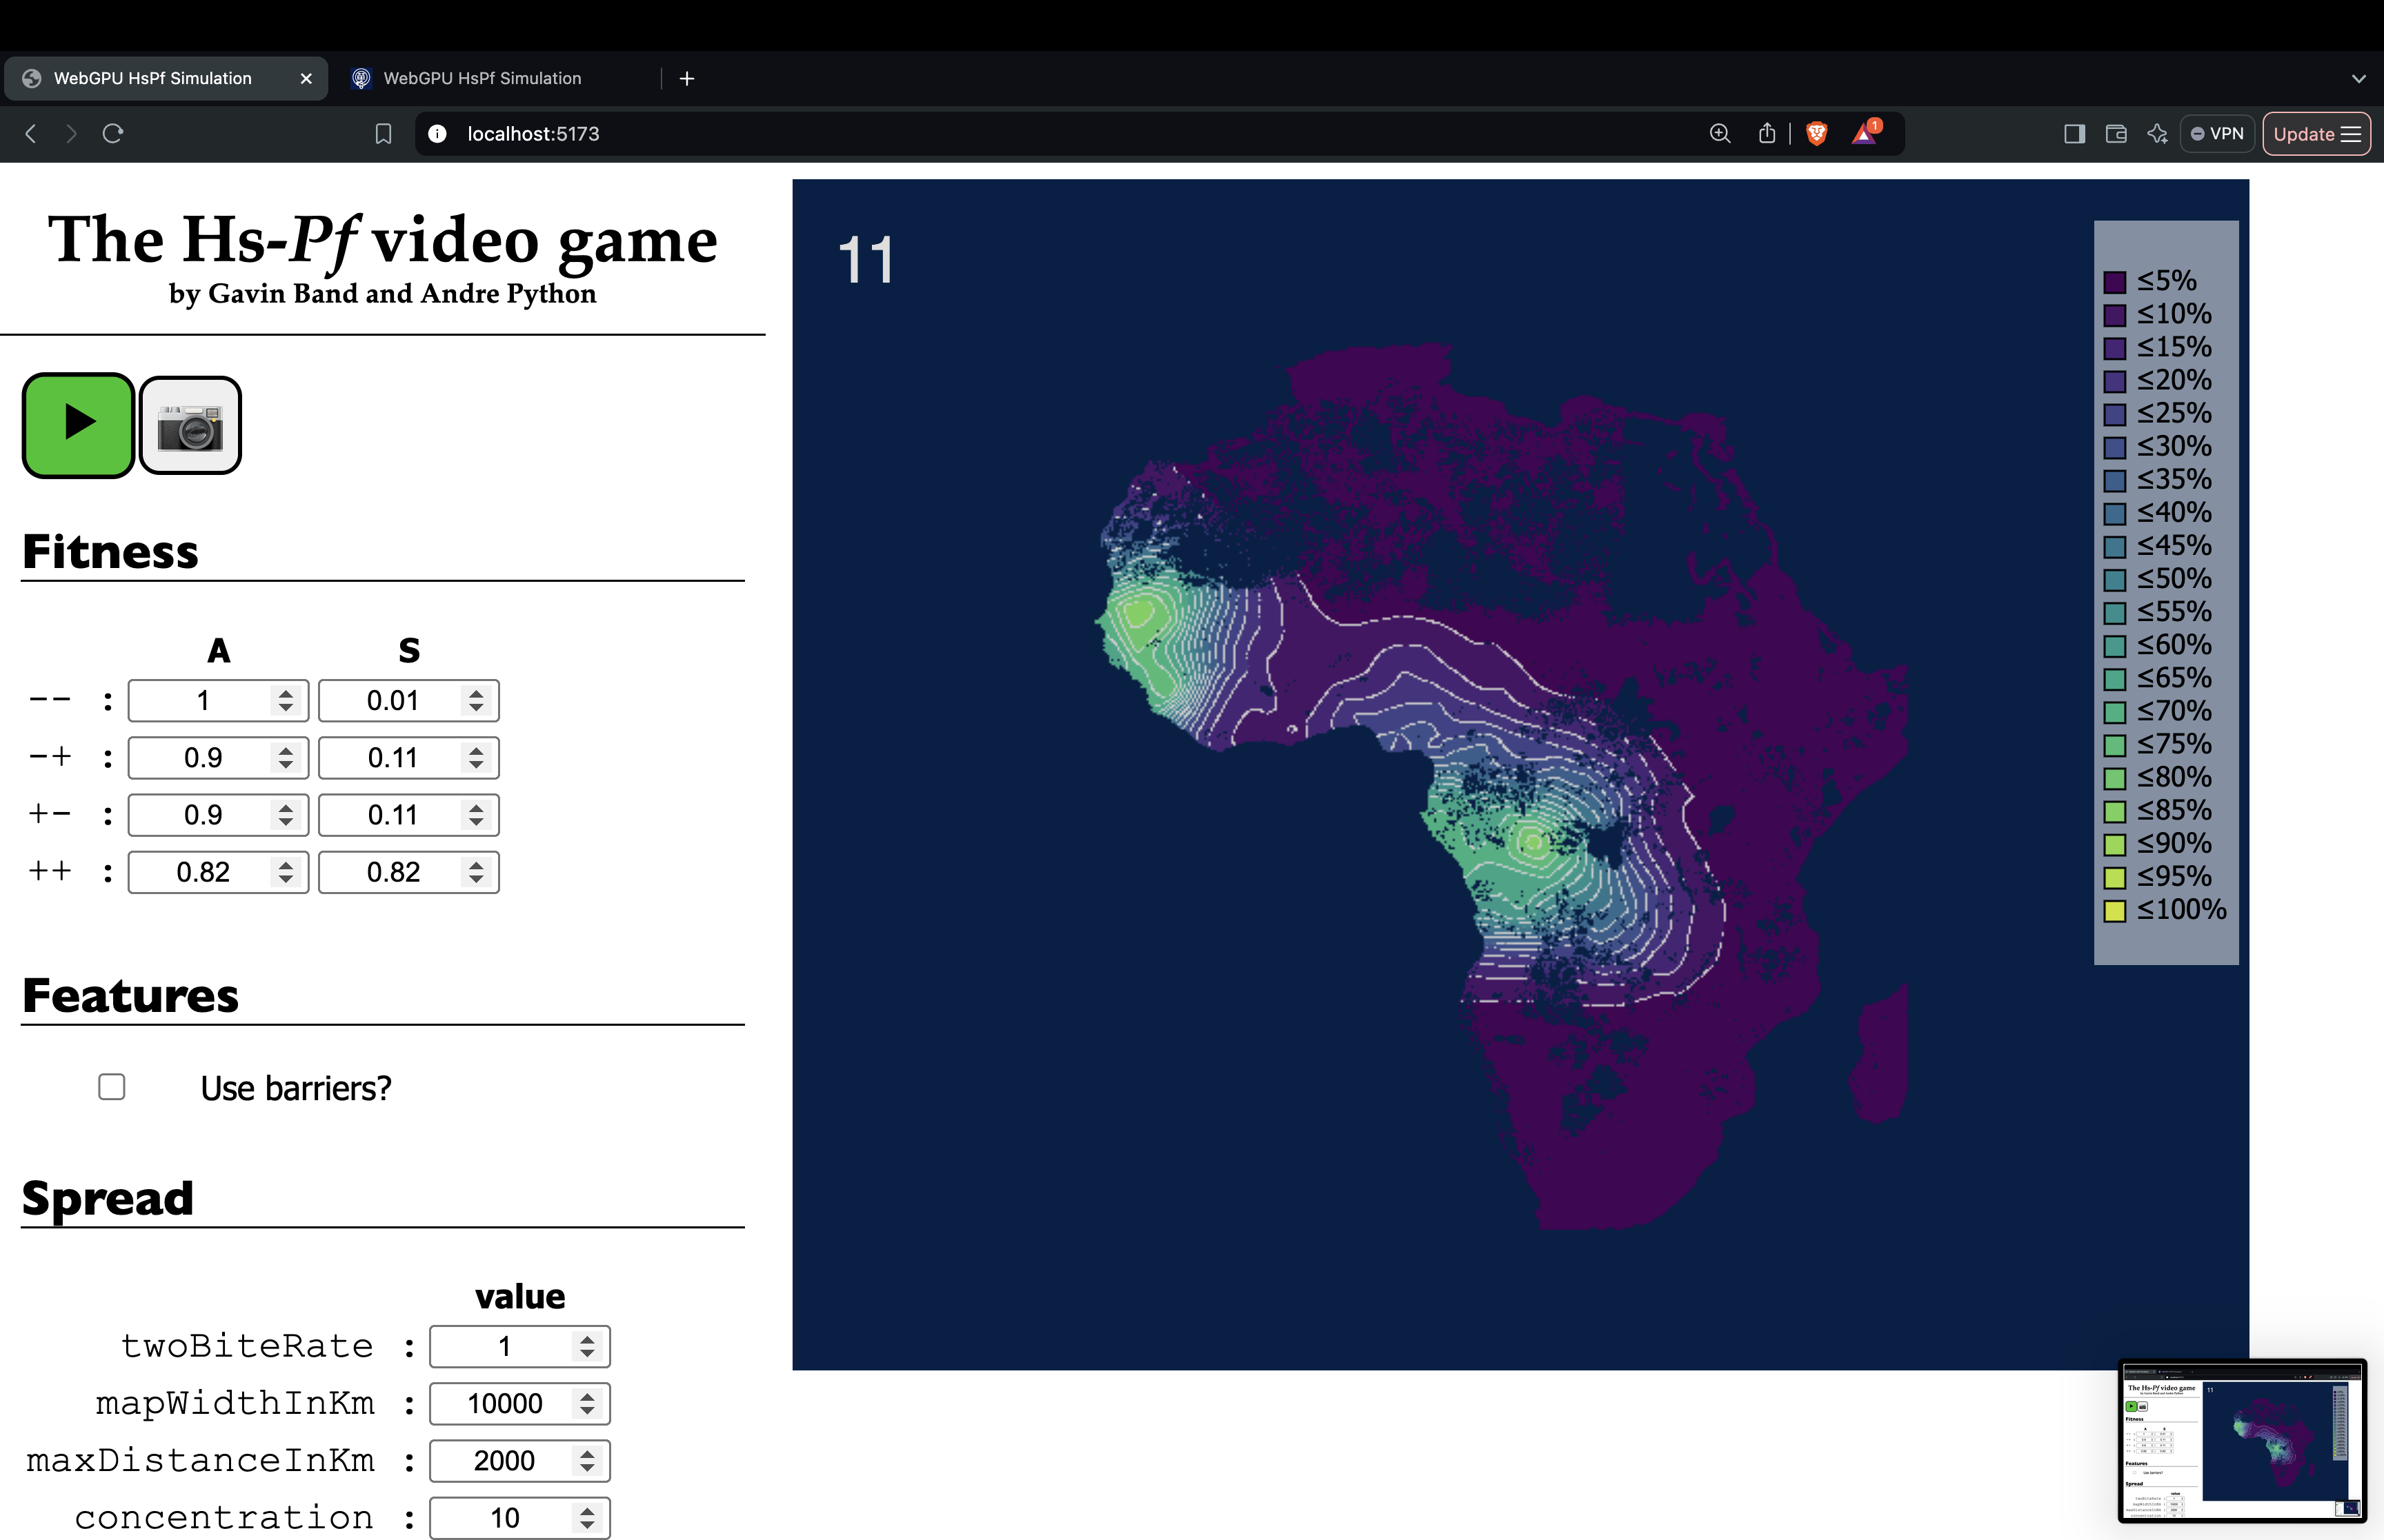
Relative fitness:
 | A | S
- | 100% | 1%
+ | 82% | 82%

Slide 37

Relative fitness:
 | A | S
- | 100% | 1%
+ | 82% | 82%

Slide 38

Relative fitness:
 | A | S
- | 100% | 1%
+ | 82% | 82%

Slide 39

Relative fitness:
 | A | S
- | 100% | 1%
+ | 82% | 82%

Slide 40

Relative fitness:
 | A | S
- | 100% | 1%
+ | 82% | 82%

Slide 41

Relative fitness:
 | A | S
- | 100% | 1%
+ | 82% | 82%

Slide 42

Relative fitness:
 | A | S
- | 100% | 1%
+ | 82% | 82%

Slide 43

Relative fitness:
 | A | S
- | 100% | 1%
+ | 82% | 82%

Slide 44

Relative fitness:
 | A | S
- | 100% | 1%
+ | 82% | 82%

Slide 45

Relative fitness:
 | A | S
- | 100% | 1%
+ | 82% | 82%

Slide 46

Relative fitness:
 | A | S
- | 100% | 1%
+ | 82% | 82%

Slide 47

Relative fitness:
 | A | S
- | 100% | 1%
+ | 82% | 82%

Slide 48

Relative fitness:
 | A | S
- | 100% | 1%
+ | 82% | 82%

Slide 49
Relative fitness:
 | A | S
- | 100% | 1%
+ | 82% | 82%

Slide 50
Relative fitness:
 | A | S
- | 100% | 1%
+ | 82% | 82%

Slide 51
Relative fitness:
 | A | S
- | 100% | 1%
+ | 82% | 82%
(end!)

Slide 52
The parasite population evolves to a stable equilibrium.
The alleles have not swept, but stay polymorphic

Slide 53
Simulated allele frequencies
Observed allele frequencies

Slide 54
This model suggests balancing selection driven by spatial variation in selection pressure.
c.f. Levene model (1953), source-sink theory (Pullian 1988), …
Relative fitness:
 | A | S
- | 100% | 1%
+ | 82% | 82%

Slide 55
Executive summary
Pfsa+ alleles are +vely associated with HbS at multiple geographic scales
This is evidence they are positively selected by the presence of HbS
But they haven’t swept to fixation
The simulation suggests a possible explanation.
Requires a modest opposing fitness cost + spatial variation

Slide 56
Caveats
Lots! (Discuss.)

Slide 57
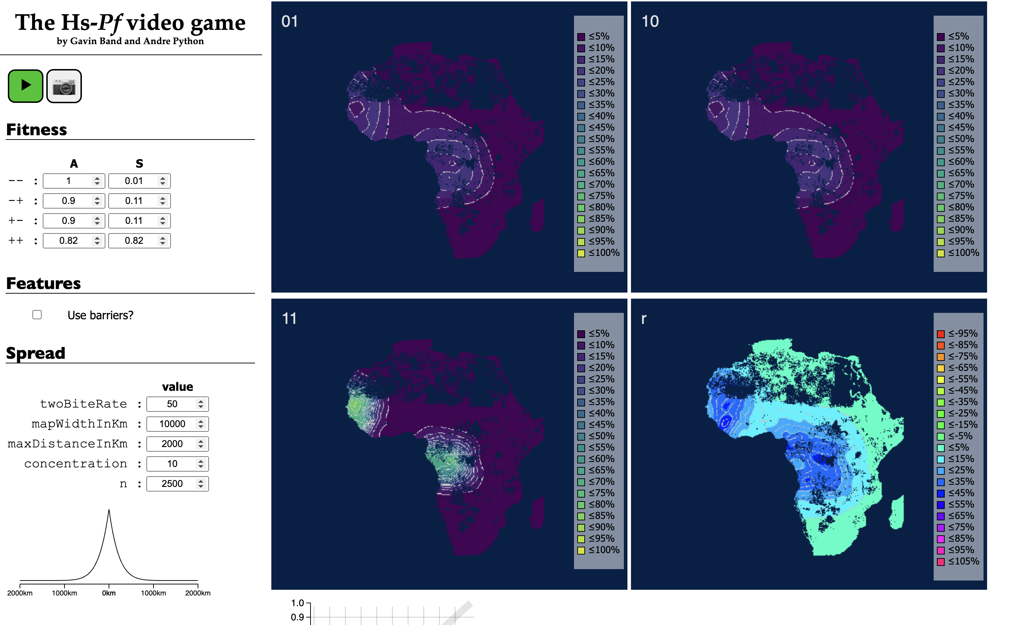
What about between-locus LD?
+ +
genotype
Relative fitness:
 | A | S
- - | 100% | 1%
- + | 90% | 11%
+ - | 90% | 11%
+ + | 82% | 82%
50% of mosquitos bite twice

Slide 58
What about between-locus LD?
+ +
genotype
R
between loci
Relative fitness:
 | A | S
- - | 100% | 1%
- + | 90% | 11%
+ - | 90% | 11%
+ + | 82% | 82%
50% of mosquitos bite twice
The model can generate nonzero between-locus LD

Slide 59





Thanks to:
NIMR Tanzania:
Deus Ishengoma
Zheijiang University:
Andre Python
Brown University:
Jeffrey A. Bailey
Imperial College London:
Robert Verity
UNC School of Medicine
John Juliano, Jonathan Parr
MalariaGEN
University of Oxford:
Annie Forster
Pete Todd
John Todd
University of Utah:
Ellen Leffler
LSHTM:
David Conway
KEMRI-Wellcome:
Thomas N. Williams
and thank you for listening!

