Slide 1
Genomic Medicine and Statistics 4-year DPhil Programme
Gavin Band
4 year Dphil Directors & Administrators’ meeting
Wellcome
3rd December 2024

Slide 2
Genome Medicine and Statistics Wellcome-funded 4-year DPhil programme
Started in 2008
Funding renewed in 2019
Since then we have trained 88 exceptional students
Over 60 affiliated research groups from across fields and departments Oxford

Slide 3
Genome Medicine and Statistics Wellcome-funded 4-year DPhil programme
“Our programme aims… to train future leaders in the application of genomics to advance human health,
...they will conduct experimental and analytical genomic science,… ...address current roadblocks through innovation…
…and realise the potential of genomics.”
Image: tissue imaging (Leedham group, cancer genomics)

Slide 4
Anatomy of the programme…
The 2024 intake are here
September
October
January
Year 1:
Training term
Three lab rotations…
Project
proposal

Slide 5
Anatomy of the programme…
The 2024 intake are here
September
October
January
Year 1:
Training term
Three lab rotations…
Project
proposal
Year 2:
Year 3:
Year 4:
Thesis submission!

Slide 6
Anatomy of the programme…
The 2024 intake are here
September
October
January
Year 1:
Training term
Three lab rotations…
Project
proposal
Year 2:
Year 3:
Year 4:
Thesis submission!
Transition:
Massive success in chosen field(s)

Slide 7
Anatomy of the programme…
The 2024 intake are here
September
October
January
Year 1:
Training term
Three lab rotations…
Project
proposal
Year 2:
Year 3:
Year 4:
Thesis submission!
Transition:
Massive success in chosen field(s)
The 2020 intake are here.

Slide 8
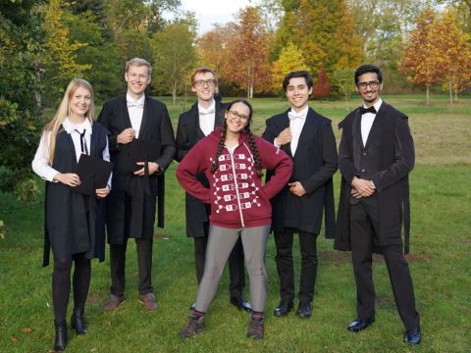
The 2020 intake
In 2020

Slide 9
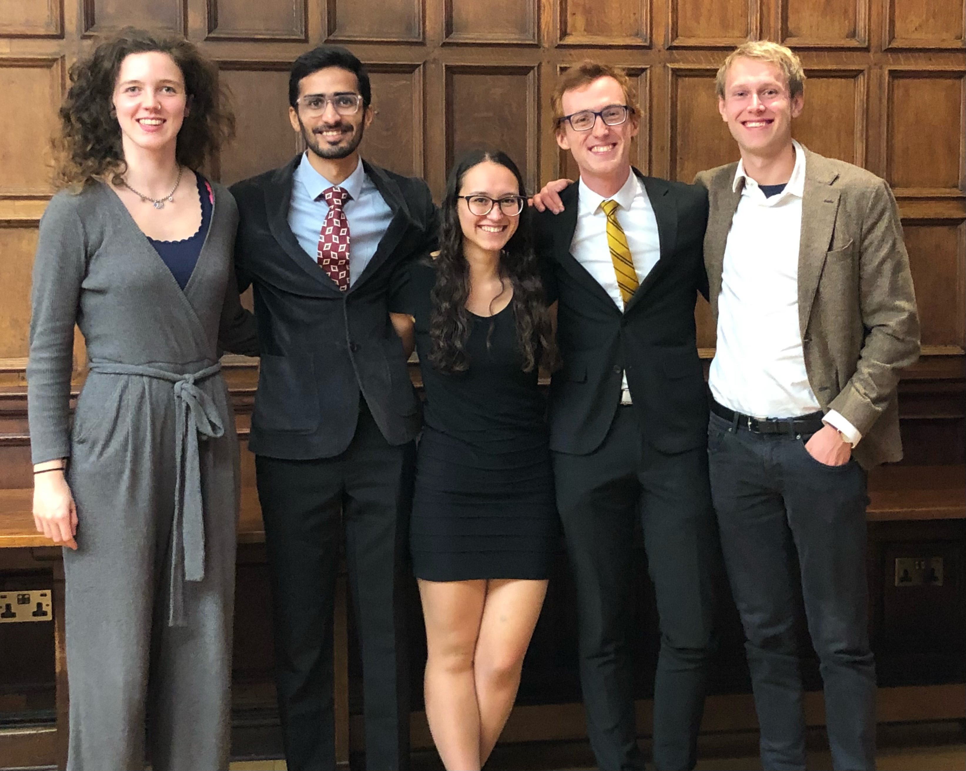
The 2020 intake
In 2020
…and in 2024

Slide 10
Of 7 students in the 2020 year group –
Five have opted to use the transition funds
One has opted not to!
(One has deferred thesis submission, so isn’t there yet)

Slide 11
Aims for transition
Complete work on publications expanding on doctoral work
Develop new skills and methods, distinct from Dphil
Focus on aspects find most inspiring
Networking and career relationships, and entrepreneurship

Slide 12
Quotes from the students
“The fund has been a real game-changer in helping me move into the deep tech startup space … having this support has given me the breathing room to really think through how scientific research can work in the commercial world, and we have now secured space in bio-escalator labs for our venture.”
“My goal is… to shift to translational research closely linked to clinical applications.”
“You feel full to the brim with knowledge, having intensely studied for four years. But you’re also aware of all the interesting side quests you could have gone on but had to ignore in order to finish the thesis. With four years of perspective, you’re in a perfect position to choose which are now worth getting into.”
“I will now applyghostbusters to global human populations, identifying and characterizing possible ‘ghost’ populations in the history of homo sapiens”

Slide 13
Areas of work
Genomic epidemiology of malaria, and vaccines
Statistical methods to understand human ancestry
Fundamental biological mechanisms
Effects of coding and non-coding mutations on human health
Understanding individuals whose phenotypes differ from genetic predictions

Slide 21
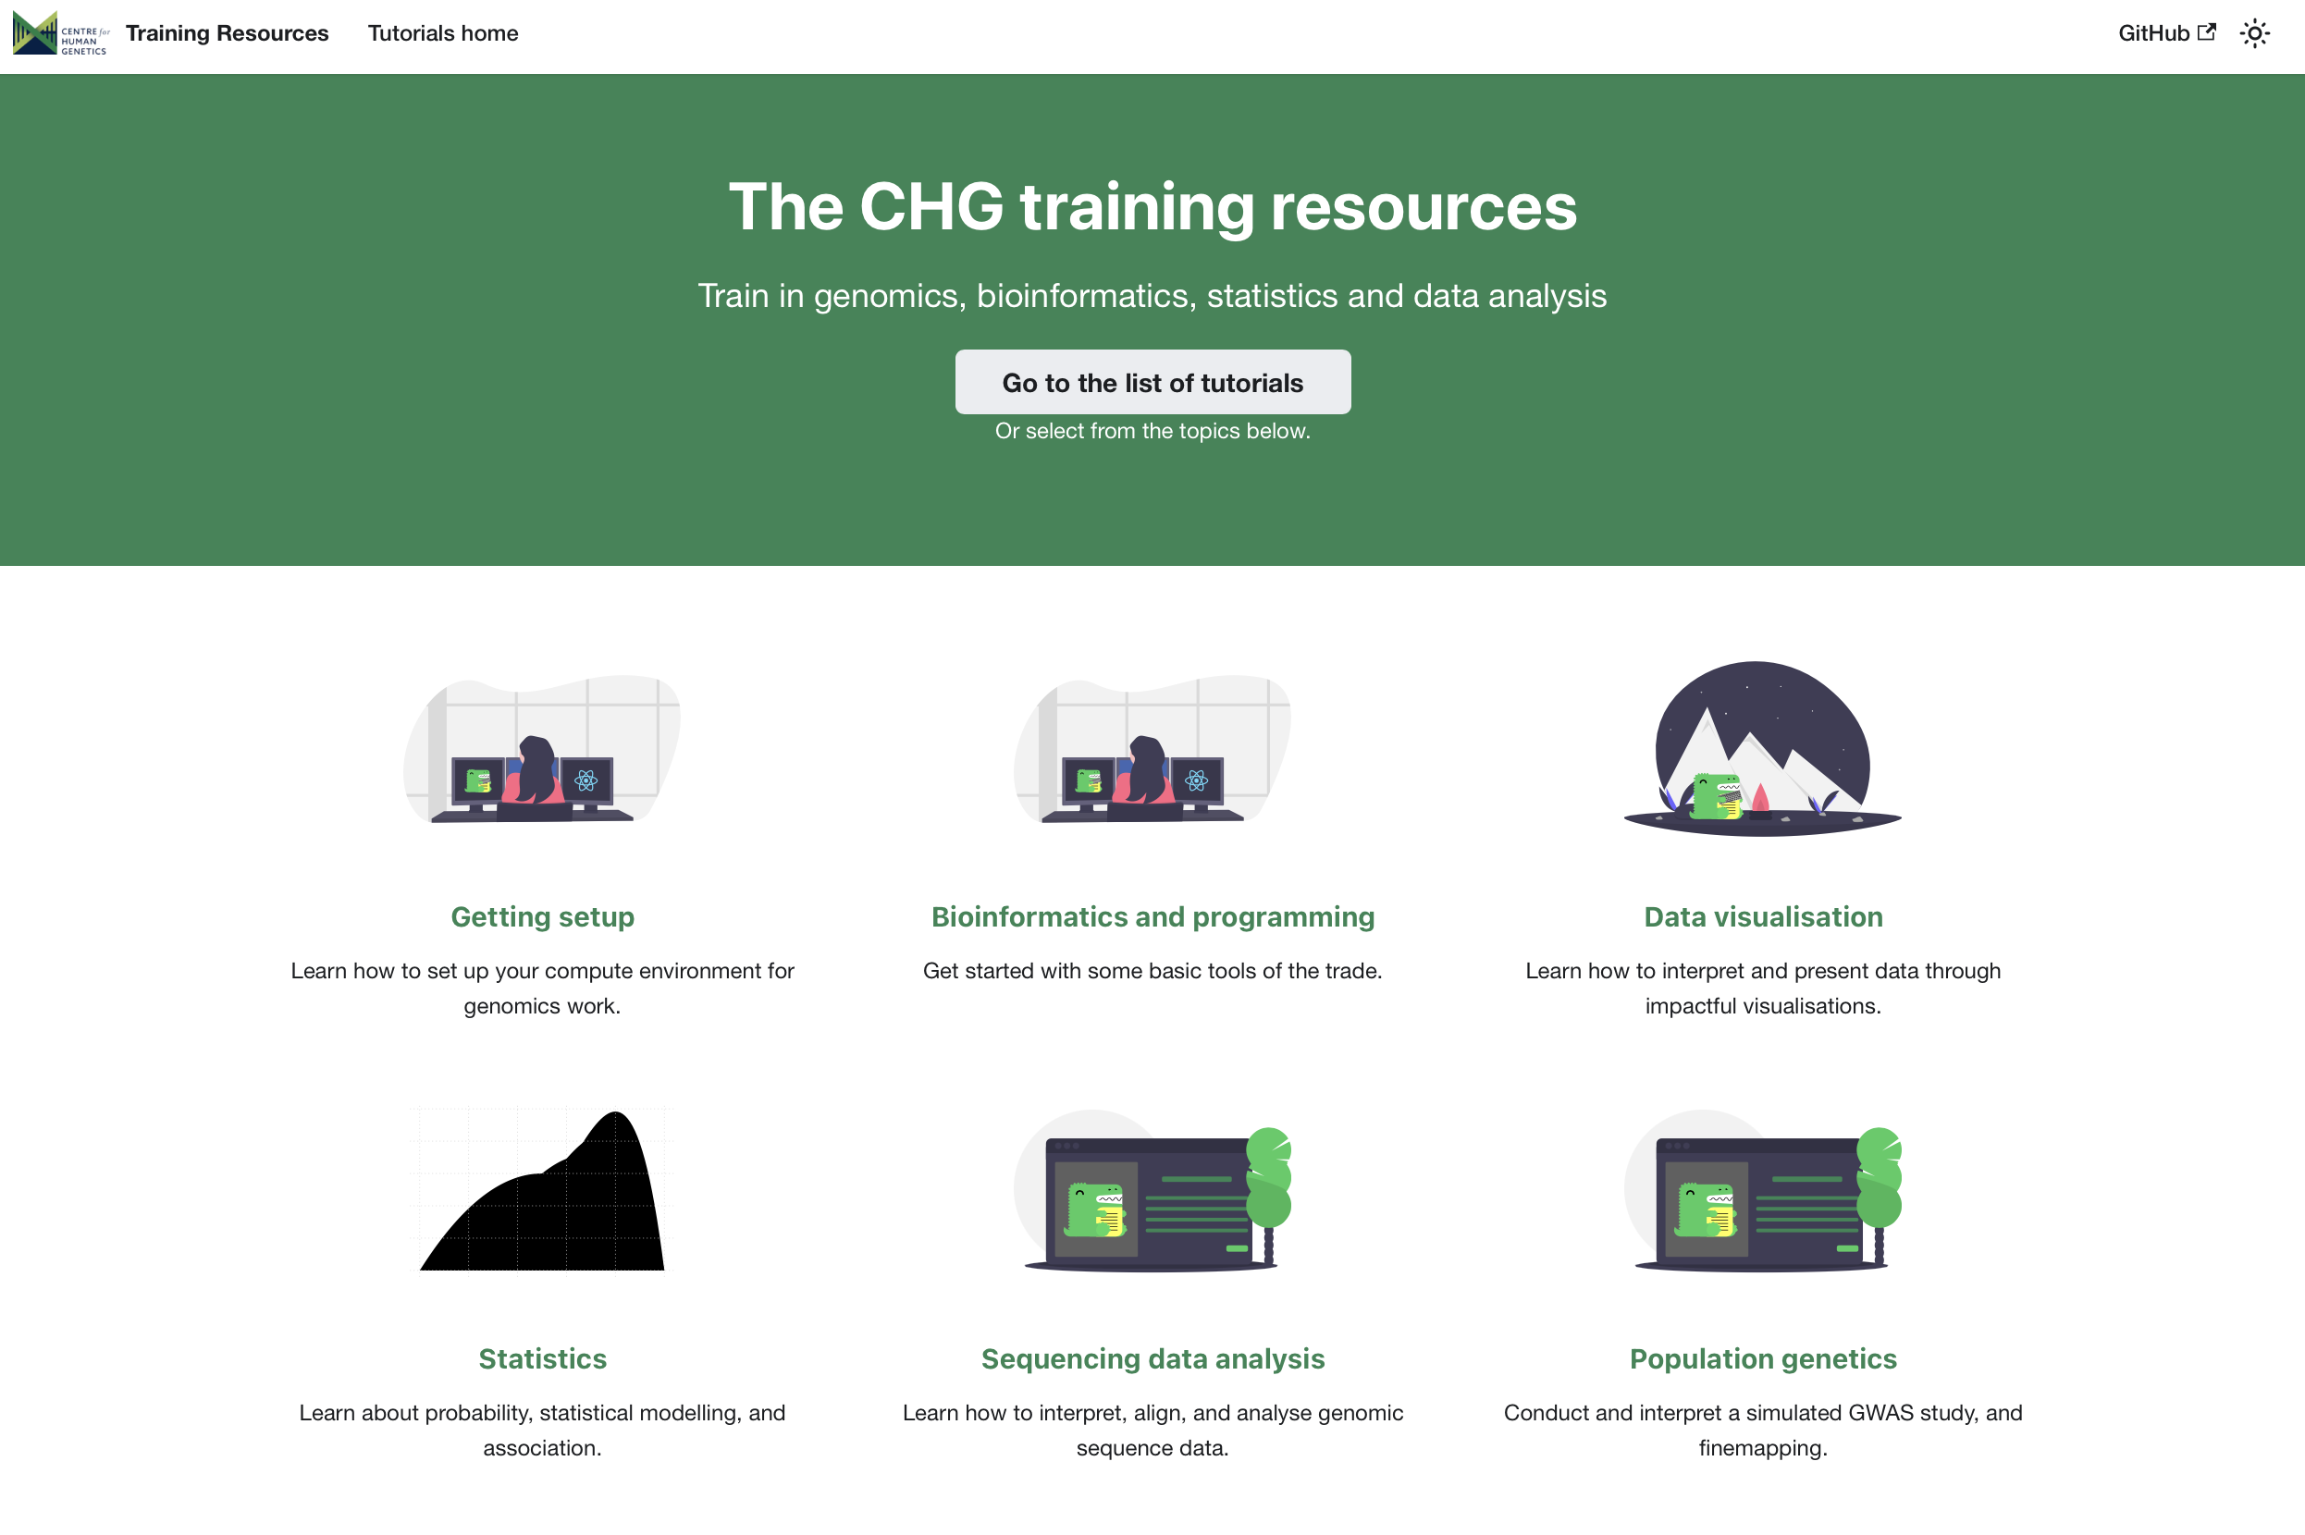
Huge benefits from the programme to the research environment
Bevefits to the research environment also can’t be overstated!
Training for additional participants
over 60 students, postdocs and others have benefitted from training since 2019
Development opportunities for postdocs
Bringing research groups
together - new research
synergies

Slide 23
Please consider re-funding
the 4-year Dphil programmes!

Slide 24
Dear Santa
This year, could Wellcome
please consider re-funding
the 4-year Dphil programmes?
Thank you!
P.S. aalso like a pair of socks.)

Slide 25
Thanks for listening!

