Slide 1

Genome-wide association studies I: Identifying genetic associations with complex traits
Gavin Band gavin.band@well.ox.ac.uk
MSc Global Health Science and Epidemiology
Genetic Epidemiology Module
Tuesday 4th Mar 2025
Notes:
The title of my talk is genome-wide studies as this has been the main focus of my research over the last 3 years.

Slide 2
Learning objectives
Understand a genome-wide association study (GWAS) and the concept of a hypothesis-free approach to studying genetic associations.
Have a working knowledge of the different steps involved in the conduct of GWAS, including study design, quality control and basic analyses.
Be able to interpret and critically appraise evidence from genome-wide association studies.
Understand the relevance of replication, meta-analysis and consortia, and multi-ancestry approaches, in genome-wide association studies.
Appreciate the use of post-GWAS analyses including fine mapping, gene and pathway analyses, and the concept of causal variants.

Slide 3
Main lecture messages
1. Most human phenotypes are highly heritable
(a large proportion of variation is due to genetics)
2. But many ‘complex’ traits are not mendelian - they are polygenic
3. The discovery of this fact is due to genome-wide association studies (GWAS), the first of which was conducted in the mid 2000s.
We will go into this in some detail – methodology, population genetics, GWAS in practice
4. (But understanding the biology can be hard…)

Slide 4
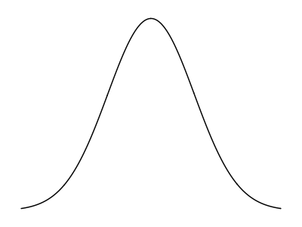
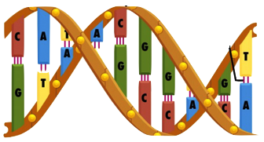
The human genome is ~3.2 billion base pairs long.
About 1 in 100 – 1000 of those bases vary between people.
What proportion of phenotypic variation is due to genetic variation?

Slide 5
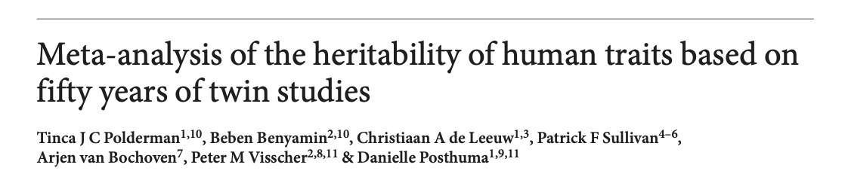
Human traits are highly heritable
We don’t have to guess!
Idea: if genetics determines a trait, then more genetically similar individuals should have more similar phenotypes.
We can estimate how much genetics determines trait variation by comparing trait similarity in more genetically similar and less genetically similar individuals, such as monozygotic and dizygotic twins.
(2015)
Large meta-analysis of > 2000 twin studies
(Browse the results at: https://match.ctglab.nl)

Slide 6
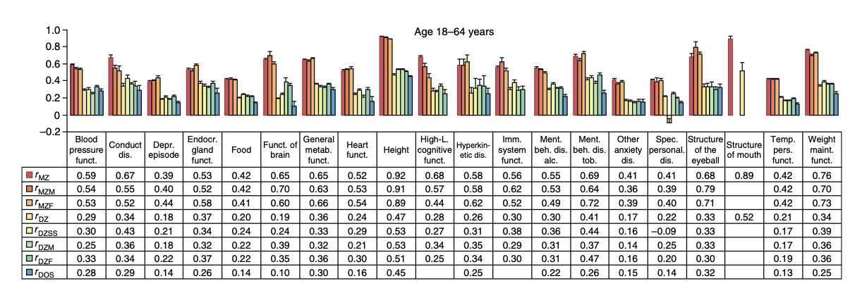
Human traits are highly heritable
Idea: if genetics determines a trait, then more genetically similar individuals should have more similar phenotypes.
MZ
Twins r~0.92
DZ
Twins
r~0.47
Compare trait correlations between twins.
(Adult) height is much more similar between monozygotic than dizygotic twins.
The heritability is about 90%.
All studied traits
Heritability is the proportion of trait variation explained by inherited factors (including genetics) . Can be estimated as $h2≈2×\left(r_{MZ}−r_{DZ}\right).$

Slide 7





Human traits are highly heritable
If genetics determines a trait, then more genetically similar individuals should have more similar phenotypes.
(2015)
Monozygotic
Dizygotic
Blood pressure
$$h^{2}≈60\%$$
Depression
$$h^{2}≈42\%$$
Adult height
$$h^{2}≈90\%$$
“Higher level cognitive function”
$$h^{2}≈80\%$$
Structure of the eyeball
$$h^{2}≈70\%$$
Lots of theoretical caveats might apply here – see Lecture 1. But in general it is true that a large proportion of variation in most human phenotypes is caused by genetics.
(Browse the results at: https://match.ctglab.nl)

Slide 8
Two possible extreme genetic architectures
Affected
Example: Huntingdon’s
Not affected
Phenotype
Genotype
population
Affects ~1 in 20,000 people of European ancestry
(less in Africa and Asia)
Discovered by looking in families
Strength of effect
Very rare
rare
common
Very common
Genotype frequency
A “Mendelian” trait

Slide 9




Two possible extreme genetic architectures
Affected
Example: Huntingdon’s
Not affected
Phenotype
Genotype
population
Affects ~1 in 20,000 people of European ancestry
(less in Africa and Asia)
$$1,000$$
Discovered by looking in families
Relative risk
$$100$$
$$10$$
$$1$$
Very rare
rare
common
Very common
Genotype frequency
A “Mendelian” trait

Slide 10
End of an era
“Linkage Mapping was successful in identifying the genetic basis of many human diseases in which the disease penetrance resembles a simple Mendelian model e.g. Huntington’s disease, Cystic Fibrosis, some forms of breast cancer, Alzheimers, …“
Cystic fibrosis (CFTR)
Discovery of A/B/O
‘Sanger’ DNA sequencing
Breast cancer (BRCA1/2 )
1901
1970’s
1989
1994-5
1950’s
1980’s
1993
“…but the literature is now replete with linkage screens for an array of common ‘complex’ disorders such as schizophrenia, manic depression, autism, asthma, type I and type II diabetes, Multiple Sclerosis, Lupus. Although many of these studies have reported significant linkage findings, none has lead to convincing replication”
– Risch “Searching for genetic determinants in the new millennium” Nature (2000)
Structure of DNA
Low-throughput genotyping methods
Huntingdon’s (HTT)
Alzheimer’s (APOE)
The era of linkage (family) studies

Slide 11
Common variant, common disease hypothesis
Affected
Phenotype
Genotype
population
Strength of effect
Very rare
rare
common
Very common
Genotype frequency

Slide 12


Common variant, common disease hypothesis
Affected
Phenotype
Genotype
population
$$4$$
Relative risk
$$2$$
$$1$$
Very rare
rare
common
Very common
Genotype frequency

Slide 13
Common variant, common disease hypothesis
Affected
Phenotype
Genotype
population
A complex trait.
Caused by many factors, each having a small overall effect. Including
Many genetic variants, including common ones
Environmental factors
Gene-environment or gene-gene interactions
…
$$4$$
Relative risk
$$2$$
$$1$$
Very rare
rare
common
Very common
Genotype frequency

Slide 14
Summary
Most human phenotypes are highly heritable - a large proportion of phenotype variation seems to be caused by genetics. ~60% on average!
In principle this heritability could occur in different ways – for example through single variants with strong effects, or through multiple variants with small effects.
By the 2000s family studies had identified the causes of several mendelian traits, but had failed to solve the genetics of multiple complex diseases.
Was the “common variant, common disease“ hypothesis true?

Slide 15
End of the linkage era
Cystic fibrosis (CFTR)
Discovery of A/B/O
‘Sanger’ DNA sequencing
Breast cancer (BRCA1/2 )
1901
1970’s
1989
1994-5
1950’s
1980’s
1993
Structure of DNA
Low-throughput genotyping methods
Huntingdon’s (HTT)
Alzheimer’s (APOE)

Slide 16
The birth of GWAS
Cystic fibrosis (CFTR)
First proof of principle GWAS studies e.g. WTCCC
Human genome completed
Discovery of A/B/O
‘Sanger’ DNA sequencing
Breast cancer (BRCA1/2 )
1901
1970’s
1989
1994-5
2003
2007
1950’s
1980’s
1993
2005
2010
Structure of DNA
Low-throughput genotyping methods
Huntingdon’s (HTT)
Mapping of > 1 million common genetic variants
(International HapMap Project)
High-throughput ‘next generation’ sequencing
Alzheimer’s (APOE)
Microarray genotyping technology
(100s of 1000s of markers)

Slide 17
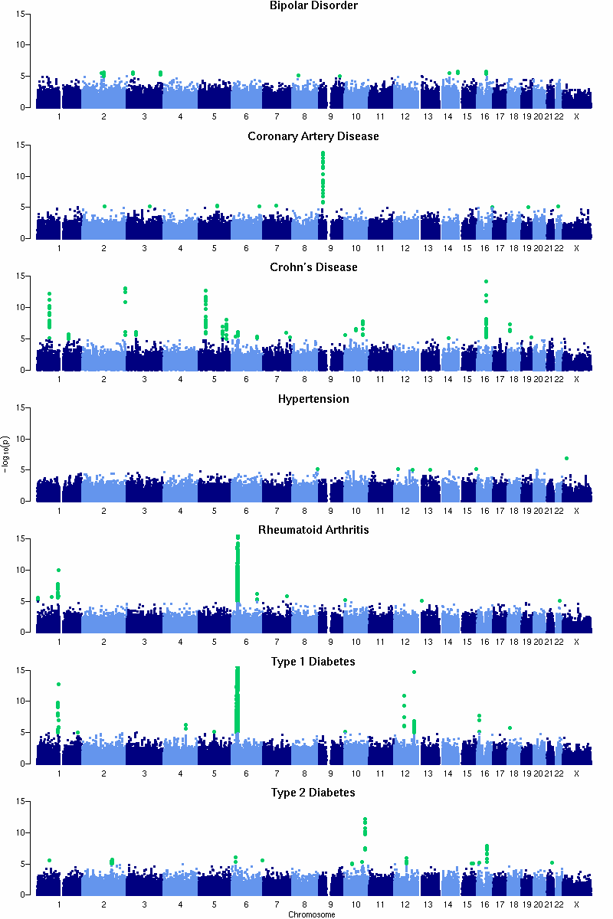
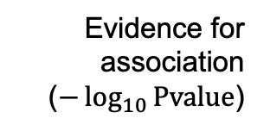
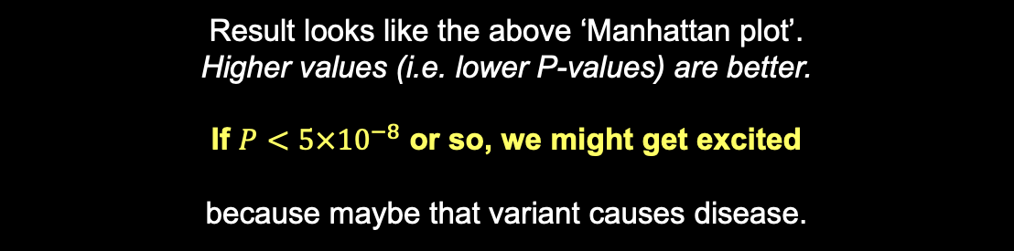
What we are aiming for – GWAS roadmap:
Evidence for association ($−\log_{10}{\text{Pvalue}}$)
Variants across the genome
Collect as many samples as possible
Genotype at as many variants across the genome as possible
Run a statistical test of association between each genetic variant and the trait
Result looks like the above ‘Manhattan plot’.
Higher values (i.e. lower P-values) are better.
If $P<5×{10}^{−8}$ or so, we might get excited
because maybe that variant causes disease.

Slide 18
Rest of lecture - outline
Testing for association
How to do the statistical tests? How many samples? How to deal with confounders?
What variants to genotype, and how?
Patterns of linkage disequilbrium and the HapMap study
A real GWAS study – WTCCC
The common variant, common disease hypothesis in practice

Slide 19
Testing for association
Imagine a genetic variant that affects risk of disease
G
g
Unaffected individuals
Disease “cases”
Phenotype distribution
in the population

Slide 20

Testing for association
G
g
Unaffected individuals
Disease “cases”
If genotype G causes disease, then carrying G will make you more likely to have disease.
“Chance/frequency of disease given genotype G”
$$= \frac{P\left(\text{disease}|\text{genotype} G\right)}{P\left(\text{disease}|\text{genotype} g\right)}>1$$
Relative risk
“Chance/frequency of disease given genotype g”

Slide 21

Testing for association
G
g
Unaffected individuals
Disease “cases”
If genotype G causes disease, then carrying G will make you more likely to have disease.
$$=\frac{P\left(\text{disease}|G\right)}{P\left(\text{disease}|g\right)}>1$$
Relative risk
Using probability notation
If the genotype causes disease, then the relative risk will be different from 1

Slide 22

How to estimate relative risk?
$$RR=\frac{P\left(\text{disease}| G\right)}{P\left(\text{disease}| g\right)}$$
(in population)
Disease frequencies given genotype

Slide 23

How to estimate relative risk?
$$RR=\frac{P\left(\text{disease}| G\right)}{P\left(\text{disease}| g\right)} = \frac{P\left(G|\text{disease}\right)}{P\left(g|\text{disease}\right)}×\frac{P(g)}{P(G)}$$
(in population)
Disease frequencies given genotype
Genotype frequencies in cases and controls
To estimate the relative risk, we just need to measure the genotypes in some disease cases and population controls.
(Note: apply Bayes’ theorm)

Slide 24

How to estimate relative risk?
$$RR=\frac{P\left(\text{disease}| G\right)}{P\left(\text{disease}| g\right)} = \frac{P\left(G|\text{disease}\right)}{P\left(g|\text{disease}\right)}×\frac{P(g)}{P(G)}$$
(in population)
Disease frequencies given genotype
Genotype frequencies in cases and controls
To estimate the relative risk, we just need to measure the genotypes in some disease cases and population controls.
 | G | g
Disease cases: | a | b
Controls*: | c | d
$$OR=\frac{a}{b}×\frac{d}{c}$$
(in sample)

Slide 25
How to estimate relative risk?
$$RR=\frac{P\left(\text{disease}| G\right)}{P\left(\text{disease}| g\right)} = \frac{P\left(G|\text{disease}\right)}{P\left(g|\text{disease}\right)}×\frac{P(g)}{P(G)}$$
(in population)
Disease frequencies given genotype
Genotype frequencies in cases and controls
To estimate the relative risk, we just need to measure the genotypes in some disease cases and population controls.
 | G | g
Disease cases: | a | b
Controls*: | c | d
$$OR=\frac{a}{b}×\frac{d}{c}$$
(in sample)
The odds ratio in a sample of cases and (population) controls
estimates the population relative risk.
Note: Also approximately true for ‘true’ controls, provided the disease is relatively rare.

Slide 26

Key fact
 | G | g
Disease cases: | a | b
Population controls*: | c | d
$$OR=\frac{a}{b}×\frac{d}{c}$$
(in a sample of disease cases and population controls)
The odds ratio in a sample of cases and controls*
estimates the population relative risk.
Stricyly this applies to ‘population controls’, but also approximately true for ‘true’ disease controls, as long as the disease is not too common.

Slide 27
Example: O blood group and severe malaria
Cases were ascertained as children arriving in hospital with severe symptoms compatible with malaria & parasitaemia, in a hospital in Kilifi, eastern Kenya. Controls were ascertained from new births in the same hospitals.
 | O | non-O
Severe malaria cases | 686 | 843
Controls: | 839 | 700
Can you compute the odds ratio?
N=3,068 samples
MalariaGEN 2019 doi: 10.1038/s41467-019-13480-z

Slide 28

Example: O blood group and severe malaria
Cases were ascertained as children arriving in hospital with severe symptoms compatible with malaria & parasitaemia, in a hospital in Kilifi, eastern Kenya. Controls were ascertained from new births in the same hospitals.
 | O | non-O
Severe malaria cases | 686 | 843
Controls: | 839 | 700
$$OR=\frac{686}{843}×\frac{700}{839}=0.68$$
N=3,068 samples
MalariaGEN 2019 doi: 10.1038/s41467-019-13480-z

Slide 29

Suggests people with O blood group get severe malaria at ~70% of the rate of people without
Could say: “O blood group is associated with ~30% reduced risk of severe malaria.”
But how much statistical evidence is there that this is a real effect?
$$OR=\frac{686}{843}×\frac{700}{839}=0.68$$

Slide 30





The key association test summary statistics
How strong is the estimated effect?
In our example this is the odds ratio (OR).
Often seen on the log scale, i.e. as log(OR) where the maths works out better.
Effect size estimate
$\hat{β}$ = log(OR)
Standard error
How much noise is there in the estimate, because we only have a finite sample?
$$se$$
$$\hat{β}$$
$$1.96⋅\text{se}$$
$$1.96⋅\text{se}$$
A 95% confidence interval
P-value
How unlikely was such a big estimate, if actually there was no effect?
In practice computed from the beta and standard error:
$$P=Φ^{−1}\left(\frac{log⁡(\text{OR})}{\text{se}}\right)$$
Informally, a small p-value means the effect is unlikely to be zero
Normal distribution function

Slide 31


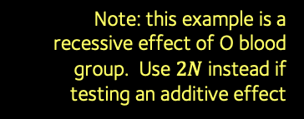

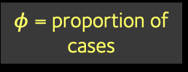
Incredibly useful formula
Fact: the standard error is largely determined by the study design.
Here is a very useful formula which approximates it in the 2x2 table example:
$$\text{Standard} \text{error}(\log{OR)}≈\frac{1}{\sqrt{N×f\left(1−f\right)×φ(1−φ)}}$$
N = sample size = $a+b+c+d$
$φ$ = proportion of cases
f = frequency of G allele
Note: this example is a recessive effect of O blood group. Use $2N$ instead if testing an additive effect
The standard error depends on sample size, frequency, and case/control ratio.
It gets smaller (at rate $\frac{1}{\sqrt{N}}$ ) as the sample size increases.

Slide 32








Example: O blood group is associated with malaria protection
 | O | non-O
Severe malaria cases | 686 | 843
Controls: | 839 | 700
$$N=3,068$$
$$f≈0.55$$
$$φ≈0.5$$
$$OR=\frac{686}{843}×\frac{700}{839}=0.68$$
i.e. $\log\left(OR\right)≈−0.386$
$$\text{Standard} \text{error}(\log{OR)}≈\frac{1}{\sqrt{3068×0.45×0.55×0. 5^{2}}}≈0.073$$
(on log scale)
$$N$$
$$f(1−f)$$
$$φ(1−φ)$$
Estimated relative risk = 0.68
95% CI = 0.59-0.78
(estimate +/- 1.96 standard errors)
0.5
0.75
1
RR
Estimate is about 5 standard errors from zero
$$P=9.6×{10}^{−8}$$

Slide 33
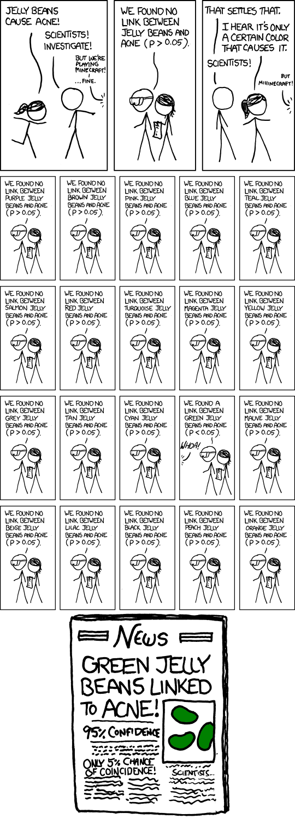
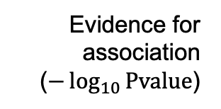

How low a P-value do we need?
Evidence for association ($−\log_{10}{\text{Pvalue}}$)
Variants across the genome
However, remember we are going to do this for millions of variants
Most of them not well-known variants like O blood group!
Each one has very little ‘prior’ chance of being associated
Lots of statistical tests so to get excited we need strong evidence
$P<5×{10}^{−8}$ is a commonly-used threshold.
https://xkcd.com/882/

Slide 34
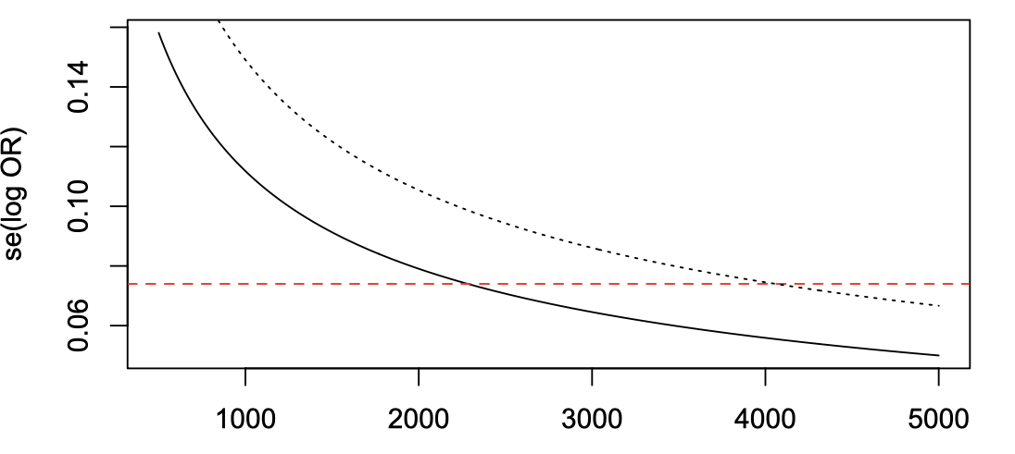







How many samples do we need?
That same formula gives us a way to answer this.
E.g. suppose the variant we’re looking for has frequency $f=20\%$ and the effect size is $RR=1.5$.
$P=5×{10}^{−8}$ corresponds to an effect about 5.5 standard errors from zero, so very roughly we need a standard error at least as small as
$$\frac{log\left(1.5\right)}{5.5}≈0.07$$
$$\text{se}(\log{OR)}≈\frac{1}{\sqrt{2N×f(1−f) ×{0.5}^{2}}}$$
$$f=10\%$$
Answer: at least thousands!
…even if the variant is quite high frequency
$$P≈5×{10}^{−8}$$
$$f=20\%$$
Number of samples

Slide 35
Association testing in practice
In practice you would use a ‘regression’ method*, rather than this simple 2x2 table approach to make these estimates:
More flexible, e.g. allows modelling additive, dominance or recessive effects
Can include other covariates which help explain the phenotype
Can control for possible confounders
*E.g logistic regression (for case/control traits) or linear regression for continuous traits.

Slide 36

Major gotcha! Confounders
G
g
$P<5×{10}^{−8}$, yay!
So you’ve found an association
Can you really conclude it is the genetic variant causing the disease?

Slide 37
Major gotcha! Confounders
G
g
Poor quality genotyping
Population structure
+ other confounding factors?
So you’ve found an association
Can you really conclude it is the genetic variant causing the disease?
Answer: not if it is confounded.
A confounder is a causal pathway that is not the one we’re looking for, but affects the association
All good GWAS studies pay close attention to possible confounders
including population structure and genotyping quality

Slide 38
Major confounder 1: poor genotyping
Association tests capture all causal paths from genotype to phenotype – even those that have nothing to do with biology.
G
g
Genotyping process
E.g. cases more poorly genotyped than conrtols
Experimental setup
Before testing, you should expect to have to look carefully at genotyping and perhaps remove samples or variants that have genotyped poorly

Slide 39
Major confounder 2: population structure/relatedness
Association tests capture all causal paths from genotype to phenotype – even those that have nothing to do with biology.
G
g
Population structure
E.g. different rates of sampling cases in different ancestral backgrounds
Case/control sampling
You should expect to have to deal with population structure and other confounders
Best practice: replicate findings in other studies!

Slide 40
Major confounder 3: linkage disequilibrium
Association tests capture all causal paths from genotype to phenotype – even those that have nothing to do with biology.
Linkage disequilibrium
H
h
G
g
Will also pick up effects from all nearby causal variants that are in LD
If this variant were the causal one, we’d still detect it through G/g
You might still have problems finding the real causal variant!
(but this is also helpful – as shown in a moment.)

Slide 41
Association testing in practice
In practice expect careful genotype quality control (QC) and use of a regression method* (instead of the simple 2x2 table) to make the estimates:
Allows to control for possible confounders like measures of population structure
Also more flexible - can also model different modes of inheritance – e.g. additive, dominant or recessive effects.
*E.g logistic regression (for case/control traits) or linear regression for continuous traits.

Slide 42
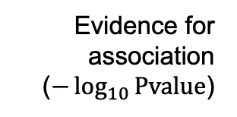
GWAS association testing – putting it together
1. Collect as many samples as possible
2. Genotype at as many variants across the genome as possible
3. Run a statistical test for genotype-phenotype association
Evidence for association ($−\log_{10}{\text{Pvalue}}$)
Variants across the genome
If strong evidence e.g. $P<5×{10}^{−8}$ => maybe we’ve found our disease-causing variant

Slide 43
GWAS association testing – put together
1. Collect as many samples as possible
How many samples?
2. Genotype at as many variants across the genome as possible
Genotype quality control!
3. Run a statistical test for genotype-phenotype association
How to do the stats test?
Can we deal with confounders?
Evidence for association ($−\log_{10}{\text{Pvalue}}$)
Variants across the genome
If strong evidence e.g. $P<5×{10}^{−8}$ => maybe we’ve found our disease-causing variant

Slide 44
Rest of lecture - outline
Testing for association
How to do the statistical tests? How many samples? How to deal with confounders?
What variants to genotype, and how?
Patterns of linkage disequilbrium and the HapMap study
A real GWAS study – WTCCC
The common variant, common disease hypothesis in practice

Slide 45
The birth of GWAS
Cystic fibrosis (CFTR)
First proof of principle GWAS studies e.g. WTCCC
Human genome completed
Discovery of A/B/O
‘Sanger’ DNA sequencing
Breast cancer (BRCA1/2 )
1901
1970’s
1989
1994-5
2003
2007
1950’s
1980’s
1993
2005
2010
Structure of DNA
Low-throughput genotyping methods
Huntingdon’s (HTT)
Mapping of > 1 million common genetic variants
(International HapMap Project)
High-throughput ‘next generation’ sequencing
Alzheimer’s (APOE)
Microarray genotyping technology
Microarrays developed in the late 90’s / early 2000’s.
For the first time was possible to rapidly type hundreds of thousands or millions of SNPs

Slide 46
Patterns of inheritance generate linkage disequilibrium*
Mutation arises
Gets passed on through many generations
Time
Changes in frequency cause variants to become correlated (LD)
Recombination breaks this down leading to local patterns
* LD = correlations between genotypes at nearby genetic variants along a chromosome

Slide 47
Patterns of inheritance generate linkage disequilibrium*
Mutation arises
Gets passed on through many generations
Time
Changes in frequency cause variants to become correlated (LD)
Recombination breaks this down leading to local patterns
These variants have become correlated (tend to be seen together).
They are in ‘linkage disequilbrium’.
* LD = correlations between genotypes at nearby genetic variants along a chromosome

Slide 48
Patterns of inheritance generate linkage disequilbrium
Mutation arises
Gets passed on through many generations
Time
Changes in frequency cause variants to become correlated (LD)
Recombination breaks this down leading to local patterns
Idea: maybe we can just genotype a dense set of marker genotypes?
E.g. if we happened to include , we might pick up the true signal at

Slide 49
The HapMap project estimated LD
The extent of LD depends on the amount of recombination.
International HapMap Project
doi:10.1038/nature0422 (2005)
A database of > 1M SNPs found in European, African, and Asian ancestry individuals
(A subset of the samples later used in the 1000 Genomes Project)
Recombination turns out to be highly nonuniform. It is concentrated in recombination hotspots. So mutations are carried on longer haplotypes than had been expected.
Shared haplotype lengths
Map of recombination rate

Slide 50
YRI
CEU
Block-like structure of LD
(correlations between SNPs in two different regions)
CHB
+JPT

Slide 51
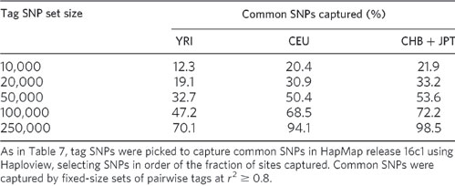
HapMap estimated how many SNPs genome-wide would need to be typed to capture (by LD) most common genetic variants. E.g. 250,000 would capture ~95% of SNPs in European populations.

Slide 52
The birth of GWAS
Cystic fibrosis (CFTR)
First proof of principle GWAS studies e.g. WTCCC
Human genome completed
Discovery of A/B/O
‘Sanger’ DNA sequencing
Breast cancer (BRCA1/2 )
1901
1970’s
1989
1994-5
2003
2007
1950’s
1980’s
1993
2005
2010
Structure of DNA
Low-throughput genotyping methods
Huntingdon’s (HTT)
Mapping of > 1 million common genetic variants
(International HapMap Project)
High-throughput ‘next generation’ sequencing
Alzheimer’s (APOE)
Microarray genotyping technology
Microarrays developed in the late 90’s / early 2000’s.
For the first time was possible to rapidly type hundreds of thousands or millions of SNPs

Slide 53
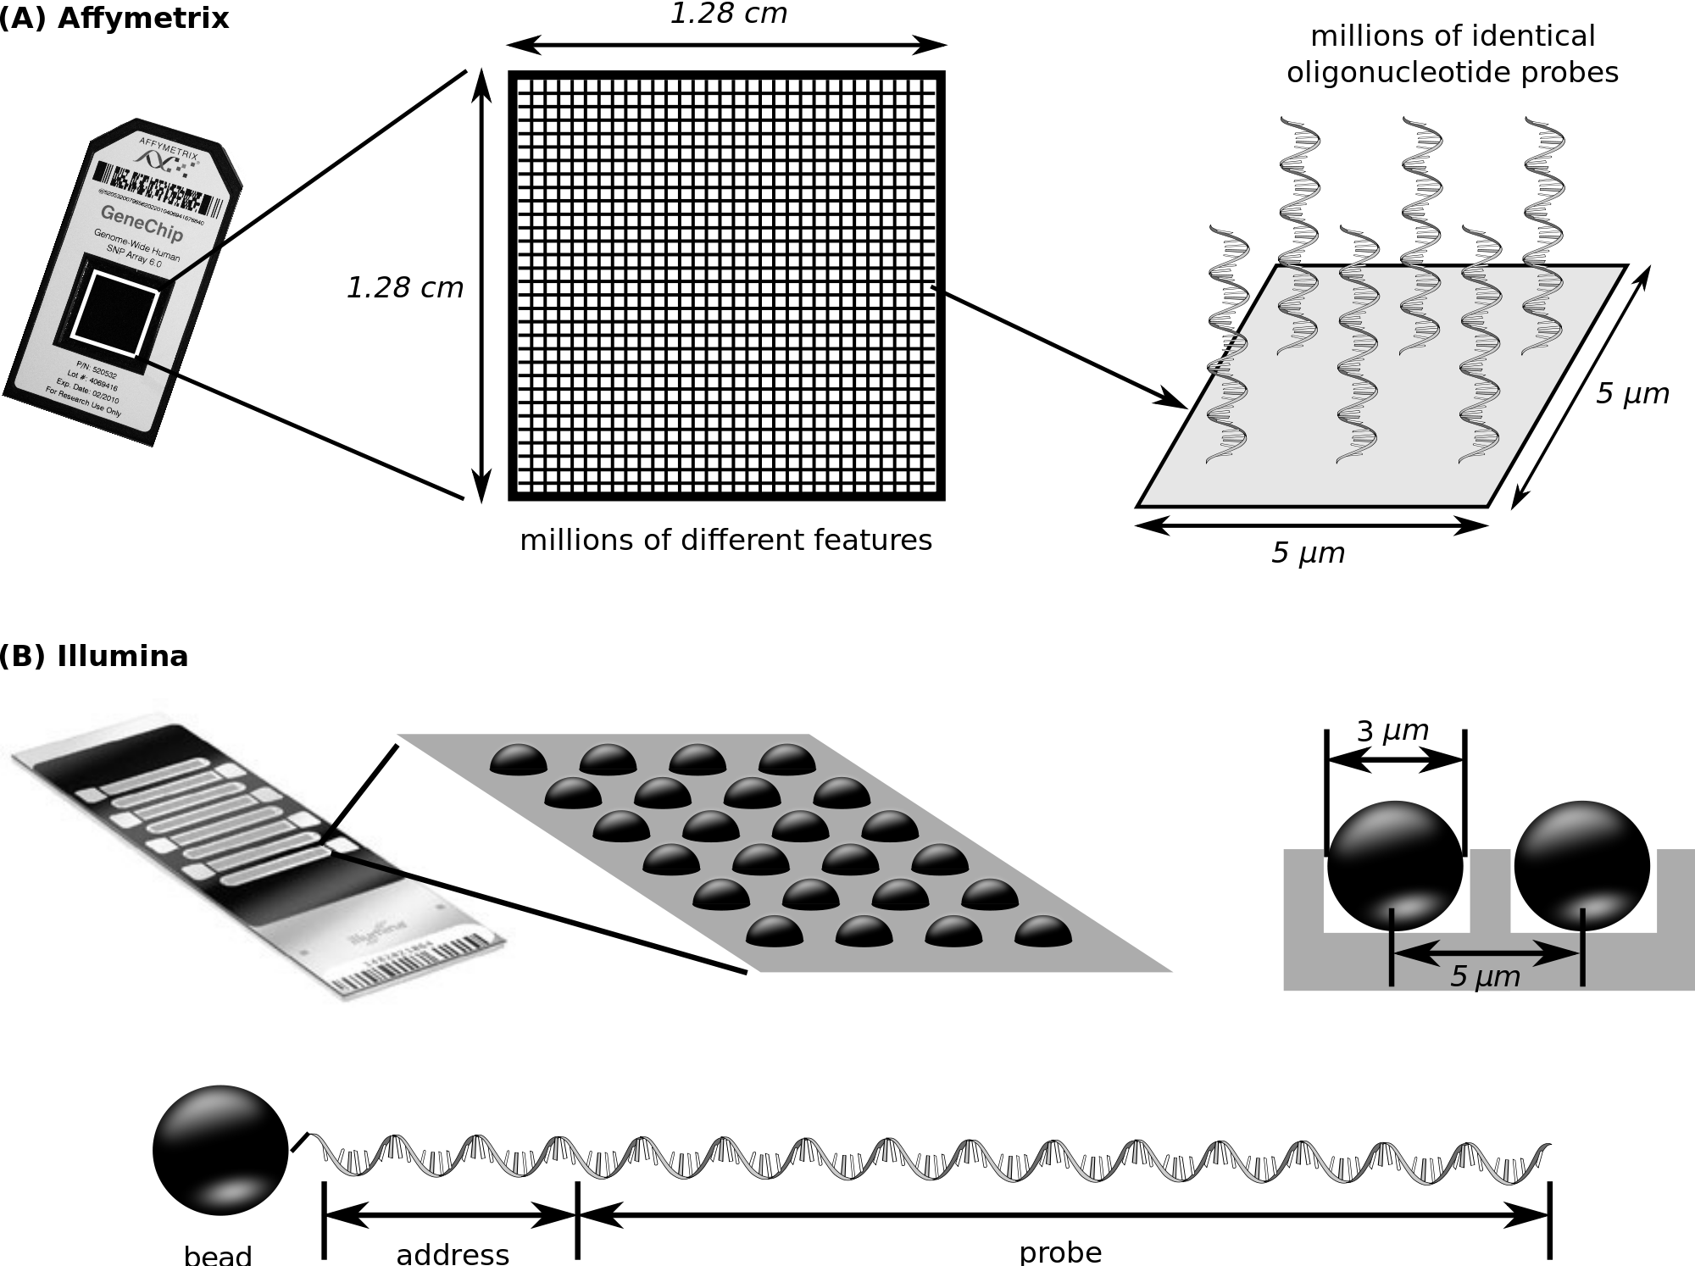
How a microarray works
Wash the DNA over and let it hybridise to millions of probes – one for each SNP
Flourescent markers are then attached. A picture is taken of the array.

Slide 54
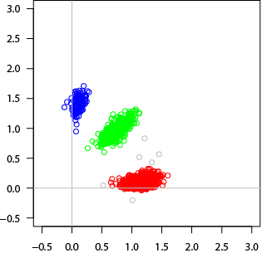
A microarray gives you intensities, not genotypes
For each (well-genotyped) SNP, you get back this:
B/B
A/B
A clustering algorithm has been used to turn the intensity values (x/y axis values) into genotype calls (colours).
A/A
Each dot represents DNA from one individual.
X axis = image intensity for 1st SNP allele
Y axis = image intensity for 2nd SNP allele

Slide 55
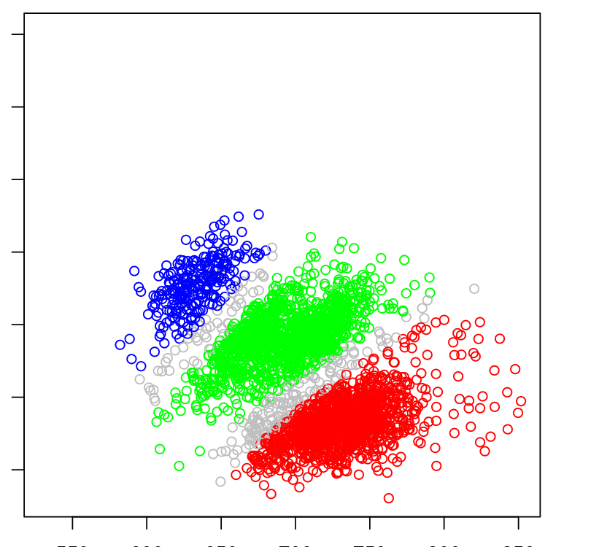
A microarray gives you intensities, not genotypes
For each SNP, you get back this:
Or this if you’re less lucky:
B/B
A/B
B/B?
?
A/B?
?
A/A
A/A?
Each dot represents DNA from one individual.
X axis = image intensity for 1st allele
Y axis = image intensity for 2nd allele
Small genotyping errors in cases or controls could easily confound the study
Careful quality control needed with
these technologies

Slide 56
Rest of lecture - outline
Testing for association
How to do the statistical tests? How many samples? How to deal with confounders?
What variants to genotype, and how?
Patterns of linkage disequilbrium and the HapMap study
A real GWAS study – WTCCC
The common variant, common disease hypothesis in practice

Slide 57
The birth of GWAS
Cystic fibrosis (CFTR)
First proof of principle GWAS studies e.g. WTCCC
Human genome completed
Discovery of A/B/O
‘Sanger’ DNA sequencing
Breast cancer (BRCA1/2 )
1901
1970’s
1989
1994-5
2003
2007
1950’s
1980’s
1993
2005
2010
Structure of DNA
Low-throughput genotyping methods
Huntingdon’s (HTT)
Mapping of > 1 million common genetic variants
(International HapMap Project)
High-throughput ‘next generation’ sequencing
Alzheimer’s (APOE)
Microarray genotyping technology
Microarrays developed in the late 90’s / early 2000’s.
For the first time was possible to rapidly type hundreds of thousands or millions of SNPs

Slide 58

Anatomy of a GWAS – what to look for
1. Collect as many cases and controls as possible
What samples How many?
2. Genotype (or impute) them at as many variants across the genome as possible
How many?
3. Deal with potential confounders – careful data quality control and handle population structure.
Have they done adequate data quality control? Have they dealt with possible confounders?
4. Estimate relative risks, and look for statistical evidence that of $RR≠ 1$
5. If estimate is many standard deviations from zero, bingo! We may have found a true causal effect.
Did they find anything with enough evidence?
6.Replicate in other studies, or find other corroborating evidence?
Is it corroborated by other evidence?
7. (Now try to understand the underlying biology.)
Can they understand the biology?

Slide 59
A real GWAS study - WTCCC
Nature (2007)
Studied seven common diseases in the UK
Bipolar disorder, Coronary Artery Disease, Crohn’s disease, Hypertension, Rheumatoid arthritis, Type 1 and Type 2 Diabetes
Genotyped at 500,000 SNPs across the genome
doi:10.1038/nature05911

Slide 60
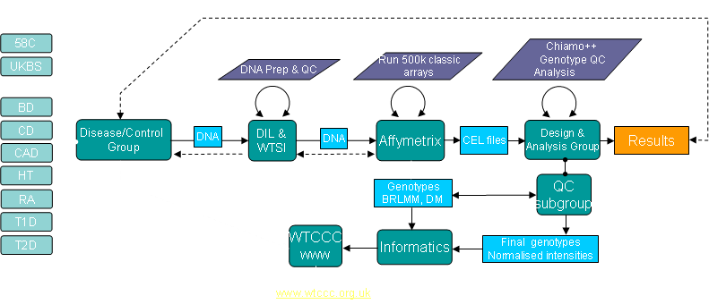
A real study - WTCCC

Slide 61

Anatomy of a GWAS – what to look for
1. Collect as many cases and controls as possible
2. Genotype (or impute) them at as many variants across the genome as possible
3. Deal with potential confounders – careful data quality control and handle population structure.
Have they done adequate data quality control? Have they dealt with possible confounders?
4. Estimate relative risks, and look for statistical evidence that of $RR≠ 1$
5. If estimate is many standard deviations from zero, bingo! We may have found a true causal effect.
6. Does it replicate in other studies, or have other corroborating evidence?
7. (Now try to understand the underlying biology.)

Slide 62
They then threw away 809 samples!
Due to:
Poor genotyping rates
Evidence of contamination (too many heterozygous genotypes)
Evidence of being not of European ancestry
A duplicate, or close relative of another sample
Proportion missing calls
Proportion missing calls
They kept these samples
Chronological order of genotyping
Some of the poor quality data was apparently due to batch effects.
Proportion heterozygous calls

Slide 63
To avoid confounding by population structure, the samples were all supposed to be from the United Kingdom, and with European ancestry.
They used a method called principal components analysis to detect ancestry against the HapMap project samples. Some non-European ancestry individuals had been typed.
153 individuals were excluded on this basis.
Population structure
PCA computes genome-wide relationships between samples and then looks for directions of greatest variation. Since relatedness typically decreases with geographic distance, principal components typically reflect geography.
G
g
Case/control sampling

Slide 64
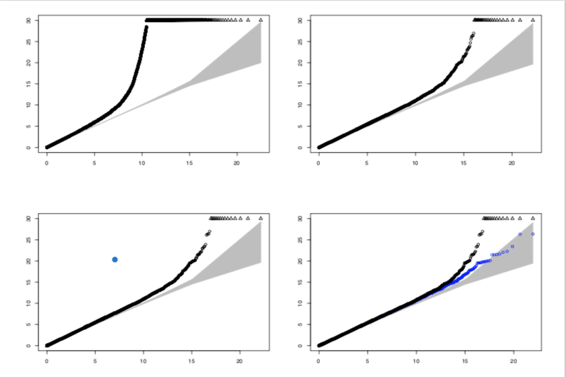
Using quantile-quantile plots to assess residual confounding
They also excluded 25,567 SNPs from the study for
High missing data rates
Deviation from Hardy-Weinberg equilibrium (lecture 1) in controls
Frequency differences between the two control groups
And they visually inspected cluster plots for remaining SNPs
Before SNP exclusions
After SNP exclusions
After visually inspecting cluster plots for remaining associated SNPs
(Blue dots)… and after removing remaining strongly-associated regions that they claim to be real
If there are few true signals, and if we have removed confounders – then P-values should largely come from a uniform distribution - they should lie on the diagonal.

Slide 65
Phew!

Slide 66
Bipolar disorder
Coronary artery disease
Crohn’s Disease
Hypertension
The main result of the study
Rheumatoid arthritis
T1D
T2D

Slide 67
Bipolar disorder
1
Number of associations
with strong evidence
Coronary artery disease
1
The study found 25 associations at their nominal P-value threshold.
Twelve of these provided replication of previously implicated variants. Thirteen were new associations.
The traits clearly differ in their genetic architecture
Some SNPs were associated with some evidence with multiple traits (mainly for the autoimmune diseases).
Crohn’s Disease
9
Hypertension
0
Rheumatoid arthritis
3
T1D
7
T2D
3

Slide 68
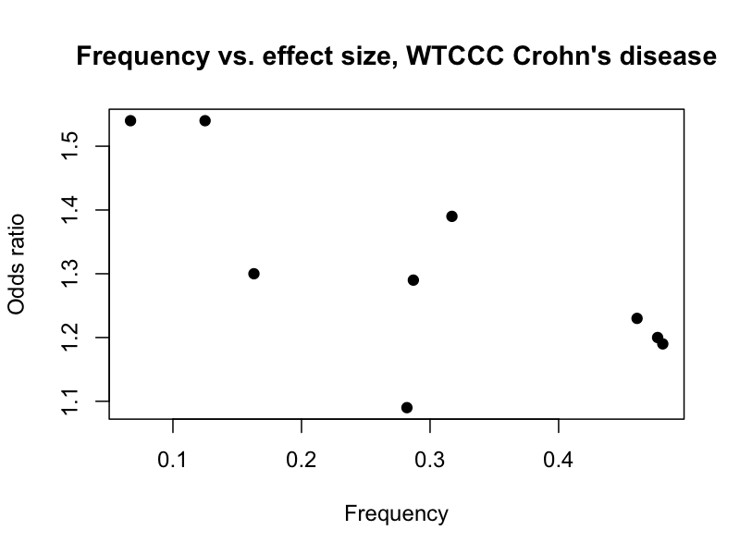
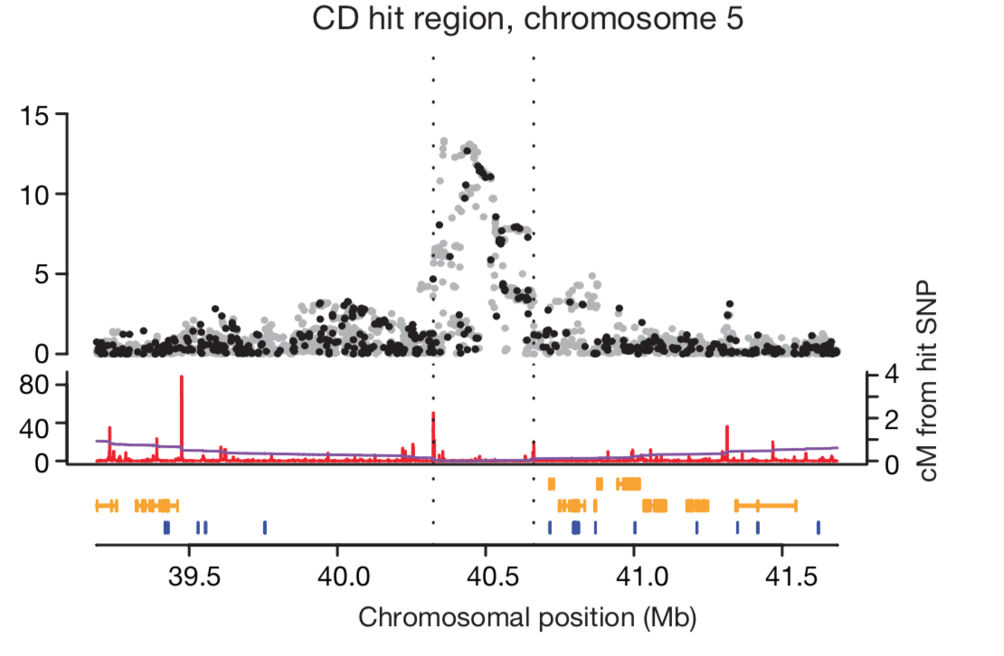
Effect sizes were generally modest
E.g. across the 9 associations with Crohn’s disease, the maximum estimated odds ratio was 1.54, (similar to the O blood group example)
(A strong effect with Type 1 Diabetes was also observed in the MHC locus)
Zooming into these associations vies us a more detailed picture of the regional association – here shown for the strong association on chromosome 5.

Slide 69
Zooming in to a GWAS ‘hit’ plot
Sometimes called a ‘locus zoom’ plot. Here are some things to look for:
Evidence for association with each SNP
(-log10 P-value or log10 Bayes factor)
Delineation of association region boundaries (usually based on heuristics)
Black points were typed, grey points were imputed from HapMap
Signal ought to follow LD patterns. In particular ought to drop off near recombination hotspots
The recombination rate, here as estimated by HapMap
Regional genes
Position of SNPs in the reference genome assembly

Slide 70

More signals in supplementary
The results above actually used a P-value threshold of $P< 5×{10}^{−7}$
They also reported a longer list of association at lesser levels of evidence ($P< 5×{10}^{−7}$). Many of these must be real as well.
How much statistical evidence do we really need? How did they choose a good threshold?

Slide 71
Main lecture messages
1. Most human phenotypes are highly heritable
(a large proportion of variation is due to genetics)
2. But many ‘complex’ traits are not mendelian - they are polygenic - “common variant, common trait” hypothesis
3. The discovery of this fact is due to genome-wide association studies (GWAS)
Collect lots of samples – type lots of variants – careful quality control – conduct statistical test of association – use stringent statistical thresholds.
The first of these studies was conducted in the mid 2000s and showed the hypothesis is definitely true.

Slide 72
Summary
GWAS is a very simple study design in principle - just genotyping a lot of cases and controls, and test for association. The hard parts are in the implementation details
In the early 2000’s, The HapMap and other projects enabled the first GWAS by mapping SNPs genome-wide, and describing human haplotype variation.and patterns of LD. High-throughput genotyping microarray technology was developed to type these SNPs.
The WTCCC was one of the first large GWAS studies. It provided compelling evidence that the ‘common variant, common disease’ hypothesis really holds.
Although the overall design is simple, we are looking for small differences in risk between cases and controls (often RR = 1.5 or smaller). Consequently a lot of careful work is needed to ensure there is no subtle confounding – e.g. from sample collection, genotyping and data quality issues, or environmental covariates.

Slide 73
Bipolar disorder
Coronary artery disease
Crohn’s Disease
We have clearly learned something about the biology of these traits.
Hypertension
Rheumatoid arthritis
…so what?
T1D
T2D

Slide 74
Bipolar disorder
Coronary artery disease
Crohn’s Disease
Hypertension
Let’s zoom in
Rheumatoid arthritis
T1D
T2D

Slide 75
Biology is hard

Slide 76
Biology is hard
No genes under the main association signal!

Slide 77
Bipolar disorder
Coronary artery disease
Crohn’s Disease
Hypertension
Rheumatoid arthritis
T1D
T2D

Slide 78
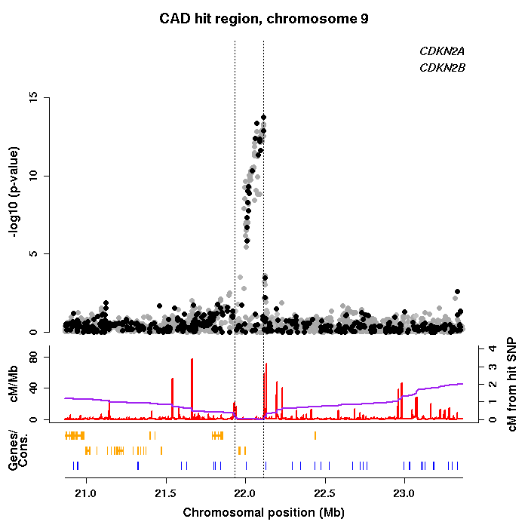
Biology is hard
Association observed with CAD over a ~100kb region of chromosome 9. This is unquestionably a real association (it has been replicated in several independent studies).
The functional mechanism of this association is not fully solved; it probably involves regulation of expression of the two nearby genes CDKN2A/B.
Neither gene was an obvious candidate beforehand - thus, this association does point to novel biology.
Harismendy et al Nature 2011; Almontishari, et al JACC 2013; Almonitishari et al, Circulation 2015

Slide 79
Bipolar disorder
Coronary artery disease
Crohn’s Disease
Hypertension
Rheumatoid arthritis
T1D
T2D

Slide 80
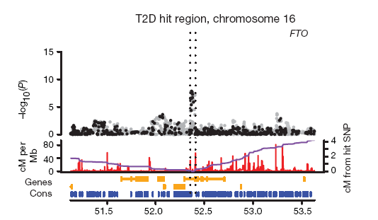
FTO
IRX3
This association with Type 2 Diabetes turned out to be through a second, related trait (obesity), again unquestionably a real effect.
But as of 2018 the functional mechanism remains unclear. Expression of FTO is known to affect obesity, but the SNPs may also affect expression of another gene, IRX3, 200kb away.
Smemo et al, Nature 2014
Notes:
‘Fat mass and obesity-associated gene’.

Slide 81
This pattern has turned out to be typical. It has generally proven extremely hard to narrow down GWAS associations to underlying ‘causal’ variants.
LD is a double-edged sword.
Next lecture: we will look at this.

Slide 82
Anatomy of a GWAS – what to look for
1. Collect as many cases and controls as possible
What samples How many?
2. Genotype (or impute) them at as many variants across the genome as possible
How many?
3. Deal with potential confounders – careful data quality control and handle population structure.
How did they do quality control – is it adequate?
4. Estimate relative risks, and look for statistical evidence that of $RR≠ 1$
5. If estimate is many standard deviations from zero, bingo! We may have found a true causal effect.
Did they find anything with enough evidence?
6.Replicate in other studies, or find other corroborating evidence?
Is it convincing?
7. (Now try to understand the underlying biology.)
Can they understand the biology?

Slide 83
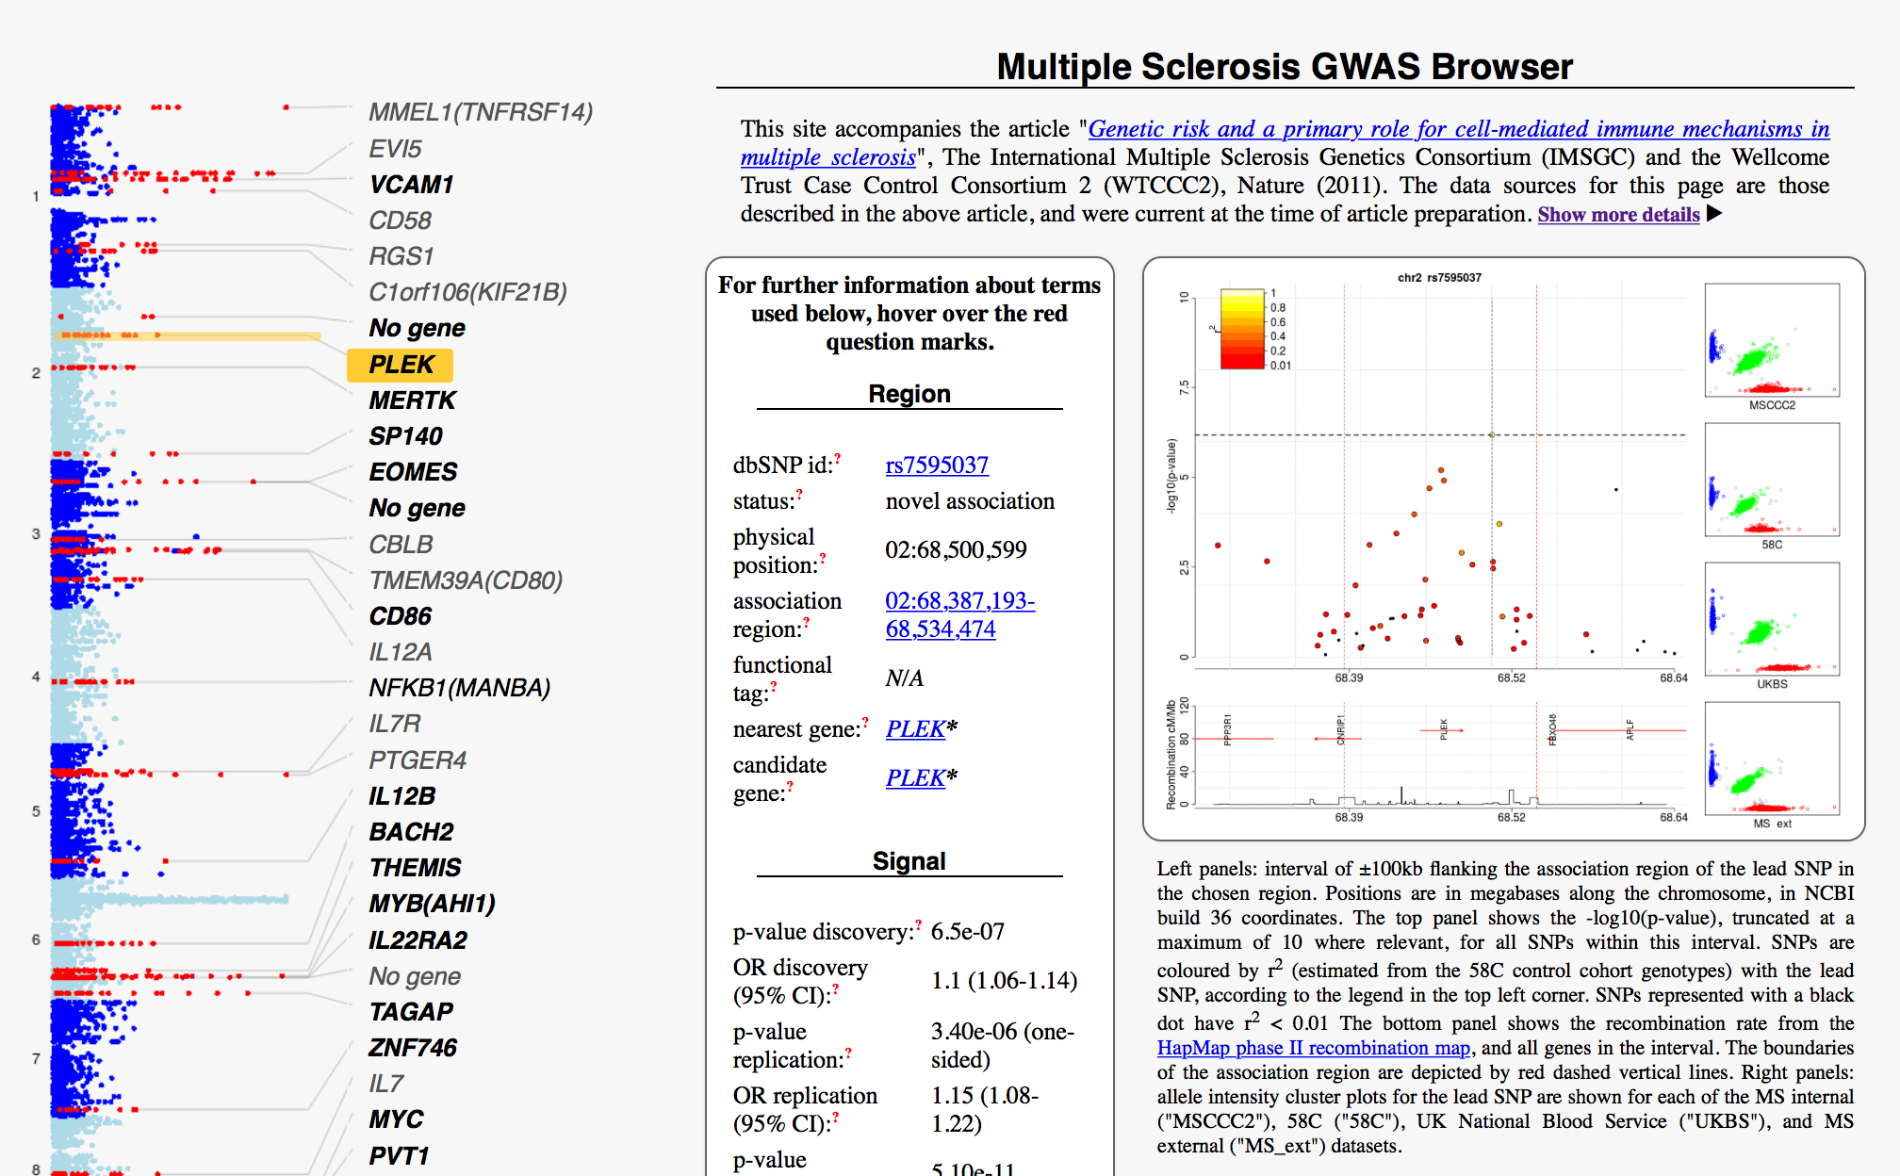
Consolidation question
GWAS of multiple sclerosis (2011)
9772 cases, 17,376 controls from across Europe
www.chg.ox.ac.uk/wtccc2/ms/
(I think this url requires the trailing /)
Visit the above site and make sure you understand what is shown. Pick a signal and try to work out
What is the estimated effect size?
How strong was the evidence?
Did it replicate?
Does the association signal look sensible – does it follow LD patterns, and do the cluster plots look sensible?
Can you figure out what the nearby genes do? (Warning: this can be a time sink!)
Bonus question: read the paper and try to figure out the questions on the checklist.

Slide 84


Appendix: How to choose a P-value threshold
WTCCC reasoned like this: Based on what we know from HapMap, there are maybe 1 million ‘LD blocks’ in the human genome. Suppose maybe 10 of them, or so, are associated with the trait. Then the prior chance of association for a randomly chosen region (i.e. chosen ‘hypothesis free’) will be 10 in a million, i.e. plausibly
Prior odds = $1×{10}^{−5}$
before we see any data.
For a P-value threshold $α$ it works out that:
$$\text{odds}\left(\text{associated} | \text{P}<α\right)=\frac{\text{statistical} \text{power}}{α} × \text{prior} \text{odds}$$
=> If the statistical power is 50%, say, then setting $α=5×{10}^{−7}$ will give a posterior odds of 10 to 1.
This was a good choice! All of their associations have subsequently replicated in larger studies.
Many GWAS use a more stringent $α=5×{10}^{−8}$ threshold. Others attempt to directly estimate the above (using ‘False discovery rate’ methods).

Slide 85

Appendix: How to choose a P-value threshold
Alternate reasoning: We are doing maybe 1 million ‘independent’ tests.
For a ‘null’ SNP with no true signal, there’s a 5% chance of seeing P < 0.05 ‘by chance’.
Therefore if we want at most 5% chance of seeing a spurious signal ‘by chance’ across all of the 1 million SNPs, we need
$$P<\frac{0.05}{1 \text{million}}=5×{10}^{−8}$$
(This argument is simpler, but less satisfying than the one on the previous slide, because it doesn’t tell us what observing $P<5×{10}^{−8}$ actually implies about whether the SNP is associated.
On the other hand you don’t need to invent a prior for this argument.)
Many GWAS use a more stringent $α=5×{10}^{−8}$ threshold. Others attempt to directly estimate the above (using ‘False discovery rate’ methods).

Slide 86
Next lecture: Wednesday 4th Mar @11am
Genome-wide association studies II: Identifying genetic associations with complex traits
Gavin Band gavin.band@well.ox.ac.uk
MSc Global Health Science and Epidemiology
Genetic Epidemiology Module
4th Mar 2025
Notes:
The title of my talk is genome-wide studies as this has been the main focus of my research over the last 3 years.

