Slide 1

Understanding the genetics of complex traits I
Gavin Band gavin.band@well.ox.ac.uk
BA Human Sciences
Friday 27th Feb 2026
Notes:
The title of my talk is genome-wide studies as this has been the main focus of my research over the last 3 years.

Slide 2
Main lecture messages
1. Most human phenotypes are highly heritable
(a large proportion of variation is due to genetics)
2. But many ‘complex’ traits are not mendelian - they are polygenic - “common variant, common trait” hypothesis
3. The discovery of this fact is due to genome-wide association studies (GWAS), the first of which was conducted in the mid 2000s.
We will go into this in some detail – methodology, population genetics, GWAS in practice
4. But understanding the biology can be hard…

Slide 3
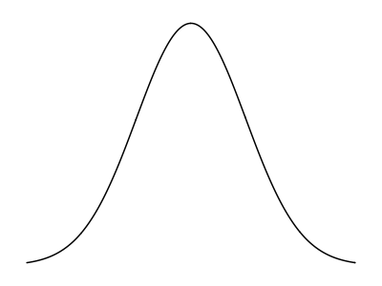
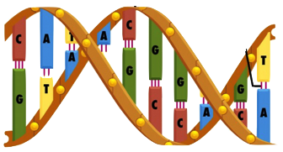
The human genome is ~3.2 billion base pairs long.
About 1 in 100 – 1000 of those bases vary between people.
What proportion of phenotypic variation is due to genetic variation?

Slide 4
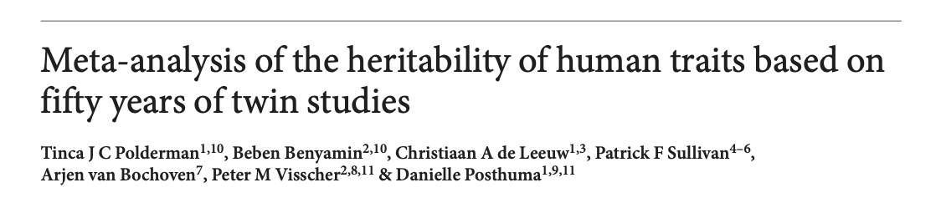
Human traits are highly heritable
We don’t have to guess!
Idea: if genetics determines a trait, then more genetically similar individuals should have more similar phenotypes.
We can estimate how much genetics determines trait variation by comparing trait similarity in more genetically similar and less genetically similar individuals, such as monozygotic and dizygotic twins.
(2015)
Large meta-analysis of > 2000 twin studies
(Browse the results at: https://match.ctglab.nl)

Slide 5
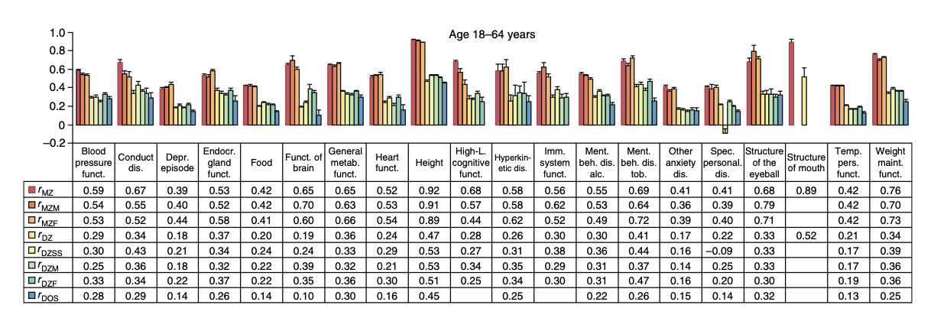
Human traits are highly heritable
Idea: if genetics determines a trait, then more genetically similar individuals should have more similar phenotypes.
MZ
Twins r~0.92
DZ
Twins
r~0.47
Compare trait correlations between twins.
(Adult) height is much more similar between monozygotic than dizygotic twins.
The heritability is about 90%.
All studied traits
Heritability is the proportion of trait variation explained by inherited factors (including genetics) . Can be estimated as $h2≈2×\left(r_{MZ}−r_{DZ}\right).$

Slide 6





Human traits are highly heritable
If genetics determines a trait, then more genetically similar individuals should have more similar phenotypes.
(2015)
Monozygotic
Dizygotic
Blood pressure
$$h^{2}≈60\%$$
Depression
$$h^{2}≈42\%$$
Adult height
$$h^{2}≈90\%$$
“Higher level cognitive function”
$$h^{2}≈80\%$$
Structure of the eyeball
$$h^{2}≈70\%$$
Lots of theoretical caveats might apply here – see Lecture 1. But in general it is true that a large proportion of variation in most human phenotypes is caused by genetics.
(Browse the results at: https://match.ctglab.nl)

Slide 7
Two possible extreme genetic architectures
Affected
Example: Huntingdon’s
Not affected
Phenotype
Genotype
population
Affects ~1 in 20,000 people of European ancestry
(less in Africa and Asia)
Discovered by looking in families
Strength of effect
Very rare
rare
common
Very common
Genotype frequency
A “Mendelian” trait

Slide 8




Two possible extreme genetic architectures
Affected
Example: Huntingdon’s
Not affected
Phenotype
Genotype
population
Affects ~1 in 20,000 people of European ancestry
(less in Africa and Asia)
$$1,000$$
Discovered by looking in families
Relative risk
$$100$$
$$10$$
$$1$$
Very rare
rare
common
Very common
Genotype frequency
A “Mendelian” trait

Slide 9
End of an era
“Linkage Mapping was successful in identifying the genetic basis of many human diseases in which the disease penetrance resembles a simple Mendelian model e.g. Huntington’s disease, Cystic Fibrosis, some forms of breast cancer, Alzheimers, …“
Cystic fibrosis (CFTR)
Discovery of A/B/O
‘Sanger’ DNA sequencing
Breast cancer (BRCA1/2 )
1901
1970’s
1989
1994-5
1950’s
1980’s
1993
“…but the literature is now replete with linkage screens for an array of common ‘complex’ disorders such as schizophrenia, manic depression, autism, asthma, type I and type II diabetes, Multiple Sclerosis, Lupus. Although many of these studies have reported significant linkage findings, none has lead to convincing replication”
– Risch “Searching for genetic determinants in the new millennium” Nature (2000)
Structure of DNA
Low-throughput genotyping methods
Huntingdon’s (HTT)
Alzheimer’s (APOE)
The era of linkage (family) studies

Slide 10
Common variant, common disease hypothesis
Affected
Phenotype
Genotype
population
Strength of effect
Very rare
rare
common
Very common
Genotype frequency

Slide 11


Common variant, common disease hypothesis
Affected
Phenotype
Genotype
population
$$4$$
Relative risk
$$2$$
$$1$$
Very rare
rare
common
Very common
Genotype frequency

Slide 12
Common variant, common disease hypothesis
Affected
Phenotype
Genotype
population
A complex trait.
Caused by many factors, each having a small overall effect. Including
Many genetic variants, including common ones
Environmental factors
Gene-environment or gene-gene interactions
…
$$4$$
Relative risk
$$2$$
$$1$$
Very rare
rare
common
Very common
Genotype frequency

Slide 13
Summary
Most human phenotypes are highly heritable - a large proportion of phenotype variation seems to be caused by genetics. ~60% on average!
In principle this heritability could occur in different ways – for example through single variants with strong effects, or through multiple variants with small effects.
By the 2000s family studies had identified the causes of several mendelian traits, but had failed to solve the genetics of multiple complex diseases.
Was the “common variant, common disease“ hypothesis true?

Slide 14
End of the linkage era
Cystic fibrosis (CFTR)
Discovery of A/B/O
‘Sanger’ DNA sequencing
Breast cancer (BRCA1/2 )
1901
1970’s
1989
1994-5
1950’s
1980’s
1993
Structure of DNA
Low-throughput genotyping methods
Huntingdon’s (HTT)
Alzheimer’s (APOE)

Slide 15
The birth of GWAS
Cystic fibrosis (CFTR)
First proof of principle GWAS studies e.g. WTCCC
Human genome completed
Discovery of A/B/O
‘Sanger’ DNA sequencing
Breast cancer (BRCA1/2 )
1901
1970’s
1989
1994-5
2003
2007
1950’s
1980’s
1993
2005
2010
Structure of DNA
Low-throughput genotyping methods
Huntingdon’s (HTT)
Mapping of > 1 million common genetic variants
(International HapMap Project)
High-throughput ‘next generation’ sequencing
Alzheimer’s (APOE)
Microarray genotyping technology
(100s of 1000s of markers)

Slide 16
Rest of lecture - outline
Testing for association
How to do the statistical tests? How many samples? How to deal with confounders?
What variants to genotype, and how?
Patterns of linkage disequilbrium and the HapMap study
A real GWAS study – WTCCC
The common variant, common disease hypothesis in practice

Slide 17
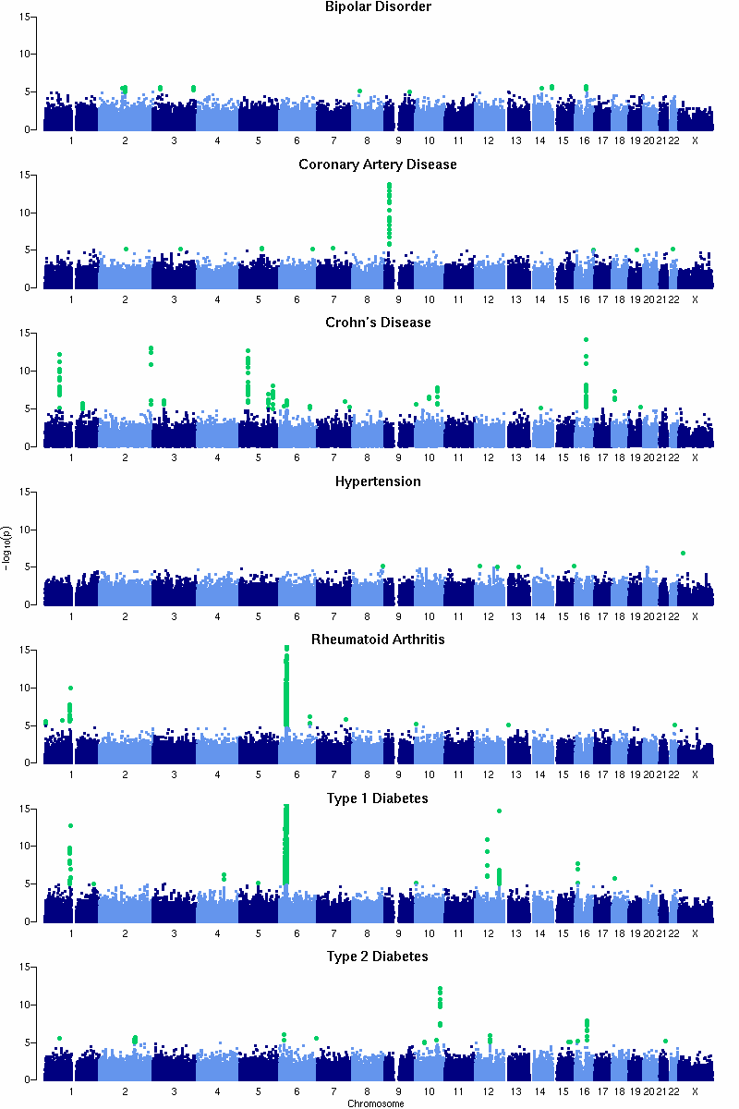
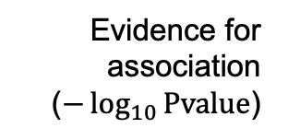
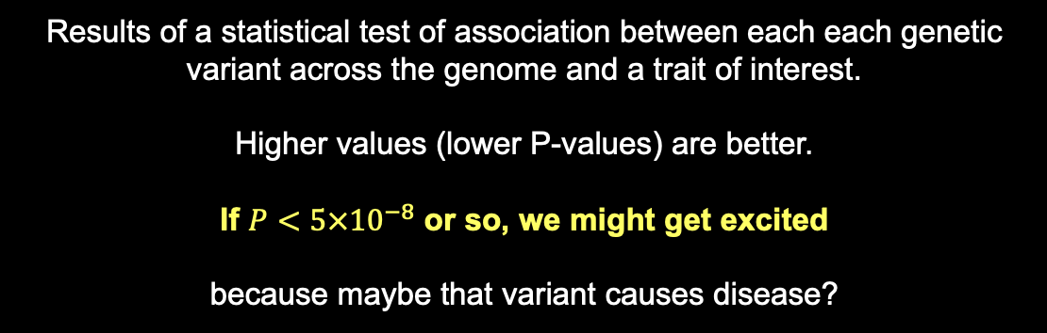
What we are aiming for:
Evidence for association ($−\log_{10}{\text{Pvalue}}$)
Variants across the genome
Results of a statistical test of association between each each genetic variant across the genome and a trait of interest.
Higher values (lower P-values) are better.
If $P<5×{10}^{−8}$ or so, we might get excited
because maybe that variant causes disease?

Slide 18
Testing for association
Imagine a genetic variant that affects risk of disease
G
g
Unaffected individuals
Disease “cases”
Phenotype distribution
in the population

Slide 19

Testing for association
G
g
Unaffected individuals
Disease “cases”
If genotype G causes disease, then carrying G will make you more likely to have disease.
“Chance/frequency of disease given genotype G”
$$= \frac{P\left(\text{disease}|\text{genotype} G\right)}{P\left(\text{disease}|\text{genotype} g\right)}>1$$
Relative risk
“Chance/frequency of disease given genotype g”

Slide 20

Testing for association
G
g
Unaffected individuals
Disease “cases”
If genotype G causes disease, then carrying G will make you more likely to have disease.
$$=\frac{P\left(\text{disease}|G\right)}{P\left(\text{disease}|g\right)}>1$$
Relative risk
Using probability notation
If the genotype causes disease, then the relative risk will be different from 1

Slide 21

How to estimate relative risk?
$$RR=\frac{P\left(\text{disease}| G\right)}{P\left(\text{disease}| g\right)}$$
(in population)
Disease frequencies given genotype

Slide 22

How to estimate relative risk?
$$RR=\frac{P\left(\text{disease}| G\right)}{P\left(\text{disease}| g\right)} = \frac{P\left(G|\text{disease}\right)}{P\left(g|\text{disease}\right)}×\frac{P(g)}{P(G)}$$
(in population)
Disease frequencies given genotype
Genotype frequencies in cases and controls
To estimate the relative risk, we just need to measure the genotypes in some disease cases and population controls.
(Note: apply Bayes’ theorm)

Slide 23

How to estimate relative risk?
$$RR=\frac{P\left(\text{disease}| G\right)}{P\left(\text{disease}| g\right)} = \frac{P\left(G|\text{disease}\right)}{P\left(g|\text{disease}\right)}×\frac{P(g)}{P(G)}$$
(in population)
Disease frequencies given genotype
Genotype frequencies in cases and controls
To estimate the relative risk, we just need to measure the genotypes in some disease cases and population controls.
 | G | g
Disease cases: | a | b
Controls*: | c | d
$$OR=\frac{a}{b}×\frac{d}{c}$$
(in sample)

Slide 24

Key fact
 | G | g
Disease cases: | a | b
Population controls*: | c | d
$$OR=\frac{a}{b}×\frac{d}{c}$$
(in a sample of disease cases and population controls)
The odds ratio in a sample of cases and controls*
estimates the population relative risk.
Stricyly this applies to ‘population controls’, but also approximately true for ‘true’ disease controls, as long as the disease is not too common.

Slide 25
Example: O blood group and severe malaria
Cases were ascertained as children arriving in hospital with severe symptoms compatible with malaria & parasitaemia, in a hospital in Kilifi, eastern Kenya. Controls were ascertained from new births in the same hospitals.
 | O | non-O
Severe malaria cases | 686 | 843
Controls: | 839 | 700
Can you compute the odds ratio?
N=3,068 samples
MalariaGEN 2019 doi: 10.1038/s41467-019-13480-z

Slide 26

Example: O blood group and severe malaria
Cases were ascertained as children arriving in hospital with severe symptoms compatible with malaria & parasitaemia, in a hospital in Kilifi, eastern Kenya. Controls were ascertained from new births in the same hospitals.
 | O | non-O
Severe malaria cases | 686 | 843
Controls: | 839 | 700
$$OR=\frac{686}{843}×\frac{700}{839}=0.68$$
N=3,068 samples
MalariaGEN 2019 doi: 10.1038/s41467-019-13480-z

Slide 27
Example: O blood group and severe malaria
Cases were ascertained as children arriving in hospital with severe symptoms compatible with malaria & parasitaemia, in a hospital in Kilifi, eastern Kenya. Controls were ascertained from new births in the same hospitals.
 | O | non-O
Severe malaria cases | 686 | 843
Controls: | 839 | 700
$$OR=\frac{686}{843}×\frac{700}{839}=0.68$$
N=3,068 samples
MalariaGEN 2019 doi: 10.1038/s41467-019-13480-z
People with O blood group get severe malaria at ~70% of the rate of people without.
(Could say: “O blood group is associated with ~30% reduced risk of severe malaria.”)
How much statistical evidence is there that this is a real effect?

Slide 28




The key association test summary statistics
Effect size estimate
$\hat{β}$ = log(OR)
$$\hat{β}$$
Standard error
$$1.96⋅\text{se}$$
$$1.96⋅\text{se}$$
95% confidence interval
“How much uncertainty?”
P-value*
“How unlikely was such a big estimate, if actually there was no true effect?”
A small p-value means the effect is unlikely to be zero
*In practice P-value is computed from the beta and standard error:
$$P=Φ^{−1}\left(\frac{log⁡(\text{OR})}{\text{se}}\right)$$
Normal distribution function

Slide 29


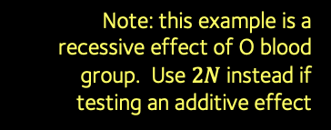

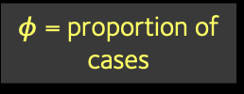
Incredibly useful formula
Fact: the standard error is largely determined by the study design.
Here is a very useful formula which approximates it in the 2x2 table example:
$$\text{Standard} \text{error}(\log{OR)}≈\frac{1}{\sqrt{N×f\left(1−f\right)×φ(1−φ)}}$$
N = sample size = $a+b+c+d$
$φ$ = proportion of cases
f = frequency of G allele
Note: this example is a recessive effect of O blood group. Use $2N$ instead if testing an additive effect
The standard error depends on sample size, frequency, and case/control ratio.
It gets smaller (at rate $\frac{1}{\sqrt{N}}$ ) as the sample size increases.

Slide 30






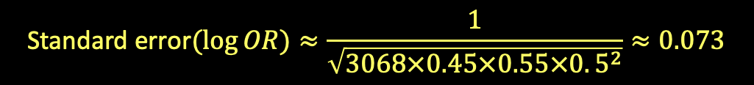

Example: O blood group is associated with malaria protection
 | O | non-O
Severe malaria cases | 686 | 843
Controls: | 839 | 700
$$N=3,068$$
$$f≈0.55$$
$$φ≈0.5$$
$$OR=\frac{686}{843}×\frac{700}{839}=0.68$$
i.e. $\log\left(OR\right)≈−0.386$
$$\text{Standard} \text{error}(\log{OR)}≈\frac{1}{\sqrt{3068×0.45×0.55×0. 5^{2}}}≈0.073$$
(on log scale)
$$N$$
$$f(1−f)$$
$$φ(1−φ)$$
Estimated relative risk = 0.68
se = 0.07
95% CI = 0.59-0.78 (estimate +/- 1.96 standard errors)
0.5
0.75
1
RR
Estimate is about 5 standard errors from zero
$$P=9.6×{10}^{−8}$$

Slide 31
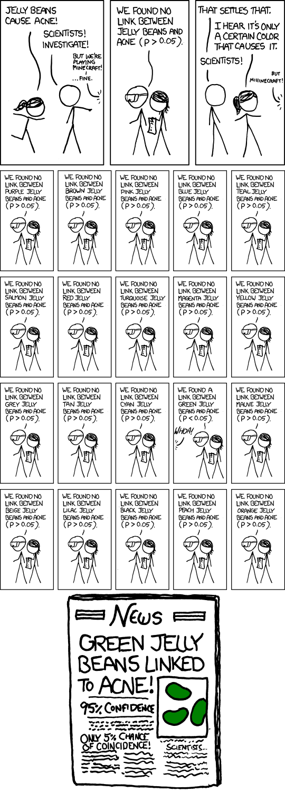
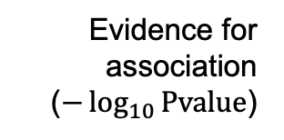

Evidence for association ($−\log_{10}{\text{Pvalue}}$)
Variants across the genome
However, remember we are going to do this for millions of variants
Most of them not well-known variants like O blood group!
Each one has very little ‘prior’ chance of being associated
Lots of statistical tests so to get excited we need strong evidence
$P<5×{10}^{−8}$ is a commonly-used threshold.
https://xkcd.com/882/

Slide 32
How many samples did we need anyway?
…to have a chance of such small P-values?
$$\text{Standard} \text{error}(\log{OR)}≈\frac{1}{\sqrt{N×f\left(1−f\right)×φ(1−φ)}}$$
N = sample size = $a+b+c+d$
$φ$ = proportion of cases
f = frequency of G allele
The standard error depends on sample size, frequency, and case/control ratio.
It gets smaller (at rate $\frac{1}{\sqrt{N}}$ ) as the sample size increases.

Slide 33
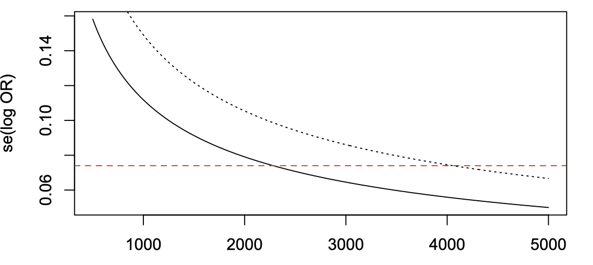




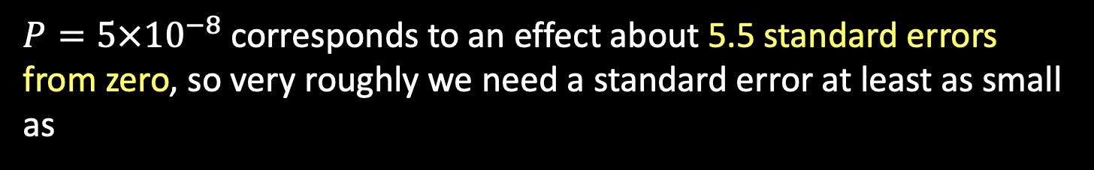

How many samples did we need anyway?
E.g. suppose the variant we’re looking for has frequency $f=20\%$ and the effect size is $RR=1.5$.
$P=5×{10}^{−8}$ corresponds to an effect about 5.5 standard errors from zero, so very roughly we need a standard error at least as small as
$$\frac{log\left(1.5\right)}{5.5}≈0.07$$
$$\text{se}(\log{OR)}≈\frac{1}{\sqrt{2N×f(1−f) ×{0.5}^{2}}}$$
$$f=10\%$$
Answer: we need thousands!
$$f=20\%$$
Number of samples

Slide 34

Major gotcha! Confounders
G
g
$P<5×{10}^{−8}$, yay!
So you’ve found an association
Can you really conclude it is the genetic variant causing the disease?

Slide 35
Major gotcha! Confounders
G
g
Poor quality genotyping
Population structure
So you’ve found an association with a small P-value
Can you really conclude it is the genetic variant causing the disease?
Answer: not if it is confounded.
All good GWAS studies pay careful attention to possible confoudners
including population structure and genotyping quality

Slide 36
Association testing in practice
In practice would use a regression method* (instead of the simple 2x2 table) to make these estimates:
Can control for possible confounders like measures of population structure
Also more flexible - can also model different modes of inheritance – e.g. additive, dominant or recessive effects.
*E.g logistic regression (for case/control traits) or linear regression for continuous traits.

Slide 37
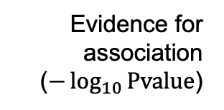
GWAS association testing – putting it together
1. Collect as many samples as possible
2. Genotype at as many variants across the genome as possible
3. Run a statistical test for genotype-phenotype association
Evidence for association ($−\log_{10}{\text{Pvalue}}$)
Variants across the genome
If strong evidence e.g. $P<5×{10}^{−8}$ => maybe we’ve found our disease-causing variant

Slide 38
GWAS association testing – put together
1. Collect as many samples as possible
How many samples?
2. Genotype at as many variants across the genome as possible
How to deal with confounders?
Genotype quality control!
3. Run a statistical test for genotype-phenotype association
How to do the stats test?
Can we deal with confounders?
Evidence for association ($−\log_{10}{\text{Pvalue}}$)
Variants across the genome
If strong evidence e.g. $P<5×{10}^{−8}$ => maybe we’ve found our disease-causing variant

Slide 39
Rest of lecture - outline
Testing for association
How to do the statistical tests? How many samples? How to deal with confounders?
What variants to genotype, and how?
Patterns of linkage disequilbrium and the HapMap study
A real GWAS study – WTCCC
The common variant, common disease hypothesis in practice

Slide 40
The birth of GWAS
Cystic fibrosis (CFTR)
First proof of principle GWAS studies e.g. WTCCC
Human genome completed
Discovery of A/B/O
‘Sanger’ DNA sequencing
Breast cancer (BRCA1/2 )
1901
1970’s
1989
1994-5
2003
2007
1950’s
1980’s
1993
2005
2010
Structure of DNA
Low-throughput genotyping methods
Huntingdon’s (HTT)
Mapping of > 1 million common genetic variants
(International HapMap Project)
High-throughput ‘next generation’ sequencing
Alzheimer’s (APOE)
Microarray genotyping technology
Microarrays developed in the late 90’s / early 2000’s.
For the first time was possible to rapidly type hundreds of thousands or millions of SNPs

Slide 41
Patterns of inheritance generate linkage disequilibrium*
Mutation arises
Gets passed on through many generations
Time
Changes in frequency cause variants to become correlated (LD)
Recombination breaks this down leading to local patterns
* LD = correlations between genotypes at nearby genetic variants along a chromosome

Slide 42
Patterns of inheritance generate linkage disequilibrium*
Mutation arises
Gets passed on through many generations
Time
Changes in frequency cause variants to become correlated (LD)
Recombination breaks this down leading to local patterns
These variants are correlated (tend to be seen together).
* LD = correlations between genotypes at nearby genetic variants along a chromosome

Slide 43
Patterns of inheritance generate linkage disequilbrium
Mutation arises
Gets passed on through many generations
Time
Changes in frequency cause variants to become correlated (LD)
Recombination breaks this down leading to local patterns
Idea: maybe we can just genotype a dense set of marker genotypes
If we happened to include , we might pick up the true signal at

Slide 44
The HapMap project estimated LD
The extent of LD depends on the amount of recombination.
International HapMap Project
doi:10.1038/nature0422 (2005)
A database of > 1M SNPs found in European, African, and Asian ancestry individuals
(A subset of the samples later used in the 1000 Genomes Project)
Recombination turns out to be highly nonuniform. It is concentrated in recombination hotspots. So mutations are carried on longer haplotypes than had been expected.
Shared haplotype lengths
Map of recombination rate

Slide 45
YRI
CEU
Block-like structure of LD
(correlations between SNPs in two different regions)
CHB
+JPT

Slide 46
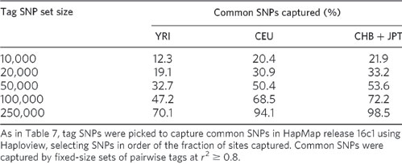
HapMap estimated how many SNPs genome-wide would need to be typed to capture (by LD) most common genetic variants. E.g. 250,000 would capture ~95% of SNPs in European populations.

Slide 47
The birth of GWAS
Cystic fibrosis (CFTR)
First proof of principle GWAS studies e.g. WTCCC
Human genome completed
Discovery of A/B/O
‘Sanger’ DNA sequencing
Breast cancer (BRCA1/2 )
1901
1970’s
1989
1994-5
2003
2007
1950’s
1980’s
1993
2005
2010
Structure of DNA
Low-throughput genotyping methods
Huntingdon’s (HTT)
Mapping of > 1 million common genetic variants
(International HapMap Project)
High-throughput ‘next generation’ sequencing
Alzheimer’s (APOE)
Microarray genotyping technology
Microarrays developed in the late 90’s / early 2000’s.
For the first time was possible to rapidly type hundreds of thousands or millions of SNPs

Slide 48
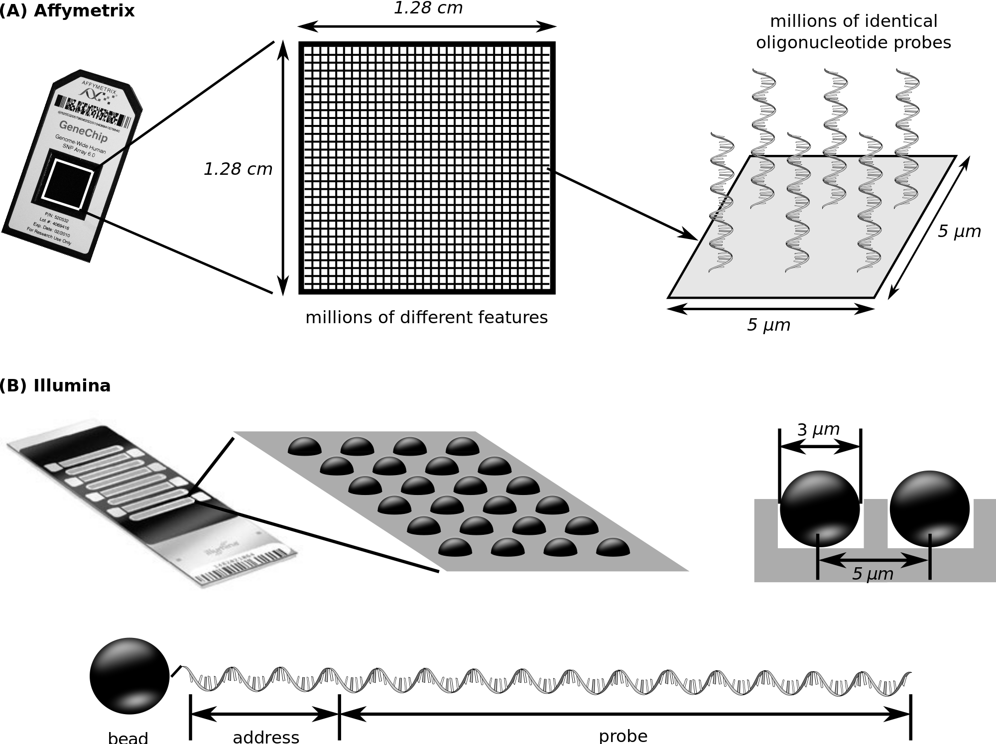
How a microarray works
Wash the DNA over and let it hybridise to millions of probes – one for each SNP
Flourescent markers are then attached. A picture is taken of the array.

Slide 49
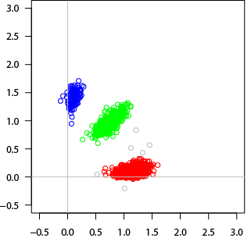
A microarray gives you intensities, not genotypes
For each (well-genotyped) SNP, you get back this:
B/B
A/B
A clustering algorithm has been used to turn the intensity values (x/y axis values) into genotype calls (colours).
A/A
Each dot represents DNA from one individual.
X axis = image intensity for 1st allele
Y axis = image intensity for 2nd allele

Slide 50
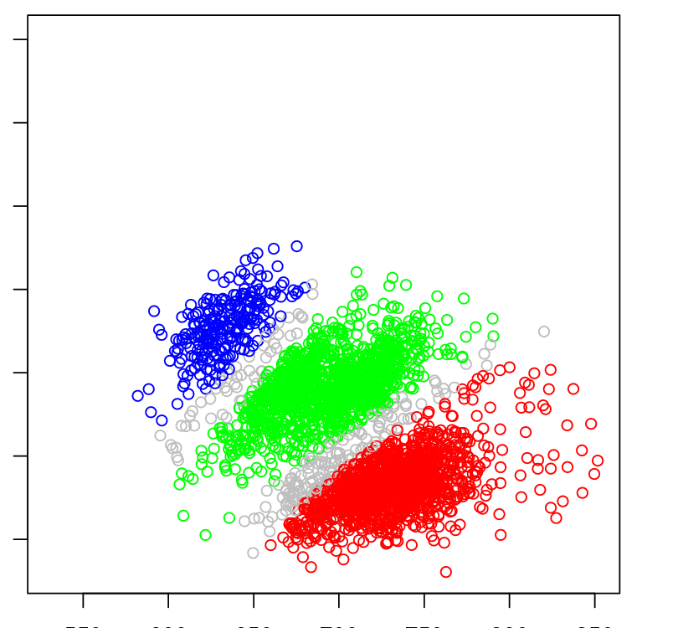
A microarray gives you intensities, not genotypes
For each SNP, you get back this:
Or this if you’re less lucky:
B/B
A/B
B/B?
?
A/B?
?
A/A
A/A?
Each dot represents DNA from one individual.
X axis = image intensity for 1st allele
Y axis = image intensity for 2nd allele
Small genotyping errors in cases or controls could easily confound the study
Careful quality control needed with
these technologies

Slide 51
Rest of lecture - outline
Testing for association
How to do the statistical tests? How many samples? How to deal with confounders?
What variants to genotype, and how?
Patterns of linkage disequilbrium and the HapMap study
A real GWAS study – WTCCC
The common variant, common disease hypothesis in practice

Slide 52
The birth of GWAS
Cystic fibrosis (CFTR)
First proof of principle GWAS studies e.g. WTCCC
Human genome completed
Discovery of A/B/O
‘Sanger’ DNA sequencing
Breast cancer (BRCA1/2 )
1901
1970’s
1989
1994-5
2003
2007
1950’s
1980’s
1993
2005
2010
Structure of DNA
Low-throughput genotyping methods
Huntingdon’s (HTT)
Mapping of > 1 million common genetic variants
(International HapMap Project)
High-throughput ‘next generation’ sequencing
Alzheimer’s (APOE)
Microarray genotyping technology
Microarrays developed in the late 90’s / early 2000’s.
For the first time was possible to rapidly type hundreds of thousands or millions of SNPs

Slide 53

Anatomy of a GWAS – what to look for
1. Collect as many cases and controls as possible
What samples How many?
2. Genotype (or impute) them at as many variants across the genome as possible
How many?
3. Deal with potential confounders – careful data quality control and handle population structure.
Have they done adequate data quality control? Have they dealt with possible confounders?
4. Estimate relative risks, and look for statistical evidence that of $RR≠ 1$
5. If estimate is many standard deviations from zero, bingo! We may have found a true causal effect.
Did they find anything with enough evidence?
6.Replicate in other studies, or find other corroborating evidence?
Is it corroborated by other evidence?
7. (Now try to understand the underlying biology.)
Can they understand the biology?

Slide 54
A real GWAS study - WTCCC
Nature (2007)
Studied seven common diseases in the UK
Bipolar disorder, Coronary Artery Disease, Crohn’s disease, Hypertension, Rheumatoid arthritis, Type 1 and Type 2 Diabetes
Genotyped at 500,000 SNPs across the genome
doi:10.1038/nature05911

Slide 55
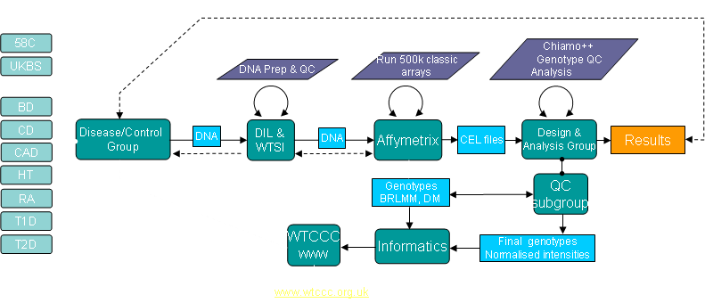
A real study - WTCCC

Slide 56

Anatomy of a GWAS – what to look for
1. Collect as many cases and controls as possible
N=2,000 cases and 3,000 controls
2. Genotype (or impute) them at as many variants across the genome as possible
Genotyped at 500k SNPs
3. Deal with potential confounders – careful data quality control and handle population structure.
4. Estimate relative risks, and look for statistical evidence that of $RR≠ 1$
5. If estimate is many standard deviations from zero, bingo! We may have found a true causal effect.
6. Does it replicate in other studies, or have other corroborating evidence?
7. (Now try to understand the underlying biology.)

Slide 57

Anatomy of a GWAS – what to look for
1. Collect as many cases and controls as possible
2. Genotype (or impute) them at as many variants across the genome as possible
3. Deal with potential confounders – careful data quality control and handle population structure.
Have they done adequate data quality control? Have they dealt with possible confounders?
4. Estimate relative risks, and look for statistical evidence that of $RR≠ 1$
5. If estimate is many standard deviations from zero, bingo! We may have found a true causal effect.
6. Does it replicate in other studies, or have other corroborating evidence?
7. (Now try to understand the underlying biology.)

Slide 58
They then threw away 809 samples!
Due to:
Poor genotyping rates
Evidence of contamination (too many heterozygous genotypes)
Evidence of being not of European ancestry
A duplicate, or close relative of another sample
Proportion missing calls
Proportion missing calls
They kept these samples
Chronological order of genotyping
Some of the poor quality data was apparently due to batch effects.
Proportion heterozygous calls

Slide 59
To avoid confounding by population structure, the samples were all supposed to be from the United Kingdom, and with European ancestry.
They used a method called principal components analysis to detect ancestry against the HapMap project samples. Some non-European ancestry individuals had been typed.
153 individuals were excluded on this basis.
Population structure
PCA computes genome-wide relationships between samples and then looks for directions of greatest variation. Since relatedness typically decreases with geographic distance, principal components typically reflect geography.
G
g
Case/control sampling

Slide 60
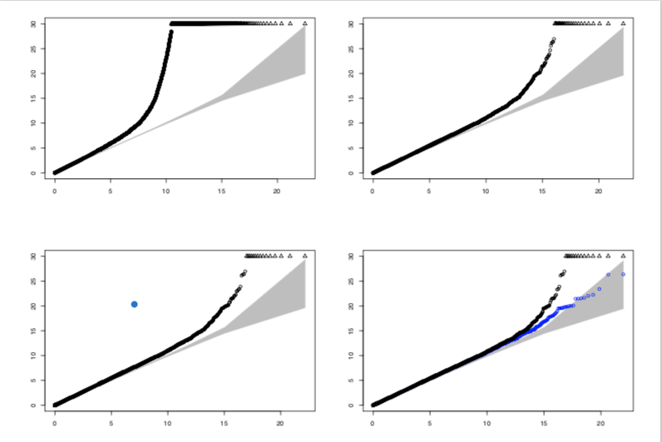
Using quantile-quantile plots to assess residual confounding
They also excluded 25,567 SNPs from the study for
High missing data rates
Deviation from Hardy-Weinberg equilibrium (lecture 1) in controls
Frequency differences between the two control groups
And they visually inspected cluster plots for remaining SNPs
Before SNP exclusions
After SNP exclusions
After visually inspecting cluster plots for remaining associated SNPs
(Blue dots)… and after removing remaining strongly-associated regions that they claim to be real
If there are few true signals, and if we have removed confounders – then P-values should largely come from a uniform distribution - they should lie on the diagonal.

Slide 61
Phew!

Slide 62
Bipolar disorder
Coronary artery disease
Crohn’s Disease
Hypertension
The main result of the study
Rheumatoid arthritis
T1D
T2D

Slide 63
Bipolar disorder
1
Number of associations
with strong evidence
Coronary artery disease
1
The study found 25 associations at their nominal P-value threshold.
Twelve of these provided replication of previously implicated variants. Thirteen were new associations.
The traits clearly differ in their genetic architecture
Some SNPs were associated with some evidence with multiple traits (mainly for the autoimmune diseases).
Crohn’s Disease
9
Hypertension
0
Rheumatoid arthritis
3
T1D
7
T2D
3

Slide 64
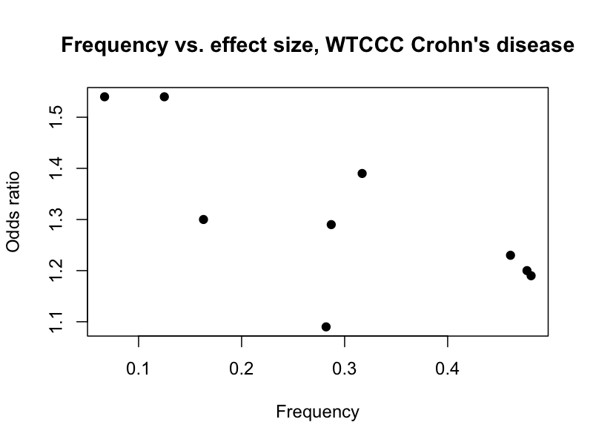
Effect sizes were generally modest
E.g. across the 9 associations with Crohn’s disease, the maximum estimated odds ratio was 1.54, (similar to the O blood group example)
(A strong effect with Type 1 Diabetes was also observed in the MHC locus)
$$4$$
Relative risk
$$2$$
$$1$$
Very rare
rare
common
Very common
Genotype frequency

Slide 65
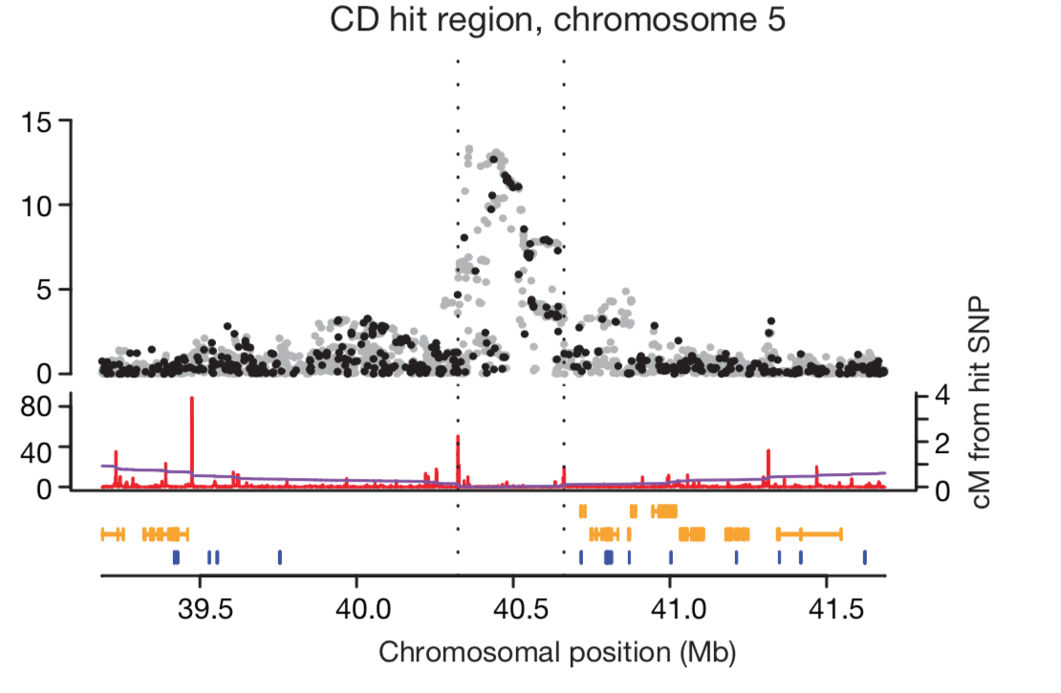
Zooming in to a GWAS ‘hit’ plot
Sometimes called a ‘locus zoom’ plot. Here are some things to look for:
Evidence for association with each SNP
(-log10 P-value or log10 Bayes factor)
Delineation of association region boundaries (usually based on heuristics)
Black points were typed, grey points were imputed from HapMap
Signal ought to follow LD patterns. In particular ought to drop off near recombination hotspots
The recombination rate, here as estimated by HapMap
Regional genes
Position of SNPs in the reference genome assembly

Slide 66
Main lecture messages
1. Most human phenotypes are highly heritable
(a large proportion of variation is due to genetics)
2. But many ‘complex’ traits are not mendelian - they are polygenic - “common variant, common trait” hypothesis
3. The discovery of this fact is due to genome-wide association studies (GWAS)
Collect lots of samples – type lots of variants – careful quality control – conduct statistical test of association – use stringent statistical thresholds.
The first of these studies was conducted in the mid 2000s and showed the hypothesis is definitely true.

Slide 67
What about the underlying biology?

Slide 68
Bipolar disorder
Coronary artery disease
Crohn’s Disease
We have clearly learned something about the biology of these traits.
Hypertension
Rheumatoid arthritis
…but what have we learned?
T1D
T2D

Slide 69
Bipolar disorder
Coronary artery disease
Crohn’s Disease
Hypertension
Let’s zoom in
Rheumatoid arthritis
T1D
T2D

Slide 70
Biology is hard

Slide 71
Biology is hard
No genes under the main association signal!

Slide 72
Bipolar disorder
Coronary artery disease
Crohn’s Disease
Hypertension
Rheumatoid arthritis
T1D
T2D

Slide 73
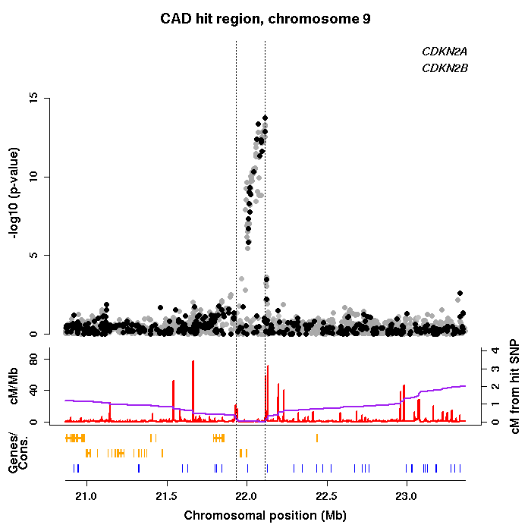
Biology is hard
Association observed with CAD over a ~100kb region of chromosome 9. This is unquestionably a real association (it has been replicated in several independent studies).
The functional mechanism of this association is not fully solved; it probably involves regulation of expression of the two nearby genes CDKN2A/B.
Neither gene was an obvious candidate beforehand - thus, this association does point to novel biology.
Harismendy et al Nature 2011; Almontishari, et al JACC 2013; Almonitishari et al, Circulation 2015
Notes:
Cyclin dependent Kinase Inhibitor – known as tumor suppressors.

Slide 74
Bipolar disorder
Coronary artery disease
Crohn’s Disease
Hypertension
Rheumatoid arthritis
T1D
T2D

Slide 75
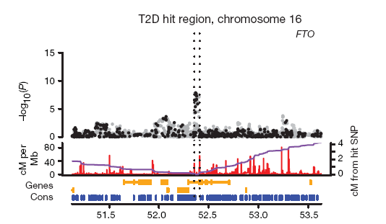
FTO
IRX3
This association with Type 2 Diabetes turned out to be through a second, related trait (obesity), again unquestionably a real effect.
But as of 2018 the functional mechanism remains unclear. Expression of FTO is known to affect obesity, but the SNPs may also affect expression of another gene, IRX3, 200kb away.
Smemo et al, Nature 2014
Notes:
‘Fat mass and obesity-associated gene’.

Slide 76
This pattern has turned out to be typical. It has generally proven extremely hard to narrow down GWAS associations to underlying ‘causal’ variants.
LD is a double-edged sword.
Next lecture: we will look at this.

Slide 77
Anatomy of a GWAS – what to look for
1. Collect as many cases and controls as possible
What samples How many?
2. Genotype (or impute) them at as many variants across the genome as possible
How many?
3. Deal with potential confounders – careful data quality control and handle population structure.
How did they do quality control – is it adequate?
4. Estimate relative risks, and look for statistical evidence that of $RR≠ 1$
5. If estimate is many standard deviations from zero, bingo! We may have found a true causal effect.
Did they find anything with enough evidence?
6.Replicate in other studies, or find other corroborating evidence?
Is it convincing?
7. (Now try to understand the underlying biology.)
Can they understand the biology?

Slide 78
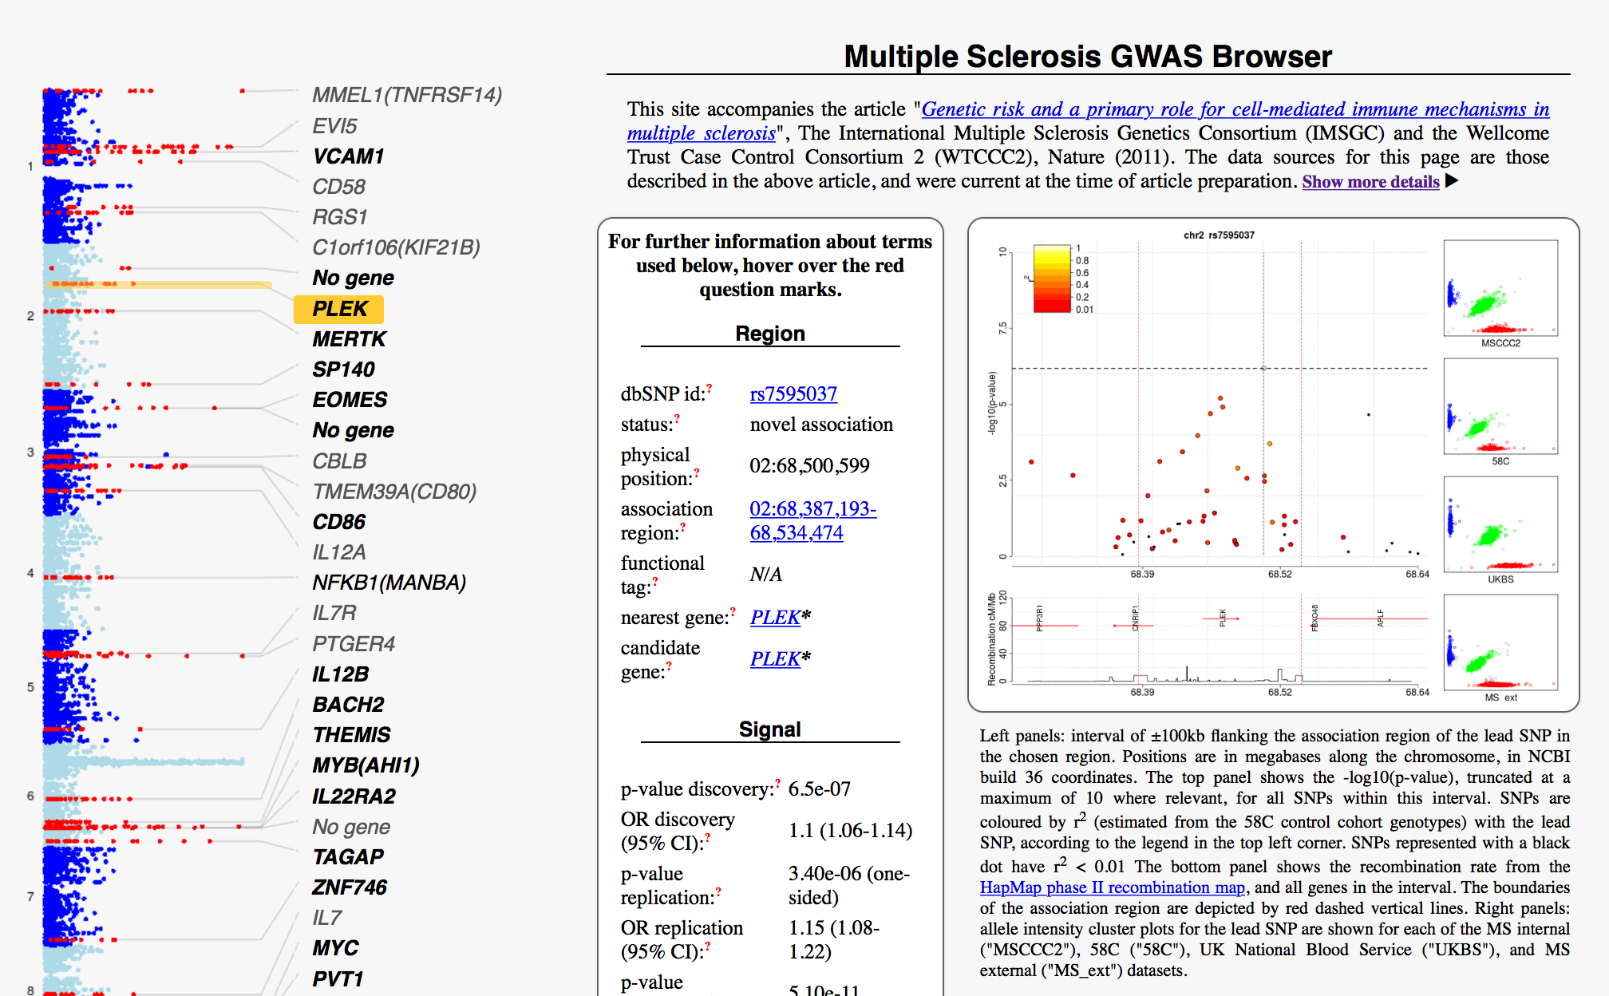
Consolidation question
GWAS of multiple sclerosis (2011)
9772 cases, 17,376 controls from across Europe
www.chg.ox.ac.uk/wtccc2/ms/
(I think this url requires the trailing /)
Visit the above site and make sure you understand what is shown. Pick a signal and try to work out
What is the estimated effect size?
How strong was the evidence?
Did it replicate?
Does the association signal look sensible – does it follow LD patterns, and do the cluster plots look sensible?
Can you figure out what the nearby genes do? (Warning: this can be a time sink!)
Bonus question: read the paper and try to figure out the questions on the checklist.

Slide 79
Next lecture: Friday 6th Mar @14:00
Understanding the genetics of complex traits II
Gavin Band gavin.band@well.ox.ac.uk
BA Human Sciences
Friday 6th March 2026
Notes:
The title of my talk is genome-wide studies as this has been the main focus of my research over the last 3 years.

