Slide 1

Understanding the genetics of complex traits II
Gavin Band gavin.band@well.ox.ac.uk
BA Human Sciences
Friday 6th March 2026
Notes:
The title of my talk is genome-wide studies as this has been the main focus of my research over the last 3 years.

Slide 2
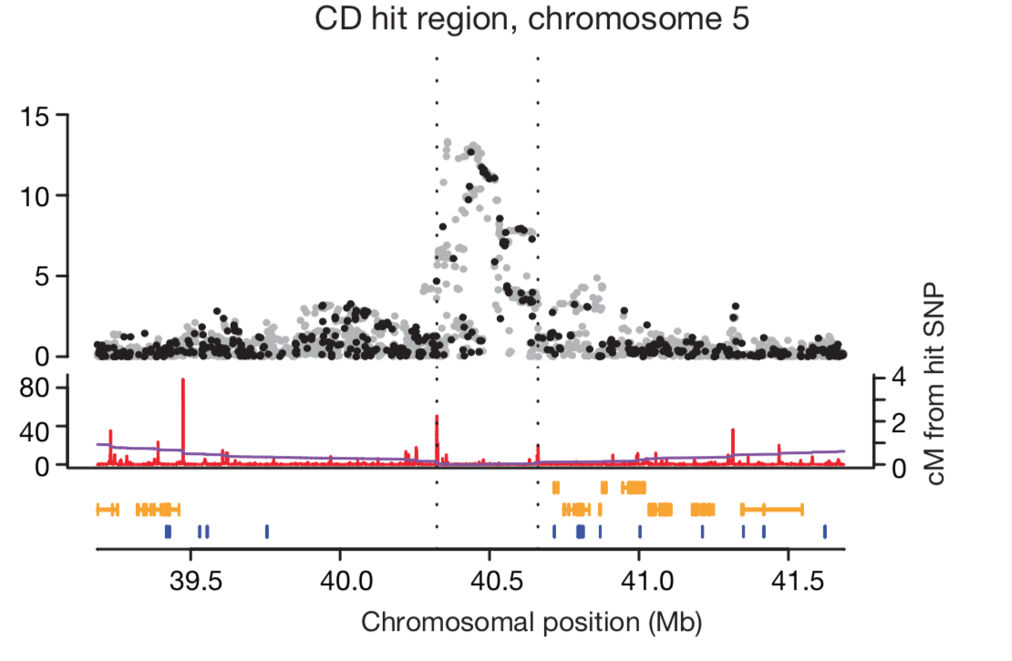



Main points in this lecture
How polygenic do traits get, anyway?
Extracting biological information from GWAS
$$4$$
Relative risk
$$2$$
$$1$$
Very rare
rare
common
Very common

Slide 3
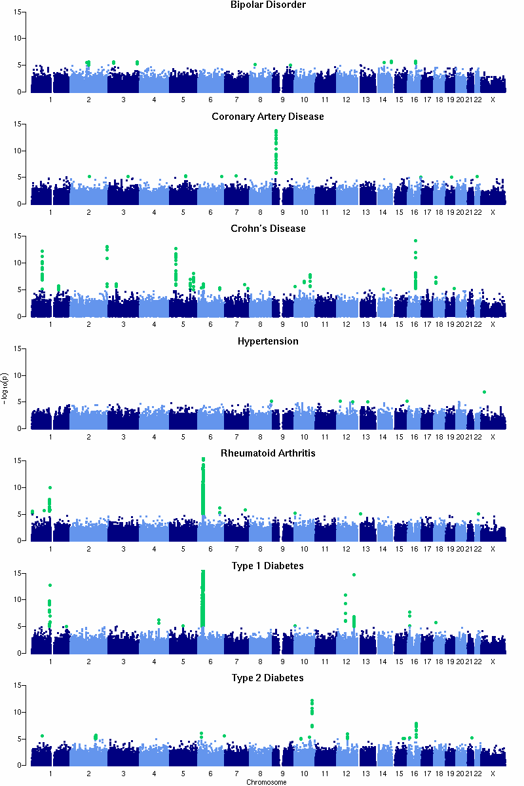



Actual results
from the Wellcome Trust Case-Control Consortium study:
Number of signals
My cartoon:
Bipolar disorder
1
$$4$$
Coronary artery disease
Relative risk
1
$$2$$
Crohn’s Disease
$$1$$
Very rare
rare
common
Very common
9
Genotype frequency
Hypertension
“Common variant, common trait” hypothesis
0
Rheumatoid arthritis
Are you convinced?
3
T1D
7
T2D
3
Additive model, N=2,000 cases + 3000 controls per phenotype

Slide 4
Actual results
from the Wellcome Trust Case-Control Consortium study:
Number of signals
My cartoon:
Bipolar disorder
1
$$4$$
Coronary artery disease
Relative risk
1
$$2$$
Crohn’s Disease
$$1$$
Very rare
rare
common
Very common
9
Genotype frequency
Hypertension
“Common variant, common trait” hypothesis
0
Rheumatoid arthritis
Are you convinced?
3
T1D
Maybe we haven’t found them all - how could we find more?
7
T2D
3
Additive model, N=2,000 cases + 3000 controls per phenotype

Slide 5
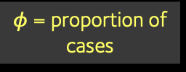




Remember the formula
$$\text{Standard} \text{error}(\log{OR)}≈\frac{1}{\sqrt{2N×f\left(1−f\right)×φ(1−φ)}}$$
N = sample size
$φ$ = proportion of cases
f = frequency of allele
$$4$$
Relative risk
To find more associations we should:
increase the sample size
$$2$$
$$1$$
Very rare
rare
common
Very common
Genotype frequency

Slide 6
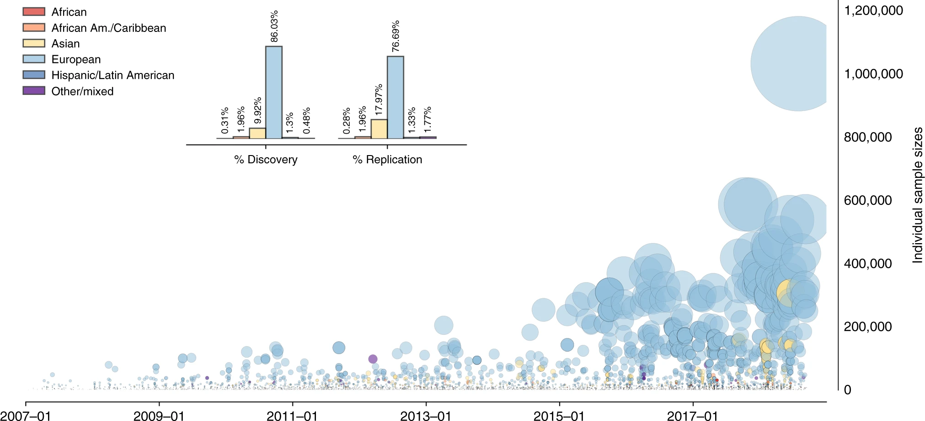
GWAS revolution
1.2M
1M
800k
600k
Study sample size
WTCCC study
Multiple sclerosis study
400k
200k
0
2007
2009
2011
2013
2015
2017
…
Mills & Rahal, “A scientometric review of genome-wide association studies”, Communications Biology 2019
NHGRI GWAS Catalog: https://www.ebi.ac.uk/gwas/

Slide 7
GWAS revolution
1.2M
1M
800k
600k
Study sample size
WTCCC study
Multiple sclerosis study
400k
200k
0
2007
2009
2011
2013
2015
2017
…
Mills & Rahal, “A scientometric review of genome-wide association studies”, Communications Biology 2019
NHGRI GWAS Catalog: https://www.ebi.ac.uk/gwas/

Slide 8
GWAS revolution
1.2M
UK Biobank
Full (500k)
1M
Interim (150k)
800k
600k
Study sample size
WTCCC study
Multiple sclerosis study
400k
200k
0
2007
2009
2011
2013
2015
2017
…
Mills & Rahal, “A scientometric review of genome-wide association studies”, Communications Biology 2019
NHGRI GWAS Catalog: https://www.ebi.ac.uk/gwas/

Slide 9
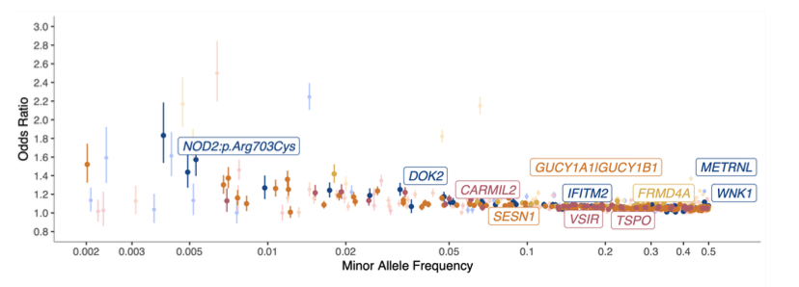
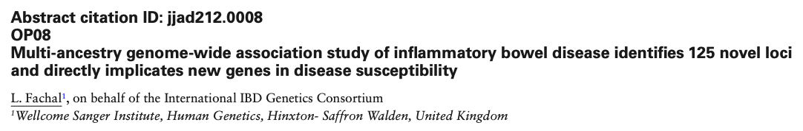



Inflammatory bowel disease
(Crohn’s disease and ulcerative colitis)
$$4$$
Relative risk
$$2$$
$$1$$
Very rare
rare
common
Very common
N = 125,992 IBD cases
1.2 million controls
> 600 association signals.

Slide 10
Type 2 diabetes
$$4$$
Relative risk
$$2$$
N = 74,000 T2D cases
And 824,000 controls
$$1$$
Very rare
rare
common
Very common
403 signals
“conditionally independent” meaning some of them overlap the same regions

Slide 11
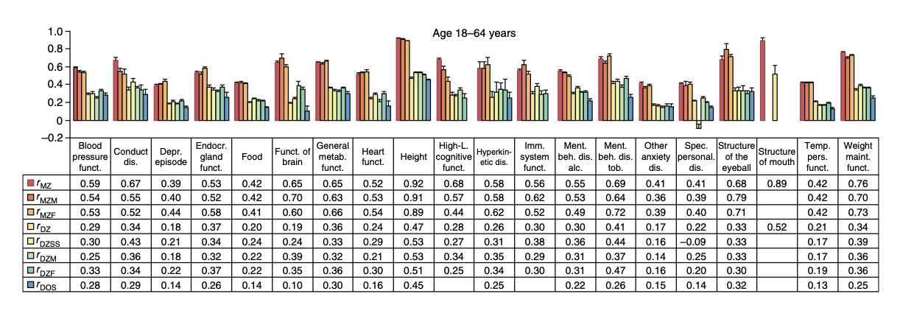
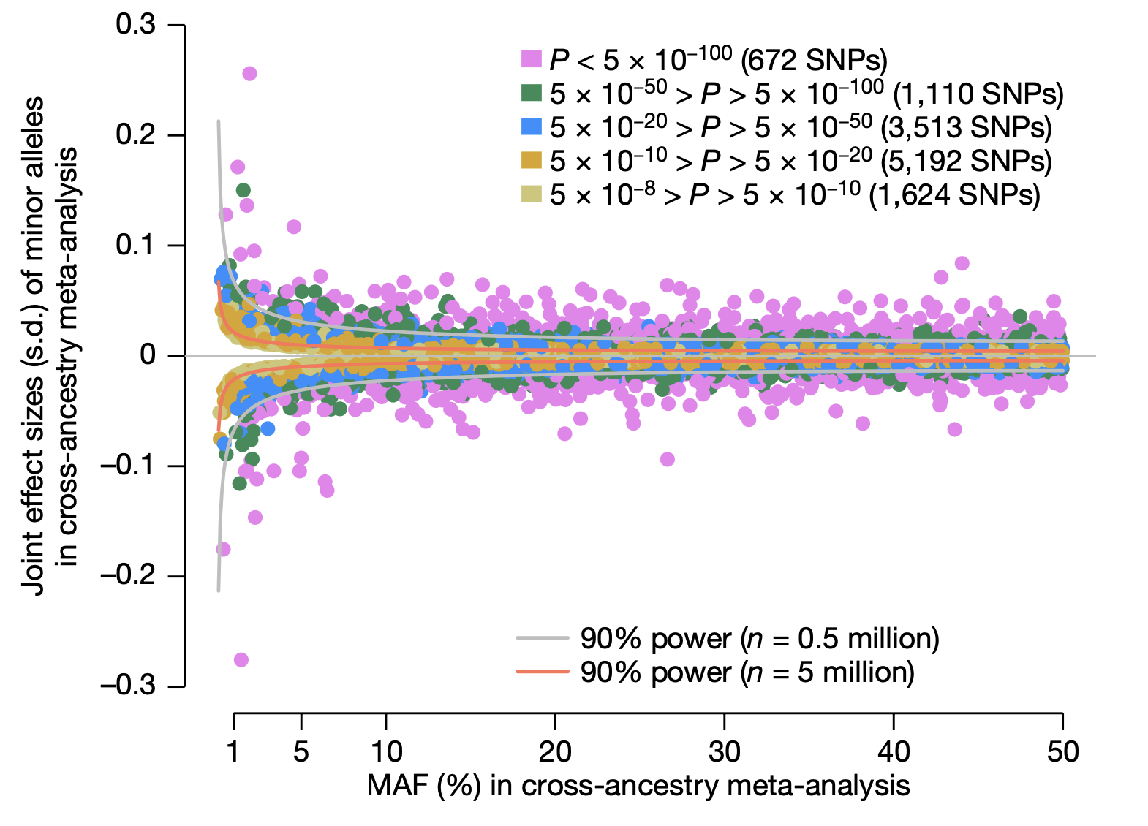
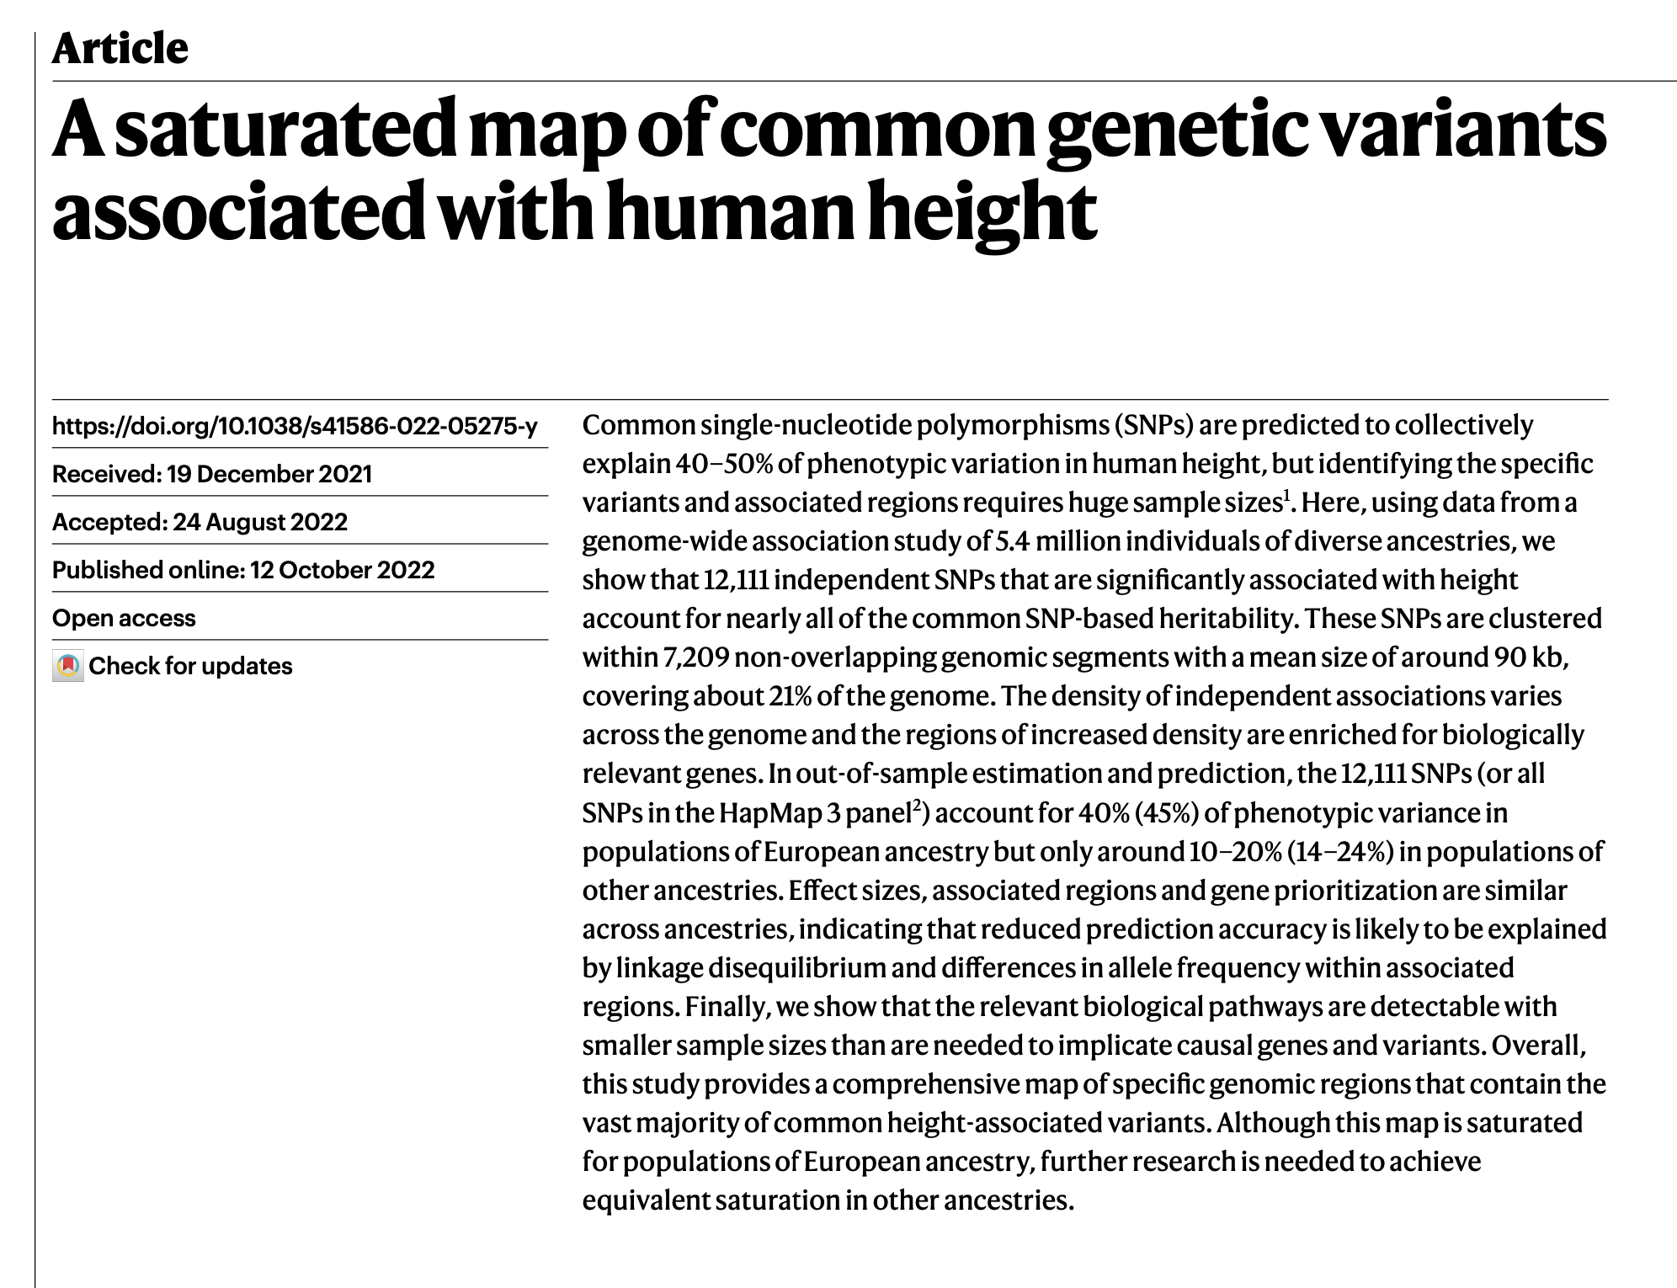
GWAS of human height
In 5.4 million individuals
$$4$$
Relative risk
$$2$$
~90% heritability
$$1$$
Very rare
rare
common
Very common
? signals
N = 5.4 million

Slide 12
GWAS of human height
In 5.4 million individuals
$$4$$
Relative risk
$$2$$
$$1$$
Very rare
rare
common
Very common
~90% heritability
12,111 independent signals
Collectively explaining 50% of heritability
N = 5.4 million
They collectively explain ~ 50% of heritability
In European ancestry people

Slide 13
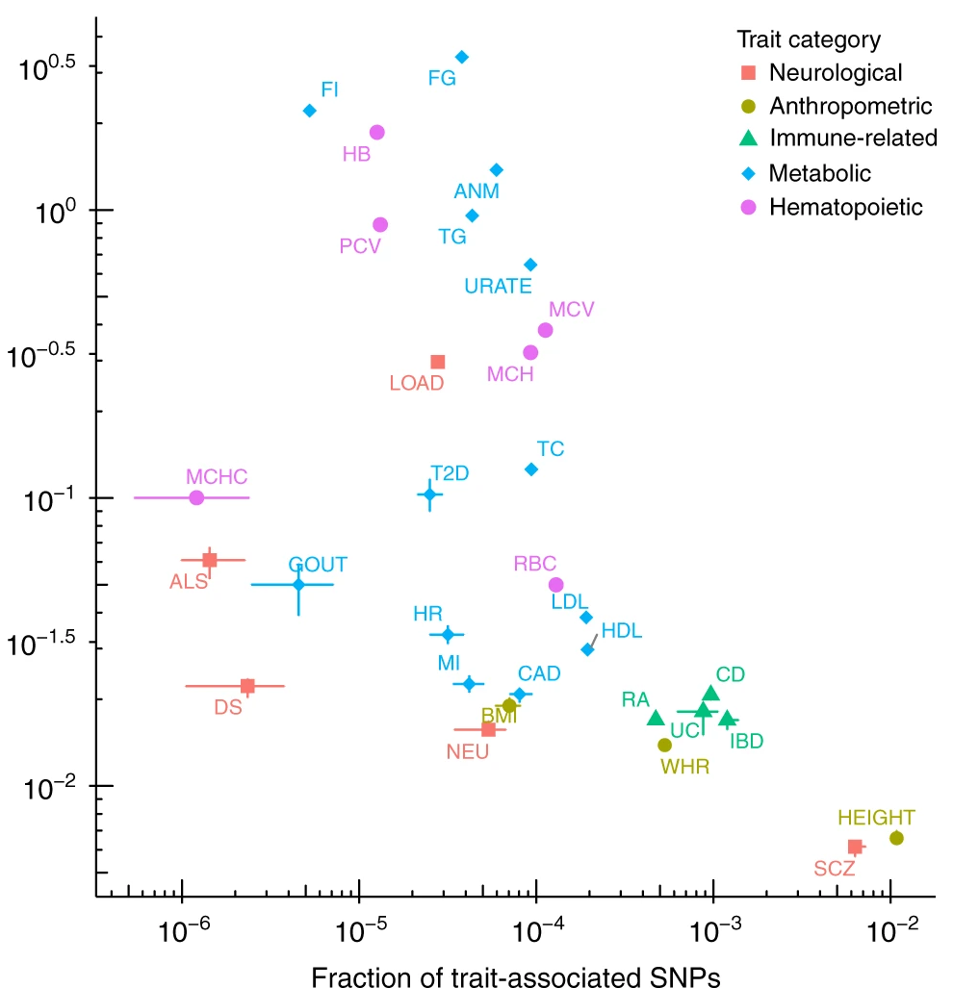
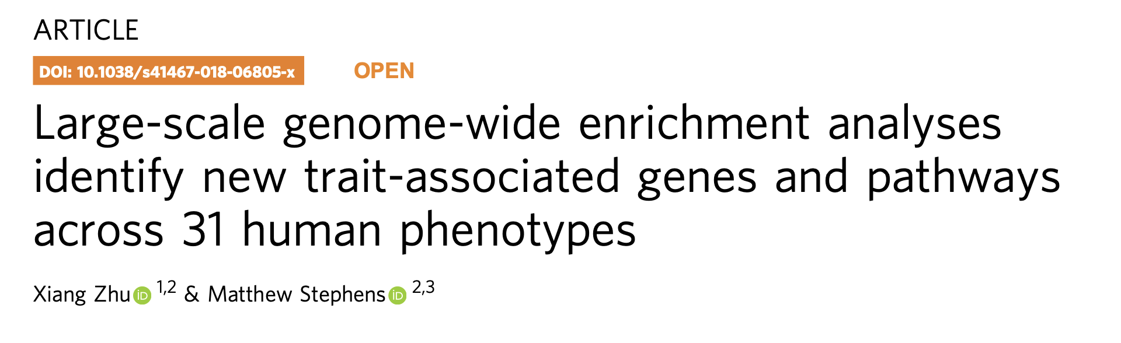
Comparing across traits
With all this data it’s possible to fit more sophisticated models that estimate the amount of polygenicity across traits.
Average effect size
(normalized so no longer on log OR scale)
Fraction of SNPs that are associated
(out of 1.1 million HapMap SNPs)

Slide 14
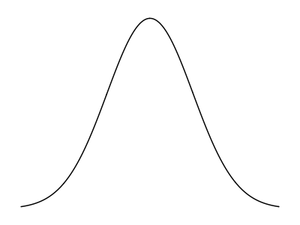



Common variant, common disease hypothesis
Affected
Phenotype
Genotype
population
A complex trait.
Caused by many factors, each having a small overall effect. Including
Many genetic variants, including common ones
Environmental factors
Gene-environment or gene-gene interactions
…
$$4$$
Relative risk
$$2$$
$$1$$
Very rare
rare
common
Very common
Genotype frequency

Slide 15
How are these studies possible? Consortia and meta-analysis

Slide 16
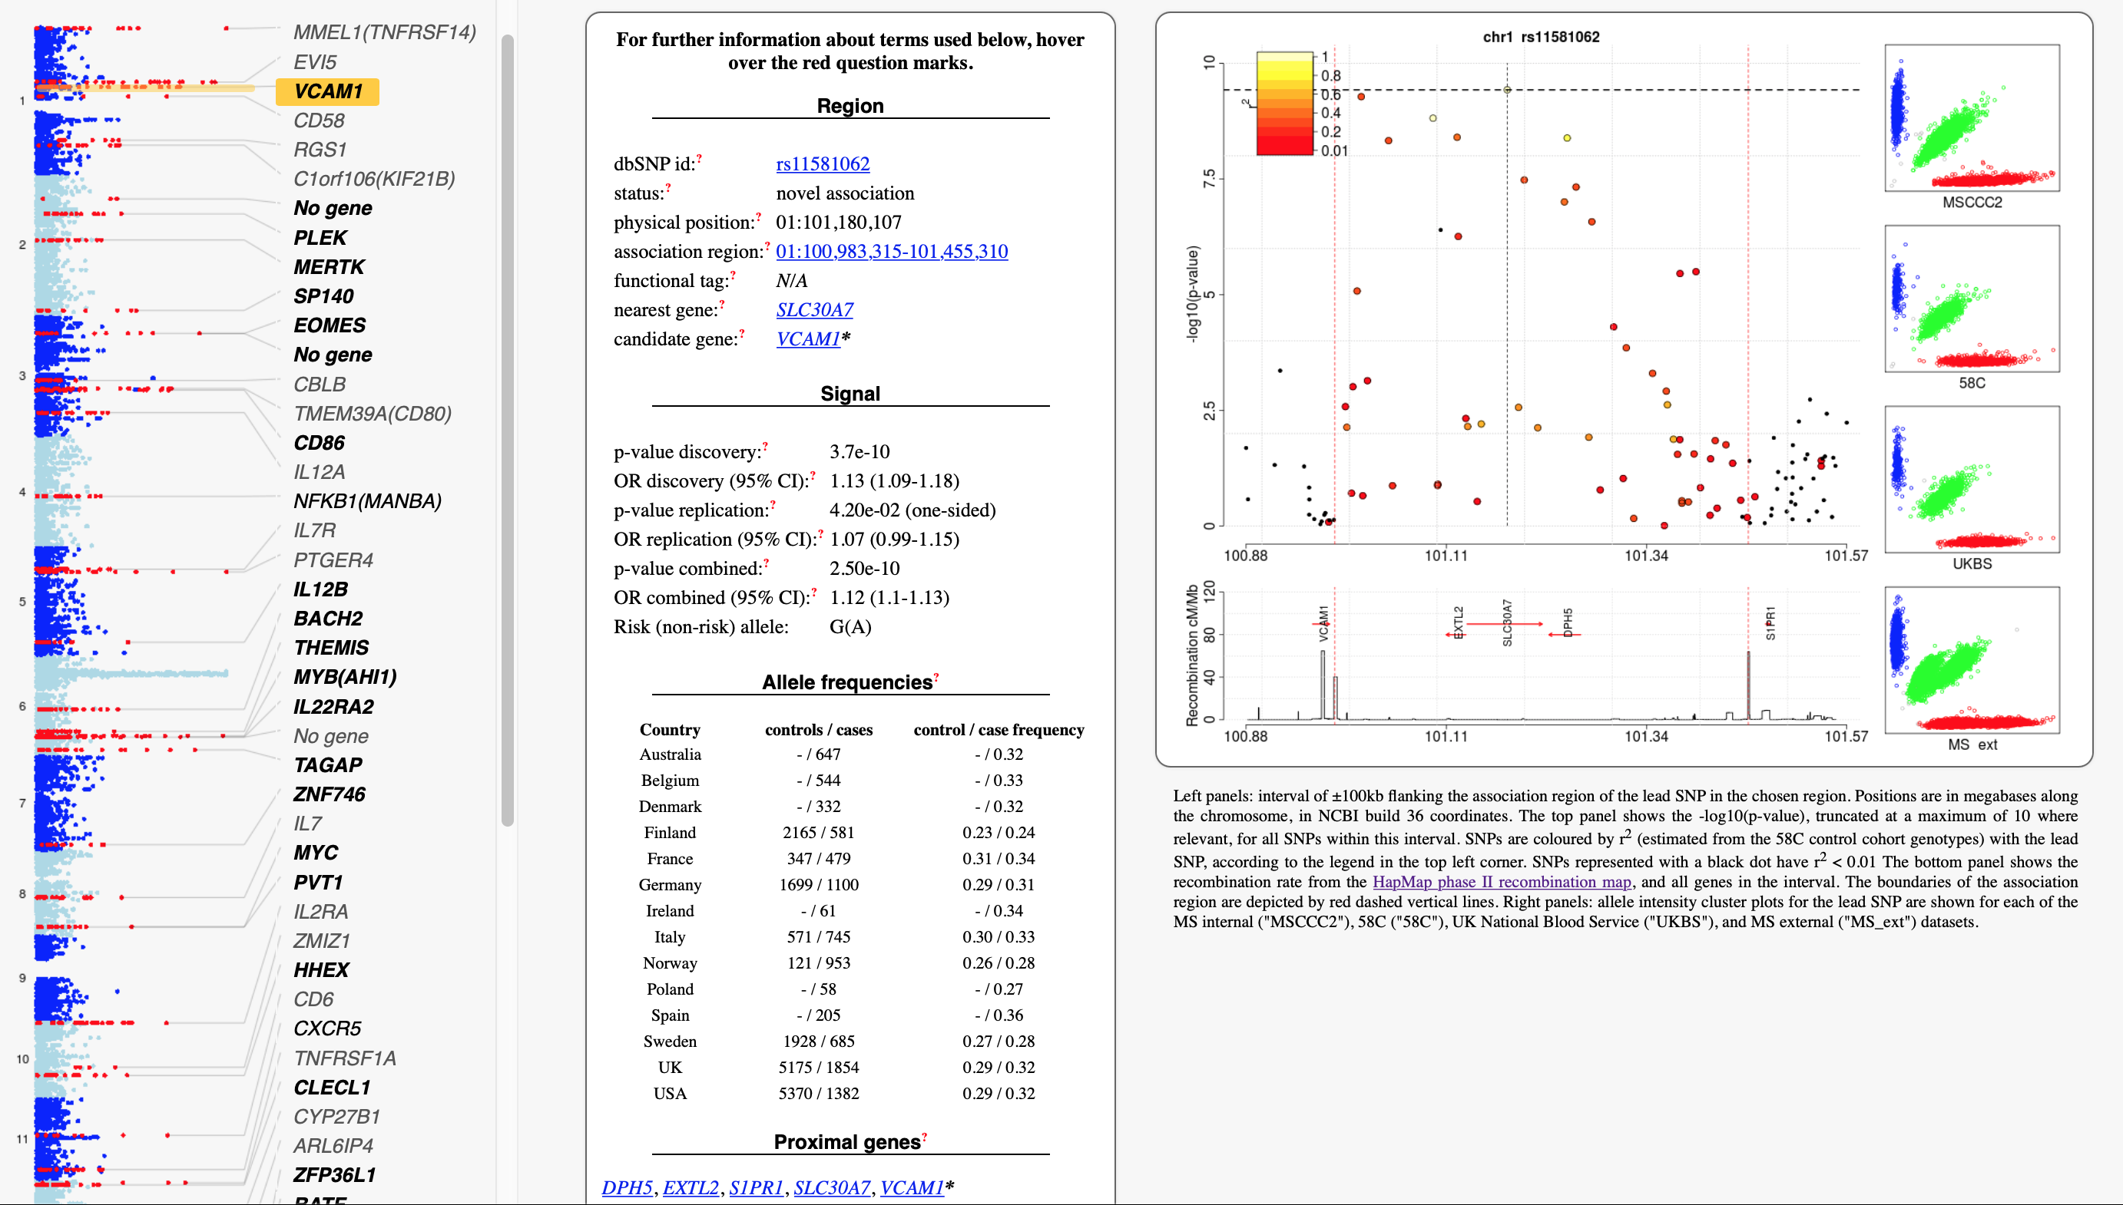
Consolidation question from last lecture
WTCCC2 GWAS of multiple sclerosis (9,772 cases and 7,376 controls).
www.well.ox.ac.uk/wtccc2/ms/
(I think this requires the trailing /)
Can you explain?

Slide 17
Consortia and meta-analysis
To generate such large sample sizes for “common” (but still relatively rare ) diseases, requires setting up large multi-centre collaborations. This is fun to be involved in but comes with its own analysis challenges….

Slide 18
Dealing with population structure
# cases /
# controls
This study suffered from a key problem. Can you see what it is?
Per country

Slide 19
Dealing with population structure
# cases /
# controls
This study suffered from a key problem. Can you see what it is?
Per country
Case-control sampling is correlated with genome-wide genetic variation.
G
g
Population
structure
First two “principal components” obtained purely from the genotypes
“Confounding by population structure”
Case/control
sampling

Slide 20
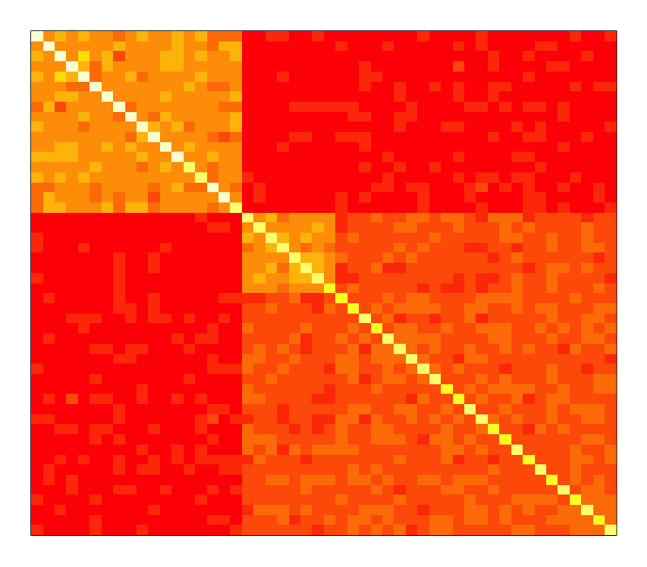


Population structure: solutions
Instead of simple 2x2 table
1. Regression including principal components
2. Linear mixed model
$$\text{outcome} \sim \text{genotype}+PCs$$
$$\text{outcome} \sim \text{genotype}+$$
Include a genetic relatedness matrix computed from genome-wide genotypes in the association test
Uses the entire matrix of relationships
Plot of first two principal components obtained from the genome-wide genotypes
MS study
Uses just the strongest directions of variation in relatedness (population structure)
Most p-values are now not inflated

Slide 21
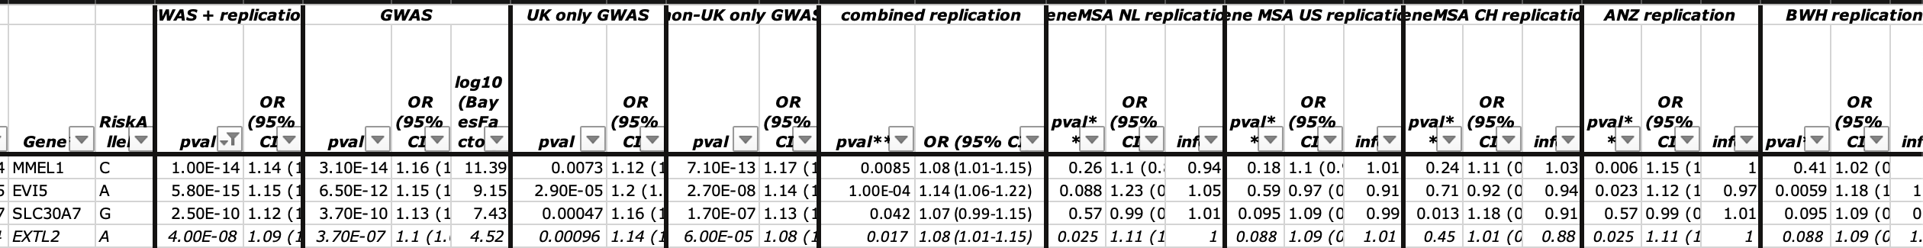



Anatomy of an association analysis
All GWAS should report data in a way that can be re-used by future studies.
This study used several previous GWAS to conduct replication. All the details are given in a supplementary table:
Discovery and overall data as on web page
Evidence for the same effect direction was seen separately in both arms of the discovery…
…and in the combined replication...
…and in most of the individual replication studies.
This is a common analysis approach: to gain sample size, use meta-analysis to combine results across several component studies. Then look for consistency between the studies.
$${\text{v}}_{meta}=1/\left(\sum_{i}{\frac{1}{v_{i}}}\right)$$
$$β_{\text{meta}}=\left(\sum_{i}{\frac{β_{i}}{v_{i}}}\right)×{\text{v}}_{meta}$$
(Where $v$ denotes squared standard error)
” Inverse variance weighted fixed-effect meta-analysis“, gives results approximately equal to joint analysis of genotype data.

Slide 22
Main points in this lecture
Extracting biological information from GWAS

Slide 23
We now have thousands of GWAS signals across thousands of traits. What do they teach us about the underlying biology?
?

Slide 24
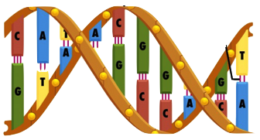
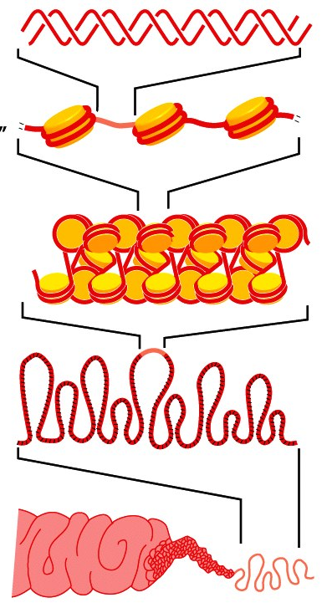
The circle of genetic causation
DNA gets physically packaged up into chromosomes...
Notes:
Population individuals pass on DNA with recombination and mutation
DNA is wrapped up into chromosomes inside cells, where it encodes

Slide 25
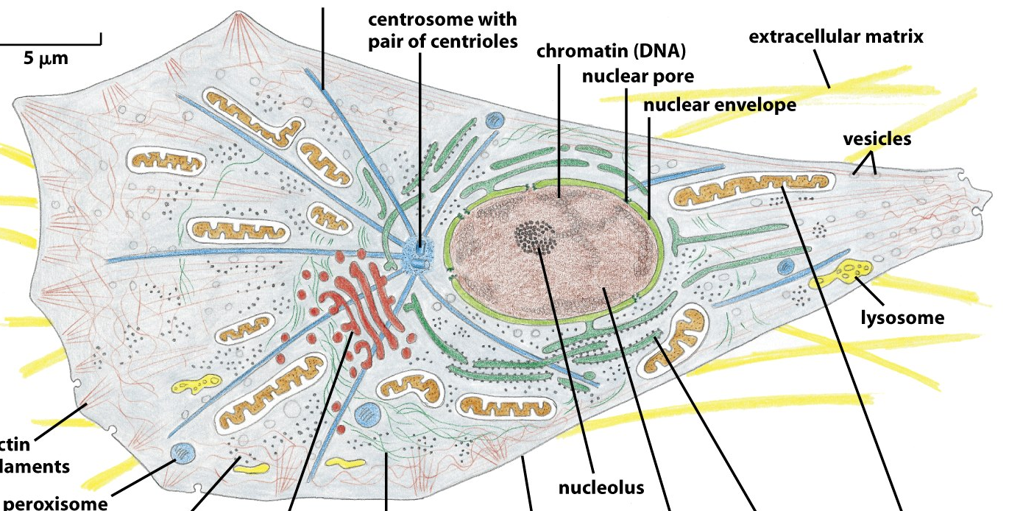
The circle of genetic causation
DNA gets physically packaged up into chromosomes...
...inside cells, where it is transcribed to form proteins and other molecules...
Notes:
Population individuals pass on DNA with recombination and mutation
DNA is wrapped up into chromosomes inside cells, where it encodes....
(2 metres of linear DNA per cell, 50 trillion cells)

Slide 26
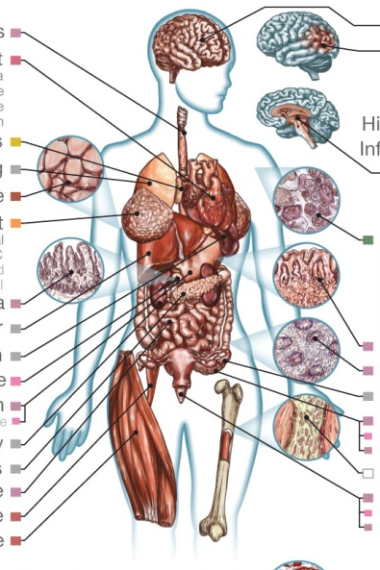
The circle of genetic causation
DNA gets physically packaged up into chromosomes...
...that combine to make individuals...
...inside cells, where it is transcribed to form proteins and other molecules...
...that affect how the cells behave, forming different organs...
Notes:
Population individuals pass on DNA with recombination and mutation
DNA is wrapped up into chromosomes inside cells, where it encodes

Slide 27
The circle of genetic causation
...whose success is affected by the traits they have...
DNA gets physically packaged up into chromosomes...
...that combine to make individuals...
...inside cells, where it is transcribed to form proteins and other molecules...
...that affect how the cells behave, forming different organs...
Notes:
The map from genetics to phenotypes is incredibly complicated
And it gets at what makes us human: evolution.

Slide 28
The circle of genetic causation
...passing on DNA, with mutations and recombination, to new generations...
...whose success is affected by the traits they have...
...that gets physically packaged up into chromosomes...
There is complex biology at all stages
...that combine to make individuals...
...inside cells, where it is transcribed to form proteins and other molecules...
...that affect how the cells behave, forming different organs...
Notes:
The map from genetics to phenotypes is incredibly complicated
And it gets at what makes us human: evolution.

Slide 29
The circle of genetic causation
...passing on DNA, with mutations and recombination, to new generations...
...whose success is affected by the traits they have...
microarrays, genome sequencing
Clinical phenotype measurements
...that gets physically packaged up into chromosomes...
There is complex biology at all stages
Biomarker measurements
Chromatin state marker assays, ChIP-seq, ...
and we can measure it
RNA-seq, spectroscopy, antibody binding
...that combine to make individuals...
...inside cells, where it is transcribed to form proteins and other molecules...
...that affect how the cells behave, forming different organs...
Notes:
The map from genetics to phenotypes is incrediblyt complicated
And it gets at what makes us human: evolution.

Slide 30
Gaining biological knowledge from GWAS
There are several ways we can try to translate knowledge of associations into new biological insights. I will try to describe a few of these.
Pathway analysis – even if we can’t fine-map, we can still try to assess whether associations group into particular biological pathways that might shed light on biology
Pleiotropy – how are associations shared between traits?
Fine-mapping – can we identify the actual causal variants underlying these associations, and hence discover specific proteins and disease pathways?

Slide 31
The circle of genetic causation
Pathway analysis
and pleiotropy
...that combine to make individuals...
Notes:
The map from genetics to phenotypes is incrediblyt complicated
And it gets at what makes us human: evolution.

Slide 32
Pathway analysis example
The primary cause of MS has typically been thought to be inflammation causing downstream neurodegeneration – with some debate about this. Can the GWAS of MS we discussed shed light on this?
As the main figure shows, many of the association signals looked like they were near immune-system related genes.
www.well.ox.ac.uk/wtccc2/ms/

Slide 33
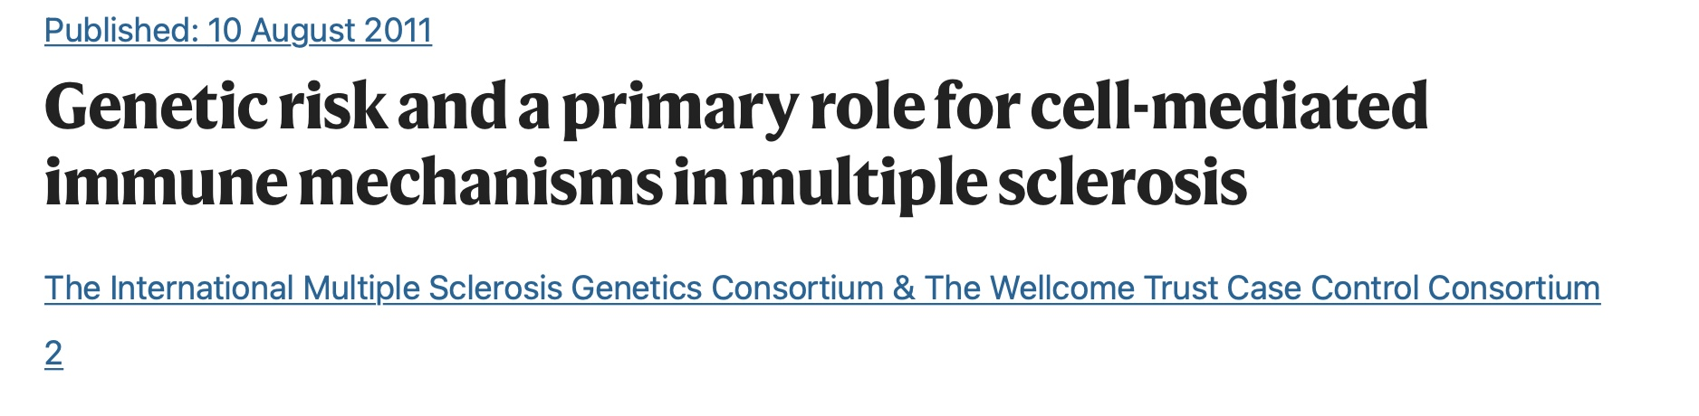
Pathway analysis example
We:
Assigned SNPs to their nearest gene using the available annotation
Used the Gene Ontology Project to classify genes into functionally related groups
Conducted a statistical test (Fisher’s exact test) to identify whether the nearest genes were enriched in each group.
Particularly strong enrichment was observed for immune system pathways – notably in “T cell activation and proliferation” (P=1.9x10⁻⁹)
“Although GO immune system genes only account for 7% of human genes, in 30% of our association regions the nearest gene to the lead SNP is an immune system gene”
T-helper-cell differentiation pathway
(from Ingenuity Pathway Analysis software)
www.well.ox.ac.uk/wtccc2/ms/

Slide 34
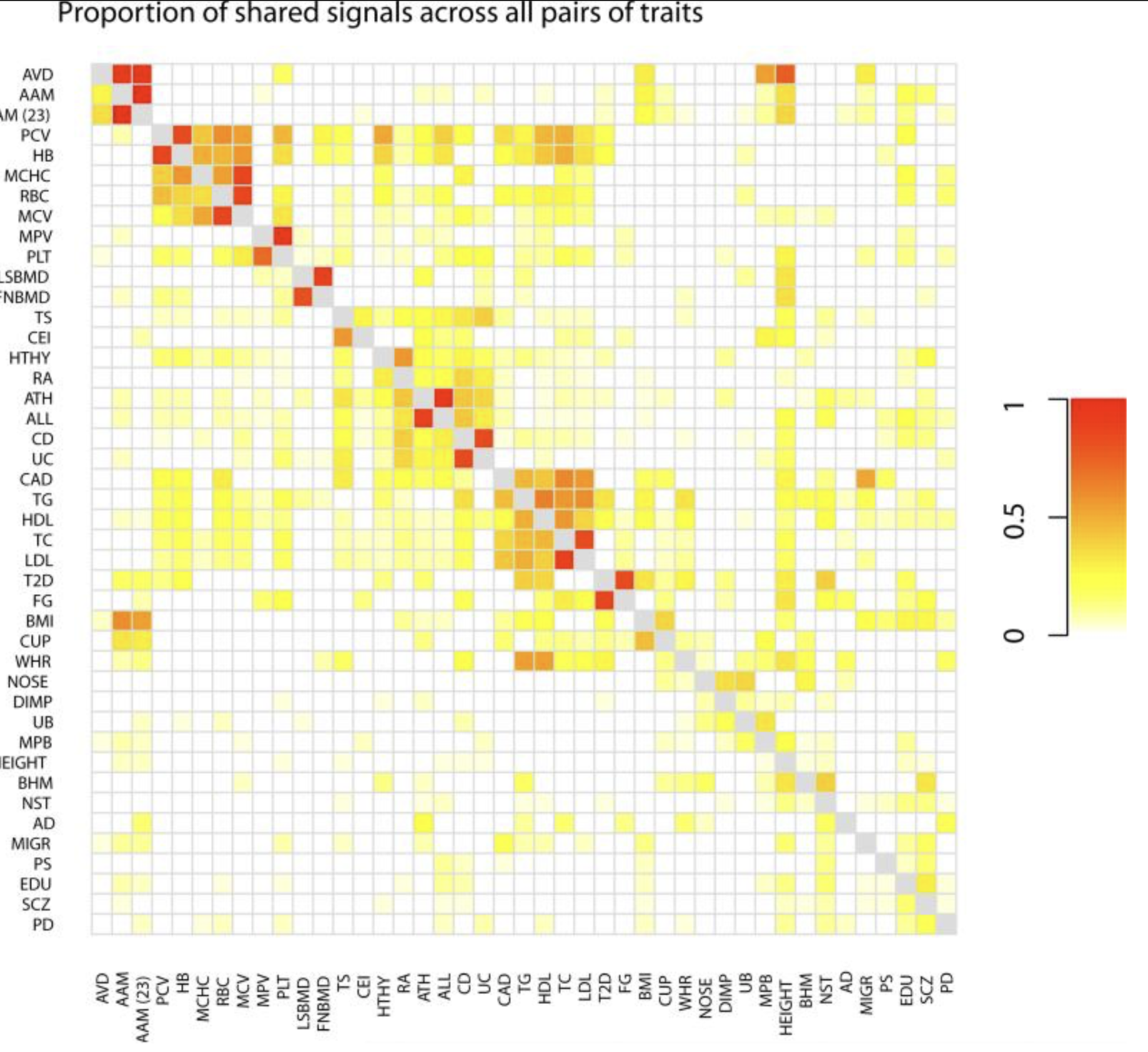
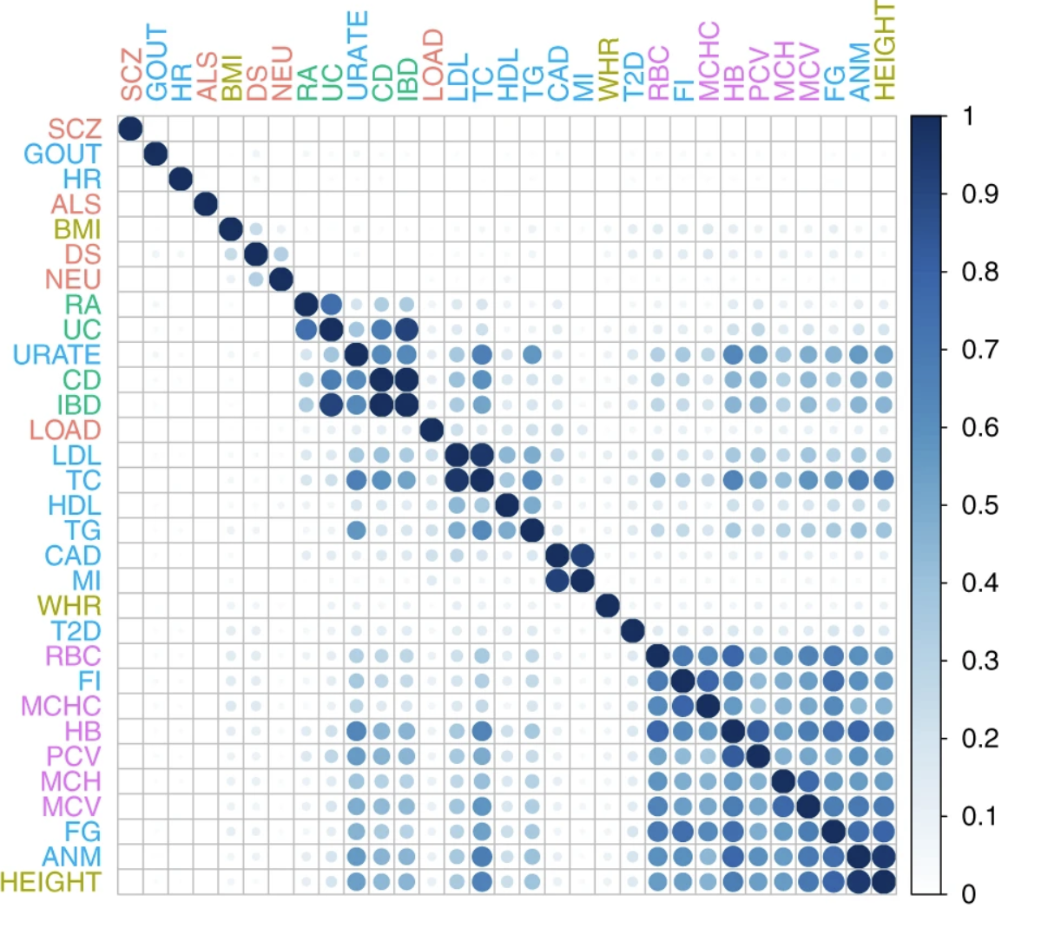
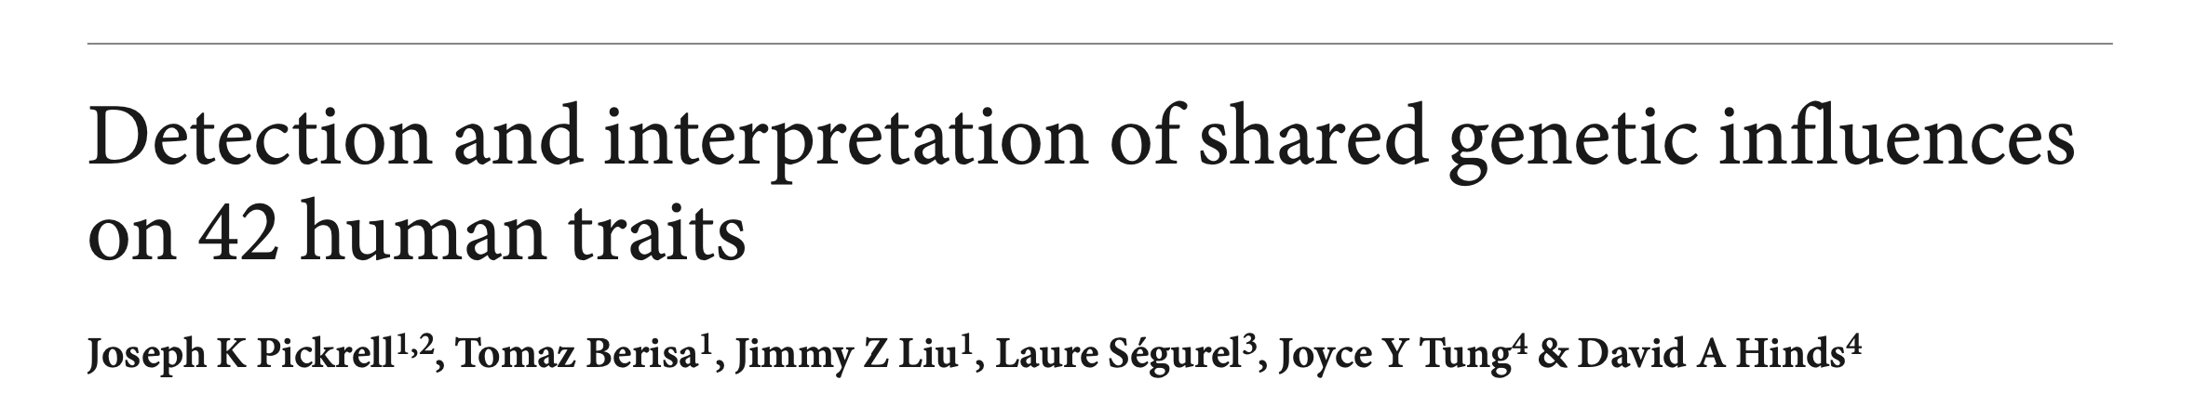
Sharing of associations between traits
(”proportion of associations for trait i (row) that are also associations for trait j (column)”)
Sharing of pathways between traits
(” proportion of pathways that are enriched in both traits, among pathways enriched in at least one of the traits”)

Slide 35
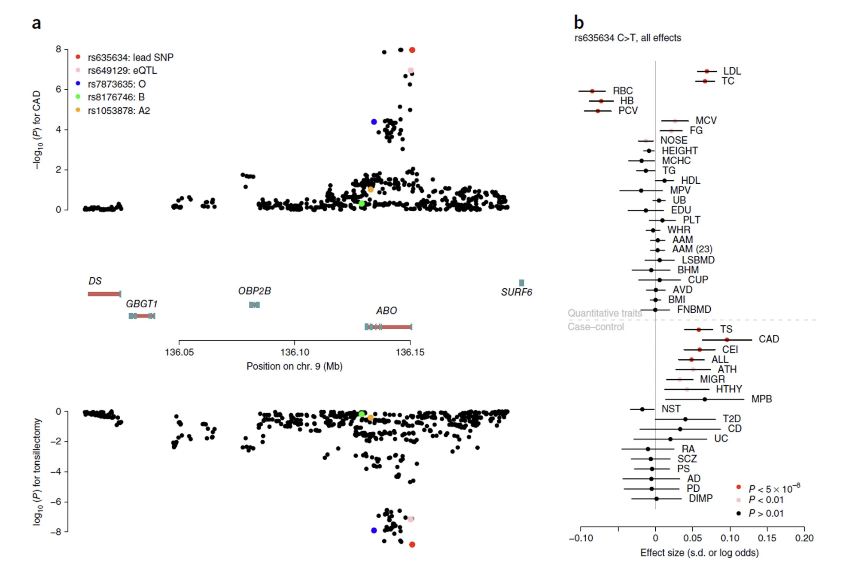
From GWAS to PheWAS
PheWAS
= one SNP, across traits
Coronary artery disease
GWAS
= one trait, across SNPs

Slide 36
Fine-mapping
“Fine-mapping” is the general term used for attempts to narrow down association signals to the underlying causal variants. A typical process involves:
Gathering complete information on genetic variation in the region of interest – for example by deep-sequencing a large number of individuals. (Large databases such as gnomAD / TopMed now make this easier.)
Gathering information on genome function – including gene structure and regulatory regions.
Potentially leveraging data from different ancestral backgrounds, hoping that differences in LD patterns will help narrow down signals.
Fitting models that attempt to parse apart multiple associations in the same region
Possible underlying mechanisms are pretty diverse and a healthy dose of genomic detective work is often needed.

Slide 37
The circle of genetic causation
Fine-mapping example
Complex genetic variation
...that combine to make individuals...
Notes:
The map from genetics to phenotypes is incrediblyt complicated
And it gets at what makes us human: evolution.

Slide 38
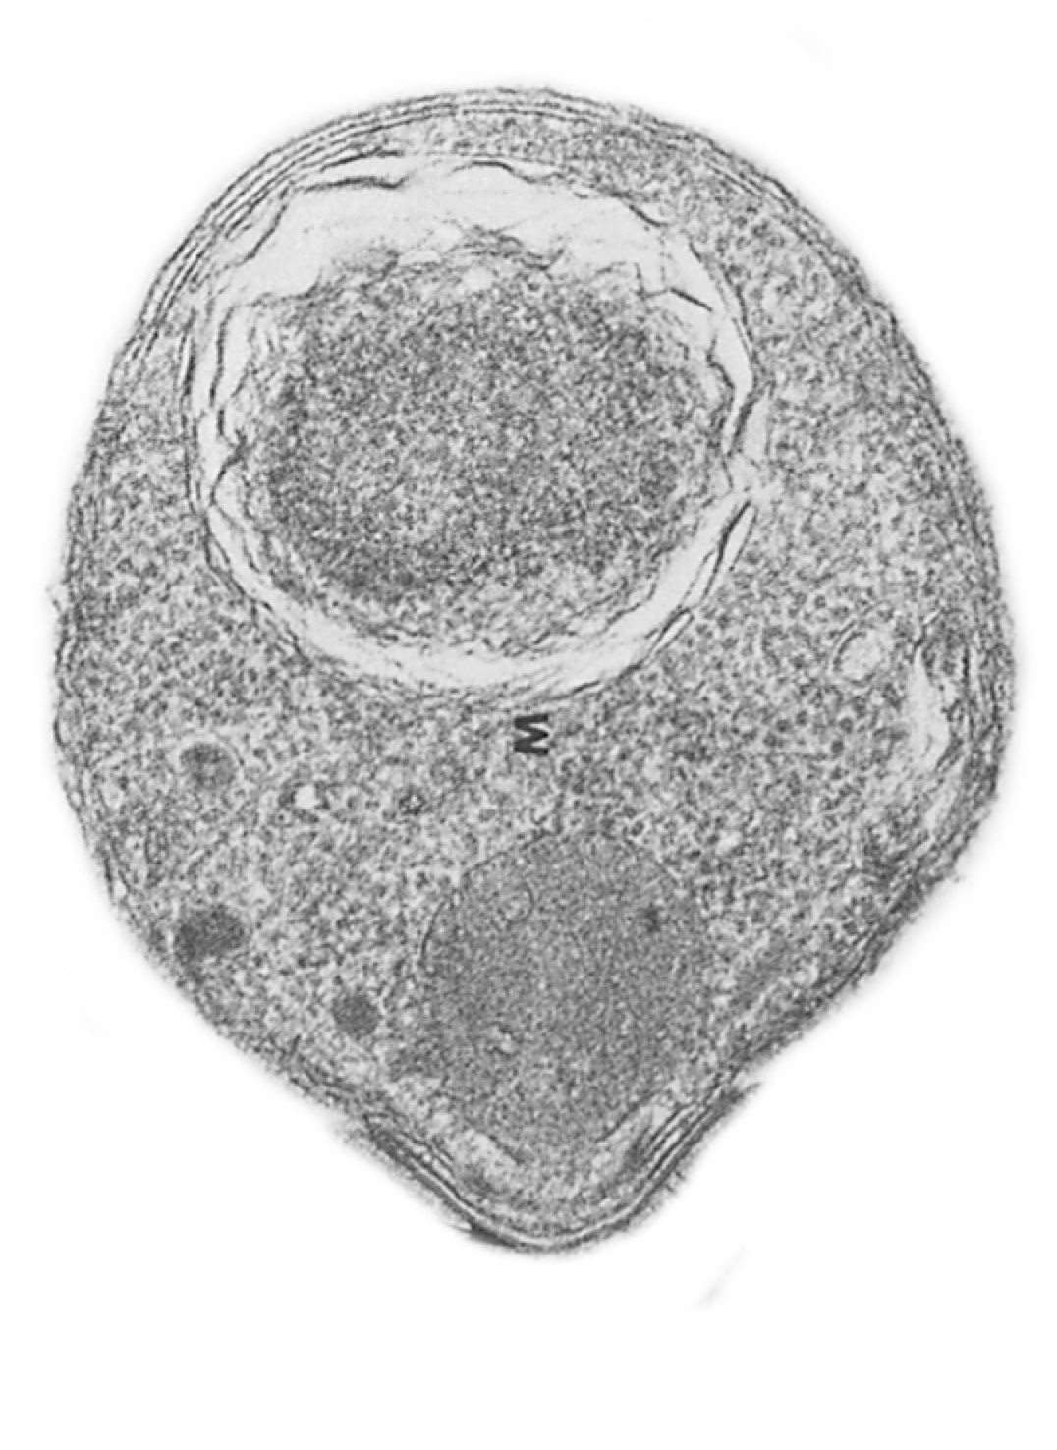
Plasmodium falciparum
VS
humans
Notes:
This is an evolutionary conflict which has affected both species.
And today I want to show you results which suggest it’s still shaping diversity on the red blood cell surface.
And then at the end I’ll give you a genome-wide view if time permits.

Slide 39
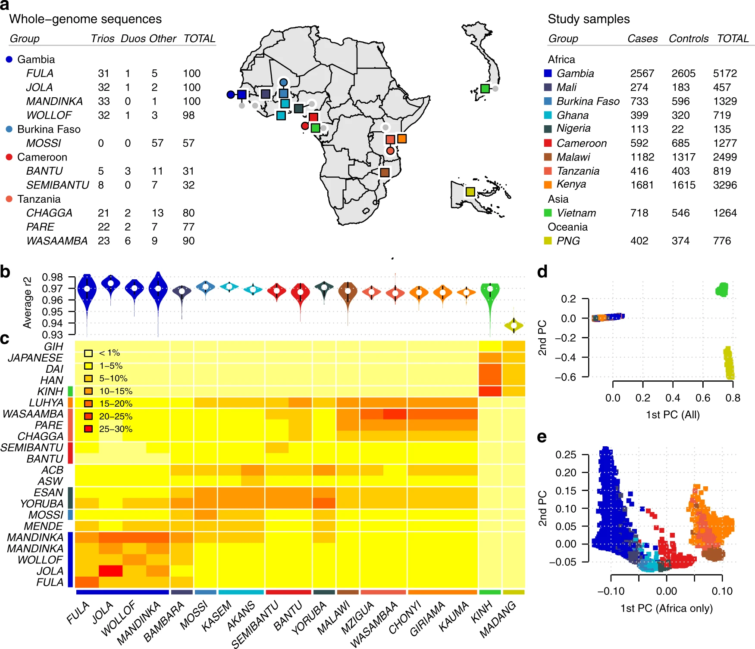
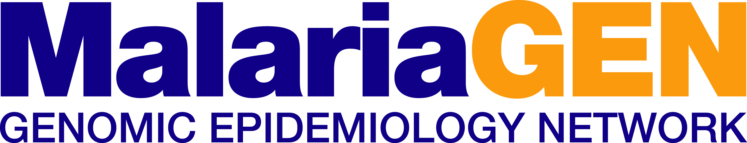
GWAS of susceptibility to severe malaria
GWAS in 17,000 severe malaria cases and population controls
From 12 sites in Africa, Oceania, and SE Asia.
Genotyped on the Illumina Omni 2.5M array
+ whole-genome sequences for imputation
Malaria Genomic Epidemiology Network. “Insights into malaria susceptibility using genome-wide data on 17,000 individuals from Africa, Asia and Oceania”.
Nature Communications (2019). https://doi.org/10.1038/s41467-019-13480-z
www.malariagen.net

Slide 40
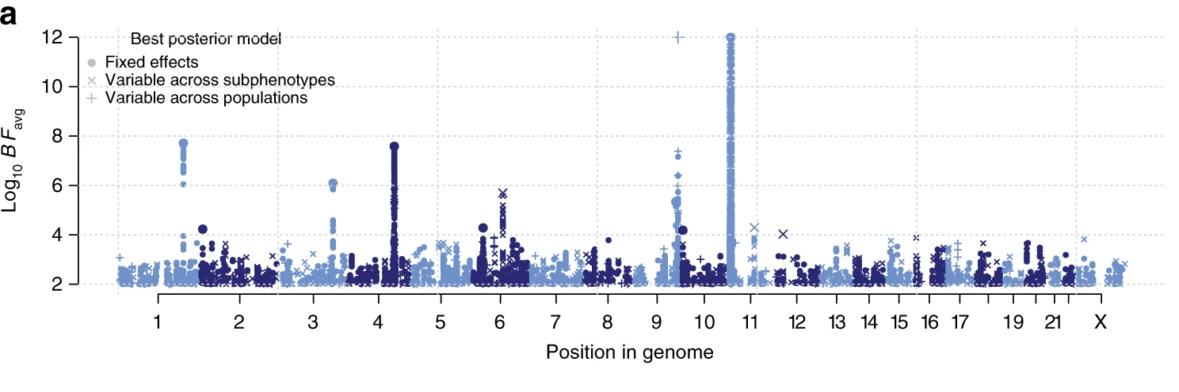
Natural resistance is driven by red blood cell variation
New signals discovered by GWAS
Known associations at O blood group and sickle trait
(We don’t know if this one is real)

Slide 41
Natural resistance is driven by red blood cell variation
New signals discovered by GWAS
Known associations at O blood group and sickle trait
(We don’t know if this one is real)

Slide 42
SNPs on chromosome 4 are associated with proection against severe malaria
Signal identified and replicated (rs186873296)
4,921 Gambians
2,516 Malawians
2,984 Kenyans
MalariaGEN, Nature 2015
Chromosome 4
Notes:
Our starting point was a GWAS.
Hitplot
GYPA abundant diverse rbc surface
To capture african genetic diversity we…

Slide 43
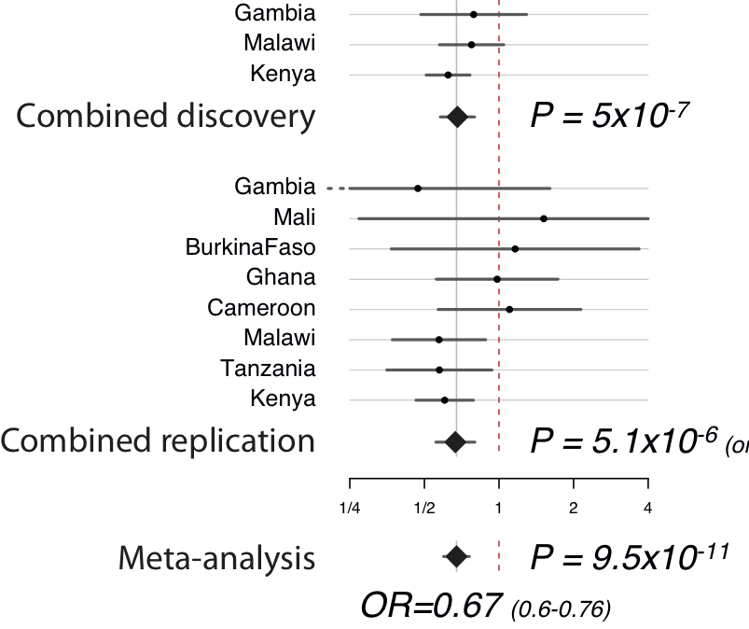

The association has quite large effect
> 30% protective effect per copy of the derived allele
$$\text{Standard} \text{error}(\log{OR)}≈\frac{1}{\sqrt{N×f\left(1−f\right)×φ(1−φ)}}$$
Notes:
Evidence at directly-typed most-associated marker in discovery samples (controlling for genome-wide population structure).
Evidence at directly-typed marker in replication samples (controlling for reported ethnicity)
Point-estimate for a homozygote is about 0.39 in Kenya (non-discovery samples).
From last week – this is a relative risk of around 1.5
Budget: 2m30s / 6m20s.

Slide 44
Can we finemap?
We had an exciting association. But fine-mapping has proven to be difficult for many GWAS loci.
To hope for success we might need:
- Good candidates for the functional gene?
- Good candidates for the causal mutation(s)?

Slide 45
SNPs on chromosome 4 are associated with proection against severe malaria
Signal identified and replicated (rs186873296)
4,921 Gambians
2,516 Malawians
2,984 Kenyans
MalariaGEN, Nature 2015
Glycophorins!
Notes:
Our starting point was a GWAS.
Hitplot
GYPA abundant diverse rbc surface
To capture african genetic diversity we…

Slide 46
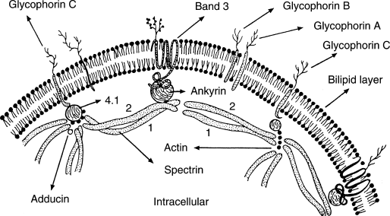
Glycophorins encode the ‘MNS’ blood group (antigenic molecules on RBC surface)
Glycophorins
Outside red blood cell
Red blood cell membrane
Inside red blood cell
Grimes and Slater, The Inherited Metabolic Diseases, 1994

Slide 47
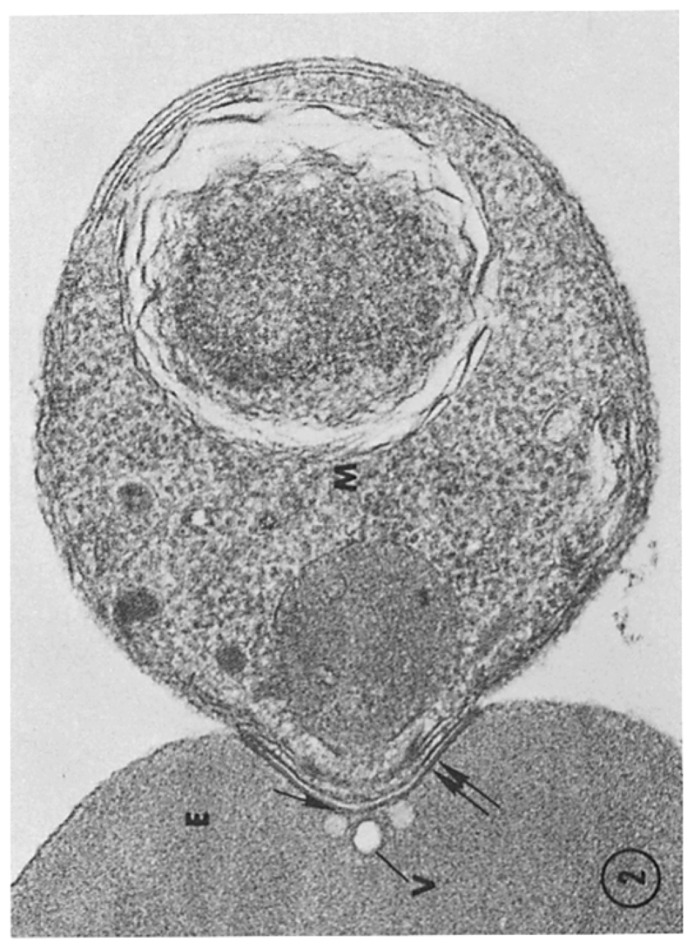
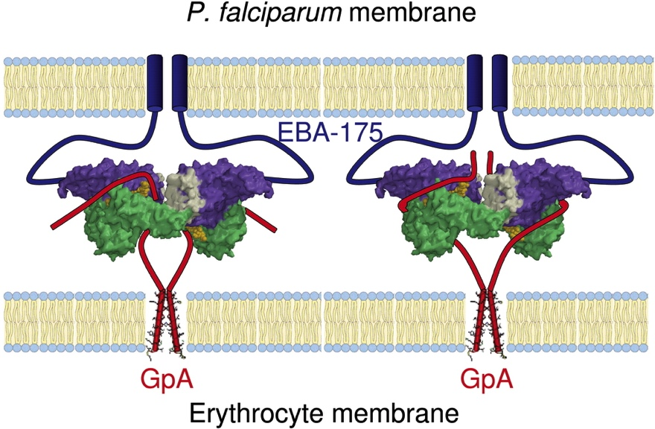
Glycophorins are receptors for P.falciparum during red blood cell invasion
P. Falciparum parasite
red blood cell
Glycophorin A
Miller et al, J. Exp. Med 1979
Tolia et al, Cell 2005
Notes:
Indeed one of the key pathogens that interact with these genes is malaria.
Figure on left shows P.falciparum invading a RBC. This involves a complex sequence of molecular interactions.
One of these is the binding of Pf EBA-175 to GYPA. (GYPB is similarly thought to act as an invasion receptor.)
Note other pathogens, e.g. influenza and Hep A, are also thought to bind to these glycophorins.

Slide 48
Can we finemap?
We had an exciting association. But fine-mapping has proven to be difficult for many GWAS loci.
To hope for success we might need:
✅ - Good candidates for the functional gene?
- Good candidates for the causal mutation(s)?

Slide 49
Can we finemap?
We had an exciting association. But fine-mapping has proven to be difficult for many GWAS loci.
To hope for success we might need:
✅ - Good candidates for the functional gene?
- Good candidates for the causal mutation(s)?

Slide 50
Can we finemap?
We had an exciting association. But fine-mapping has proven to be difficult for many GWAS loci.
To hope for success we might need:
✅ - Good candidates for the functional gene?
- Good candidates for the causal mutation(s)?

Slide 51
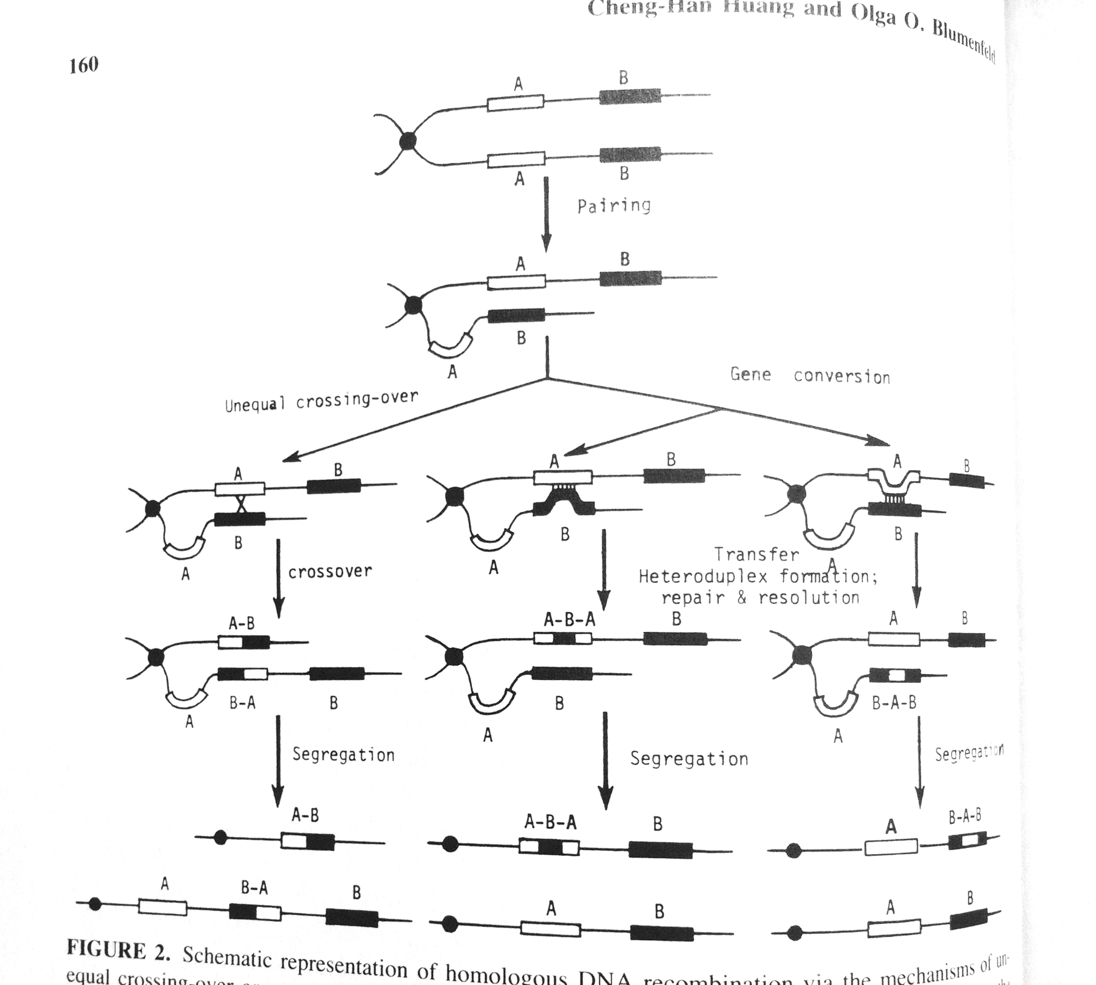
Structural variants create deletions, duplications, and hybrid genes
The MNS blood group is highly diverse, with over 45 known antigens.
Encoded by single nucleotide polymorphisms and structural variants
Deleted / duplicated / hybrid genes

Slide 52
Can we finemap?
We had an exciting association. But fine-mapping has proven to be difficult for many GWAS loci.
To hope for success we might need:
✅ - Good candidates for the functional gene?
✅ - Good candidates for the causal mutation(s)?

Slide 53
Steps to fine-map
Step 1: type or sequence as much of the genetic variation in the region as possible – hope to catch the causal mutation.
Step 2: re-analyse the association.
Step 3: look for functional mutations

Slide 54
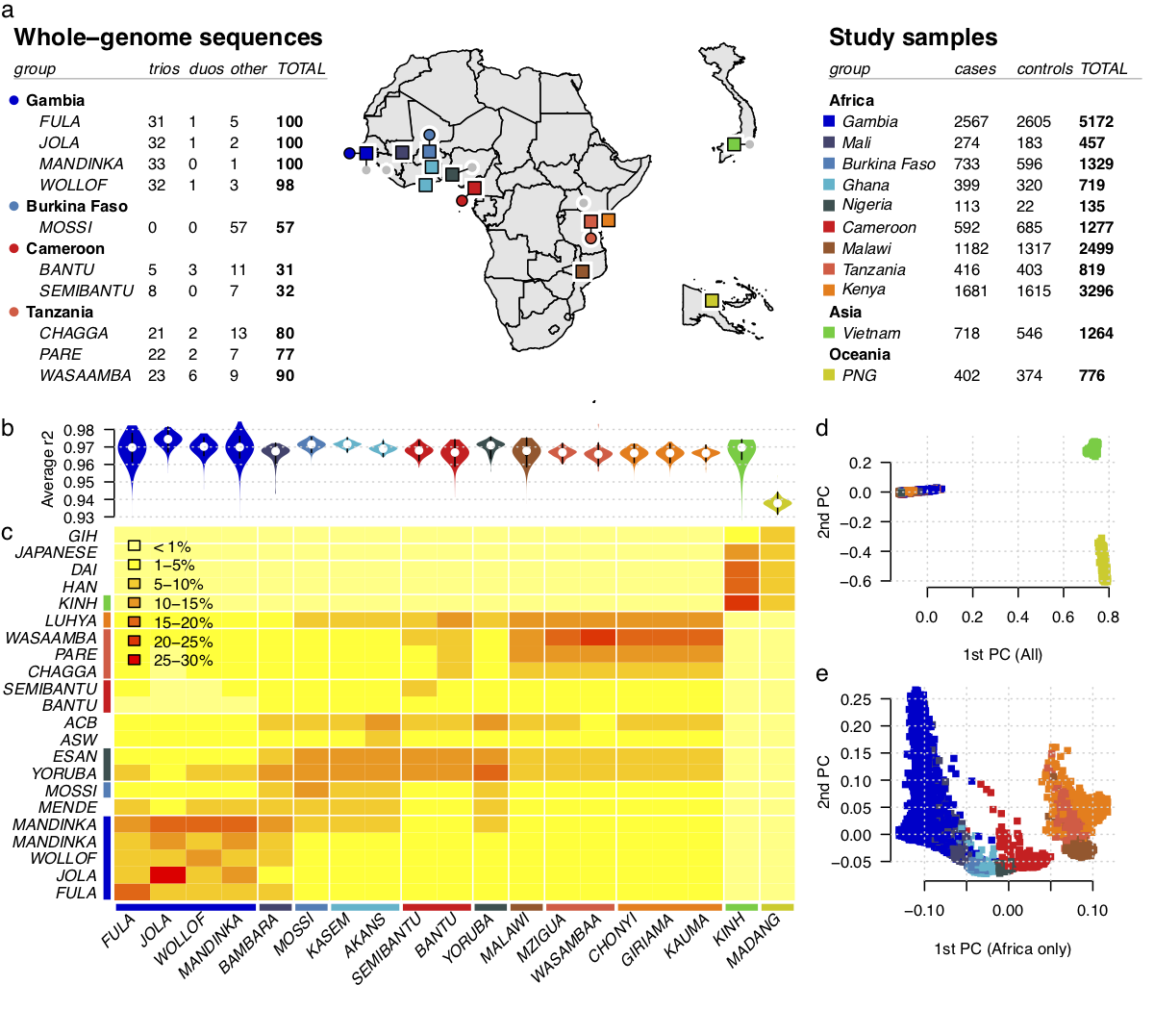
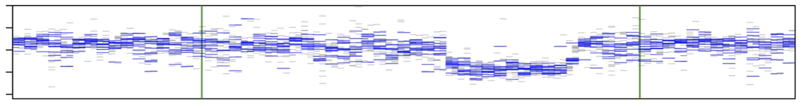
A regional reference panel capturing structural variation
We used the >3,600 samples including
1000 Genomes Project Phase III reference panel
plus our newly-sequenced samples
…to call SNPs and indels and structural variation.
Illustration of structural variant calling:
Sequencing depth
(this sample has a deletion in this region)

Slide 55
A regional reference panel capturing structural variation
We used the >3,600 samples including
1000 Genomes Project Phase III reference panel
plus our newly-sequenced samples
…to call SNPs and indels and structural variation.
Illustration of structural variant calling:
Sequencing depth
(this sample has a deletion in this region)
…our method infers the copy number

Slide 56
The region turned out to have a lot of structural variation
Deletions
Duplications
DEL1
deleted
DEL2
DEL3
DEL4
DEL5
DEL6
DEL7
DEL8
E
B
A
14% of Africans carry a CNV affecting these genes

Slide 57
The region turned out to have a lot of structural variation
Deletions
Duplications
DEL1
DUP1
deleted
DEL2
duplicated
DUP2
triplicated
DEL3
DUP3
DEL4
DUP4
DEL5
DUP5
DEL6
DUP6
DEL7
DUP7
DEL8
DUP8
E
B
A
E
B
A
14% of Africans carry a CNV affecting these genes

Slide 58
Before fine-mapping
Original GWAS result

Slide 59
After fine-mapping
Previous top SNP
Result after incorporating genetic variation discovered in sequenced samples.

Slide 60
After fine-mapping
Previous top SNP
DUP4

Slide 61
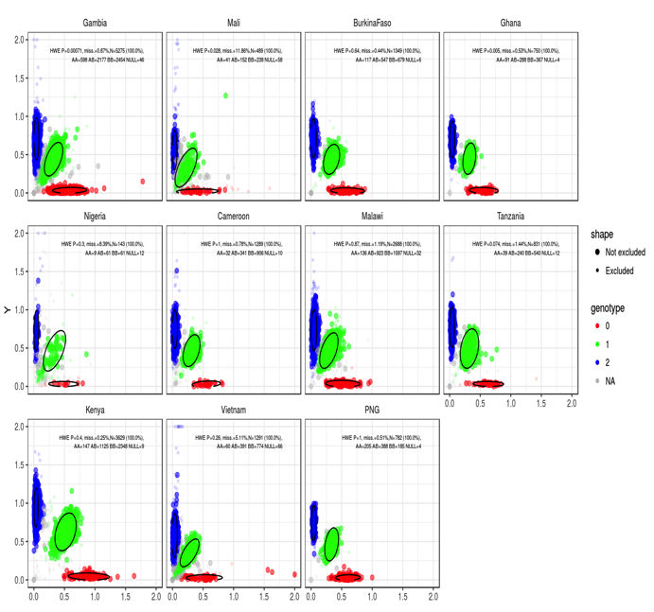
Confirming structural variants using cluster plots
microarray intensities
This is how a microarray cluster plot should look: 3 clusters for AA / AB / BB genotypes

Slide 62
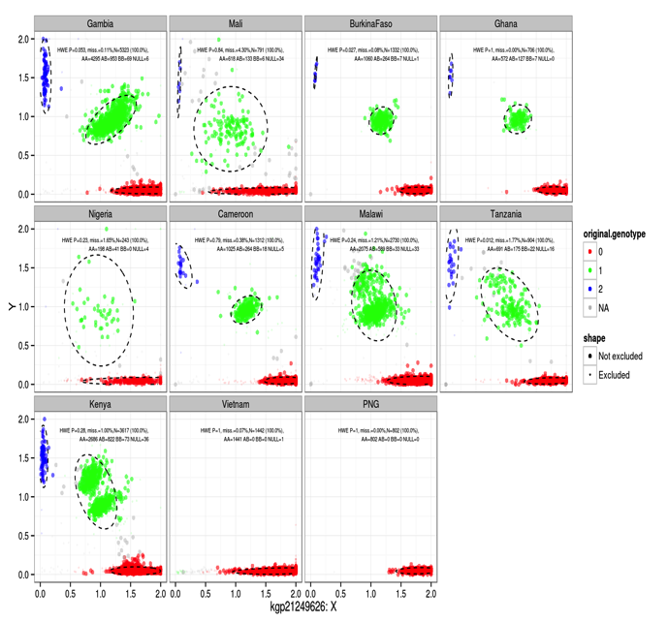
Confirming structural variants using cluster plots
Actually this signal was evident in our cluster plots
microarray intensities
This is how a microarray cluster plot should look: 3 clusters for AA / AB / BB genotypes
What we saw in this region

Slide 63
Confirming structural variants using cluster plots
Still true that nothing seemed to be functional. What next?
Protective: relative risk ~ 0.6
microarray intensities
microarray intensities
Not protective: RR ~ 0
This is how a microarray cluster plot should look: 3 clusters for AA / AB / BB genotypes
What we saw in this region

Slide 64
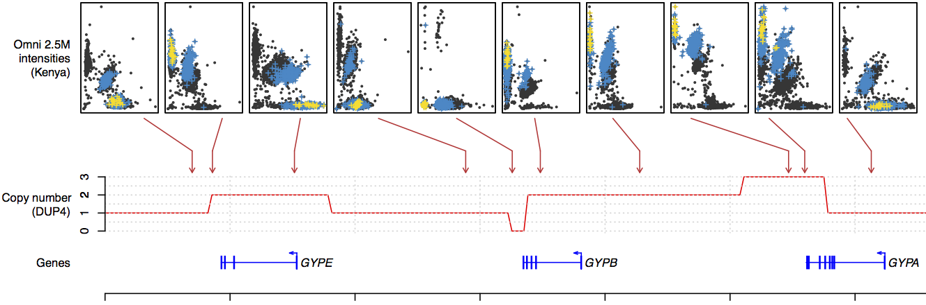
Confirming structural variants using cluster plots
DUP4
normal
normal
triplicated
normal
duplicated
duplicated
deleted
We were able to use cluster plots to confirm individuals in our GWAS really do carry the complicated structural variant “DUP4”.
DUP4 is pretty complicated – what could it be?

Slide 65
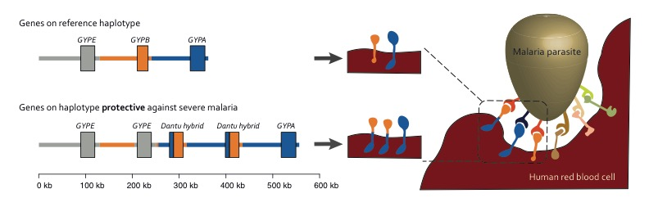
What is DUP4?
“Normal” haplotype:
DUP4 haplotype:
Leffler et al, “Resistance to malaria through structural variation of red blood cell invasion receptors”, Science (2017)
https://doi.org/10.1126/science.aam6393

Slide 66
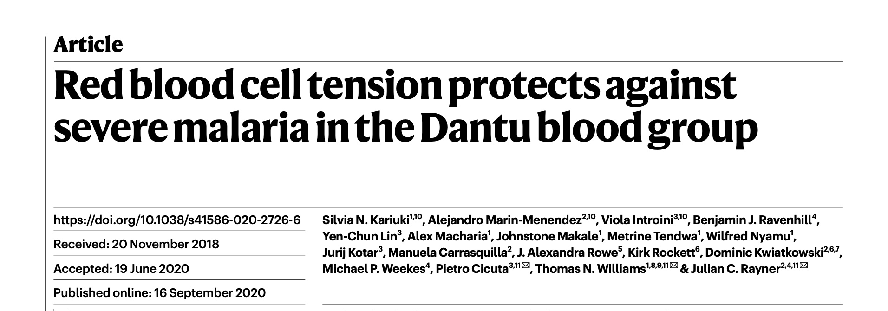
What is DUP4?
“Normal” haplotype:
DUP4 haplotype:
Leffler et al, “Resistance to malaria through structural variation of red blood cell invasion receptors”, Science (2017)
https://doi.org/10.1126/science.aam6393
Functional followup study
https://doi.org/10.1038/s41586-020-2726-6

Slide 67
Dantu is globally rare...
The Dantu blood group has been found in:
1 in 44,112
Londoners*
0 in 1,000
Germans†
1 in 320
African Americans†
0 in 2870
Gambians‡

Slide 68
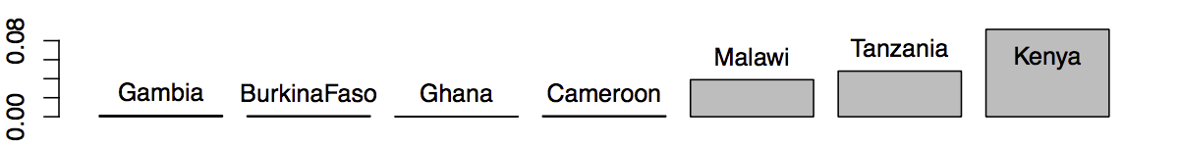
…but found at high frequency in east Africa
The Dantu blood group has been found in:
1 in 44,112
Londoners*
0 in 1,000
Germans†
1 in 320
African Americans†
0 in 2870
Gambians‡
1 in 12
Malawians‡
1 in 6
Kenyans (from the Kilifi region)‡
Allele frequency:
West Africa
East Africa

Slide 69
The circle of genetic causation
Fine-mapping example 2
Cell-specific gene regulation
...that combine to make individuals...
Notes:
The map from genetics to phenotypes is incrediblyt complicated
And it gets at what makes us human: evolution.

Slide 70
Natural resistance is driven by red blood cell variation
New signals discovered by GWAS
Known associations at O blood group and sickle trait
(We don’t know if this one is real)

Slide 71
Natural resistance is driven by red blood cell variation

Slide 72
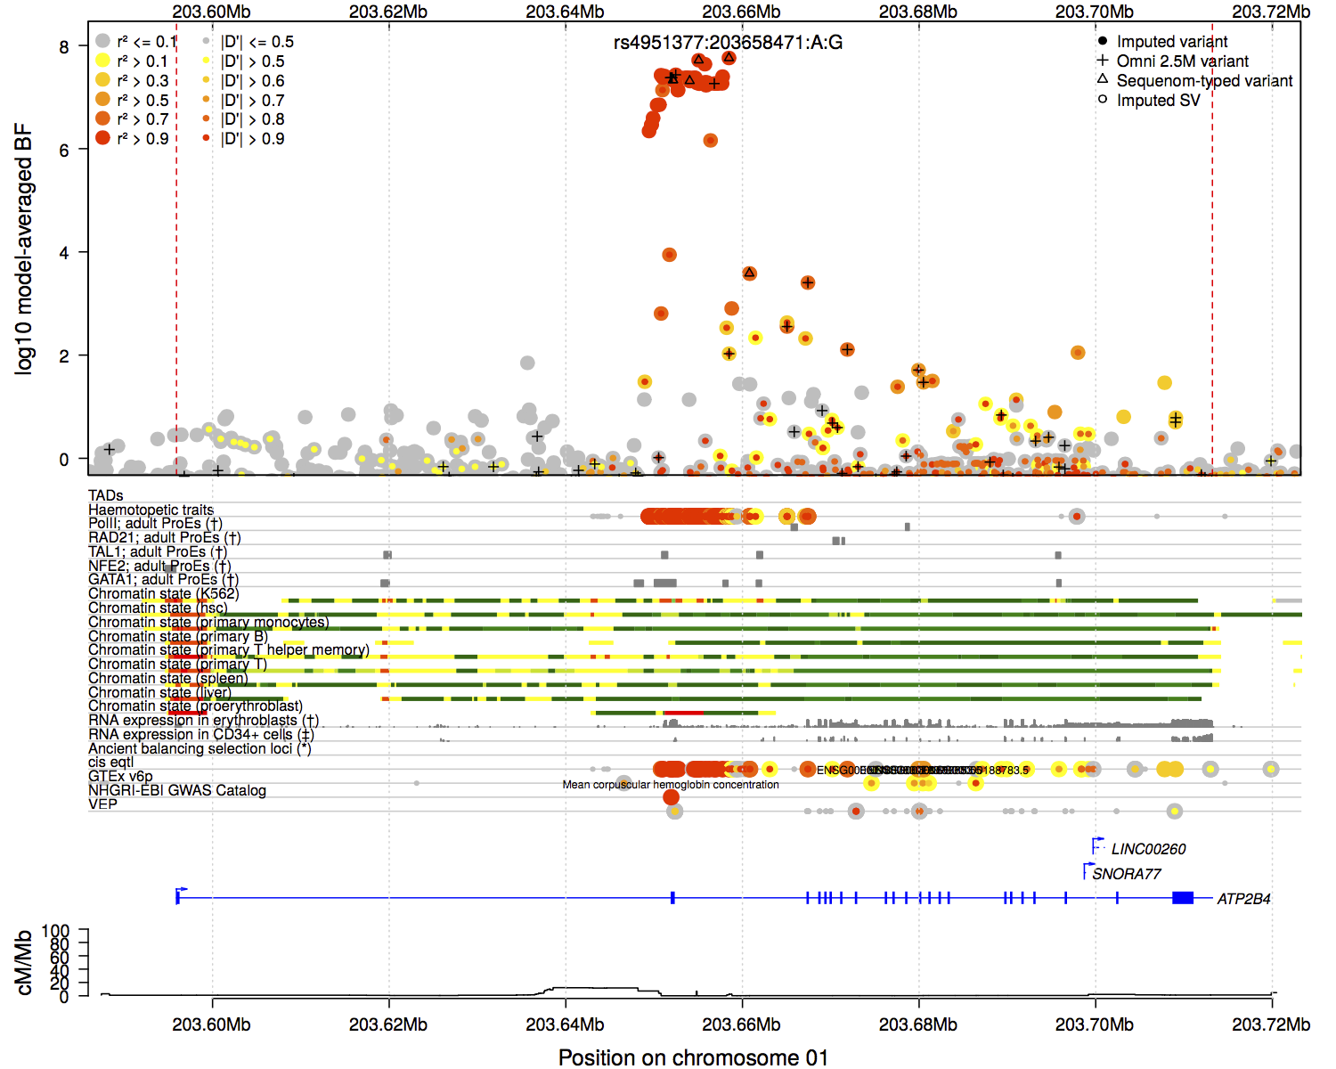
Association near 2nd exon of ATP2B4
Evidence for association
ATP2B4
The associated SNPs cover a region around the second exon.
In a gene called ATP2B4, which encodes a calcium pump.
ATP2B4
Ca⁺
Ca⁺
Ca⁺

Slide 73
Association near 2nd exon of ATP2B4
Evidence for association
ATP2B4
The associated SNPs cover a region around the second exon.
In a gene called ATP2B4, which encodes a calcium pump.
ATP2B4
Ca⁺
None of these SNPs make changes to the protein.
What could be going on?
Ca⁺
Ca⁺

Slide 74
Cartoon of a gene
1st exon
last exon
Introns

Slide 75
Cartoon of a gene
Direction of transcription
RNA polymerase
Binding at
promoter region
1st exon
Introns

Slide 76
Cartoon of a gene
Messenger RNA:
Transcription to mRNA
Direction of transcription
promoter region
1st exon
Introns

Slide 77
Cartoon of a gene
Messenger RNA:
Transcription to mRNA
Direction of transcription
What happens at the promoter can really affect transcription.

Slide 78
Cartoon of a gene
Messenger RNA:
Transcription to mRNA
Direction of transcription
“Transcription factors“ must be able to bind.

Slide 79
Cartoon of a gene
Messenger RNA:
Transcription to mRNA
Direction of transcription
DNA must be “accessible”
(not wound round nucleosomes)
“Transcription factors“ must be able to bind.

Slide 80
Cartoon of a gene
Messenger RNA:
Transcription to mRNA
Direction of transcription
“Enhancer” – promoter interactions
All this can be measured

Slide 81
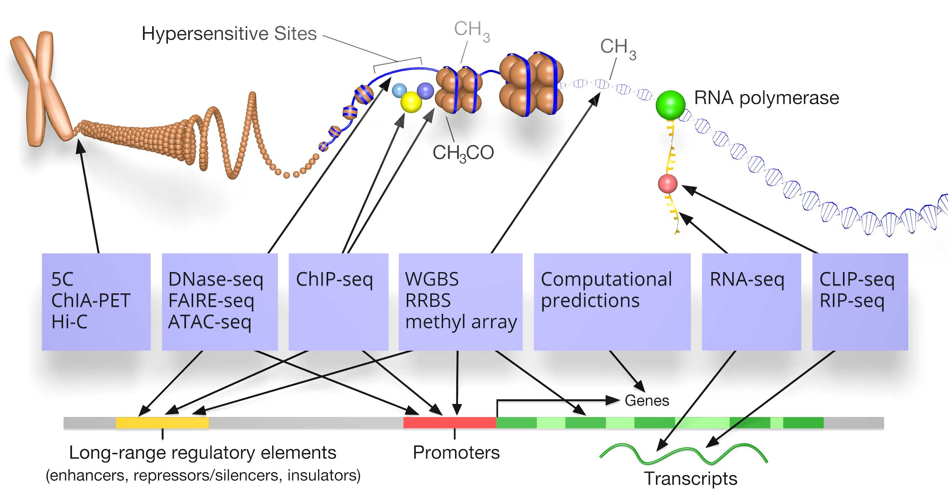
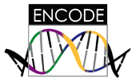


Two ways to look at transcription
molecular assays
chromatin state, transcription factor binding, RNA transcription...
Enhancer
Active promoter
Can look at chromatin state
https://www.encodeproject.org
RNA expression

Slide 82
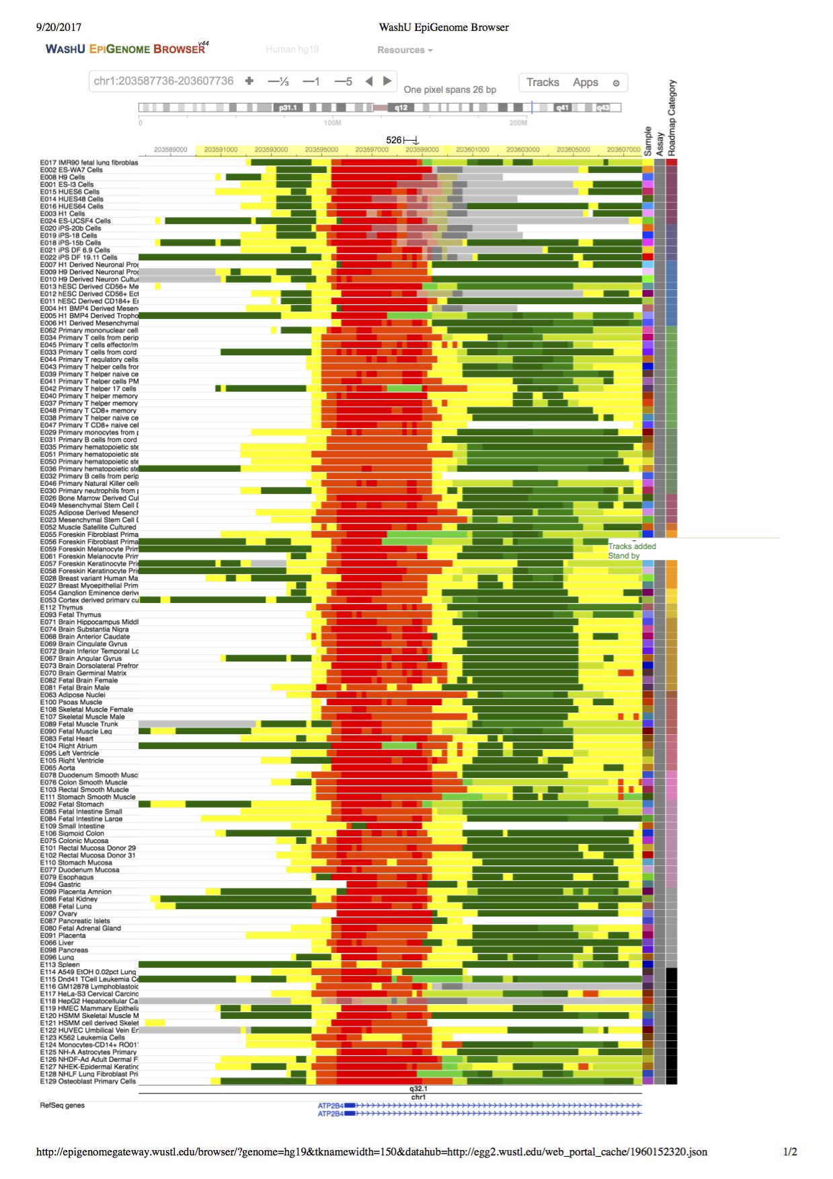
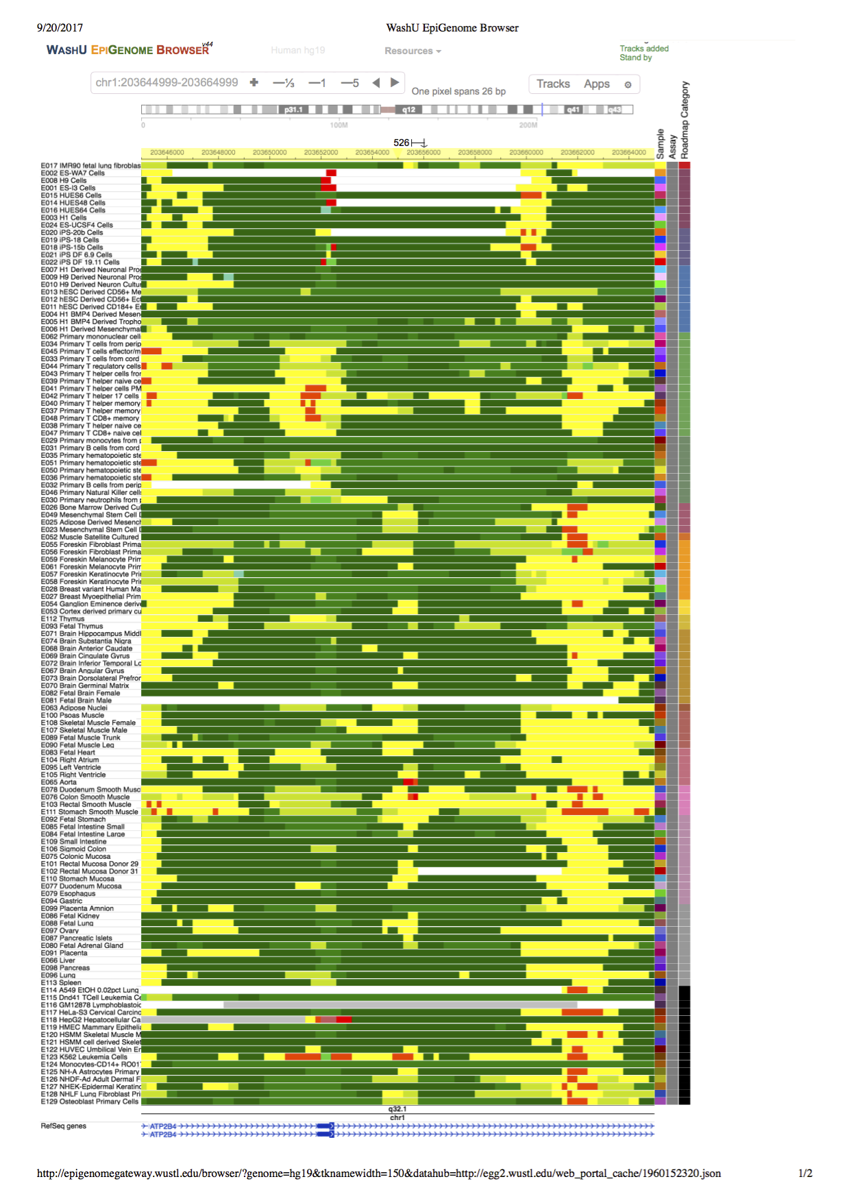
Chromatin state across cell types…
1st exon
2nd exon
Chromatin states in 130 cell types
Data from ENCODE / Roadmap
Malaria-associated region

Slide 83
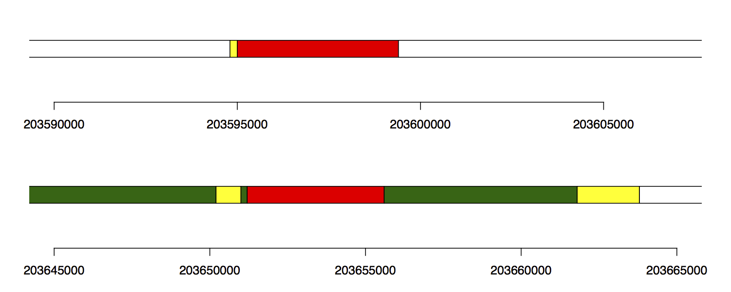
…looks different, maybe, in RBCs?
1st exon
2nd exon
Chromatin states in 130 cell types
Proerythroblasts:
Data from Xu et al Dev Cell (2012)
Malaria-associated region

Slide 84
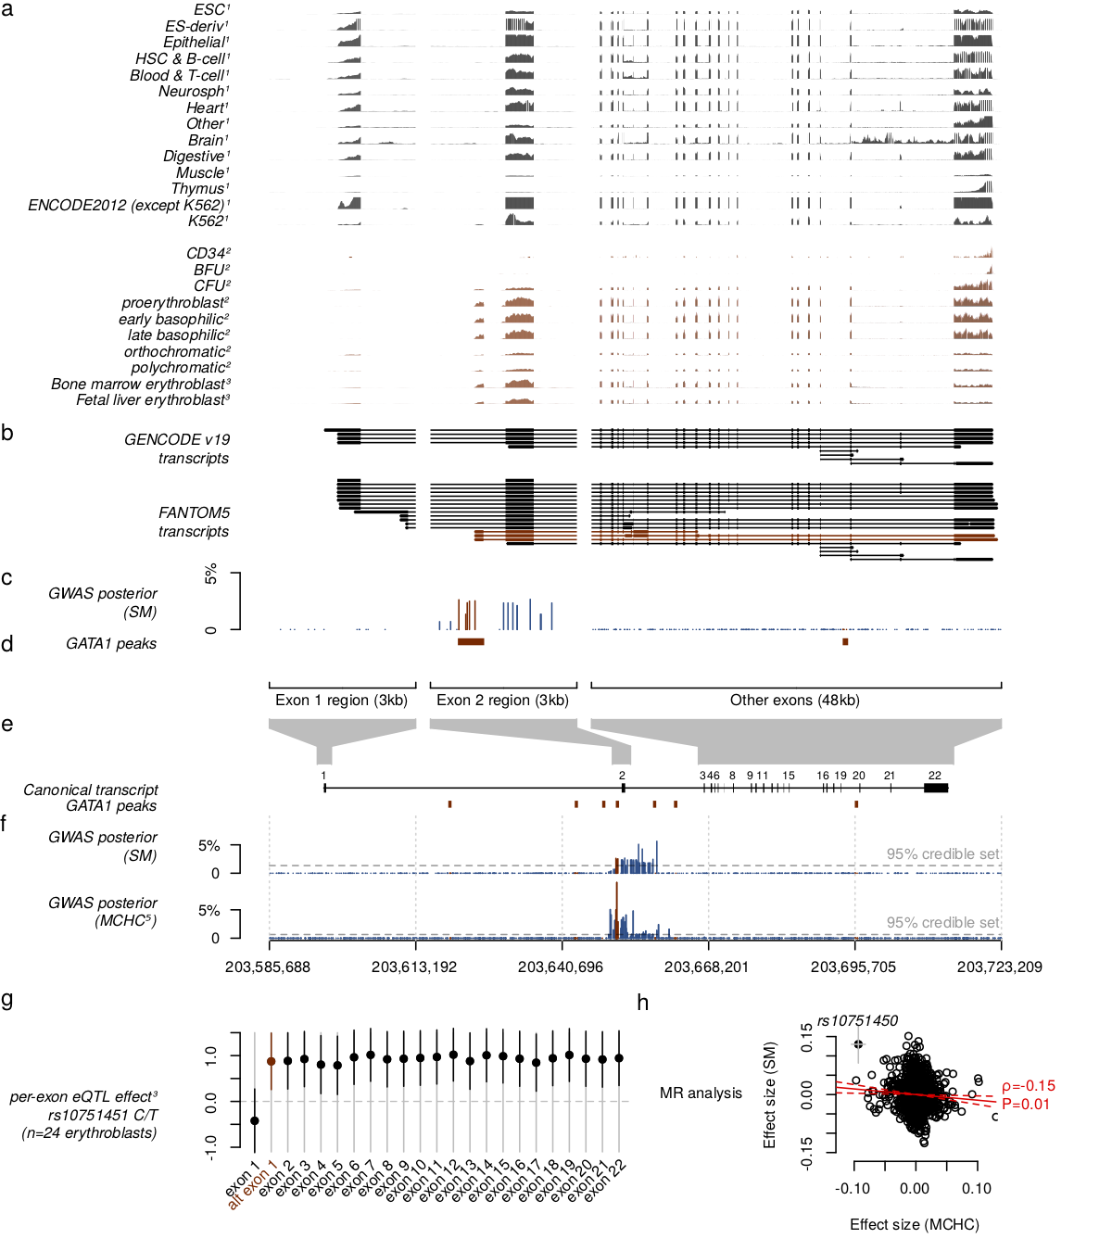
Expression data (RNA-seq) across cell types
1st exon
2nd exon
direction of transcription
Non-erythroid cells
ATP2B4 is expressed essentially in all cells in the body
It looks like the gene model says it should
What if we look in red cells?

Slide 85
Expression data (RNA-seq) across cell types
1st exon
2nd exon
direction of transcription
Proerythroblasts
Red cell (precursors) show a different pattern
There’s a new 1st exon!

Slide 86
Expression data (RNA-seq) across cell types
1st exon
2nd exon
direction of transcription
Proerythroblasts
GWAS SNPs
Red cell (precursors) show a different pattern
There’s a new 1st exon!
Could these upstream GWAS SNPs be affecting transcription in red cells?

Slide 87
ATP2B4 has an erythroid-specific transcript
Measured RNA transcription (RNA-seq)
1st exon
2nd exon
GWAS SNPs
Putting together data from a variety of sources suggests the existence of an alternative transcription start site near the GWAS signal, but only active in erythrocytes. How can this be?

Slide 88
What is different about RBCs?
Direction of transcription
GATA1
Transcription factor (TF) binding helps promote transcription
A major TF in red cells is GATA1.
“GATA1 regulates the expression (i.e. formation of the genes' products) of an ensemble of genes that mediate the development of red blood cells and platelets.”
- Wikipedia

Slide 89
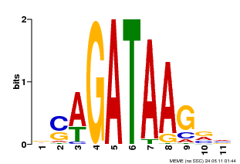
What is different about RBCs?
Direction of transcription
GATA1
Transcription factor (TF) binding helps promote transcription
A major TF in red cells is GATA1.
…so-called because of the DNA motif it binds to.
“GATA1 regulates the expression (i.e. formation of the genes' products) of an ensemble of genes that mediate the development of red blood cells and platelets.”
- Wikipedia
v1.factorbook.org

Slide 90
Putting the story together
GWAS SNPs
GATA1 does bind this region in erythroid cells
measured using ChIP-seq

Slide 91
Putting the story together
GWAS SNPs
rs10715451
(malaria-protective allele)
...GGAGCGGTAAGATA...
(malaria risk allele)
...GGAGCGATAAGATA...

Slide 92
Putting the story together
GWAS SNPs
rs10715451
(malaria-protective allele)
...GGAGCGGTAAGATA...
Predict lower expression
(malaria risk allele)
...GGAGCGATAAGATA...
Predict higher expression
Prediction from all this detective work:
The malaria risk allele causes higher expression of ATP2B4 – and more calcium pumping – in red cells
Probably without affecting other cells in the body

Slide 93
Genetic prediction
This prediction is borne out by RNA-seq data in cells from people with different genotypes.
Relative level of expression
(A vs. G allele)
N = 24
Only limited data is available

Slide 94
This example illustrates the complexities of fine-mapping
We’ve gone from a GWAS signal and (putatively) narrowed it down to a possible causal effect of a single SNP, in a single relevant cell type.
To get there we used a raft of functional genomic data – RNA-seq, ChIP-seq, chromatin state models – across different cell types.

Slide 95
There is one remaining conundrum…
ATP2B4 encodes a calcium pump. It removes Ca⁺ from the cell.
Parasites need calcium to grow. They should like the cell on the right…
Ca⁺
Ca⁺
Ca⁺
Ca⁺
Ca⁺
Ca⁺
Ca⁺
Ca⁺
rs10715451 G allele
associated with malaria risk
rs10715451 A allele
associated with malaria protection

Slide 96
There is one remaining conundrum…
ATP2B4 encodes a calcium pump. It removes Ca⁺ from the cell.
Hypothesis: pump gets inverted in the membrane of the parasitophorous vacuole.
Ca⁺
Ca⁺
Ca⁺
Ca⁺
Ca⁺
Ca⁺
Ca⁺
Ca⁺
Ca⁺
Ca⁺
Ca⁺
Parasitophorous vacuole
Ca⁺
rs10715451 G allele
associated with malaria risk
rs10715451 A allele
associated with malaria protection
Lessard et al 2017, Zambo et al 2017, Joof 2024

Slide 97
The circle of genetic causation
...passing on DNA, with mutations and recombination, to new generations...
...whose success is affected by the traits they have...
microarrays, genome sequencing
Clinical phenotype measurements
...that gets physically packaged up into chromosomes...
There is complex biology at all stages
And we can measure it.
Biomarker measurements
Chromatin state marker assays, ChIP-seq, ...
RNA-seq, spectroscopy, antibody binding
...that combine to make individuals...
...inside cells, where it is transcribed to form proteins and other molecules...
...that affect how the cells behave, forming different organs...
Notes:
The map from genetics to phenotypes is incrediblyt complicated
And it gets at what makes us human: evolution.

Slide 98
Learning biology from GWAS - summary
Have highlighted two of the complexities that could occur when trying to fine-map genetic association signals.
They are pretty fascinating and luckily there is lots more of tis type of thing to find!
Anything that can happen, does happen.
…and there is lots of data!

Slide 99
Learning biology from GWAS - summary
Non-coding variants
Long-distance interactions in the genome
Changes to gene expression
Polygenic effects (lots of variants involved)
Cell-type / tissue heterogeneity
Pleiotropy (a variant affects lots of phenotypes at once)
Genetic interactions
Host-pathogen interactions
Repetitive DNA / repeat expansions
Genome structural variation
Genome evolution
Anything that can happen, it does happen.

Slide 100
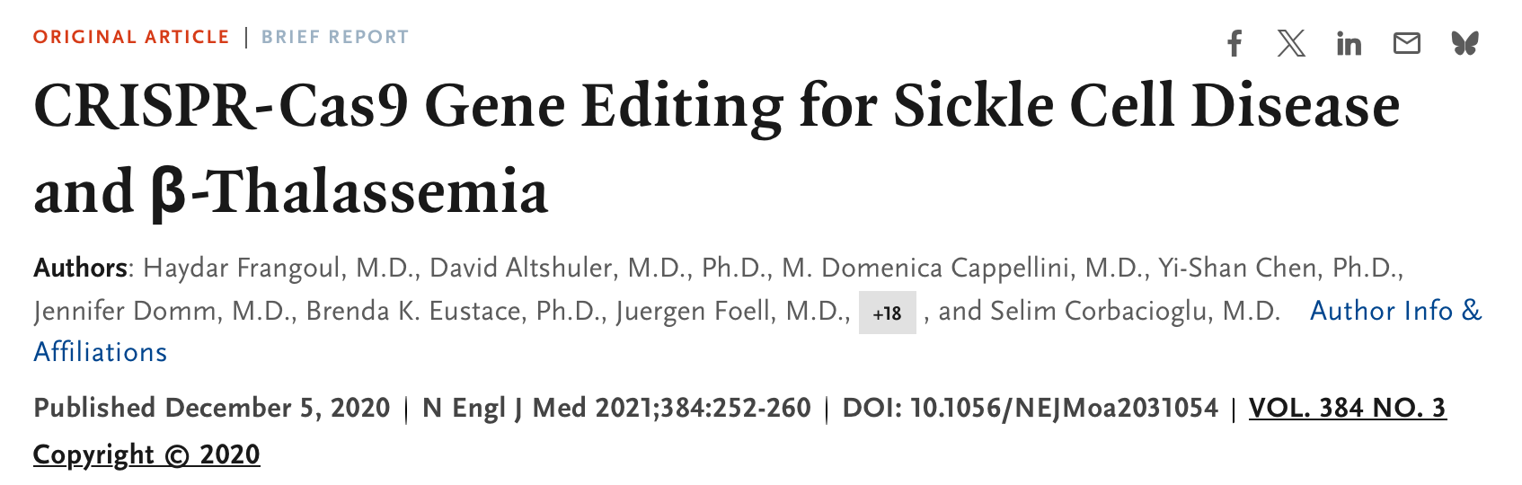

Clinical translation?
It is safe to say that there has been only limited translation of GWAS outputs into clinically useful results so far.
But there are some success stories, e.g.:
Gene editing of GWAS SNPs on chromosome 2 in adults with severe sickle cell disease or beta thalassaemia.
The SNP turns off suppression of fetal haemoglobin expression
After editing

Slide 101

Clinical translation?
It is safe to say that there has been only limited translation of GWAS outputs into clinically useful results so far.
But there are some success stories, e.g.:
*Warning: it works best in Europeans.
Low
Genetic prediction of risk
High
Polygenic risk score modelling of Type II Diabetes
Armed with the GWAS results, you can predict* lifetime risk of T2D just from genome-wide genetics
Guo et al Nat. Comm 2025 doi:10.1038/s41467-025-63546-4

Slide 102








Prospective cohort studies
A new crop of studies aims to create a database of deep genotype, phenotype, and exposure data across large cohorts of individuals sampled from the population or from health services. Examples:
CartaGene (Canada)
China Kadoorie Biobank
Precision Medicine Initiative,
All of Us (US)
FinnGen (Finland)
UK Biobank
The 100,000 genomes project (UK)

Slide 103

https://ourfuturehealth.org.uk
Recruiting now

Slide 104
Conclusions and summary
Most human traits are highly heritable
For ‘complex’ traits, the effects are made up of many genetic variants often with modest effects - polygenicity
GWAS study designs can find these variants. They rely on large samples and dense genotyping, and patterns of linkage disequilbirum to detect signals.
A major frontier is to understand the biology and translate these findings into clinically useful insights and predictions.

Slide 105
Thanks for listening!
Notes:
The map from genetics to phenotypes is incredibly complicated
And it gets at what makes us human: evolution.

