Slide 1

Genome-wide association studies II: Identifying genetic associations with complex traits
Gavin Band gavin.band@well.ox.ac.uk
MSc Global Health Science and Epidemiology
Genetic Epidemiology Module
Feb 2023
Notes:
The title of my talk is genome-wide studies as this has been the main focus of my research over the last 3 years.

Slide 2
Learning objectives
Understand a genome-wide association study (GWAS) and the concept of a hypothesis-free approach to studying genetic associations.
Have a working knowledge of the different steps involved in the conduct of GWAS, including study design, quality control and basic analyses.
Be able to interpret and critically appraise evidence from genome-wide association studies.
Understand the relevance of replication, meta-analysis and consortia, and multi-ancestry approaches, in genome-wide association studies.
Appreciate the use of post-GWAS analyses including fine mapping, gene and pathway analyses, and the concept of causal variants.

Slide 3
Lecture plan
Recap & fallout from last lecture
Gaining biological knowledge from GWAS
Biological examples
Heritability and prediction

Slide 4
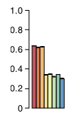
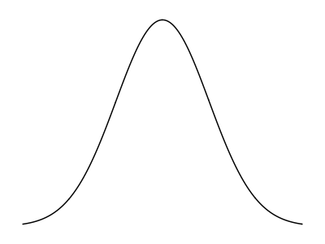
Recap
MZ
Twins
1. Most human traits are highly heritable
A large proportion of population variation is explained by genetics
DZ
Twins
2. For many ‘complex’ traits, this is caused by lots of variants with small effects
Effect size
Very rare
rare
common
Very common
Genotype frequency
3. To find these genetic variants, we can use genome-wide association study methodology.
e.g. genotype cases and controls at a dense set of markers across the genome, and do a statistical test of association.
Relies on block-like structure of LD to access untyped variants.
Aim to uncover the underlying biology of disease.

Slide 5


Last time – basic GWAS approach
Basic idea: try to find causal effects of genetic variants on phenotypes.
G
g
Many traits are heritable but complex: caused by many genetic variants with small effects across the genome (along with environmental factors, interactions, …)
Strategy: use genome-wide genotyping and imputation to access as much genetic variation as possible. For a disease phenotype, a case-control (or population control) design then allows us to directly estimate the relative risk of each variant.
Relative risk
$$=\frac{P\left(\text{disease}|\text{genotype} G\right)}{P\left(\text{disease}|\text{genotype} g\right)}$$
Measures the association between genotype and phenotype.
Estimated as an odds ratio in the study
The accuracy of our estimates, and the power to detect nonzero effects, depends mainly on the sample size and the frequency of the variant:
$$\text{Standard} \text{error}(\log{OR)}≈\frac{1}{\sqrt{N×f\left(1−f\right)×φ(1−φ)}}$$
Sample size
Ratio of cases to controls in study
Genotype frequency

Slide 6
Three potential problems
Case-control designs do not control for confounding – this has to be done in the analysis stage.
Association picks up all ‘causal’ paths from genotype to phenotype.
There are at least three important ways the study could be confounded:
G
g
Genotyping process
Experimental confounding - for example, differential genotyping between cases and controls.
Experimental setup
G
g
Population
structure
Confounding by population structure – for example, if the sampling structure, or the true distribution of the phenotype, happens to covary with genetic background
Case/control
sampling
Confounding by LD
Nearby variants are correlated (in linkage disquilibrium) because of population genetic drift broken down by recombination. This makes it easier to detect association, but harder to narrow down to the actual causal variant.
Linkage disequilibrium
G
g
H
h

Slide 7
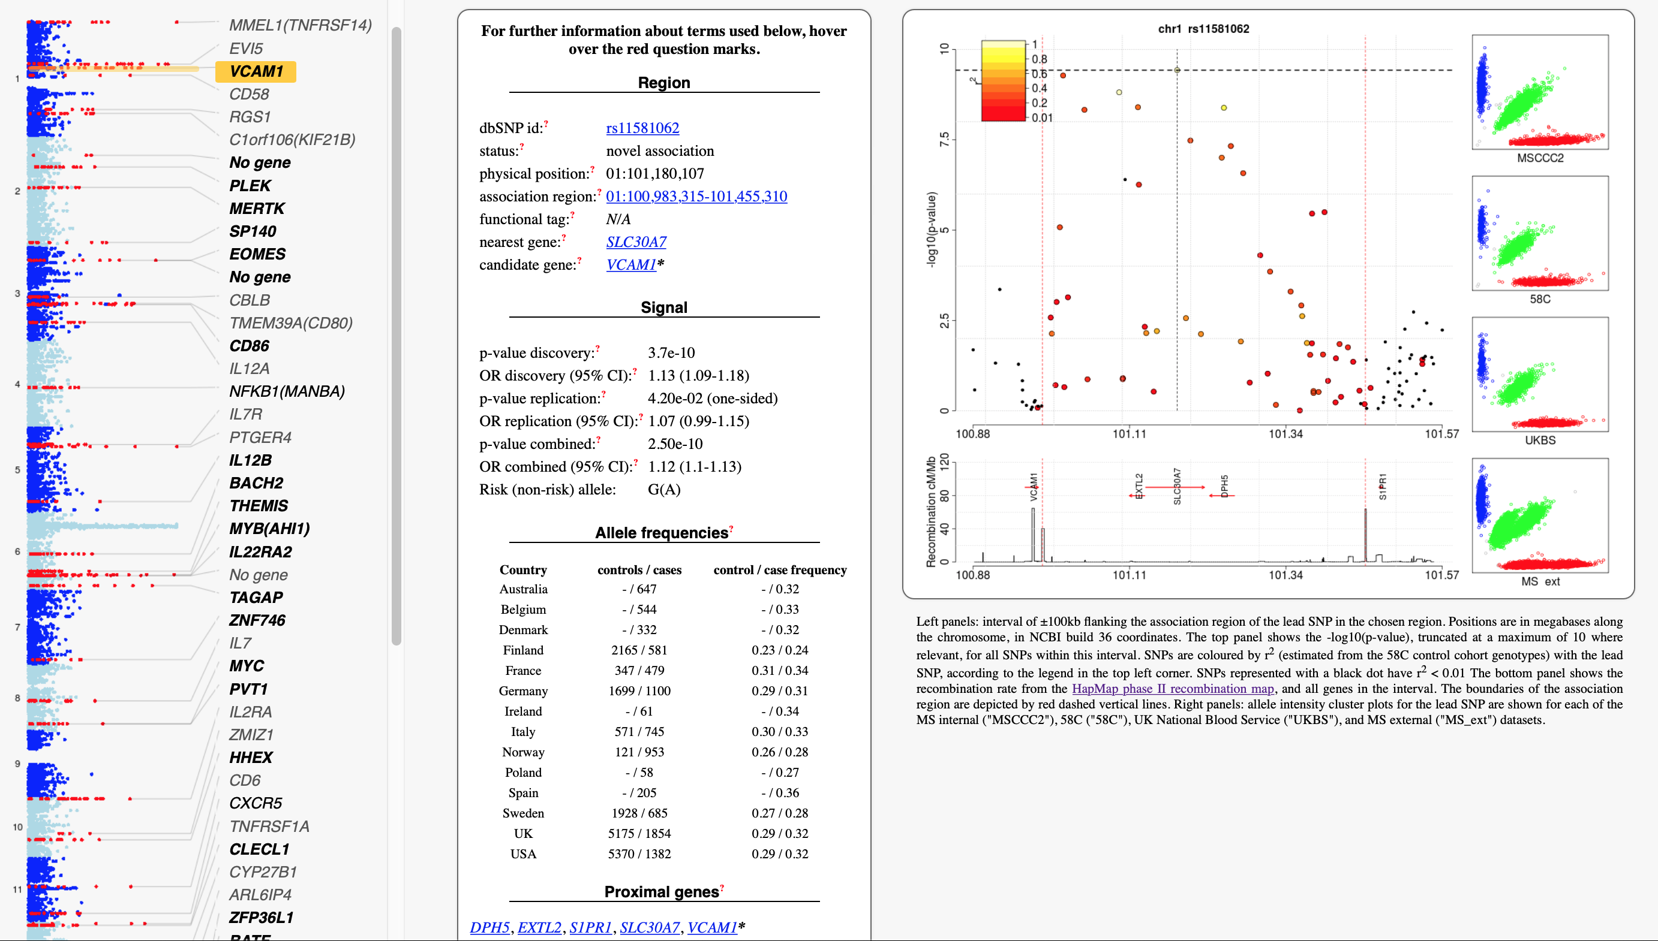
Consolidation question from last lecture
WTCCC2 GWAS of multiple sclerosis (9,772 cases and 7,376 controls).
www.well.ox.ac.uk/wtccc2/ms/
(I think this requires the trailing /)
Can you explain?

Slide 8
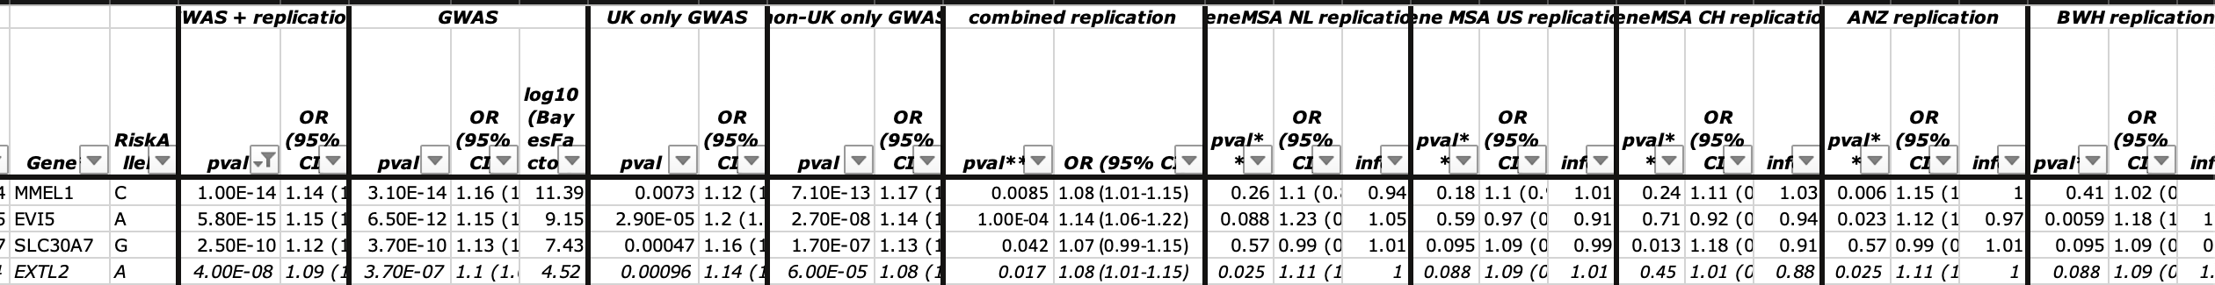



Anatomy of an association analysis
All GWAS should report data in a way that can be re-used by future studies.
This study used several previous GWAS to conduct replication. All the details are given in a supplementary table:
Discovery and overall data as on web page
Evidence for the same effect direction was seen separately in both arms of the discovery…
…and in the combined replication...
…and in most of the individual replication studies.
This is a common analysis approach: to gain sample size, use meta-analysis to combine results across several component studies. Then look for consistency between the studies.
$${\text{v}}_{meta}=1/\left(\sum_{i}{\frac{1}{v_{i}}}\right)$$
$$β_{\text{meta}}=\left(\sum_{i}{\frac{β_{i}}{v_{i}}}\right)×{\text{v}}_{meta}$$
(Where $v$ denotes squared standard error)
” Inverse variance weighted fixed-effect meta-analysis“, gives results approximately equal to joint analysis of genotype data.

Slide 9
Dealing with population structure
This study suffered from a key problem. Can you see what it is?
# cases /
# controls
Per country

Slide 10
Dealing with population structure
Answer: very strong confounding by population structure / sampling
# cases /
# controls
Per country
G
g
Population
structure
Case/control
sampling
This is a quantile-quantile plot of all association tests genome-wide. It shows vastly inflated –log₁₀ P-values.
(A more advanced way to do this distinguishing structure from polygenicity is LD score regression – covered in a later lecture).
Actual –log10 P-value
Expected –log10 P-value

Slide 11
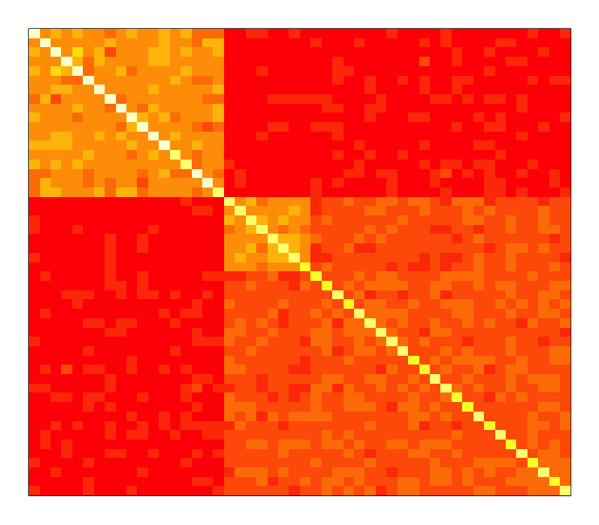
Dealing with population structure
Answer: very strong confounding by population structure / sampling
# cases /
# controls
Per country
G
g
Population
structure
Case/control
sampling
Solution:
1. Use genome-wide genotypes to estimate genetic relatedness between samples
2. Include the relatedness as a covariate in the association test

Slide 12


Using regression to test for association
(instead of the 2x2 table method)
1. Logistic regression including principal components
2. Linear mixed model
$$\text{outcome} \sim \text{genotype}+PCs$$
$$\text{outcome} \sim \text{genotype}+$$
Include a genetic relatedness matrix computed from genome-wide genotypes in the association test
Uses the entire matrix of relationships
Plot of first two principal components obtained from the genetic relatedness matrix
Uses just the strongest directions of variation in relatedness (population structure)
Most p-values are now not inflated

Slide 13
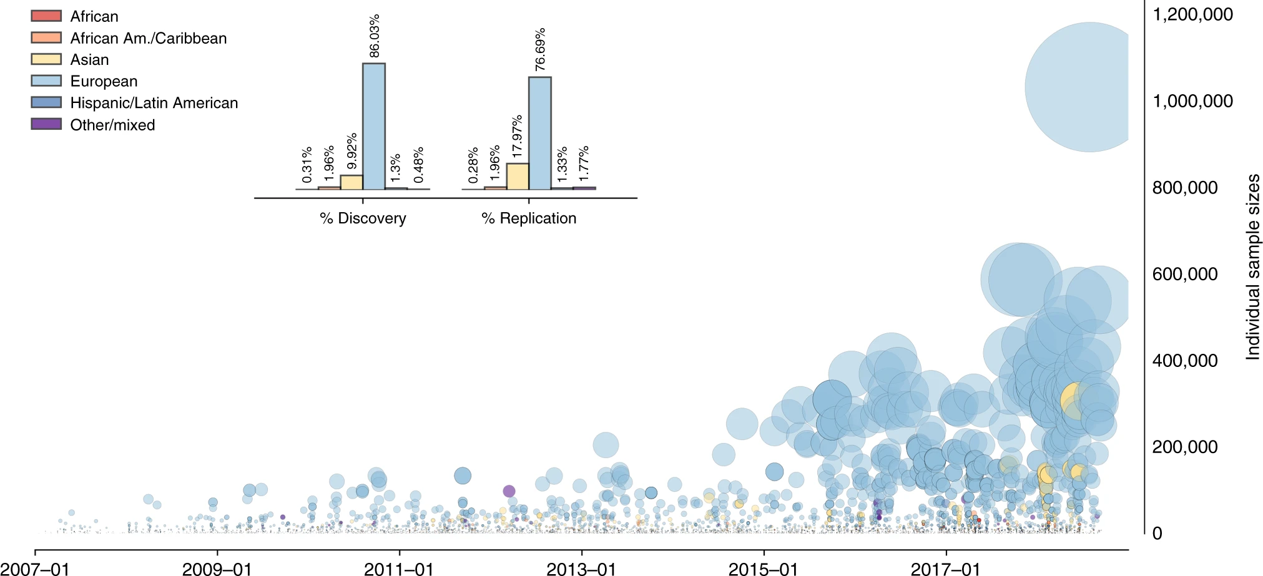
GWAS revolution
WTCCC study
Multiple sclerosis study
Mills & Rahal, “A scientometric review of genome-wide association studies”, Communications Biology 2019

Slide 14
Lecture plan
Recap & fallout from last lecture
Gaining biological knowledge from GWAS
Uncovering biology: examples
Pleiotropy, heritability and prediction

Slide 15
GWAS revolution
Type 2 diabetes study
Mills & Rahal, “A scientometric review of genome-wide association studies”, Communications Biology 2019

Slide 16
Type 2 diabetes study
N = 74,000 T2D cases
And 824,000 controls
Have gone from a handful of T2D signals in 2007 to 403 in 2018
These loci give a detailed view of the ‘genetic architecture’ of this trait.

Slide 17
Type 2 diabetes study
But finding biology is hard
Even using this large sample, and exploiting functional data in relevant cell types, only a handful of these signals could be unambiguously mapped to individual variants.

Slide 18
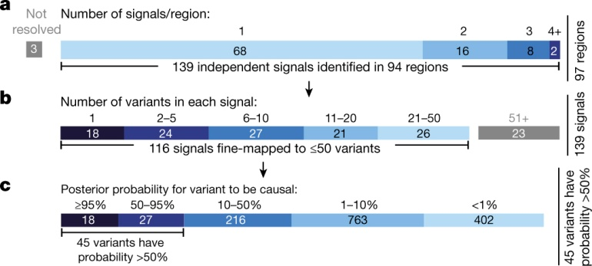
Another example - IBD
Attempted fine-mapping of 139 signals of association with inflammatory bowel disease (IBD), using genotype data on 67,852 individuals, and data on the functional state in relevant cell types.
...with mixed success:
Huang et al Nature 2017
Among 45 likely causal variants:
13 protein-coding changes
3 = disruption of transcription factor binding
10 = tissue specific epigenetic marks
At least 21 loci could not be assigned a plausible function despite the extensive data.

Slide 19
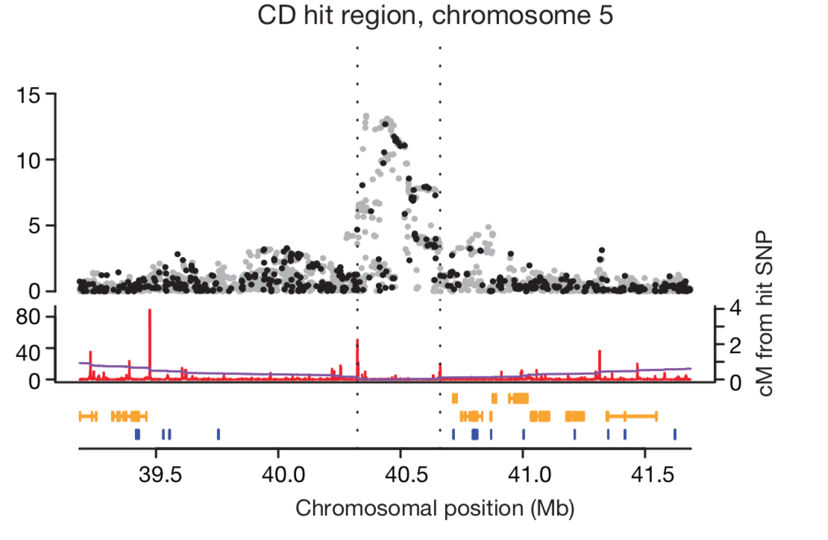
Another example - IBD
Attempted fine-mapping of 139 signals of association with inflammatory bowel disease (IBD), using genotype data on 67,852 individuals, and data on the functional state in relevant cell types.
...with mixed success:
Huang et al Nature 2017
Among 45 likely causal variants:
13 protein-coding changes
3 = disruption of transcription factor binding
10 = tissue specific epigenetic marks
At least 21 loci could not be assigned a plausible function despite the extensive data.

Slide 20
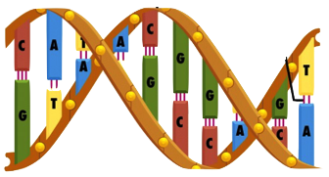
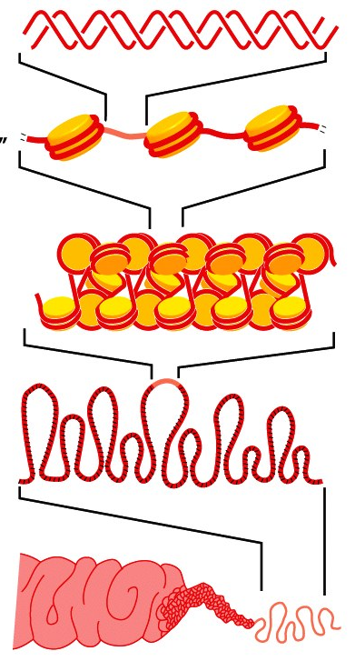
The circle of genetic causation
DNA gets physically packaged up into chromosomes...
Notes:
Population individuals pass on DNA with recombination and mutation
DNA is wrapped up into chromosomes inside cells, where it encodes

Slide 21
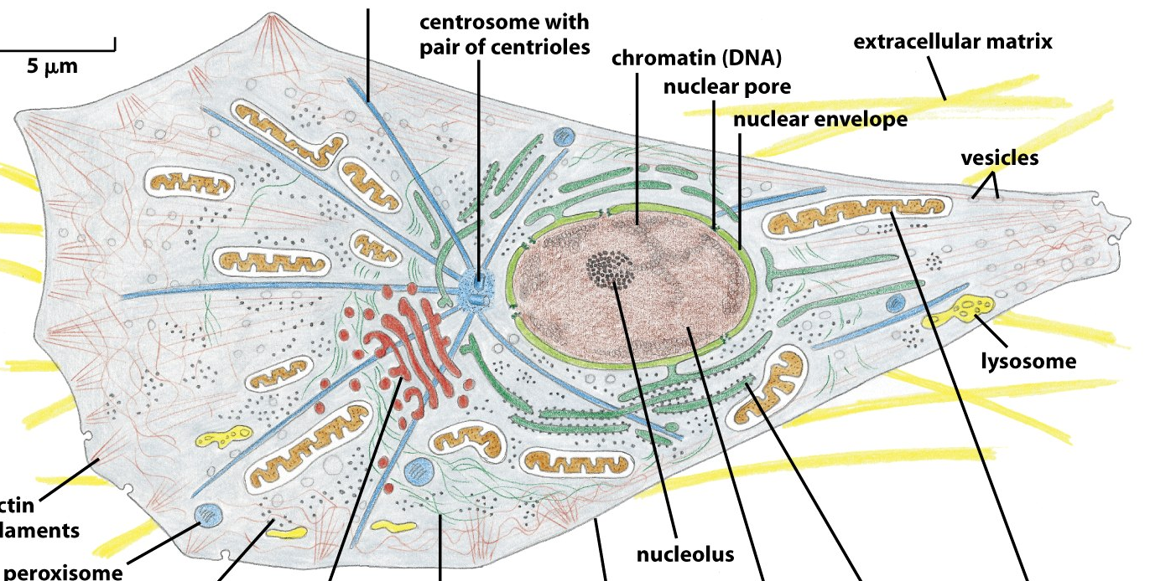
The circle of genetic causation
DNA gets physically packaged up into chromosomes...
...inside cells, where it is transcribed to form proteins and other molecules...
Notes:
Population individuals pass on DNA with recombination and mutation
DNA is wrapped up into chromosomes inside cells, where it encodes....
(2 metres of linear DNA per cell, 50 trillion cells)

Slide 22
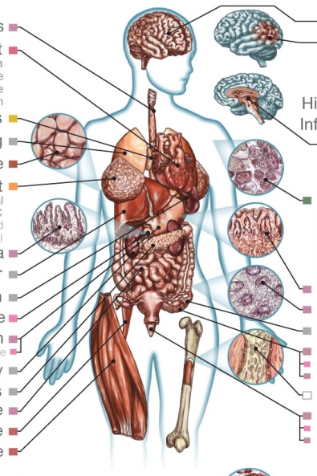
The circle of genetic causation
DNA gets physically packaged up into chromosomes...
...that combine to make individuals...
...inside cells, where it is transcribed to form proteins and other molecules...
...that affect how the cells behave, forming different organs...
Notes:
Population individuals pass on DNA with recombination and mutation
DNA is wrapped up into chromosomes inside cells, where it encodes

Slide 23
The circle of genetic causation
...whose success is affected by the traits they have...
DNA gets physically packaged up into chromosomes...
...that combine to make individuals...
...inside cells, where it is transcribed to form proteins and other molecules...
...that affect how the cells behave, forming different organs...
Notes:
The map from genetics to phenotypes is incredibly complicated
And it gets at what makes us human: evolution.

Slide 24
The circle of genetic causation
...passing on DNA, with mutations and recombination, to new generations...
...whose success is affected by the traits they have...
...that gets physically packaged up into chromosomes...
There is complex biology at all stages
...that combine to make individuals...
...inside cells, where it is transcribed to form proteins and other molecules...
...that affect how the cells behave, forming different organs...
Notes:
The map from genetics to phenotypes is incredibly complicated
And it gets at what makes us human: evolution.

Slide 25
The circle of genetic causation
...passing on DNA, with mutations and recombination, to new generations...
...whose success is affected by the traits they have...
microarrays, genome sequencing
Clinical phenotype measurements
...that gets physically packaged up into chromosomes...
There is complex biology at all stages
And we can measure it.
Biomarker measurements
Chromatin state marker assays, ChIP-seq, ...
RNA-seq, spectroscopy, antibody binding
...that combine to make individuals...
...inside cells, where it is transcribed to form proteins and other molecules...
...that affect how the cells behave, forming different organs...
Notes:
The map from genetics to phenotypes is incrediblyt complicated
And it gets at what makes us human: evolution.

Slide 26
Gaining biological knowledge from GWAS
There are several ways we can try to translate knowledge of associations into new biological insights. I will try to describe a few of these.
Fine-mapping – can we identify the actual causal variants underlying these associations, and hence discover specific proteins and disease pathways?
Pathway analysis – even if we can’t fine-map, we can still try to assess whether associations group into particular biological pathways that might shed light on biology
Pleiotropy analysis – are associations shared between traits, improving our understanding of disease etiology?
Heritability analysis – how much of the heritability do the signals explain?

Slide 27
Lecture plan
Recap & fallout from last lecture
Gaining biological knowledge from GWAS
Uncovering biology: examples
Pleiotropy, heritability and prediction

Slide 28
The circle of genetic causation
Example 1: a pathway analysis
...that combine to make individuals...
Notes:
The map from genetics to phenotypes is incrediblyt complicated
And it gets at what makes us human: evolution.

Slide 29
Pathway analysis
Pathway analyses and gene enrichment analysis seek to determine whether there is a statistical tendency for association signals to fall into known groups of related genes. These can be
Known biological pathways (functional networks of proteins and molecules, performing known specific biological functions) – such as those available from the KEGG and Reactome databases
More general classifications of genes by function, such as those from the Gene Ontology Project
A slightly different direction is to try to group signals by genome function – for example, do they lie in exons? Or gene promoters? Or in regulatory regions active in particular cells?
https://www.genome.jp/kegg/
https://reactome.org
http://geneontology.org

Slide 30
Pathway analysis example
The primary cause of MS has typically been thought to be inflammation causing downstream neurodegeneration – with some debate about this. Can the GWAS of MS we discussed shed light on this?
As the main figure shows, many of the association signals looked like they were near immune-system related genes.
www.well.ox.ac.uk/wtccc2/ms/

Slide 31
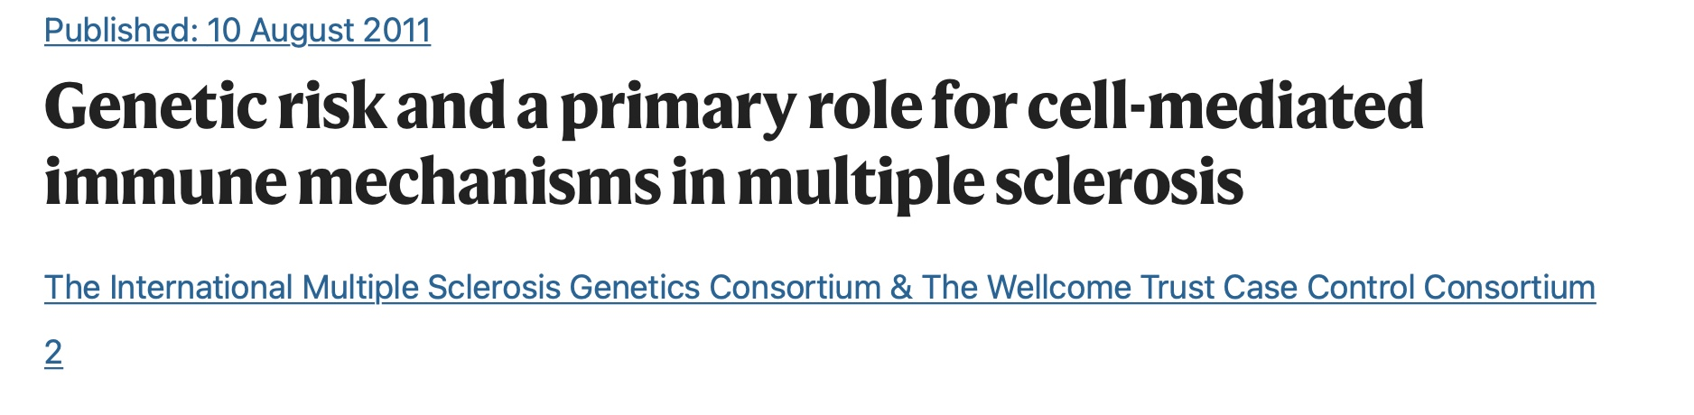
Pathway analysis example
We:
Assigned SNPs to their nearest gene using the available annotation
Used the Gene Ontology Project to classify genes into functionally related groups
Conducted a statistical test (Fisher’s exact test) to identify whether the nearest genes were enriched in each group.
Particularly strong enrichment was observed for immune system pathways – notably in “T cell activation and proliferation” (P=1.9x10⁻⁹)
“Although GO immune system genes only account for 7% of human genes, in 30% of our association regions the nearest gene to the lead SNP is an immune system gene”
T-helper-cell differentiation pathway
(from Ingenuity Pathway Analysis software)
www.well.ox.ac.uk/wtccc2/ms/

Slide 32
Fine-mapping
“Fine-mapping” is the general term used for attempts to narrow down association signals to the underlying causal variants. A typical process involves:
Gathering complete information on genetic variation in the region of interest – for example by deep-sequencing a large number of individuals. (Large databases such as gnomAD / TopMed now make this easier.)
Gathering information on genome function – including gene structure and regulatory regions.
Potentially leveraging data from different ancestral backgrounds, hoping that differences in LD patterns will help narrow down signals.
Fitting models that attempt to parse apart multiple associations in the same region
Possible underlying mechanisms are pretty diverse and a healthy dose of genomic detective work is often needed.

Slide 33
The circle of genetic causation
Example 2: fine-mapping
...that combine to make individuals...
Notes:
The map from genetics to phenotypes is incrediblyt complicated
And it gets at what makes us human: evolution.

Slide 34
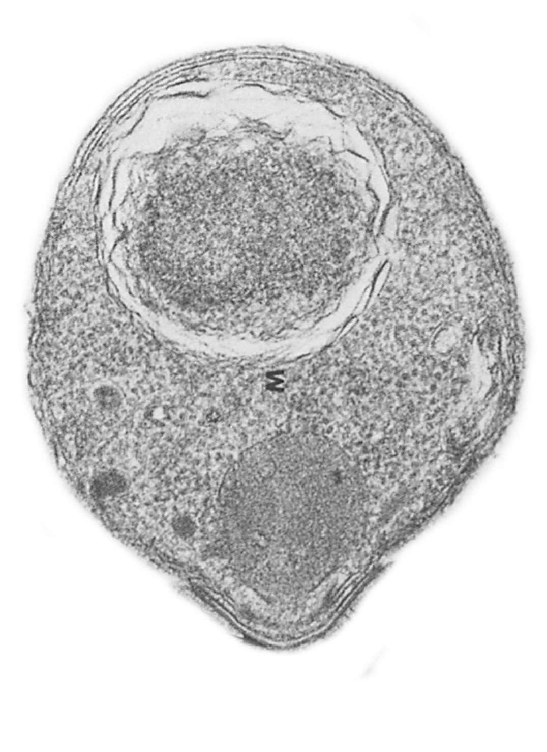
Plasmodium falciparum
VS
humans
Nature Communications: doi.org/10.1038/s41467-019-13480-z
or on bioArxiv: doi.org/10.1101/535898
Notes:
This is an evolutionary conflict which has affected both species.
And today I want to show you results which suggest it’s still shaping diversity on the red blood cell surface.
And then at the end I’ll give you a genome-wide view if time permits.

Slide 35
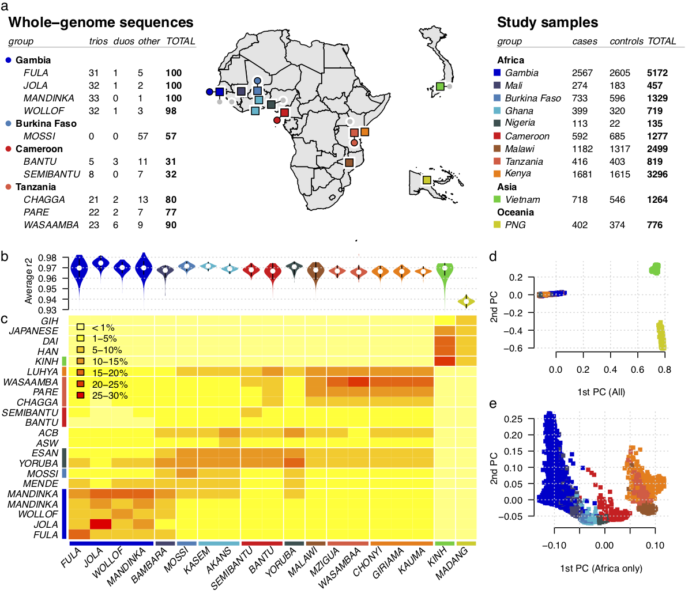
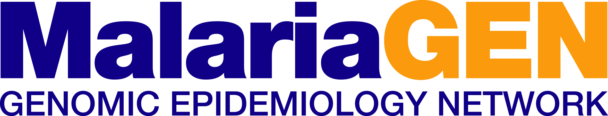
GWAS of susceptibility to severe malaria
~17,000 clinical samples from West and East Africa, Oceania and South East Asia.
Genotyped on the Illumina Omni 2.5M array
www.malariagen.net

Slide 36
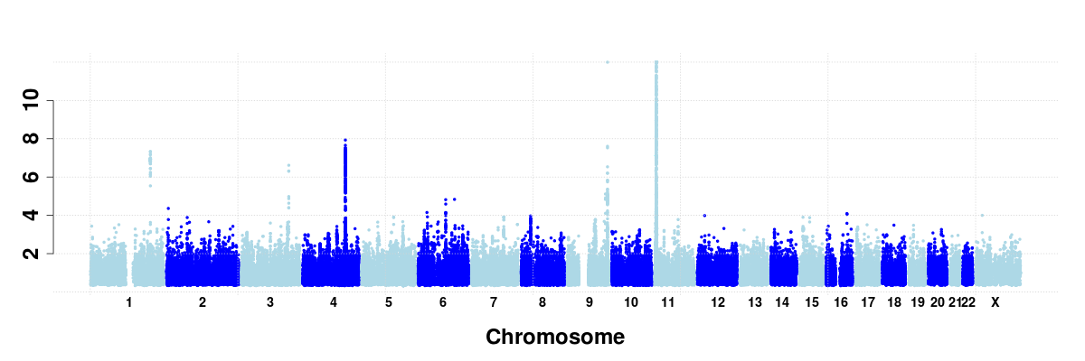
Natural resistance is driven by red blood cell variation
Known associations at O blood group and sickle trait
New loci identified by GWAS
Evidence
~20M SNPs across the human genome

Slide 37
Natural resistance is driven by red blood cell variation
Known associations at O blood group and sickle trait
New loci identified by GWAS
Evidence
~20M SNPs across the human genome

Slide 38
SNPs on chromosome 4 are associated with proection against severe malaria
Signal identified and replicated (rs186873296)
4,921 Gambians
2,516 Malawians
2,984 Kenyans
MalariaGEN, Nature 2015
Chromosome 4
Notes:
Our starting point was a GWAS.
Hitplot
GYPA abundant diverse rbc surface
To capture african genetic diversity we…

Slide 39
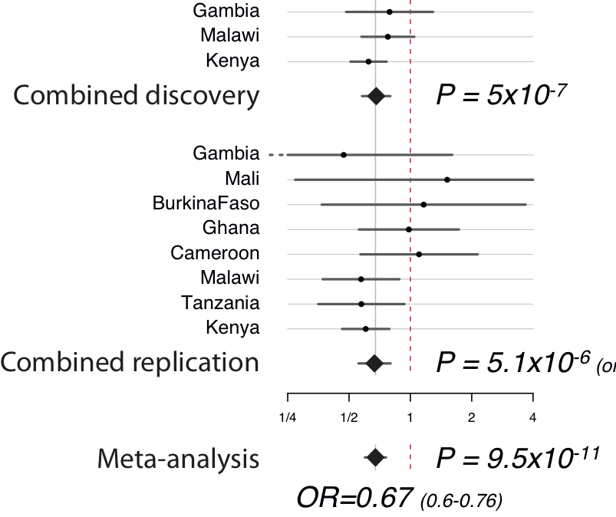

The association has quite large effect
> 30% protective effect per copy of the derived allele
$$\text{Standard} \text{error}(\log{OR)}≈\frac{1}{\sqrt{N×f\left(1−f\right)×φ(1−φ)}}$$
Notes:
Evidence at directly-typed most-associated marker in discovery samples (controlling for genome-wide population structure).
Evidence at directly-typed marker in replication samples (controlling for reported ethnicity)
Point-estimate for a homozygote is about 0.39 in Kenya (non-discovery samples).
From last week – this is a relative risk of around 1.5
Budget: 2m30s / 6m20s.

Slide 40
Can we finemap?
We had an exciting association. But fine-mapping has proven to be difficult for many GWAS loci.
To hope for success we might need:
- Good candidates for the functional gene?
- Good candidates for the causal mutation(s)?

Slide 41
SNPs on chromosome 4 are associated with proection against severe malaria
Signal identified and replicated (rs186873296)
4,921 Gambians
2,516 Malawians
2,984 Kenyans
MalariaGEN, Nature 2015
Glycophorins!
Notes:
Our starting point was a GWAS.
Hitplot
GYPA abundant diverse rbc surface
To capture african genetic diversity we…

Slide 42
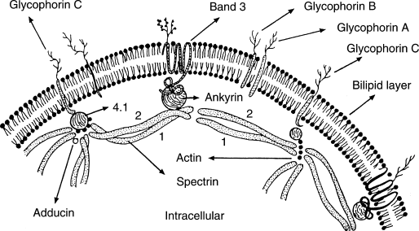
Glycophorins encode the ‘MNS’ blood group
(antigenic molecules on RBC surface)
Glycophorins
Outside red blood cell
Red blood cell membrane
Inside red blood cell
Grimes and Slater, The Inherited Metabolic Diseases, 1994

Slide 43
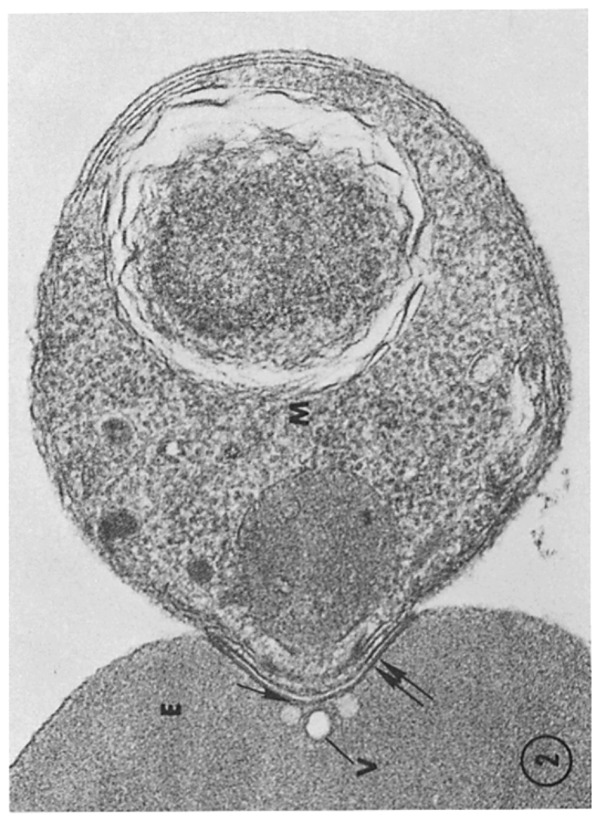
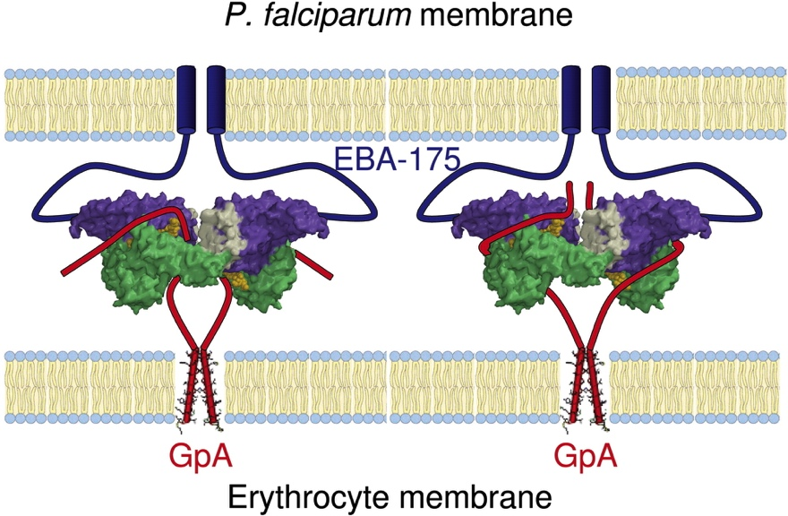
Glycophorins are receptors for P.falciparum during red blood cell invasion
P. Falciparum parasite
red blood cell
Glycophorin A
Miller et al, J. Exp. Med 1979
Tolia et al, Cell 2005
Notes:
Indeed one of the key pathogens that interact with these genes is malaria.
Figure on left shows P.falciparum invading a RBC. This involves a complex sequence of molecular interactions.
One of these is the binding of Pf EBA-175 to GYPA. (GYPB is similarly thought to act as an invasion receptor.)
Note other pathogens, e.g. influenza and Hep A, are also thought to bind to these glycophorins.

Slide 44
Can we finemap?
We had an exciting association. But fine-mapping has proven to be difficult for many GWAS loci.
To hope for success we might need:
✅ - Good candidates for the functional gene?
- Good candidates for the causal mutation(s)?

Slide 45
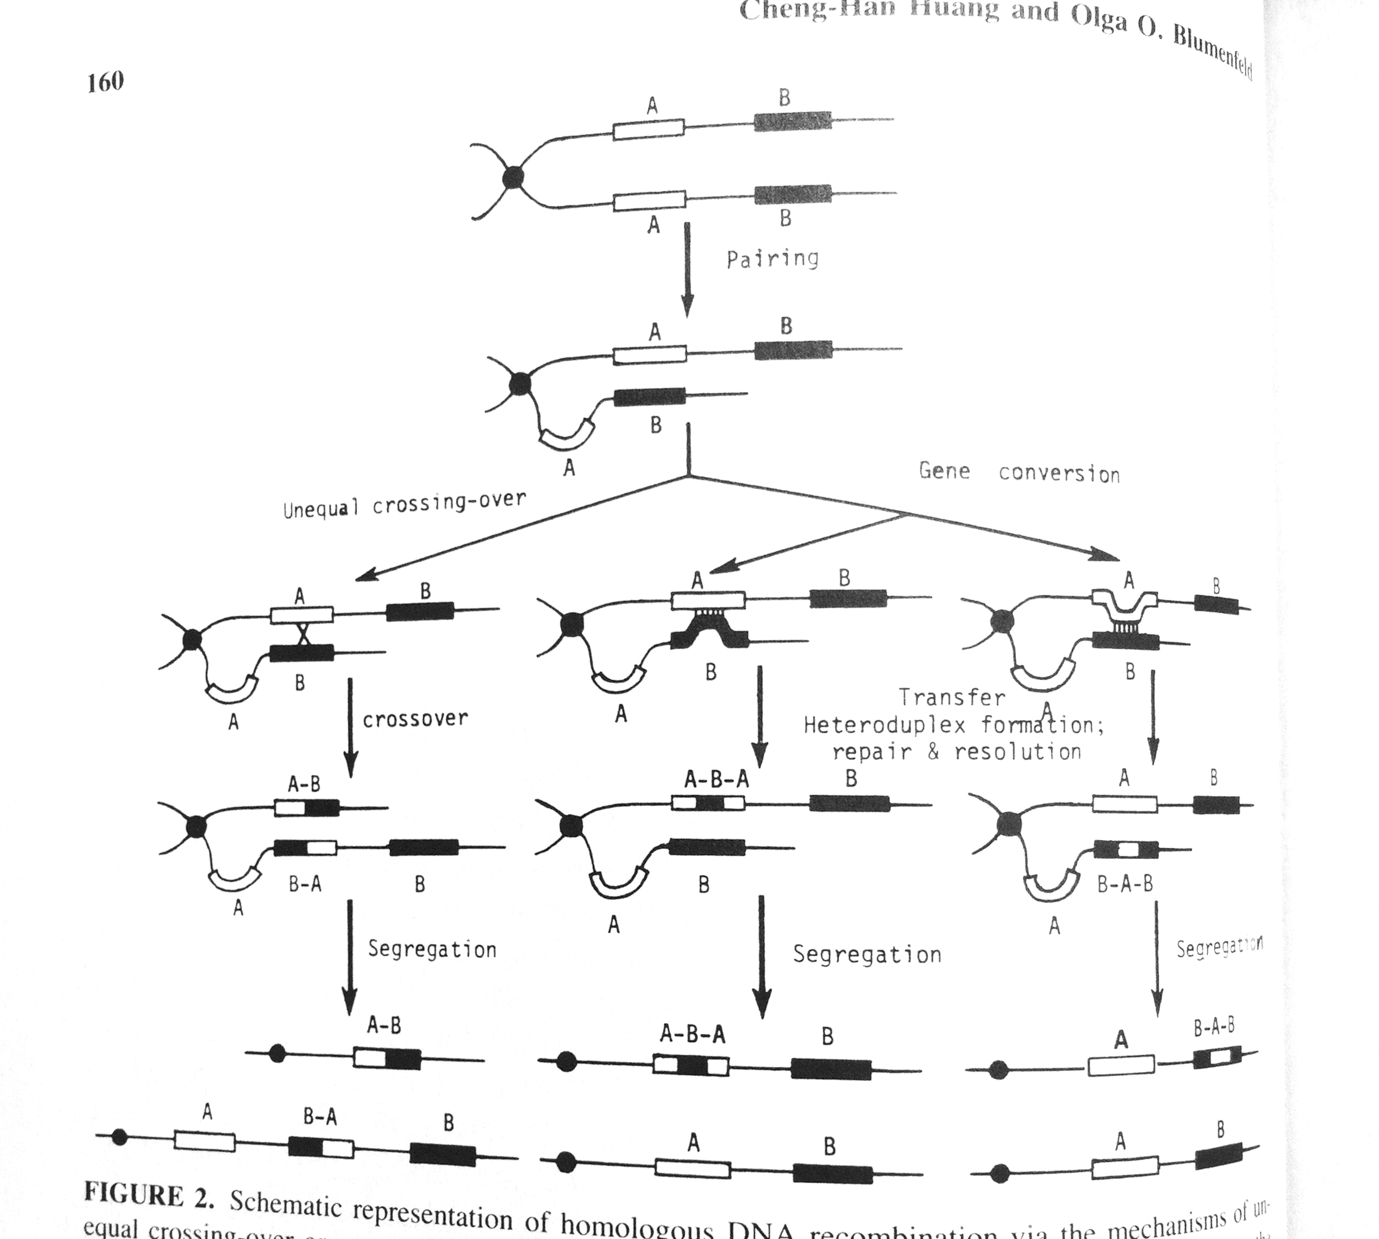
Structural variants create deletions, duplications, and hybrid genes
The MNS blood group is highly diverse, with over 45 known antigens.
Encoded by single nucleotide polymorphisms and structural variants
Deleted / duplicated / hybrid genes

Slide 46
Can we finemap?
We had an exciting association. But fine-mapping has proven to be difficult for many GWAS loci.
To hope for success we might need:
✅ - Good candidates for the functional gene?
✅ - Good candidates for the causal mutation(s)?

Slide 47
Steps to fine-map
Step 1: type or sequence as much of the genetic variation in the region as possible – hope to catch the causal mutation.
Step 2: re-analyse the association.
Step 3: look for functional mutations

Slide 48
A regional reference panel capturing structural variation
We used the 1000 Genomes Project Phase III reference panel, plus:
Use whole-genome sequencing from over 3,600 individuals worldwide.
Discover genetic variation (including structural variants).
www.malariagen.net

Slide 49
Structural variants from sequencing data
Deletions
Duplications
DEL1
DUP1
deleted
DEL2
duplicated
DUP2
triplicated
DEL3
DUP3
DEL4
DUP4
DEL5
DUP5
DEL6
DUP6
DEL7
DUP7
DEL8
DUP8
E
B
A
E
B
A
14% of Africans carry a CNV affecting these genes

Slide 50
Before fine-mapping
Original result before adding information from new African sequenced genomes

Slide 51
After fine-mapping
Previous top SNP
Result after incorporating genetic variation discovered in sequenced samples

Slide 52
After fine-mapping
Previous top SNP
DUP4

Slide 53
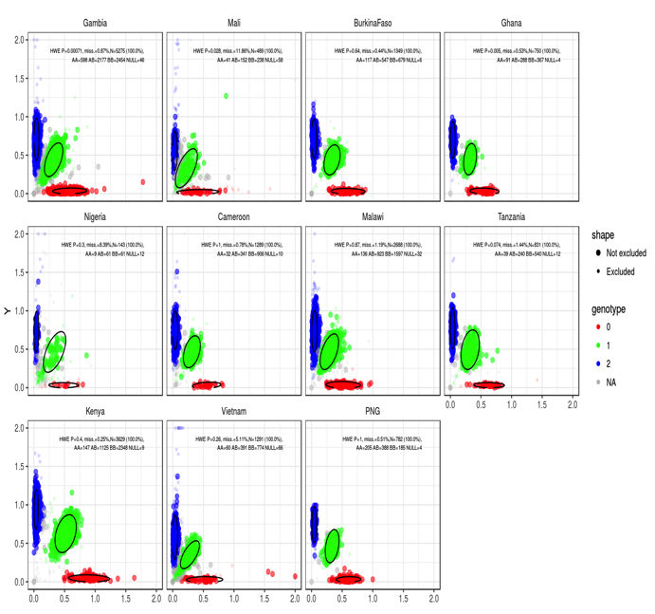
Confirming structural variants using cluster plots
microarray intensities
This is how a microarray cluster plot should look: 3 clusters for AA / AB / BB genotypes

Slide 54
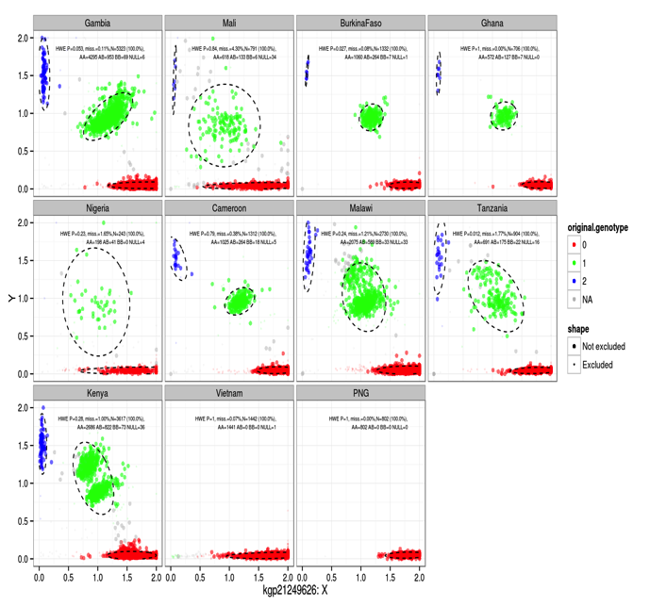
Confirming structural variants using cluster plots
Actually this signal was evident in our cluster plots
microarray intensities
This is how a microarray cluster plot should look: 3 clusters for AA / AB / BB genotypes
What we saw in this region

Slide 55
Confirming structural variants using cluster plots
Still true that nothing seemed to be functional. What next?
Protective: relative risk ~ 0.6
microarray intensities
microarray intensities
Not protective: RR ~ 0
This is how a microarray cluster plot should look: 3 clusters for AA / AB / BB genotypes
What we saw in this region

Slide 56
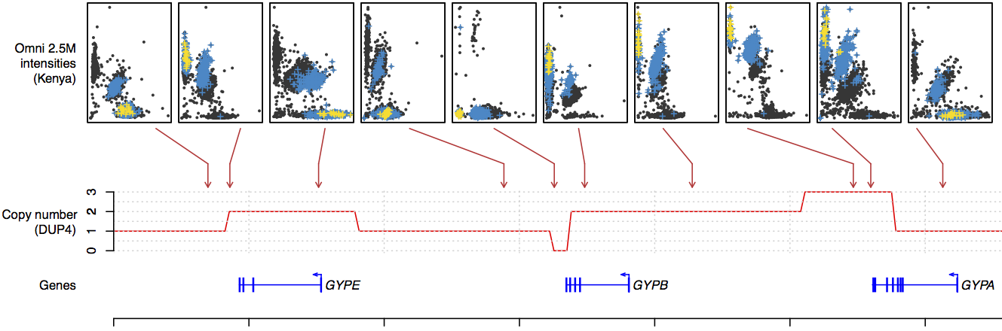
Confirming structural variants using cluster plots
DUP4
normal
normal
triplicated
normal
duplicated
duplicated
deleted
We were able to use cluster plots to confirm individuals in our GWAS really do carry the complicated structural variant “DUP4”.
DUP4 is pretty complicated – what could it be?

Slide 57
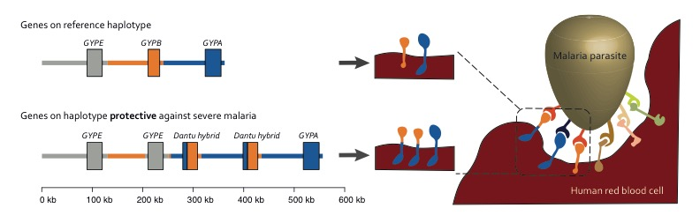
What is DUP4?
“Normal” haplotype:
DUP4 haplotype:
https://doi.org/10.1126/science.aam6393

Slide 58
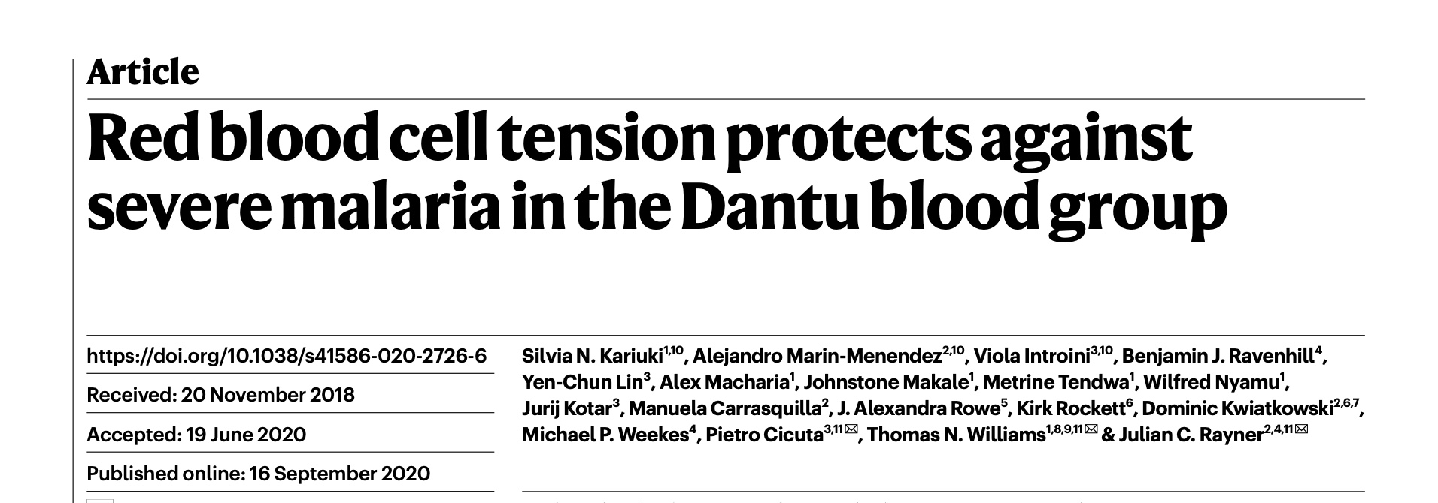
What is DUP4?
“Normal” haplotype:
DUP4 haplotype:
https://doi.org/10.1126/science.aam6393
Functional followup study
https://doi.org/10.1038/s41586-020-2726-6

Slide 59
Dantu is globally rare...
The Dantu blood group has been found in:
1 in 44,112
Londoners*
0 in 1,000
Germans†
1 in 320
African Americans†
0 in 2870
Gambians‡

Slide 60
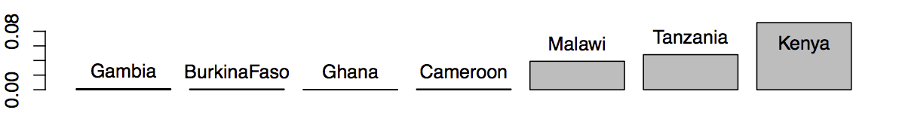
…but found at high frequency in east Africa
The Dantu blood group has been found in:
1 in 44,112
Londoners*
0 in 1,000
Germans†
1 in 320
African Americans†
0 in 2870
Gambians‡
1 in 12
Malawians‡
1 in 6
Kenyans (from the Kilifi region)‡
Allele frequency:
West Africa
East Africa

Slide 61
The circle of genetic causation
Example 3: more fine-mapping
...that combine to make individuals...
Notes:
The map from genetics to phenotypes is incrediblyt complicated
And it gets at what makes us human: evolution.

Slide 62
Natural resistance is driven by red blood cell variation
Known associations at O blood group and sickle trait
New loci identified by GWAS
Evidence
~20M SNPs across the human genome

Slide 63
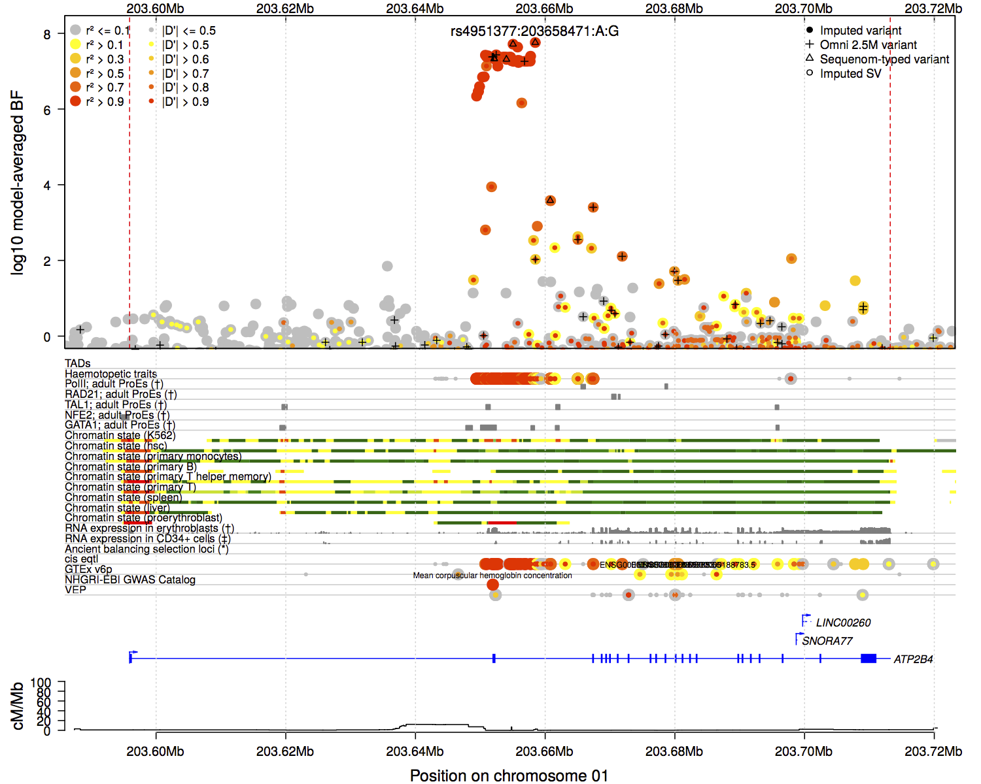
Association near 2nd exon of ATP2B4
Evidence for association
ATP2B4
“Canonical” gene model for ATP2B4
ATP2B4 = a red cell “calcium pump”
The associated SNPs cover a region around the second exon.
None of these SNPs make changes to the protein.
What could be going on?

Slide 64
Cartoon of a gene
Introns
enhancer
promoter
Transcription factors bind…
5’ UTR
Exons
3’ UTR
…and help recruit RNA polymerase…
…which transcribes the gene into “pre-mRNA”.
The pre-mRNA is then typically further postranscriptionally modified to remove introns.
mRNA:
Coding sequence

Slide 65
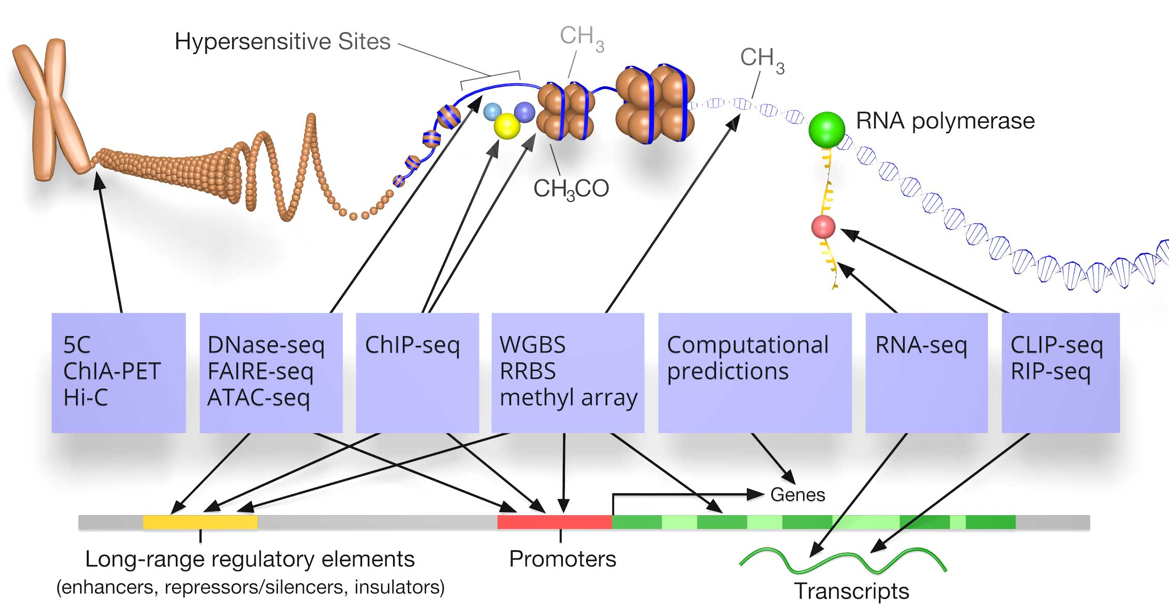
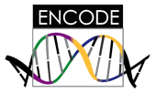


Two ways to look at transcription
molecular assays
chromatin state, transcription factor binding, RNA transcription...
Can look at chromatin state
RNA expression

Slide 66
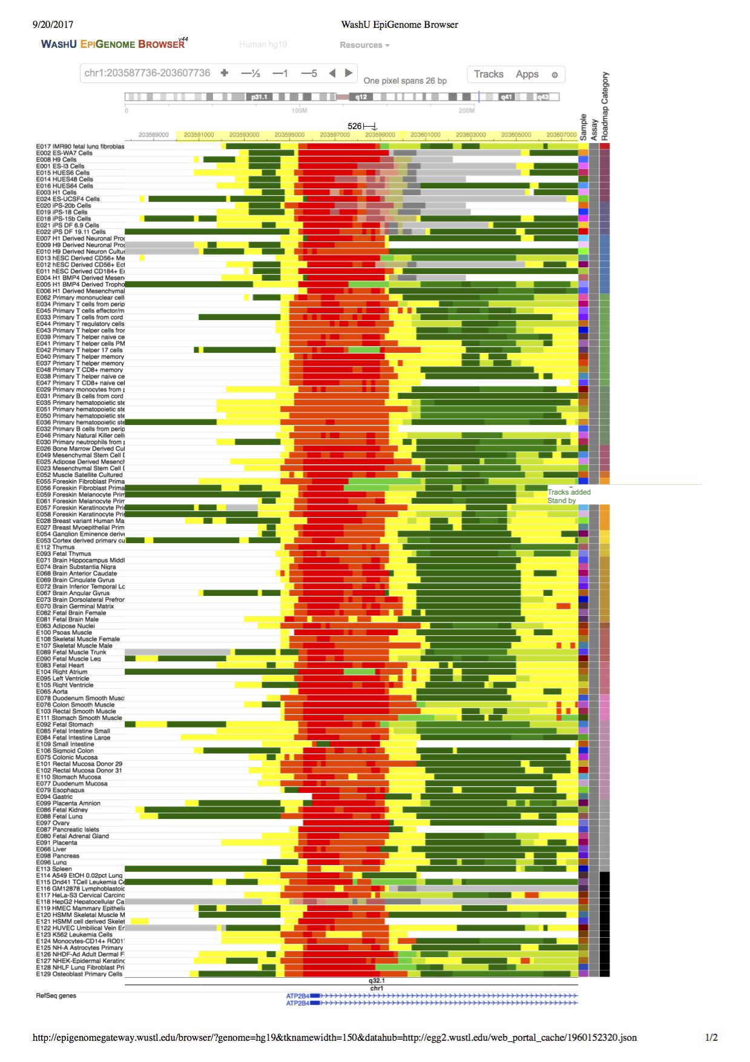
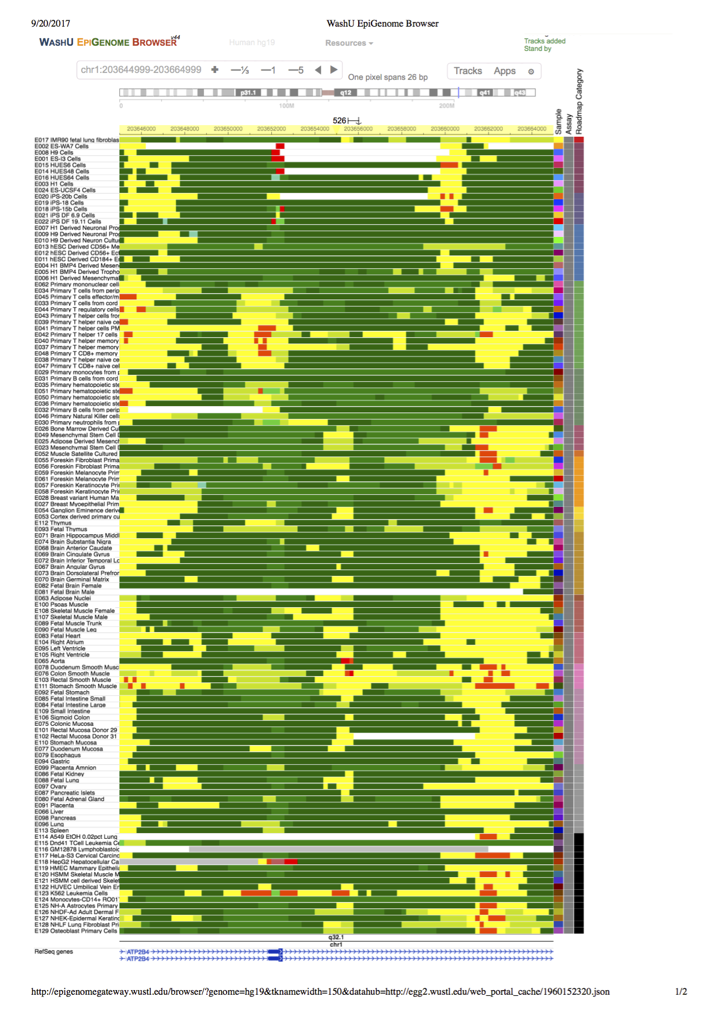
ATP2B4 is widely expressed...
1st exon
2nd exon
Chromatin states in 130 cell types
Data from ENCODE / Roadmap
Malaria-associated region

Slide 67
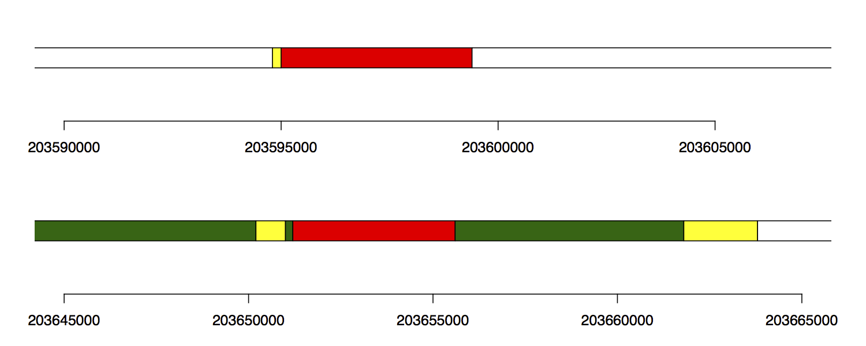
...but shows chromatin differences in RBCs
1st exon
2nd exon
Chromatin states in 130 cell types
Proerythroblasts:
Data from Xu et al Dev Cell (2012)
Malaria-associated region

Slide 68
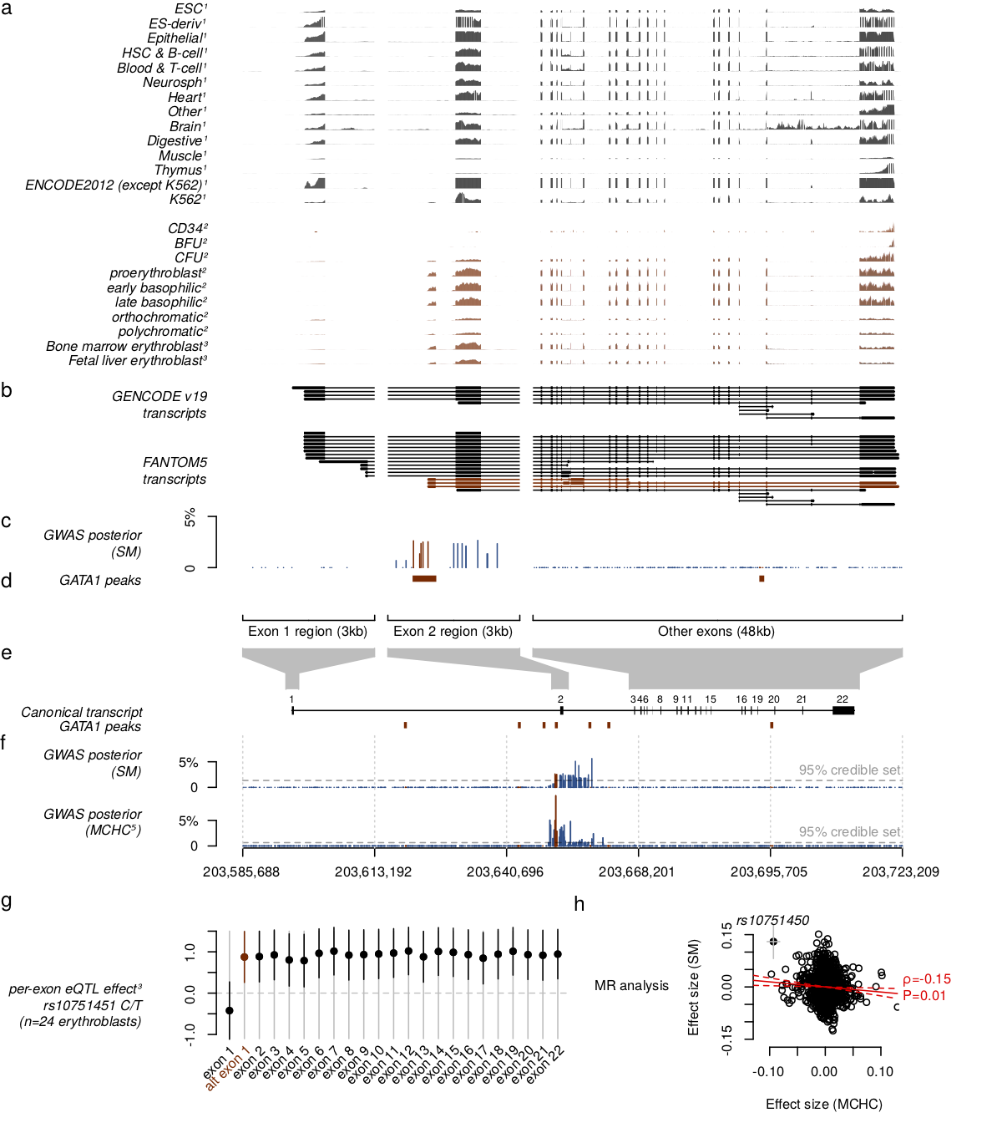
ATP2B4 is widely expressed…
Measured RNA transcription (RNA-seq)
1st exon
2nd exon
Non-erythroid cells (i.e. no red blood cells)

Slide 69
ATP2B4 has an erythroid-specific transcript
Measured RNA transcription (RNA-seq)
1st exon
2nd exon
Red cells do not have nuclei, so to capture mRNA expression in red cells, these studies experimentally differentiated stem cells into the erythroid lineage, and measured transcription before enucleation.
Erythroid cells show a different expression pattern.

Slide 70
ATP2B4 has an erythroid-specific transcript
Measured RNA transcription (RNA-seq)
1st exon
2nd exon
GWAS SNPs
Putting together data from a variety of sources suggests the existence of an alternative transcription start site near the GWAS signal, but only active in erythrocytes. How can this be?

Slide 71
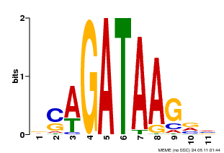
What is different about RBCs?
Transcription factor
binding
The transcription of genes in red blood cells is controlled by a particular set of transcription factors – a key one is GATA1.
GATA1 is named after the DNA motif it recognises:
v1.factorbook.org

Slide 72
GATA1 binds just upstream of 2nd exon
Measured GATA1 binding
1st exon
2nd exon
GWAS SNPs
ChIP-seq experiments show GATA1 binds just upstream of our new exon.
Moreover, one of the associated SNPs disrupts the GATA1 motif.

Slide 73
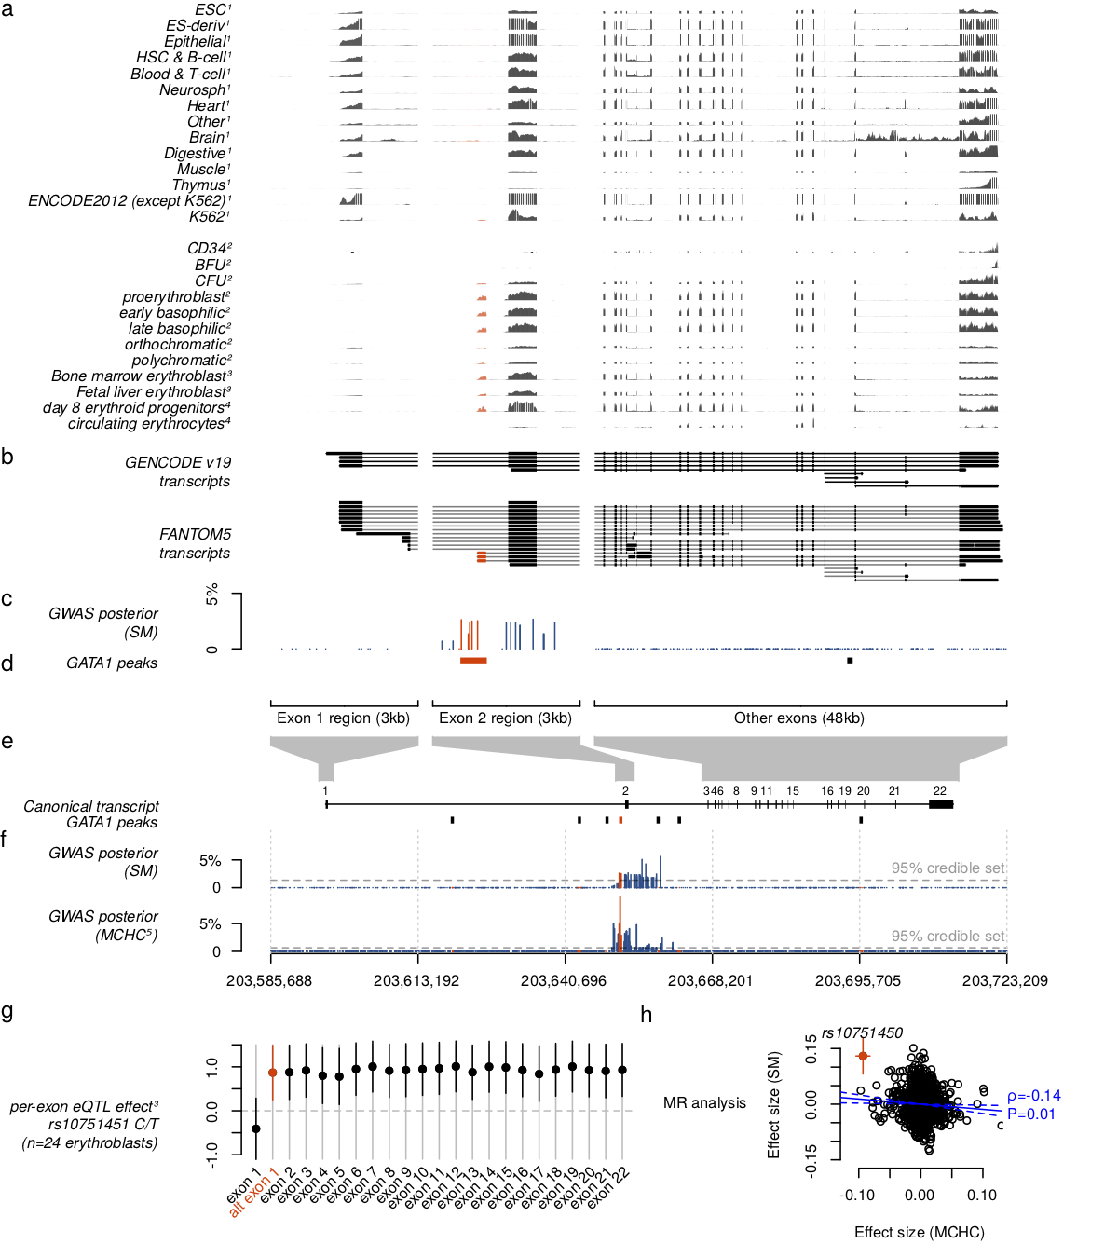
One of the malaria-associated SNPs disrupts the GATA site
Association signal
Known transcripts
Erythroid cells
from two experiments; N=3 & N=24
...GGAGCGGTAAGATA...
rs10715451
(malaria-protective allele)
...GGAGCGATAAGATA...
(malaria risk allele)
RNA expression
(N=24)
Risk allele creates GATA motif and is associated with increased ATP2B4 expression – of the erythroid transcript
exons

Slide 74
Does this really hold up?
Prediction: the alternative (=risk) allele creates a GATA1 site. It would increase expression of ATP2B4 starting at the new exon. But it wouldn’t affect expression of the ‘usual’ 1st exon.
N = 24 experimentally differentiated erythrocyte precursor cells

Slide 75
Functional hypothesis
ATP2B4 encodes a calcium pump (called PMCA4) in the RBC membrane. It acts to remove calcium from the cell.
When the parasite invades, the membrane gets inverted around the parasite, so presumably PMCA4 must also get inverted.
This might explain why lower expression of the gene provides protection – since parasites require calcium to grow effectively.
This is a hypothesis - not experimentally tested (yet)!
Ca⁺
PMCA4
Ca⁺
PMCA4
Ca⁺
Ca⁺
Zambo et al, Cell Calcium 2017

Slide 76
Biology from GWAS - summary
Non-coding variants
Long-distance interactions in the genome
Changes to gene expression
Polygenic effects (lots of variants involved)
Cell-type / tissue heterogeneity
Pleiotropy (a variant affects lots of phenotypes at once)
Genetic interactions
Host-pathogen interactions
Repetitive DNA / repeat expansions
Genome structural variation
Genome evolution
Anything that can happen, does happen.
…and there is lots of data!

Slide 77
Lecture plan
Recap & fallout from last lecture
Gaining biological knowledge from GWAS
Biological examples
Pleiotropy, heritability and prediction

Slide 78
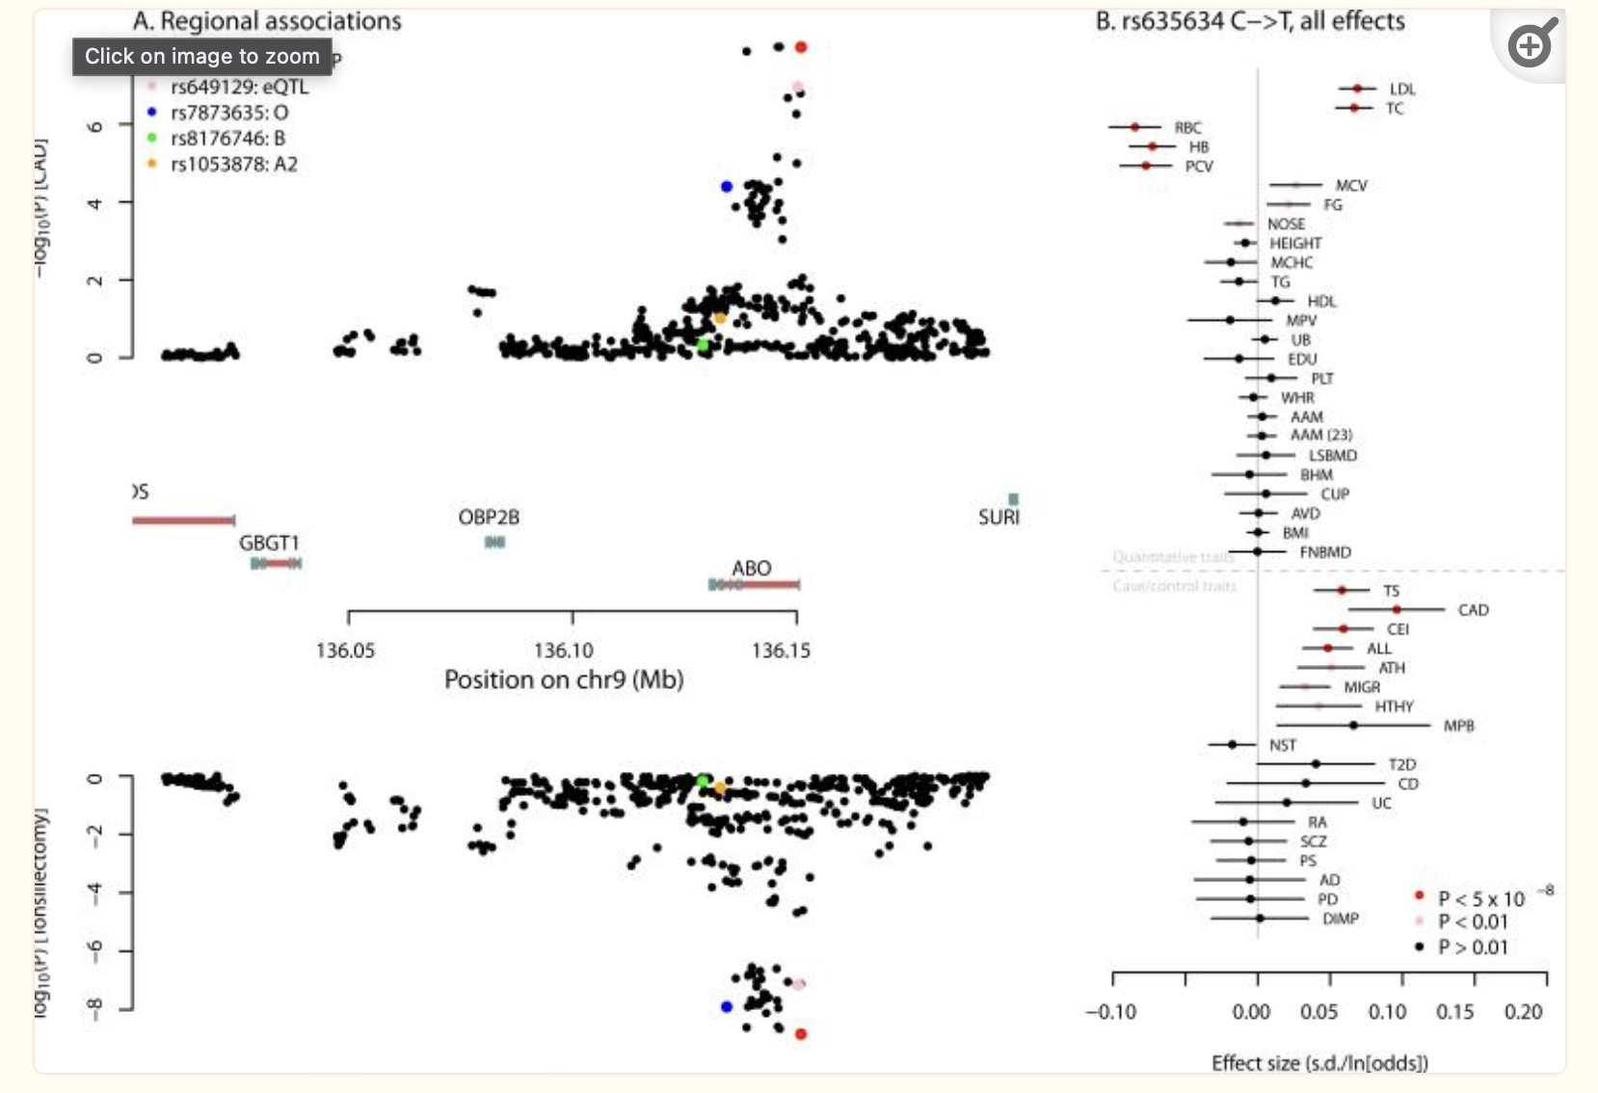
We should be looking across traits
Pickrell et al Nat. Genet. 2016

Slide 79


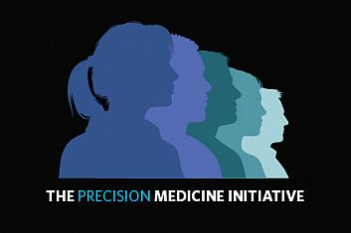
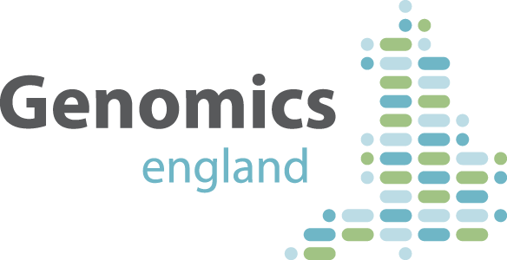

Prospective cohort studies
A new crop of studies aims to create a database of deep genotype, phenotype, and exposure data across large cohorts of individuals sampled from the population or from health services. Examples:
CartaGene (Canada)
China Kadoorie Biobank
Precision Medicine Initiative (US)
UK Biobank
The 100,000 genomes project (UK)

Slide 80
http://www.ukbiobank.ac.uk/
Collected 500,000 UK individuals who were 40-69 years old in 2006-2010.
Participants provided blood, urine and saliva samples. They also provided rich information on health and lifestyle.
Participants have been extensively genotyped and phenotyped

Slide 81
http://www.ukbiobank.ac.uk/
“The UK Biobank... aims to include 500,000 people from all around the UK... aged 40-69. This age group is being studied because it involves people at risk over the next few decades of developing a wide range of important diseases (including cancer, heart disease, stroke, diabetes, dementia). The NHS treats the single largest group of people anywhere in the world, and keeps detailed records on all of them from birth to death... This will help researchers to understand the causes of diseases better, and to find new ways to prevent and treat many different conditions”

Slide 82
http://www.ukbiobank.ac.uk/
Genetic data
 | N SNPs | N samples
Genotyping on a custom microarray (Affymetrix UK Biobank Axion array) | 800,000 | 500,000
Imputation to almost all common and rare variants | 100 million | 500,000
Exome sequencing | Everything in gene exons | 500,000 in future - by Regeneron
Genome sequencing | Everything | Sequencing is underway

Slide 83
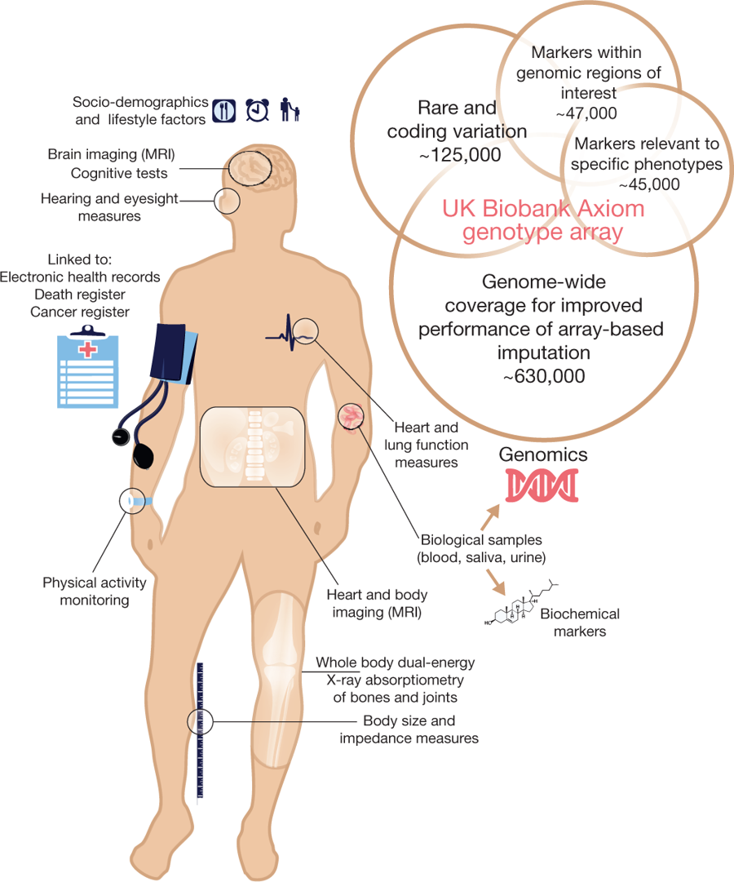
http://www.ukbiobank.ac.uk/
“As of May 2018, there were over 14,000 deaths, 79,000 participants with cancer diagnoses, and 400,000 participants with at least one hospital admission. Considerable efforts are now underway to incorporate data from a range of other national datasets including primary care, screening programmes, and disease-specific registries, as well as asking participants directly about health-related outcomes through online questionnaire. Efforts are also underway to develop scalable approaches that can characterize in detail different health outcomes by cross-referencing multiple sources of coded clinical information”
Bycroft et al Nature 2018

Slide 84
The UK biobank has let us discovery associations with 100s of traits across the whole genome, and indeed many variants are associated with many traits.
Number of statistically significant assocaitions among 717 traits
Canela-Xandri et al, http://geneatlas.roslin.ed.ac.uk/phewas/

Slide 85
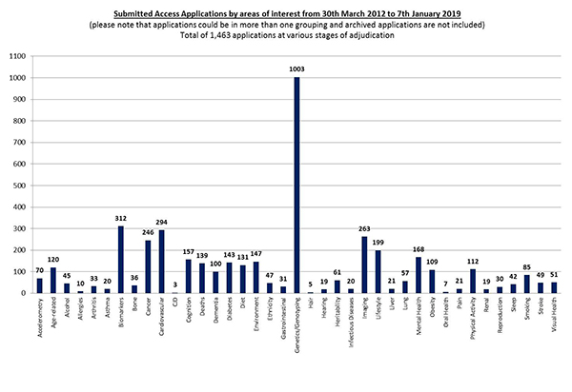
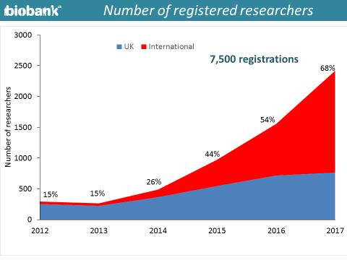
Any researcher can apply for this data.
You can browse available data and apply at https://www.ukbiobank.ac.uk

Slide 86
Finally – the largest GWAS conducted to date

Slide 87
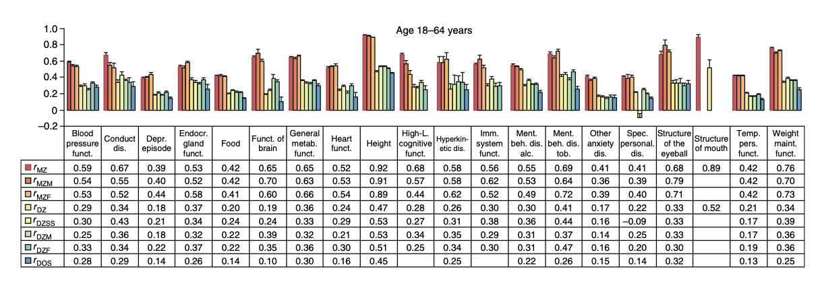
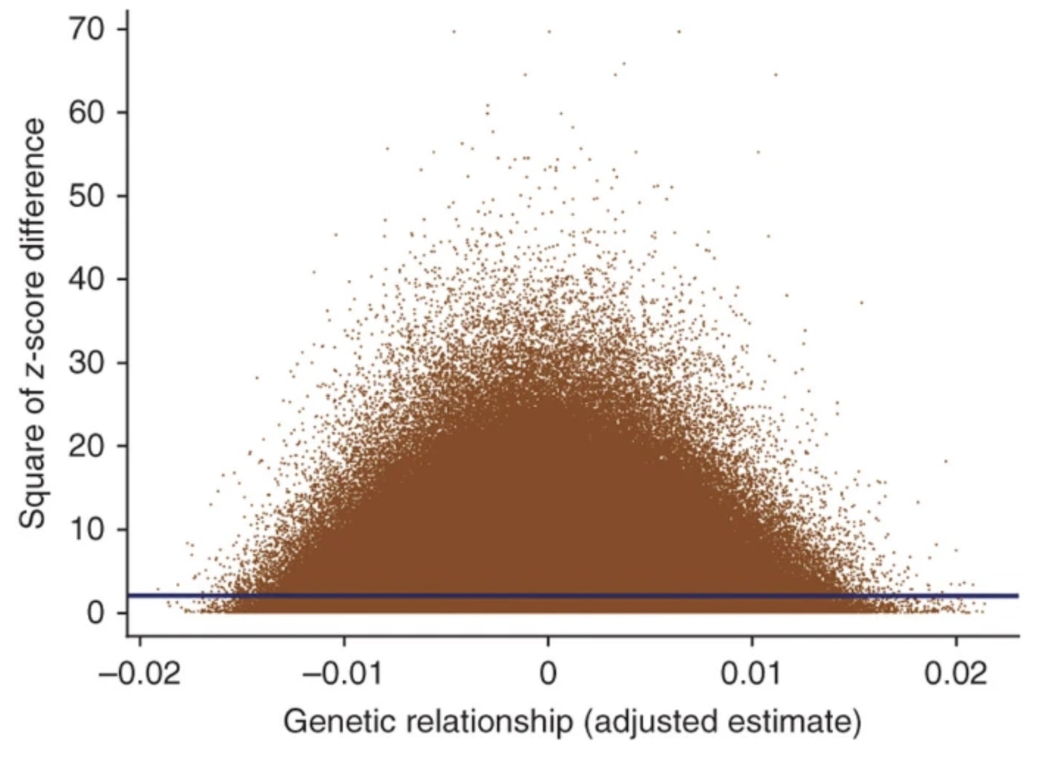
Idea: if genetics determines a trait, then more genetically similar individuals should have more similar phenotypes. Can estimate how much genetics determines trait variation by comparing trait similarity in monozygotic (identical) and dizygotic twins.
In twins
From GWAS
(Adult) height is ~90% heritable
(2010)
About half of the 90% heritability is explained by common SNPs.

Slide 88
GWAS of height in 5.4 million individuals
This very preprint appeared on bioRxiv in January 2022
It claims to map essentially all of the common mutations that determine human height.
There are 12,111 of them and (grouped into regions) they cover 21% of the genome.
Yengo et al bioRxiv (2021) https://doi.org/10.1101/2022.01.07.475305

Slide 89
GWAS of height in 5.4 million indiiduals
12,111 SNPs in regions covering ~21% of genome

Slide 90
GWAS of height in 5.4 million indiiduals
The regions identified explain a very large proportion of the heritability of height – especially in European populations. (The rest of the heritability is probably in rarer variants not accessed by this study).

Slide 91
Conclusions and summary
Most human traits are highly heritable
For ‘complex’ traits, the effects are made up of many genetic variants often with modest effects
GWAS study designs can find these variants. 100s of 1000s of trait-associated SNPs have now been identified. They rely on large samples and dense genotyping, and exploit ancestral recombination between samples to narrow down signals.
A major frontier is to understand the biology and translate these findings into clinically useful insights and predictions.
(We need lots of quantitively-minded people to do this!)

Slide 92
Thanks!
Notes:
The map from genetics to phenotypes is incredibly complicated
And it gets at what makes us human: evolution.

