Slide 1
Long read accuracy and genome assembly
Gavin Band
  LR CASe Detectives meeting
  Septembr 7th 2023

Slide 2
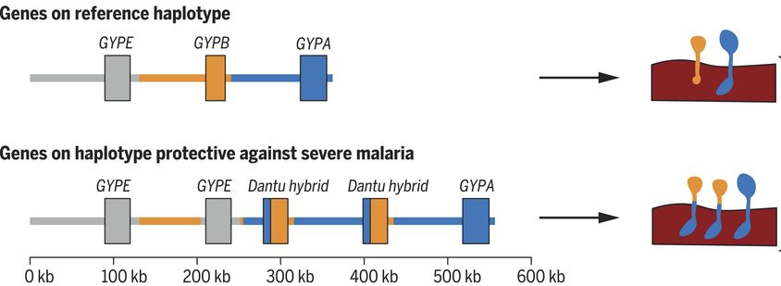
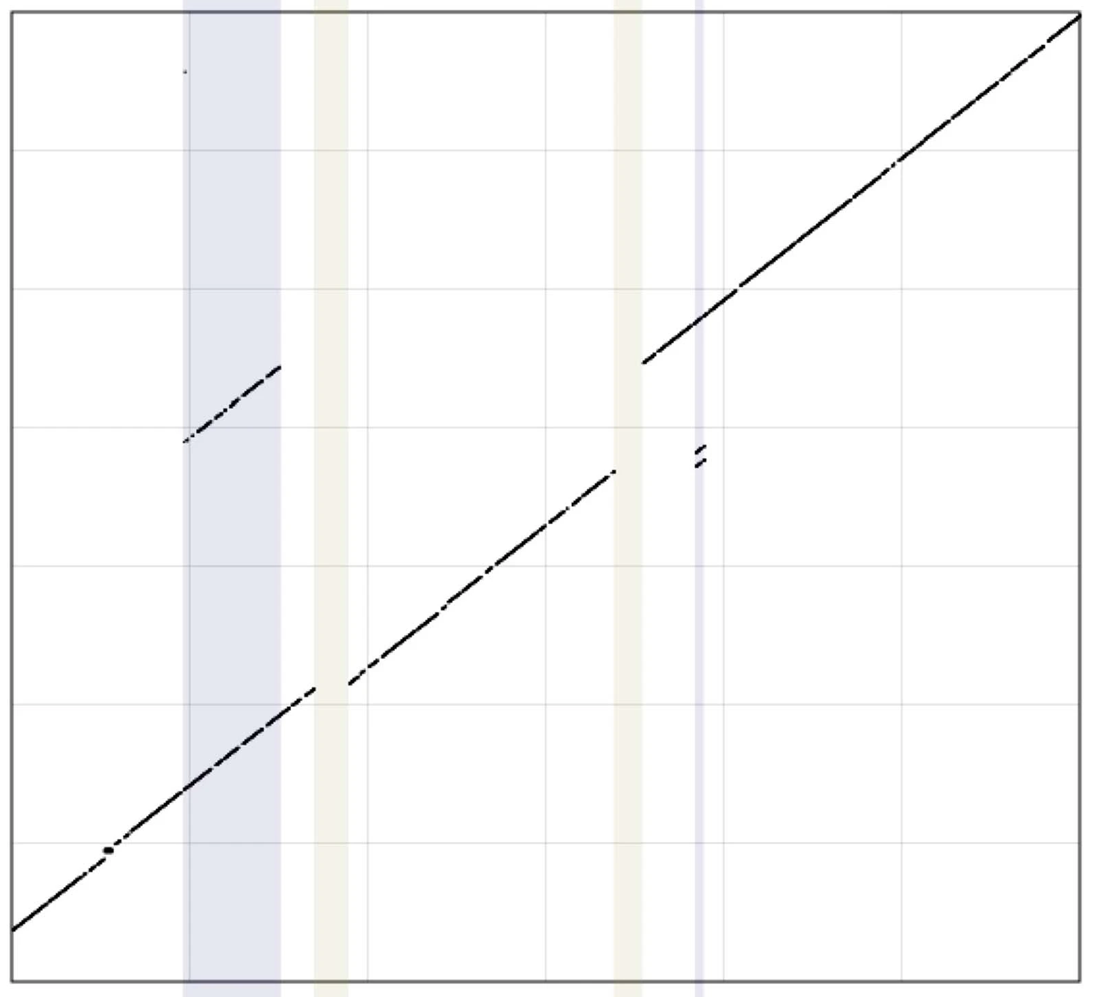
Motivation: structural variation in hosts and pathogens
“Resistance to malaria through structural variation of red blood cell invasion receptors”
2017
duplicated segments
Another P.falciparum genome
“Malaria protection due to sickle haemoglobin depends on parasite genotype”
2021
deleted segments
P.falciparum reference genome

Slide 3
Many questions
What is the structure of the variant?
What is their functional effect?
What is their phenotypic impact?
How are they evolving?
What other variants segregate?
How can we genotype them?

Slide 4
Talk outline
1. How accurate are recent long-read platforms?
2. Two genome assembly applications

Slide 5

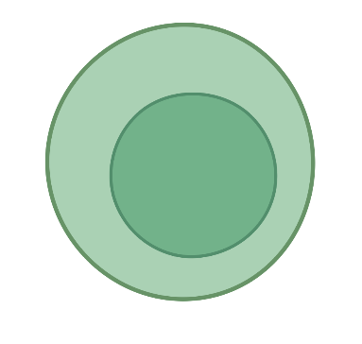
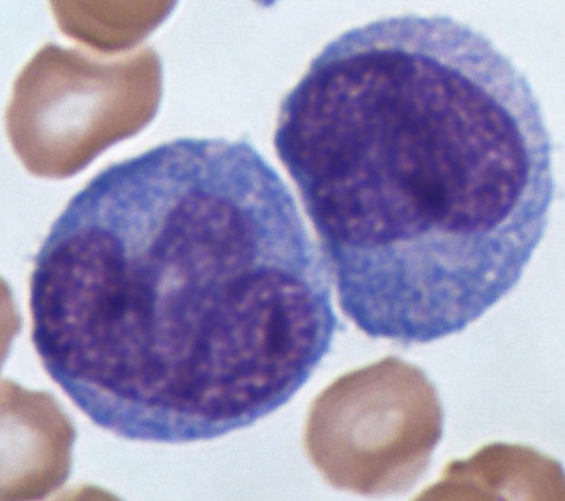
The HV31 omniome project: data
Genomic data:
Functional data:
Illumina and MGI short-read data, to ~200x
PacBio ‘continuous long reads’ (Sequel II), to ~35x
PacBio ‘HiFi’ reads (Sequel II and IIe) to ~24x
New!! PacBio ‘HiFi’ reads (Revio), to ~57x
Oxford Nanopore Technologies R9.4.1, to ~63x
New!! ONT R10.4.1 data, to ~69x
10X linked-reads (to ~40x)
MGI stLFR linked reads
BioNano optical mapping, to ~150x coverage by fragments
(B cells)
(T helper cells)
(Monocytes)
(Cytotoxic T)
RNA-seq for gene expression
ATAC-seq for chromatin accessibility
CHiP-seq for histone modifications
Methylation (from long read datasets)
All data is, or will be available through the EGA: EGAS00001005046
Image credit: Dr Graham Beards - Own work, CC BY-SA 3.0

Slide 6
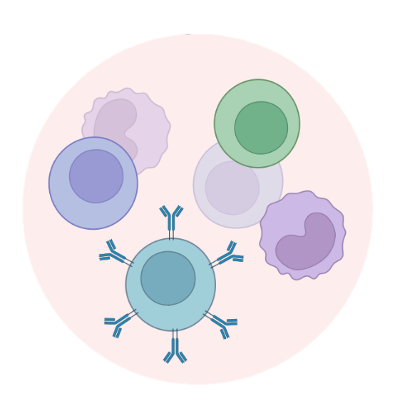


PBMCs
stored in foetal calf serum
Andrew Brown
Julian Knight lab
Connor Davison
DNA extraction
Qiagen Gentra Puregene Kit
Simon Mayes
Philipp Reschender
Tonya McSherry
Rosemary Sinclair-Dokos
Riki Aydeniz
Eirini Maria Lampraki
Mike Eberle
Cillian Nolan
Sequencing using
5 x Promethion flowcells
To approx 67x depth
Sequencing using
2 x Revio SMRT cell
To approx 60x depth
Analysis by our team @ Oxford

Slide 7
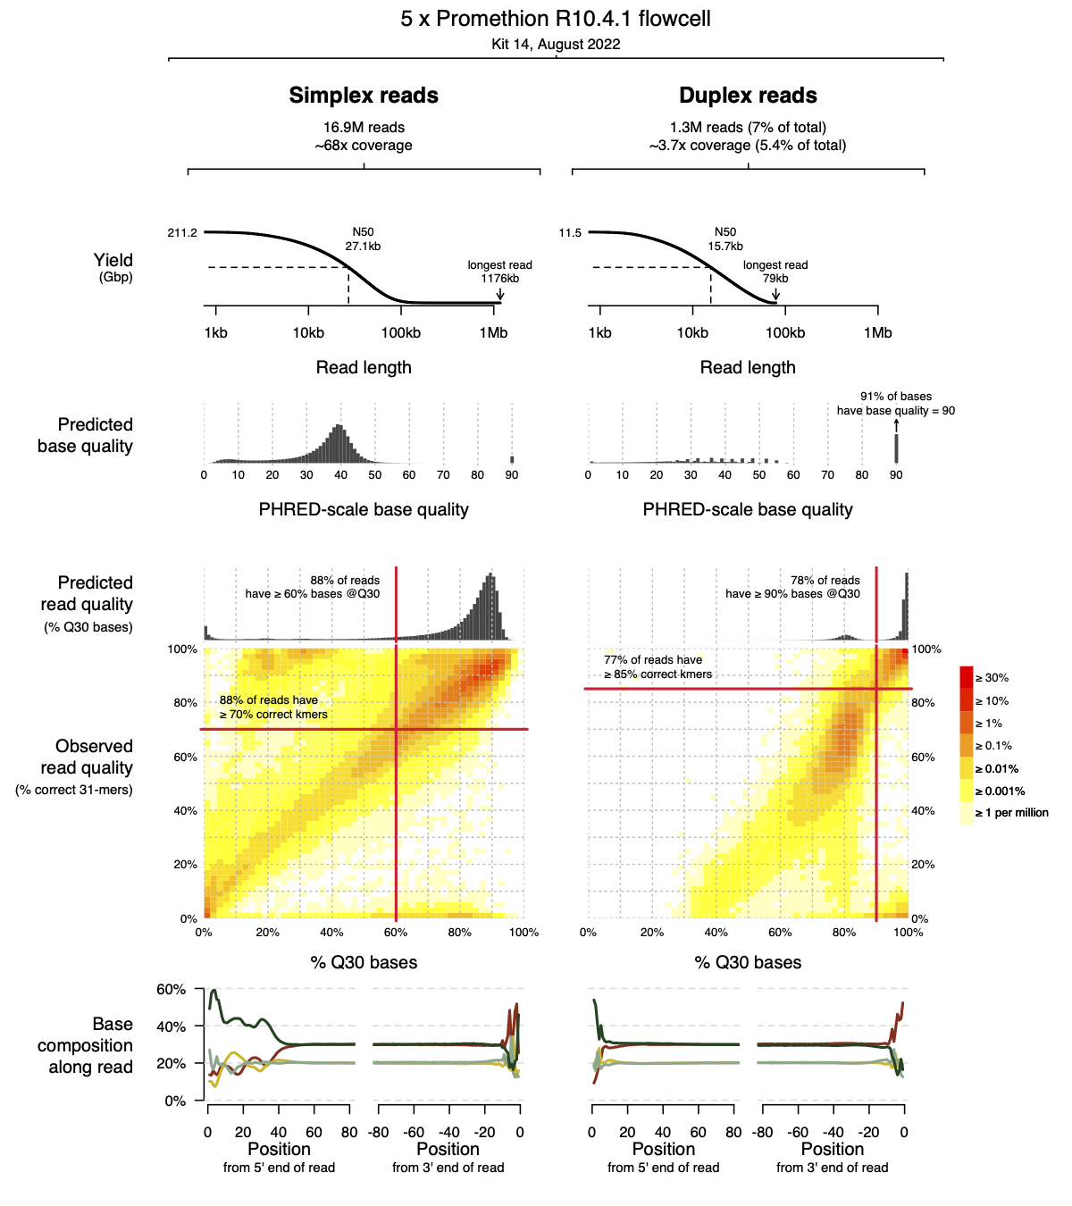
Read length comparison
Simplex reads
Nanopore R10.4.1
In this expt, most nanopore reads were 1-100kb long…

Slide 8
Read length comparison
Simplex reads
Duplex reads
about 5% of total reads
Nanopore R10.4.1
In this expt, most nanopore reads were 1-100kb long…
and duplex reads were slightly shorter

Slide 9
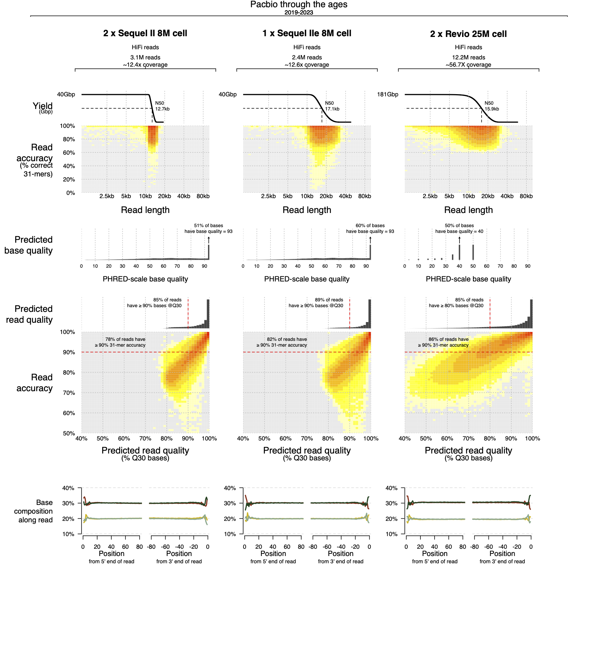
Read length comparison
Simplex reads
Duplex reads
about 5% of total reads
Nanopore R10.4.1
Pacbio Revio
Pacbio reads are shorter, on average
than nanopore reads.
About 10-20kb long

Slide 10
Base quality comparison
E.g. bq 40 predicts 1 error per 10,000 bases
Simplex
Duplex
(~5% of total reads)
Nanopore
R10.4.1
!
bq 90 predicts 1 error per billion bases
Pacbio base qualities are similar to nanopore simplex but compressed into discrete set of values to make the files smaller.
Pacbio
Revio

Slide 11
Two ways to measure error rates
1. Measure kmer accuracy using a set of known true kmers
2. Measure base accuracy based on alignment to a reference

Slide 12
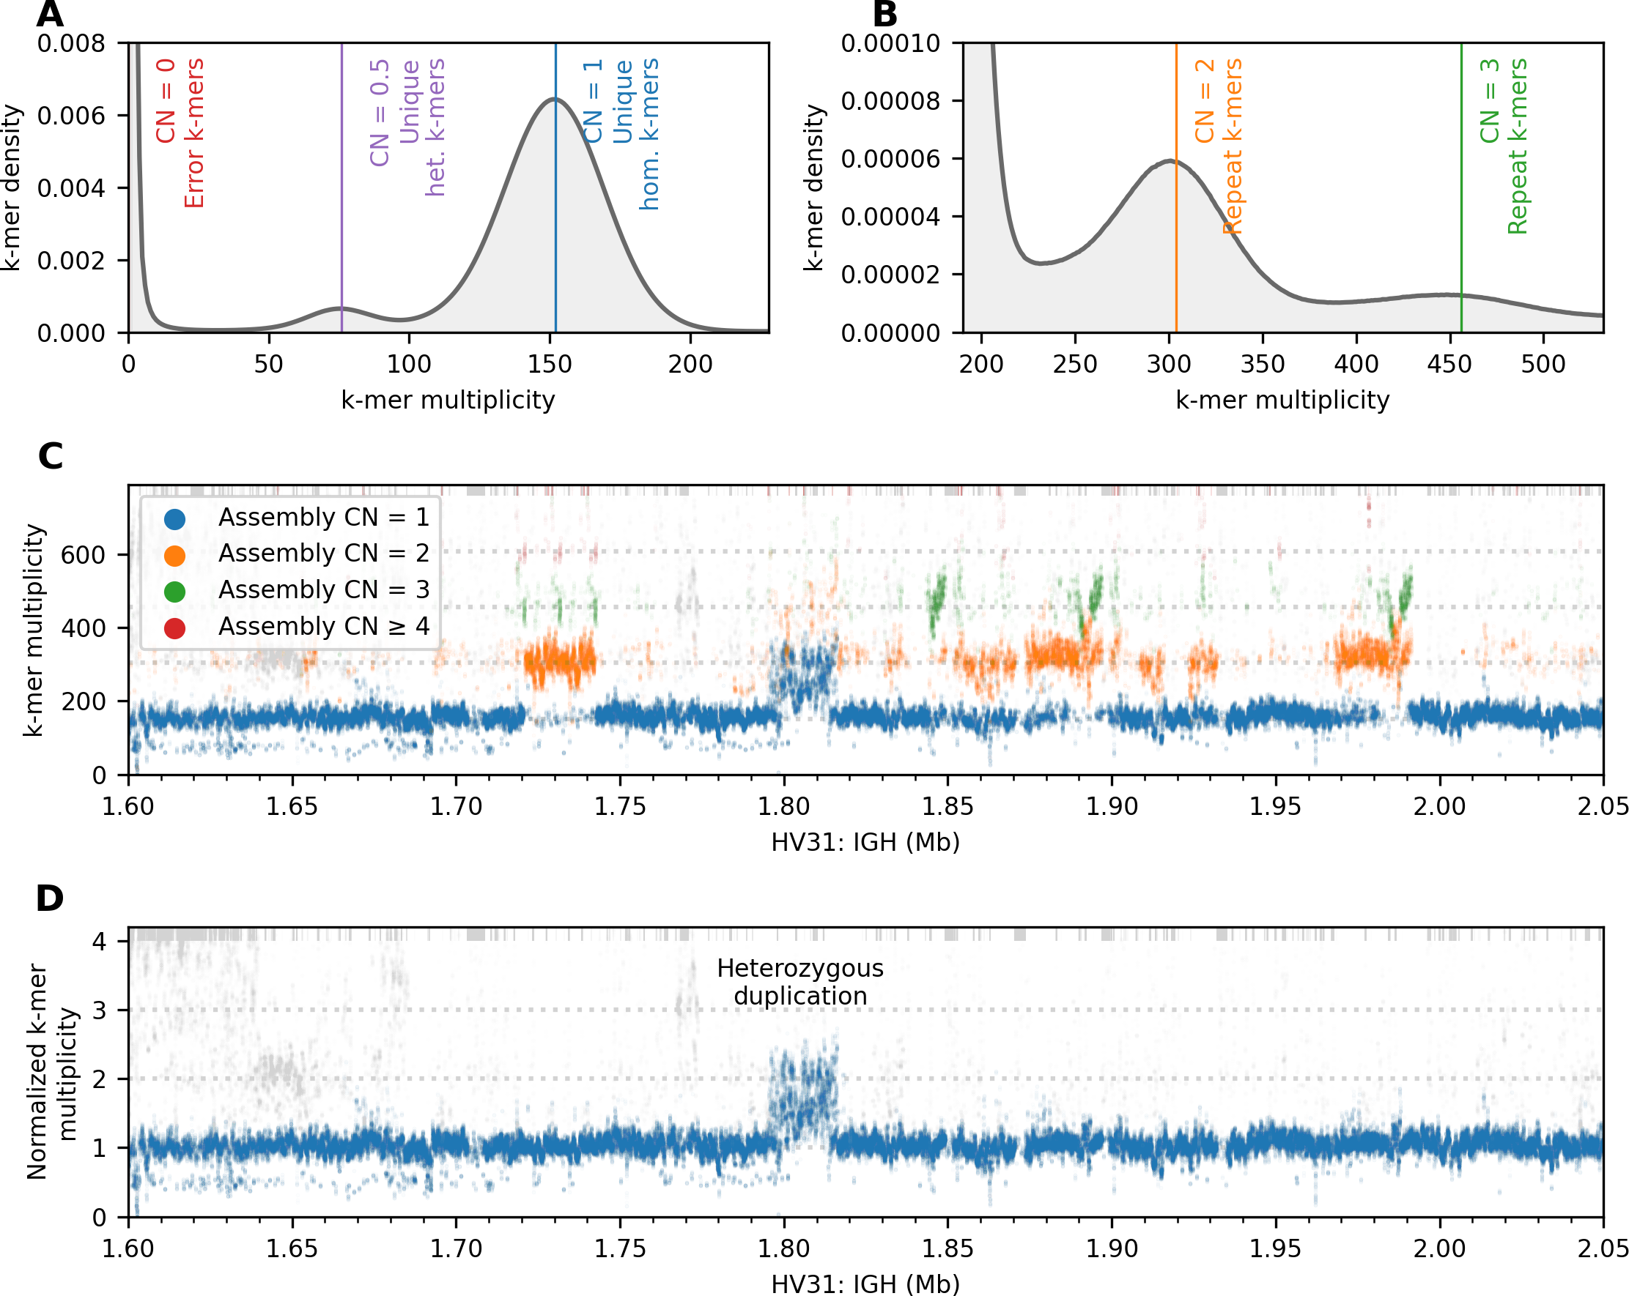
Measuring kmer accuracy
Method: learn the set of true HV31 k-mers from short reads…
Histogram of k-mer multiplicity observed in Illumina, MGI, MGI CoolMPS, 10X and Sequel II data.
…and for each long read, count the number of true HV31 kmers (k=31)
* This histogram is mainly based on short reads, but also includes the 2019 Sequel II data.

Slide 13
K-mer accuracy vs. predicted accuracy
Nanopore simplex has a roughly linear relationship between the quality predicted by base quality scores (x axis) and the observed quality (y axis)
…as measured by accurate kmer rates.
% correct 31-mers
Still about 20% of reads are poor quality.
% bases >= Q30
Nanopore R10.4.1 (simplex)

Slide 14
K-mer accuracy vs. predicted accuracy
% correct 31-mers
% bases >= Q30
% bases >= Q30
Nanopore R10.4.1 (simplex)
Nanopore R10.4.1 (duplex)

Slide 15
K-mer accuracy vs. predicted accuracy
Good duplex reads
% correct 31-mers
Bad duplex reads
% bases >= Q30
% bases >= Q30
Nanopore R10.4.1 (simplex)
Nanopore R10.4.1 (duplex)

Slide 16
K-mer accuracy vs. predicted accuracy
Good duplex reads
% correct 31-mers
Bad duplex reads
Contaminant reads
Contaminant reads
% bases >= Q30
% bases >= Q30
Nanopore R10.4.1 (simplex)
Nanopore R10.4.1 (duplex)

Slide 17
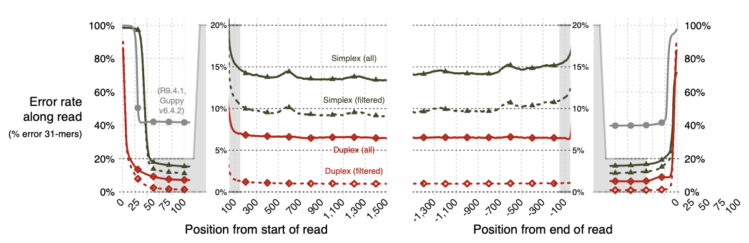
Accuracy along the read

Slide 18
Accuracy along the read
R10.4.1 is better than R9.4.1, especially after filtering.
Filtered duplex data has stupendously low error rates across most of the read.
Prominent read-end artifacts due to adapters (that might not be completely removable)
(Also, note the weird error bumps every 600bp…)

Slide 19
K-mer accuracy vs. predicted accuracy
K-mer accuracy (% correct 31-mers)
Predicted read quality
Nanopore R10.4.1
simplex
Pacbio Revio
Measuring predicted quality as: % bases >= Q30

Slide 20
K-mer accuracy vs. predicted accuracy
K-mer accuracy (% correct 31-mers)
Predicted read quality
Nanopore R10.4.1
duplex
Pacbio Revio
Measuring predicted quality as: % bases >= Q30

Slide 21
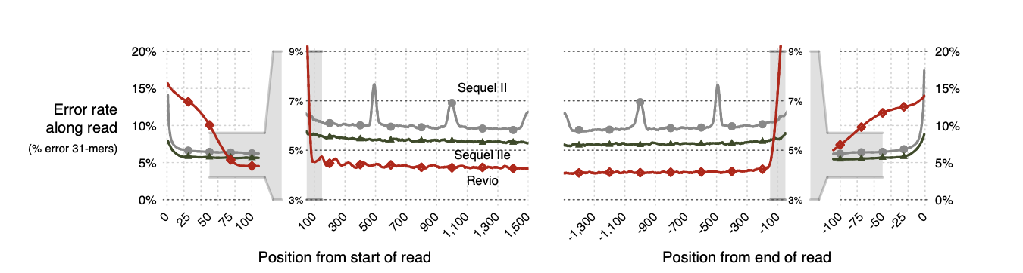
Accuracy along the read
Our Revio data also shows elevated rates at the end of reads - !!
But improves upon Sequel Iie across most of the read length
(Meanwhile our older Sequel II data has weird, unexplained ‘bumps’ every 500bp.)

Slide 22
Accuracy along the read
Error rates comparable to some Illumina data
Though some short-read datasets are better

Slide 23
Summary
Nanopore R10.4.1 data improves over R9.4.1 data.
Nanopore still noisy and has a few artifacts
Pacbio Revio also improves over Sequel IIe across most of the read
Nanopore duplex reads are somewhat comparable to Pacbio reads – maybe better after filtering, but are only 4-5% of data
Both platforms have annoying-looking read-end effects.
Alternate approach: align to a reference sequence, mask out true variation and repetitive sequence
We use T2T assembly, mask out SNPs, INDELS, and SVs from HV31 data, and satellite arrays, segdups, repeat-masked elts.

Slide 24
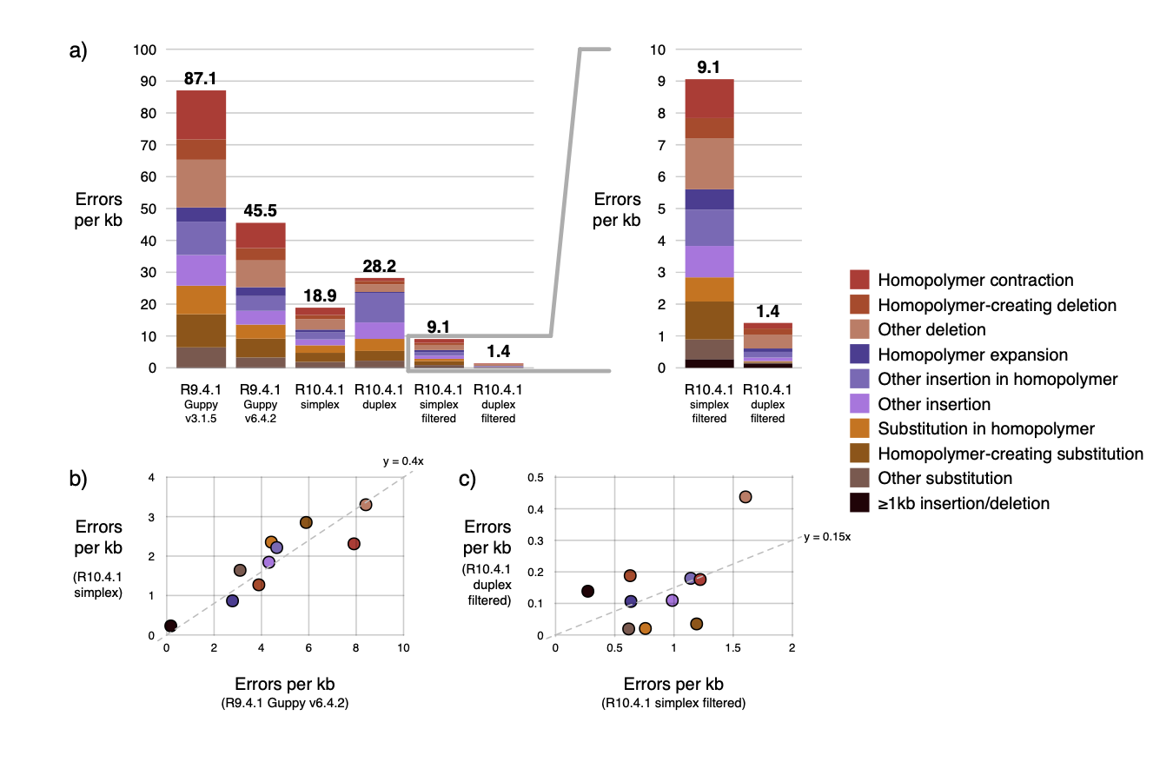
Nanopore
Errors per kb
Duplex
Duplex
Duplex
R9.4.1
(older and new basecalls)
R10.4.1
(all reads)
R10.4.1
(filtered)
R10.4.1
(filtered)

Slide 25
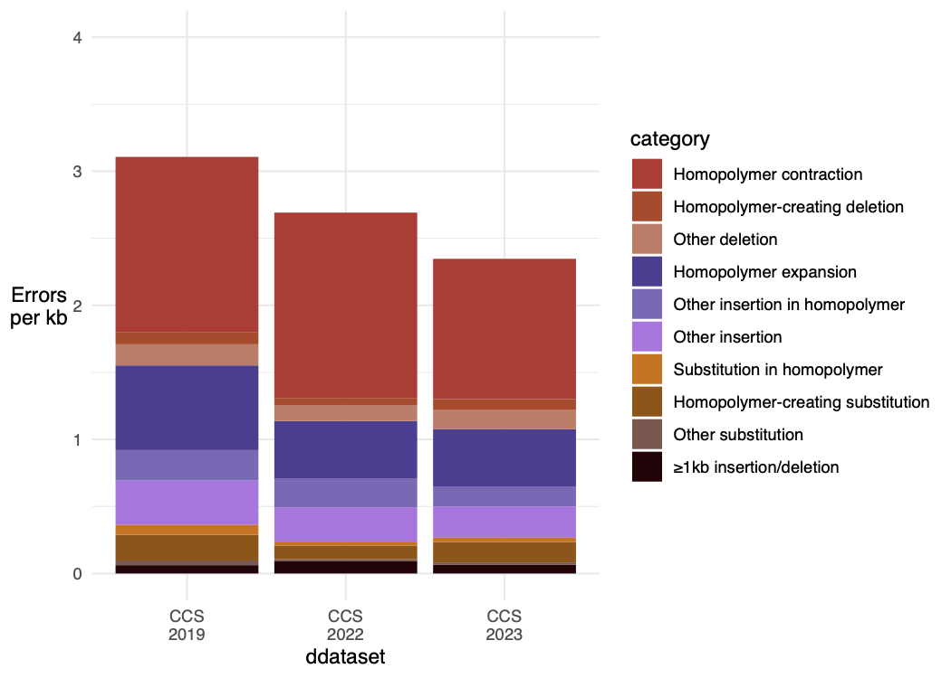
Nanopore
Pacbio
3.1
3
2.7
2.3
2
Errors per kb
Duplex
Duplex
Duplex
1
0
R9.4.1
(older and new basecalls)
R10.4.1
(all reads)
R10.4.1
(filtered)
R10.4.1
(filtered)
Revio
Sequel IIe
Sequel II

Slide 26
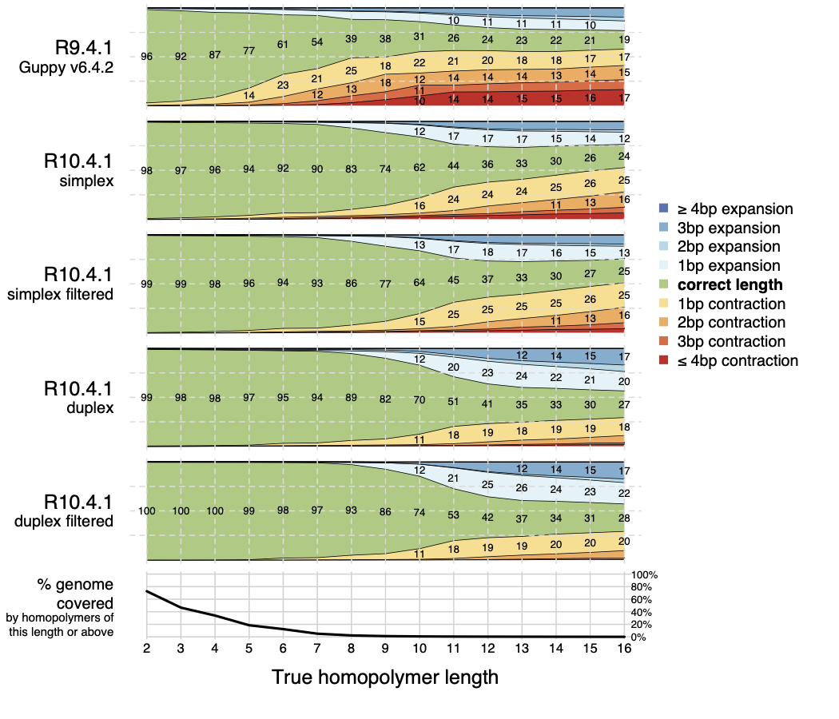
R9 pore size
Nanopore homopolymer length calling still drops off above pore size…
(but R10 pore size is larger)
R10 pore size

Slide 27
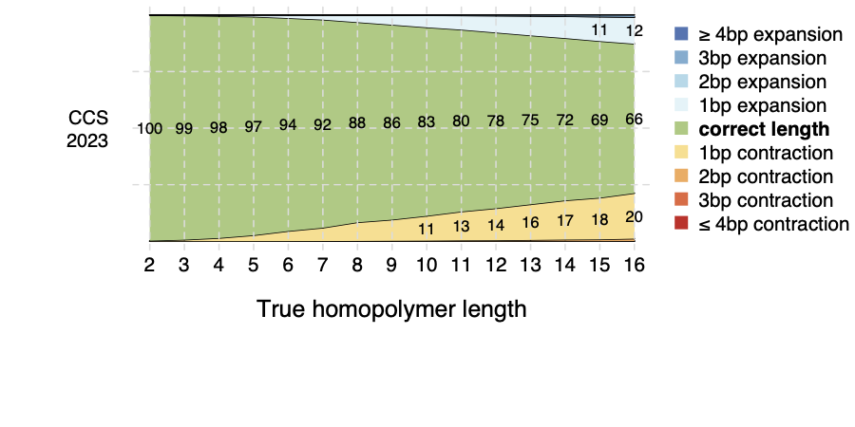
R9 pore size
Nanopore homopolymer length calling still drops off above pore size…
(but R10 pore size is larger)
Pacbio calls longer homopolymers better
still only ~60-70% accuracy for longest lengths
Pacbio
Revio
R10 pore size

Slide 28
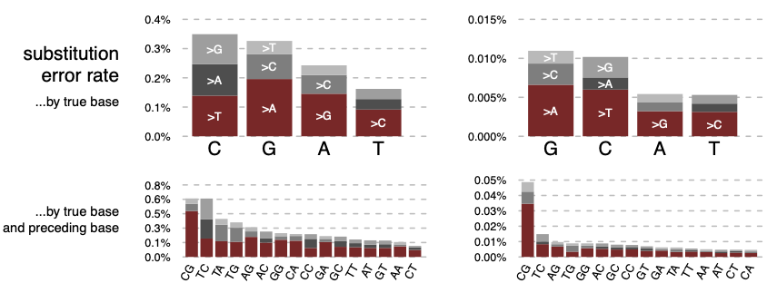
Subtle substitution biases are also present
Nanopore tends to make transition-like errors
(A<->G and C <-> T).
CpG sites appear to have a particularly high substitution rates.
But the absolute rate is still low.

Slide 29
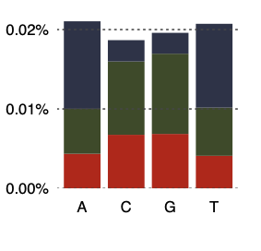
Subtle substitution biases are also present
Simplex
Duplex
Nanopore makes substitutions of C and G bases, and tends to make transition-like errors (A<->G and C <-> T).
CpG sites appear to have a particularly high substitution rates.
But the absolute rate is still low.
Pacbio
Pacbio makes more substitutions at A and T bases and tends to miscall to A or T.
T
A
A
T
C
G

Slide 30
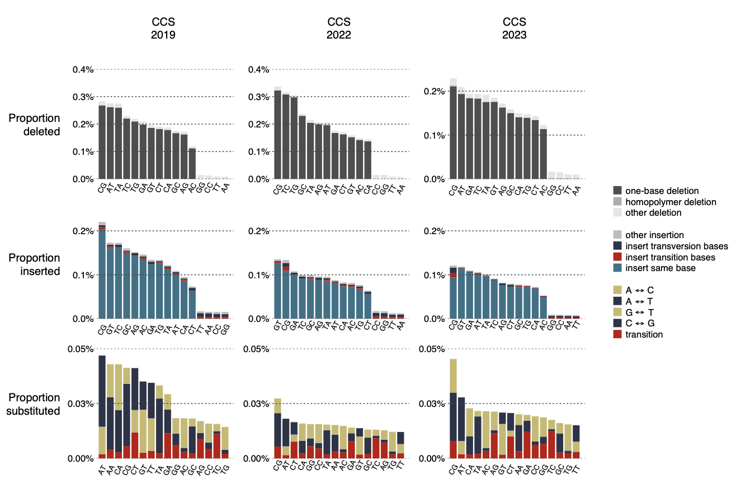
Subtle substitution biases are also present
T
T
C
C
A
C
T
T
Moreover both platforms appear to have elevated substitution rates at CpG sites
T
A
A
A
A
G
T
A
A
G
T
A
G
A
A
G
T
A
A
C
G
T
T
A
A
C
G
C
C
G
T

Slide 31
Summary
New revisions of ONT and Pacbio data are both fantastic.
Nanopore requires more downstream work to filter / process.
Duplex reads look very exciting, if low throughput can be overcome.

Slide 32
Costs
For this experiment we 5 Promethion flowcells and 2 Revio SMRT cells were used.
For ONT, the list cost places the consumables cost at £2,700 - £4,050 flowcell cost, depending on order volumes, plus possibly £500 for library reagents. However you might only need 3 flowcells with current version (because it runs at a faster rate), so perhaps £2,120 - £2,930 in total
For Pacbio, it’s a bit unclear to me but two flowcells might cost ~£2,000 with library prep on the order of £500 (I think - very ballpark.), so £2,500 in total.
In other words - the costs look very similar to me.
Note these costs do not include equipment, service, personnel or additional reagent costs.

Slide 33
Genome assembly application 1

Slide 34

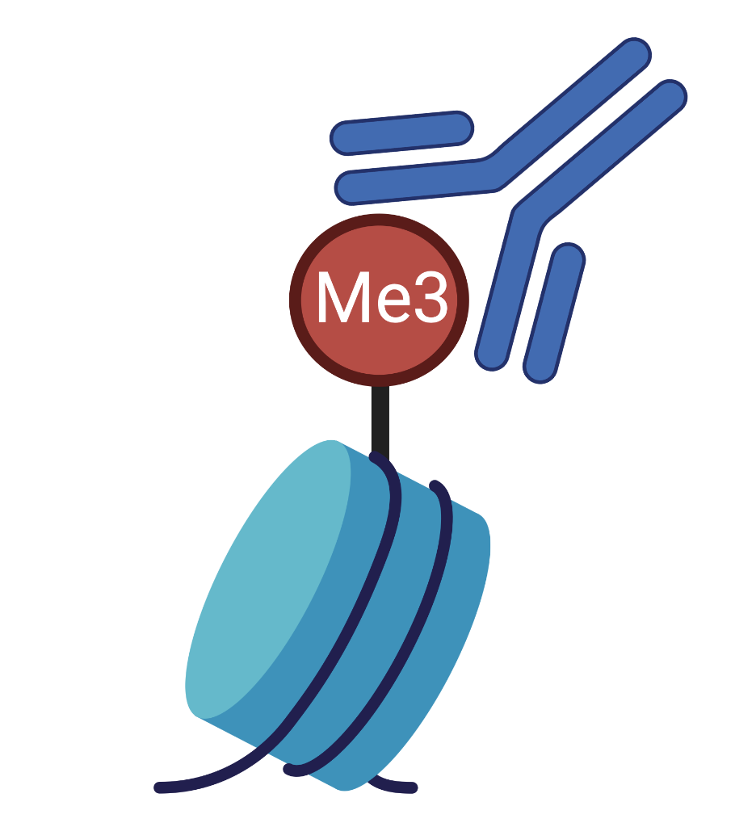
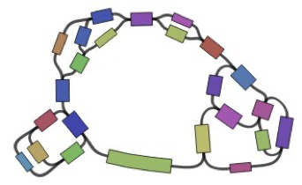


A haplotype-resolved assembly with functional data
PacBio Sequel II/IIe
ONT R10.4.1
Jia-Yuan Zhang
RNA-seq
(expression)
Verkko
Methylation
Align and resolve phase
ChIP-seq
(For histone modifications)
Multiple approaches
(BubbleGun, Linked reads, kmer approach), WhatsHap, HapCut2
ATAC-seq
(detects open chromatin)
Phased ‘omniome”
reflecting immune cell types

Slide 35
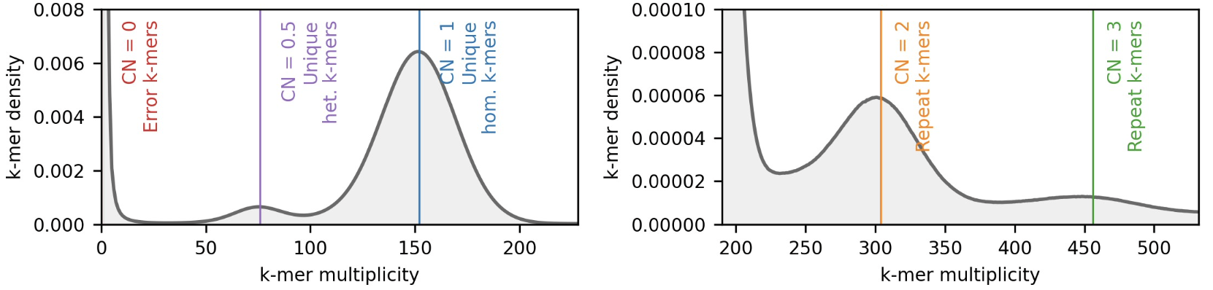
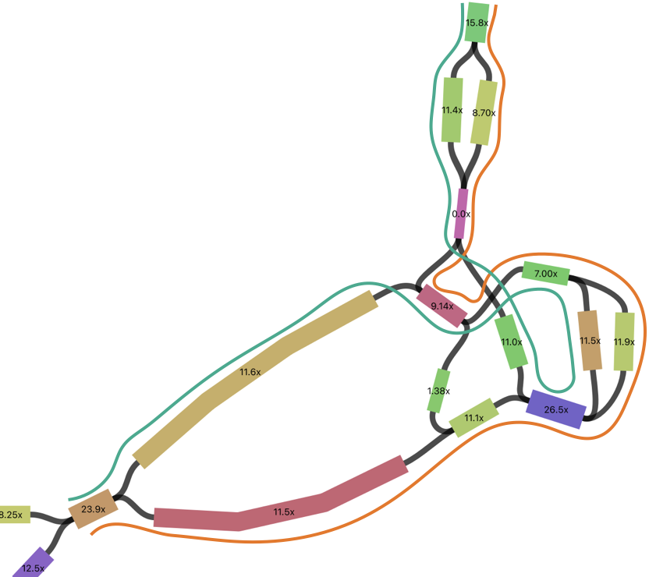
Jia-Yuan Zhang
Example: a segmental duplication at TCAF1/2 locus
Not fully resolved in the Verkko assembly graph.
Use an empirical model of the k-mer distribution to probabilistically resolve the most-likely pair of haplotypes.

Slide 36
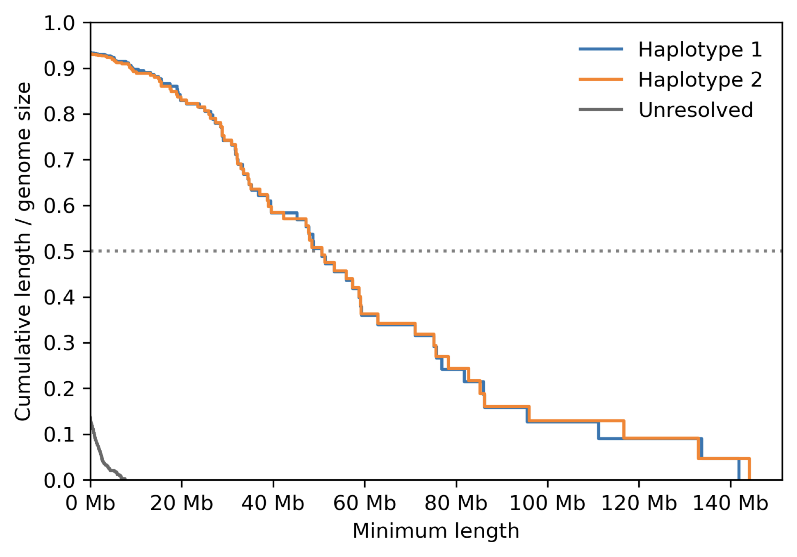
A ~50Mb ‘phased’ NG50
(50% of assembly bases are in phased contigs of 50Mb or greater)

Slide 37
Genome assembly application 2: resolving malaria structural variants involved in host-parasite interactions

Slide 38
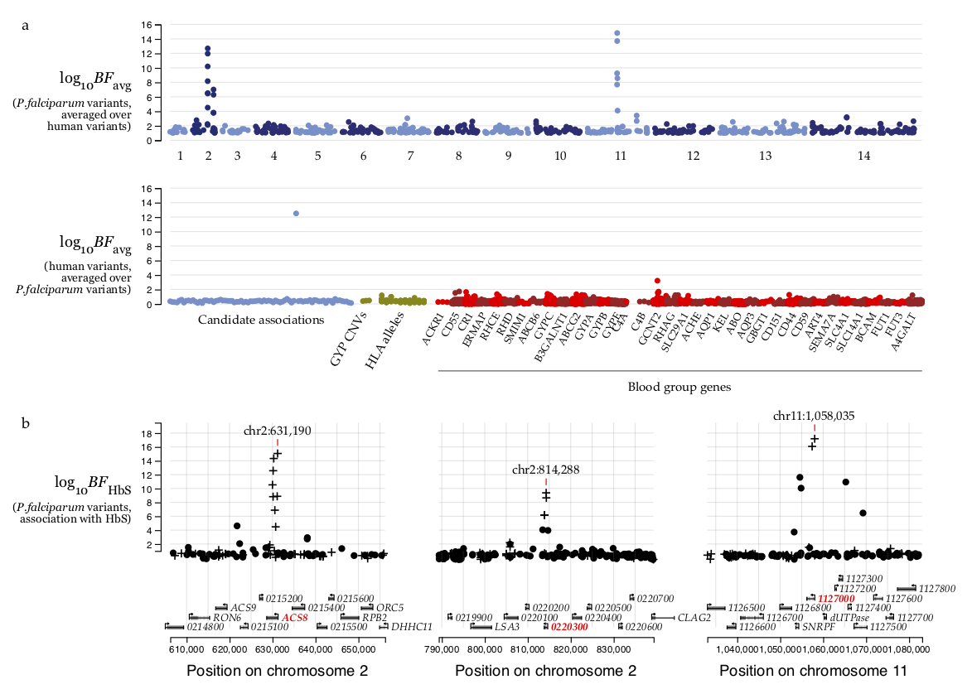
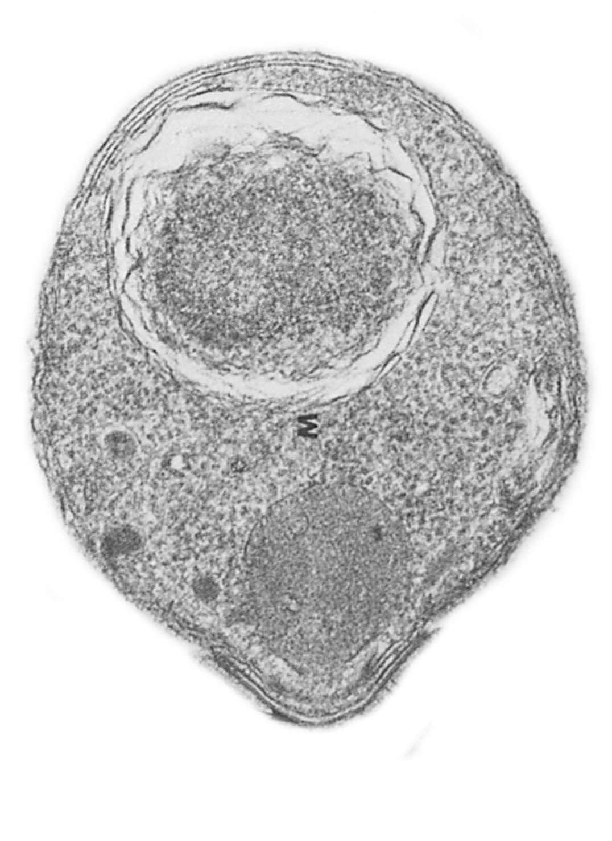
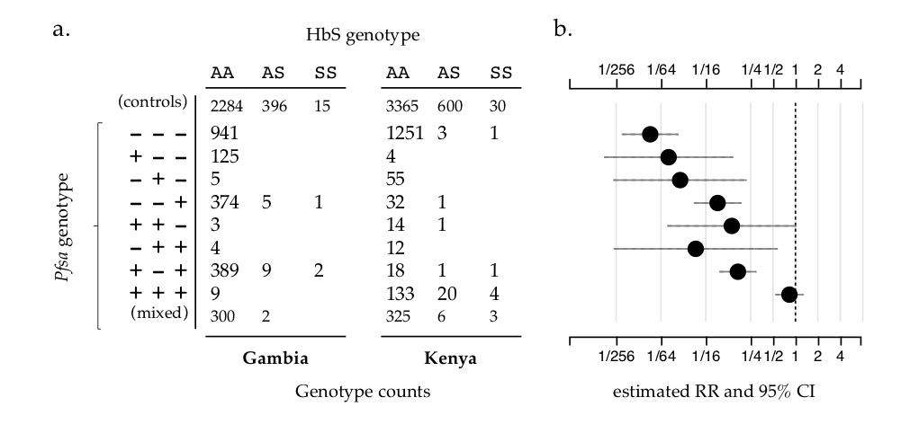




Three regions of the Pf genome are associated with sickle hamoglobin
Evidence for association
for P.falciparum variants
(averaged over human variants)
P.falciparum genetic variants
Pfsa3
Relative risk of HbS
by Pf genotype
Pfsa2
HbS appears to give very strong protection against reference-like parasites, but maybe hardly any against + + + parasites
Pfsa1
$$RR=0.012$$
Pfsa genotype
- = reference allele
+ = HbS-associated allele
$RR=0.0$9
$$RR=0.17$$
$$RR=0.83$$

Slide 39
Evidence for association
for P.falciparum variants
(averaged over human variants)
Pfsa3
The top SNPs are non-synonymous changes.
However they also appear to be linked to a surrounding structural variant, and are associated with increase transcription.
duplicated segments
Evidence for association
for P.falciparum variants
with HbS
+ + + parasite
deleted segments
Reference parasite
39

Slide 40
Attempt 1: Nanopore-based amplicon sequencing
Annie Forster
Jason Hendry
Mariateresa de Cesare
Anna Jeffresy

Slide 41
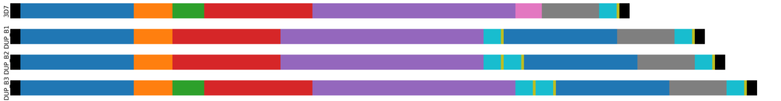
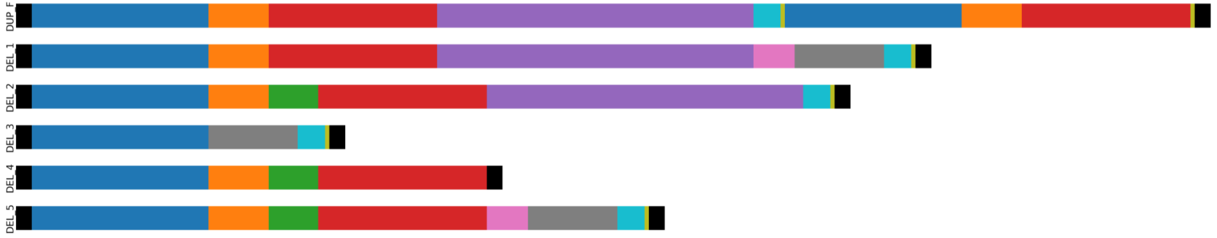
3673bp
2
3
4
5
6
7
8
9
3863bp
3359bp
5286bp
3359bp
5595bp
Analysis of short read data (MalariaGEN PF6) revealed there are multiple structural types segregating.
3673bp
5595bp
3359bp
1015bp
4766bp
3863bp
3038bp
3673bp
1015bp
3673bp
1867bp
Annie Forster
Nanopore amplicon sequencing:
Jason Hendry
Mariateresa de Cesare
Anna Jeffreys
3A
3B
3X

Slide 42
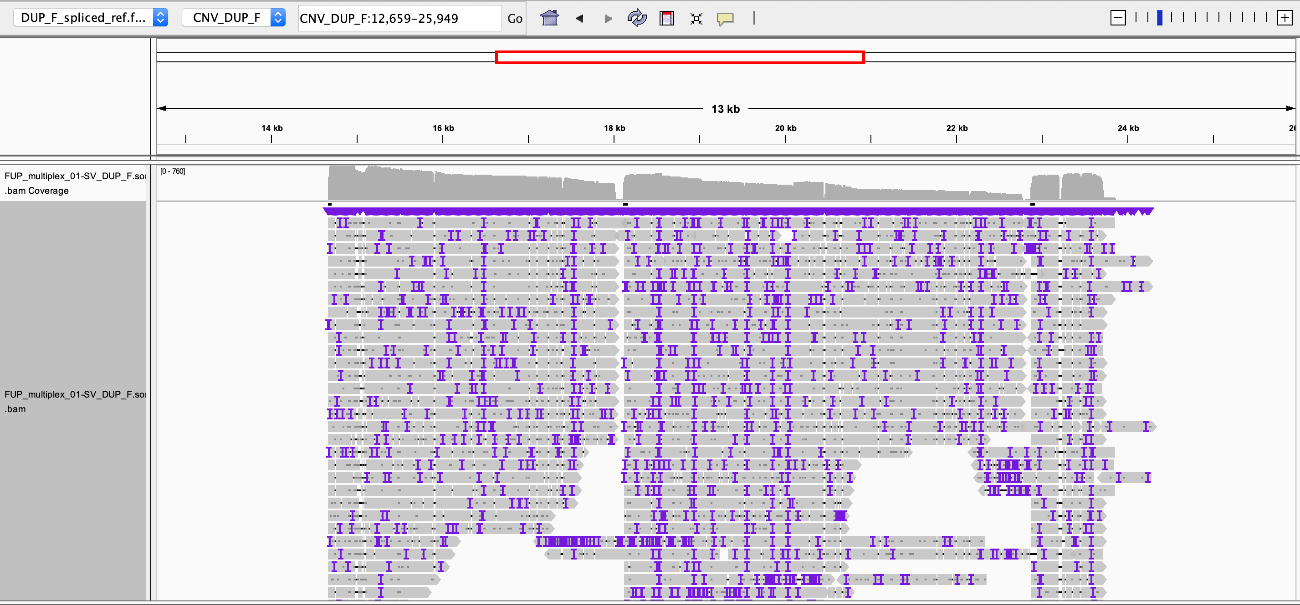
FUP_multiplex01 aligned to a mock-up DUP_F reference. Looks like there are three fragments as predicted! It's a bit difficult to count length but roughly they seem to be...
1: 3350bp
2: 4651bp
3: 979bp?
Predicted lengths were:
Pfsa3A – 3,359bp
Hybrid – 4,766bp
Pfsa3B – 1,015bp
2
3
5
6
9
2
3
5

Slide 43
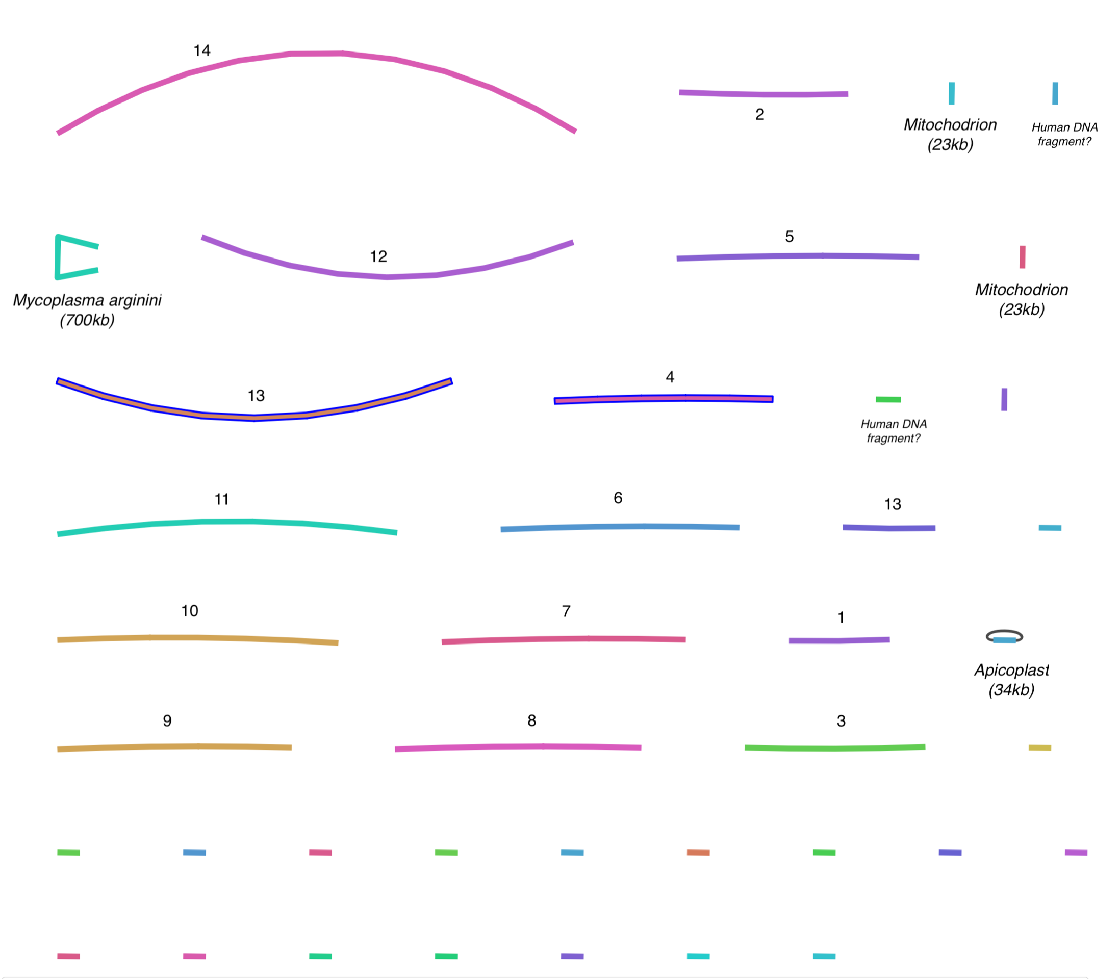
2nd attempt: Pacbio whole-genome sequencing
3D7
FUP-H
4 Kenyan parasites
2 Gambian parasites
1 parasite from single-cell sorting
?
Carried out by James Docker and Amy Trebes, Oxford Genomics Centre for a test of new fragmentation protocol.
Worked amazingly well
Alex Macharia, Patrick
Parasite from blood culture Kilfi
Process: hifiasm -> BandageNG

Slide 44
2nd attempt: Pacbio whole-genome sequencing
3D7
FUP-H
4 Kenyan parasites
2 Gambian parasites
1 parasite from single-cell sorting
Carried out by James Docker and Amy Trebes, Oxford Genomics Centre for a test of new fragmentation protocol.
Worked amazingly well
Hifiasm -> BandageNG

Slide 45
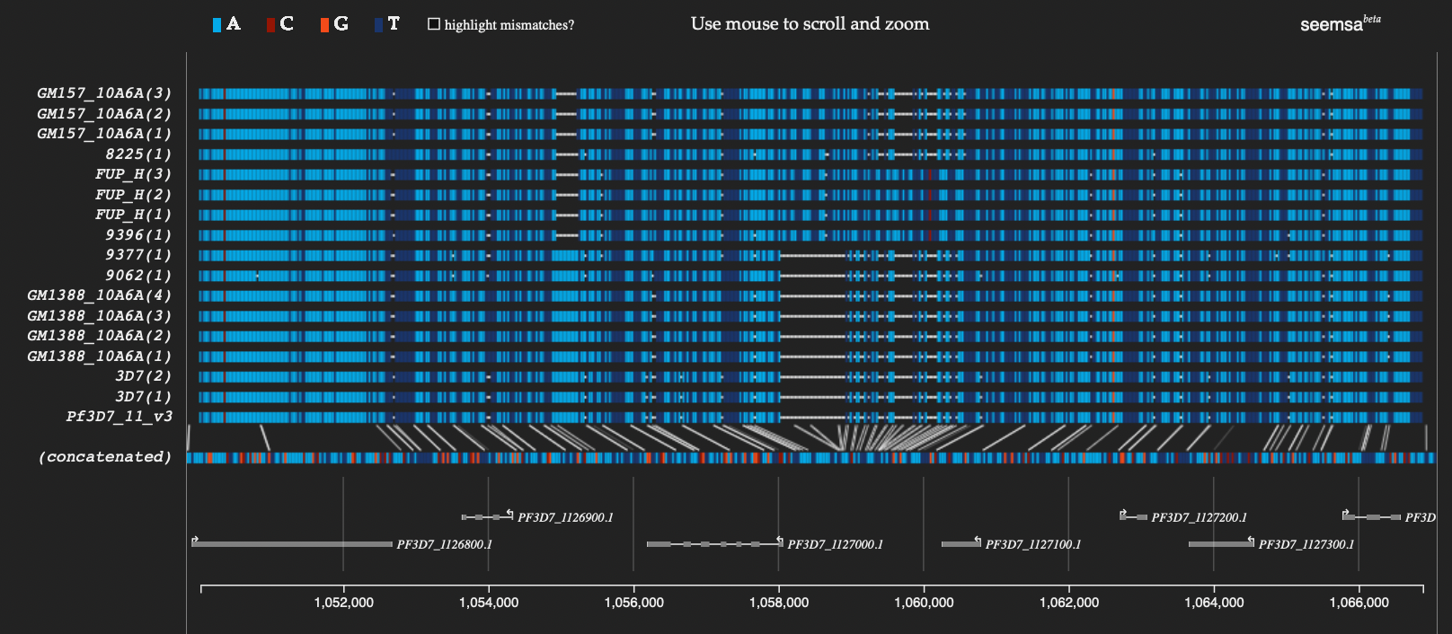
Multiple sequence alignment of P.falciparum whole genomes

Slide 46

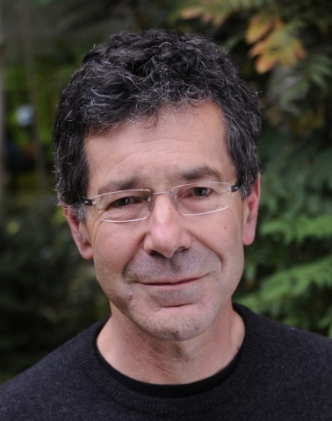

Acknowledgments
KEMRI-Wellcome
Kilifi, Kenya
Alexander W. Macharia
Patrick Ombati
Silvia Kariuki
CIMR:
Julian Rayner
Riki Aydeniz
Eirini Maria Lampraki
Mike Eberle
Cillian Nolan
Simon Mayes
Philipp Reschender
Tonya McSherry
John Todd
Julian Knight
Andrew Brown
Tony Cutler
Connor Davison
Jia-yuan Zhang
David Smith
Annie Forster
Qijing Shen
Jason Hendry
Hitomi Kuwabara
David Buck
Paolo Piazza
Helen Lockstone
MalariaGEN
…and HV31.
Dominic Kwiatkowski
Ellen Leffler
Kirk Rockett
OGC:
Amy Trebes
James Docker
David Buck
“We thank the patients and staff at the Paediatric Department of the Royal Victoria Hospital in Banjul, Gambia, and at Kilifi County Hospital and the KEMRI-Wellcome Trust Research Programme, Kilifi, Kenya for their help with this study.”
Dominic
Kwiatkowski
1953-2023
Thanks!

