Slide 1



Bioinformatics
CORE
Introduction to Next-Generation Sequencing:
from sequencing to variant calling
1st November, 2021
Taught module for DPhil programme in
Genomic Medicine and Statistics
Organised and delivered by Bioinformatics Core at the

Slide 2
Genomic Sequencing Platforms
[MORNING SESSION]

Slide 3
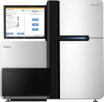

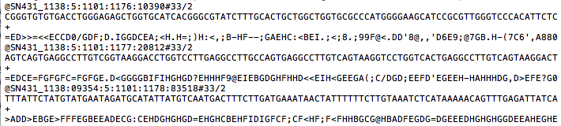
Sequencing At a Glance
The process of determining a sequence of nucleotides and producing a digital representation (a.k.a a read sequence) for further analysis.
  In a perfect world, we could sequence entire chromosomes in real-time and get a single error-free readout for each chromosome as our output.
  (not the world we live in)
A FASTQ file (more on those later…)

Slide 4
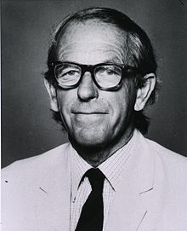
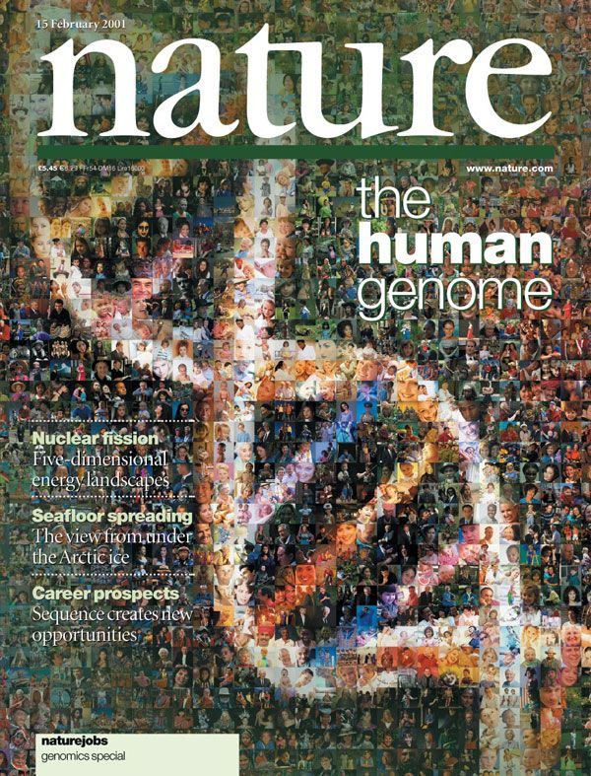
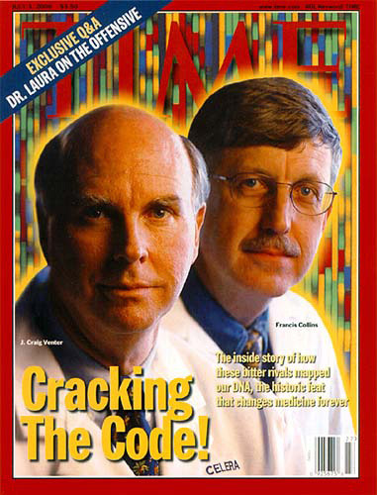
Early Sequencing
For nearly 40 years, the Sanger method was the dominant approach to sequencing.
  Originally required a lot of lab work,
  progressively automated.
  Various organisms sequenced
  for the first time using the Sanger
  method, including us Homo sapiens!
    The Human Genome Project (HGP)
    was begun in 1990 and took about
    13 years to ‘complete’.
      Today multiple genomes can be sequenced in a matter of days! (more on that later…)
Twice Nobel Prize winner
Frederick Sanger
Notes:
Why ‘complete’? Until recently, all iterations of the Human Genome Reference contained gaps, regions of low complexity or repeats that were difficult to sequence. Over the years, with each subsequent version of the Human Genome Reference, these gaps have been painstakingly filled.
Scientists working under the banner of the telomere-to-telomere consortium (T2T) have since gone on to complete the entire human genome, partly helped by improving long-read sequencing technologies (see for example: https://youtu.be/fOLlXSu5k14)
For more on the history of the human genome see interviews from key players at https://www.genome.gov/leadership-initiatives/History-of-Genomics-Program/oral-history-collection and Craig Venter’s autobiography ‘A Life Decoded: My Genome, My Life’.

Slide 5

How does Sanger work? 1/2
Base incorporation stops when labelled ddNTP is added.
How can we determine the sequence of this fragment?
Complement with a single nucleotide.
CCAGCTGATCAAGTA
PCR amplified and denatured sequences
+
Mixture of dNTPs and fluorescently-labelled ddNTPs
Base incorporation continues in unlabeled strand.
Complement with two nucleotides.
Complement with three nucleotides.
etc…
This process gives rise to multiple incomplete complement fragments of various lengths.
Length is a proxy for the position at which the chain terminating ddNTP was incorporated.
dNTP = Deoxynucleoside triphosphate
ddNTP = Dideoxynucleoside triphosphate (chain-terminating)
Notes:
Original method used only one type of fluorescence. To distinguish bases, four separate solutions had to be created, each containing only one type of ddNTP.

Slide 6
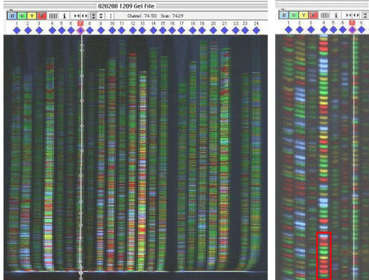
How does Sanger work? 2/2
Complement fragments are passed through a capillary tube using electrophoresis, their final ordering determined by size.
  The smaller a fragment the faster the pass through.
  ddNTP fluorescence captured via laser excitation.
TACTTGATCAGCTGG
Notes:
All automated now using machines like ThermoFisher’s Genetic Analyzer (for a visual example, see next slide)

Slide 7
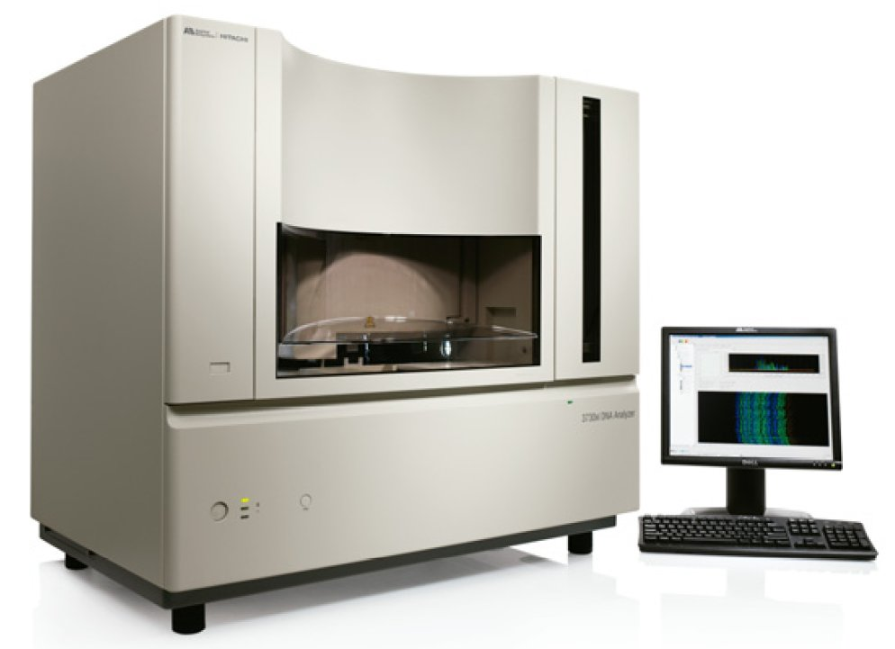
Sanger method’s success
To this day, Sanger’s single read per base quality remains unmatched.
  For a fragment spanning ~500 base pairs (bp), per base accuracy reaches 99.999%
    1 error per 100 000 bases.
  Fragments can now reach up
  to 1000 bp in length.
How can you sequence the 3 billion base pairs of the human genome with technology that only takes fragments of up to*1000bp at a time?
*and originally much less than
Notes:
Very important technicality to note here: we are talking about single read per base quality and not per base quality over several reads. This makes all the difference when using other platforms such as those described as next-generation sequencing or the more recent Pacbio long-read sequencing platforms.
Nevertheless, Sanger is still useful for things such as validation for which a single read is generated for a particular fragment.

Slide 8
Clone-by-clone Sequencing
The HGP began with clone-by-clone sequencing:
  Genome broken into large 150 kbp fragments, the position of each fragment carefully recorded.
    Fragments were clonally amplified and then broken into smaller overlapping fragments which could be sequenced, themselves clonally amplified.
      Overlapping fragments enabled fairly straightforward assembly.
genome
-laborious
-costly
-slow
…
-orderly
c.a. large fragments
c.a small fragments
c.a = clonally amplified

Slide 9
Shotgun Sequencing
A quicker and cheaper approach, developed during (and speeding up) the HGP effort, is shotgun sequencing.
  Genome directly broken into small overlapping sequence-ready fragments, all clonally amplified.
    No ordering conserved in the process.
      Computational biologists now have a big problem to solve ➔ mapping all the reads back to the genome.
-cheaper
-faster
…
-assembly
challenging
genome
c.a small fragments
Which part of the genome did each read come from?!
Does read x align with read y?!

Slide 10
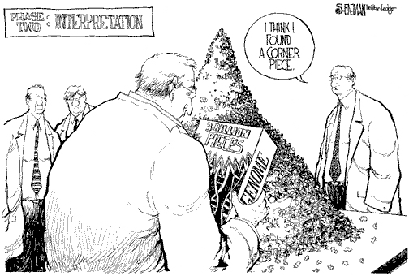
Assembly/mapping after shotgun

Slide 11
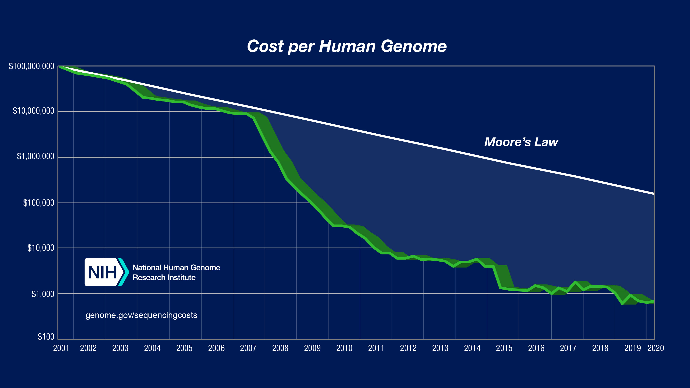
Next-generation Sequencing
Mid 2000s: several high-throughput/massively parallel sequencing (HTS/MPS) platforms released:
  the start of next-generation sequencing (NGS).
  What took 13 years to complete now takes days and costs around 1000$ in no small part thanks to
  these innovative
  new platforms.

Slide 12
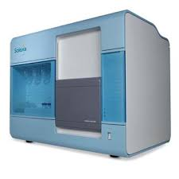
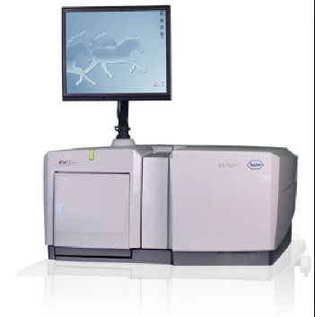
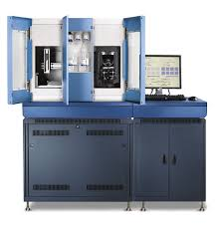
The First Three NGS Platforms
Next-generation sequencing (NGS) originally referred two three sequencing platforms:
2006
Solexa (now Illumina) Genome Analysis System
2005
Roche 454
2007
ABI SOLiD
Notes:
Elaine Mardis has several videos on the subject of next-generation sequencing technologies which have been refined year after year. Here is one of many examples of interest: https://youtu.be/v1DbcJD4Ry0

Slide 13
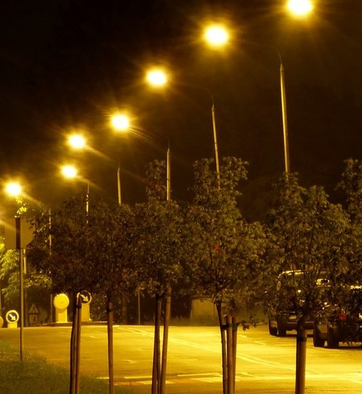

Innovations of NGS
NGS platforms (and their subsequent iterations) each use distinct biochemical processes to produce reads from shotgun sequencing, but they do have some attributes in common:
  PCR amplification is used to turn weak bioluminescent signals generated by a small fragment, into the strong signal of a cluster of identical fragments.
  Sequencing-by-synthesis
  https://youtu.be/fCd6B5HRaZ8

Slide 14
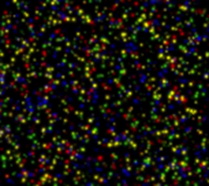
Limitations of NGS
While sequencing-by-synthesis makes high-throughput sequencing possible, it does place new constraints on read length and accuracy.
  Determining the bases of a sequence (a.k.a base calling) via bioluminescence has some pitfalls:
        Signals from clusters in close proximity can interfere with each other.
        Synchronicity between strands in a cluster is gradually lost (one big reason for short reads).
        The intensity of a signal naturally varies.
        A signal can be ambiguous when bases repeat
        (e.g. Did the machine detect C-C- or C-C-C- ?).

Slide 15
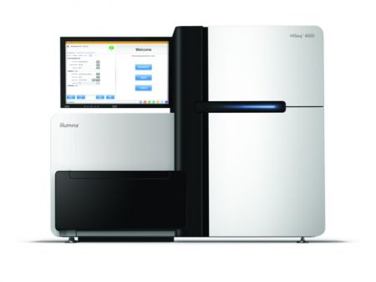
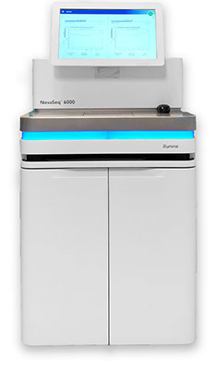
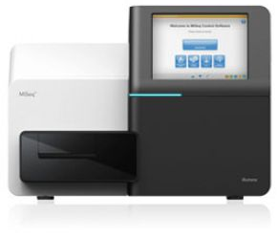
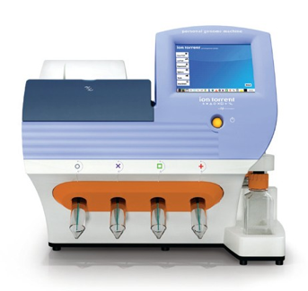
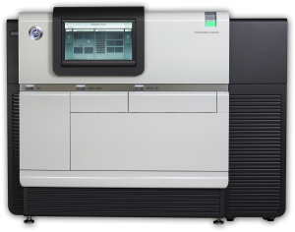
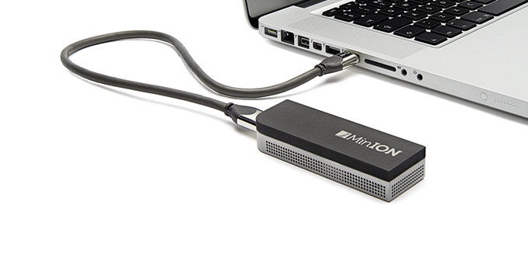
Sequencing Platforms since
Since the mid-2000s, NGS platforms have either been further refined or fallen out of favour.
  Illumina is the grand champion and now offers a wide range of platforms tailored to different throughput needs.
  New platforms have also sprung up to address some of NGS’ flaws (e.g. short reads). But, they have their own flaws (e.g. lower base qualities)
Notes:
To see more detailed comparisons between NGS technologies, see data collected by Albert Vilella: https://docs.google.com/spreadsheets/d/1GMMfhyLK0-q8XkIo3YxlWaZA5vVMuhU1kg41g4xLkXc/edit?usp=sharing
The latter technologies, originally referred to as third-generation technologies (but that term has fallen into disuse), have flaws of their own which explains why they haven’t replaced NGS platforms completely. Despite producing long reads when NGS platforms produce short reads, their accuracy still isn’t high enough for purposes like variant discovery. They are useful for other tasks, like finishing genome assemblies.
This might be changing with the PacBio Sequel II and its HiFi reads: https://www.pacb.com/smrt-science/smrt-sequencing/hifi-reads-for-highly-accurate-long-read-sequencing/

Slide 16
Sequencing Platform Comparison
 | Illumina (NGS) | Oxford Nanopore (3rd Gen)
Method | Sequencing-by-synthesis | Nanopore Sequencing
Read length | MiniSeq, NextSeq: 75-150 bp; MiSeq: 50-300 bp; HiSeq 2500: 50-250 bp; HiSeq 3/4000: 50-150 bp; HiSeq X: 150 bp | Dependent on library prep, not the device, so user chooses read length. (up to 500 kb reported)
Accuracy (single read not consensus) | 99.9% (Phred30) | ~92–97% single read
Reads per run | MiniSeq/MiSeq: 1-25 Million; NextSeq: 130-00 Million, HiSeq 2500: 300 million - 2 billion, HiSeq 3/4000 2.5 billion, HiSeq X: 3 billion | Dependent on read length selected by user
Time per run | 1 to 11 days, depending upon sequencer and specified read length. | Data streamed in real time. Choose 1 min to 48 hrs
Cost per 1 million bases (in US$) | $0.05 to $0.15 | $500–999 per Flow Cell, base cost dependent on experiment.
Advantages | Potential for high sequence yield, depending upon sequencer model and desired application. | Longest individual reads. Accessible user community. Portable (Palm sized).
Disadvantages | Equipment can be very expensive. Requires high concentrations of DNA. | Lower throughput than other machines, single read accuracy in 90% range.

Slide 17
Sequencing Data Concepts

Slide 18
Read Length
Read length is constrained by the sequencing technology used, but it does not vary within a particular run.
  A read is generated from part of one end of a DNA fragment. If the platform allows paired-end sequencing, two reads can be generated from either end of a single fragment.

Slide 19
Single-End/Paired-End Reads
From a DNA fragment, we can generate:
A single read from one end Reads from both ends
  Single-end read
Paired-end reads
Notes:
Paired-end is most likely what you will end up working with if you go down the genomics route.

Slide 20
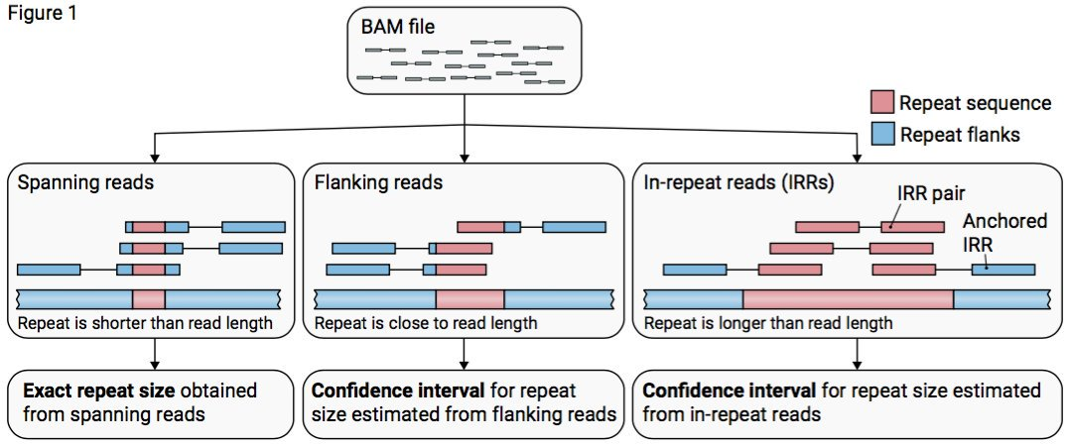
The Advantage of paired-end
Within a single run, the distance between paired-end reads does not vary and can therefore be use to resolve difficult repeat/low complexity regions.

Slide 21
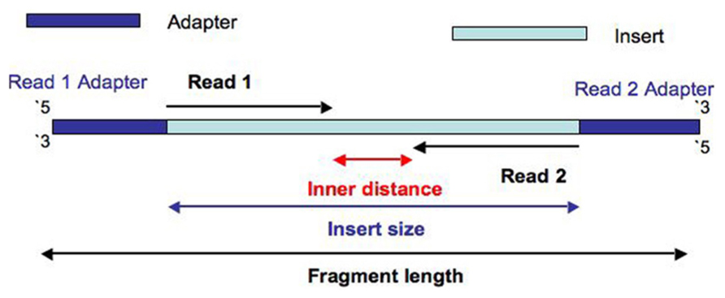
Fragment/Insert Size
Notes:
A fragment is composed of various sections, only some part of which gets turned into reads.

Slide 22
Understanding Sequence Reads
and Quality Control

Slide 23
FASTA File Format
One of the simplest sequence file formats for storing sequence data (ext: .fasta, .fa…).
  Contains at least one identifier line followed by a sequence (of any given length).
  It can contain several separate sequences stored one after the other, each with its own identifier
  (e.g. human genome reference, each sequence is a chromosome)
Let’s have a look at one recurring example:
Let’s download the latest Human Genome Reference
GRCh38

Slide 24
The Human Genome Reference
Since its first assembly, the human genome has seen 20 major updates.*
  The last 5 version are available through either of these portals:
  University of California Santa-Cruz
  https://genome.ucsc.edu
  (downloads>Humans>hg38>Full data set>hg38.fa.gz)
  Genome Reference Consortium
  https://www.ncbi.nlm.nih.gov/grc
  (human>GRCh38.p13 (latest minor release) FTP>GCA_000001405.28_GRCh38.p13_genomic.fna.gz)
*and many many more minor updates
Notes:
2003 first available assembly had about 15 000 gaps, current (hg38) has 875. This year a new sequence was obtained by the T2T consortium (T2T-CHM13) which truly is complete. A new version of the human genome reference could result.
Some efforts have been made to make the references stored at both portals match as much as possible. However, even for hg38 (which at least shares the same number on either portal, previous version was 37 and 19 depending on the portal!) there are some small differences. You should therefore absolutely work with one reference only for a given study, from alignment all the way through to variant calling and visualization. Other variations exist online. Some represent chromosomes with the prefix “chr”, others don’t. This is obviously a bit problematic and the source of many unnecessary errors.
Moving from one genome version to another is a difficult exercise. A lot of researchers still use the hg19 version of the genome despite hg38 having been available for years. Versions are not backward-compatible, the positions are sometimes wildly different. It is important not to mix them up or mix up resources meant for one version or another of the human genome (for example databases of known single nucleotide variants).

Slide 25
FASTQ File format
Builds on FASTA, but crucially adds a line for base call quality (ext: .fastq, .fq…).
  Base call quality is shown as a sequence of ASCII values, each single character value representing a (typically) double-digit number.
    Each value corresponds to the quality of the base directly above it in the DNA sequence.
  When handling sequencing data, this is likely the first file format you will encounter.
  (i.e. one sequence = one read from the sequencer)
Let’s take a look at an example!

Slide 26
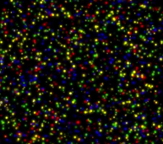
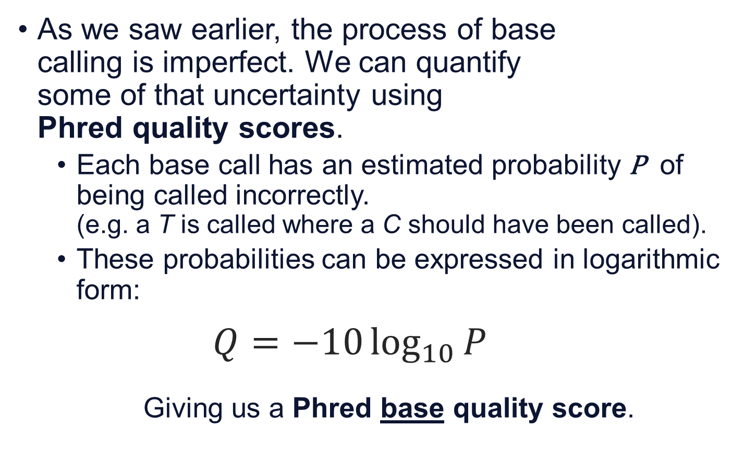
Phred base Quality Score 1/2
As we saw earlier, the process of base
calling is imperfect. We can quantify
some of that uncertainty using
Phred quality scores.
  Each base call has an estimated probability P of being called incorrectly.
  (e.g. a T is called where a C should have been called).
  These probabilities can be expressed in logarithmic form:
  $$Q=−10\log_{10}{P}$$
  Giving us a Phred base quality score.
Notes:
To learn some more about Phred quality scores, a ubiquitous measure in sequencing today, see original papers: https://doi.org/10.1101%2Fgr.8.3.175 and https://doi.org/10.1101%2Fgr.8.3.186

Slide 27
Phred base Quality Score 2/2
The conversion between score and probability is fairly intuitive.
Phred quality score | Probability of incorrect base call | Base calling accuracy
10 | 1/10 | 90%
20 | 1/100 | 99%
30 | 1/1 000 | 99.9%
40 | 1/10 000 | 99.99%
50 | 1/100 000 | 99.999%

Slide 28
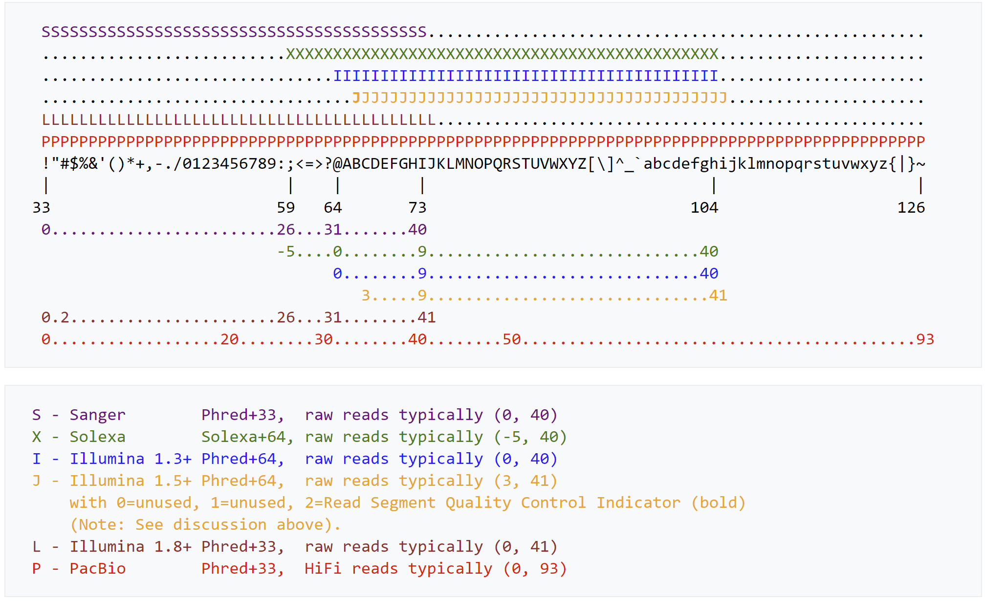
Phred+33 Encoding
These Phred quality scores are present in FASTQ files encoded in ASCII+(index for quality 0).
  Phred+33 now the standard.
  (i.e. a quality of 0 encoded by ASCII symbol 33 or ‘!’)
Notes:
For more information, the Wikipedia article on FASTQ is sufficiently exhaustive: https://en.wikipedia.org/wiki/FASTQ_format. The above figure comes from this page and is a reliable reference.

Slide 29

First Step: Quality Control
This is an absolutely crucial, unescapable step.
  Bad quality data lead to disappointing results (garbage in → garbage out).
Quality Controlled Reads
Raw Reads
Quality Checking
FastQC
Widely used for Illumina data because it’s fast. It works on a subset of reads.
http://www.bioinformatics.babraham.ac.uk/projects/fastqc/
PRINSEQ
Used for smaller datasets because it computes every sequence.
http://prinseq.sourceforge.net/

Slide 30


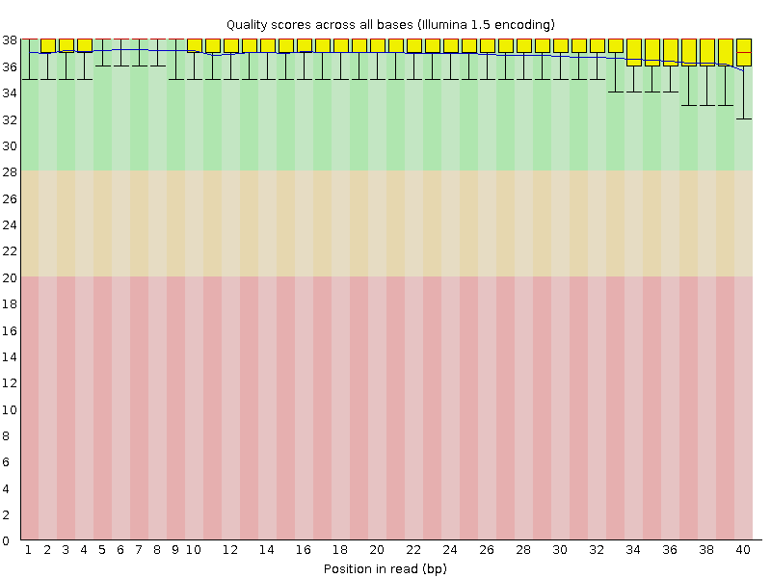
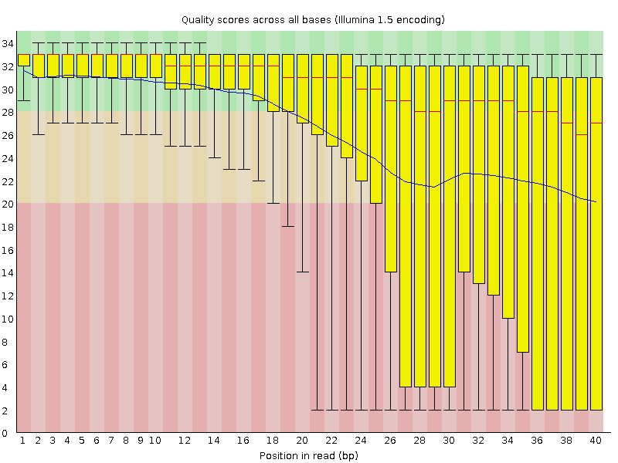
Per Base Sequence Quality

Slide 31


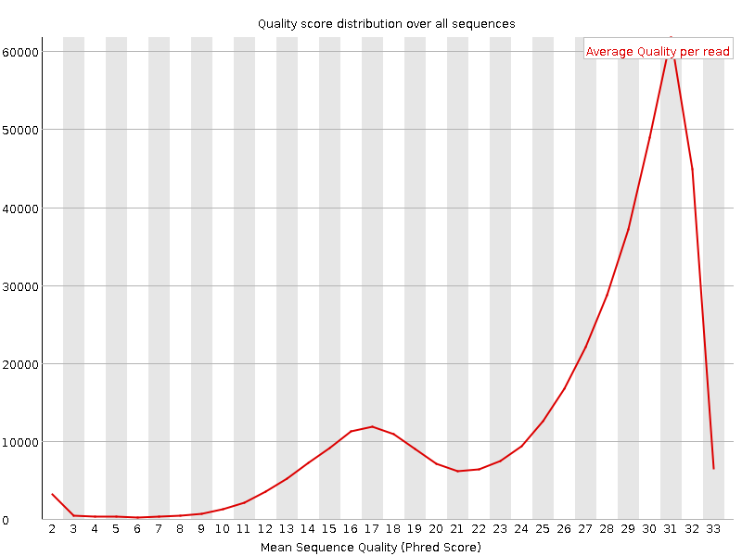
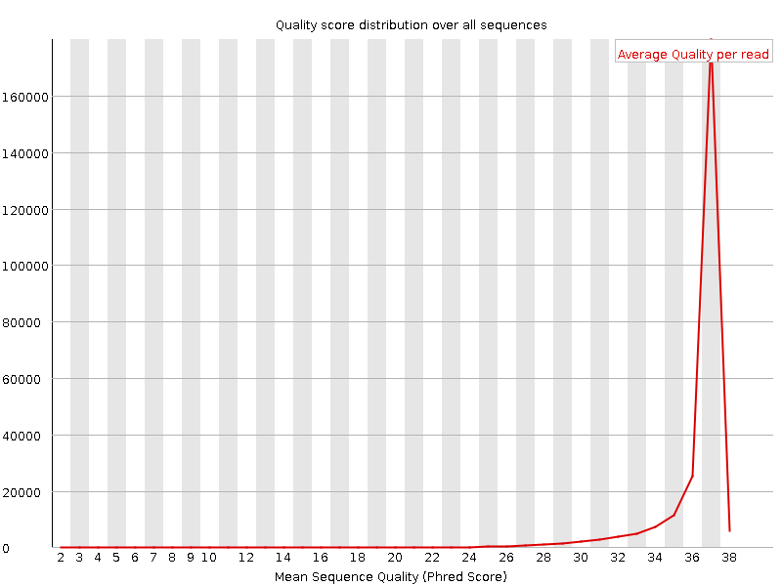
Per Sequence Quality

Slide 32
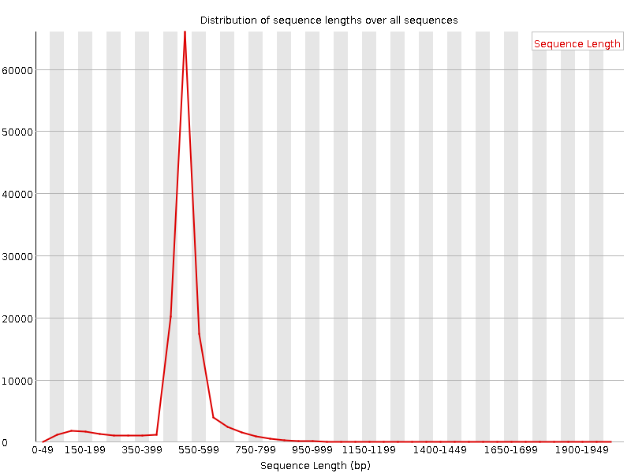
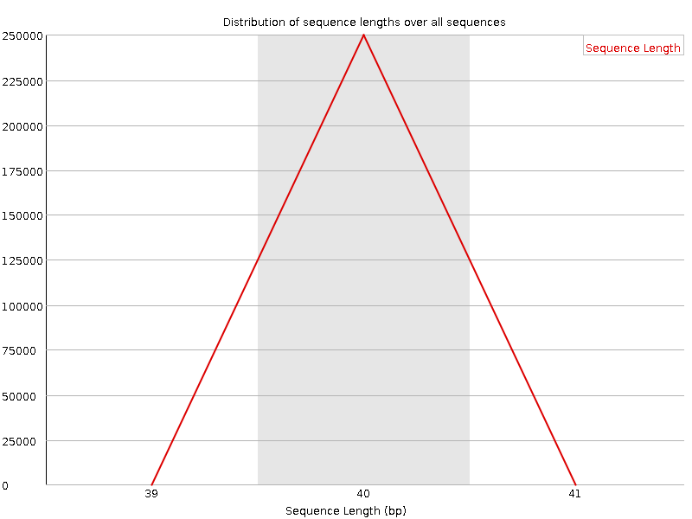
Sequence Length Distribution
E.g. 454/Roche
E.g. Illumina

Slide 33
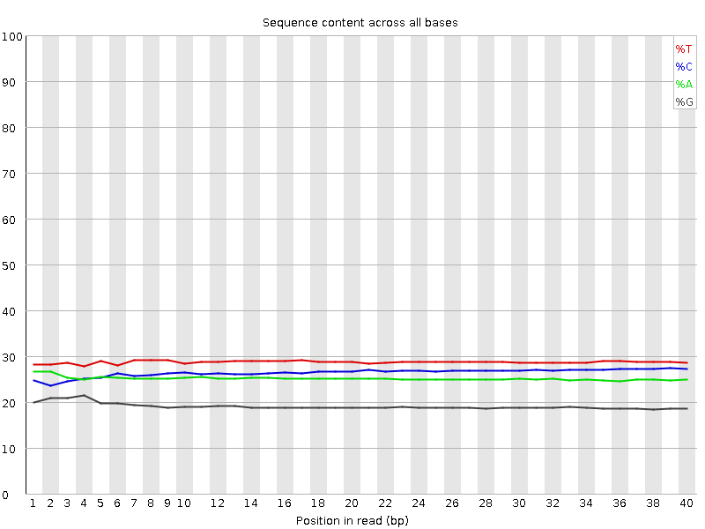
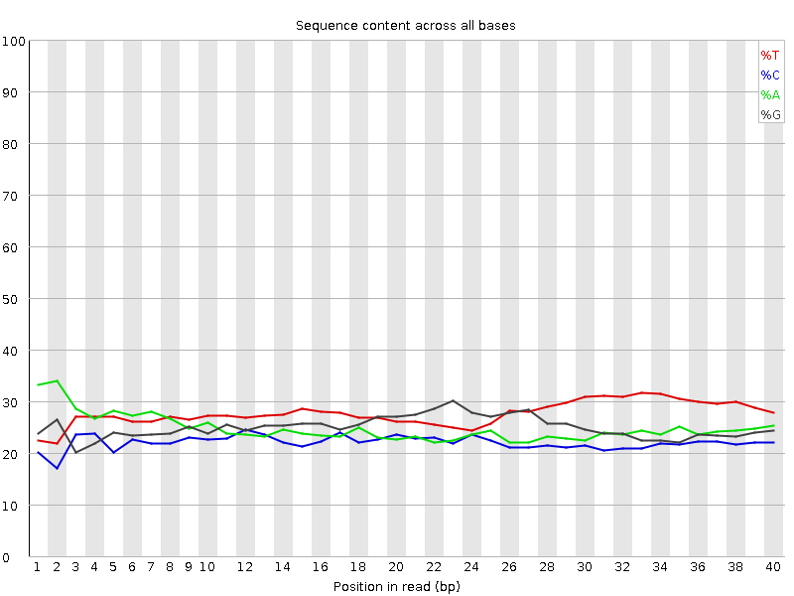
Per Base Sequence Content

Slide 34
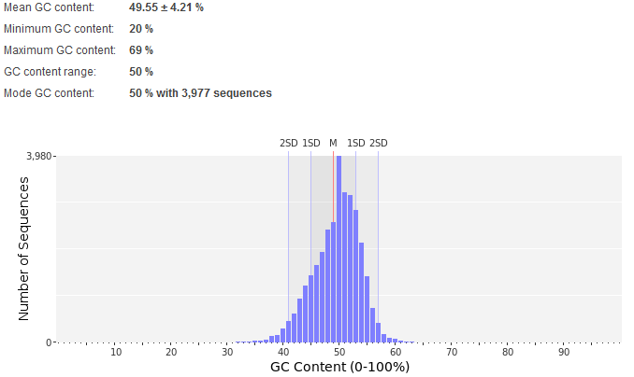
PRINSEQ: GC Content

Slide 35
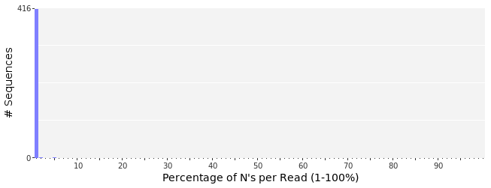
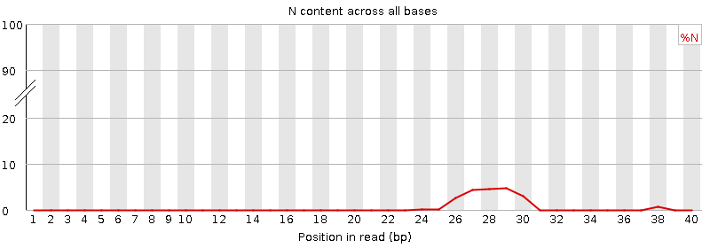
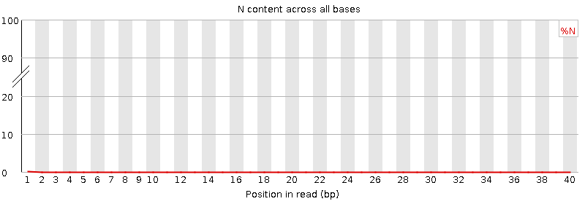
N Base Content

Slide 36
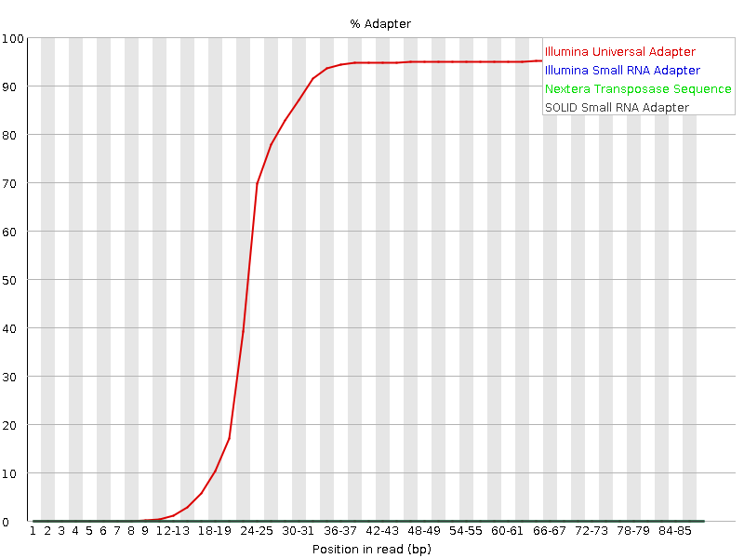
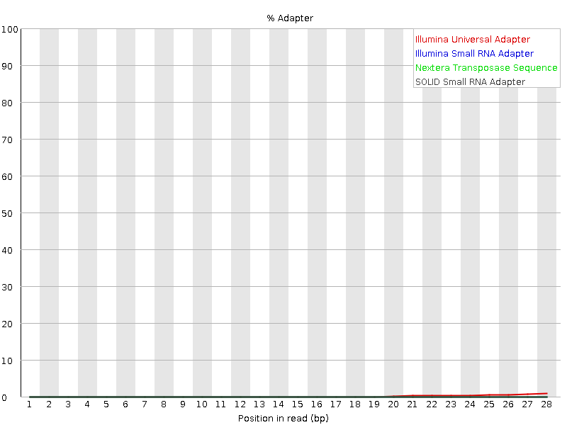
Adapter Content
Presence of adapter early in the reads.
Presence of adapter towards reads end.

Slide 37
Sequence alignment/mapping
[AFTERNOON SESSION]

Slide 38

Assembly or alignment
We have one or more sequenced genomes/exomes and we performed quality control, what are our options?
  The first genome of a species has to be assembled from scratch (de novo assembly), a computationally intensive operation.
NO
De novo assembly
Does a public reference sequence exist for this species?
Alignment/mapping against a reference
(s.k.a. comparative assembly)
YES
Notes:
The exact technical term hiding behind ‘computationally intensive’ is NP-hard where NP stands for nondeterministic polynomial. Given a large enough set of reads, one cannot be guaranteed to get the best possible assembly within polynomial time. In fact, one cannot check if the solution is the best possible solution within polynomial time. This is where heuristics come in: given a problem, find an approach that can be run in a reasonable amount of time and gives an answers that is close enough to being correct as to be useful (e.g. assembling a genome, if some repeat regions are misassembled, the resulting assembly is still by and large correct). The author Mihai Pop has several papers (and a few talks) on the subject of assembly. For more on the distinction between P, NP, NP-complete and NP-hard see: https://youtu.be/YX40hbAHx3s or https://youtu.be/EHp4FPyajKQ
Note that a common example of a problem that is NP-hard in computational biology is protein folding which can lead to some confusion given Alphafold2 has been widely reported as solving protein folding. In a strict sense, that is incorrect, Alphafold2 does not systematically produce the best results, albeit results so good as to be extremely useful for the field (i.e. most protein folding predictions test are correct, others are just a little bit wrong). In effect what we have with Alphafold2 is a tremendously good heuristic that will revolutionize the field…but it still looks like p ≠ np is more likely.
Alignment to a reference is sometimes referred to as resequencing. Not so much anymore given that it doesn’t really feel like resequencing now that many millions of genomes and exomes have been sequenced (I personally never liked that term).

Slide 39
Alignment to a Reference
Once a complete species (reference) genome exists, we can align/map any new individual of the same species to that genome.
    Many reads will align perfectly due to strong intra-species similarities!
    Many other reads will only deviate from the reference by one or two bases.
FASTQ
FASTA
Genome reference
reads from new individual, aligned to reference
SAM/BAM/CRAM

Slide 40
Challenges of Alignment
Despite being less computationally demanding than de novo assembly, aligning/mapping reads to a reference does provide its own challenges:
  Millions of short reads to align to an entire genome ➔ a data structure for rapid matching is needed.
  The presence of both errors and individual variation complicates the alignment process.
  ➔ requires some clever dynamic programming.
  Low complexity and repetitive regions are difficult to align to.
  ➔ paired-end reads help in some cases.

Slide 41
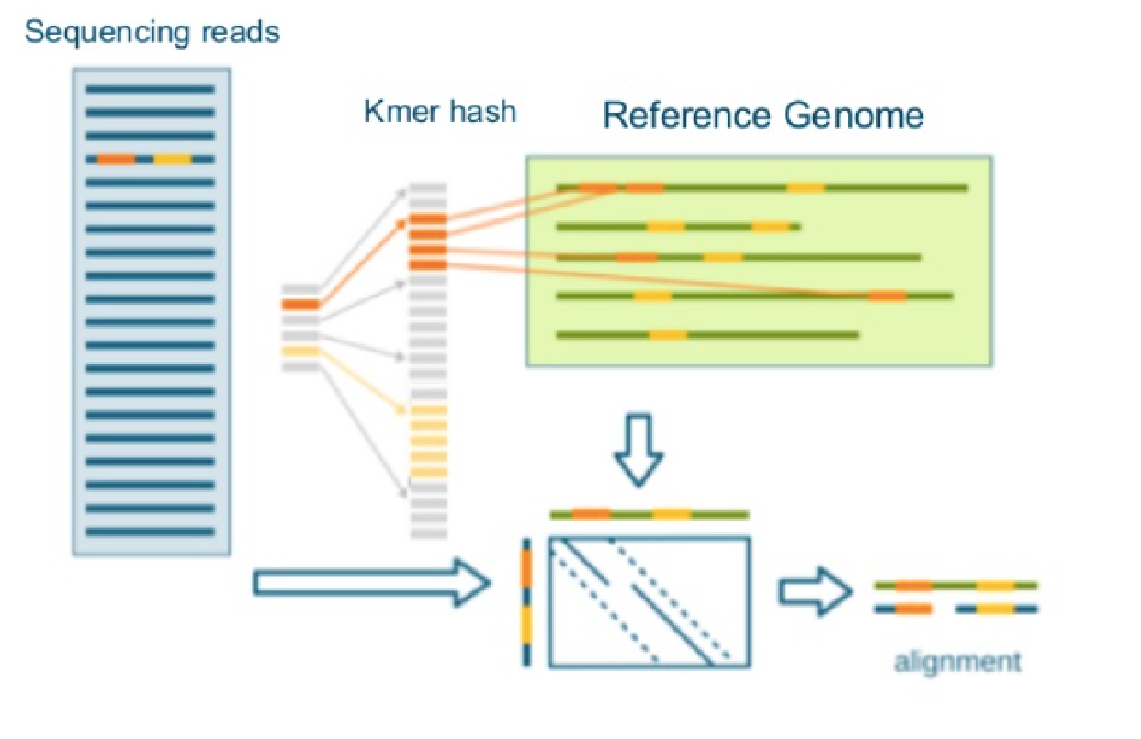
Fast Alignment using Hash
Fast aligners largely fall into two categories based on underlying data structure used to store and compare reads and reference:
  Hash table
    Used by aligners
    Novoalign
    and MAQ
    (also BLAST)
    Reference genome
    stored as subsets of
    size k (a.k.a. k-mers)
    in a hash.
    Subsets of reads matched
    against the reference.
    Based on perfect matches, align the mismatching reads.

Slide 42
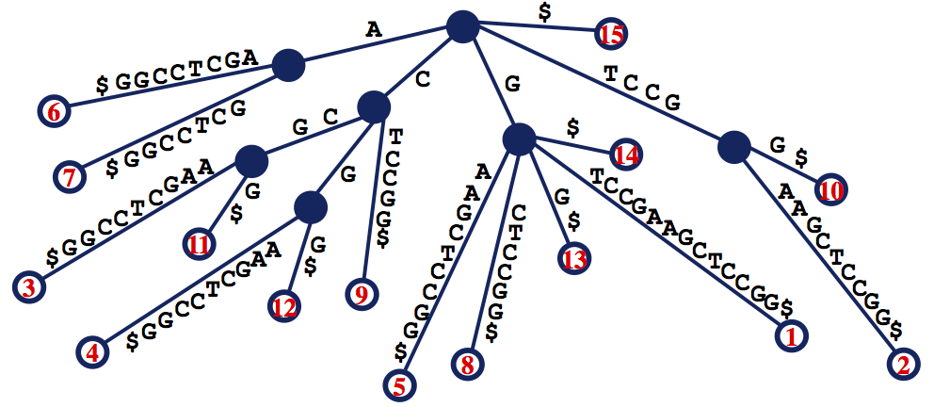
Fast Alignment using Tries
Fast aligners largely fall into two categories based on underlying data structure used to store and compare reads and reference:
  Suffix tries or arrays, or FM-index
    Structures based on storing all possible
    suffixes of a sequence.
    Used by BWA and Bowtie2.
    (both very popular methods for fast alignment).
GTCCGAAGCTCCGG$
TCCGAAGCTCCGG$
CCGAAGCTCCGG$
CGAAGCTCCGG$
GAAGCTCCGG$
AAGCTCCGG$
AGCTCCGG$
GCTCCGG$
CTCCGG$
TCCGG$
CCGG$
CGG$
GG$
G$
$
A suffix trie for GTCCGAAGCTCCGG
Notes:
Trie from retrieval (play on the word tree as well).
BWA gets its name from the Burrows-Wheeler Transform (BWT), a compression algorithm which is also useful for storing and querying the reference genome. For a really great overview of the algorithm, see Ben Langmead’s excellent explainer: https://youtu.be/kvVGj5V65io

Slide 43
Deviations from the reference
Hashes and tries are useful for exact matches, but not all reads match a region of the reference.
  Mismatches take different forms:
    Single nucleotide alteration.
    Insertion
    Deletion
Ref | …ATGATGCCATGACTGACCCTGAT…
Read | …ATGATGCCATGACTGACACTGAT…
source: variant (SNV) or
base calling error.
Jointly referred to as indels
Ref | …TCCATGTGTGACTA******CACC…
Read | …TCCATGTGTGACTATTTGTCACC…
source: real insertion or region
difficult to align
Ref | …AAACTTAGTGCAACAGTGCACGAG…
Read | …AAAC**AGTGCAACAGTGCACGAG…
source: real deletion or region
difficult to align

Slide 44
Phred Quality Score Revisited
Phred quality scores are also used to quantify mapping uncertainty.
  Mapping quality is applied to a single read rather than individual bases.
We also need to account for insertions and deletions (in relation to the reference). This is done using a CIGAR (more in a minute…).
ATTTGAACCATGAATTTGCCGATCAGATCCATGCA
Basecall quality score (BQ o BASEQ). Encoded in Phred-33.
→
Mapping quality score (MQ o MAPQ). Not encoded.

Slide 45
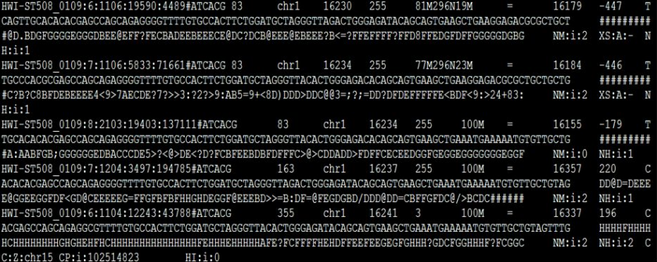
Sequence Alignment/Mapping Format
Most popular fast-aligners (e.g. BWA, Bowtie2) take FASTQ as input and produce SAM/BAM files.
  Adds alignment information to FASTQ read data (i.e. position relative to reference, mapping quality, presence of insertions/deletions).
Let’s take a look at an example using Samtools

Slide 46
Alignment Information
SAM/BAM file contains the following info about each read alignment.
  Position relative to reference where a read
  (inc. chromosome) and its corresponding read pair
  (incl. relative to the first half) are mapped.
  Mapping quality (MAPQ).
  The CIGAR (Concise Idiosyncratic Gapped Alignment Report*)
  A Bitwise flag for additional information about the read.
*Perhaps the worse backronym in bioinformatics

Slide 47
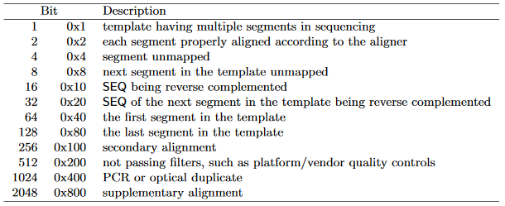
Bitwise flag and CIGAR
Crucial bits of information about a given read can be stored in a single bit.
A CIGAR signals where a reads needs an insertion/deletion to “match” the reference.
e.g. 40M5I30M2D25M
The bit is a sum of the statements that are true about a read (e.g. 1033 corresponds to 1, 8 and 1024).
ATGATGCCATGACTGACCCTGATGGTCCATGTGTGACTA*****CACCACATGCTGGATAGGTGCCCGTGAAACTTAGTGCAACAGTGCACGAGATGAGGAGTG
ATGATGCCATGACTGACCCTGATGGTCCATGTGTGACTATTTGTCACCACATGCTGTATAGGTGCCCGTGAAAC**AGTGCAACAGTGCACGAGATGAGGAGTG
Notes:
Match is used very loosely here to mean a subsequence we have aligned to the reference without having to add gaps even if one or two bases in fact do not match. The CIGAR is agnostic about single base alterations. This is as opposed to insertion or deletions that require a gap in either reference or read.

Slide 48
Variant Calling
and Related Preprocessing Steps

Slide 49
Preparing files for calling
Once SAM files have been generated, a number of steps can be reduce file size and prepare the file for variant calling:
  SAM files can be compressed to smaller binary files. ➔ BAM, no longer human-readable.
    Crucial when sequencing hundreds of samples.
  BAM files can then be sorted and indexed to further reduce size and speed up subsequent variant calling.
  Duplicates are removed.
If using GATK, one final step is needed*
➔ Base Quality Score Recalibration (BQSR)
*There are plans to discontinue BQSR in the near future.

Slide 50
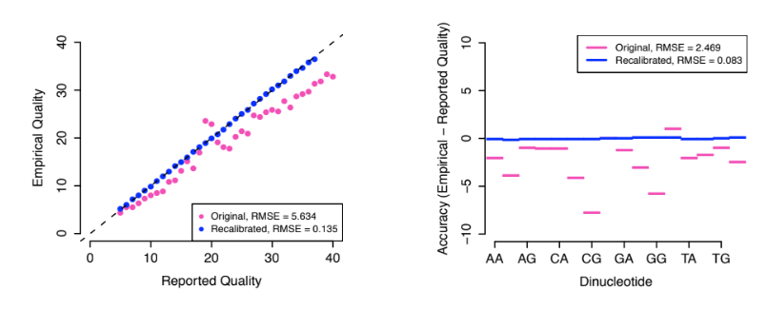
GATK’s BQSR step
Base quality scores are only as good as the error predictions a platform makes.
  Some systematic biases have been observed.
  These can be addressed using known variants at a population level (e.g. the dbSNP database).
    Base changes present in the data and also present in a database
    treated as real.
    Other
    variants
    treated as
    errors.
    These assumptions are true enough to be a useful approximation.

Slide 51

Variant calling and genotyping
A number of reads mapped to the reference contain one or more bases deviating from the reference.
  The task of a variant caller is to distinguish real variants ☑ from error🗶 based on various supporting evidence
    read depth, base/mapping quality scores, fits within an existing genotype configuration, larger haplotype context…
  As a useful secondary goal, a variant caller can produce a genotype assignment.
    For a human sequence this is codified as:
    -0/0 or 1/1 (homozygous wildtype and variant respectively)
    -0/1 (heterozygous)

Slide 52
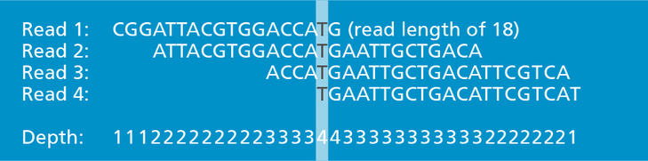
Read Depth/Coverage
Base call accuracy for NGS platforms is usually around ~99.9%* (~1 error every 1000 bases).
  However, the high throughput nature of these platforms translates to most regions or loci being covered by multiple reads.
*Remember, that Sanger method has 99.999% base call accuracy.

Slide 53


Calling Variants with Read Depth
The quantity of reads that overlap a locus of interest ➔ read depth.
  Consensus between reads gives us our first clue at the validity of a variant. More reads constitutes more evidence confirming or denying the existence of a variant at said locus.
    Genotypes can be derived from read depth as well (homozygous variant would appear in most reads, heterozygous in about half the reads).
reference
…TGAATAGGCGTACTTCATCCATGC…
…TGAATAGGCGTACTTCATCCATGC…
AATAGGCGTACTTC
AATAGGCGTACTTC
reads
ATAGGCGTACTTCA
Higher read depth =
Higher certainty
ATAGGCGTACTTCA
AGGCCTACTACATC
AGGCCTACTACATC
GCCTACTTCATCCA
CTACTTCAGCCATG
Real variant or
sequencing error?
...
TACTTCATCCATGC

Slide 54
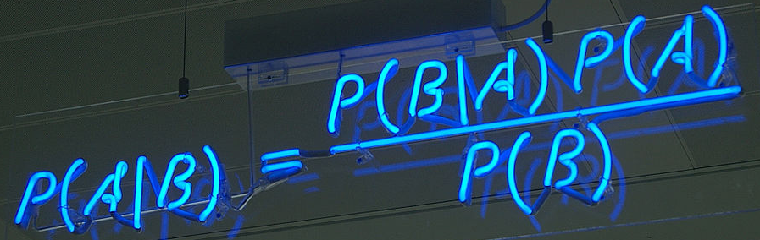
Using Quality Scores and More
Another aspect of reads that a variant caller needs to account for is base and mapping quality.
The various lines of evidence
are usually combined using
some form of Bayesian statistics.
  GATK HaplotypeCaller further incorporates local realignment and haplotype context.
reference
…TGAATAGGCGTACTTCATCCATGC…
AATAGGCGTACTTC
MQ: 60 BQ: 38
MQ: 60 BQ: 32
MQ: 5 BQ: 15
MQ: 10 BQ: 10
MQ: 10 BQ: 5
In this example, C doesn’t look as good as it did previously.
ATAGGCGTACTTCA
AGGCCTACTACATC
GCCTACTTCATCCA
CTACTTCAGCCATG

Slide 55
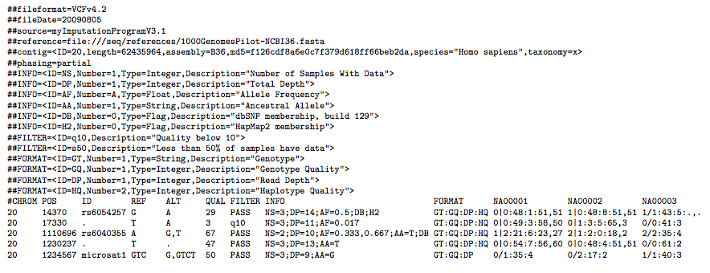
VCF Format
The Variant Call Format (VCF) is designed to be human-readable.
  We can use it for some further quality filtering
  Filtering by genotype, particularly if working with families.

Slide 56
The Final Steps with
Annotation and Visualisation

Slide 57
Genetic Context and Effects
To use the vast wealth of database knowledge at our disposal, we start any variant call analysis with annotation, starting with genic context.
  What genes are they in? Exonic region? What consequence for the underlying transcript?
  Does it risk changing protein structure?
    Variants that lead to the same underlying AA sequence (synonymous) ➔ little interest.
    A new early stop/frameshifting change ➔ very relevant.
    To ascertain risk for missense changes we use programs that predict protein structure (Polyphen2, SIFT, MutationTaster).

Slide 58
Population Databases
The reference genome can only represent one possible sequence, therefore a lot of so called variants will be quite common.
  At a population level, we refer to these as single nucleotide polymorphisms (SNPs).
    Various databases (e.g. dbSNP) host large collections of SNPs based on previous sequencing efforts.
1000 Genomes Project
2 504 individuals in 26 populations
Exome Aggregation Consortium (ExAC)
60 706 individuals
NHLBI Exome Sequencing Project
Variants in 6 503 samples
Genome Aggregation Database
138 632 individuals (123,136 exomes and 15,496 genomes)

Slide 59
Filtering common variants
As a general rule, variants are considered rare with an allelic frequency of <0.001.
  Danger! 0.001 doesn’t mean the same for all databases.
    1000genomes (2504 individuals) <0.001 ~ 1 individual ➔ Possible error that slipped through?
    gnomAD (138632 individuals) <0.001 ~ 100 individuals ➔ much more reliable.

Slide 60
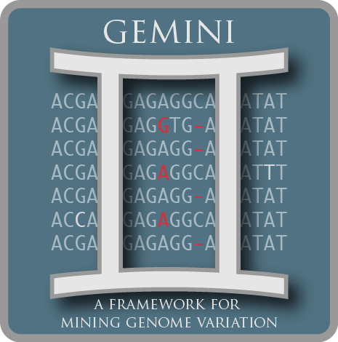

Annotation in one go!
There are various databases and tools we need to annotate and filter our data. How do we gather these tools together?
  It has already been done for us! We can use tools such as ANNOVAR or GEMINI.
    There is a web application that
    we can use for the former:
Gemini query –query “select chrom, start, end, ref, alt, qual, gene, transcript, aa_change, is_exonic, is_coding, is_splicing, is_lof, type, sub_type, biotype, impact, impact_severity, in_exac, aaf_exac_all, gerp_bp_score, gerp_element_pval, cadd_scaled from variants where (impact_severity='HIGH' or impact_severity='MED') and aaf_exac_all < 0.001”

Slide 61
Checking a locus with IGV

Slide 62
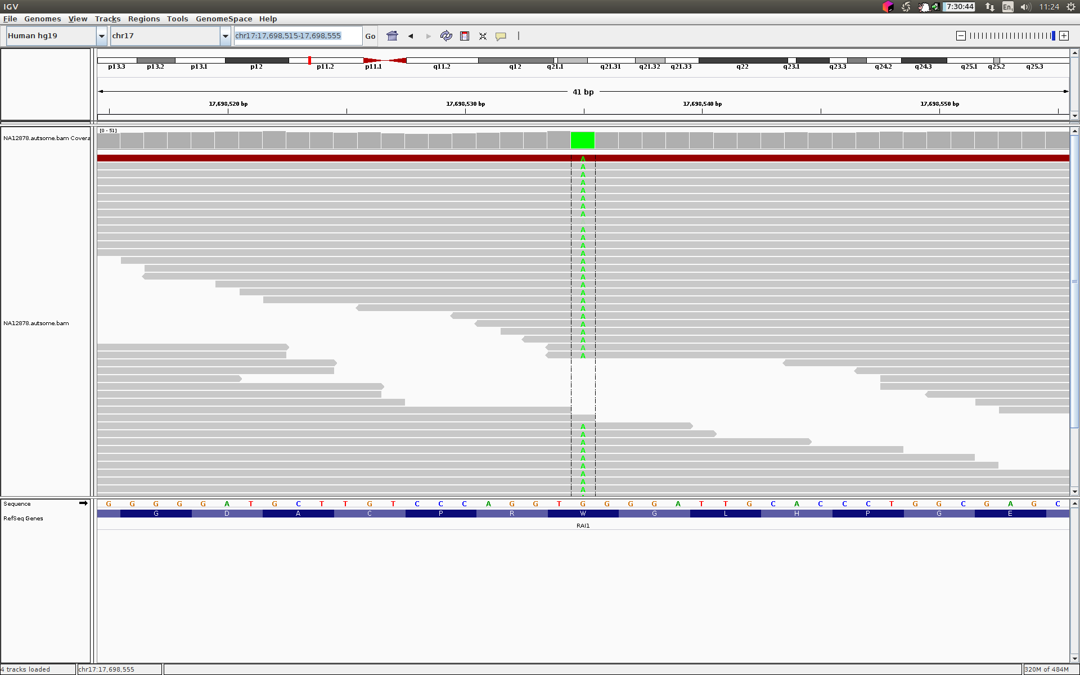
Checking a locus with IGV

Slide 63
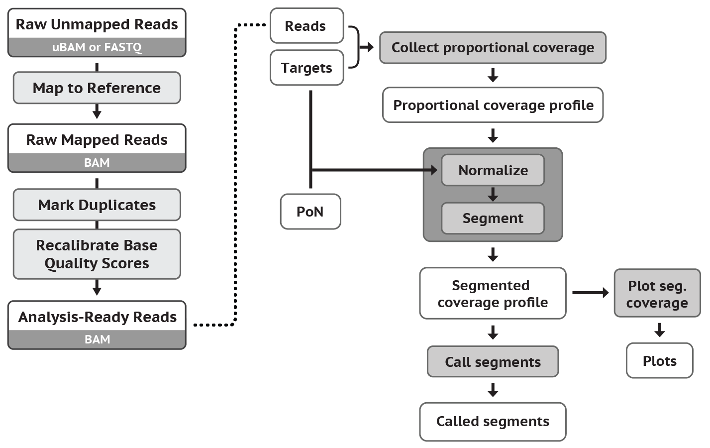






Available pipelines
The various tools can be and have been organized into various pipelines.
  The Broad Institute provide
  their preferred pipelines
  using WDL.
  For cases in which one
  wants to create their own
  pipeline:
Snakemake tomorrow!!
Notes:
If you’re interesting in learning WDL and/or genomics in the cloud (especially using GATK), the recent O’reilly release Genomics in the Cloud by Géraldine Van der Auwera and Brian O’connor has got that covered (a case study I worked on is showcased in chapter 14).

Slide 64
Questions
Thanks for listening
Any questions?

