Slide 1
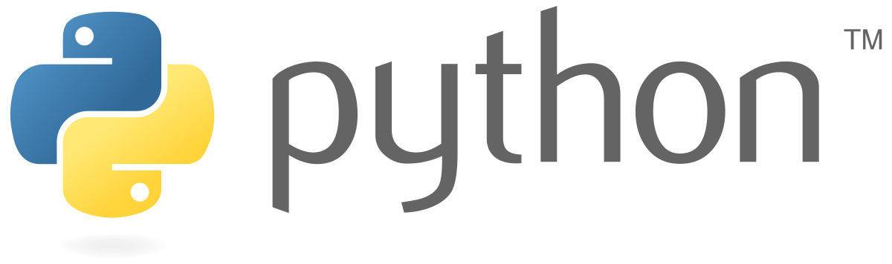
Programming with
I
PART
Matthieu Miossec, PhD (@RealMattJM)
Bioinformatics Core
https://www.well.ox.ac.uk/people/matthieu-miossec
12/10/2022-
(Part II: 14/03/2022)

Slide 2
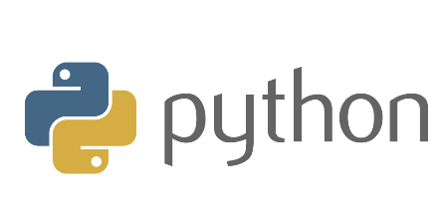

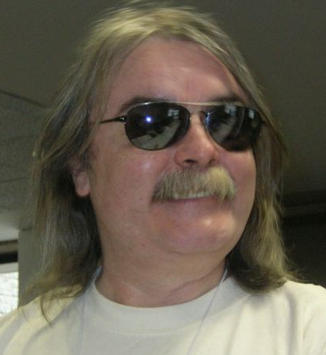
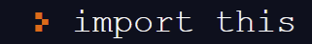
What is Python?
Python is a high-level programming language originally developed by Guido Van Rossum in 1991.
  The last major revision of the language in 2008
  led to Python 3*, but the language is continually
  evolving (latest version 3.10.7 released last month).
To understand the driving philosophy behind
Python, let’s write our first line of code.
        The resulting 19 statements are what Tim Peters calls the Zen of Python.
*Please don’t use Python 2, support has officially been discontinued. Also Python 4, is not happening…

Slide 3

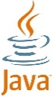

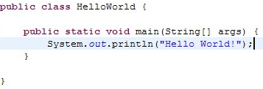
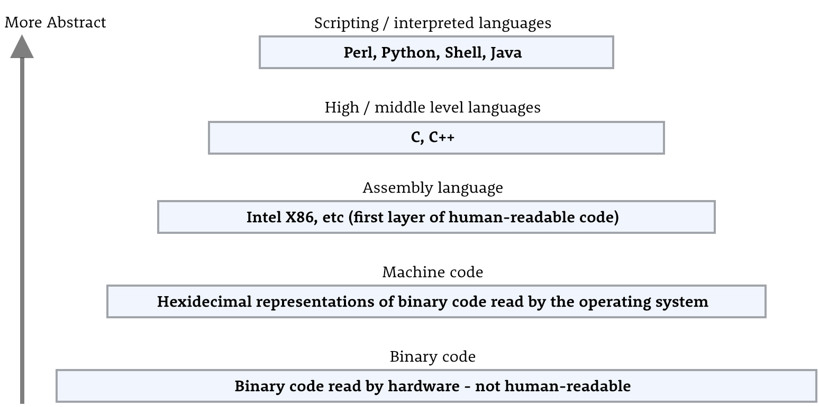
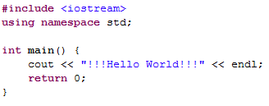

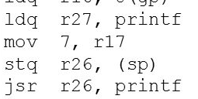
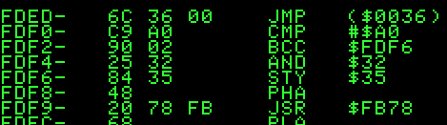
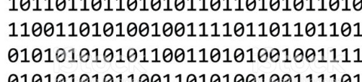
High-level programming language?
A high-level programming language is one with a high level of abstraction from the details of a computer system.
  Closer to natural language (typically English).

Slide 4
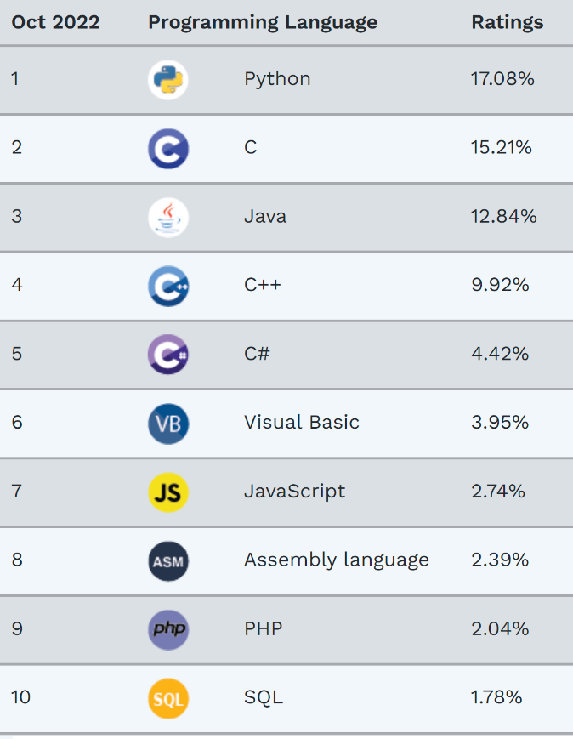
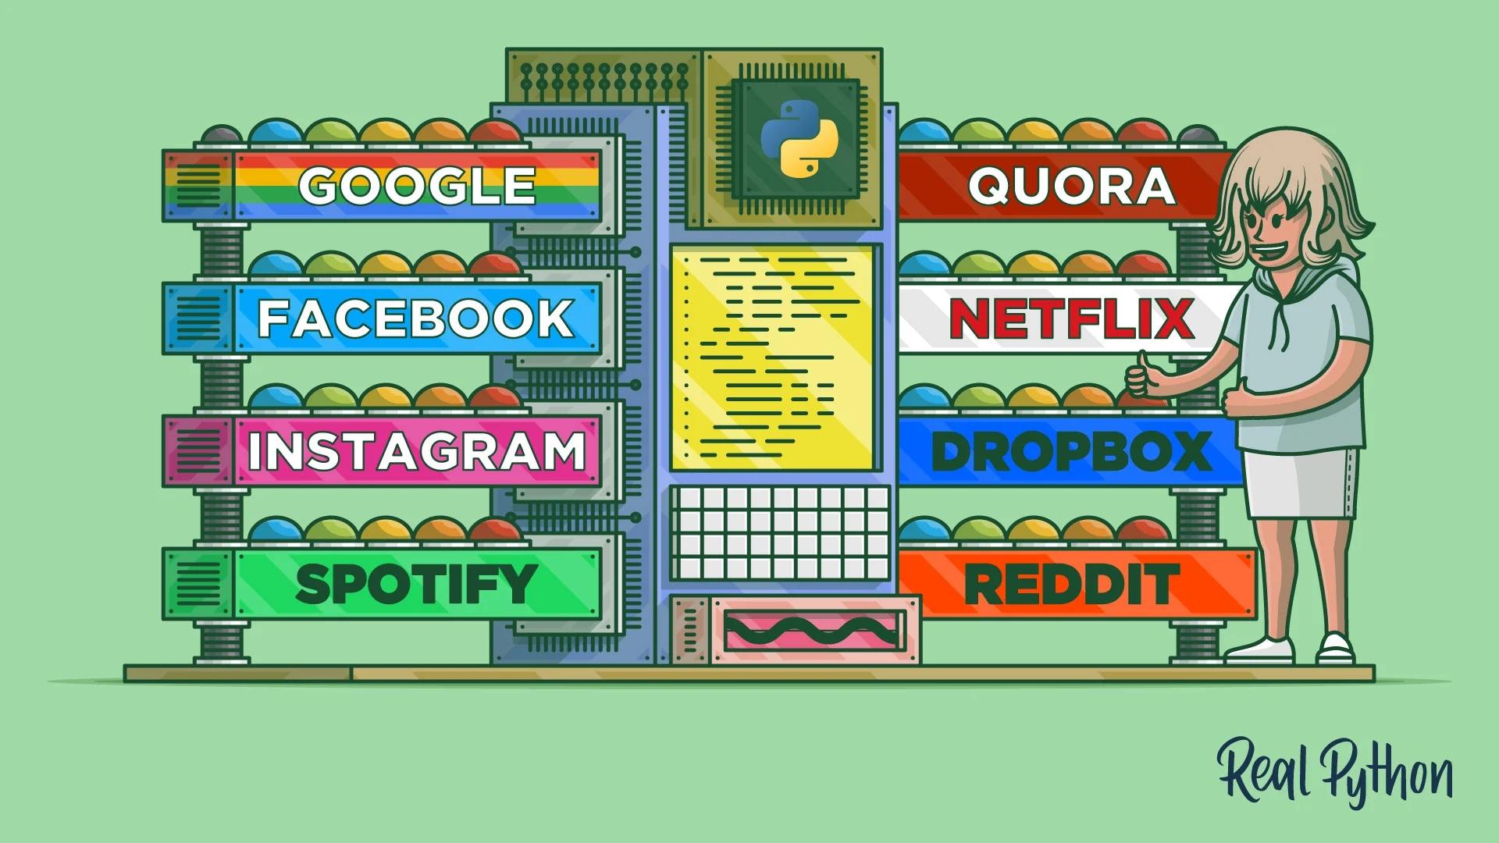
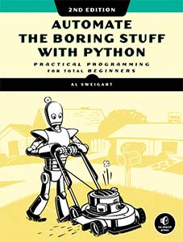
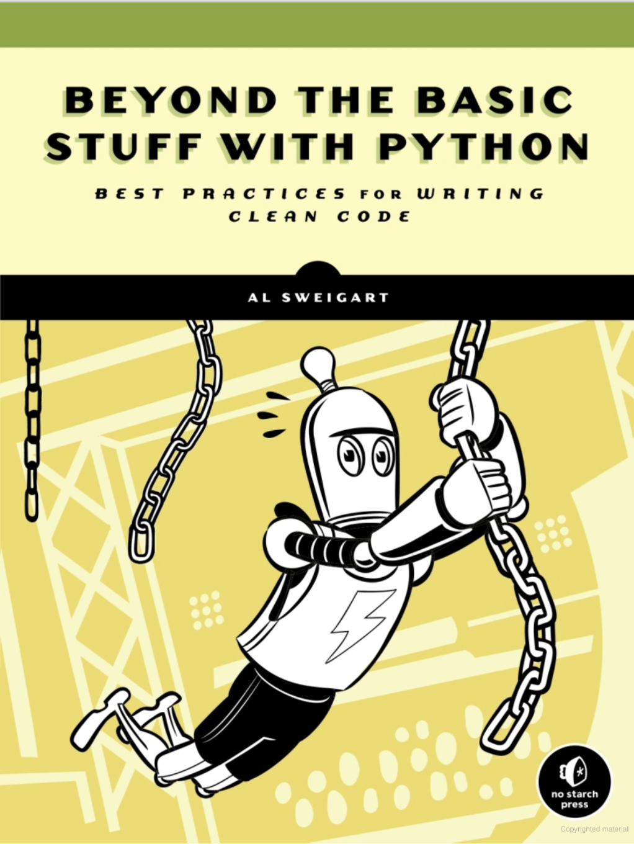
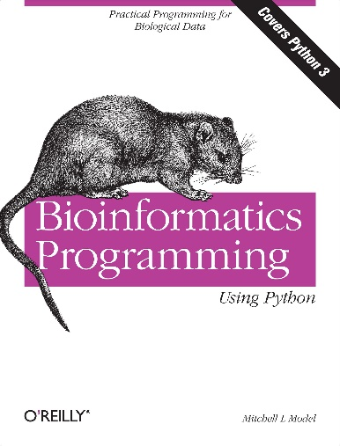
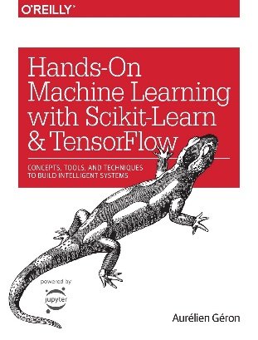
Why learn Python?
One of the top languages right now. With applications across
a variety of industries.
Popular in academia.
(see: https://realpython.com/world-class-companies-using-python/ for some examples)
These books are free online!
(source: TIOBE programming community index, Oct 2022)
Easier to start coding in Python than Java or C.
Large community of users (many libraries).
A popular choice for scientific computing, data science and machine learning.

Slide 5
A challenge to start thinking about…
By the end of today’s session you should have all the necessary tools to implement the following task:
  Write a script that takes the numbers 1 through 100, prints fizz (to screen) if said number is a multiple of 3, buzz if a multiple of 5 and fizzbuzz if a multiple of 5 and 3 (…and prints numbers otherwise).
As we cover various aspects of Python today, think about what might be useful in addressing the following:
  Identifying multiples of 3 or 5 or both.
  Running through a list of numbers.
  Performing an action when a specific condition is fulfilled

Slide 6
Let’s start coding!

Slide 7
Integers and Floats, Expressions and Operators 1/2
Python has several data types, we will start by looking at integers (Int).
  We can use several familiar operators to join values into expressions which evaluate to a single new value:
  The above division expression evaluates to a floating-point number (float). If we want the fractional part of a division ignored, we can use //, or if we want the modulus/remainder of a division %.
  We can also raise values to a given power using **.
7 + 3 # Evaluates to 10.
7 - 3 # 4
7 * 3 # 21
7 / 3 # 2.3333333333333335
7 // 3 # 2, integer division/floored quotient
7 % 3 # 1
7 ** 3 # 343
type() tells you what type of value you’re working with. # denotes comments.

Slide 8
Integers and Floats, Expressions and Operators 2/2
We can use the same operators to work with floats or a combination of ints and floats.
  An expression that includes a float will evaluate to a float, even if the fractional part is 0.
  If we want a value of type int (integer) again we use casting which converts a data type into another. Here with the function int().
  Casting only removes the fractional part, it does not round numbers to the nearest integer.
5.2 * 5 # Evaluates to 26.0, not 26
type(5.2 * 5) # Type() shows <class 'float'>
int(5.2 * 5) #26
int(5.2 * 8) # Evaluates to 41 from 41.6
round(5.2 * 8) # Use round() instead for rounding up to 42.
type(), int() and round() are functions. More on those later.

Slide 9
Print, Strings and Quotes in Python
We’ve already seen one example of the print() function.
  The statement contained in double/single quotes is another common data type: string (i.e. string of characters) or str.
  If the string you want to write contains an apostrophe, you can either escape the character (using \).
  or use double quotes.
  or vice versa.
print("Hello World!")
or
print('Hello World!')
or
print('''Hello World!''')
print('Season\'s greetings')
print('1')
print("My first message said 'Hello World!'")
This is a String rather than an int
print(‘2+2')
print('My first message said "Hello World!"')

Slide 10
More Print and Input
In Python, we can include several comma separates values into print() and get a single output message. These values can be formed from a mix of data types and expressions.
  …including Booleans (more on these soon!).
  This is useful for creating a message that varies slightly between runs. Let’s give a variable a value determined during execution with the help of a new function, input().
print("The year is", 2021+1, "AD") #Notice the added space between each value.
print(2+2<4) # This will evaluate to False
adjective = input("Your input here:") # saves input to adjective
print(“What a", adjective, "World") # used here.

Slide 11
Bonus: The PyInputPlus Module
Whether you input a number, text or structured data, input() always returns a String (since Python 3).
  The typical remedy is to cast String to the desired type.
  There is another way: PyInputPlus.
  Here’s a list of handy functions to try!:
inputDatetime(), inputYesNo(), inputEmail(), inputFilepath(), inputPassword()
num = int(input("Type in a number:")) # notice int() here
print(num*10)
In your CLI, you will have to run:
pip install pyinputplus
import pyinputplus as pyip
num = pyip.inputNum(“Type in a number")
print(num) # no casting

Slide 12
Bonus: The Pyperclip Module
There’s another nifty way to input and output small bits of text: send/receive them to/from your computer’s clipboard with pyperclip!
  To send data to your clipboard, use pyperclip’s copy().
  To input data from your clipboard, it’s paste().
import pyperclip
pyperclip.copy("Paste me in a text file")
clippy = pyperclip.paste() #No idea what’s in your clipboard.
print(clippy)
In your CLI, you will have to run:
pip install pyperclip

Slide 13
Variables in Python
A variable provides a way to store and access a value without needing to know where it is located in computer memory. An assignment statement looks like this:
  In most programming languages, we can assign the value of a variable to another variable via an assignment statement with both.
  Only the value is assigned.
  Future changes to one variable won’t affect the other afterwards.
word = "bird" # Takes the form variable = value
x = 5
y = 3
x = y
print(x) # Outputs 3
Python Pros can check out the infamous Walrus Operator
:=
https://youtu.be/KN2TTiGpDvM
y = 7
print(x) # Still 3
The = is always an assignment operator, while == is an equality operator.

Slide 14
Expressions with variables
Using operators directly on values is of limited use. We can apply them to variables and assign the resulting value to a new variable.
  With strings, the + operator takes on new meaning: it joins
  (aka. concatenates) strings together.
  The * symbol (followed by an int) is used to repeat a string a given number of times.
  You cannot concatenate a string and another data type unless you cast the latter as a string first using str().
avg = (x + y + 10) / 3
print(avg)
greet = "Hello"
place = “world!"
msg = greet+"\t"+place
print(msg)
print(greet*3) # HelloHelloHello
print("Hello it’s "+2022) # What does the error code say?
\t stands for tab. If you want to skip a line there’s also \n for newline

Slide 15
Comparison Operators
To compare values or expressions, we use comparison operators, many already familiar (but let’s first create 3 variables with one line of code).
  The = operator is already reserved for variable assignment, to test equality we will use == instead.
  To find out if two expressions are not equal, we use !=
  All these comparison operations lead to True or False values. What type are we dealing with? String? Int?...Boolean.
x, y, word = 4, 10, "hello“
print(x < y) # Less than. True
print(x >= y) # Greater or equal to. False
print(word <= "Hello") # Works with Strings. Case matters. False
A quick lil’ Python trick
print(y == 10) #Equals to. True
print(y != 10) #Not equal. True

Slide 16
Booleans (and a quick break?)
One final data type to look at today is Boolean (bool).
  Booleans only have two possible values: True or False*.
  Despite their simplicity, Booleans are very powerful when used for flow control (i.e. IF statements and WHILE loops…).
In Python, every type inherently has a True or False value, a ‘truthiness’.
  Little break challenge: Can you figure out what is True and what is False for int and string using bool()?
print(bool(4)) # True
# Try a few notable integers…
# What about floats?
print(bool("Hello")) # True
# What could possibly cause False for a string?
*In Python, True and False are capitalized (and no quotes or it’s a string)

Slide 17
Logical statements
Comparison expressions/boolean variables can be further joined together using logical connectors such as and…
…or…(this is an inclusive or, if both statements are true, evaluates to True)
…not
We can use the ‘truthiness’ associated with types to write concise code.
(though of course you don’t have to. No pressure!)
num = int(input("Is this number even and bigger than 3?"))
print(num%2==0 and num>3) # True if both statements are true. False otherwise.
num = int(input("Is this number negative or even"))
print(num<0 or num%2==0) # True if both or at least one statement true.
some_val = False
print(not some_val) # True if False. False if True.
num = int(input("Is this number odd?"))
print(num%2) # Can you figure out how this works?
Don’t forget to cast input() to int, otherwise it’s a string.

Slide 18
IF…ELSE statements
So far, we’ve written a lot of statements that can fit into a single line. However, an IF statement takes up a few lines.
The general syntax:
num = int(input("Is this number even or odd?"))
if num % 2 == 0: # When True, the block of code below is executed.
print(num, "is an even number")
else: # Otherwise this block of code is.
print(num, "is an odd number")
if condition:
some action.
some more action.
else:
some other action
some more other action
Notice the indentation. This is how you separate blocks of code in Python. Only what is indented after IF (its clause) will be executed if the condition is true. Otherwise, only the block after else (another clause) will be executed.

Slide 19
ELIF
What if we want to evaluate more than one conditional statement? For this we use ELIF (contraction of else and if).
  Notice this final print statement appears to be aligned with the if structure, meaning that it is outside of it and will be executed regardless.
  A flow control structure can contain any number of ELIF statements*.
num = int(input("Is this number negative, 0 or positive?"))
if num == 0 :
print("is", num)
elif num > 0 :
print(num, "is positive")
else:
print(num, "is negative")
print(“Done.")
*…too many ELIFs might be a sign there’s a better solution.

Slide 20
There can only be one True statement
More than one condition could be true. Say we want to know if a number is 4, or otherwise even or odd.
  The number 4 is even. Two statements therefore could evaluate to True. So what happens in this case?
  In Python, as in other programming languages, only the first True statement is evaluated.
num = int(input("Is this number 4, even or odd?"))
if num == 4 : # only the indented block below is executed if number is 4
print("is", num)
elif num % 2 == 0 : # this is never checked if previous condition is True.
print(num, "is even")
else: # this won’t be checked either.
print(num, "is odd")

Slide 21
The FOR loop
One of the big benefits of programming is that it allows us to perform repetitive actions in an automated fashion.
  One way to apply an action repeatedly in Python, is by using a FOR loop. As with the IF statement, the block to be executed repeatedly is indented.
  This also works for a string.
for i in range(100):
print(i+1) # Why +1?
for variable in iterable data structure:
some action
some action on current variable
some other action
# How do you spell Python user?
you = "Pythonista"
print("it's...")
for letter in you:
print(letter)
print("...") # Pause
The first element of the iterable data structure is assigned to the variable and some actions are performed. The second element is assigned to the variable…and so on until the last element.
range() creates a sequence of numbers to iterate through.

Slide 22
The WHILE loop
A WHILE loop also repeats a block of code, but does this while a certain condition is True.
  Our previous counting to 100 example with a WHILE loop.
  When writing WHILE loops, be very careful or else your loop could be infinite!
i = 0 # starting value for variable i
while i <= 100:
print(i)
i = i + 1 # don’t forget this!!
print("done!")
#Hit ctrl-C when you realise the mistake!
i = 0
while i <= 100:
print(i) # this keeps given us 0!
print("done!") # This statement will never be reached.
I once filled up a disk drive with a while loop ☹.

Slide 23
You’re ready for Part I challenge!
A common interview question* that uses some of the things we’ve covered today:
  Write a script that takes the numbers 1 through 100, prints fizz (to screen) if said number is a multiple of 3, buzz if a multiple of 5 and fizzbuzz if a multiple of 5 and 3 (…and prints numbers otherwise).
To approach this problem, as with any problem in programming, divide and conquer.
  Break the big problem into smaller manageable sub-problems and built up to the ultimate solution.
    For example, before writing a program that prints out fizz, buzz and fizzbuzz, write a program that prints numbers 1 through 100 and build on that
*It happened to me once.

Slide 24
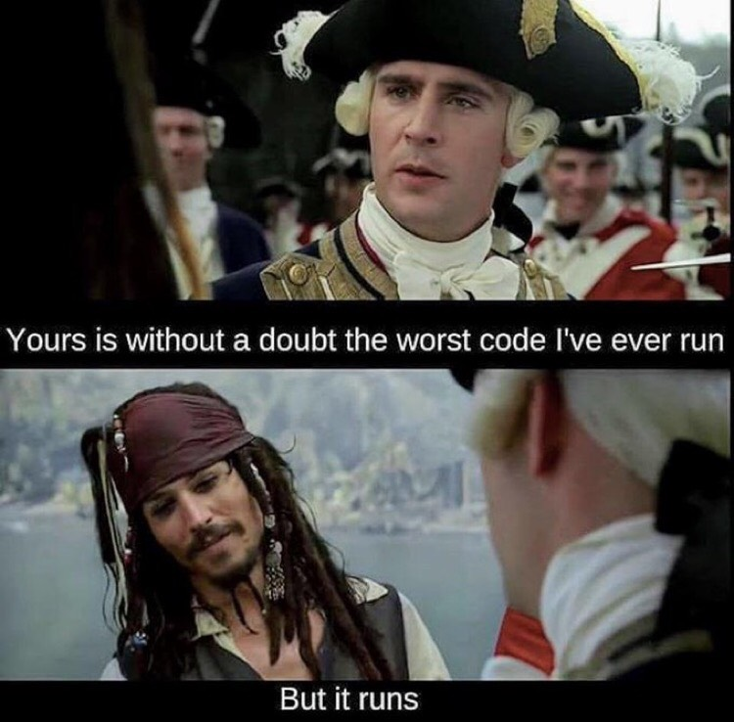
Don’t worry if your solution isn’t optimal…
…step 1 of writing good code is writing code that runs.
  You can always revisit your code and make incremental improvements. This is the way.

Slide 25
How are we doing for time?!

Slide 26
Manipulating a string (of characters) variable 1/2
A string is actually a subsettable string of characters.
  We can access specific elements of a string stored in a variable using an index between square brackets.
  The final slice shows elements 0 through 4. Elements are indexed from 0 and the index after the colon is not included*.
  Strings are immutable, you cannot change individual characters…except by replacing the entire string.
greet = "Hello World!"
print(len(greet)) # What is the string’s length? Find out using len()
print(greet[0]) # H. first element of the String.
print(greet[11]) # !. Last element of the String.
print(greet[0:5]) # The word Hello.
greet[11] = "?" #This will cause an error!
*This is the source of many errors, so try to keep that in mind.
Notes:
Note for future genomics researchers: Some sequences in genomics are similarly 0-based instead of 1-based. Be mindful of this, especially when converting sequences between formats.

Slide 27
Manipulating a String (of characters) variable 2/2
There exists a shorter way of referencing the start and end of a string.
  Although this might not seem useful for now, it is also possible to use negative indices which refer to elements from the end of the string.
greeting = "Hello World!"
print(greeting[:5]) # Hello. Absence of index implies the start index.
print(greeting[6:]) # World! Likewise, end index is implied.
# What happens if you type the following? Is it useful?
print(greeting[:])
print(greeting[-1]) # ! Last element.
print(greeting[-1:-3]) # This doesn’t work.
print(greeting[-3:-1]) # ld. This does.
print(greeting[9:-1]) # ld. And this.
H | e | l | l | o |  | W | o | r | l | d | !
0 1 2 3 4 5 6 7 8 9 10 11 (12)
-12 -11 -10 -9 -8 -7 -6 -5 -4 -3 -2 -1

Slide 28
Thanks for listening, see you next week for Part II!
II
PART

Slide 29
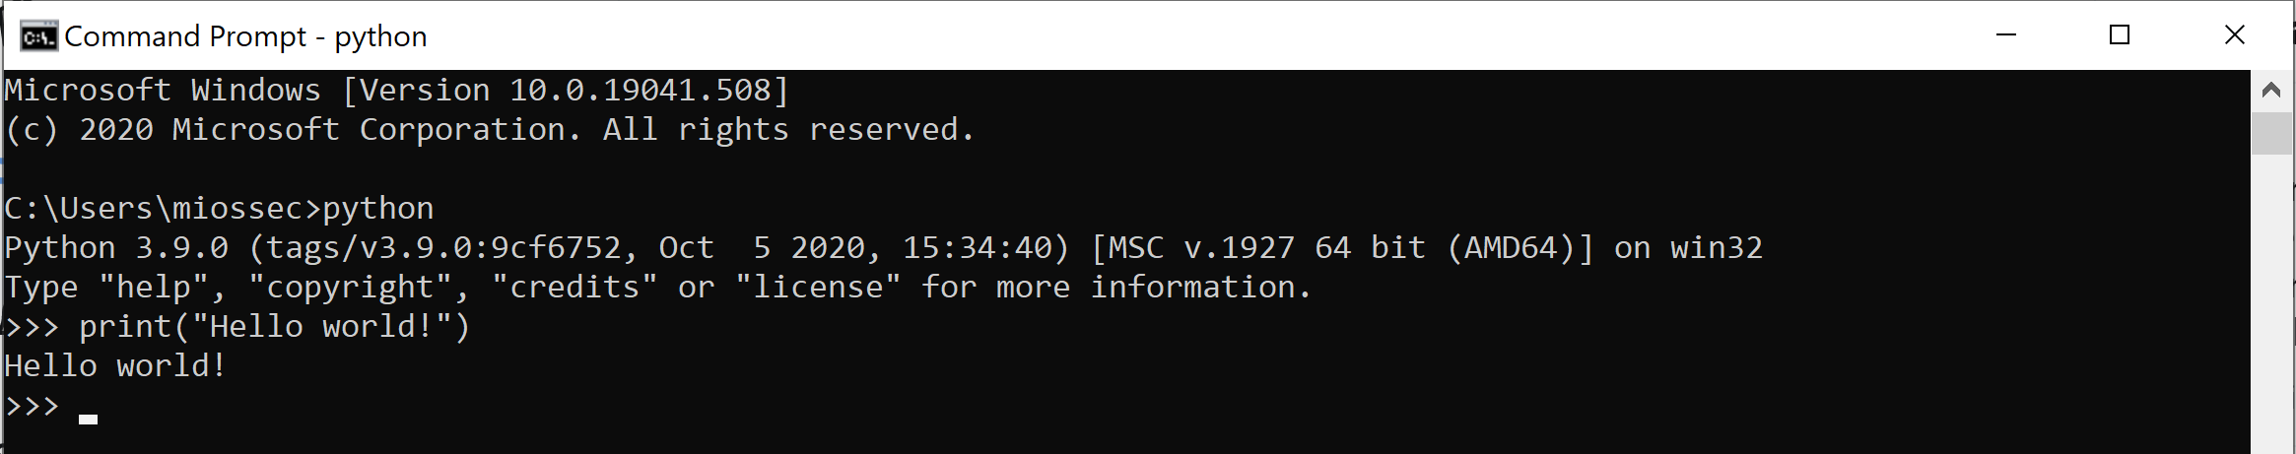
Extra: Ways to run Python –Interactive mode–
With Python installed on your machine, you can start writing and executing Python code directly into the command line terminal.
  Interactive mode: In a terminal, type either python or python3. This will start the Python prompt/shell or REPL (Read-Evaluate-Print-Loop) in which you can type individual commands:
  When you’re done, type quit() to exit.

Slide 30
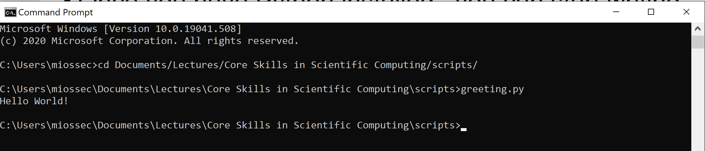
Extra: Ways to run Python –script mode–
A REPL is a good place to test single lines of code, but to execute and re-use full blocks of code, you will need to write them in a python script file (.py extension).
  Script mode: You can use a simple text editor or an Integrated Development Environment (IDE) to write your code and then execute the resulting script from the terminal.
  If you are using an IDE, you can both write and execute your code within that environment!

Slide 31

Extra: Ways to run Python –IDE–
An integrated development environment (IDE) brings together an interface with which to write code, a kernel to execute said code and a combination of useful tools to assist in various related tasks.
  Recurring features include debugging, auto-complete, linting (checking for potential sources of errors as you write code), file-management and version control.
For an online IDE, use Replit . Beyond this course, a desktop environment is highly recommended.
  This includes IDEs either compatible with (e.g. Atom, Sublime, Eclipse) or made for Python (e.g. Mu, PyCharm, Spyder, PyDev and JupyterLab). A good starting place: IDLE*, created in Python for Python.
*The extra L is for learning, but really it’s a nod to Monty Python’s Eric Idle.

Slide 32
Extra: Triple Quotes
What if we want to include both types of quotes in a string?
  Use triple quotes! (single/double x3)
  Triple quotes let’s you write and print over lines the way it appears on your screen. This is a feature unique to Python (last I checked…).
  For everyday programming tasks, single/double quotes are adequate. We can always go to a new line using \n.
print('''Here's a 'great' example…''')
print('''Here is some DNA:
…A T G A A C…
| | | | | |
…T A C T T G…
''')
print("Hello World! \nHow's it going?")

Slide 33
Extra: Breaking out of a FOR loop early
A FOR loop will typically iterate through each element of an iterable data structure.
  That is, unless there is a reason to ‘break out of the loop early’. This is done using break and involves combining a FOR loop with an IF statement.
  It is also possible to simply skip to the next iteration using the keyword continue.
prod = 1
for num in [2, 100, 0, 4.3, 6]: #This is a list, more on these in part II
if(num==0):
prod = 0 #Notice the double-indentation.
break #Multiplying anything by 0 gives 0 again, exit loop
else:
prod*= num
print(prod)

Slide 34
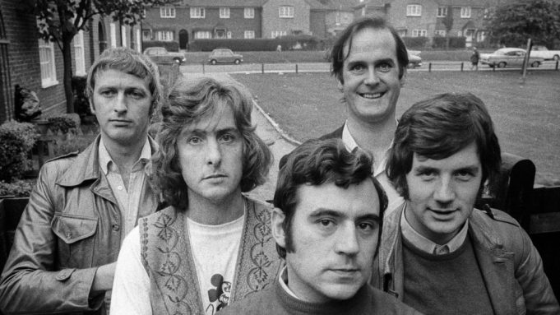
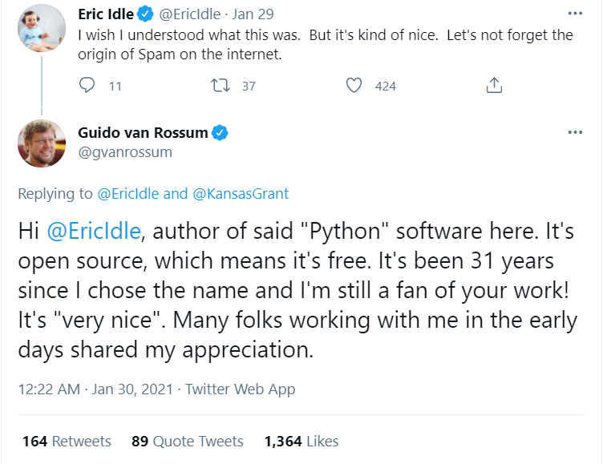
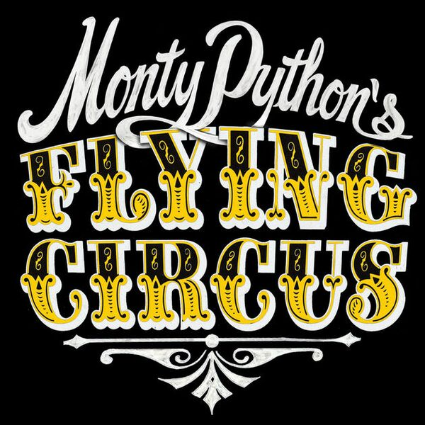
Extra: Why is it called Python?
Does Guido Van Rossum really like snakes?

