Slide 1
Genome-Wide association studies for bacterial pathogens
Danny Wilson
Associate Professor and Sir Henry Dale Fellow
Nuffield Department of Medicine, University of Oxford

Slide 2
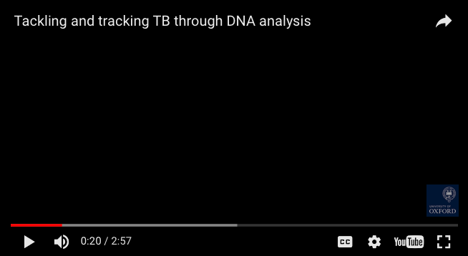
Modernising Medical Microbiology
<iframe width="560" height="315" src="https://www.youtube.com/embed/6dkaeg6_oiM" frameborder="0" allowfullscreen></iframe>

Slide 3
Modernising Medical Microbiology
Microbial genomics for
  Detecting transmission
  Predicting antimicrobial resistance
  Discovering the genetics underlying important traits

Slide 4




Explaining Phenotypic Diversity
One of the broad aims of biology is to explain the
natural phenotypic diversity that surrounds us
Ernst Haeckel (1904) Kunstformen der Natur

Slide 5


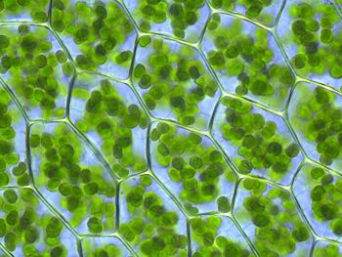

Phenotype
Inheritance
(Genetics)
Development
Mechanism
Adaptive value

Slide 6
Genome-Wide Association Studies for Bacterial Pathogens
What are GWAS?
  Cataloguing genetic variation and its origins
  Examples of genotype-phenotype relations
  GWAS explained
  The Manhattan plot
Pitfalls for GWAS
  Confounding
  Population structure
  Artefactual associations
  False positives
  Lack of power
Bacterial GWAS in practice
  Antibiotic resistance
  Other phenotypes: toxicity, host-specificity, virulence
Bibliography

Slide 7
Cataloguing genetic variation and its origins
What types of genetic variation do bacteria harbour?
Where does this variation come from?
Notes:
Flip-chart exercise. SNPs, indels, gene presence/absence, mobile element presence/absence, core genome, accessory genome, pan genome, structural variation, copy number variants, inversions, translocations, minisatellites, microsatellites
Mutation, horizontal gene transfer, homologous, non-homologous, transduction/transformation/conjugation, within-species, between-species, even between domains

Slide 8
Genotype → phenotype mechanisms
Examples of phenotypes that are
  Continuous
  Discrete (case/control classification)
Examples of resistance conferred by
  Point mutations
  Gene presence/absence
Notes:
Ciprofloxacin resistance conferred by a point mutation in DNA gyrase subunit A gyrA. Mechanism: prevent competitive binding of the antibiotic, allowing replication/transcription to continue
Beta-lactam resistance conferred by presence of beta-lactamases. Mechanism: hydrolysis of the antibiotic’s beta-lactam ring, preventing inhibition of cell wall synthesis
Vancomycin resistance: both point mutations in walKR and presence of the vanA gene

Slide 9
Escherichia coli
Klebsiella pneumoniae
Mycobacterium tuberculosis
Staphylococcus aureus

Slide 10
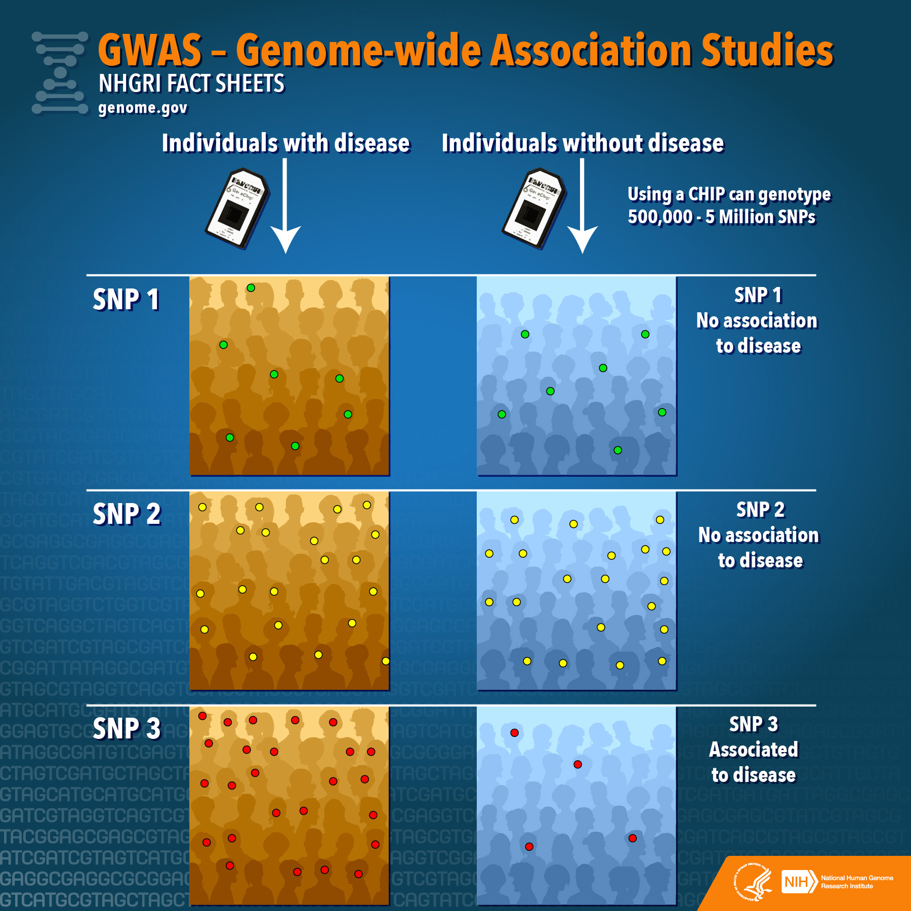
Notes:
History of human gwas

Slide 11
Null hypothesis: no genetic variant is associated with case vs control status
Single nucleotide polymorphisms
(SNPs)
 | Controls (Susceptible) | Cases (Resistant)
C (TCA/Ser) | 326 | 10
T (TTA/Leu) | 3 | 161
Presence vs absence of
entire genes
 | Controls (Susceptible) | Cases (Resistant)
Absent (blaZ⁻) | 59 | 3
Present (blaZ⁺) | 1 | 439
Presence vs absence of
short haplotypes (kmers)
e.g. Resistance to ciprofloxacin
conferred by S84L substitution in the gyrA gene
p = 10^{-114.9}
 | Controls (Susceptible) | Cases (Resistant)
Absent (kmer⁻) | 342 | 1
Present (kmer⁺) | 0 | 158
e.g. Resistance to penicillin
conferred by the blaZ gene
p = 10^{-71.3}
e.g. Resistance to methicillin
conferred by the mecA gene that contains the sequence AAAACAAGTTATAAAATCGATGGTAAAGGTT
p = 10^{-109.2}
Notes:
Introduce kmers

Slide 12
Null hypothesis: no genetic variant is associated with case vs control status
Presence vs absence of
entire genes
 | Controls (Susceptible) | Cases (Resistant)
Absent (blaZ⁻) | 59 | 3
Present (blaZ⁺) | 1 | 439
Odds of case vs control status when blaZ is absent: 3/59
Odds of case vs control status when blaZ is present: 439/1
e.g. Resistance to penicillin
conferred by the blaZ gene
p = 10^{-71.3}
Odds Ratio of case vs control status when blaZ is present vs absent: (439/1) / (3/59) = 25901/3
This gives a log odds ratio, alias Effect Size, of 9.1
Test against the null hypothesis of an odds ratio of 1 (equivalently, an effect size of 0)
Notes:
Introduce kmers

Slide 13
Fusidic acid resistance in Staphylococcus aureus
Fusidic acid
mechanism of action:
Interferes with bacterial protein synthesis
Resistance by substitutions in fusA
Prevents fusidic acid from binding
Resistance by presence of fusB,fusC
Rescue translation from fusidic acid-mediated inhibition
Notes:
** Far is a mobile-element associated gene. It causes resistance by preventing fusidic acid from interacting with its target EF-G **
These proteins bind to elongation factor G (EF-G), the target of FA, and rescue translation from FA-mediated inhibition by an unknown mechanism
Fusidic acid resistance is caused by either the presence of the mobile-element associated far gene, or substitutions within the fusA gene.
We tested for associations between fusidic acid resistance and the presence or absence of short 31bp kmers, as this approach aims to capture resistance encoded by substitutions in the core genome, the presence of mobile accessory genes, or both.
The far-encoded resistance, however, was population-stratified and associated exclusively with strains ST-1 and 8.

Slide 14
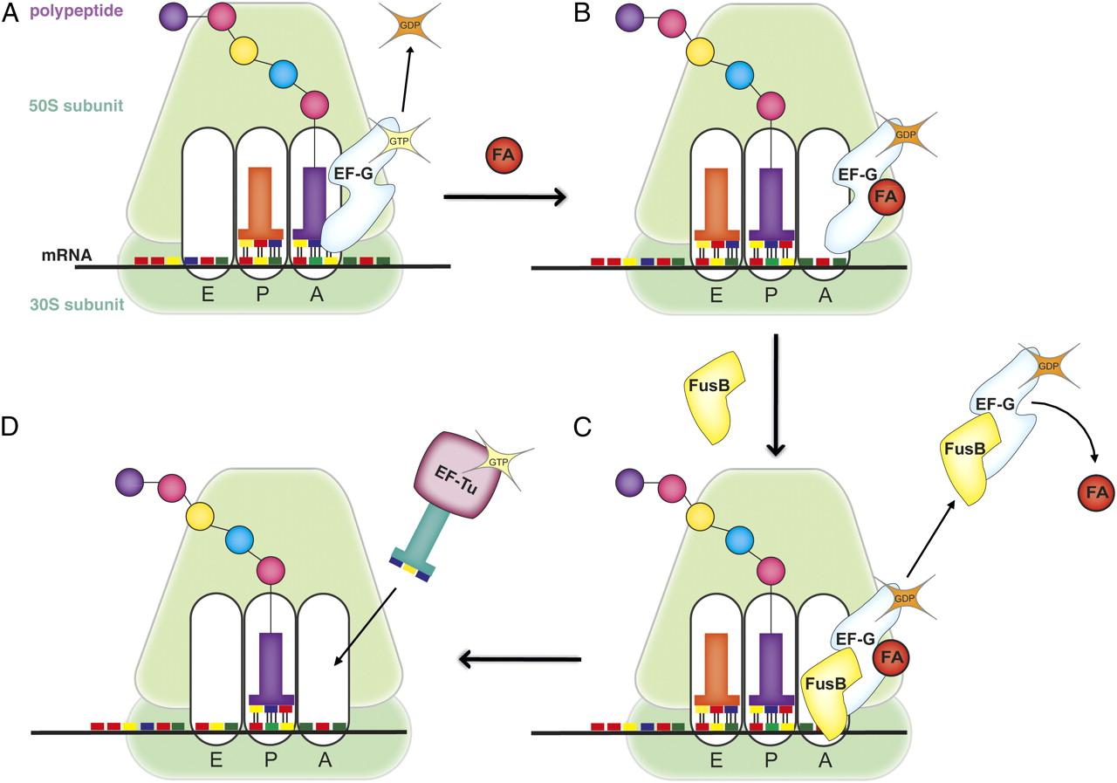
Fusidic acid resistance in Staphylococcus aureus
Protein synthesis requires elongation factor G (EF-G) to proceed normally
Fusidic acid (FA) binds to EF-G, locking it to the ribosome and stalling protein synthesis. Mutations in fusA, the gene encoding EF-G, prevent FA binding, allowing protein synthesis to proceed.
Accessory genes fusB and fusC encode chaperones that bind to EF-G and destablize binding of FA. This promotes dissociation of FA and allows protein synthesis to proceed.

Slide 15
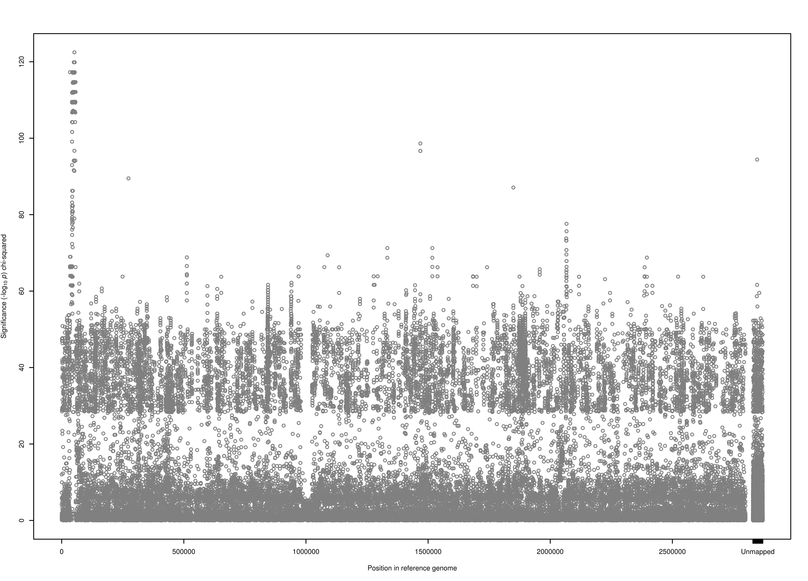
Manhattan plot: Fusidic acid resistance χ² test
31mer presence/absence versus resistance/sensitivity
120
fusC and SCC genes
100
-log₁₀ p χ² test
80
60
40
20
0
0
0.5
1
1.5
2
2.5
Unmapped
Position in reference genome MSSA476 (Mb)
Notes:
Fusidic acid resistance is caused by either the presence of the mobile-element associated far gene, or substitutions within the fusA gene.
We tested for associations between fusidic acid resistance and the presence or absence of short 31bp kmers, as this approach aims to capture resistance encoded by substitutions in the core genome, the presence of mobile accessory genes, or both.
** At the simplest level, a GWAS is just a chi-squared test done lots of times. **
The far-encoded resistance, however, was population-stratified and associated exclusively with strains ST-1 and 8.

Slide 16
Pitfalls for observational studies

Slide 17
Pitfalls for observational studies
False positives
  Especially caused by multiple testing
Confounders
  Especially population structure
Lack of power
  Caused by the need to correct for multiple testing and population structure

Slide 18
Fusidic acid resistance χ² test
31mer presence/absence versus resistance/sensitivity
120
fusC and SCC genes
100
-log₁₀ p χ² test
80
60
40
20
0
0
0.5
1
1.5
2
2.5
Unmapped
Position in reference genome MSSA476 (Mb)
Notes:
Fusidic acid resistance is caused by either the presence of the mobile-element associated far gene, or substitutions within the fusA gene.
We tested for associations between fusidic acid resistance and the presence or absence of short 31bp kmers, as this approach aims to capture resistance encoded by substitutions in the core genome, the presence of mobile accessory genes, or both.
** At the simplest level, a GWAS is just a chi-squared test done lots of times. **
The far-encoded resistance, however, was population-stratified and associated exclusively with strains ST-1 and 8.

Slide 19
Pitfalls for observational studies
Myopic parents
Nightime lighting for children
Myopia
Confounding
Quinn GE, Shin CH, Maguire MG, Stone RA. Myopia and ambient lighting at night. Nature. 1999;399:113–4.

Slide 20
Pitfalls for observational studies
Plasmid-borne β-lactamase
Plasmid-borne transposase
β-lactam resistance
Confounding caused by linkage disequilibrium

Slide 21
Pitfalls for observational studies
Plasmid-borne β-lactamase
Plasmid-carrying strain
β-lactam resistance
All variants associated with that strain
Confounding caused by linkage disequilibrium

Slide 22
Artefactual associations caused by confounding with population structure
Ciprofloxacin resistant S. aureus
Ciprofloxacin sensitive S. aureus
Hospital-associated
clonal complex 22
CC22-specific variants
Hospital-associated
clonal complex 30

Slide 23
Fusidic acid resistance χ² test
31mer presence/absence versus resistance/sensitivity
120
fusC and SCC genes
100
-log₁₀ p χ² test
80
60
40
20
0
0
0.5
1
1.5
2
2.5
Unmapped
Position in reference genome MSSA476 (Mb)
Notes:
Fusidic acid resistance is caused by either the presence of the mobile-element associated far gene, or substitutions within the fusA gene.
We tested for associations between fusidic acid resistance and the presence or absence of short 31bp kmers, as this approach aims to capture resistance encoded by substitutions in the core genome, the presence of mobile accessory genes, or both.
** At the simplest level, a GWAS is just a chi-squared test done lots of times. **
The far-encoded resistance, however, was population-stratified and associated exclusively with strains ST-1 and 8.

Slide 24
Control of population structure
Subpopulations
  Expect individuals in the same subpopulation to have phenotypes that are more similar
Principal components analysis (PCA)
  Expect individuals with similar principal components to have phenotypes that are more similar
Linear mixed models
  Expect individuals that are closely related to have phenotypes that are more similar

Slide 25
Fusidic acid resistance χ² test
120
fusC and SCC genes
100
-log₁₀ p χ² test
80
60
40
20
0
0
0.5
1
1.5
2
2.5
Unmapped
Position in reference genome MSSA476 (Mb)
Notes:
Fusidic acid resistance is caused by either the presence of the mobile-element associated far gene, or substitutions within the fusA gene.
We tested for associations between fusidic acid resistance and the presence or absence of short 31bp kmers, as this approach aims to capture resistance encoded by substitutions in the core genome, the presence of mobile accessory genes, or both.
** At the simplest level, a GWAS is just a chi-squared test done lots of times. **
The far-encoded resistance, however, was population-stratified and associated exclusively with strains ST-1 and 8.

Slide 26
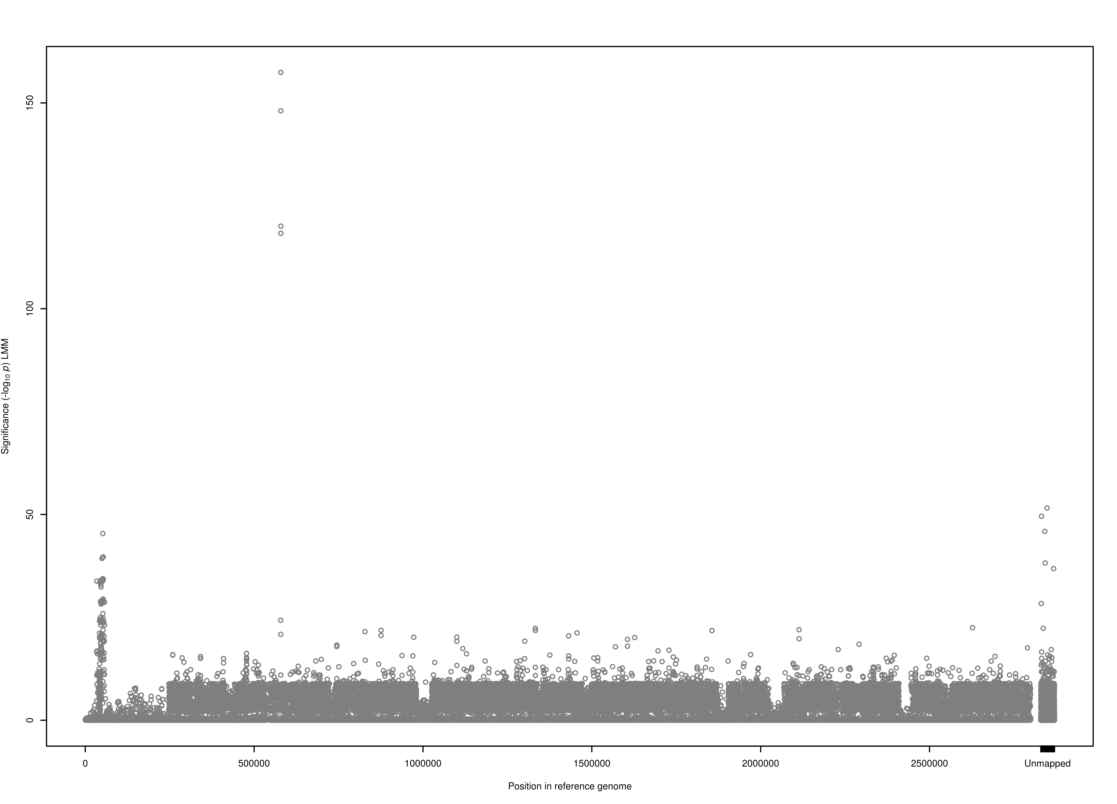
Fusidic acid resistance χ² test
120
fusA gene
100
80
Linear Mixed Model (LMM) -log₁₀ p
60
40
fusC and SCC genes
20
0
0
0.5
1
1.5
2
2.5
Unmapped
Position in reference genome MSSA476 (Mb)
Notes:
Fusidic acid resistance is caused by either the presence of the mobile-element associated far gene, or substitutions within the fusA gene.
We tested for associations between fusidic acid resistance and the presence or absence of short 31bp kmers, as this approach aims to capture resistance encoded by substitutions in the core genome, the presence of mobile accessory genes, or both.
** At the simplest level, a GWAS is just a chi-squared test done lots of times. **
The far-encoded resistance, however, was population-stratified and associated exclusively with strains ST-1 and 8.

Slide 27
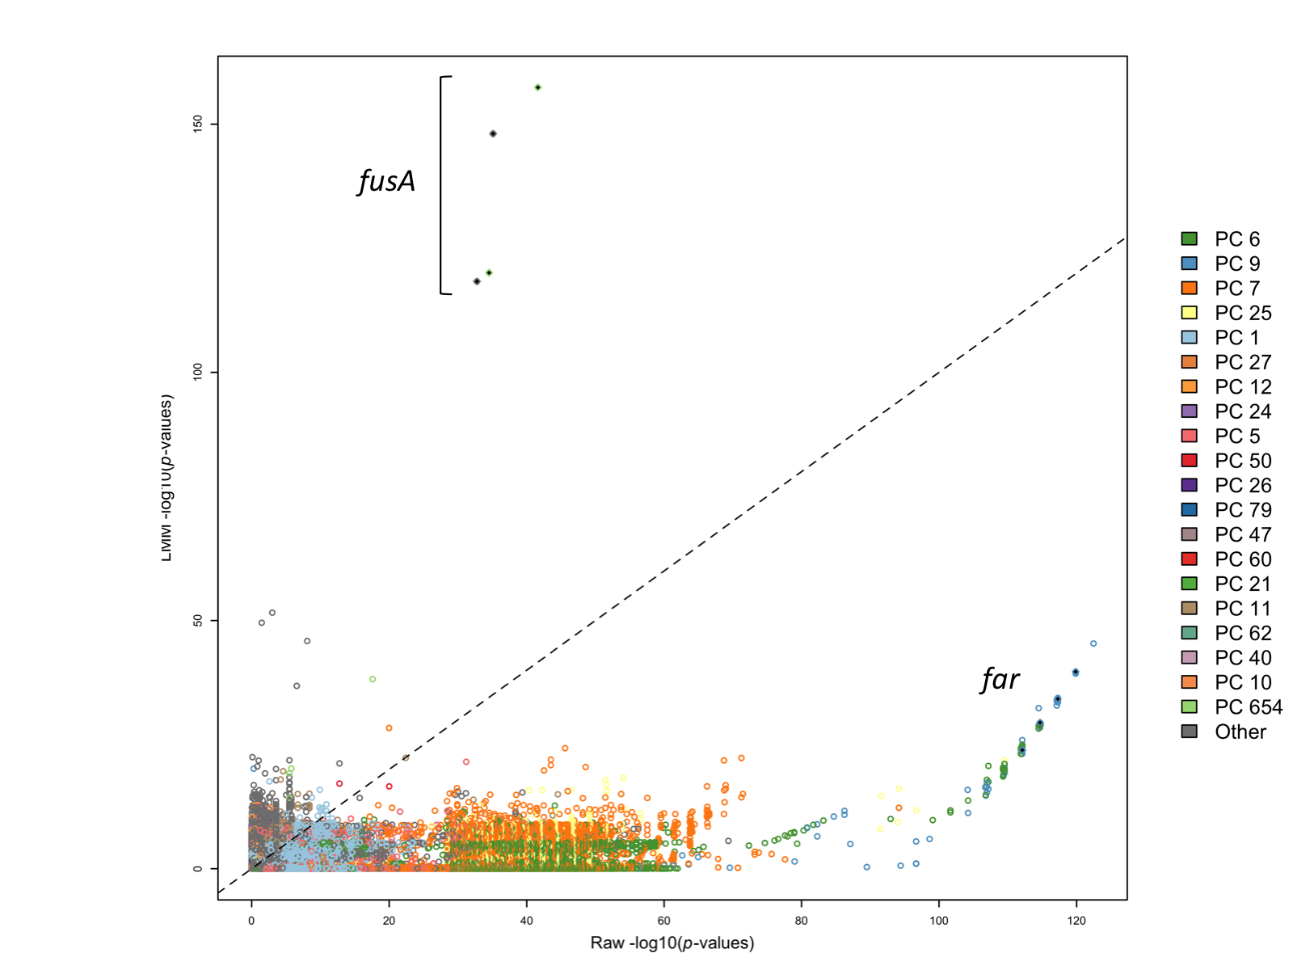

Where did the signal of association at fusC go?
Controlling for population structure reduced significance of fusC kmers from p < 10⁻¹²² to
p < 10⁻³⁹
Kmers capturing fusA increased from p < 10⁻¹²² to
p < 10⁻³⁹
150
fusA
100
Linear Mixed Model (LMM) -log₁₀ p
Linear Mixed Model (LMM) -log₁₀ p
50
fusC
-log₁₀ p χ² test -log₁₀ p
0
0
20
40
60
80
100
120
Notes:
So we reassessed the locus specific effects by assigning variants to lineages according to the PC to which they were most correlated, and comparing the significance of variants within lineages. This showed that far, and variants in LD with far, accounted for the strongest signals within PCs 6 and 9.

Slide 28
Sensitivity vs specificity
Multiple testing correction sacrifices power to achieve an acceptable false positive rate
Power, sensitivity or the true positive rate is the probability of avoiding a type II error: incorrectly failing to reject the null hypothesis
Superior methods achieve greater power for a fixed false positive rate
Methods that correct for population structure are generally superior
Specificity (1-the false positive rate) is the probability of avoiding a type I error: incorrectly rejecting the null hypothesis
 | Test does not reject H₀ | Test rejects H₀
H₀ is true | True negative (sensitivity) | False positive
H₀ is false | False negative | True positive (power/specificity)

Slide 29
Bacterial GWAS in practice

Slide 30
Earle et al 2016 Nature Microbiology
Resistance determined by gene presence
Resistance determined by SNPs
Resistance determined by gene presence or SNPs or both
Most significant variant was the expected mechanism
Most significant variant was in physical linkage (PL) with the expected mechanism
Most significant variant was not the expected mechanism or in PL with the expected mechanism
Genuine resistance-conferring variants were detected in all but one study
Notes:
After controlling for population structure, both the combined SNP and pangenome results and the kmer results were correct is 25/26 cases. We have defined correct as the most significant result being either the causal mechanism, or a gene found in close physical linkage with a causal mechanism.
Genuine resistance-conferring variants were detected in all but one study.
However, these results also reflect extraordinary selection pressures exerted by antimicrobials. High homoplasy at resistance-conferring loci caused by repeat mutation and recombination break down LD, assisting mapping.

Slide 31
GWAS for toxicity

Slide 32
GWAS for host association

Slide 33
Using GWAS results for predicting resistance

Slide 34
summary

Slide 35
Genome-wide association studies for bacterial pathogens
Accessibility of genome sequencing paves the way to discover genetic basis of diverse traits
Studies must overcome a range of pitfalls, notably
  False positives caused by many tests
  Artefactual associations generated by confounders, especially population structure
  Limited power
Proof of principle for bacterial GWAS established by studies of antimicrobial resistance
New studies are shedding light on other phenotypes such as components of virulence
Knowledge about genotype-phenotype relations will be used in future in the clinic for rapid prediction of genotypes including antimicrobial resistance

Slide 36
Bilbiography
Bacterial GWAS
Earle et al (2016) Nature Microbiology 1: 16041
Laabei et al (2014) Genome Research 24: 839
Bradley et al (2015) Nature Communications 6: 10063
Sheppard et al (2013) PNAS 110: 11923
Reviews
Didelot et al (2016) Nature Reviews Microbiology 14: 150
Wilson (2012) PLoS Pathogens 8: e1002874
Contact daniel.wilson@ndm.ox.ac.uk
Web www.daniel wilson.me.uk

Slide 37
Pitfalls for observational studies
Myopic parents
Inherited genotype
Myopia
Mediation

Slide 38
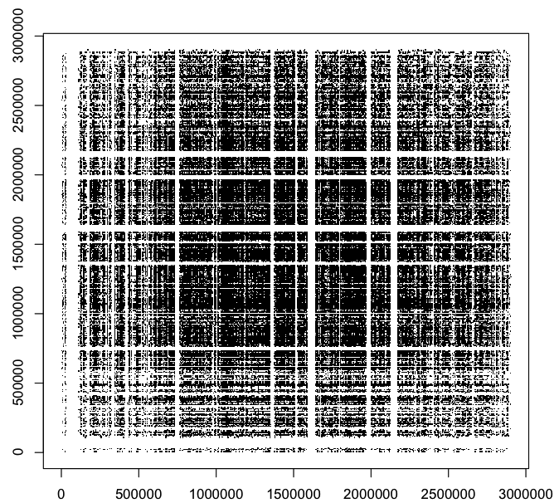
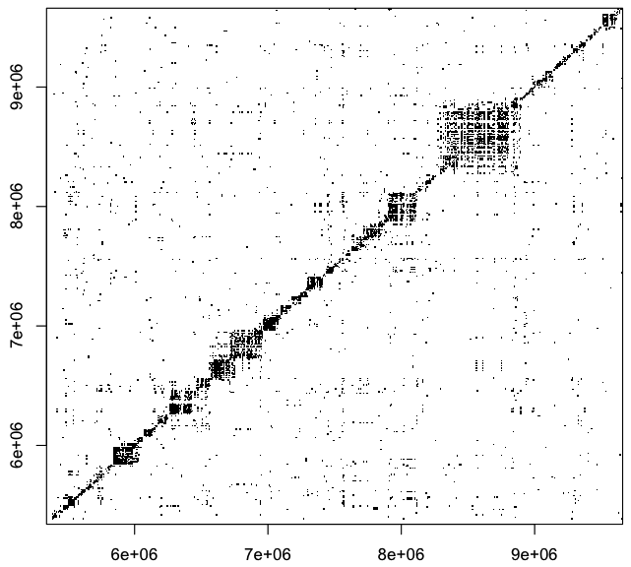
The Challenge of Bacterial Linkage Structure
Human chromosome 1
Staphylococcus aureus
Points show the position of SNP pairs in moderate to high linkage disequilibrium
i.e. r² > 0.4
Physical position on chromosome (base pairs)

