Slide 1
Within-host evolution of bacterial pathogens
Danny Wilson
Associate Professor and Sir Henry Dale Fellow
Nuffield Department of Medicine, University of Oxford

Slide 2
Within-Host Evolution of
Bacterial Pathogens
What does evolution have to do with anything? (Harvard video)
Evolution within patients
  Bacterial evolutionary rates
  Selective sweeps
  Clonal interference
  Pleiotropy
  Convergent evolution
  Heteroresistance
Methods for detecting variation in the host
  Mapping
  Assembly

Slide 3
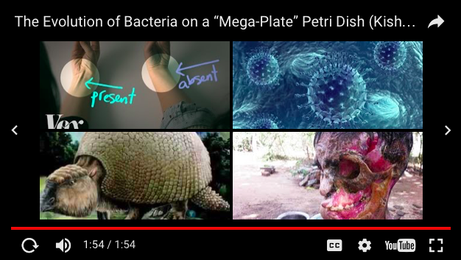
What does evolution have to do with anything?

Slide 4
evolution within patients

Slide 5
Sources of within-host genetic diversity
Where does the raw material for within-host evolution come from?
Notes:
Introduced: infection with multiple genotypes, multiple infection, HGT from other colonizing species. De novo: mutations (of all types)

Slide 6
Evolutionary forces within hosts
What are the evolutionary forces that shape genetic variability within hosts?
Notes:
Variation generation (mutation, HGT, immigration). Random genetic drift. Natural selection.
Selective forces: physical barriers to colonization/infection, competition from native microbiome, immune system, basic sanitation, medical treatment

Slide 7
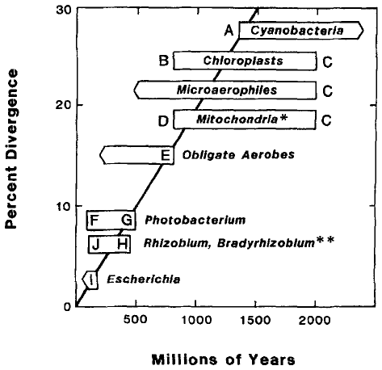
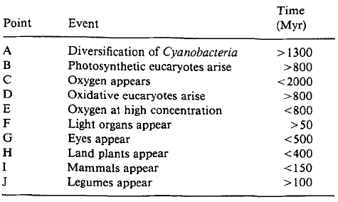
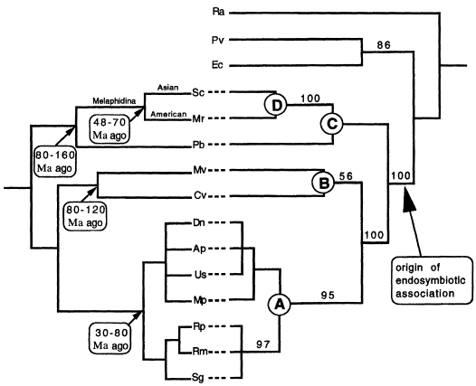
The bacterial mutation rate: geological evidence
16S rDNA
~0.01 per Mb per yr (silent sites)
Evolution in bacteria: evidence for a universal substitution rate in cellular genomes
Howard Ochman and Allan C Wilson J Mol Evol (1987) 26: 74-86.
A molecular clock in endosymbiotic bacteria is calculated using the insect hosts
Nancy A Moran, Mark A Munson, Paul Baumann and Hajime Ishikawa Proc R Soc Lond B (1993) 253: 167-171.

Slide 8
The bacterial mutation rate: genomic evidence
Lieberman et al (2011) Nature Genetics 43 1275-1280
Notes:
Supplementary slide?

Slide 9
The bacterial mutation rate: genomic evidence
Species | Mutation rate per Mb per year | Reference
Mycobacterium tuberculosis | 0.1 * | Ford et al (2011) Nat Genet 43:482
Escherichia coli | 0.2 | Reeves et al (2011) PLoS ONE 6:e26907
Burkholderia dolosa | 0.3 | Lieberman et al (2011) Nat Genet 43:1275
Clostridium difficile | 0.5 | Didelot et al (2012) Genome Biol 13:R118
Vibrio cholerae | 0.8 | Mutreja et al (2011) Nature 477:462
Streptococcus pneumoniae | 1.6 | Croucher et al (2011) Science 331:430
Staphylococcus aureus | 2.0 1.9 *, 2.7 * 3.3 3.4 | Smyth et al (2009) PLoS ONE 5:e8582 Young et al (2012) PNAS 109:4550 Harris et al (2010) Science 327:469 Nubel et al (2010) PLoS Pathog 6:e1000855
Helicobacter pylori | 19 * | Kennemann et al (2011) PNAS 108:5033
* within-host rates
Notes:
Supplementary slide?

Slide 10
Lieberman T. D. et al. Parallel bacterial evolution within multiple patients identifies candidate pathogenicity genes. Nat. Genet. 43 1275-1280 (2011)
Marvig R. L. Johansenm H. K. Molin S. & Jelsbak L. Genome analysis of a transmissible lineage of Pseudomonas aeruginosa reveals pathoadaptive mutations and distinct evolutionary paths of hypermutators. PLoS Genet. 9 e1003741 (2013)
Lieberman T. D. et al. Genetic variation of a bacterial pathogen within individuals with cystic fibrosis provides a record of selective pressures. Nat. Genet. 46 82-87 (2014)
Comas I. et al. Whole-genome sequencing of rifampicin-resistant Mycobacterium tuberculosis strains identifies compensatory mutations in RNA polymerase genes. Nat. Genet. 44 106-110 (2012)
Eldholm V. et al. Evolution of extensively drug-resistant Mycobacterium tuberculosis from a susceptible ancestor in a single patient. Genome Biol. 15 490 (2014)
Toprak E. et al. Evolutionary paths to antibiotic resistance under dynamically sustained drug selection. Nat. Genet. 44 101-105 (2012)
Yang L. et al. Evolutionary dynamics of bacteria in a human host environment. Proc. Natl. Acad. Sci. U.S.A. 108 7481-7486 (2011)
Dordel J. et al. Novel determinants of antibiotic resistance: identification of mutated loci in highly methicillin-resistant subpopulations of methicillin-resistant Staphylococcus aureus. mBio 5 e01000-12 (2014)
Gao W. et al. Two novel point mutations in clinical Staphylococcus aureus reduce linezolid susceptibility and switch on the stringent response to promote persistent infection. PLoS Pathog. 6 e1000944 (2010)
Mwangi M. M. et al. Tracking the in vivo evolution of multidrug resistance in Staphylococcus aureus by whole-genome sequencing. Proc. Natl. Acad. Sci. U.S.A. 104 9451-9456 (2007)
Snitkin S. et al. Genomic insights into the fate of colistin resistance and Acinetobacter baumannii during patient treatment. Genome Res. 23 1155-1162 (2013)
Sydenham TV, Sóki J, Hasman H, Wang M, Justesen US: Identification of antimicrobial resistance genes in multidrug-resistant clinical Bacteroides fragilis isolates by whole genome shotgun sequencing. Anaerobe 2014, doi:10.1016/j.anaerobe.2014.10.009.
Arias C. A. et al. Genetic basis for in vivo daptomycin resistance in enterococci. N. Engl. J. Med. 365 892-900 (2011)
Cannatelli A, Di Pilato V, Giani T, Arena F, Ambretti S, Gaibani P, D’Andrea MM, Rossolini GM: In vivo evolution to colistin resistance by PmrB sensor kinase mutation in KPC-producing Klebsiella pneumoniae is associated with low-dosage colistin treatment. Antimicrob. Agents Chemother. 2014, 58:4399–403.
Espedido B a, Steen J a, Ziochos H, Grimmond SM, Cooper M a, Gosbell IB, van Hal SJ, Jensen SO: Whole genome sequence analysis of the first Australian OXA-48-producing outbreak-associated Klebsiella pneumoniae isolates: the resistome and in vivo evolution. PLoS One 2013, 8:e59920.
Afonso Guerra-Assuno J. et al. Relapse or reinfection with tuberculosis: a whole genome sequencing approach in a large population-based cohort with high HIV prevalence and active follow-up. J. Infect. Dis. Pii: jiu574 (2014)
Clark T. G. et al. Elucidating emergence and transmission of multidrug-resistant tuberculosis in treatment experienced patients by whole genome sequencing. PloS ONE 8 e83012 (2013)
Fahrat M. R. et al. Genomic analysis identifies targets of convergent positive selection in drug-resistant Mycobacterium tuberculosis. Nat. Genet. 45 1183-1189 (2013)
Ford C. B. et al. Mycobacterium tuberculosis mutation rate estimates from different lineages predict substantial differences in the emergence of drug-resistant tuberculosis. Nat. Genet. 45 784-790 (2013)
Saunders N. J. et al. Deep resequencing of serial sputum isolates of Mycobacterium tuberculosis during therapeutic failure due to poor compliance reveals stepwise mutation of key resistance genes on an otherwise stable genetic background. J. Infect. 62 212-217 (2011)
Sun G. et al. Dynamic population changes in Mycobacterium tuberculosis during acquisition and fixation of drug resistance in patients. J. Infect. Dis. 206 1724-1733 (2012)
Wong A. & Kassen R. Parallel evolution and local differentiation in quinolone resistance in Pseudomonas aeruginosa. Microbiology 157 937-944 (2011)
Ba X. et al. Novel mutations in penicillin-binding protein genes in clinical Staphylococcus aureus isolates that are methicillin resistant on susceptibility testing but lack the mec gene. J. Antimicrob. Chemother. 69 594-597 (2014)
Howden B. P. et al. Evolution of multidrug resistance during Staphylococcus aureus infection involves mutation of the essential two component regulator WalKR. PLoS Pathog. 7 e1002359 (2011)
Kim S. Lieberman T. D. & Kishony R. Alternating antibiotic treatments constrain evolutionary paths to multidrug resistance. Proc. Natl. Acad. Sci. U.S.A. 111 14494-14499 (2014)
Peleg A. Y. et al. Whole genome characterization of the mechanisms of daptomycin resistance in clinical and laboratory derived isolates of Staphylococcus aureus. PLoS ONE 7 e28316 (2012)
van Hal S. J. et al. In vivo evolution of antimicrobial resistance in a series of Staphylococcus aureus patient isolates: the entire picture or a cautionary tale? J. Antimicrob. Chemother. 69 363-367 (2014)

Slide 11
blaR1
rpoB
rpoC
vraR
yycH
Notes:
Until the recent advances in WGS, the characteriza- tion of bacterial microevolution was the sole purview of experimental studies80. WGS captures this process in extraordinary detail and, as a result, has now provided valuable insights into many within-host examples of the evolution of antibiotic resistance. Consequently, the occurrence and spread of individual point mutations that increase antibiotic resistance and contribute to treatment failure can often be pinpointed, as observed in the evolu- tion of vancomycin-resistant S. aureus in a patient with an initially vancomycin-susceptible bloodstream infection81. Rifampicin resistance-associated mutations in RNA poly- merase β-subunit (rpoB), a β-lactam resistance-associated mutation in β-lactamase regulator protein (blaR1) and mutations in several genes associated with reduced vancomycin susceptibility were identified in bacteria isolated from the patient only after treatment with the respective antibiotic. Mutations progressively accumu- lated over time, concomitant with a stepwise decrease in vancomycin susceptibility81.

Slide 12
Natural selection: classic selective sweep
100% growth
advantage/week
80% growth
advantage/week
Mutation arises

Slide 13
Random genetic drift: adding stochasticity
N = 1000
Probability of substitution is just 2% because even beneficial mutations are vulnerable to stochasticity at low frequencies.
Even in a large population, a mutant that produces an additional s offspring per generation only has a substitution probability of 2s at most.

Slide 14
Months
Notes:
The sheer potency of bacterial evolution was revealed by the evolution of extensively drug resistant (XDR) M. tuberculosis from a wholly drug-sensitive ancestor, in a single patient, over just 3.5 years82,83. Resistance evolved to seven drugs to which the patient was exposed: rifampicin (to which resistance was conferred by mutations in rpoB), isoniazid (mutations in catalase–peroxidase (katG)), ethambutol (mutations in arabinosyltrans- ferase B (embB)), streptomycin (mutations in 16S rRNA (rrs) and rRNA small subunit methyltransferase (gid)), ofloxacin (mutations in DNA gyrase subunit B (gyrB)), ethionamide (mutations in d-inositol 3-phosphate glyco- syltransferase (mshA)) and amikacin (mutations in rrs). In most cases, resistance-conferring mutations arose in one or more lineages in the within-patient population after only several months of treatment with the respec- tive antibiotic. Ultimately, in an extreme example of clonal interference, a single multidrug-resistant lineage prevailed, displacing the others. The spread of advantageous resist- ance mutations increased the measured substitution rate 14-fold, and propelled the substitution of numerous syn- onymous mutations on the same genetic background as the advantageous mutations, in an example of a process known as hitchhiking.

Slide 15
Clonal Interference
Notes:
The evolution of antibiotic resistance within indivi- dual hosts epitomizes the evolutionary principle of a selective sweep, as the survival advantage gained from the resistance-conferring gene (or mutation within a gene) in the presence of antibiotic treatment increases the fre- quency of the gene (or mutation) in the within-host population. Furthermore, horizontal gene transfer can accelerate the rate of spread of resistance-conferring genes that are carried by plasmids or other mobile elements.

Slide 16
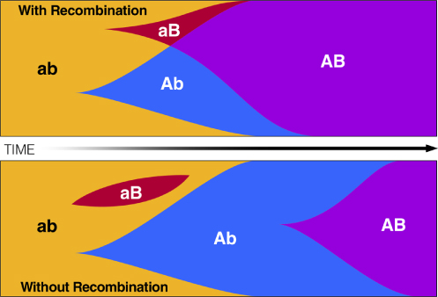
Clonal Interference
Rouzine, I M and Weinberger, L S (2013) Journal of Statistical Mechanics
Notes:
The evolution of antibiotic resistance within indivi- dual hosts epitomizes the evolutionary principle of a selective sweep, as the survival advantage gained from the resistance-conferring gene (or mutation within a gene) in the presence of antibiotic treatment increases the fre- quency of the gene (or mutation) in the within-host population. Furthermore, horizontal gene transfer can accelerate the rate of spread of resistance-conferring genes that are carried by plasmids or other mobile elements.

Slide 17
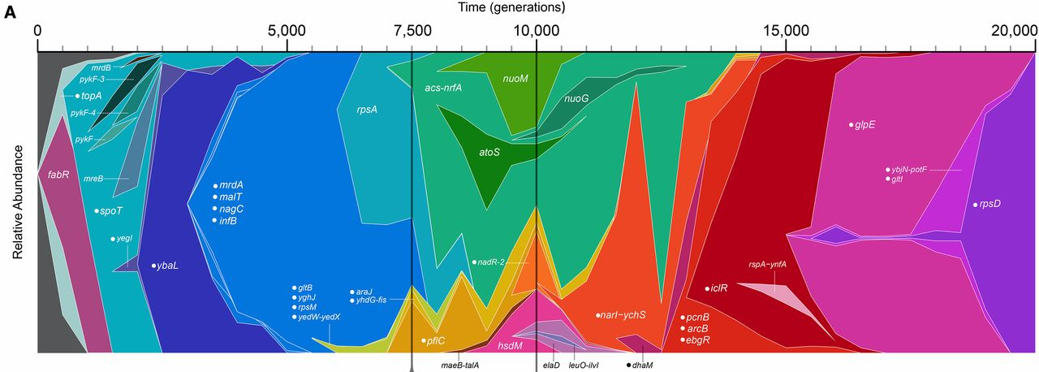
Clonal Interference
Maddamsetti, R, Lenski, R E, Barrick, J E (2015) Genetics 200: 619-631
Notes:
The evolution of antibiotic resistance within indivi- dual hosts epitomizes the evolutionary principle of a selective sweep, as the survival advantage gained from the resistance-conferring gene (or mutation within a gene) in the presence of antibiotic treatment increases the fre- quency of the gene (or mutation) in the within-host population. Furthermore, horizontal gene transfer can accelerate the rate of spread of resistance-conferring genes that are carried by plasmids or other mobile elements.

Slide 18
Notes:
Some naturally evolved resistance mutations seem to be pleiotropic, leading to multifaceted changes in bacterial phe- notype, including resistance to drugs to which the popula- tion has not been exposed81,84,85. In five patients, S. aureus with reduced vancomycin susceptibility evolved from initially susceptible strains following fewer than 6 weeks of treatment with vancomycin. Non-synonymous muta- tions in the WalKR two-component regulator84, which has a central role in controlling cell wall metabolism86, were found in four of these patients, and in six of eight unrelated bacterial isolates with reduced vancomycin susceptibility. The majority of isolates with reduced vancomycin suscep- tibility also demonstrated reduced daptomycin suscepti- bility, despite not being exposed to this antibiotic84. Allelic exchange experiments showed that mutations in walKR led to morphological and transcriptional remodelling, including reduced autolytic activity, increased cell wall thickness, reduced biofilm formation and attenuated vir- ulence in a wax moth model of infection84. This incidental pre-adaptation to other antibiotics, a phenomenon known as cross-resistance, presents a particular cause for concern by further limiting treatment options.

Slide 19
Pleiotropy
One variant
Substitution in walkR
Reduced vancomycin sensitivity
Reduced daptomycin sensitivity
Multiple phenotypic effects, e.g. cross-resistance

Slide 20
Notes:
The ability to study the evolution of antibiotic resistance in extensive detail using WGS has enabled the discovery of novel mutations and resistance mechanisms that may help predict treatment failure and aid in the development of new drugs87–93. These in vivo surveys of within-host evolution present a complementary approach to experi- mental studies. Although it is not possible for all variables to be controlled, observing natural evolution in within- host populations has the advantage of incorporating com- plexities such as strain differences, the host environment and realistic fitness trade-offs, which has highlighted the formidable adaptive potential of bacterial pathogens.
Certain genes have been identified as common sites of adaptive evolution in response to antibiotic treatment, with independently arising mutations often hitting differ- ent sites in the same gene. Common targets of selection include rpoB in response to treatment with rifampicin (which inhibits RNA polymerase) in several species85,94–96, DNA gyrase subunit A (gyrA)38,96–99 and DNA topo- isomerase IV (grlA; also known as parC)100 in response to fluoroquinolones (which target topoisomerases) in vari- ous species, and the cell wall metabolism genes walKR and vraRS in response to treatment with vancomycin (which inhibits cell wall synthesis) in S. aureus81,84,101.
Reports of convergent evolution in independent patients who were exposed to the same drugs provide the strongest evidence for adaptation. A study investigated the evolu- tion of resistance to a wide range of drugs in 123 strains of M. tuberculosis representing transmission clusters and epidemiologically unrelated cases. Resistance evolved independently up to 20 times to the first line drugs isoni- azid, pyrazinamide, ethambutol and rifampicin through substitutions in katG and NADH-dependent enoyl-acyl carrier protein reductase (inhA; conferring resistance to isoniazid), pncA (conferring resistance to pyrazinamide), embB (conferring resistance to ethambutol) and rpoB (conferring resistance to rifampicin). Identical, independ- ent substitutions were detected at two sites in rpoB and one in embB87. The observation that resistance to common antibiotics has evolved not once, but many times in par- allel, highlights the adaptive potential and repeatability of bacterial evolution.
Given the rapidity with which bacteria can respond to selection pressures by within-host evolution, it may seem surprising that antibiotic resistance has not spread more quickly. It has been suggested that the fitness costs associated with resistance might explain this discrepancy because resistance-conferring substitutions in key enzymes may reduce the efficiency of replication and transcription, and specialist resistance-conferring proteins may be costly to produce88,102. However, compensatory mutations may arise that counteract the fitness costs associated with anti- biotic resistance (FIG. 3). WGS enabled a joint investigation of naturally evolving rifampicin resistance-conferring
and compensatory mutations in tuberculosis88. Putative compensatory mutations were detected in 38 genes, with a particular enrichment of mutations affecting the inter- face between RNA polymerase α-subunit and β′-subunit. High in vitro fitness was demonstrated in strains bearing compensatory mutations subject to strong convergent evo- lution across lineages, demonstrating that a cost associated with resistance is not inevitable.

Slide 21
Convergent or parallel evolution
If selection is sufficiently strong, and the range of adaptations limited (a small ‘target size’), might expect to see the same adaptations arising independently
This is highly improbable by chance because of the low mutation rate in bacteria. The observation of parallel or convergent evolution therefore constitutes strong evidence for adaptation.

Slide 22
Notes:
Even when fitness costs are inevitable, bacteria can evolve adaptability. A well-studied form of adaptability is the previously mentioned phase variation mechanism, in which frequent, reversible genetic changes determine the expression of particular genes, such as those encoding surface antigens. Rapid mutation enables the expression of these genes to be quickly adapted to changing selection pressures. Another form of adaptability that is increas- ingly being recognized is heteroresistance. For example, population analysis profiles (PAPs) reveal that, remark- ably, most methicillin-resistant S. aureus (MRSA) strains are heteroresistant, meaning that the vast majority of the bacterial cells have only low-level or moderate-level resist- ance in the absence of exposure to methicillin, whereas cells exhibiting a several hundred-fold increase in resist- ance are present only at very low frequency95. On expo- sure to methicillin, these highly resistant bacterial cells can rapidly sweep through the population. Genome sequencing has found that high-level resistance can be conferred by numerous individual mutations within the S. aureus genome, many of which affect gene expression. Although this indicates a large target for selection, the over-representation of mutations in genes involved in transcription and the stringent response suggests a degree of convergent evolution95.
Heteroresistance demonstrates the capacity for large bacterial populations in the host to mutate and harbour potentially advantageous mutations, facilitating adapt- ability. Observations of heteroresistance to a range of antibiotics in several pathogens, including S. aureus, M. tuberculosis, S. pneumoniae and enterococci103, indi- cate that within-host evolution is not the exception, but the norm, in bacteria and may be a leading contributor to monotherapy treatment failure100. As the potential for adaptability seems to vary between bacterial strains, the capacity for within-host evolution might even explain differences in the prevalences of global lineages104.

Slide 23
Heteroresistance
Although the mutation rate is low, ~10⁻⁹ per generation, a large enough within-host population will inevitably harbour mutants
If the target size for selection is large, the opportunity for adaptation may be considerable. For example, if any of 1000 mutations across the genome can induce high-level methicillin resistance via the stringent stress response, then any large enough MRSA culture, e.g. 10⁶ cells, will contain a highly resistant mutant.
Since the mutant almost certainly exists albeit at low frequency, it can be readily selected for by increasing the antibiotic concentration.

Slide 24
Factors favouring within-host adaptation
High mutation rate
Large population size
Strong selective advantage of the mutant
Many potentially beneficial mutations (large target for selection)
Notes:
Rapid within-host adaptation depends on a range of factors, notably the rate at which mutations that confer a potential benefit occur, the effective population size and the fitness advantage of mutants131. The larger these factors are, the faster the rate of adaptation in the population as a whole. Recent studies in M. tuberculo- sis have shown that both the mutation rate and effec- tive population size within the host are very small. The genome-wide mutation rate barely registers one muta- tion every two years32,33,82, and diversity is so low that isolates sampled at the same time differ by an average of only 0.5 mutations33. Assuming, for illustrative purposes, a generation length of 24 hours132, this is equivalent to an effective population size of fewer than 200 repro- ductively viable cells. Target sizes for selection, in terms of the number of possible beneficial mutations, differ between drugs but commonly involve around a dozen sites within a particular gene. To observe adaptation, in the presence of antibiotics, in a timescale of months, 1000-fold or greater daily replicative advantage of resist- ant over susceptible cells is required. This is plausible for antibiotic-induced selection, in which the advantage of resistance over susceptibility can in some cases be of this order of magnitude. However, these values suggest that M. tuberculosis is unlikely to evolve within-host adapta- tions during the course of a single infection unless there are many potentially beneficial mutations, or unless adaptation is a matter of life or death.

Slide 25
Variant discovery

Slide 26

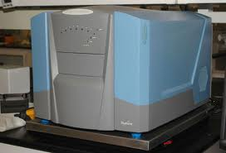



Illumina Sequencing
Sample
Quality Control
THE PIPELINE

Slide 27
Filtering workflow via GATK: possible stages
INDEL ALIGNMENT
Target regions for local realignment
Local realignment
Fix mate pairs for realigned reads
RE-CALIBRATION
Calculate covariates for recalibration
Perform recalibration
PRE-CALLING
Read clipping
Assess callability (coverage, mapQ)
CALLING
Call SNPs
(Maq, Broad Single/Multi)
Call short INDELs
PRE-FILTERING
Variant quality score recalibration
Variant annotator
(or BAMSTATS)
FILTERING
Variant filtration

Slide 28
De novo sequencing: possible stages
ASSEMBLY
VELVET OPTIMIZER
VELVET ASSEMBLY
QUALITY QUANTIFICATION
DIRECT QUERIES
MULTIPLE ALIGNMENT
BLAST OR WEB INTERFACE
ANNOTATION
ANNOTATE NOVEL REGIONS
CONTIG ALIGNMENT
ALIGNED ANNOTATED CONTIGS
AUTOMATED QUERIES
INTERFACE
Protein-coding sequences
(core/pathway)
Mobile element copy number
Accessory gene presence/
absence

Slide 29
What Mapping Is
Take a high-quality, complete genome typically ‘capillary’ sequenced as the reference.
For each 150bp read, find the best match in this reference genome.
Repeat 3 million times.
Assumes that differences relative to the reference sequence are minor
  Not too many divergent nucleotides within a 150bp window
  Not too many short indels within the window
  No major inversions, translocations or indels
Unreliable in repetitive regions

Slide 30


What Mapping Is
Like trying to do a jigsaw puzzle, but the pieces in the box are different to on the front

Slide 31

Reads (FASTQ)
Aligned Reads
(BAM)
Reference (FASTA)
Mapper
(Stampy)
Putative Variants
(VCF)
Call Variants
(Samtools/GATK)
High Quality Variants
(VCF)
Mask Dubious Variants
(various methods)

Slide 32
Reads (FASTQ)
Reference (FASTA)
Aligned Reads
(BAM)
Mapper
(Stampy)
@GAII02_0008:4:1:995:8282#ACAGTG/2
AATTCAAGTACTTCTTTCTTTAGTTTCATTTCTTTTGTCTCTTTTGATATA
+GAII02_0008:4:1:995:8282#ACAGTG/2
bbbbbbbbbbbbbbbbbbbba\b_bbbabbbbbbaaabbbbbbbbb`bbbb
@GAII02_0008:4:1:997:20585#ACAGTG/2
GAATGTATCATATTACCCCCACCTACATATATTCCAACATGACTAACAGAA
+GAII02_0008:4:1:997:20585#ACAGTG/2
bbbabbbbbbbbbaabbbb\b]YVb_`bbbbbbbbbbbb`babbabbbbUb
@GAII02_0008:4:1:997:20812#ACAGTG/2
AAATAATGTAGAAGCTATAAAATACATAAATAATGTATTAGATGTTGCGCA
+GAII02_0008:4:1:997:20812#ACAGTG/2
]]]]Z__\__Y[Wa_aaaaaaa`aaaa^aaa_`a_]^]__aQa\aaaaaa_
and another 12 million lines

Slide 33
Reads (FASTQ)
Reference (FASTA)
Aligned Reads
(BAM)
Mapper
(Stampy)
>CD630 gi|115249003|emb|AM180355.1| Clostridium difficile 630 complete genome
ATGGATATAGTTTCTTTATGGGACAAAACCCTACAATTAATAAAAGGTGACTTAACTTCAGTAAGTTTTA
ATACCTTTTTTAAAAACATCGTACCATTAAAAATACATCTTAATGATTTAATCTTACTGGCTCCTAGTGA
TTTTAATAAAGATATCTTAGAGAATAGATATTTACATTTAATTGAAGATGCTATTAGTCAACTGTCATTA
AAAAAATATAATATTAAATTTGTATTGAGCGAAAAAGAGGTTGCTGATTTAAATTCTGATAGCACAGATT
TAAATTATAGAGTTCTTTACCCCAATCTAAATCCAAAATACACATTTGATACATTCGTTATTGGTAATAG
CAATAGATTTGCACATGCTGCATGCGTTGCAGTTGCAGAATCTCCAGCTAAAGCTTATAACCCACTTTTT
TTGTATGGAGGAGTTGGATTAGGTAAGACTCACCTAATGCATGCTATAGGTCATCATATTGTTAGTCAAA
AAAAAGACTCAAAAGTAGTTTACGTTTCTTCAGAAAAATTTACTAATGAACTTATAAACTCTATAAAAGA
CGATAAAAACGAAGAATTTAGGAATAAATATAGAAACGTAGATGTATTACTAATCGACGATATTCAATTT
and another 61282 lines

Slide 34
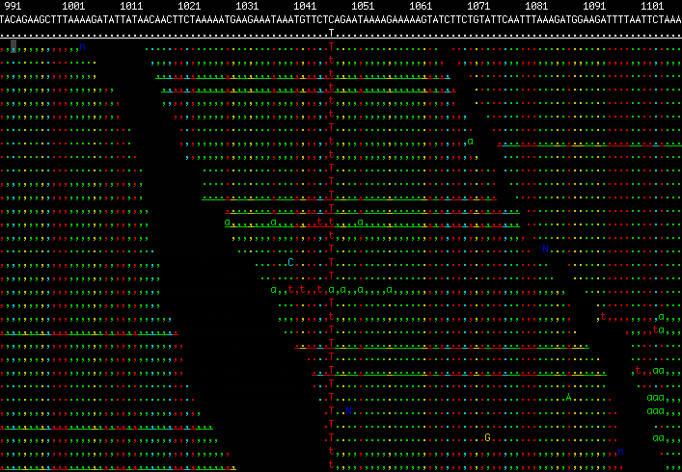
Reads (FASTQ)
Reference (FASTA)
Aligned Reads
(BAM)
Mapper
(Stampy)

Slide 35
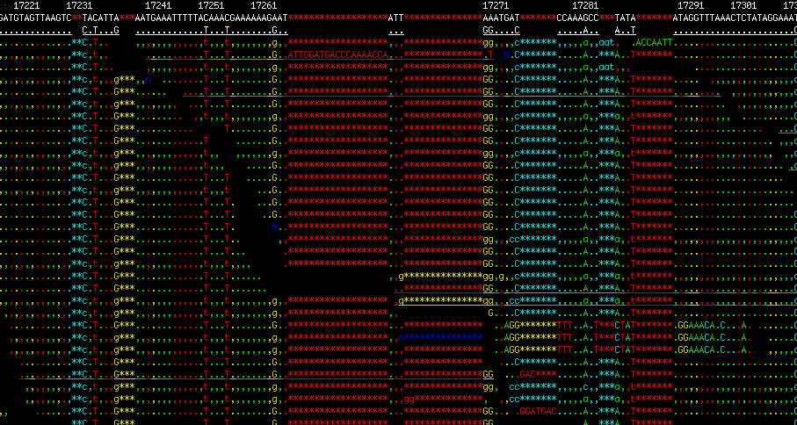
Reads (FASTQ)
Reference (FASTA)
Aligned Reads
(BAM)
Mapper
(Stampy)

Slide 36
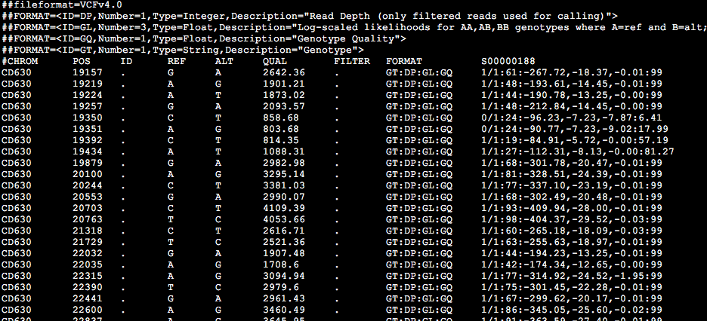
Recalibrated Reads
(BAM)
Putative Variants
(VCF)
Call Variants
(Samtools/GATK)

Slide 37
Putative Variants
(VCF)
High Quality Variants
(VCF)
Mask Dubious Variants
(various methods)
Indicators of dubious calls
  Heterozygosity (flagged during calling)
  Low base quality (calculated during recalibration)
  Low mapping quality (calculated during mapping)
Other reasons to exercise caution
  Repetitive motifs in the reference
  Duplicate regions in the reference (identified by self-self BLAST)

Slide 38
Putative Variants
(VCF)
High Quality Variants
(VCF)
Mask Dubious Variants
(various methods)
How aggressively do you filter?
What thresholds do you choose?
How do you know how well you are doing?
  Comparison to known sequences
    Sequence the reference
    Perform MLST
  Simulations
    Simulate reads from a mutated reference sequence
  Experimental replicates
    Discordance between isolates known to be identical
  Measures of performance
    Call rate versus error rate

Slide 39
End result
A whole-genome multiple sequence alignment with some limitations
It only includes regions present in the reference genome
Due to the need to aggressively QC the data, many missing base calls (‘Ns’)
Difficult to reliably call structural variants including indels

Slide 40
What Assembly Is
Like trying to do a jigsaw puzzle, but without even having the box!

Slide 41
End result
Fragmentary genomes in many ‘contigs’
  Some long fragments (100s kb or more), many short (<1 kb)
BLAST results indicating position of a particular gene among the fragments
Multiple sequence alignment of the BLAST hits from several genomes
Notes:
Can get powerful results by combining assembly and mapping, which is not too different from what Cortex does

Slide 42
summary

Slide 43
Within-host evolution of bacterial pathogens
Bacteria harbour a wide range of diversity, even within hosts
Bioinformatics techniques such as reference-based mapping and de novo assembly capture this variation
Within-host evolution occurs much more rapidly than previously appreciated
Within-host evolution is an important source of antibiotic resistance
Phenomena such as selective sweeps, cross-resistance, convergent evolution and heteroresistance contribute to within-host adaptation
There is evidence for within-host adaptation for other traits including virulence
Factors promoting within-host evolution include higher mutation rates, larger within-host population sizes, stronger selection pressures and larger mutational targets for selection

Slide 44
Bilbiography
Within-host evolution
Eldholm et al (2014) Genome Biology 15: 490
Dordel et al (2014) mBio 5: e01000
Mwangi et al (2007) PNAS 104: 9451
Howden et al (2011) PLoS Pathogens 7: e1002359
Reviews
Didelot et al (2016) Nature Reviews Microbiology 14: 150
Wilson (2012) PLoS Pathogens 8: e1002874
Contact daniel.wilson@ndm.ox.ac.uk
Web www.daniel wilson.me.uk

Slide 46
Should we expect to see within-host diversity?
Average T_{MRCA}
Cross-sectional
diversity
θ = 2 × μ × T_{MRCA}
Longitudinal divergence
Molecular clock rate μ
Long-term phylogenetic estimates
  0.01 per Mb per year (neutral rate)
  Howard Ochman and Allan C Wilson
  J Mol Evol (1987) 26: 74-86
  Nancy A Moran et al
  Proc R Soc Lond B (1993) 253: 167-171.
In the Staphylococcus aureus genome
  2.7Mb long
  Would require T_{MRCA} within hosts to exceed 25 years to expect to see more than a single SNP on average
Laboratory estimates
  0.01 per Mb per generation
  Drake, Charlesworth, Charlesworth and Crow (1998)
  Genetics 148:1667
  How many Escherichia coli generations are there in a year?
Longitudinal estimates from MLST
  Helicobacter pylori: 41 per Mb per year
  Falush et al (2001) PNAS 98:15056
  Neisseria gonorrheae: 46 per Mb per year
  Pérez-Losada et al (2007) Infect Genet Evol 7:271
  Campylobacter jejuni: 28 per Mb per year
  Wilson et al (2009) Mol Biol Evol 26:385
Notes:
Empirical observation
Spa typing
Phase variation
Moxon, Jansen (2005) Trends Microbiol 13:563
PFGE within hosts
Goerke, Wolz (2004) Int J Med Microbiol 294:195

Slide 47
What we do see
Observed
genotype
Unobserved
intermediate genotype
SNP
Indel
Synonymous
Non-synonymous
Nonsense
Intergenic
Notes:
Red background for MRSAs

Slide 48
Between 0 and 40 SNPs within the nose of a single carrier
Mean genomic divergence in a nasal population of 4 SNPs
Golubchik et al (2013) Within-host evolution of Staphylococcus aureus during asymptomatic carriage
Notes:
Average genetic divergence within hosts of 4.12 SNPs. Red background for MRSAs – lower average diversity, but not significantly so.

Slide 49
Is there a role for within-host evolution in
S. aureus invasive disease?
B cell neoplasia with cardiac complications diagnosed.
Whole genome sequencing reveals micro-variation. 30 single nucleotide polymorphisms (SNPs) and
4 insertions/deletions (indels) in 2.7million bases.
Pacemaker fitted
Flucloxacillin
Penicillin
Chemother.
Co-trimoxazole
Septic shock
Cough
Amoxicillin
Baseline
1
2
4
6
8
10
12
14
Early nasal (ENC)
nasal
Late nasal (LNC)
Blood (LBC)
Variants (SNPs and indels)
Ancestral allele
Derived (mutant) allele

Slide 50
Evolution of Staphylococcus aureus during progression from carriage to disease
Early nasal (ENC)
Late nasal (LNC)
Blood (LBC)
nasal
Synonymous
Non-synonymous
Nonsense
Intergenic
Variants (SNPs and indels)
Early nasal (ENC)
Late nasal (LNC)
7
8
Sequences cluster into three groups corresponding to early nasal (ENC), late nasal (LNC) and late blood (LBC).
Just 8 mutations separate ENC from LBC, among them 4 premature stop codons, significantly more than in the rest of the tree (p = 0.0015).
No diversity within ENC is preserved to BNC.
1
9
6
4
2
5
10
3
Late blood (LBC)

Slide 51

Synonymous
Non-synonymous
Nonsense
Intergenic
Early nasal (ENC)
Late nasal (LNC)
P
7
8
1
9
6
Bernadette Young
4
Branches | Stop codons | Other mutations
From ENC to LBC | 4 | 4
All others in P,Q, R | 7 | 115
2
5
10
p = 0.0017
3
Late blood (LBC)
Chronic condition
Flucloxacillin
Penicillin
Chemother.
Co-trimoxazole
Septic shock
Mild acute condition
Amoxicillin
Baseline
1
2
4
6
8
10
12
14
Early nasal (ENC)
nasal
Late nasal (LNC)
Blood (LBC)
Notes:
Color-coding: green (synonymous), orange (non-synonymous), red (stop codon), grey (intergenic)

