Slide 1
Statistical Challenges for Bacterial GWAS
Danny Wilson
Wellcome Trust / Royal Society Sir Henry Dale Fellow
Nuffield Department of Medicine
John Radcliffe Hospital Microbiology Department
University of Oxford

Slide 2




Explaining Phenotypic Diversity
One of the broad aims of biology is to explain the natural phenotypic diversity that surrounds us
Ernst Haeckel (1904) Kunstformen der Natur

Slide 3


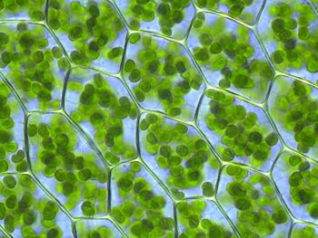

Phenotype
Inheritance (Genetics)
Development
Mechanism
Adaptive value

Slide 4
GWAS in bacteria
Example questions
Do Staphylococcus aureus genomes vary in their propensity to cause invasive disease vs asymptomatic carriage?
Are there genetic differences in the Clostridium difficile population that explain differential mortality among infections?
Can we pinpoint the mutations conferring antibiotic resistance in Mycobacterium tuberculosis?

Slide 5
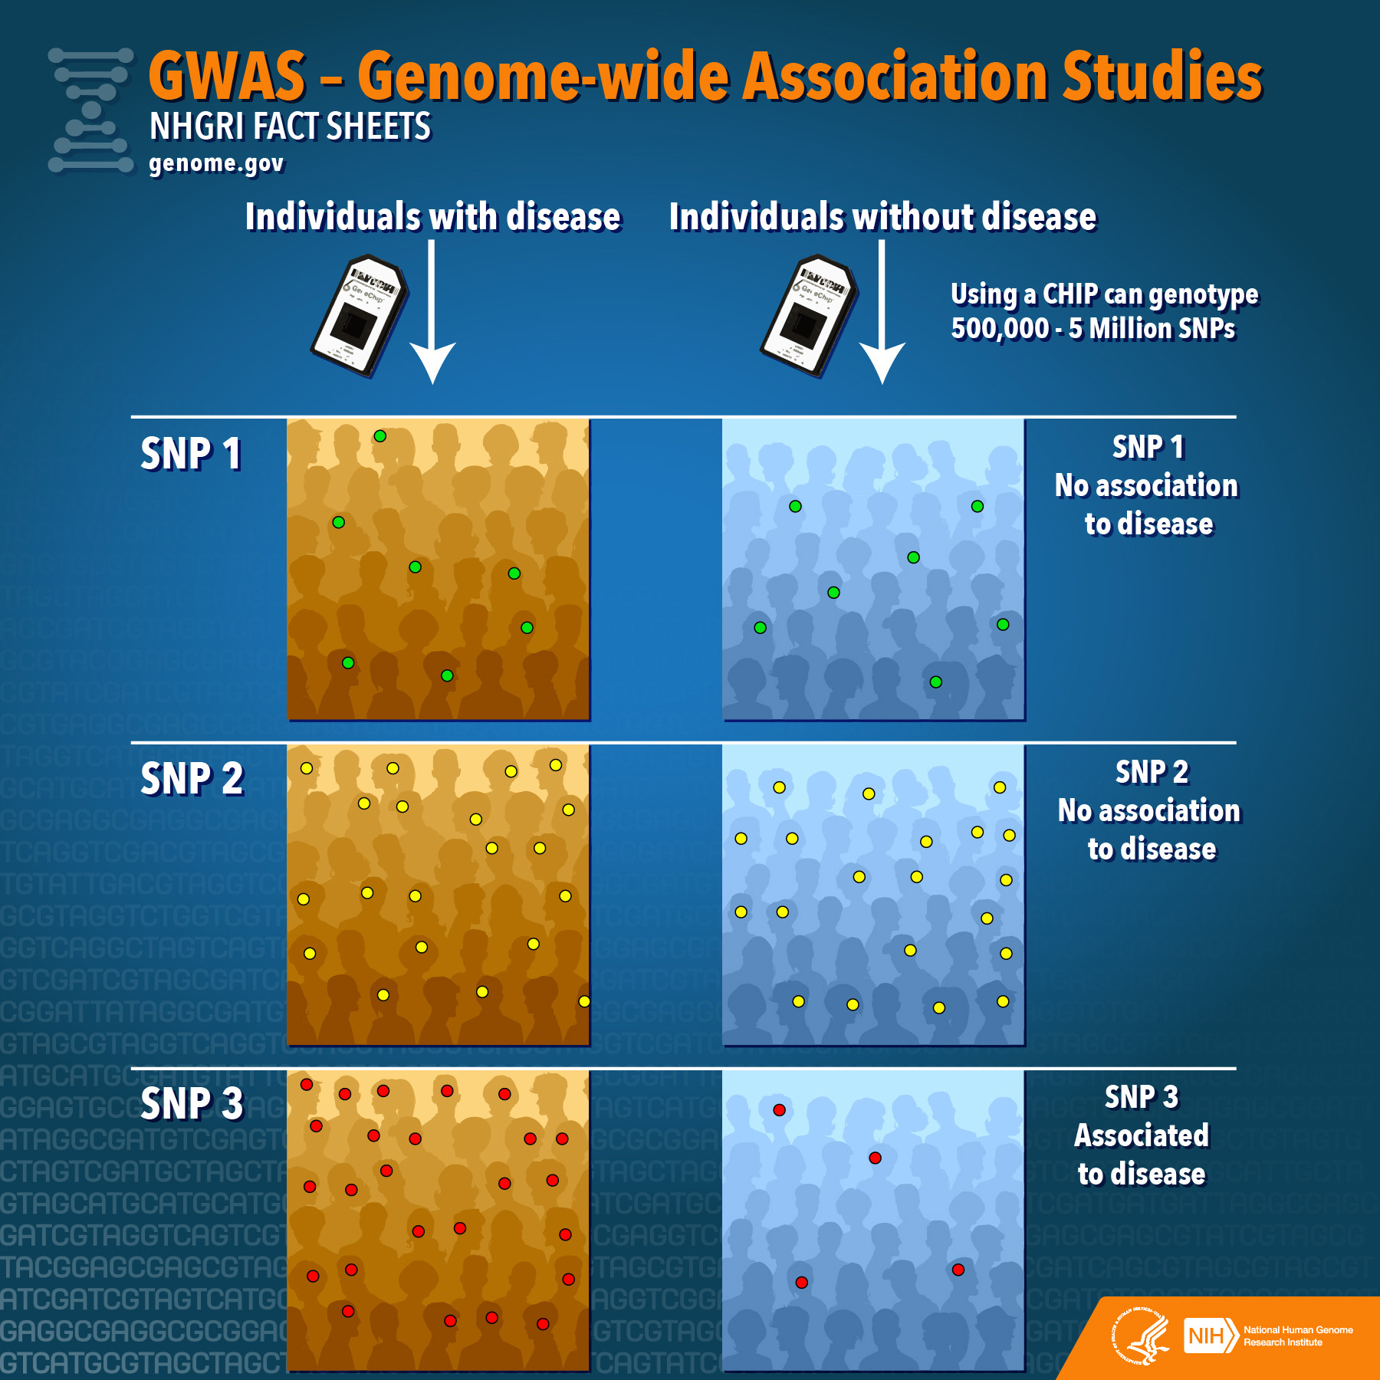
Notes:
History of human gwas

Slide 6
Challenges for GWAS: What
Scenario | Errors
 | Type I | Type II
Grand null No association | Find any variant | -
Simple alternative Some causal variants | Find the wrong variants | Miss the right variants
Complex null Confounding | Find any variant | -
Complex alternative Confounding and some causal variants | Find the wrong variants | Miss the right variants

Slide 7
Challenges for GWAS: Why
Find the wrong variants:
Variant calling
Lack of accuracy
Population stratification
Failure to account for:
LD between causal and non-causal variants
Confounding with unmeasured environmental variables
Sampling biases and batch effects
Biases caused by oversampling close relatives
Multiple testing
Inadequate control for thousands/millions of tests
Miss the right variants:
Lack of sensitivity
Side effect of controlling for population stratification
Side effect of controlling for thousands/millions of tests

Slide 8
Challenges for GWAS: How
Avoid the wrong variants:
Control the FWER
Family-Wise Error Rate
Probability of finding one or more wrong variants in the analysis
Even when there are true associations
... or the FDR
False Discovery Rate
Expected proportion of wrong variants among the significant hits
Pursue the right variants:
Maximize the Power
The probability of detecting a variant that is right
Notes:
Strong-sense control of the FWER
FDR implies strong-sense by definition

Slide 9
Variant Calling
Statistical Challenges for Microbial GWAS

Slide 10
Variant Calling
Sheppard et al (2013) PNAS 110:11923

Slide 11
SNP imputation accuracy
ClonalFrameML
BEAGLE
Estimate a maximum likelihood phylogeny
Impute missing SNP calls using a maximum likelihood algorithm
Localized haplotype cluster model
Designed for eukaryotes
Didelot & Wilson (2015) PLoS Comp Biol 11: e1004041
Browning & Browning (2007) Am J Hum Genet 81:1084

Slide 12
SNP imputation accuracy

Slide 13
Population Stratification
Statistical Challenges for Microbial GWAS

Slide 14
Control of population stratification
Genomic control (GC)
Directly adjust the p-values so the vast majority are non-significant
Subpopulations
Expect individuals in the same subpopulation to have phenotypes that are more similar
Principal components analysis (PCA)
Expect individuals with similar principal components to have phenotypes that are more similar
Linear mixed models (LMM)
Expect individuals that are closely related to have phenotypes that are more similar

Slide 15
Control of population stratification
 | Genomic Control | Block by subpopulation | Principal Components Analysis | Linear Mixed Model
Avoid wrong variants linked to the right variants
Avoid wrong variants that differentiate populations with genuine differences
Avoid wrong variants that differentiate populations with artefactual differences
Avoid biasing results by oversampling close relatives
Improve power when there are multiple causal variants

Slide 16
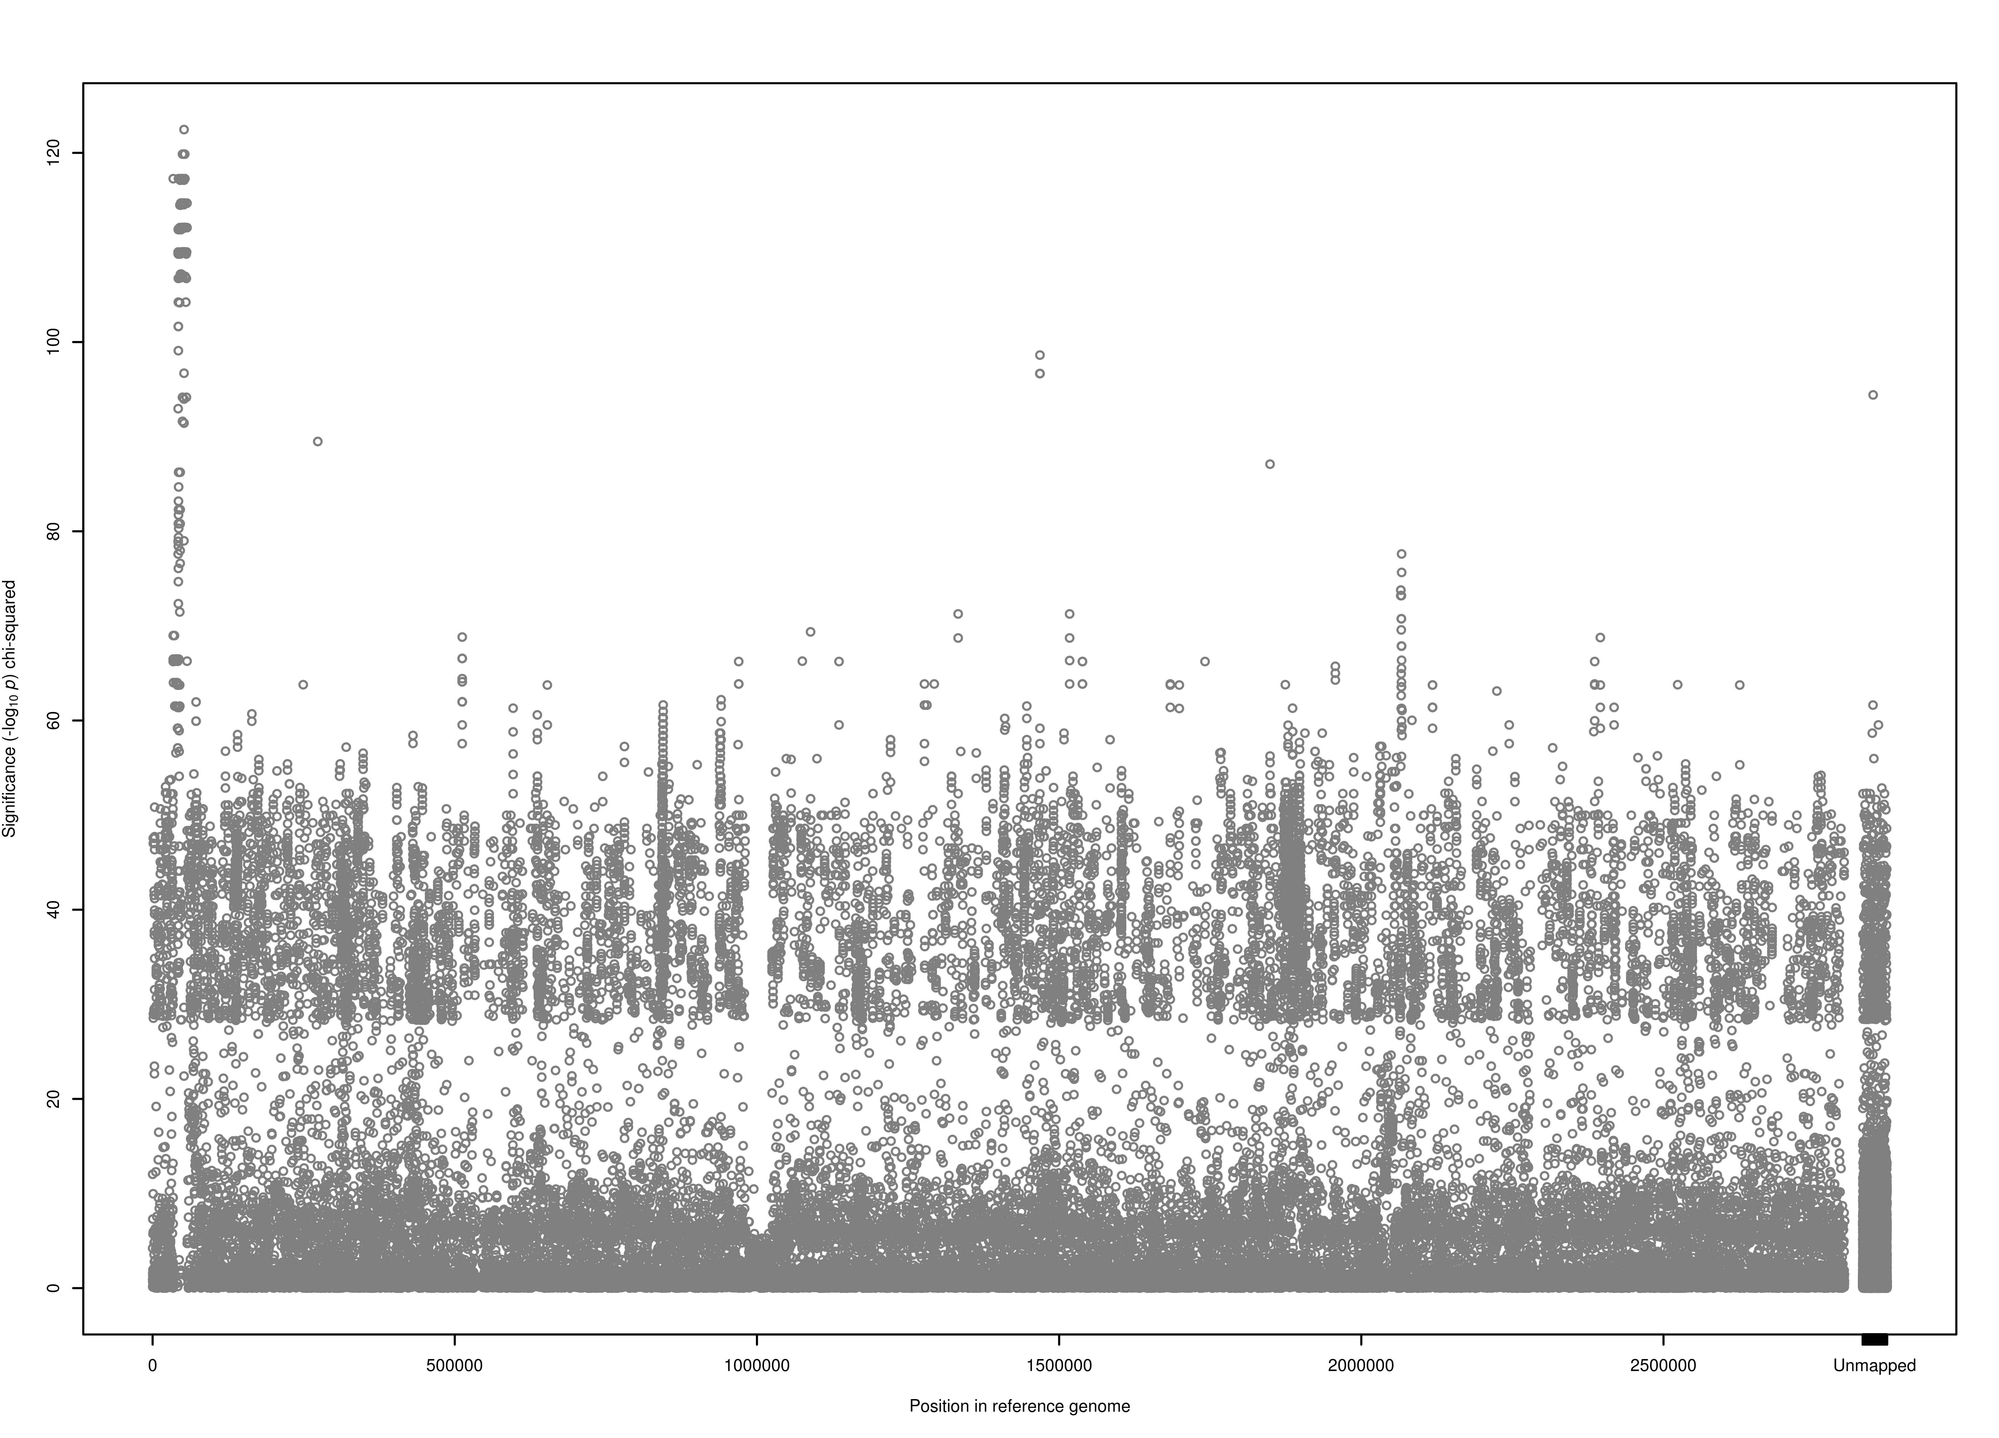
Example: GWAS for fusidic acid resistance in 992 S. aureus
Fusidic acid resistance χ² test
120
fusC and SCC genes
100
-log₁₀ p χ² test
80
60
40
20
0
0
0.5
1
1.5
2
2.5
Unmapped
Position in reference genome MSSA476 (Mb)
Notes:
Fusidic acid resistance is caused by either the presence of the mobile-element associated far gene, or substitutions within the fusA gene.
We tested for associations between fusidic acid resistance and the presence or absence of short 31bp kmers, as this approach aims to capture resistance encoded by substitutions in the core genome, the presence of mobile accessory genes, or both.
** At the simplest level, a GWAS is just a chi-squared test done lots of times. **
The far-encoded resistance, however, was population-stratified and associated exclusively with strains ST-1 and 8.

Slide 17
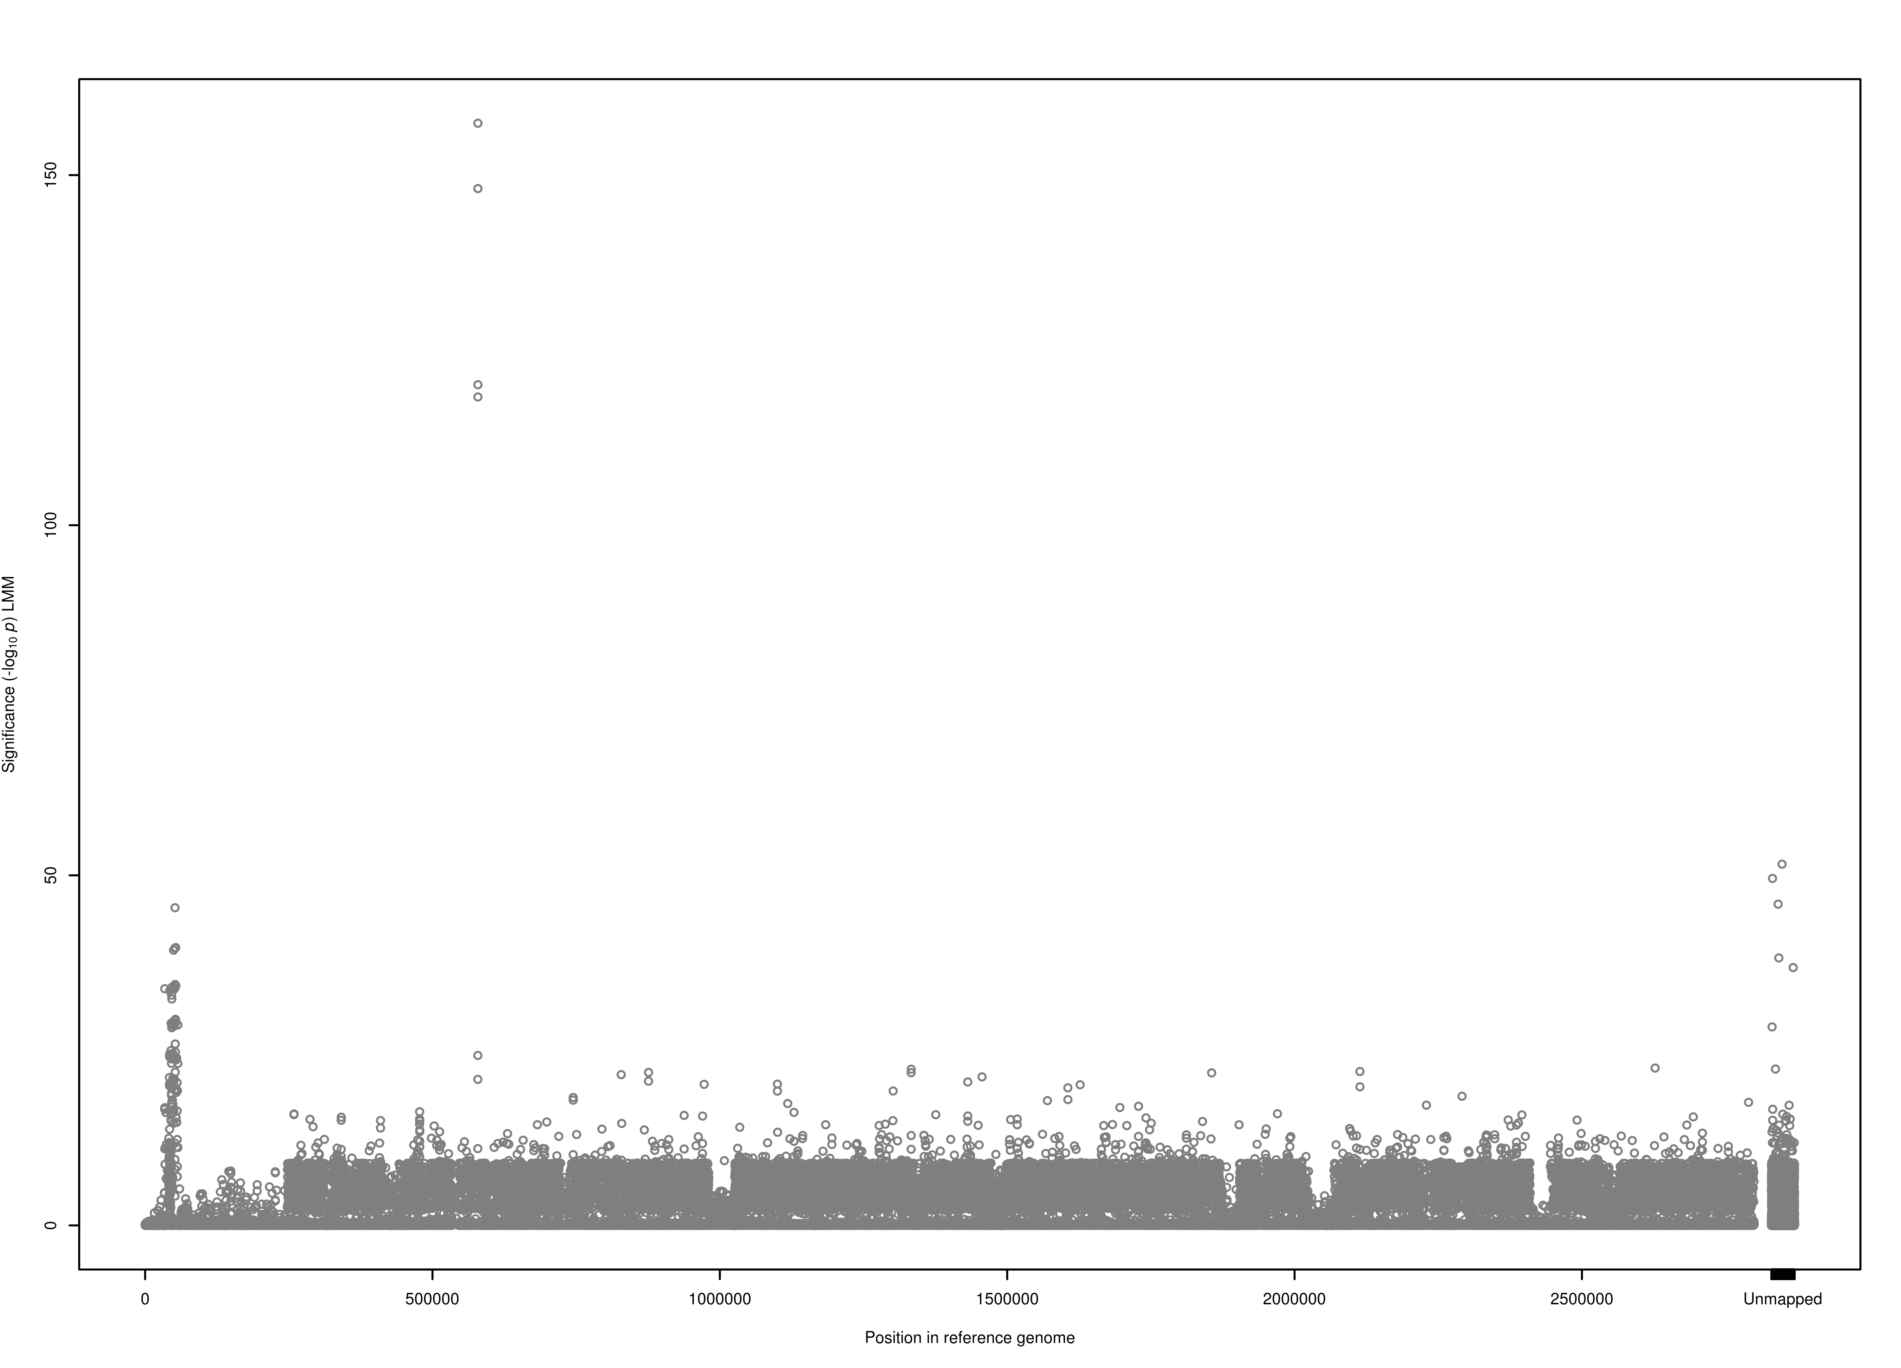
Example: GWAS for fusidic acid resistance in 992 S. aureus
Fusidic acid resistance LMM test
120
fusA gene
100
80
Linear Mixed Model (LMM) -log₁₀ p
60
40
fusC and SCC genes
20
0
0
0.5
1
1.5
2
2.5
Unmapped
Position in reference genome MSSA476 (Mb)
Notes:
Fusidic acid resistance is caused by either the presence of the mobile-element associated far gene, or substitutions within the fusA gene.
We tested for associations between fusidic acid resistance and the presence or absence of short 31bp kmers, as this approach aims to capture resistance encoded by substitutions in the core genome, the presence of mobile accessory genes, or both.
** At the simplest level, a GWAS is just a chi-squared test done lots of times. **
The far-encoded resistance, however, was population-stratified and associated exclusively with strains ST-1 and 8.

Slide 18
Evaluating performance: simulating phenotypes for GWAS
Take a large sample of real genomes
Choose one or more variants at random to be ‘causal’
Assign case/control probabilities to each allele of each causal variant
Simulate the phenotype for each genome based on those probabilities

Slide 19
Statistical properties: simulated phenotypes for real genomes
Controlling for population stratification greatly reduces the false positive rate ...
... but at a high cost in terms of lost power
M. tuberculosis (n=1573)
S. aureus (n=992)
M. tuberculosis
S. aureus
E. coli
K. pneumoniae
E. coli (n=241)
K. pneumoniae (n=176)
Fig 2/S4 Earle et al (2016) Nat Microbiol 1:16041

Slide 20
Bacterial variants are highly population-stratified
Staphylococcus aureus
Clostridium difficile
Mycobacterium tuberculosis
Escherichia coli
Klebsiella pneumoniae

Slide 21
Bacterial variants are highly population-stratified
Human chromosome 1
Staphylococcus aureus
The first few principal components are much more explanatory in S. aureus

Slide 22
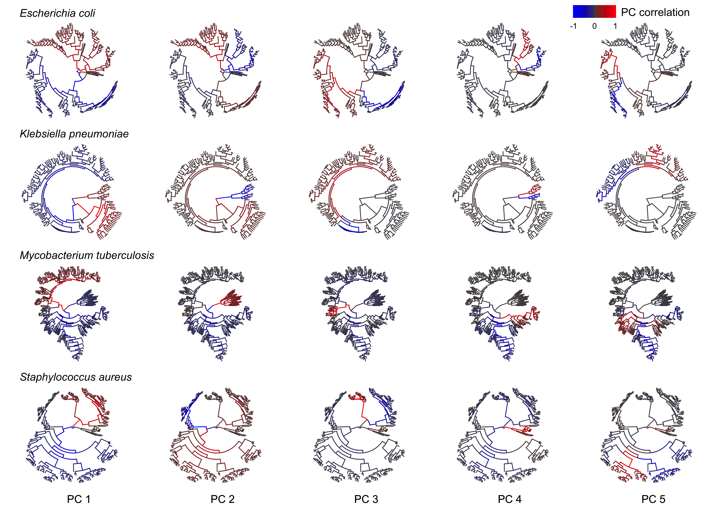
Principal components can be interpreted phylogenetically
Earle et al. 2016 Nature Microbiology
Notes:
We define lineages by principal components
the first principal component has the largest possible variance (that is, accounts for as much of the variability in the data as possible), and each succeeding component in turn has the highest variance possible under the constraint that it is orthogonal to the preceding components
Trace paths through tree

Slide 23
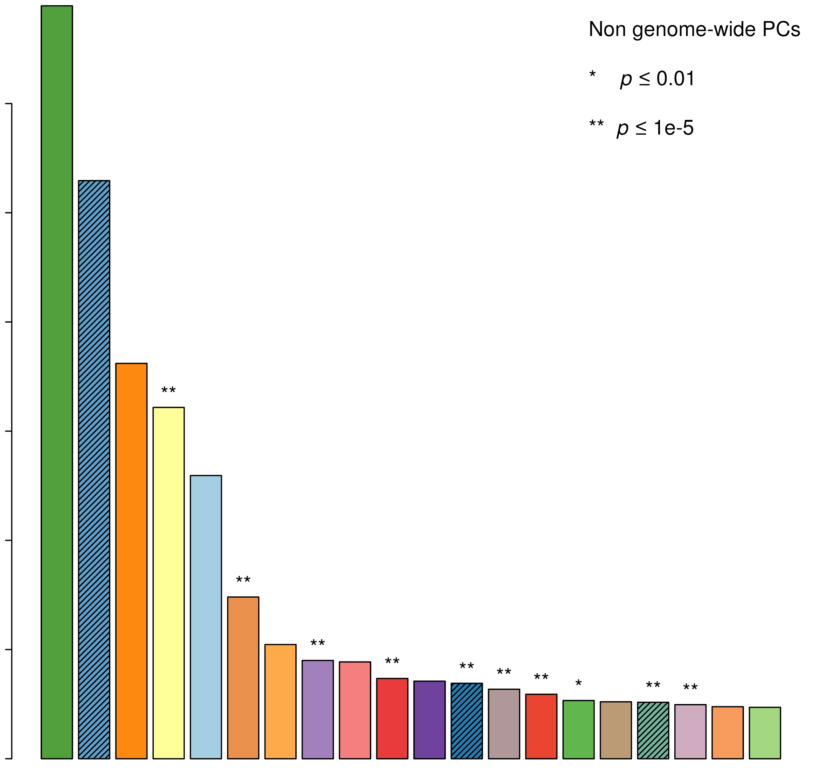
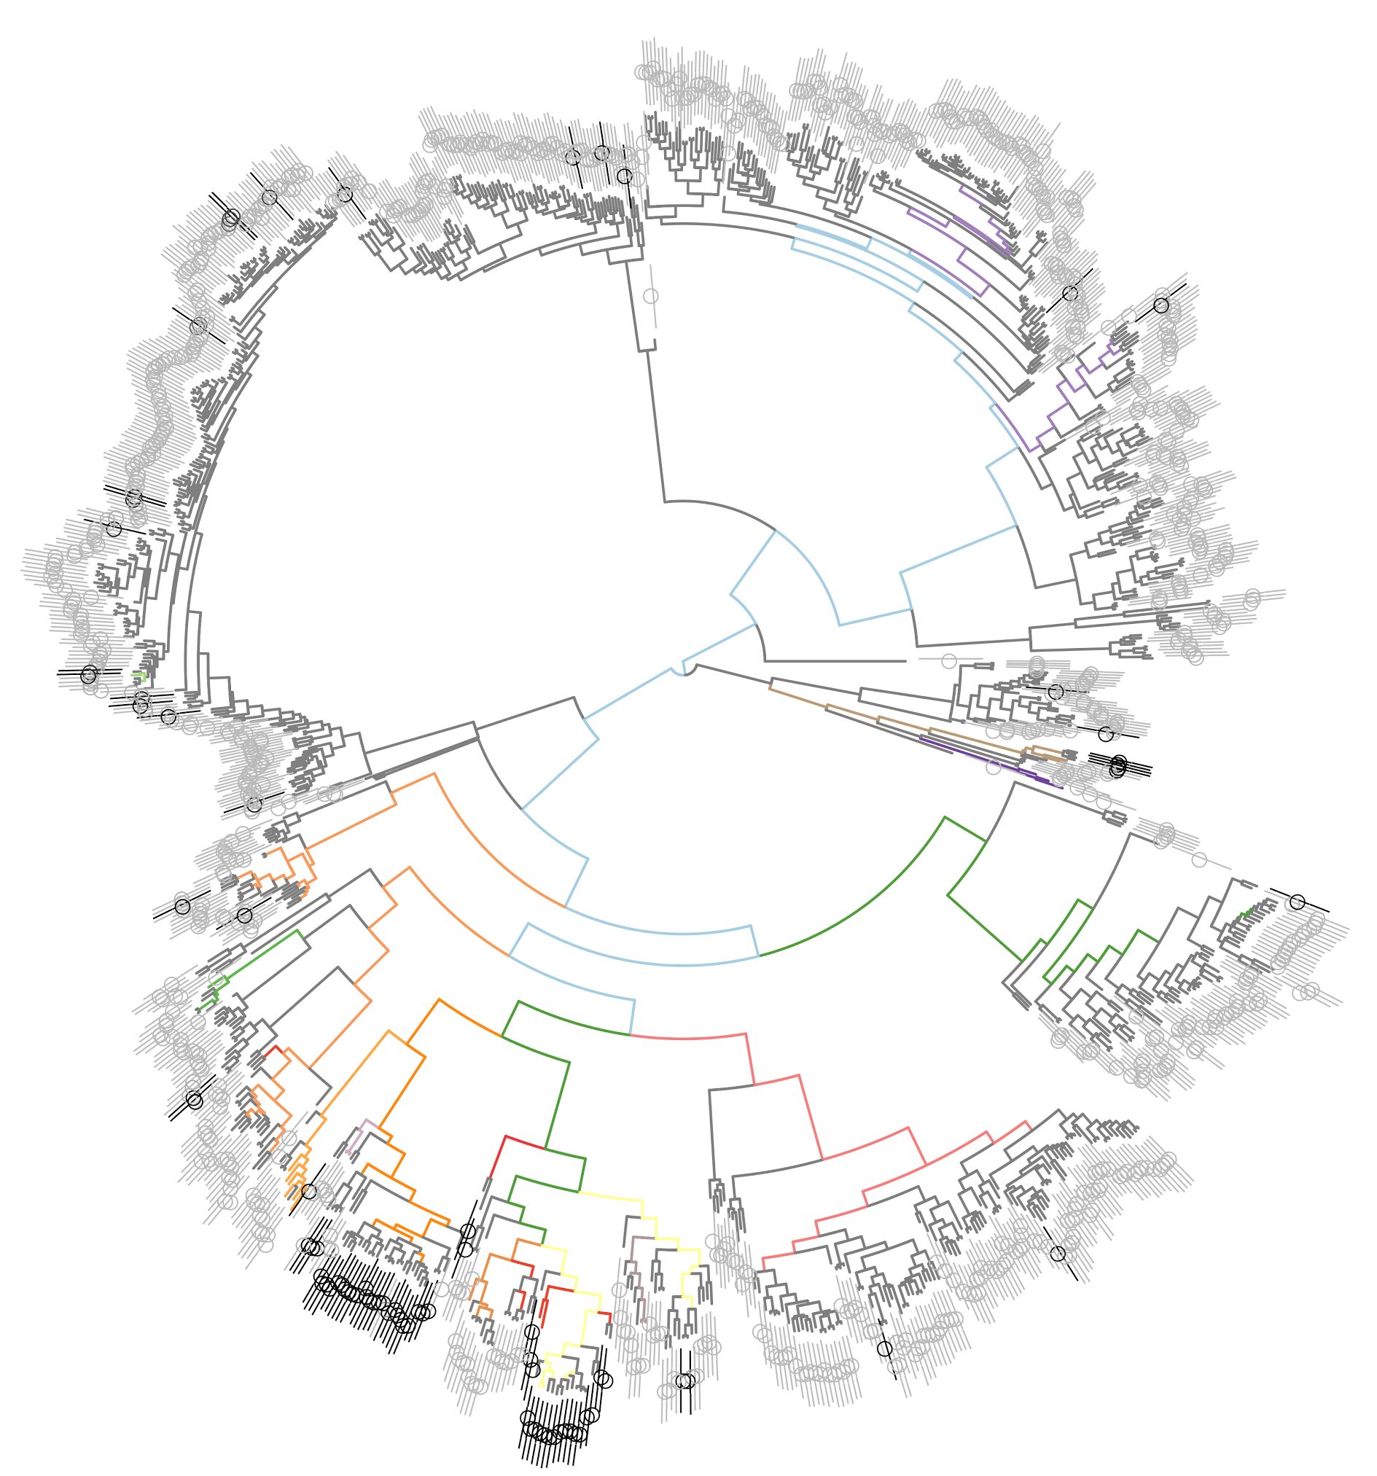
bugwas Wald Test for Lineage Effects
Fusidic acid resistance in S. aureus
120
PC24
100
PC1
80
PC654
-log10(p)
PC11
PC26
PC10
60
PC6
PC21
PC12
PC6
PC40
PC7
PC5
40
PC50
PC25
PC27
PC47
PC60
20
0
6
9
7
25
1
27
12
24
5
50
26
79
47
60
21
11
62
40
10
654
Principal Component
Notes:
Here I have shown the first 20 significant PCs (Bonferroni corrected threshold of 4.5? for multiple testing).
Our method revealed strong signals of association between fusidic acid resistance and lineages PCs 6 and 9, comparable to significance to the low frequency variants at fusA.

Slide 24
Statistical properties: simulated phenotypes for real genomes
Controlling for population stratification greatly reduces the false positive rate ...
... but at a high cost in terms of lost power
M. tuberculosis (n=1573)
S. aureus (n=992)
M. tuberculosis
S. aureus
E. coli
K. pneumoniae
E. coli (n=241)
K. pneumoniae (n=176)
Fig 2/S4 Earle et al (2016) Nat Microbiol 1:16041

Slide 25
Statistical properties: simulated phenotypes for real genomes
Controlling for population stratification greatly reduces the false positive rate ...
... but at a high cost in terms of lost power
M. tuberculosis (n=1573)
S. aureus (n=992)
M. tuberculosis
S. aureus
E. coli
K. pneumoniae
E. coli (n=241)
K. pneumoniae (n=176)
Fig 2/S4 Earle et al (2016) Nat Microbiol 1:16041

Slide 26
Control for Population Stratification

Slide 27
Multiple Testing
Statistical Challenges for Microbial GWAS

Slide 28
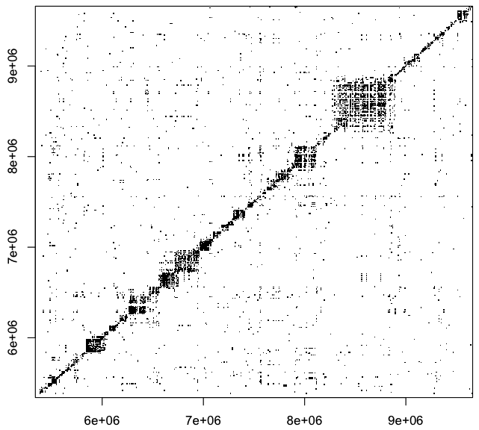
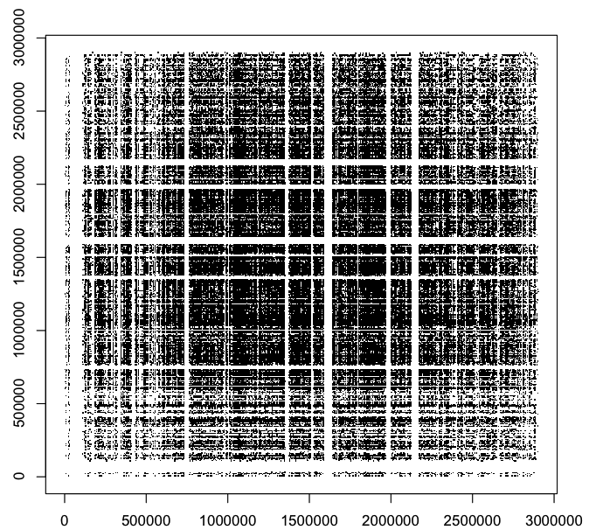
Why multiple testing correction is hard in bacteria
Genome-wide correlations (linkage) between variants
Human chromosome 1 (partial)
Staphylococcus aureus
3
9
2
Points show the position of SNP pairs in moderate to high linkage disequilibrium i.e. r² > 0.4
8
7
1
6
0
6
7
8
9
0
1
2
3
Physical position on chromosome (10⁶ base pairs)
Physical position on chromosome (10⁶ base pairs)
Every pair of variants (in conserved regions) with squared correlation coefficient exceeding r² = 0.4 is plotted
Notes:
These differences have far-reaching implications for (i) imputation (ii) maintaining power while properly controlling for population structure (iii) multiple testing correction

Slide 29
Performance of Bonferroni correction
Phylo-patterns
A | A | C | T | G | C | A | G
A | C | C | C | G | C | A | T
T | C | G | T | G | T | T | T
T | C | G | T | A | T | T | G
A | C | C | T | G | C | T | G

Slide 30
Control for Population Stratification

Slide 31
Multiple Testing Revisited
Statistical Challenges for Microbial GWAS

Slide 32
Adjusting p-values for multiple testing
GWAS is at heart a model selection problem
The same data are used to evaluate competing hypotheses
L alternative hypotheses M₁ … M_{L} and one null hypothesis M₀
So try to find the alternatives or groups of alternatives that are ‘significantly’ better than the null
Define the mean maximized likelihood ratio, a classical analogue to the model-averaged Bayes factor
(Eq.1)
Recall the distribution of a maximized likelihood ratio under the null hypothesis
By Wilks’ theorem:
degrees of freedom
When ν = 2:
(Eq.2)
Derive the tail probability of the mean maximized likelihood ratio under the null hypothesis
By Karamata’s theorem:
When ν = 2:
Notes:
Model selection view inescapable when can assume independence between tests anywhere in the genome
What Would Bayes Do?
Cannot use central limit theorem.
Appeal to generalized central limit theorem
By Karamata’s theorem (because the LogGamma distribution function is regularly varying)
Benefits of the HMP: (1) assumes only that p-values are well-calibrated (2) does not require Wilkes theorem (3) can mix degrees of freedom (4) better GCLT approx available

Slide 33
Adjusting p-values for multiple testing
The derivation of the HMP implies robustness to
The number of tests
The distribution of weights
Positive dependency between the tests
It is most influenced by the smallest p-values
The HMP admits a closed test procedure:
This constitutes a multi-level test because any significant set of hypotheses makes all supersets encompassing that set significant:
More precisely calibrated p-values can be obtained via GCLT
Notes:
What Would Bayes Do?
Cannot use central limit theorem.
Appeal to generalized central limit theorem
By Karamata’s theorem
The limiting distribution of the HMP is an inverse Landau

Slide 34
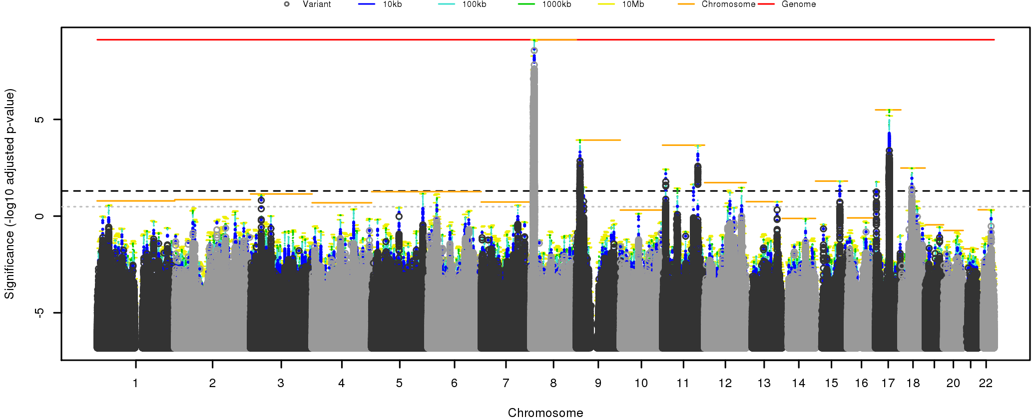
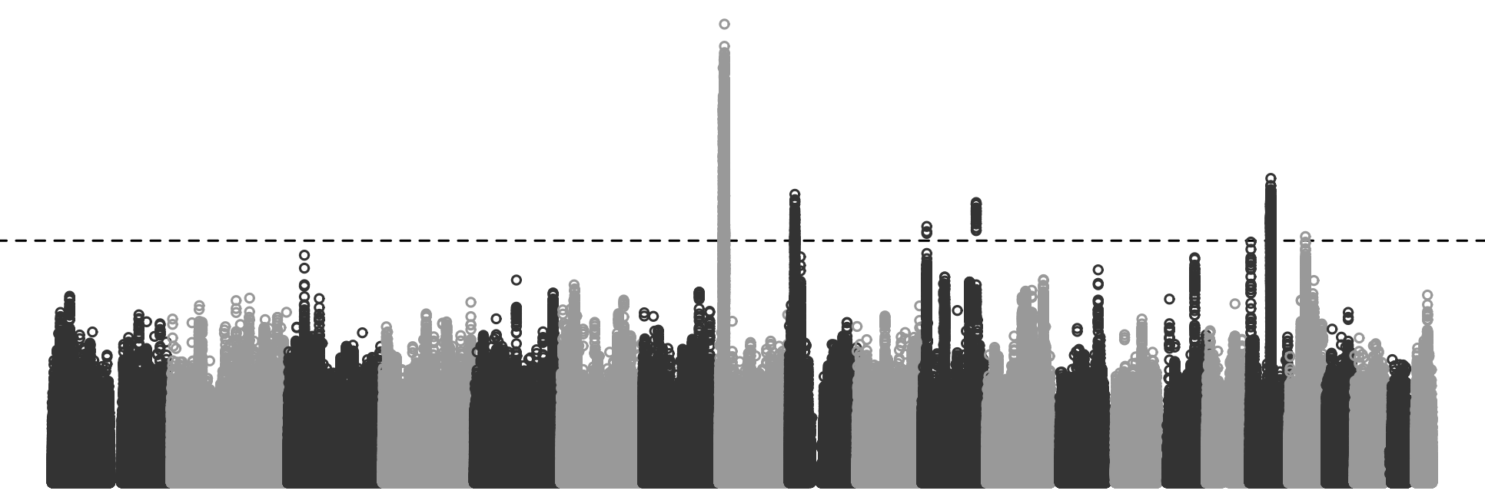
The multiple testing problem: Harmonic mean p-value
Significance threshold
Data: Okbay et al. (2016) Nature Genetics
Wilson (2017) biorxiv

Slide 35
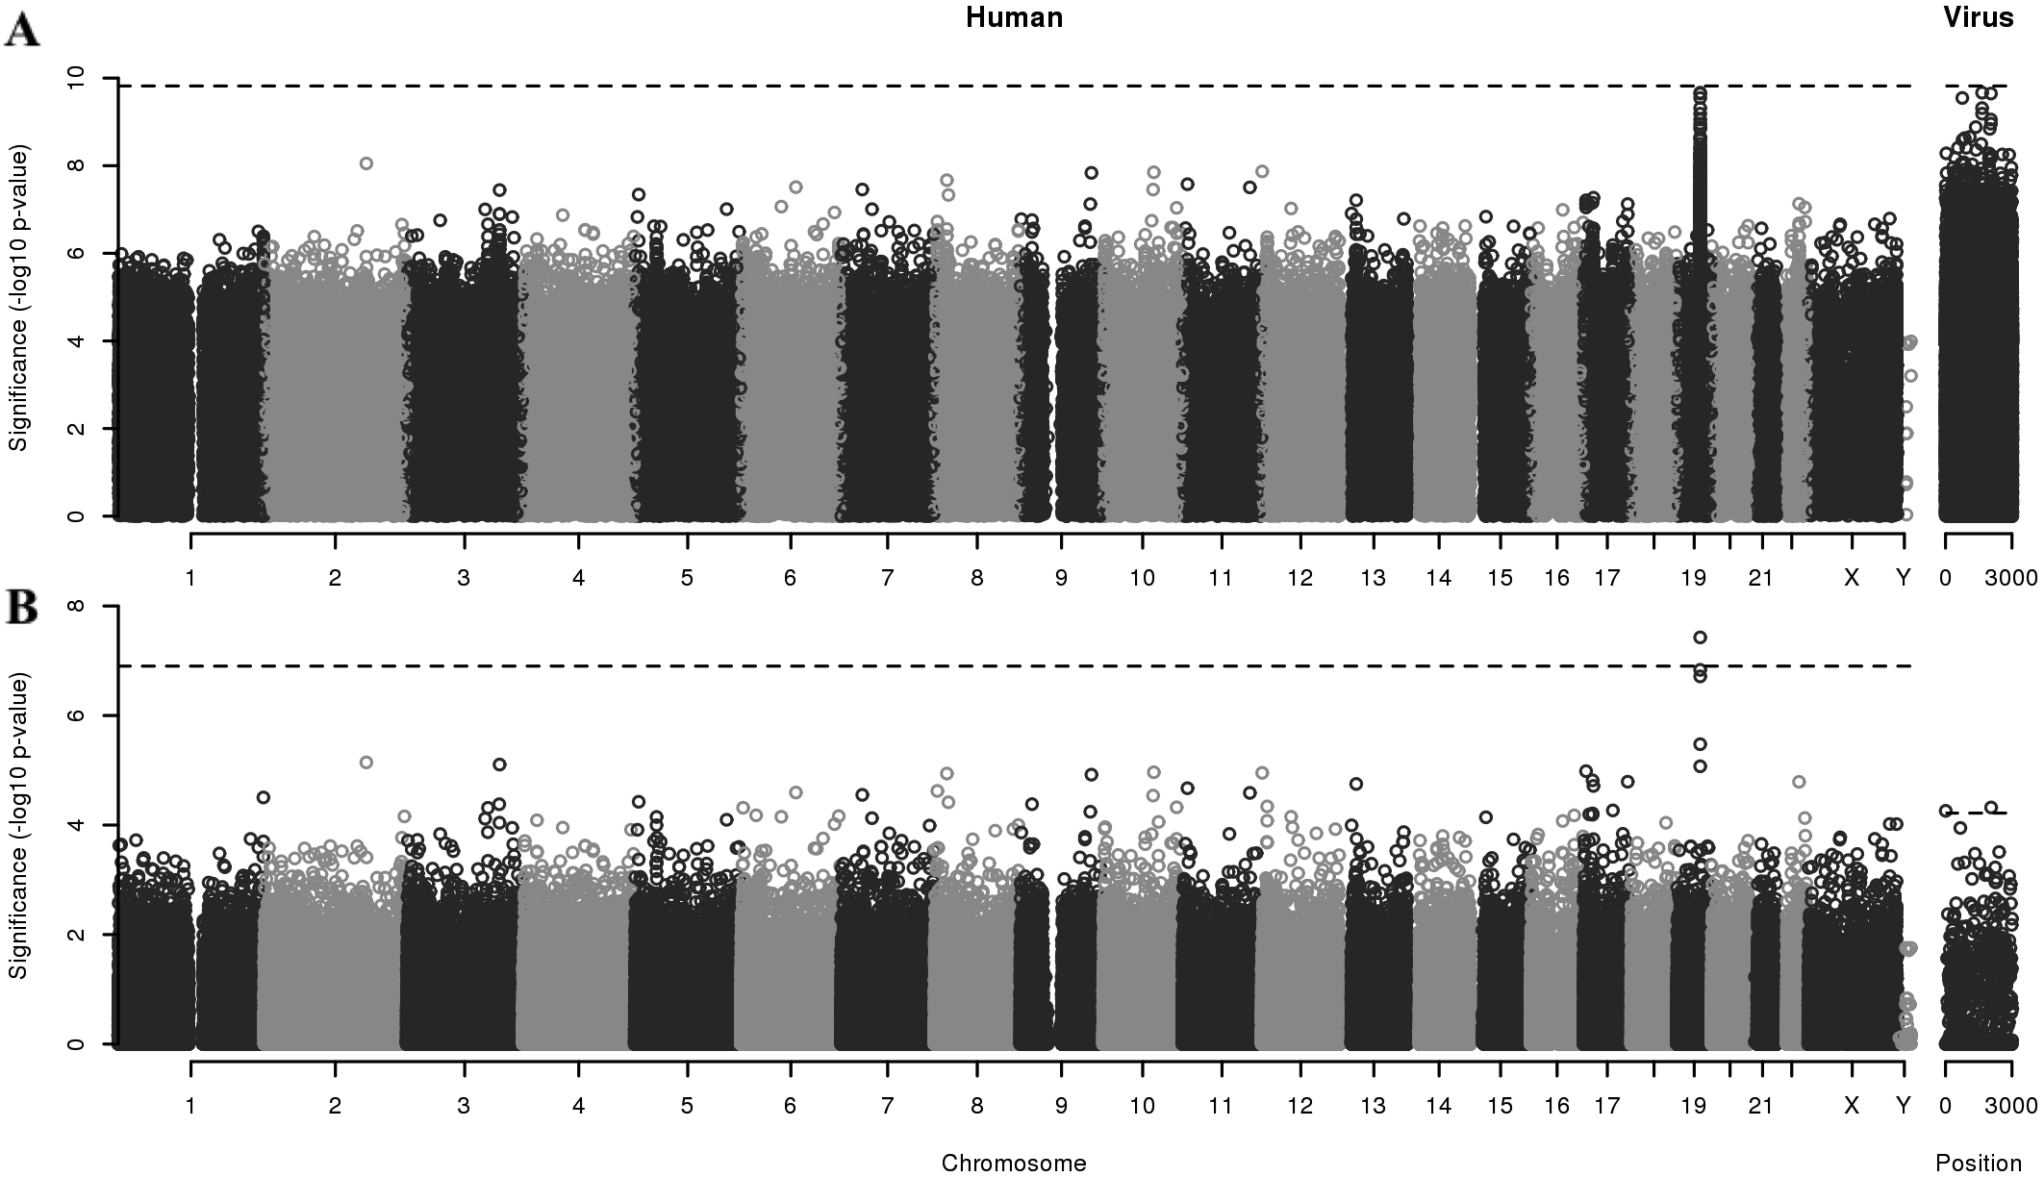
The multiple testing problem: Harmonic mean p-value
Data: Ansari et al. (2017) Nature Genetics
Wilson (2017) biorxiv

Slide 36
Statistical Challenges for Bacterial GWAS
Variant Calling
Kmer approaches for highly mobile genomes
Imputation as a critical step for SNP studies
Control for Population Stratification
LMMs best approach but sacrifice power in bacteria
Testing for lineage as well as locus effects returns that power
Multiple Testing Correction
Bonferroni for the total number of unique tests is solid
Harmonic mean p-value offers more flexible model-averaging

Slide 37
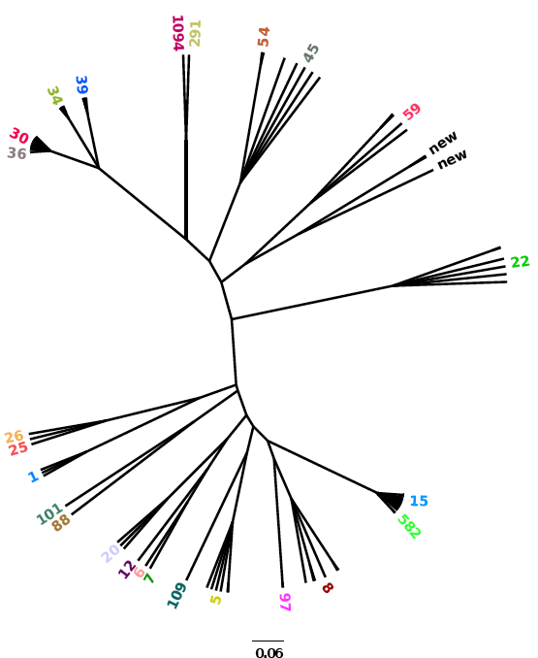
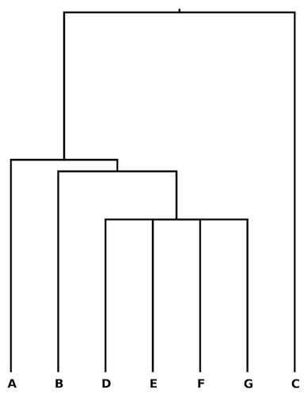
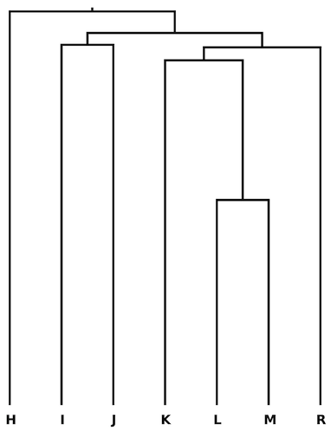








Acknowledgments
GWAS
Sarah Earle
Chieh-Hsi Wu
Jane Charlesworth
Bernadette Young
Clara Grazian
Shang-Kuan Lin
Collaborators
Derrick Crook
Tim Peto
Sarah Walker
Gil McVean
Chris Spencer
Xavier Didelot
Ellie Barnes
MMM
CRYPTIC
STOP-HCV
The harmonic mean p-value and model averaging by mean maximum likelihood
DJ Wilson (2017)
biorxiv doi:10.1101/171751
Identifying lineage effects when controlling for population structure improves power in bacterial association studies
SG Earle, C-H Wu, J Charlesworth et al (2016) Nature Microbiology 1: 16041
Contact daniel.wilson@ndm.ox.ac.uk
Web www.daniel wilson.me.uk
Funding
UKCRC Modernising Medical Microbiology

