Slide 1

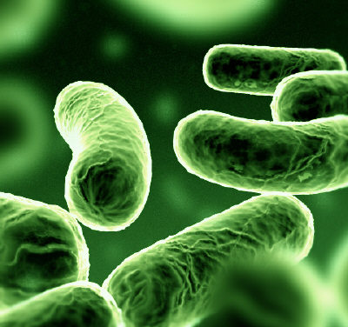
Pathogen Biology & Translational Medicine
Wellcome Trust Centre for Human Genetics
International Scientific Advisory Board
Tuesday 15th February 2011
Daniel Wilson
Nuffield Department of Medicine

Slide 2
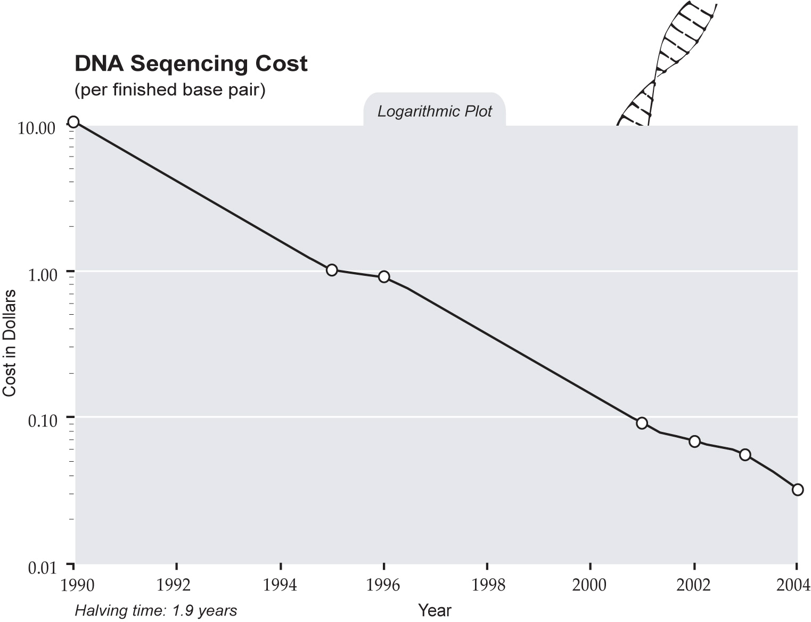
Landmarks in Bacterial Genomics
First bacterial genome sequence
1995
Avery MacLeod & McCarty show DNA transforms bacteria 1944
Watson Crick & colleagues elucidate DNA structure 1953
Sanger dideoxy sequencing of bacteriophage
1977
Mullis discovers PCR
1983
Draft human genome 2001
1890
1910
1930
1950
1970
1990
2011
1676
van Leeuwenhoek discovers bacteria
1890
Koch proves germ theory of disease
1928
Flemming discovers penicillin
1941
Penicillin trialed at Oxford Radcliffe Infirmiary
1947
Penicillin resistance in S aureus
1961
Methicillin resistance in S aureus
1989
Clindamycin resistance in C difficile
2002
Vancomycin resistance in S aureus

Slide 3
21st Century Challenges in Microbiology
Scientific
The genetic basis of virulence, antimicrobial resistance
Tracing transmission and global spread
Mechanisms of horizontal gene transfer (recombination)
Translational
Real-time genomics
Monitoring the prevalence of virulent strains and genes for drug resistance
Prevention and control of transmission
Nosocomial, community, global
Identification of drug targets
Personalized medicine

Slide 4

Pathogen Biology & Translational Medicine
Oxford consortia include
Oxford Biomedical Research Centre (BRC)
Modernising Medical Microbiology Consortium (MMM)
Focus on major human pathogens
Hospital-acquired infection
Staphylococcus aureus, Clostridium difficile, norovirus
Re-emerging infection
Mycobacterium tuberculosis
Respiratory tract infection
Streptococcus pneumoniae, Haemophilus influenzae
Drug-resistant enteric bacteria
Escherichia coli, Klebsiella pneumoniae
Combine whole genome sequencing with rich epidemiological data
meningitis
pharyngitis
skin and soft tissue infection
tuberculosis
endocarditis
pneumonia
gastroenteritis
toxic shock
septicaemia

Slide 5
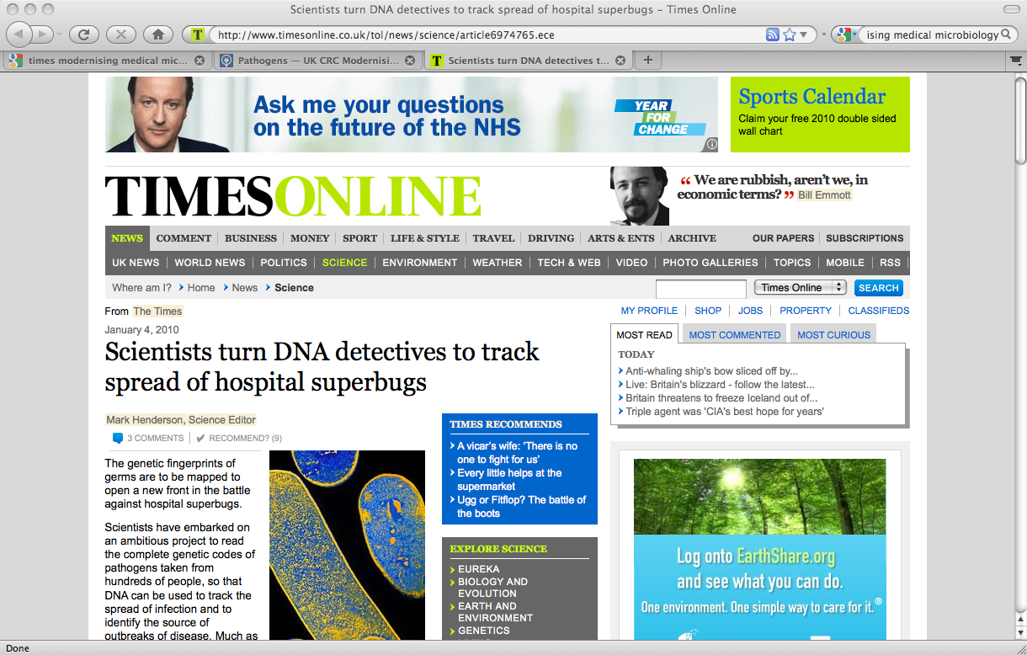
Modernising Medical Microbiology
The UKCRC Consortium Modernising Medical Microbiology is an ambitious project with the goal of revolutionising approaches to tracing and tracking clinically important micro-organisms in near-to-real time using whole genome sequencing technologies. The aim is to elucidate the evolution and epidemiology of 4 medically important pathogens, namely Mycobacterium tuberculosis, Staphylococcus aureus, Clostridium difficile and norovirus. The project represents an unprecedented collaboration between Oxford University, the Health Protection Agency, the Wellcome Trust Sanger Institute and the NHS.

Slide 6
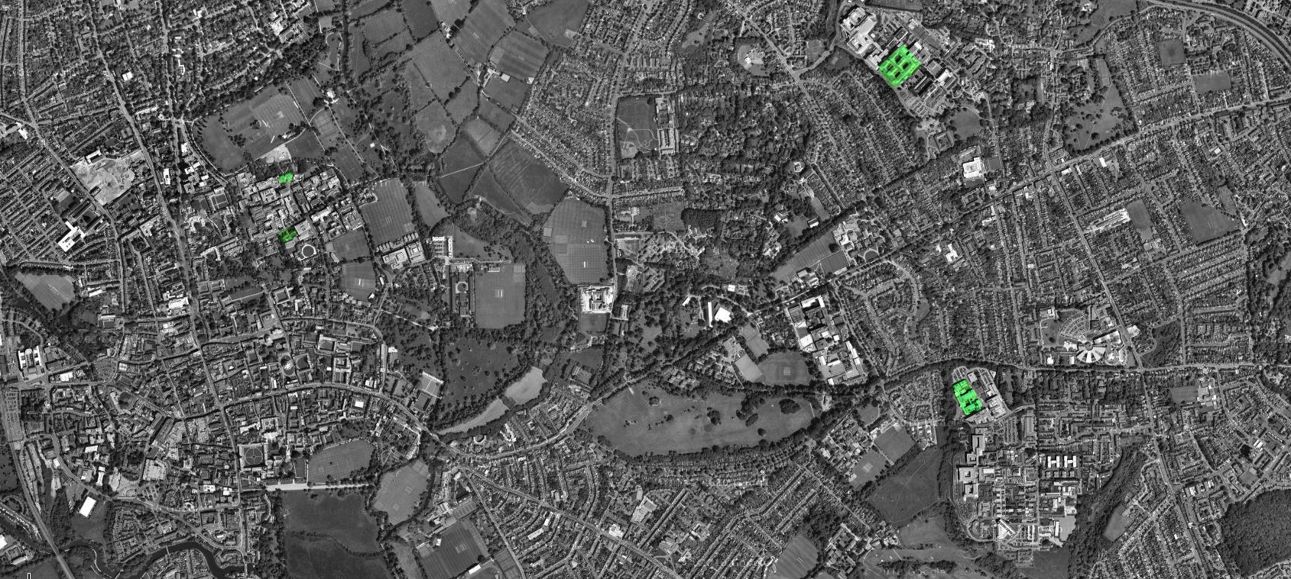
Modernising Medical Microbiology: Oxford
John Radcliffe Hospital
Nuffield Department of Clinical Medicine
Oxford Centre for Gene Function
Department of Statistics
Wellcome Trust Centre for Human Genetics
MRC High-throughput Regional Sequencing Hub
Notes:
Key people: Tim Peto, Derrick Crook (JR, NDM), Rory Bowden (OCGF, Statistics), Peter Donnelly (WTCHG, OCGF, NDM), me (WTCHG, OCGF, NDM)
Stress the power of epidemiological and medical expertise, expertise in statistical analysis, and “on demand” sequencing.

Slide 7

Modernising Medical Microbiology: the UK
Leeds
Birmingham
Oxford
Brighton

Slide 8
Pathogen Sequencing in Oxford
50+ staff directly employed in BRC and MMM projects, mainly in Oxford, also in Leeds, Birmingham and Brighton
Funding of £10 million from
National Institute of Health Research
UK Clinical Research Consortium (Wellcome Trust, Medical Research Council, NHS, Health Protection Agency)
£2 million set aside for whole genome sequencing
MMM sequencing at the WTCHG MRC Region Sequencing Hub:
880 Staphylococcus aureus
520 Clostridium difficile
50 Streptococcus pneumoniae
38 Haemophilus influenzae
In total, 1488 genomes or 5 gigabases. 5000 further planned for 2011

Slide 9
Pathogen Sequencing in Oxford
Hospital transmission in Clostridium difficile
Gram positive enteric bacterium
Associated with acquisition in hospitals
Incidence increases with duration of stay
Spores resistant to most routine cleaning fluids
Flourishes when competition is removed by treatment with broad-spectrum antibiotics
Produces toxins that can lead to life-threatening diarrhoea, abdominal pain and fever
Notes:
With WGS we get unprecented resolution for transmission studies.
Allows us to rule out putative transmission events suggested by the epidemiology.
Allows us to detect cryptic transmissions between patients apparently epidemiologically unlinked.

Slide 10
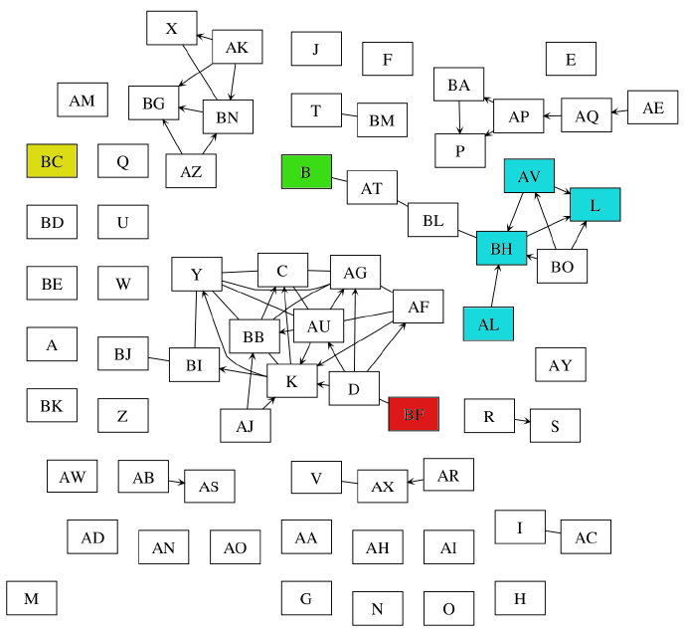
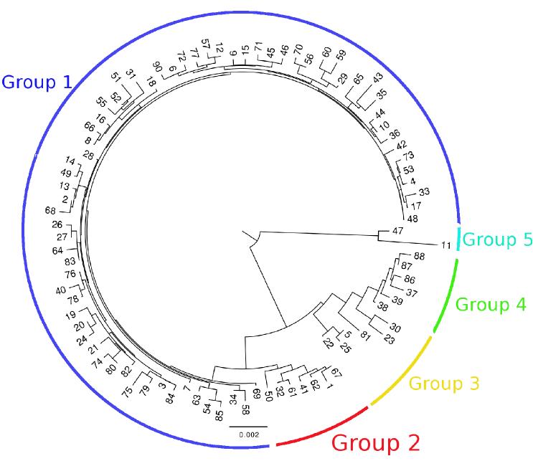
Unprecented resolution for transmission: previously undetected diversity
ST 42
Epidemiological links between patients carrying Clostridium difficile ST 42 in the Oxford Radcliffe Hospitals 2006-2010.
Position of ST 42 within the diversity of Clostridium difficile.
Notes:
Whole genomes offer 1000-fold increase in resolution over the previous gold standard, MLST.

Slide 11
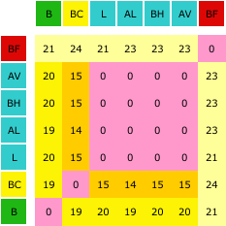
Unprecented resolution for transmission: previously undetected diversity
Epidemiological links between patients carrying Clostridium difficile ST 42 in the Oxford Radcliffe Hospitals 2006-2010.
Number of single nucleotide differences between every pair of whole genome sequences.
Notes:
Diversity invisible to previous gold standard, MLST.

Slide 12
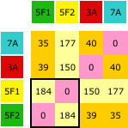
Unprecented resolution for transmission: ruling out putative transmission
ST 44
epidemiologically linked genetically divergent
Position of ST 44 within the diversity of Clostridium difficile.
Number of single nucleotide differences between every pair of whole genome sequences.

Slide 13
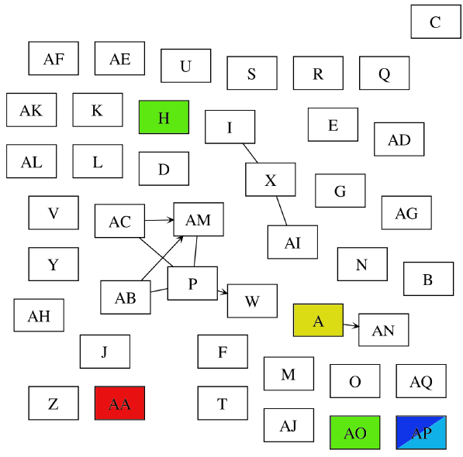
Unprecented resolution for transmission: evidence for cryptic transmission
ST 10
Epidemiological links between patients carrying Clostridium difficile ST 10 in the Oxford Radcliffe Hospitals 2006-2010.
Position of ST 10 within the diversity of Clostridium difficile.

Slide 14
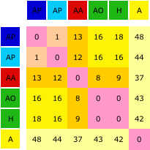
Unprecented resolution for transmission: evidence for cryptic transmission
Epidemiological links between patients carrying Clostridium difficile ST 10 in the Oxford Radcliffe Hospitals 2006-2010.
Number of single nucleotide differences between every pair of whole genome sequences.
Notes:
As well as “ruling in” apparently unrelated cases, we have further examples where we can rule out transmission in spite of apparent epidemiological linkage.

Slide 15
Pathogen Sequencing in Oxford
Dynamics of Staphylococcus aureus colonization
Gram positive bacterium colonizing epithelial surfaces
Notable for acquistion in hospitals
Resistance to methicillin and other antibiotics is a particular problem
Causes infections ranging from mild to life-threatening
Septicaemia, endocarditis, toxic shock syndrome, pneumonia, and skin and soft tissue infections
Carried asymptomatically by 27% of healthy adults

Slide 16
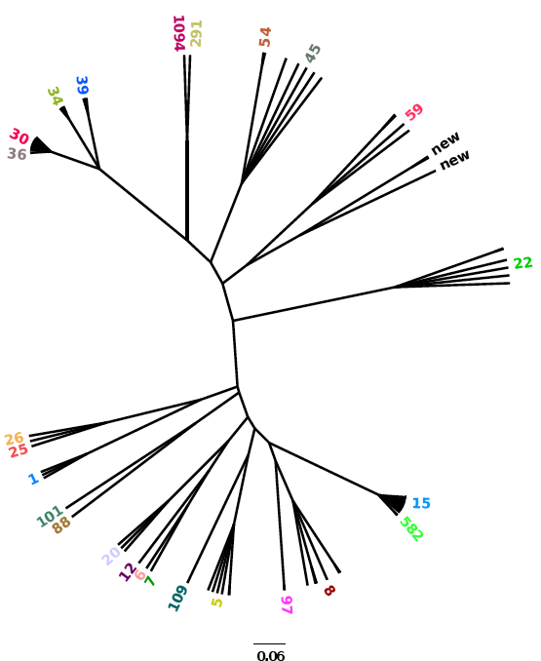
Within and between host evolution in Staphylococcus aureus
Hospital associated CC30 study
Hospital associated CC22 study
Staphylococcal carriage study

Slide 17
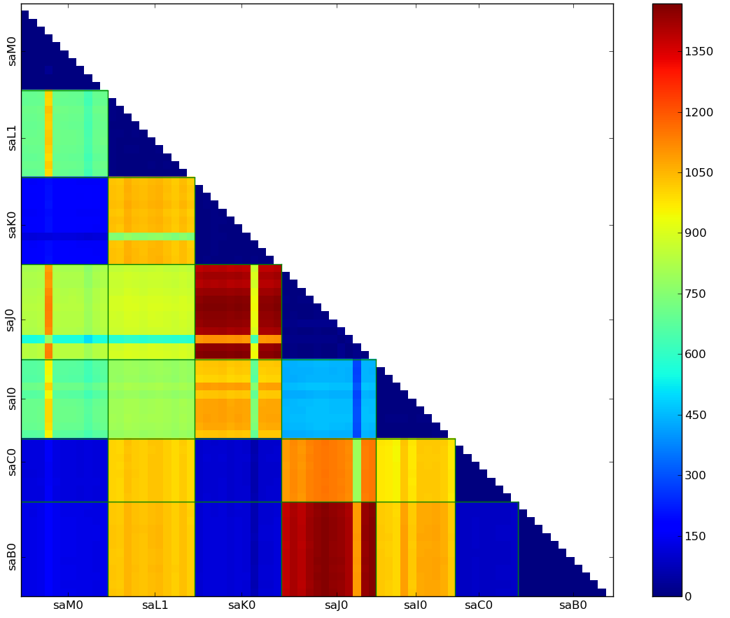
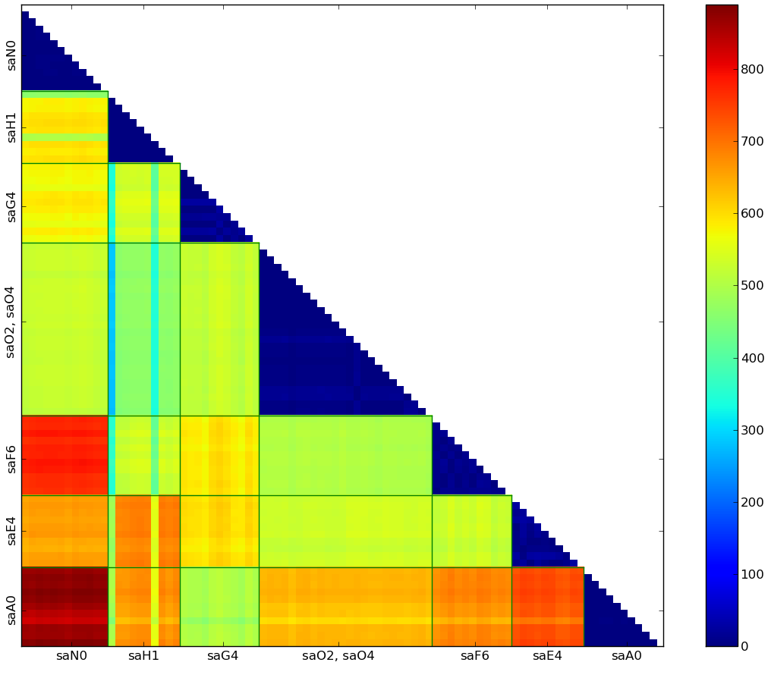
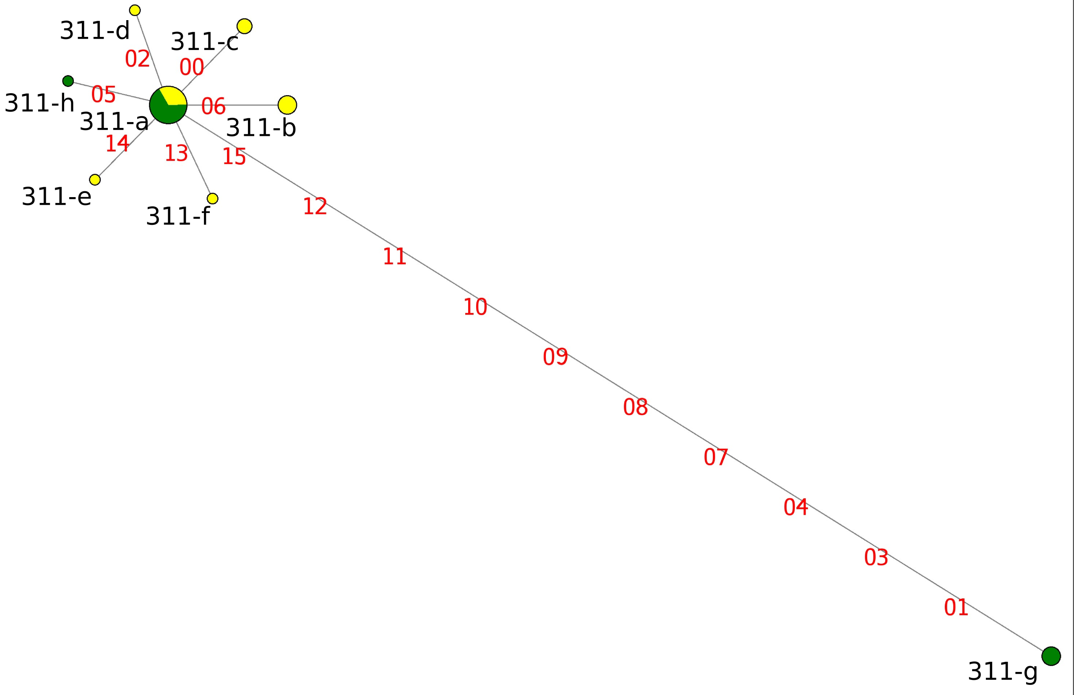
Within and between host evolution in Staphylococcus aureus
Longitudinal and cross-sectional diversity within patients detectable only by whole genome sequencing
Hospital associated CC22 study
Notes:
Sampled 8-12 isolates per timepoint per carrier
13 individuals: single timepoint each
2 individuals: two timepoints each, 2 months apart

Slide 18
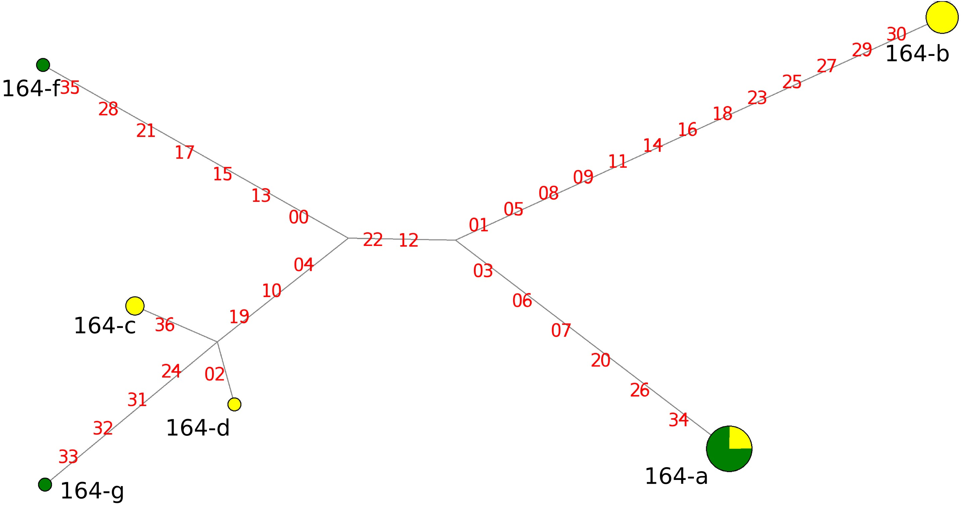
Within and between host evolution in Staphylococcus aureus
Longitudinal and cross-sectional diversity within patients detectable only by whole genome sequencing
Hospital associated CC30 study
Notes:
Most individuals (13/15) carried several S. aureus genotypes
Between 2 and 9 genotypes per timepoint (median 5 genotypes in 12 isolates).
Variation includes point mutations, indels, loss/gain of mobile genetic elements
Follow-up samples isolated from the same individual 2 months later point to continuing evolution within the genotypes.
The extent of diversity within an individual must be taken into account when examining possible routes of transmission between epidemiologically linked cases

Slide 19
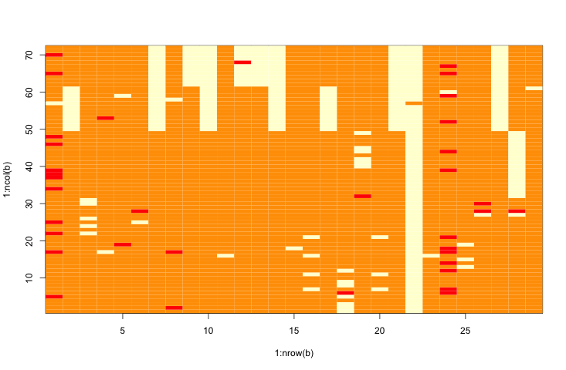
Within and between host evolution in Staphylococcus aureus
Participant in the carriage study succumbed to invasive staphylococcal infection indistinguishable from carried strain except by whole genome sequencing.
Pacemaker fitted
Blood clot in atrium
Myocardinal infiltration
Amyloidosis
Began cytotoxic chemotherapy and preventative antibiotics
Mini-stroke
Heart rhythm disturbance
Mar ‘09
May
Jul
Sep
Nov
Jan ‘10
Mar
May
Jul
Reference allele
Non-reference allele
Allele not called

Slide 20
Within and between host evolution in Staphylococcus aureus
Participant in the carriage study succumbed to invasive staphylococcal infection indistinguishable from carried strain except by whole genome sequencing.
Pacemaker fitted
Blood clot in atrium
Myocardinal infiltration
Amyloidosis
Began cytotoxic chemotherapy and preventative antibiotics
Mini-stroke
Heart rhythm disturbance
Mar ‘09
May
Jul
Sep
Nov
Jan ‘10
Mar
May
Jul
nasal
nasal
blood
Reference allele
Non-reference allele
Allele not called

Slide 21
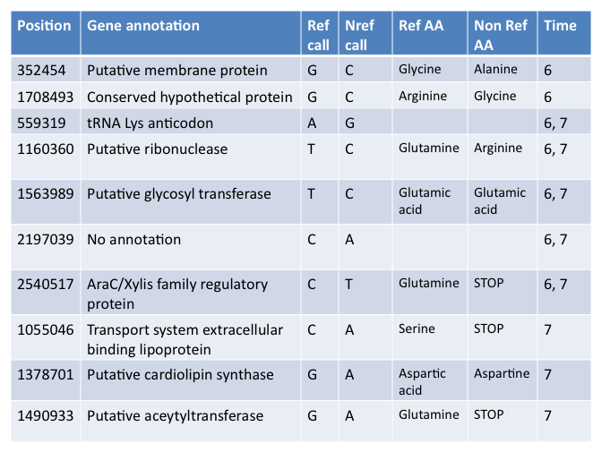
Within and between host evolution in Staphylococcus aureus
Single nucleotide polymorphisms unique to the final two timepoints
Mechanism for pathogenicity?
Widely distributed family of proteins encoding 300 amino acids with regulatory functions:
Carbon metabolism
Stress response
Pathogenesis
Gallegos (1997) Microbiol Mol Biol Rev 61: 393

Slide 22
Pathogen Biology & Translational Medicine
Pressing questions
Tracing transmission locally and globally
Elucidating the genetic basis of virulence, antimicrobial resistance
Understanding mechanisms of horizontal gene transfer
Translational imperitives
Delivering real-time genomics
Monitoring virulence and drug resistance
Prevention and control of transmission through public health measures
Identification of novel drug targets
Personalized medicine
Key personnel in Oxford BRC and MMM
Rory Bowden, Derrick Crook, Xavier Didelot, Peter Donnelly, Rosalind Harding, Lily O’Connor, Tim Peto, Sarah Walker
Funding
Medical Research Council, National Health Service, National Institute of Health Research, UK Clinical Research Consortium, University of Oxford, Wellcome Trust

