Slide 1


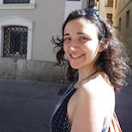
Associate Professor Daniel Wilson
Phylogenetics in Practice
Oxford Doctoral Training Programme
Monday 20th – Tuesday 21st November 2017
Sarah Earle
Biological Sciences
Steven Lin
Bioinformatics
Clara Grazian
Statistics
Wellcome Trust / Royal Society Sir Henry Dale Fellow
Nuffield Department of Medicine
Notes:
Productivity
All studies in which I have played a leading role

Slide 2
Anatomy of a phylogeny

Slide 3
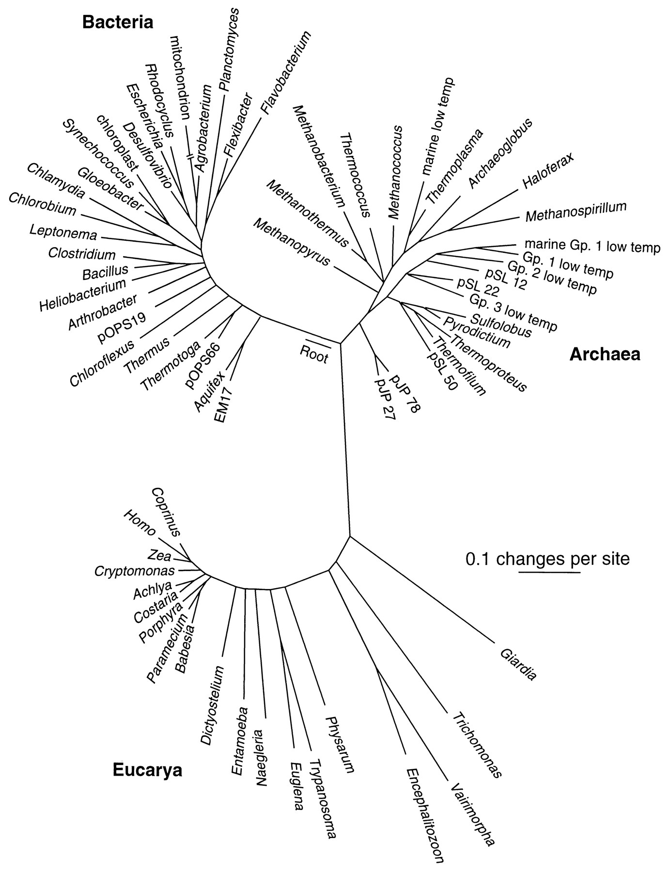
Pace (1997) Science 276:734
Notes:
What does a phylogeny represent?
What are the units?
Define edges/branches: what do they represent?
Define vertices/nodes: what do they represent?
What is the root? Is this tree rooted or unrooted?
How is time represented?

Slide 4
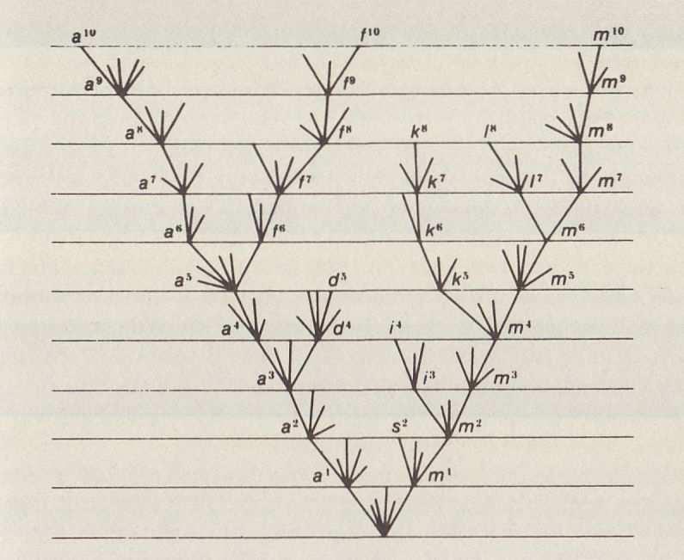
Darwin (1859) Origin of Species
Notes:
Define bifurcation
Define multifurcation
Define radiation, extinction
Define crown group

Slide 5
commons.wikimedia.org/wiki/File:Phylogenetic-Groups.svg
Notes:
Define monophyly, paraphyly, polyphyly

Slide 6
Homology

Slide 7
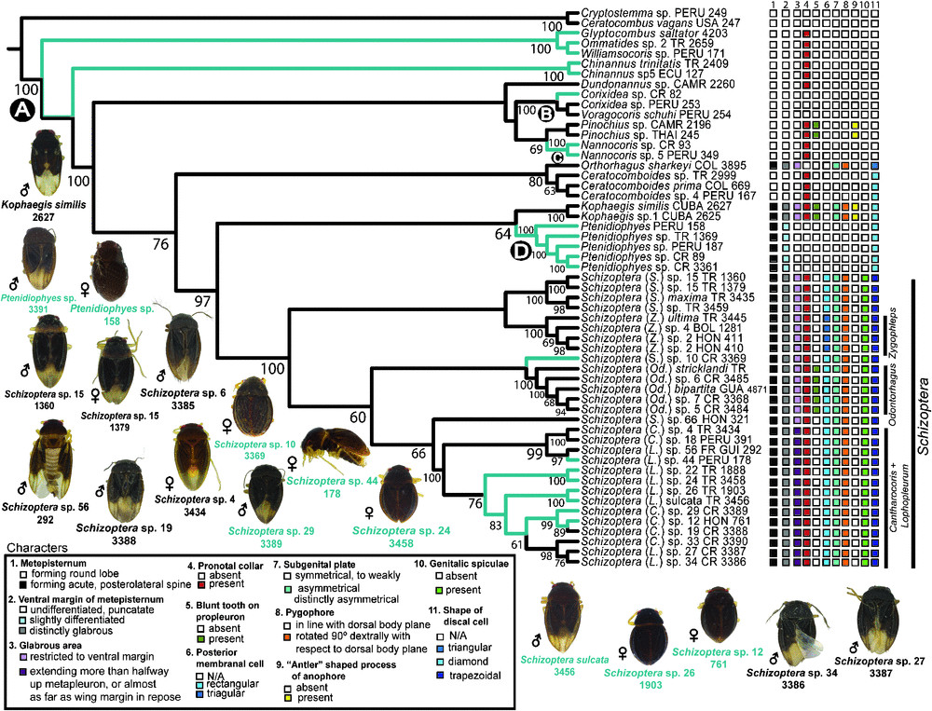
Leon & Weirauch (2016) Invertebrate Systematics 31:191

Slide 8
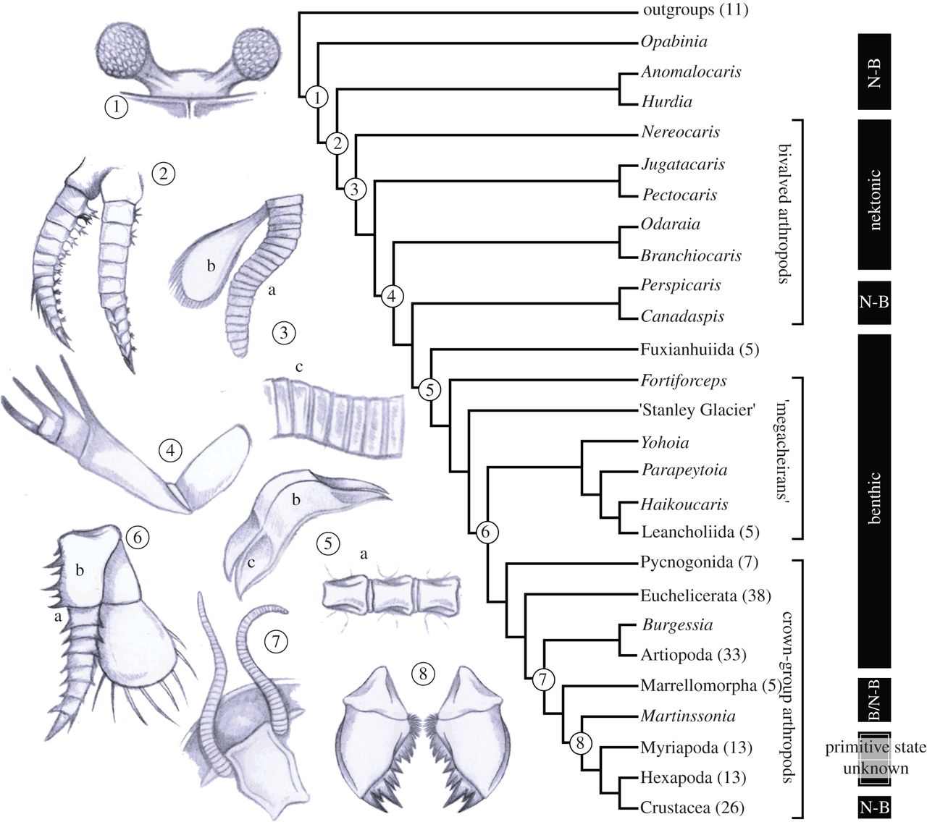
The phylogenetic position of Nereocaris and the origin of key innovations in Arthropoda.
The phylogenetic position of Nereocaris and the origin of key innovations in Arthropoda. Summary of three most parsimonious trees (MPTs) of 91.98 steps (implied character weighting, k = 3; CI = 0.565; RI = 0.863; all nodes in the arthropod stem group are identical under equal weights). Complete phylogeny in electronic supplementary material S1, figure S4. Numbers in parentheses are the number of terminal taxa within supra-generic clades. Column at right is locomotory habit (B, benthic; N-B, nekto-benthic). Key innovations include: 1 compound eyes (as figured for Odaraia), although this character has disappeared and ‘re-evolved’ a number of times with Arthropoda; 2 arthropodized limbs (Anomalocaris)— it is unclear if the arthropodized cephalic limbs of radiodontans (Anomalocaris and Hurdia) are homologous to the arthropodized trunk limbs of arthropods; 3 (a) arthropodization and (b) biramy of the trunk appendages (Fuxianhuia), and (c) arthrodization of the trunk exoskeleton (Nereocaris); 4 specialization of the cephalic appendages into raptorial ‘great-appendages’ (Yohoia); 5 (a) division of trunk somites into distinct ventral sternites (Misszhouia) and (b) dorsal tergites with (c) paratergal folds (Shankouia); 6 (a) reduction in the number of trunk limb podomeres associated with (b) the acquisition of a rigid gnathobasic protopodite (Alalcomenaeus); 7 modification of the anterior (deutocerebral) appendages into antennae (Olenoides); 8 the origin of mandibular mastication (Locusta).David A. Legg et al. Proc. R. Soc. B 2012;279:4699-4704
Notes:
Diagnostic traits
Define ancestral, derived

Slide 9
commons.wikimedia.org/wiki/File:Apomorphy_-_Homoplasy.svg
Notes:
Define parsimony
Define autapomorphy = singleton
Synapomorphy = doubleton, tripleton, etc
Homoplasy = number of substitutions greater than or equal to number of alleles

Slide 10
Trait
 | 1 | 2 | 3 | 4 | 5 | 6 | 7
A | + | + |  | + | +
B |  |  | + | + | +
C |  |  |  |  |  | +
D |  |  |  |  |  |  | +
Taxon
A
A
B
C
C
A
B
D
C
D
B
D
Page and Holmes (1998) Molecular Evolution A Phylogenetic Approach Ch 6
Notes:
Hint: singletons don’t tell you about the topology, only the branch lengths
Note: trees are like mobiles, they can be ‘swivelled’ at each node

Slide 11
Multiple sequence alignment

Slide 12
Bacteria
Archaea
Eucarya
Woese (1987) Microbiological Reviews 51: 221
Notes:
When genes are highly conserved, their similarity is evident.

Slide 13
Woese, Gutell, Gupta, Noller (1983) Microbiological Reviews 47: 621
Notes:
Still, carefully aligning them by hand is painstaking

Slide 14
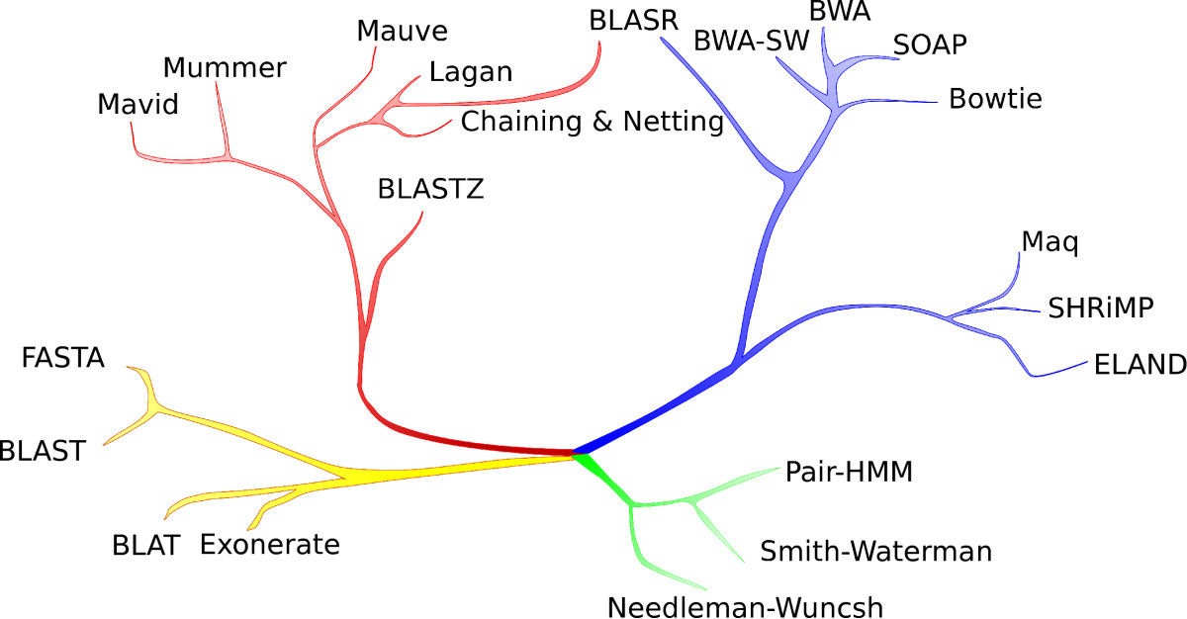
Chaisson, Tesler (2012) BMC Bioinformatics 13: 238

Slide 15
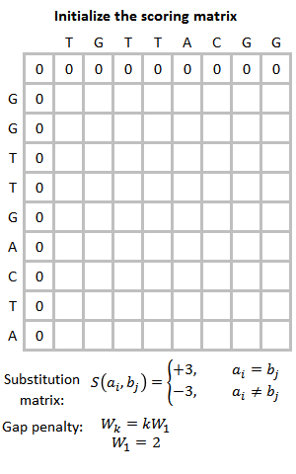
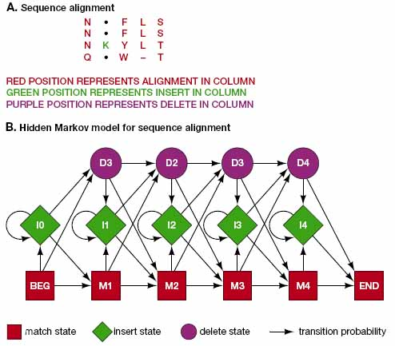
Smith-Waterman
Pairwise Hidden Markov Model
Smith, Waterman (1981) Journal of Molecular Biology 147:195
commons.wikimedia.org/wiki/File:Smith-Waterman-Algorithm-Example-En.gif
www.blopig.com/blog/2014/08/hhsearch/

Slide 17
Distance-based tree builders

Slide 18
Trait
Distance Matrix
 | 1 | 2 | 3 | 4 | 5 | 6 | 7
A | + | + |  | + | +
B |  |  | + | + | +
C |  |  |  |  |  | +
D |  |  |  |  |  |  | +
 | A | B | C | D
A | - | 3 | 5 | 5
B |  | - | 4 | 4
C |  |  | - | 2
D |  |  |  | -
Taxon
A
C
B
D
Page and Holmes (1998) Molecular Evolution A Phylogenetic Approach Fig 6.2
Notes:
Hint: singletons don’t tell you about the topology, only the branch lengths
Note: trees are like mobiles, they can be ‘swivelled’ at each node

Slide 19
Trait
Distance Matrix
 | 1 | 2 | 3 | 4 | 5 | 6 | 7
A | + | + |  | + | +
B |  |  | + | + | +
C |  |  |  |  |  | +
D |  |  |  |  |  |  | +
 | A | B | C | D
A | - | 3 | 5 | 5
B |  | - | 4 | 4
C |  |  | - | 2
D |  |  |  | -
Taxon
A
C
Unweighted pair group method average (UPGMA)
Neighbour joining (NJ)
B
D
Minimum evolution
(balanced method)
Minimum evolution
(least squares method)
Page and Holmes (1998) Molecular Evolution A Phylogenetic Approach Fig 6.2
Notes:
Hint: singletons don’t tell you about the topology, only the branch lengths
Note: trees are like mobiles, they can be ‘swivelled’ at each node

Slide 20
Distance-based tree builders
Fast
Simple to describe
Widely available
Not principled
Assumptions unclear
Wasteful of information
Vulnerable to artefacts

Slide 21
Maximum likelihood tree builders

Slide 22
Maximum likelihood
Para-meters
Statistical Model
Data
Defendant is: Guilty θ = 1 Not guilty θ = 0 | Frequency f of shoes matching the print among the suspect population | Defendant has shoes matching a print found at the crime scene
Pr(Data | θ = 1) = 1
Pr(Data | θ = 0) = f
The maximum likelihood estimate (MLE) of θ equals 1 if f < 1

Slide 23
Maximum likelihood
Extensive theory motivates the use of the maximum likelihood principle for statistical inference
ML estimates are
  Consistent: this means that as you get more and more data, the estimate gets better and better
  Asymptotically unbiased: this means that for large data sets, the estimator is as likely to be above as below the truth
  Asymptotically normal: this motivates the use of convenient methods for hypothesis testing and calculating confidence intervals
  Invariant to transformation: this means that different parameterizations of the same statistical model will give equivalent estimates

Slide 24
Maximum likelihood
Para-meters
Statistical Model
Data
Parameters: The tree, including its branch lengths
f_{A} , f_{C}, f_{G}, f_{T} – frequency of As, Cs, Gs, Ts
κ – relative rate of transitions vs transversions
Statistical model:
Data: Aligned sequences
Find the parameters that maximize Pr(Data | tree, κ, f_{A} , f_{C}, f_{G}, f_{T})
To From | A | C | G | T
A | - | f_{C} | κ f_{G} | f_{T}
C | f_{A} | - | f_{G} | κ f_{T}
G | κ f_{A} | f_{C} | - | f_{T}
T | f_{A} | κ f_{C} | f_{G} | -
Hasegawa, Kishino, Yano (1985) Journal of Molecular Evolution 22: 160

Slide 25
Maximum likelihood
The problem is that searching over all possible trees and parameter values is impossible
For n taxa there are
(2n-5) × (2n-7) × (2n-9) × … × 5 × 3 × 1
bifurcating labelled trees
Instead complex search strategies are implemented that aim to explore tree space efficiently
This involves evaluating a lot of trees, making the search slow
Ultimately, they cannot guarantee to have found the globally optimum solution

Slide 26
Maximum likelihood tree builders
Slow
Description involves mathematical models
Requires specialist software
Principled – theoretical performance guarantees
Quantitative – able to assess uncertainty
Assumptions explicit
Exploits all information

Slide 27
The problem of recombination

Slide 28
The problem of recombination
The major assumption of phylogenetic inference is that evolutionary relatedness is tree-like
At any individual position, evolution is necessarily tree-like
But across the genome this is often patently not true: consider your own family pedigree
Recombination/horizontal gene transfer (HGT) causes different parts of the genome to have different phylogenies and is a particular problem within species
Fitting a single phylogeny to recombined sequences is model misspecification and can strongly mislead inference
Many methods exist to detect recombination: they are essential and we will explore an example in the practical

Slide 29
The problem of recombination
Hedge and Wilson (2014) mBio 5:e02158

Slide 30
References
Chaisson, Tesler (2012) BMC Bioinformatics 13: 238
Darwin (1859) Origin of Species
Hasegawa, Kishino, Yano (1985) Journal of Molecular Evolution 22: 160
Hedge, Wilson (2014) mBio 5:e02158
Legg et al. (2012) Proc. R. Soc. B 279:4699
Leon, Weirauch (2016) Invertebrate Systematics 31:191
Pace (1997) Science 276:734
Page, Holmes (1998) Molecular Evolution A Phylogenetic Approach
Smith, Waterman (1981) Journal of Molecular Biology 147:195
Woese (1987) Microbiological Reviews 51: 221
Woese, Gutell, Gupta, Noller (1983) Microbiological Reviews 47: 621
Wong, Suchard, Huelsenbeck (2008) Science 319: 474
Media
commons.wikimedia.org/wiki/File:Phylogenetic-Groups.svg
commons.wikimedia.org/wiki/File:Smith-Waterman-Algorithm-Example-En.gif
www.blopig.com/blog/2014/08/hhsearch/

